Slide 1
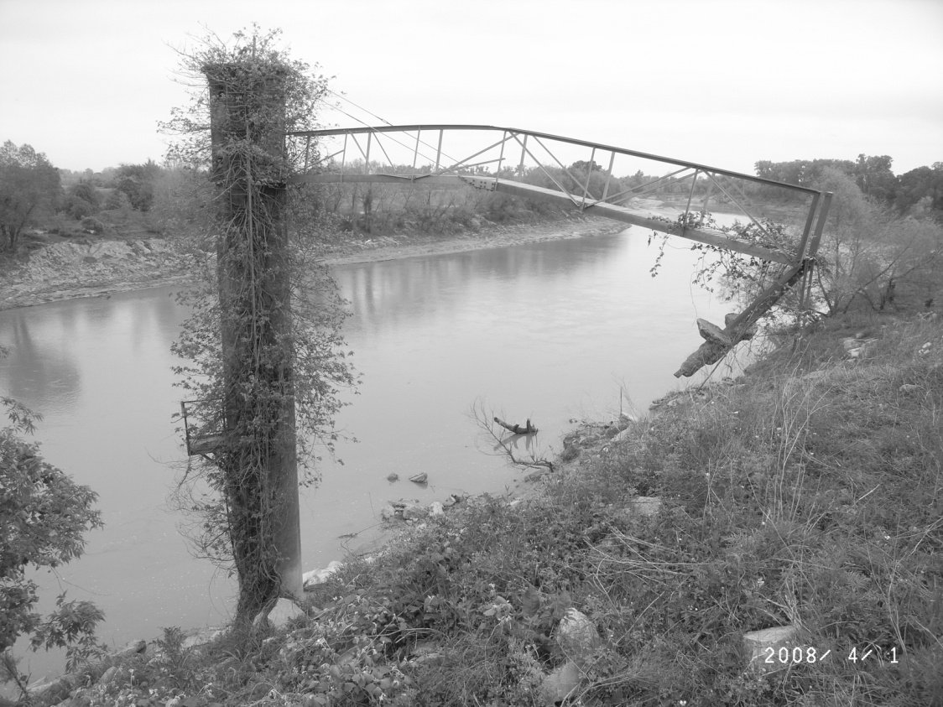
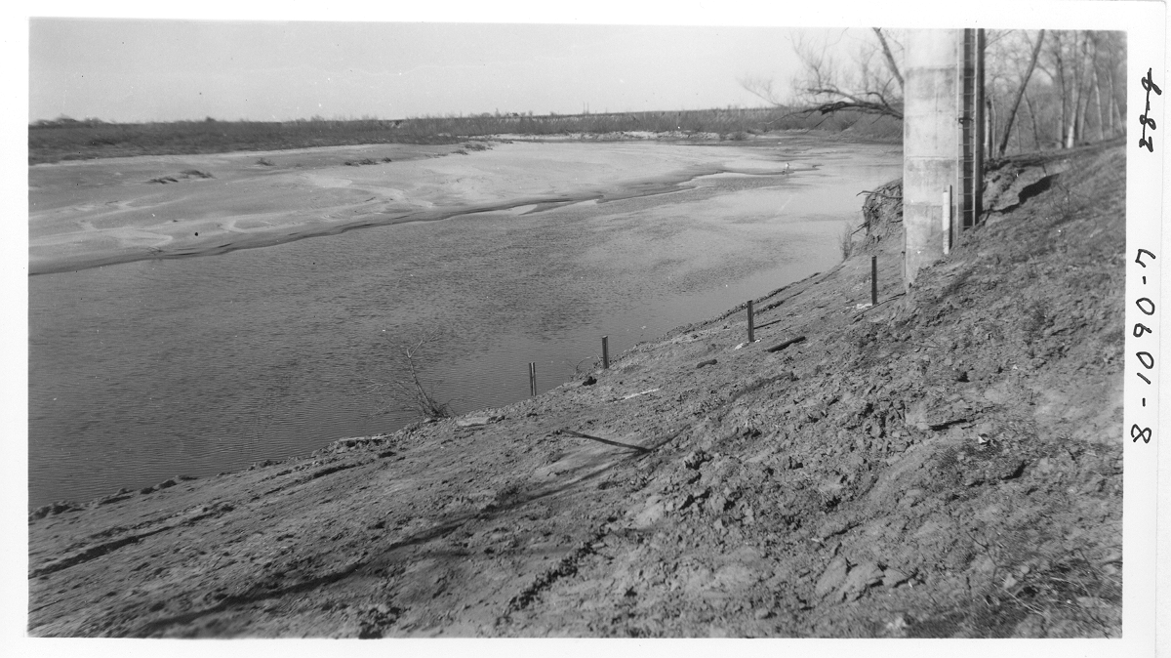

Utility of USGS Streamflow-Gaging Station Records to Assess Historical Geomorphic Adjustments along the Lower Brazos and Sabine Rivers, Texas and Louisiana, USA
Brazos River near Bryan, Texas – 2008
Franklin T. Heitmuller
Assistant Professor
Department of Geography and Geology
The University of Southern Mississippi
Franklin.Heitmuller@usm.edu
Brazos River near Bryan, Texas – 1954
FT Heitmuller
Notes:
Cover slide

Slide 2
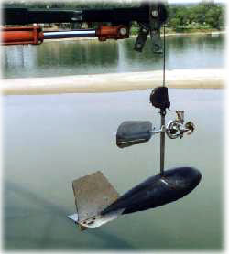
Background Methods Study Area Example Results
USGS Streamflow-Gaging Station Operations
5.0 m
5.0 m
5.0 m
5.0 m
5.0 m
5.0 m
0.0 m
0.0 m
0.5 m/s
0.4 m/s
0.2 m/s
0.7 m/s
0.8 m/s
0.7 m/s
0.1 m/s
0.2 m/s
0.2 m/s
Velocity at 0.2 depth
0.5 m
Velocity at 0.8 depth
0.3 m/s
0.3 m/s
0.3 m/s
1.0 m
1.0 m
http://ga.water.usgs.gov/edu/measureflow.html
Viewed on September 20, 2007
1.2 m
1.1 m
A
Q = AU,
where Q is discharge (m³/s);
A is cross-sectional area (m²); and
U is mean flow velocity (m/s).
U
U
A
Notes:
Downstream assessments of fluvial sediment

Slide 3
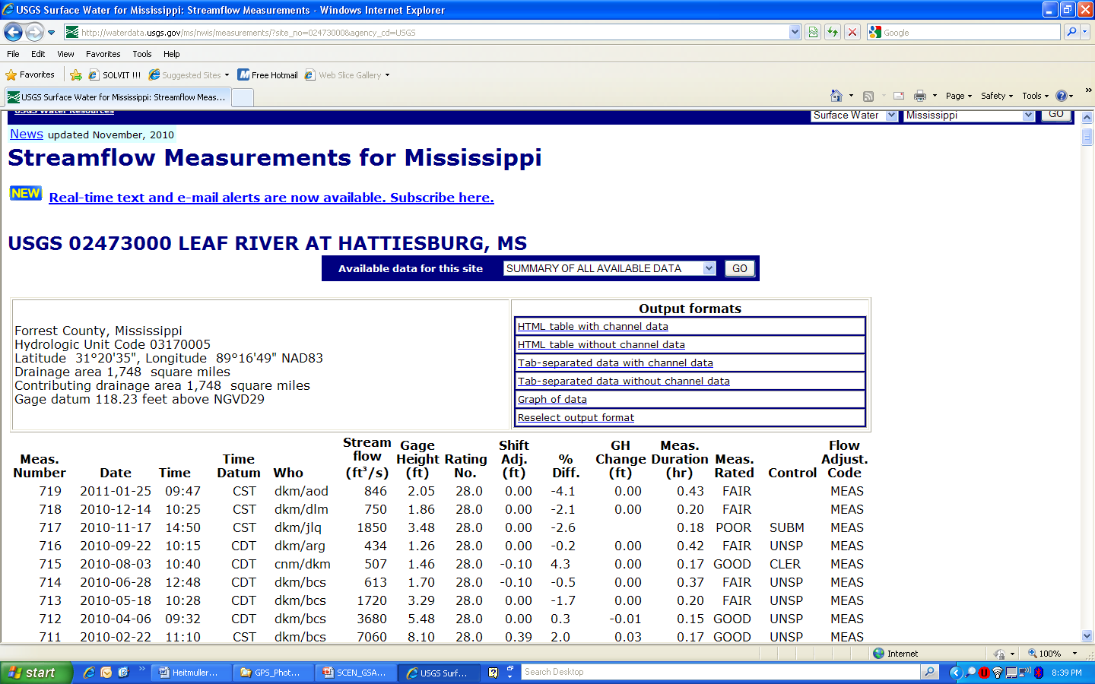
Background Methods Study Area Example Results
USGS Streamflow-Gaging Station Records
This is what the public can access from the web.
Used to have total water-surface width, mean depth, and mean velocity.
What if divided among multiple channels?
USGS Form 9–207
Notes:
USGS streamflow-gaging station records

Slide 4
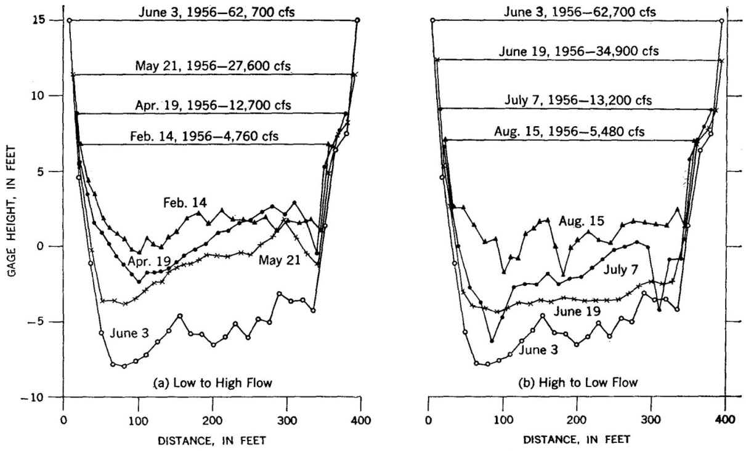
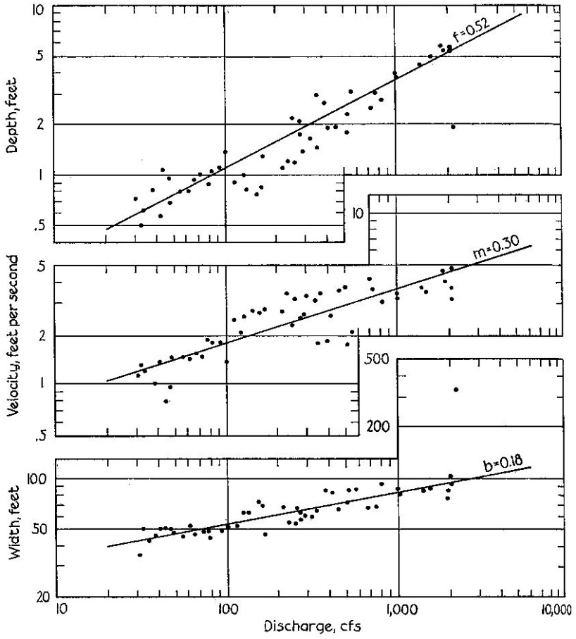
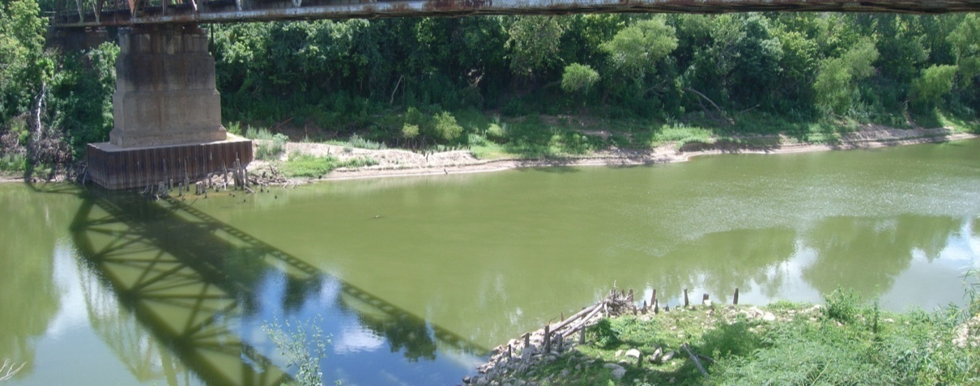
Background Methods Study Area Example Results
Previous Investigations
Hydraulic Geometry
From Leopold et al. (1964)
From Leopold et al. (1964)
Scour-and-Fill
Brazos River at Richmond, Texas
FT Heitmuller
Leopold, L.B., Wolman, M.G., and Miller, J.P., 1964, Fluvial processes in geomorphology: San Francisco, W.H. Freeman and Company, 522 p.
Notes:
Previous geomorphic investigations utilizing historical stream-gaging data

Slide 5
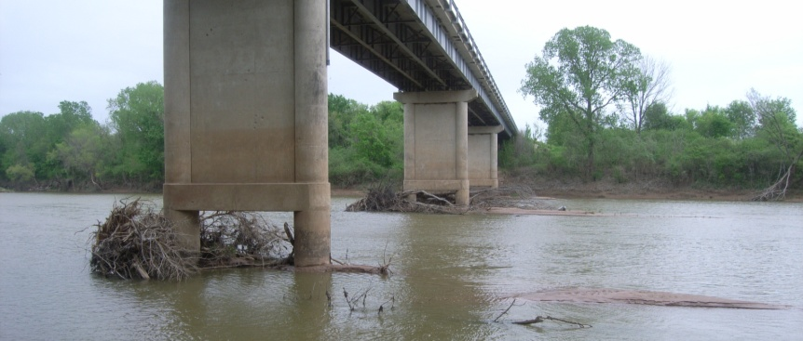
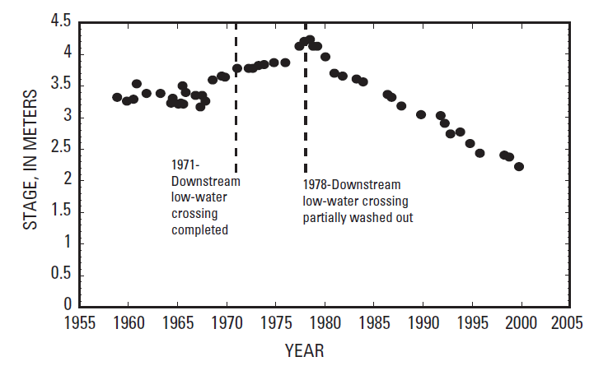
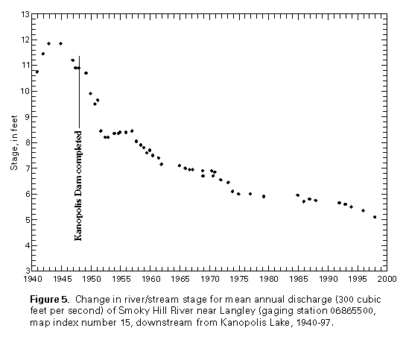
Background Methods Study Area Example Results
Previous Investigations
Brazos River near Highbank, Texas
Channel incision
FT Heitmuller
From Juracek (2001)
From Juracek and Fitzpatrick (2009)
Stage at mean annual discharge
Channel incision
Juracek, K.E., 2001, Channel-bed elevation changes downstream from large reservoirs in Kansas: U.S. Geological Survey Water-Resources Investigations Report 2001–4205, 24 p.
Juracek, K.E., and Fitzpatrick, F.A., 2009, Geomorphic applications of stream-gage information: River Research and Applications, v. 25, p. 329–347.
Notes:
Previous geomorphic investigations utilizing historical stream-gaging data

Slide 6
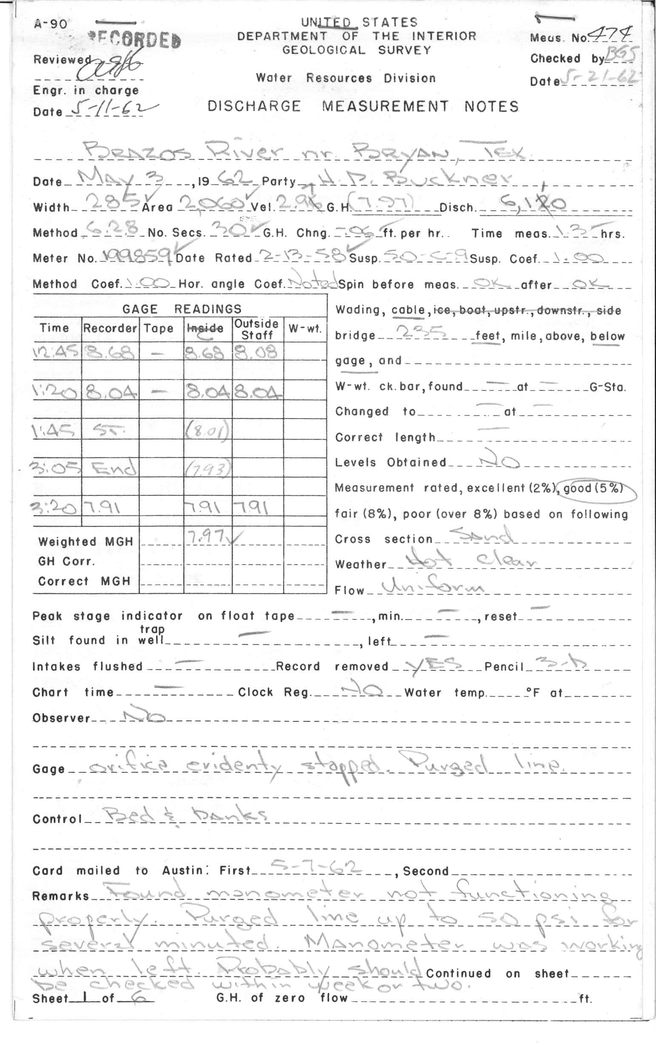
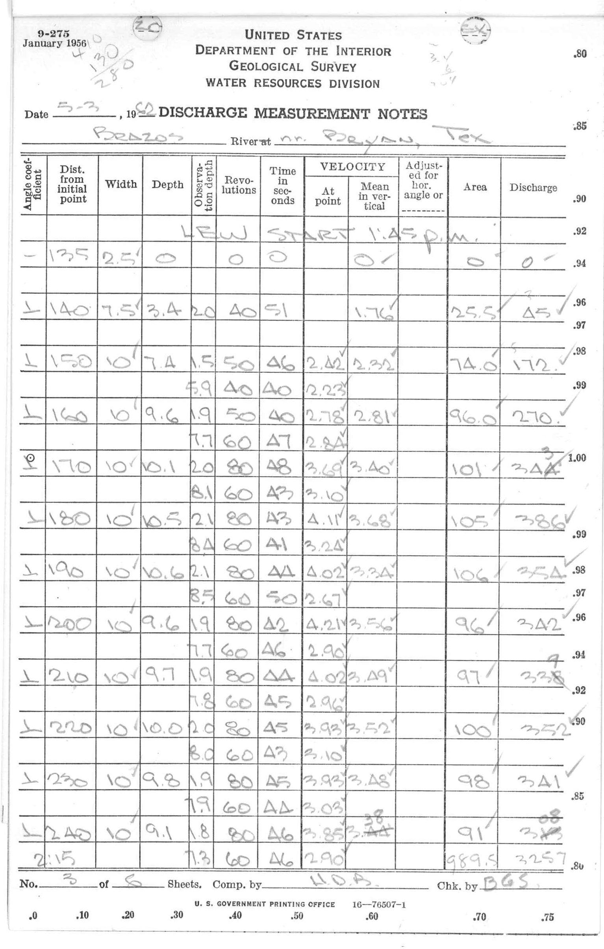
Background Methods Study Area Example Results
USGS Streamflow-Gaging Station Records
Behind the Scenes of USGS NWIS
Notes:
USGS streamflow-gaging station records

Slide 7
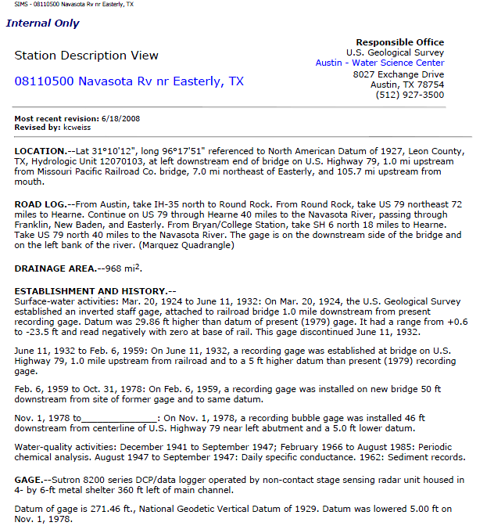
Background Methods Study Area Example Results
USGS Streamflow-Gaging Station Records
Bottom Line → If…
A measurement section has maintained consistent horizontal sectioning across the channel AND
The WGH can be corrected for adjustments to local vertical gage datum
then → historical cross-section geometry can be reconstructed.
Notes:
USGS streamflow-gaging station records

Slide 8
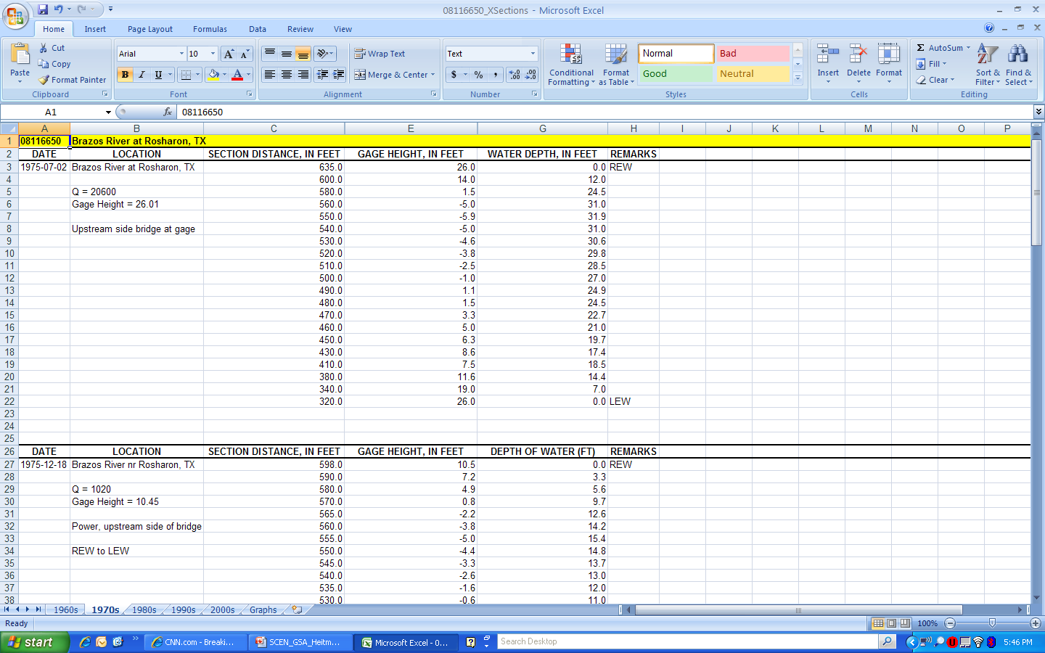
Background Methods Study Area Example Results
Rendering Historical Cross Sections
Data digitized directly from hard-copy measurement notes
WGH (water surface) – water depth = gage height of channel boundary
Plot gage height of channel boundary and section distance
Notes:
Techniques to render historical cross sections

Slide 9
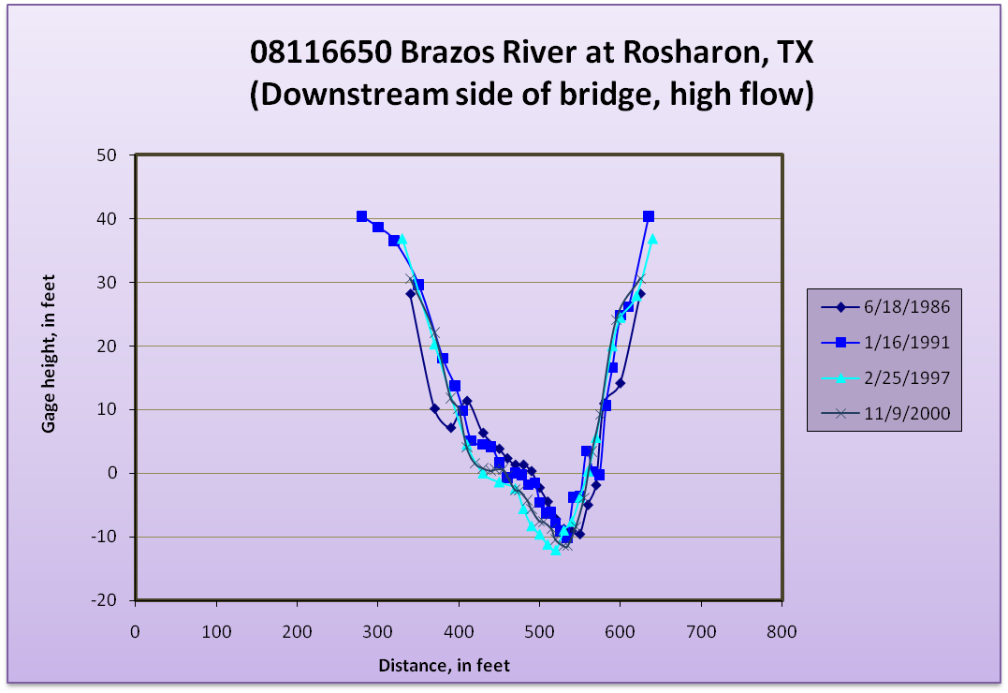
Background Methods Study Area Example Results
Rendering Historical Cross Sections
Section distance
Notes:
Techniques to render historical cross sections

Slide 10
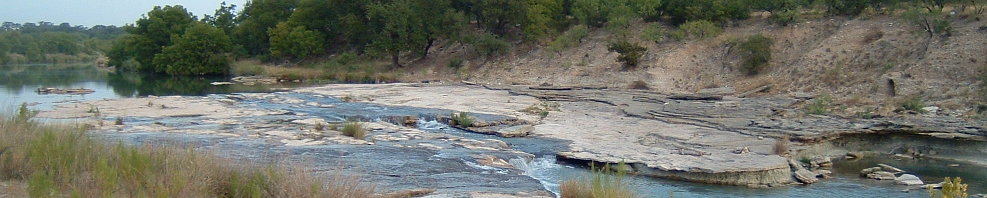
Background Methods Study Area Example Results
Rendering Historical Cross Sections
Precaution #1 → Unique location and condition
Streamflow-gaging locations selected for presence of “controls” (e.g., submerged bedrock shelves, confined valleys)
Possibly not representative of typical hydraulics
Commonly zone of minimal alluvial adjustment → stable stage-discharge relations through time
Possibly represents a “conservative” estimate of channel change
Llano River near Junction, Texas
FT Heitmuller
Notes:
Precautions for utilizing gaging-station data for geomorphic analyses

Slide 11
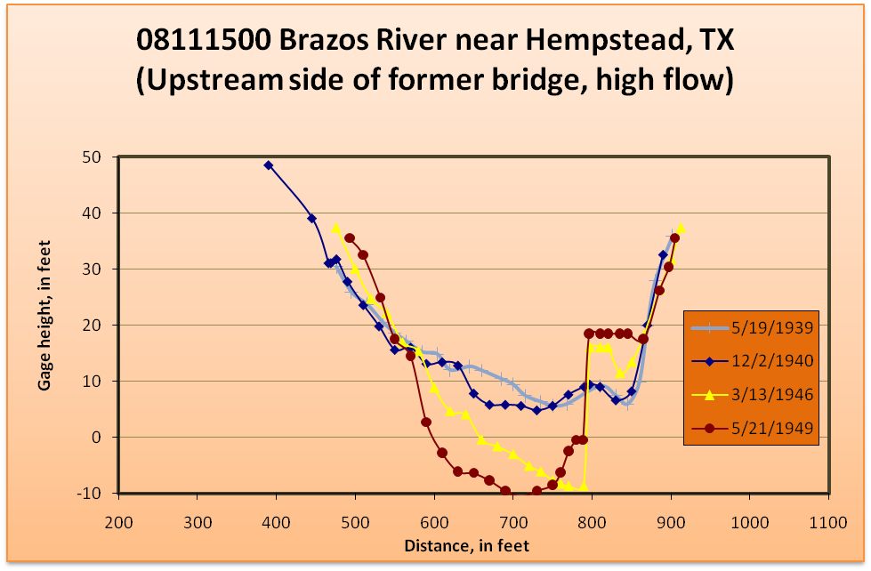
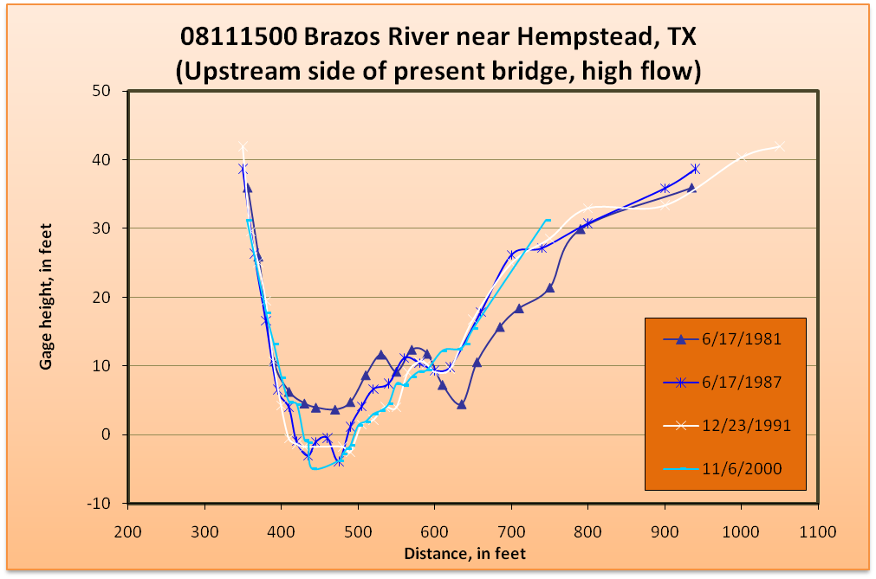
Background Methods Study Area Example Results
Rendering Historical Cross Sections
Precaution #2 → Consistent horizontal sectioning
Arbitrary horizontal distance across channel
Commonly marked with paint on bridges or cables
If section numbers change, some inferences can still be made
Wading measurements not possible
Notes:
Precautions for utilizing gaging-station data for geomorphic analyses

Slide 12
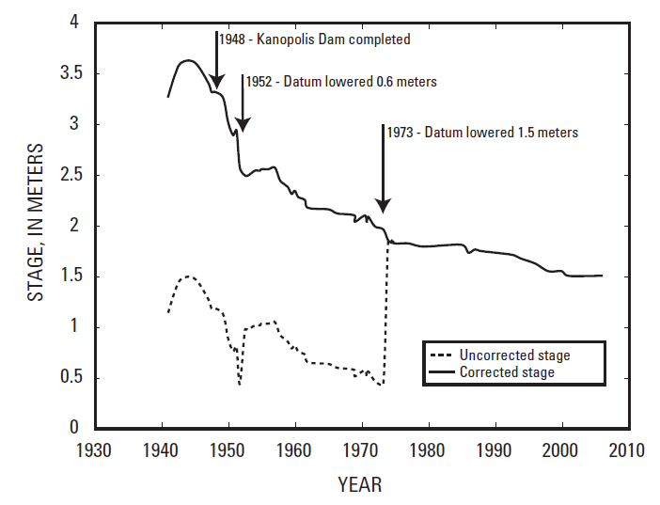
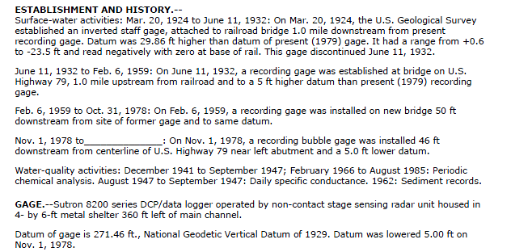
Background Methods Study Area Example Results
Rendering Historical Cross Sections
Precaution #3 → Vertical stage datum shifts
New gage construction / replacement / relocation
USGS Station Description sheets contain necessary information for corrections
From Juracek and Fitzpatrick (2009)
Juracek, K.E., and Fitzpatrick, F.A., 2009, Geomorphic applications of stream-gage information: River Research and Applications, v. 25, p. 329–347.
Notes:
Precautions for utilizing gaging-station data for geomorphic analyses

Slide 13
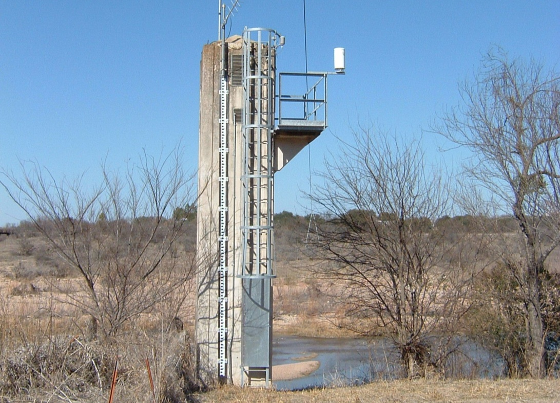
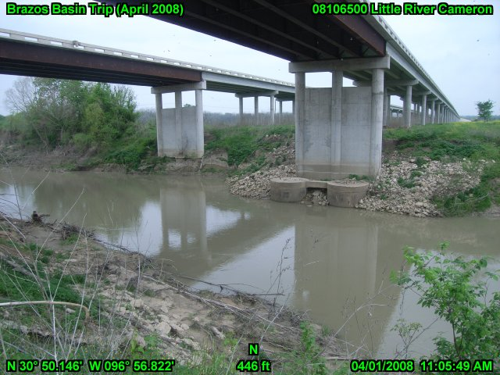
Background Methods Study Area Example Results
Rendering Historical Cross Sections
Precaution #4 → Bridge hydraulics
Highway embankments → concentrate flow energy through the measurement section
Bridge piers and abutments → increase flow resistance at the measurement section
Cableways optimal
Llano River at Llano, Texas
Little River near Cameron, Texas
FT Heitmuller
FT Heitmuller
Notes:
Precautions for utilizing gaging-station data for geomorphic analyses

Slide 14
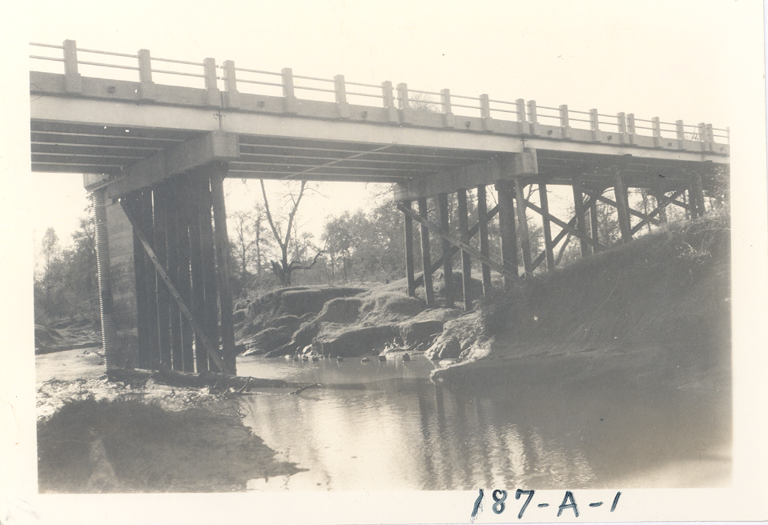
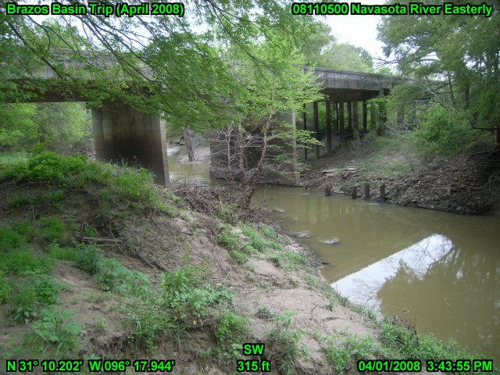
Background Methods Study Area Example Results
Rendering Historical Cross Sections
Precaution #5 → Bridge construction and repair
Construction activities involving considerable excavation and changes to channel configuration
National Bridge Inventory → provides date of last replacement or rehabilitation project
http://nationalbridges.com/
Navasota River near Easterly, Texas
Navasota River near Easterly, Texas
1941
FT Heitmuller
Notes:
Precautions for utilizing gaging-station data for geomorphic analyses

Slide 15
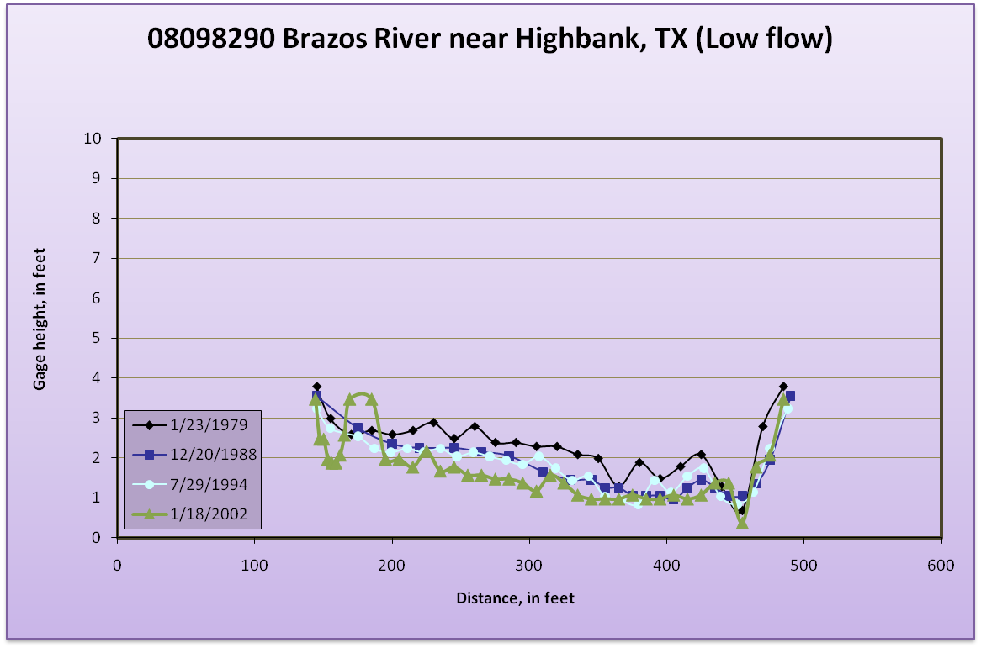
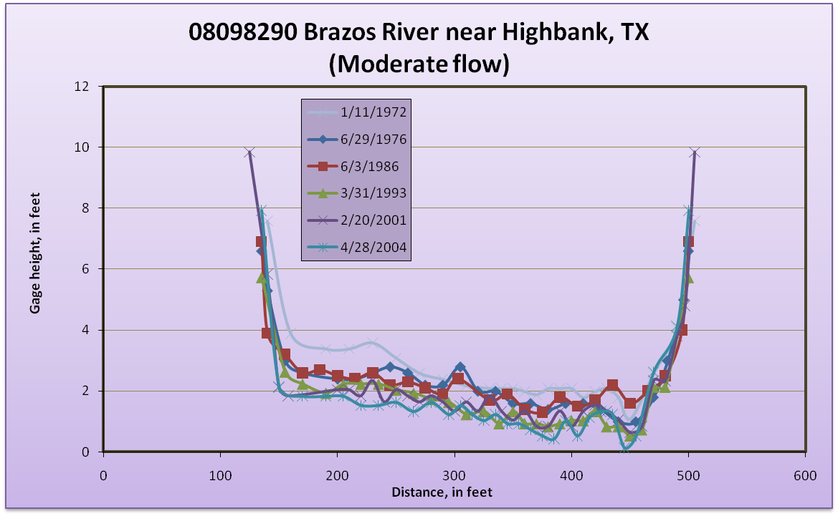
Background Methods Study Area Example Results
Rendering Historical Cross Sections
Precaution #6 → Baseflow / low-flow measurements
Baseflow and low-flow measurements → only channel-bed geometry
Little to no channel bank geometry
Notes:
Precautions for utilizing gaging-station data for geomorphic analyses

Slide 16
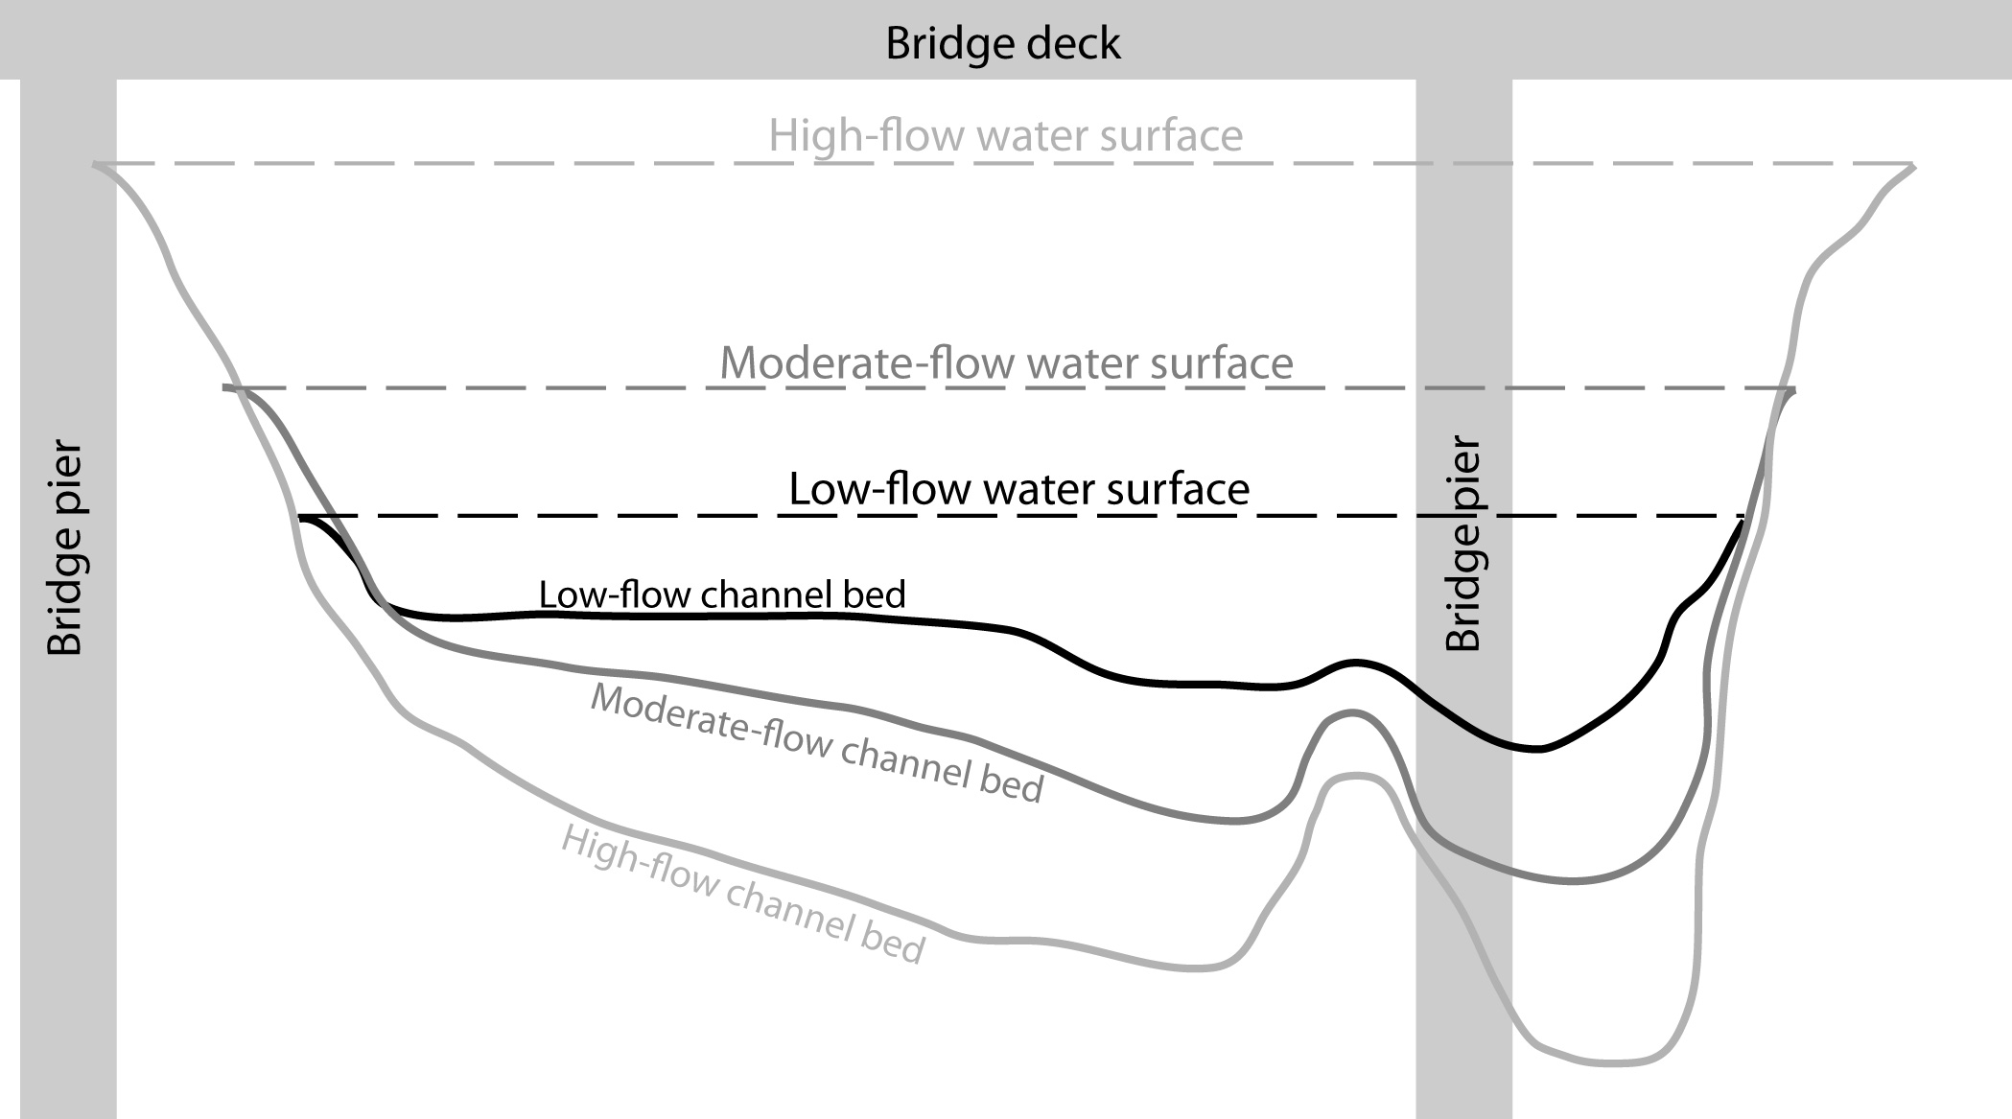
Background Methods Study Area Example Results
Rendering Historical Cross Sections
Precaution #7 → Scour-and-fill processes
Sand-bed channels especially susceptible
Exacerbated during high flows
Post-flood recovery time
From Heitmuller and Greene (2009)
Heitmuller, F.T., and Greene, L.E., 2009, Historical channel adjustment and estimates of selected hydraulic values in the lower Sabine River and lower Brazos River Basins, Texas and Louisiana: U.S. Geological Survey Scientific-Investigations Report 2009–5174, 143 p.
Notes:
Precautions for utilizing gaging-station data for geomorphic analyses

Slide 17
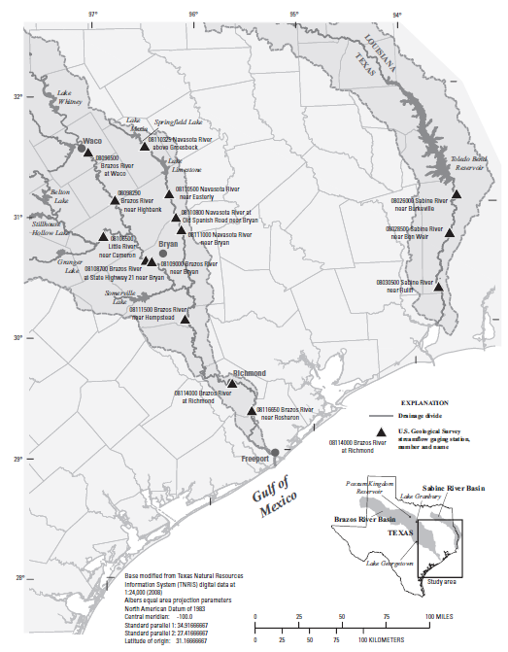
Background Methods Study Area Example Results
Lower Brazos and Sabine Rivers
Upper Brazos River → considerable impoundment along main stem channel
Lower Brazos River → NO impoundments along main stem
Lower Brazos tributaries → considerable impoundment
Lower Sabine River → Toledo Bend Reservoir
Both primarily sand bed
From Heitmuller and Greene (2009)
Heitmuller, F.T., and Greene, L.E., 2009, Historical channel adjustment and estimates of selected hydraulic values in the lower Sabine River and lower Brazos River Basins, Texas and Louisiana: U.S. Geological Survey Scientific-Investigations Report 2009–5174, 143 p.
Notes:
Lower Brazos and Sabine River study area

Slide 18
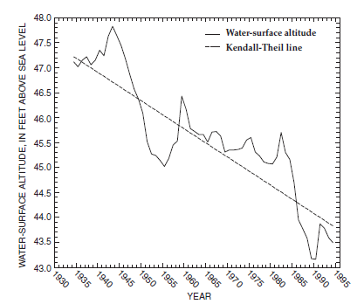
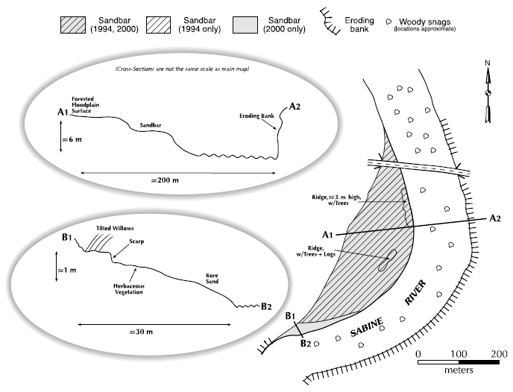
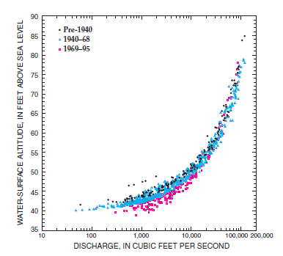
Background Methods Study Area Example Results
Lower Brazos and Sabine Rivers
Lower Brazos River → channel-bed incision documented (Dunn and Raines, 2001)
Lower Sabine River → incision only documented immediately downstream of Toledo Bend (Phillips, 2003)
Lower Brazos
From Dunn and Raines (2001)
From Dunn and Raines (2001)
Lower Sabine
Lower Brazos
From Phillips (2003)
Dunn, D.D., and Raines, T.H., 2001, Indications and potential sources of change in sand transport in the Brazos River, Texas: U.S. Geological Survey Water-Resources Investigations Report 01–4057, 32 p.
Phillips, J.D., 2003, Toledo Bend Reservoir and geomorphic response in the lower Sabine River: River Research and Applications, v. 19, p. 137–159.
Notes:
Lower Brazos and Sabine River study area

Slide 19
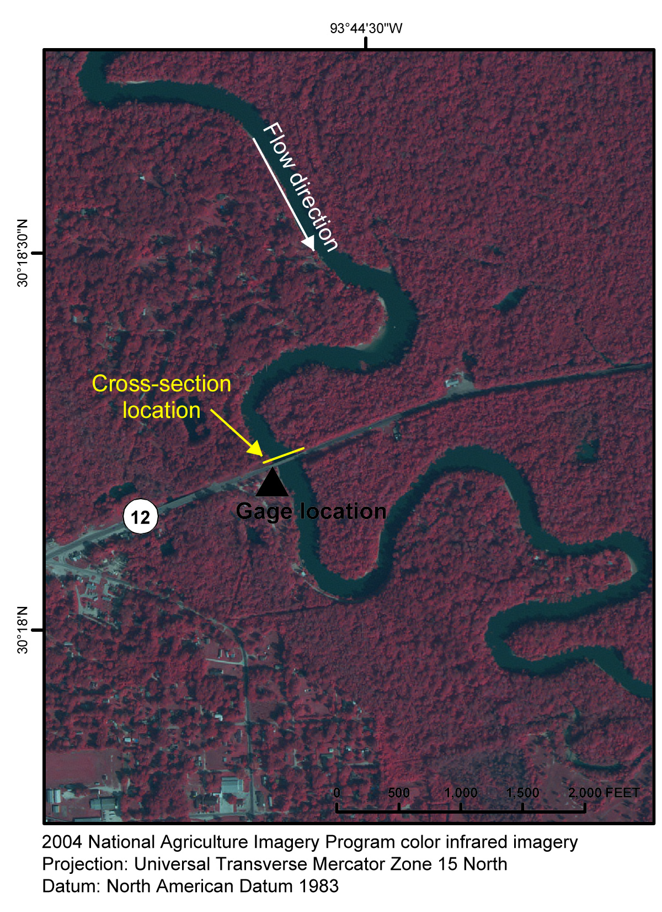
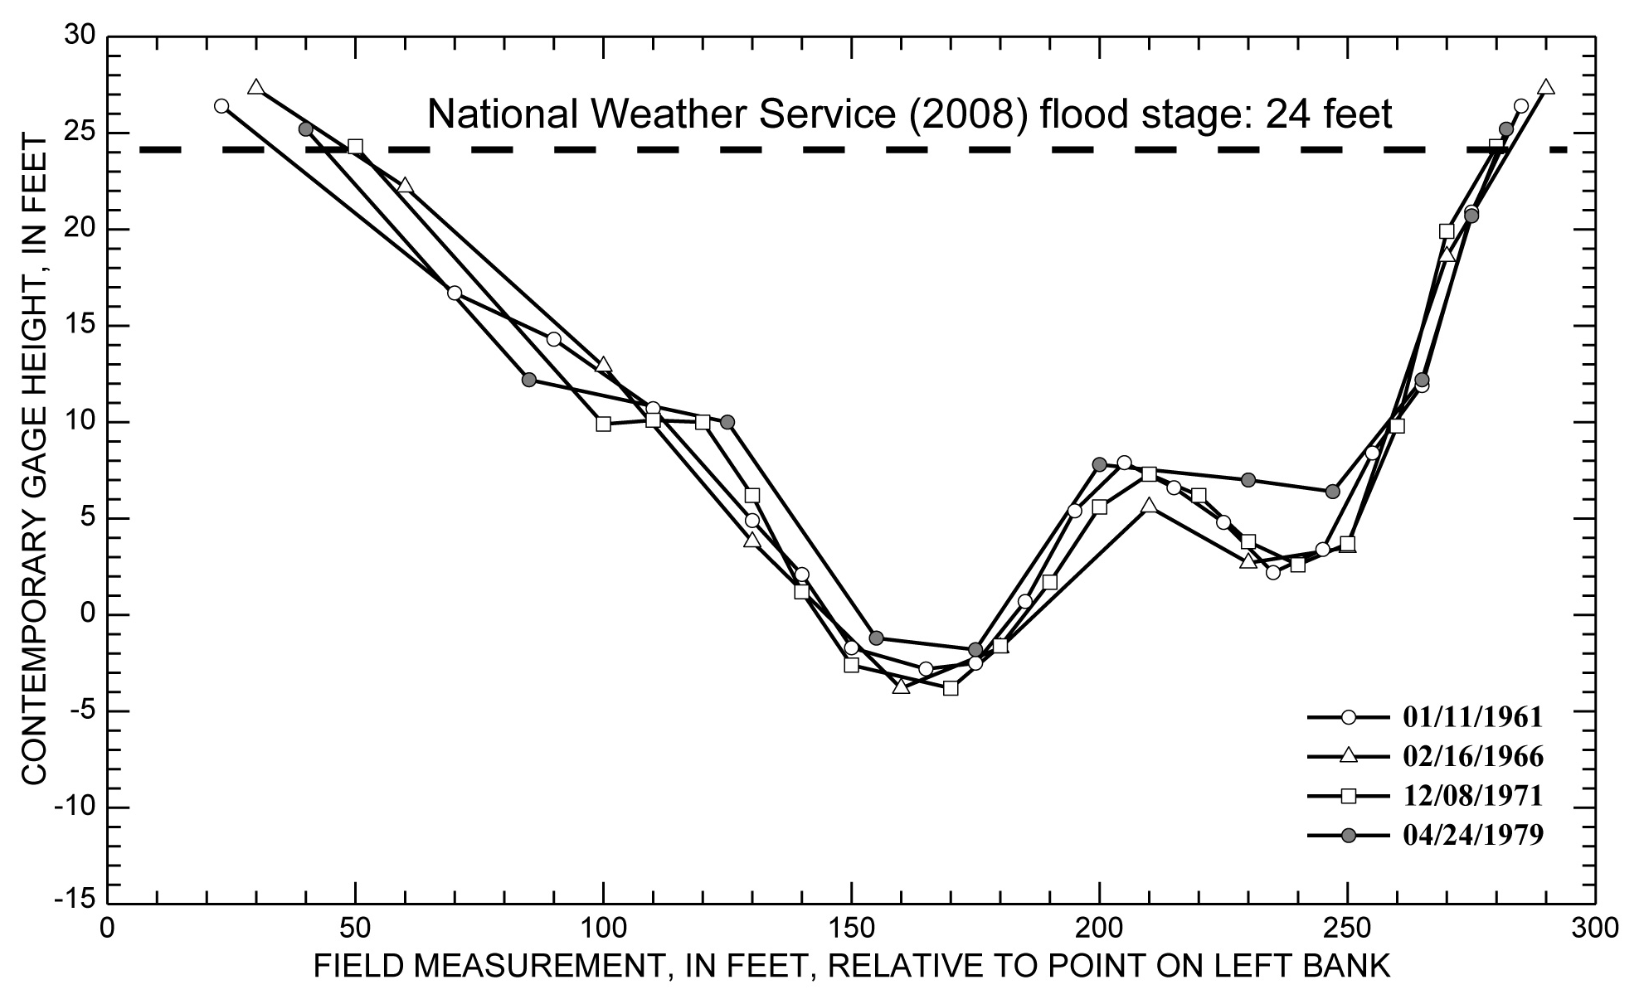
Background Methods Study Area Example Results
08030500 Sabine River near Ruliff
Lowermost gaging station
Measurement section relocated in late 1970s
1961 – 1979 → Stable cross section
1977 – present → Scour and fill, but overall stability
From Heitmuller and Greene (2009)
Heitmuller, F.T., and Greene, L.E., 2009, Historical channel adjustment and estimates of selected hydraulic values in the lower Sabine River and lower Brazos River Basins, Texas and Louisiana: U.S. Geological Survey Scientific-Investigations Report 2009–5174, 143 p.
Notes:
Lower Sabine River

Slide 20
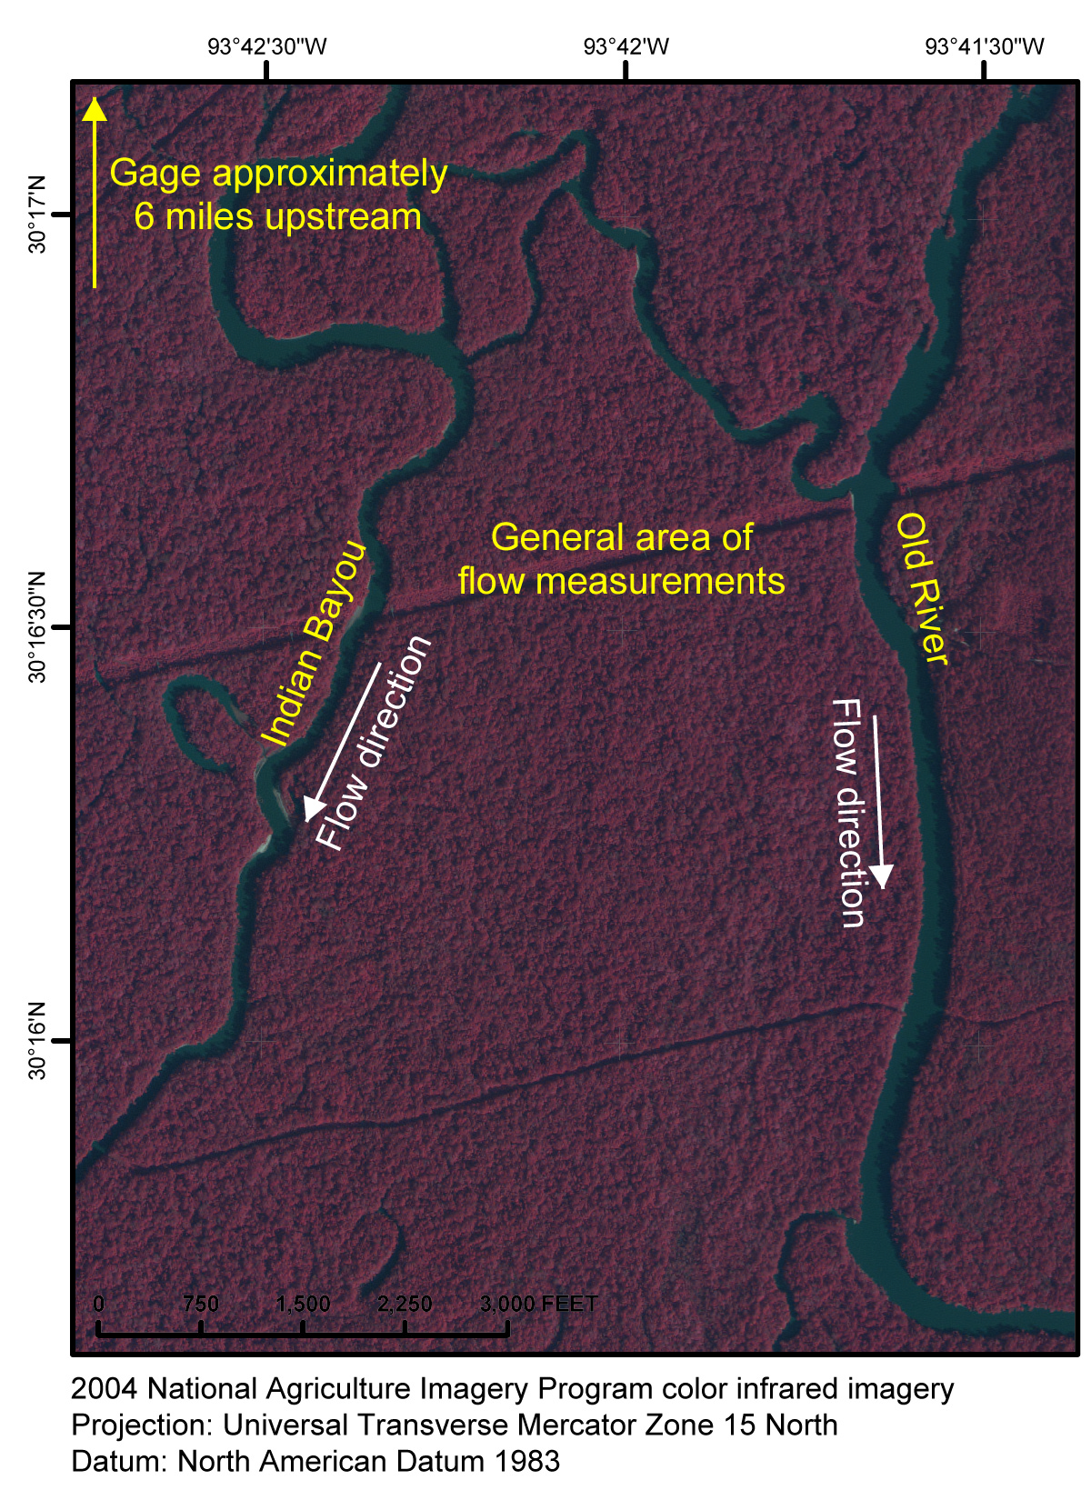
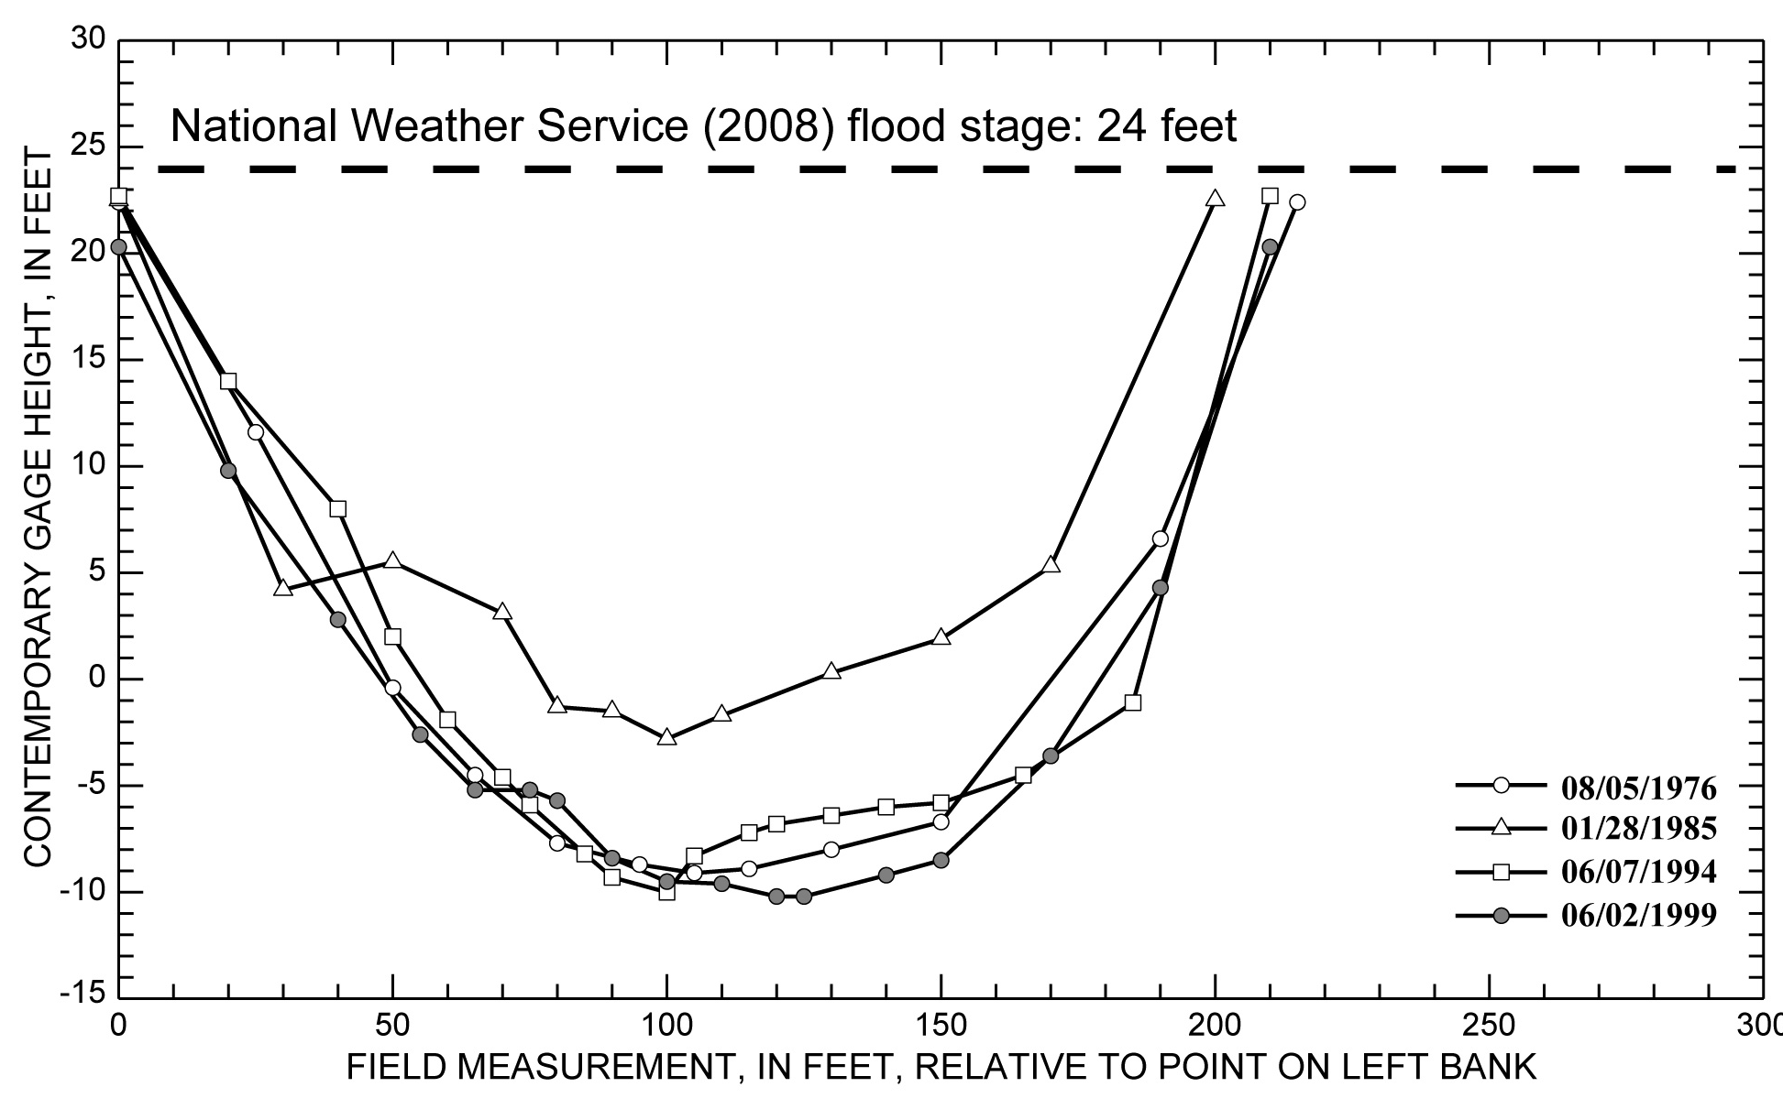
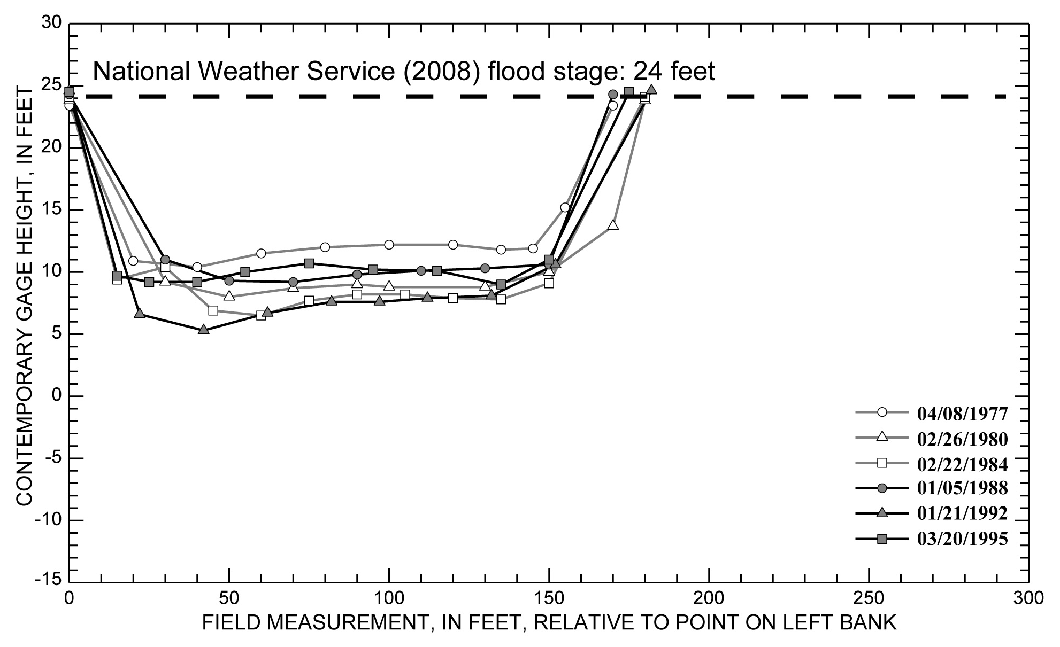
Background Methods Study Area Example Results
08030500 Sabine River near Ruliff
Temporary aggradation?
From Heitmuller and Greene (2009)
Heitmuller, F.T., and Greene, L.E., 2009, Historical channel adjustment and estimates of selected hydraulic values in the lower Sabine River and lower Brazos River Basins, Texas and Louisiana: U.S. Geological Survey Scientific-Investigations Report 2009–5174, 143 p.
Notes:
Lower Sabine River

Slide 21
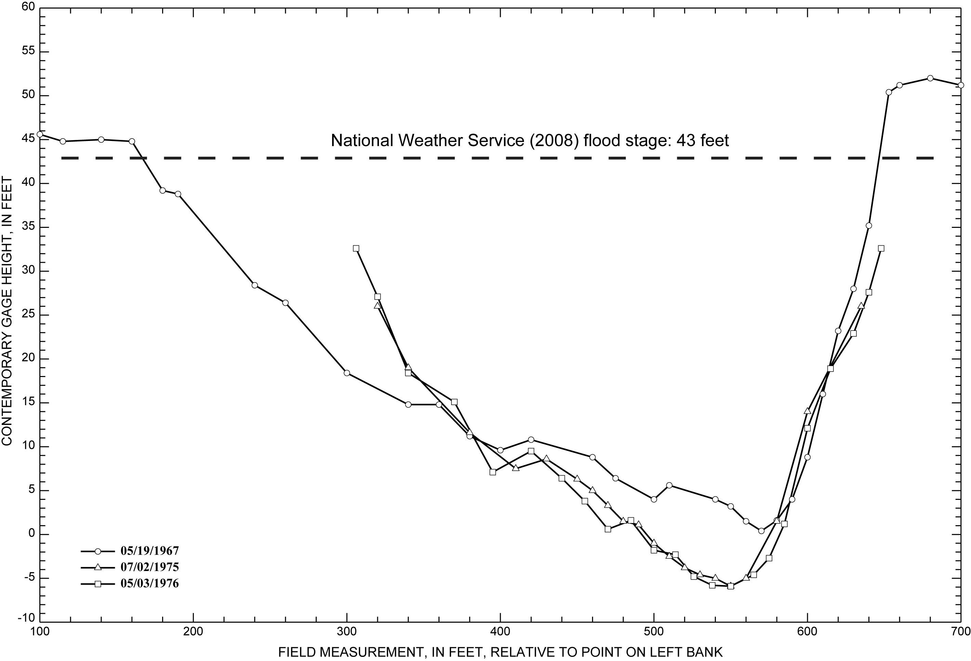
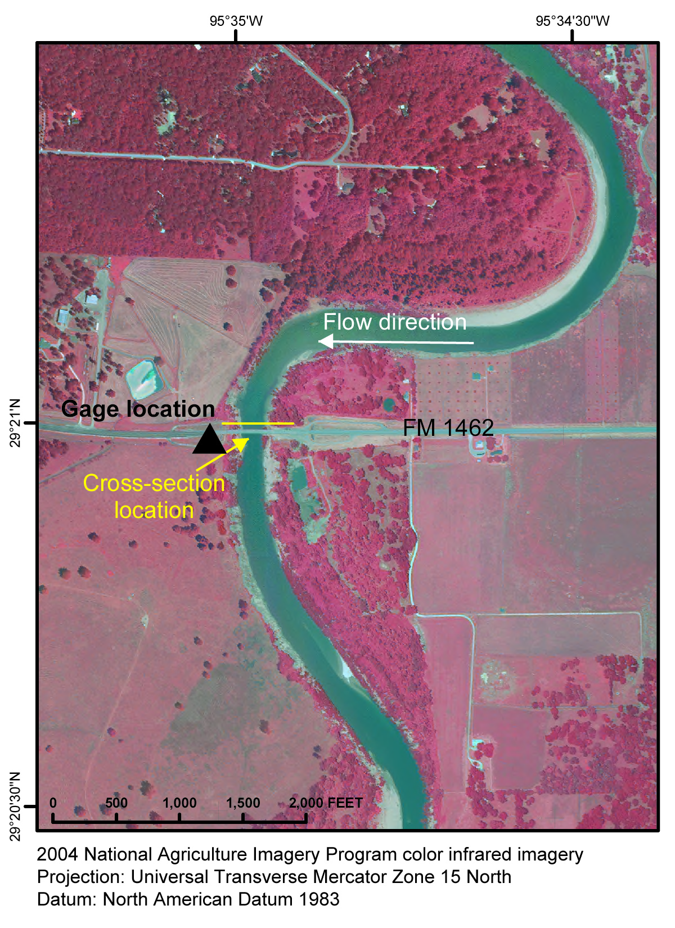
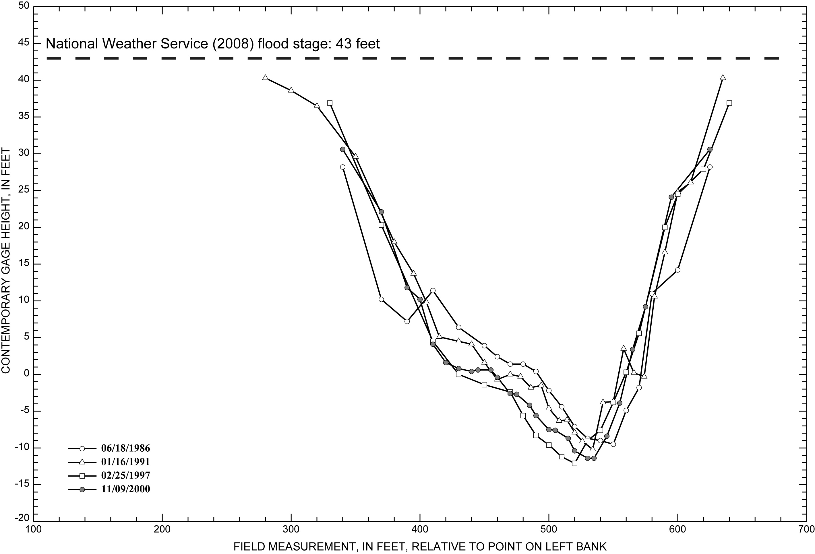
Background Methods Study Area Example Results
08114000 Brazos River near Rosharon
Channel bench development
1967 – 2000 → 10.5 feet (3.2 meters) of thalweg incision
From Heitmuller and Greene (2009)
Heitmuller, F.T., and Greene, L.E., 2009, Historical channel adjustment and estimates of selected hydraulic values in the lower Sabine River and lower Brazos River Basins, Texas and Louisiana: U.S. Geological Survey Scientific-Investigations Report 2009–5174, 143 p.
Notes:
Lower Brazos River

Slide 22
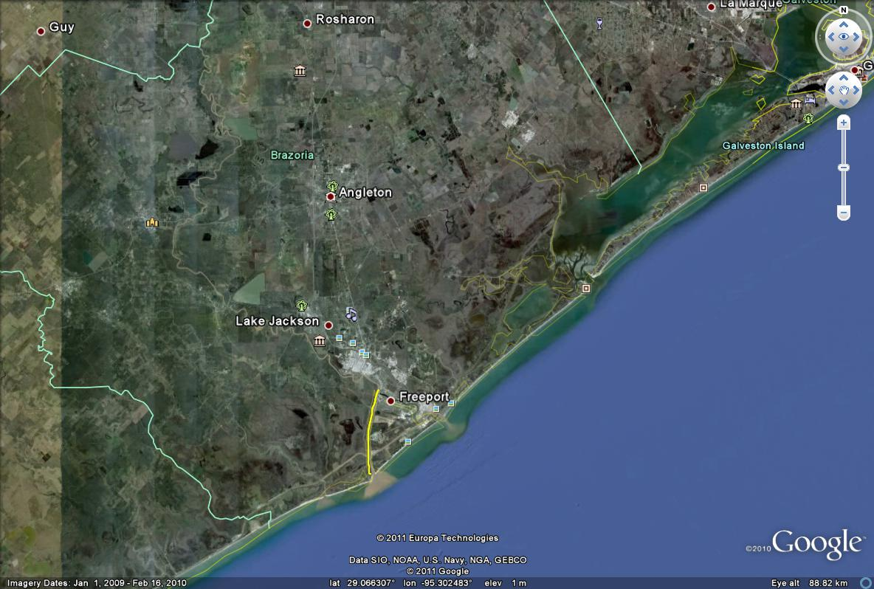
Background Methods Study Area Example Results
08114000 Brazos River near Rosharon
Upstream propagation of incision from dredging operations at Freeport?
1929
Notes:
Lower Brazos River

Slide 23
Summary
Historical USGS streamflow-gaging station records can be effectively utilized to assess geomorphic adjustments of rivers
Hard-copy digitization of streamflow measurements permits a more comprehensive evaluation of cross-sectional adjustment
Precautions should be taken to eliminate alternative explanations for change and ensure accurate interpretations
Despite the presence of a large, main-stem reservoir, the lowermost Sabine River displays geomorphic stability relative to the lower Brazos River, which has incised → probably because of downstream dredging operations
Notes:
Summary

Slide 24
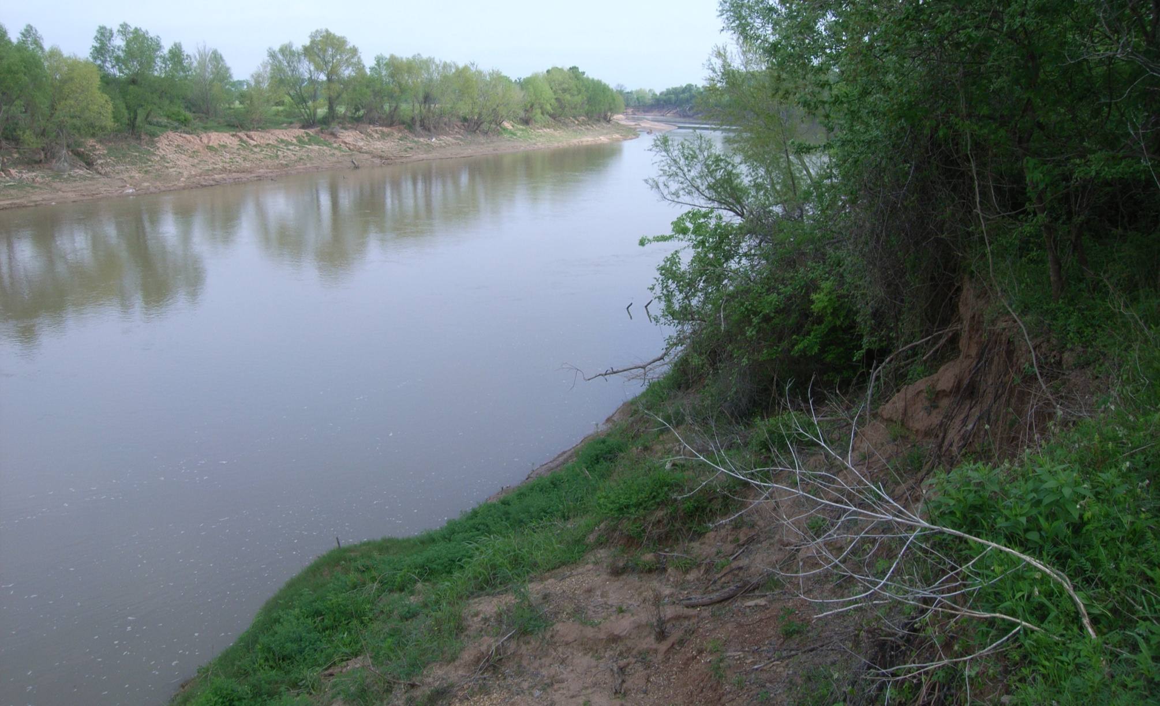
Acknowledgments
Brazos River near Bryan, Texas
FT Heitmuller
Support for this research came from the following:
Texas Water Development Board (TWDB)
U.S. Geological Survey (USGS) Texas Water Science Center
Lauren E. Greene
Notes:
Acknowledgments

Slide 25
Background Methods Study Area Example Results
Texas Instream Flow Program
Texas Senate Bill 2 (2001) → “conduct studies and analyses to determine appropriate methodologies for determining flow conditions in the state’s rivers and streams necessary to support a sound ecological environment”
focused investigations of hydrology, biology, geomorphology, and water quality
From Texas Environmental Flows Science Advisory Committee (2009)
Geomorphic “flows”
What should the channel geometry be?
Texas Environmental Flows Science Advisory Committee, 2009, Use of hydrologic data in the development of instream flow recommendations for the environmental flows allocation process and the hydrology-based environmental flow regime (HEFR) methodology: Austin, Tex., accessed on September 9, 2009, at http://www.tceq.state.tx.us/assets/public/permitting/watersupply/water_rights/eflows/hydrologicmethods04202009.pdf
Notes:
Texas Instream Flow Program

