Slide 1
EVENT sedimentation IN EMERGENT and Salt MARSHES AROUND Mobile-Tensaw River Delta and mobile Bay region
Christopher G. Smith, Lisa Osterman, Richard Z. Poore
USGS St. Petersburg Coastal and Marine Science Center

Slide 2
Outline
Problem and Background
Setting
Methods and Models
Results and Discussions
Conclusions

Slide 3
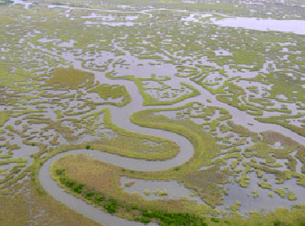
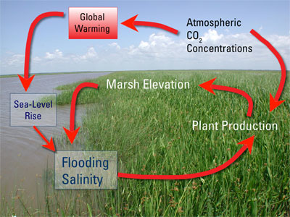
The Problem:
Marsh accretion and transgression
sea-level
rise
http://www.clear.lsu.edu/needs_in_louisiana
McKee, 2009
Cherry et al. 2009
Notes:
Marshes sit at the forefront of a ever-growing problem, sea-level rise. With growing human-infrastructure within and modification of these coastal wetland ecosystems, the fine balance between marsh accretion and their ability to migrate with sea-level transgression is of concern. Here we see a highly fragmented marsh environment along the coast here in Louisana where dredging and ditching has increased the flood frequency of this coastal wetland, converting a portion of the marsh into open-water. One potential positive observation that has been made by Cherry et al. in laboratory experiments, is that the drivers of sea-level rise (global warming due to increases in atm. CO2) may actual stimulate below ground production within the root zone, providing a feedback mechanism for coastal wetlands to maintain their position relative to sea-level rise.

Slide 4
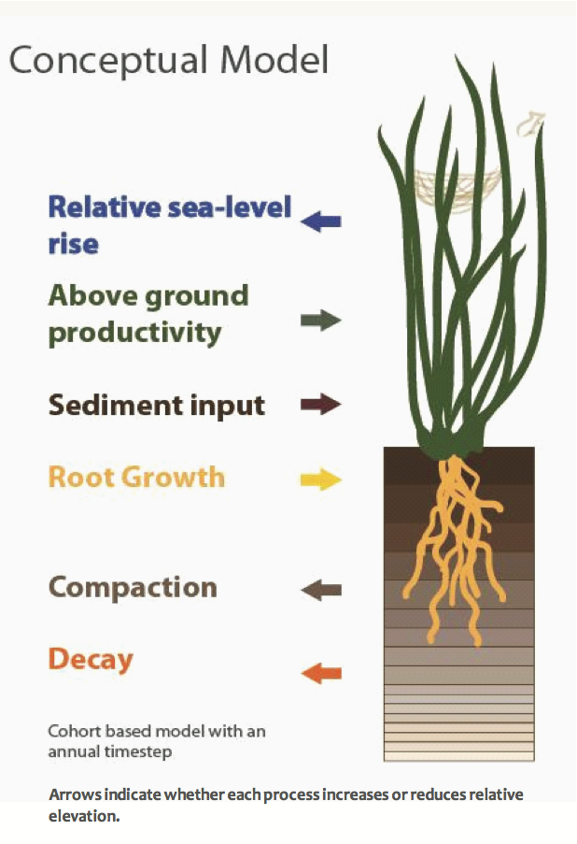
Day to Day Accretion
Marsh Accretion
  Inorganic Sediment Input
  Above Ground Productivity
  Below Ground Productivity
Removal or Subsidence
  Sediment Compaction
  Organic Matter Degradation
Sea-level
Swanson et al. 2011
Notes:
Here we see a conceptual model presented by Swanson et al. (2011) for the day to day processes that help marshes maintain their vertical position relative to mean sea-level. Deposition occurs via organic matter accumulation due to root growth and above ground production as well as inorganic sediment input; opposing non-depositional or anti-depositional terms occur as OM degrades, sediments compact, and sea-level rises.

Slide 5
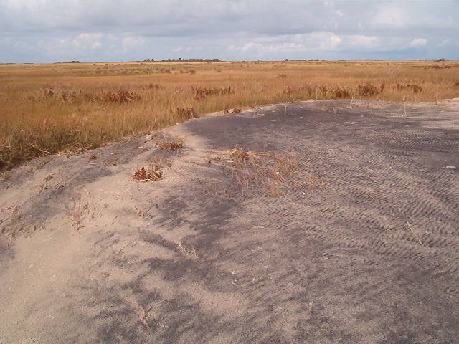
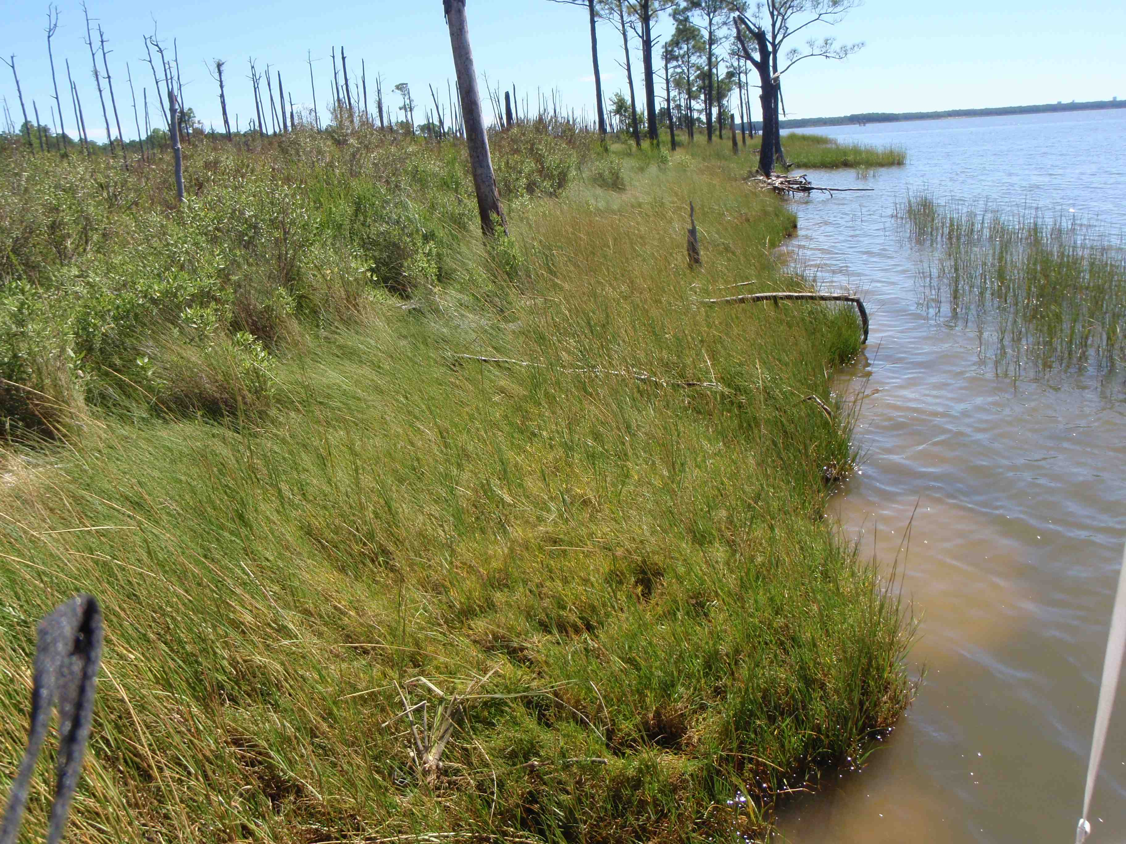
Episodic Events
The Good
The Bad
Notes:
Adding to the supply of inorganic sediment is event-deposition associated with tropical cyclones and large frontal systems. While these high-energy events can erode marshes along the shoreline, often times, there is a actual net transport of sediment to the interior portions of the marsh, as we see here in Pea Island, NC and Fowl River, AL. This additional sediment supply when incorporated into the marsh sedimentary record can help to maintain the marshes vertical position as well as transgress.

Slide 6
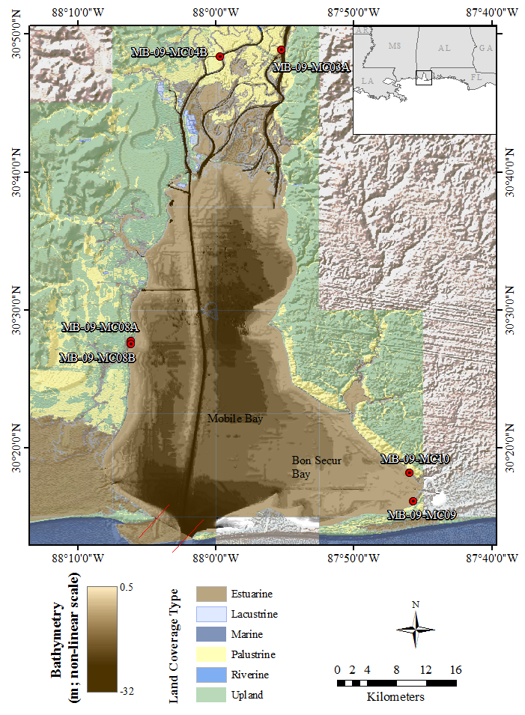
Mobile-Tensaw Delta and Mobile Bay
2nd largest river-feed delta¹
  16 km wide x 64.5 km long¹
  Wetland Habitat¹ ~ 1,000 km²
  Drainage Basin¹ = 115,000 km²
4th largest estuary in the US¹
  Total Area² = 1070 km²
  Average depth = 3 m (max 23 m)
  Tidal Amplitude² = 15 – 45 cm
6+ major storms have influenced the bay over the last 100 y
¹http://estuarium.disl.org/exhibits.htm
²Noble et al., 1996
Notes:
Hurricanes have included Camille-1969, Fredrick-1979, and Ivan-2004.
What you may notice from the image on the left is that the gradient along the east and west sides are remarkably different.

Slide 7
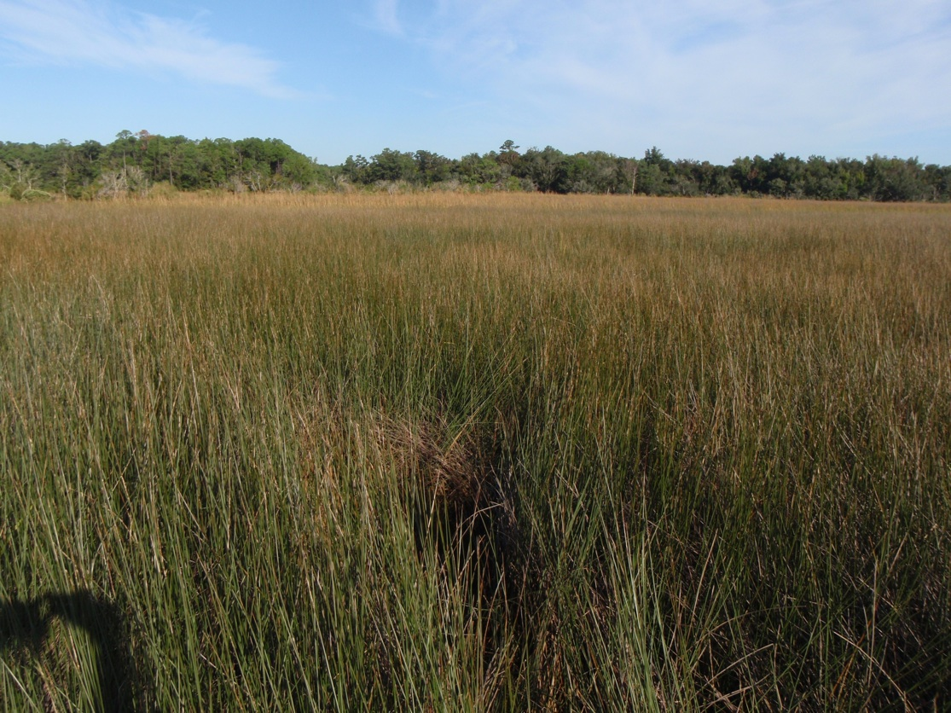
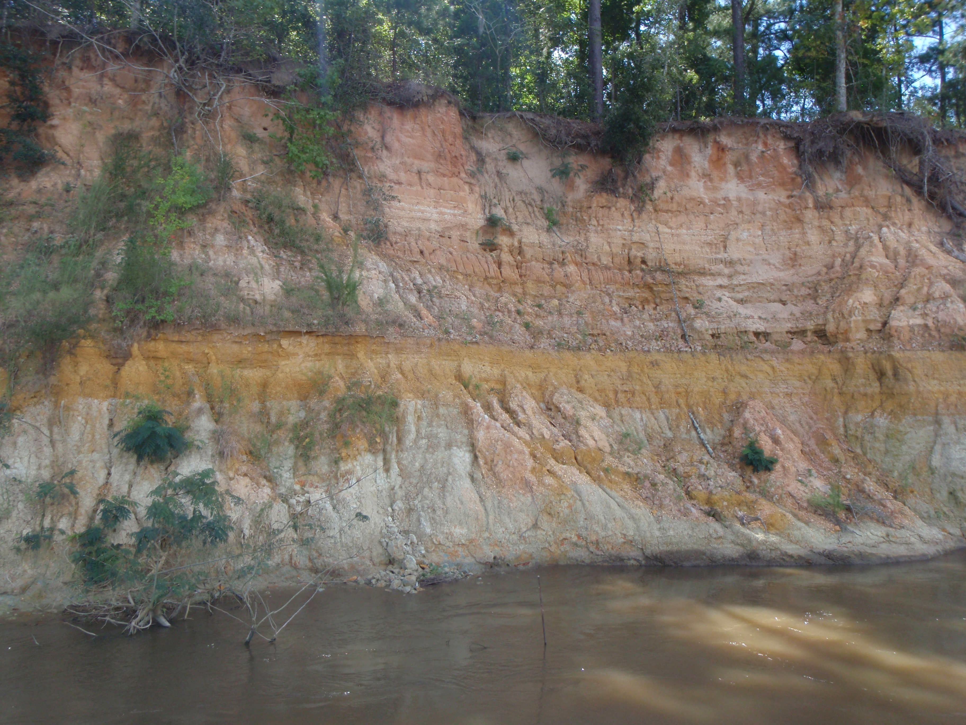
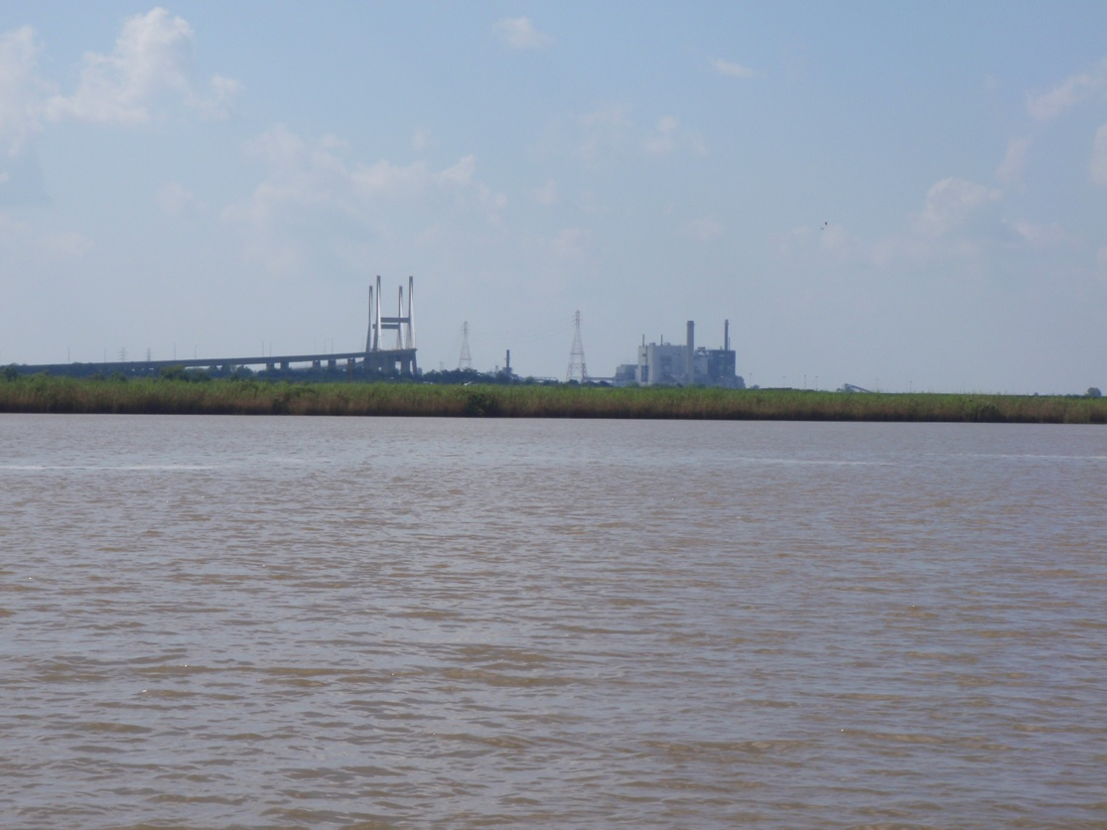
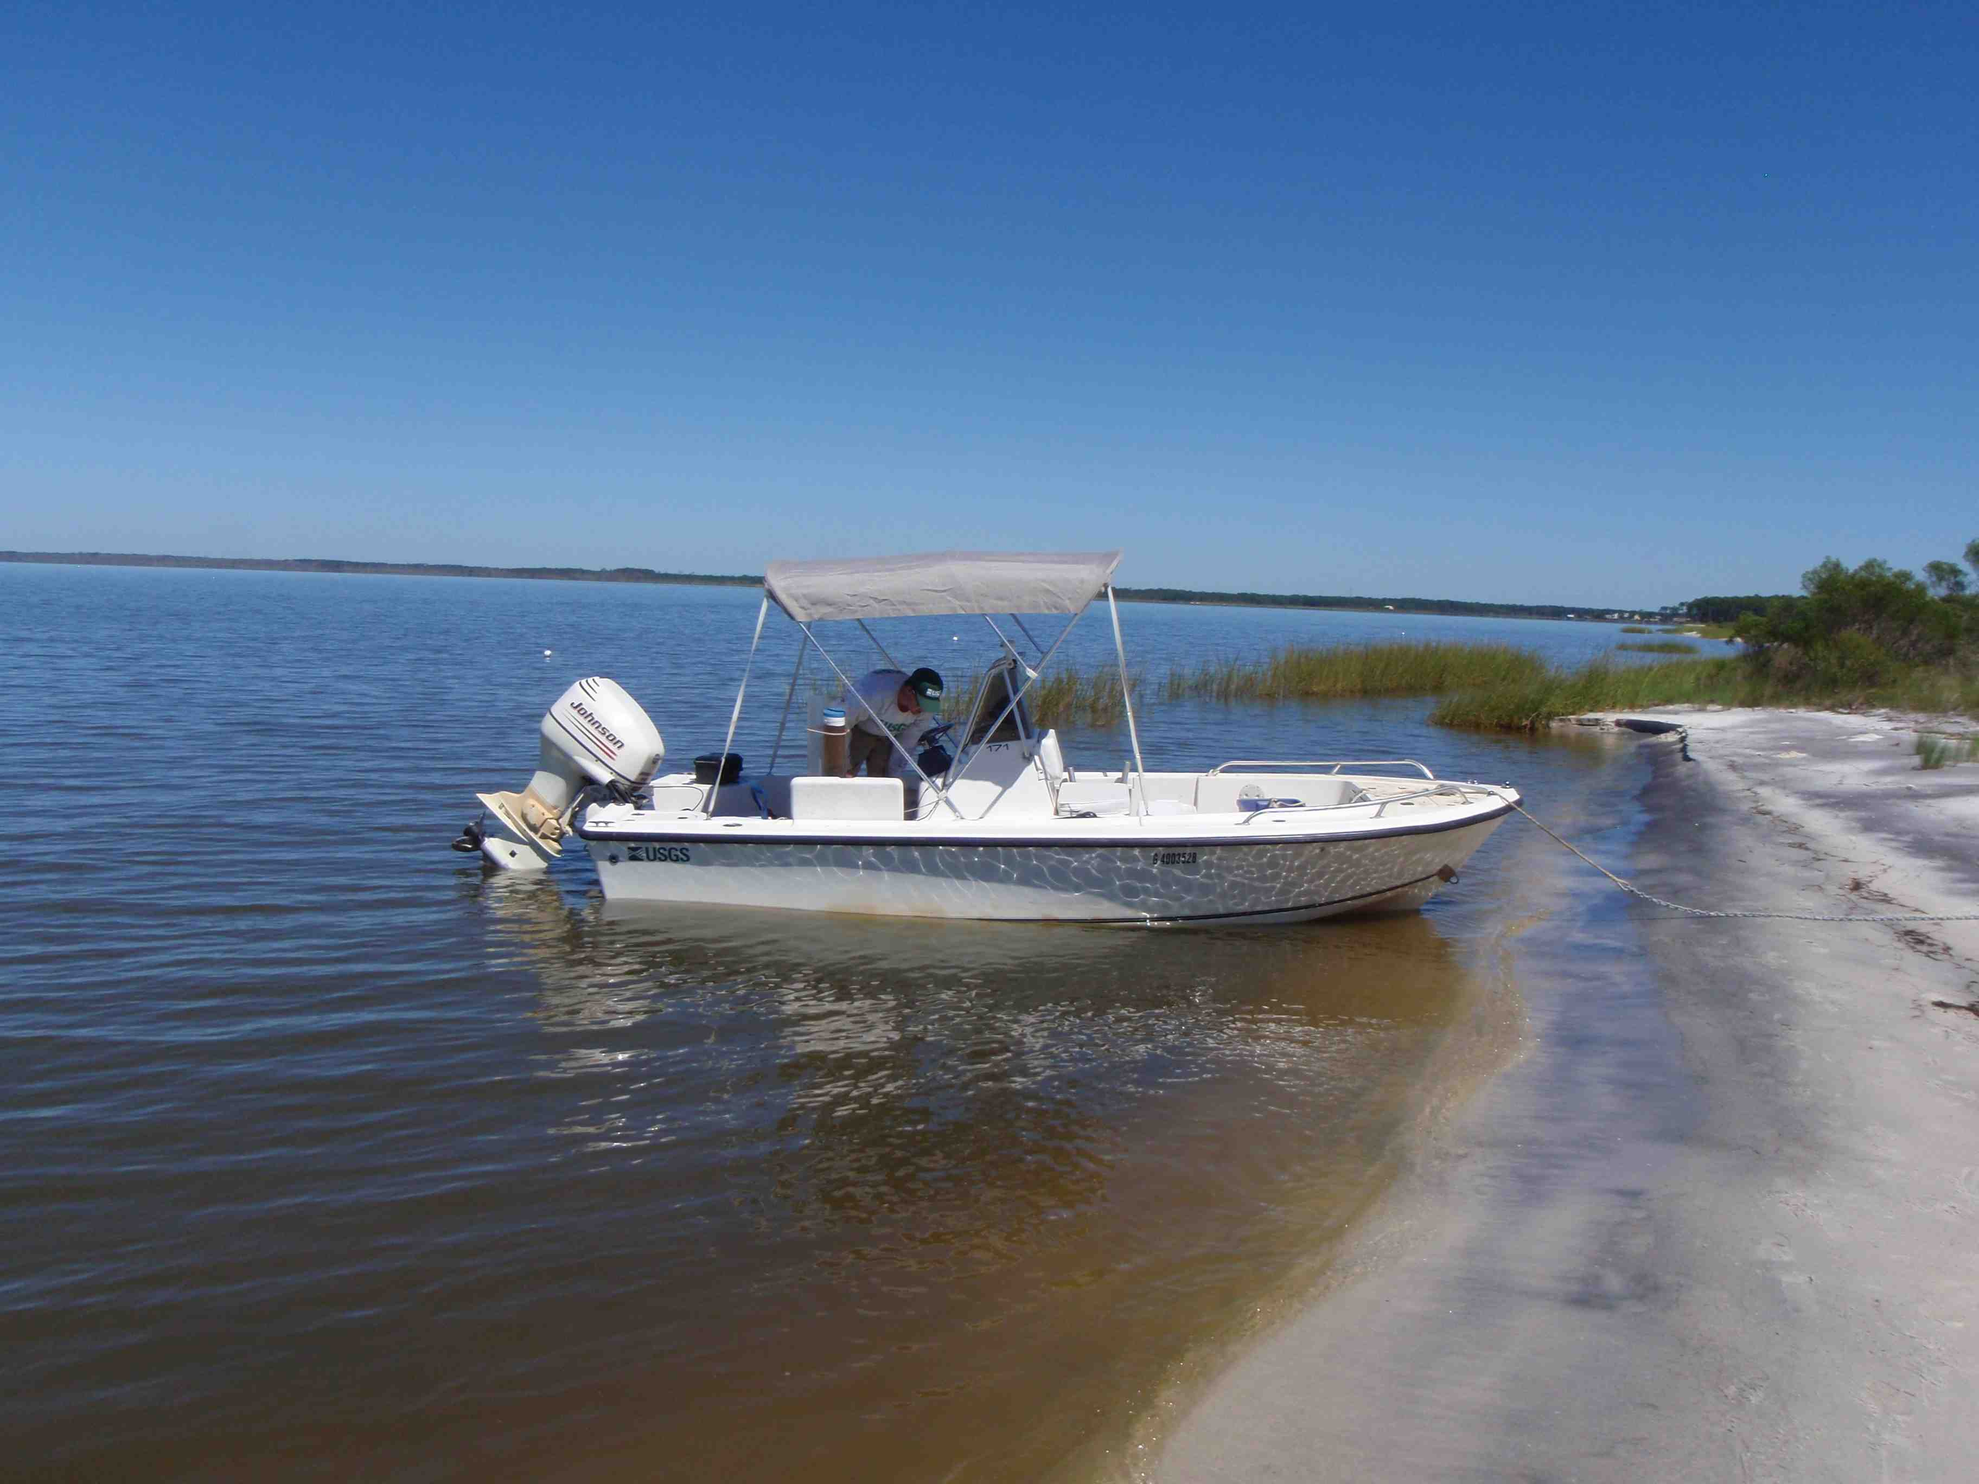
River and Bay Shorelines
West
East
Notes:
Along the East Bank, fluvial and marine terraces are common and crop out along riverbanks and bay providing coarser-grained sediments for bedload transport. Strandplain beachs are common along eastern bank of the bay, bordered by small bluffs in the north and hardwood pine forest and marsh systems in the south.

Slide 8
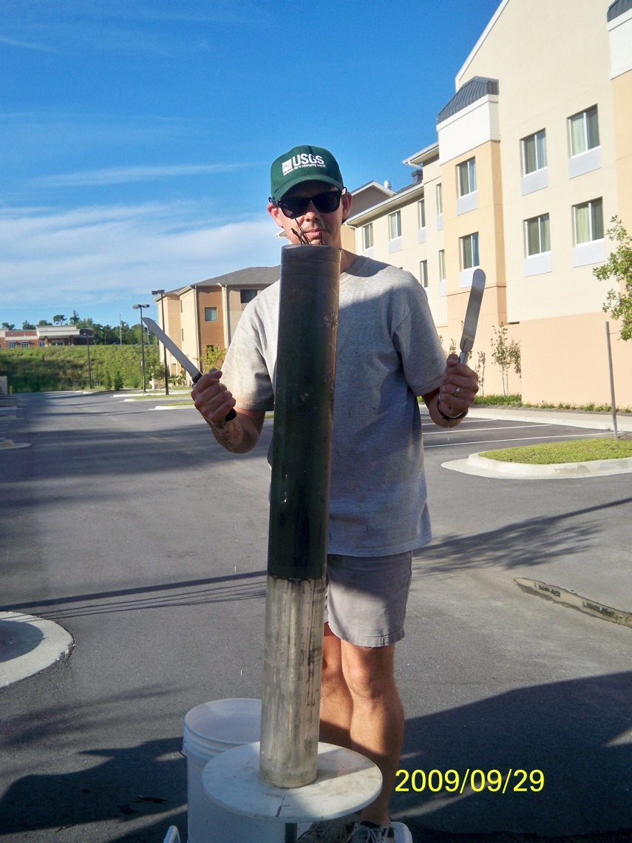
Measured Parameters
Physical Properties:
Bulk Density, Porosity, %OC (GC)
Geochemical Properties:
δ¹³C, δ¹⁵N, and C:N of bulk organic matter
Geochronology, Mass Accretion Rates, Inventories:
Pb-210 and Cs-137

Slide 9
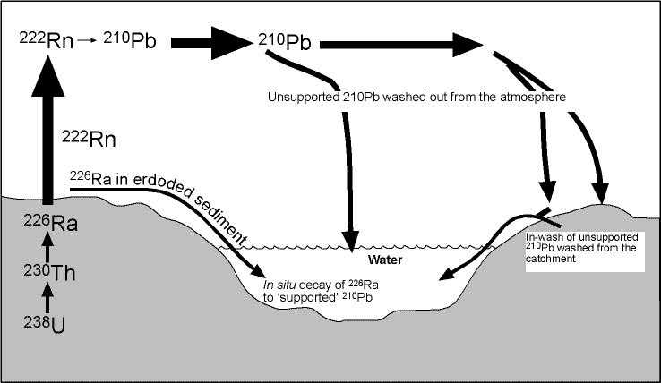
Fall-out Radionuclides
Mass Accumulation Model:
Constant ²¹⁰Pb Flux
¹³⁷Cs
(peaks 1958 – 1963)
eroded
modified from Oldfield and Appleby, 1984
Notes:
Here are my two allotted equations for this talk. Basically they are the mathematical respresentation of a exponential decay model, referred to as the CRS or Constant Rate of Supply model, applied to excess lead-210 profiles obtained from the sediment cores. Simplifying assumption for this model is that the atmospheric flux or supply of Pb-210 to the marsh remained constant over the last 150 years. It allows for variation in sedimentation rates. Top equation is for mass accumulation rates; the bottom for age.

Slide 10
Big Picture: Sea-Level Rise (SLR)?
 | Rate of Change (mm y⁻¹) (1966 – 2006)
Sea-level rise Dauphin Island Tidal Station | 2.98 ± 0.87
Mobile River Freshwater Marsh (MB-09-MC-04B) | 6.3 ± 0.1
Tensaw River Freshwater Marsh (MB-09-MC-03A) | 8.0 ± 0.2
Mobile Bay Interior Brackish Marsh (MB-09-MC-08A) | 3.1 ± 0.1
Mobile Bay Interior Brackish Marsh (MB-09-MC-09) | 4.0 ± 0.2
*source: http://tidesandcurrents.noaa.gov/sltrends/sltrends_station.shtml?stnid=8735180
Notes:
The first question we wanted to address how these marshes are responding to sea-level rise over the long-term.
The figure to the right shows the age-depth relationship for four cores from the region with there position on the figure reflective to some degree of there position within the bay and bayhead delta complex. (Top row – Bayhead delta marshes, Mobile and Tensaw Rivers left and right, respect. Bottom row – brackish marshes along the bay perphyery). Also plotted on each is the average annual sea-level from the tidal station at Dauphin Island. The 40-y average RSL rise rate for Dauphin Island is 2.98 mm/y.
As you can see all the marshes we sampled have linear sedimentation rates that are either very close to or exceed this rate of sea-level rise. The salt marshes appear to be coupled with sea-level as the long-term linear accretion rates are comparable to SLR rates. With that said, recent accretion rates in the salt marshes are higher than the long-term trend. A couple explanations exist, 1) compaction and decay are not as complete in this section, providing an apparent higher accretion rate. 2) biological mixing gives the perception of accelerated accretion rates, or 3) there has actually been a higher rate of accretion.
Fresh water marshes all in all have accretion rates that are 2 to 3 times that of sea-level rise, which would suggest they are somewhat decoupled from SLR pressures.

Slide 11
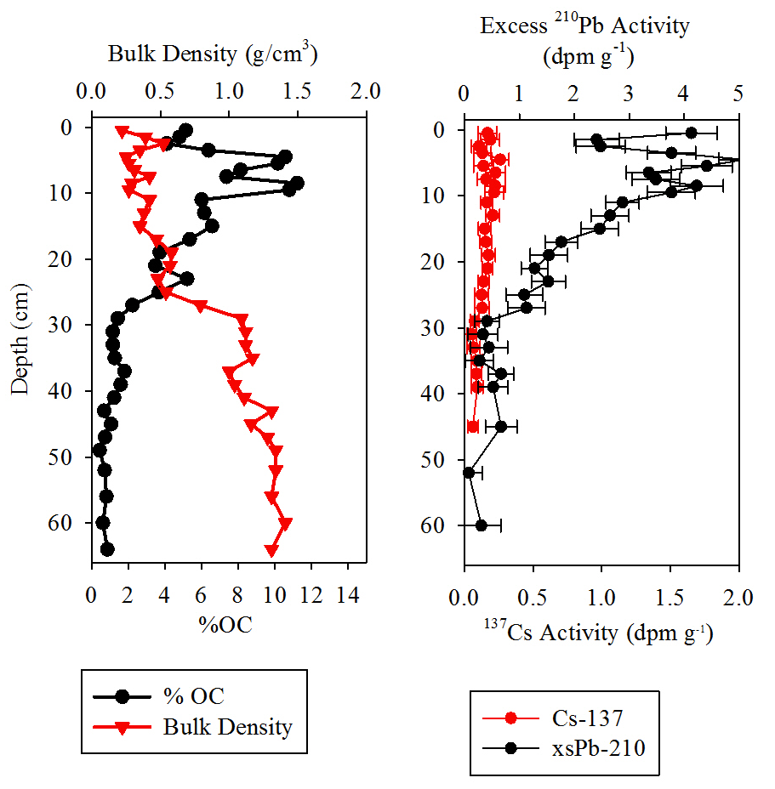
BayHead Delta FW Marsh –
MB-09-MC-04B
Collocated decreases in % OC and increases in bulk density are indicative of pulses of inorganic sediment
More uniform sediment type (sl. sandy mud) encountered below 30 cm
Excess ²¹⁰Pb specific activity also vary with sediment type
Notes:
Taking a step back and looking at more of the raw data used, here we present %OC, bulk density, xsPb210, and Cs137 for a freshwater marsh core MB-09-MC-04B. The site is an interior grass flat. We collected the core approximately 100 m from the river bank. As you can see the core has quite a variable depositional history as suggested by bulk density and %OC. The top 30 cm reflect the establshment of the marsh within the region with ever gradual increase in organic matter. However, occasional pulses of inorganic sediment (id by the collocated decreases in OC and increases in bulk density) are apparent. Below 30 cm is a sl. sandy mud that contains low amounts of xsPb210. The other fresh water marshes have a very similar shallow stratigraphy.

Slide 12
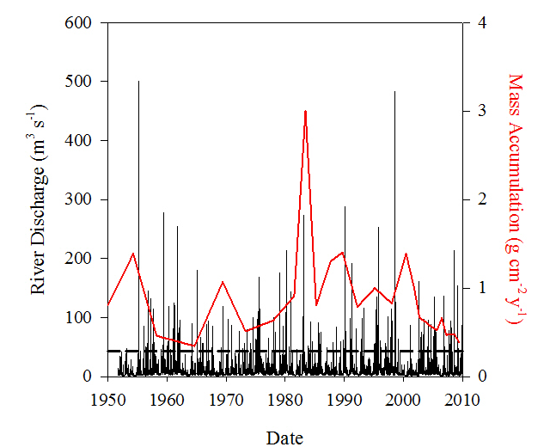
Overbank Flow to FW Marshes
Mass Accumulation Rates (MAR) highly variable during the last 50 y.
Qualitative comparison of MAR and river discharge suggest potential causal relationship, but not consistent
High discharge may be depositional at certain times and erosional at others.
Discharge data for Chickasaw Creek, a tributary of the Mobile River near Mobile, AL
Notes:
A common source of these inorganic sediment pulses is overbank flow. We compared the mass accumulation rates for two of the fresh water marsh cores with stream discharge from Chickasaw Creek, tributary to the Mobile River just north of Mobile. As you can see notable changes in MAR occasional coincide with peak discharge but the relationship is far from quantitative. One possible explanation could be that the sediment load moving down the river system has been greatly retarded by lock-dams. All and all, notable episodic deposition with the marshes in the bay-head delta can not be definitively tied to anything in the instrumented record at this point.

Slide 13
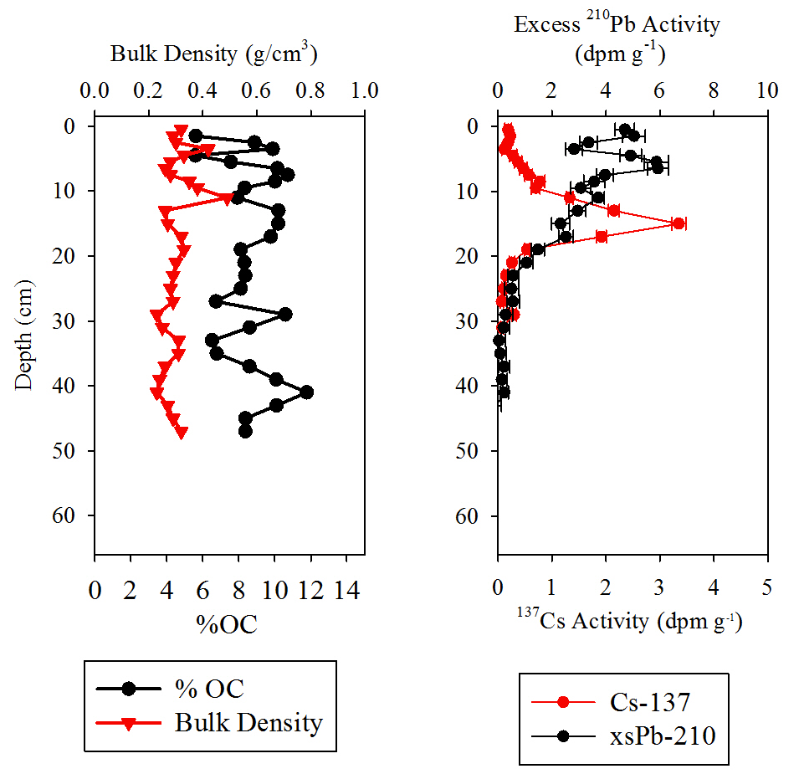
Interior Salt Marsh: MC-09-MC-08A
Collocated decreases in % OC and increases bulk density indicative of pulses of inorganic sediment
Excess ²¹⁰Pb specific activity also vary with sediment type
Relatively well preserved ¹³⁷Cs peak helps to further refine the geochronology.
Notes:
Again, we see the collocated changes in %OC and bulk density in the slat marsh cores. This core was collected from a large marsh system where the Fowl River and Mobile Bay are connected. Pb-210 activities respond to the influx of coarser grained sediments diluting the activity. Unlike the freshwater marshes, the Cs-137 peak which dates to somewhere betwene 1954 and 1965 (often assumed to be 1963) is well-preserved and allows us to refine the geochronology.

Slide 14
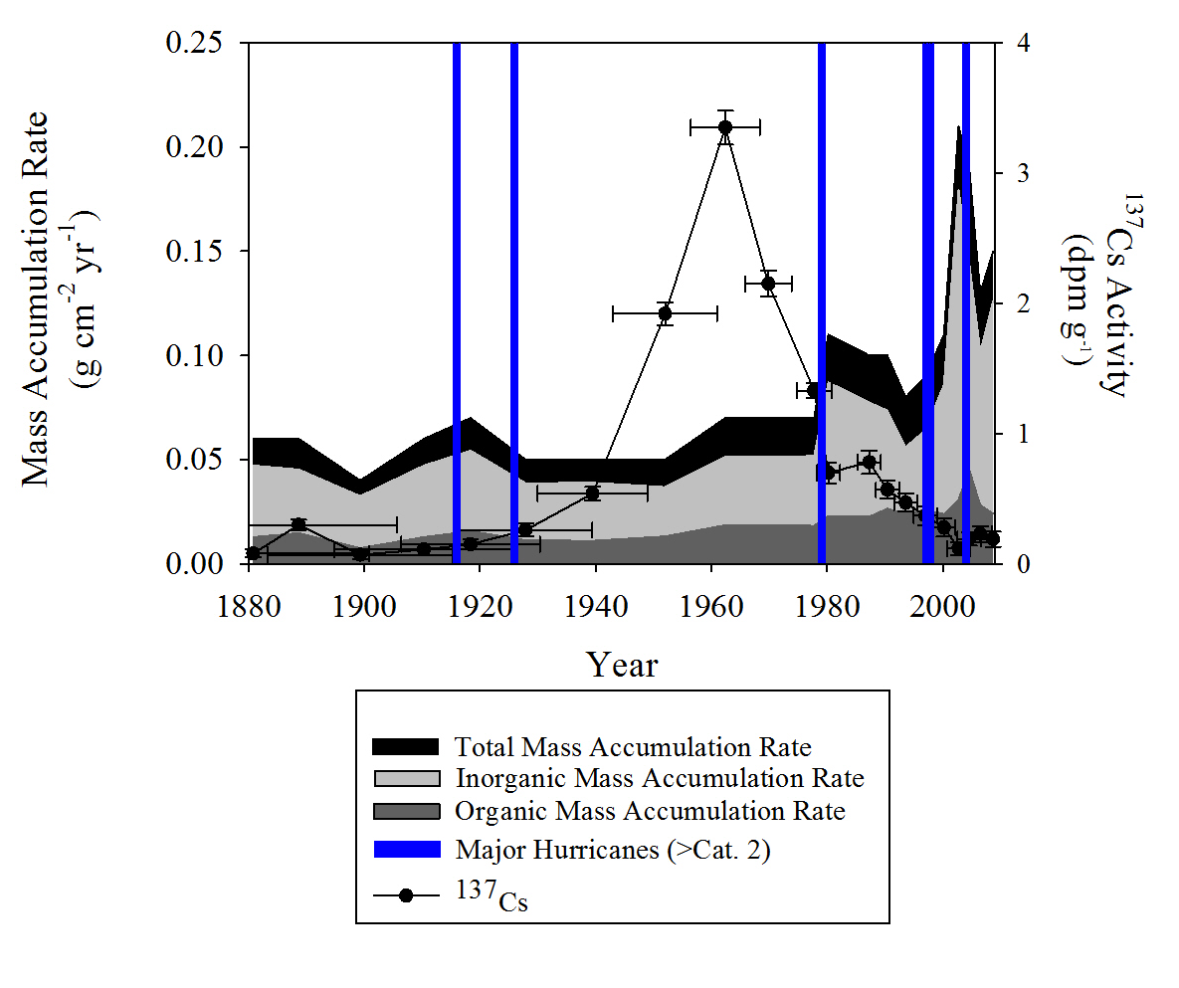
Hurricane Deposition
Qualitatively, increases in mass accumulation rates in the salt marsh often coincide with hurricane landfall near Mobile Bay.
Lower OM in these layers indicate dilution of organic marsh sediments by inorganic sediment
Critical balance between organic and inorganic sediment accumulation
Notes:
Also, unlike the freshwater marshes we see a strong correlation with inorganic pulses and documented driver (tropical cyclones). The figure to the right shows the total mass accumulation and the organic and inorganic fractions over the last 120 yrs. Also plotted is the Cs-137 specific activity versus time; error bars on this plot reflect the uncertainty in the CRS derived ages. The bars on the graph show documented tropical cyclones (> cat. 2 = blue; < cat. 3 = green). Of the six spikes in mass accumulation, four of those correspond to document tropical cyclones. These spikes in mass accumulation tend to be dominated by inorganic sediment, removing these layers from age-depth analyses results in linear sedimentation rates approximately 30 to 40% less than modern sea-level rise.

Slide 15
Summary
Salt marshes along the periphery of Mobile Bay are accreting at rates comparable to sea-level rise.
A large fraction of accretion is due to inorganic sediment accumulation.
Episodic deposition of inorganic sediment provide additional substrate for long-term accretion.
Freshwater marshes studied are decoupled from local sea-level and appear to be controlled partially by overbank sediment input.
Historic floods within the bay-head delta are not well preserved in the marshes we examined.
Notes:
So to summarize our findings:

Slide 16

Acknowledgements
USGS Coastal & Marine Geology Program
Northern Gulf of Mexico (NGOM) Ecosystem Change and Hazard Susceptibility
Thomas Harmon (USF-SP)
Marci Marot (USGS)
Adis Muslic (USGS)
Chris Reich (USGS)
Kathy Richwine (USGS)
Dr. Donny Smoak (USF-SP)

Slide 17


Questions
?

Slide 20
Excess ²¹⁰Pb Inventories
Core ID | Core Length | Excess ²¹⁰Pb Surface Activity | Excess ²¹⁰Pb Inventory | Excess ²¹⁰Pb Inventory Err
 | (cm) | (dpm g⁻¹) | (dpm cm⁻²) | (dpm cm⁻²)
MB-09-MC-04B | 62 | 4.13 | 36.23 | 5.69
MB-09-MC-03A | 54 | 2.56 | 32.30 | 3.425
MB-09-MC-08A | 42 | 4.17 | 23.29 | 3.34
MB-09-MC-09 | 36 | 1.9 | 34.09 | 7.39
Central North America* | - | - | 35.96 | 14.81
Eastern North America* | - | - | 29.67 | 12.77
*Source: modified from Appleyby and Oldfield, 1992

Slide 21
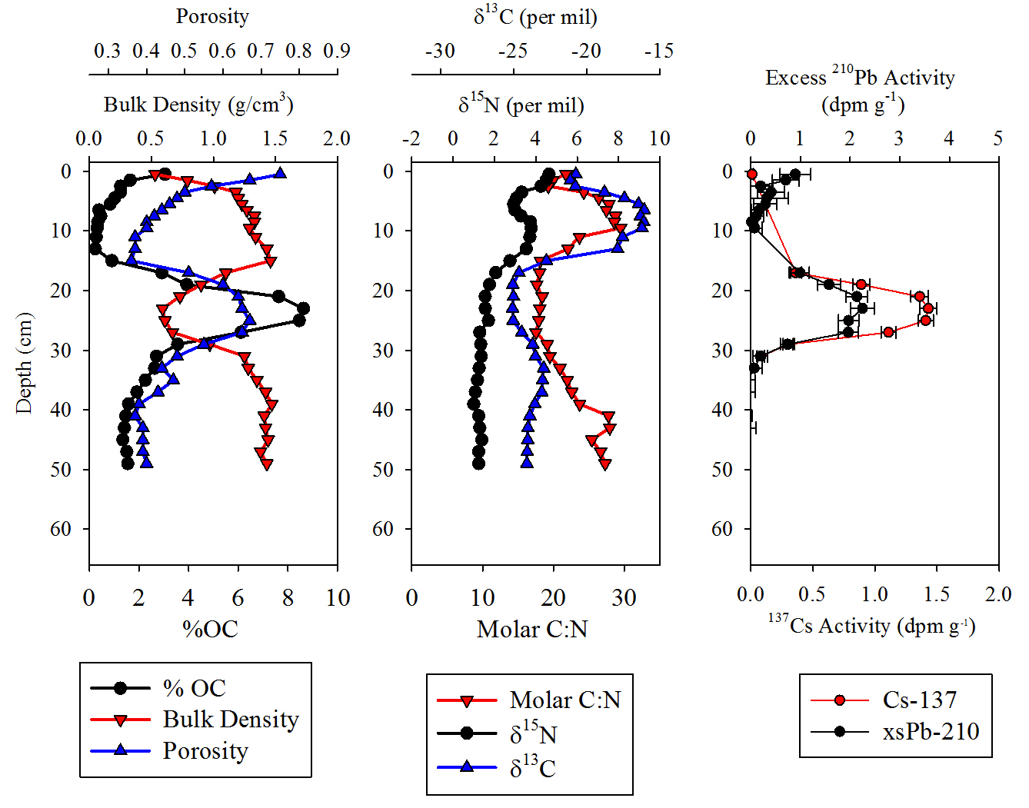
Marsh Platform: MB-09-MC10
Hurricanes Camille and/or Fredrick
1954 to 1963
Notes:
One final example of event-deposition I would like to leave you with is an example from the east side of the bay. The core was collected from a modern platform marsh. Unfornately, the stratigraphy did not allow us to get geochronology on the core, but some relative age assignments are possible based on Cs-137. The core has a very unique stratigraphy: modern marsh sitting on top of 15 cm of sand, sitting on top of 8 to 9 cm of marsh peat, on top of a basal sand. What we see is that Cs-137 is accumulated in the lower peat, and a concentration when compared to the core from the west side of the bay, is indicative of the peak in atmospheric testing, putting the deposition of the sand layer sometime around the 1960s.
The upper sand layer could have been emplaced on top of a marsh by Camille, Fredrick. If this is the case then it would seem that the platform was actually stranded for a period of time and marsh grass could not establish itself until sea level roseenough to allow roots to become established.
An alternative explanation would be that all this is response to say Fredrick and Ivan where a large section of the peat platform was eroded, sand deposited in its place, and now the marsh is finally re-colonizing the platform.

Slide 22
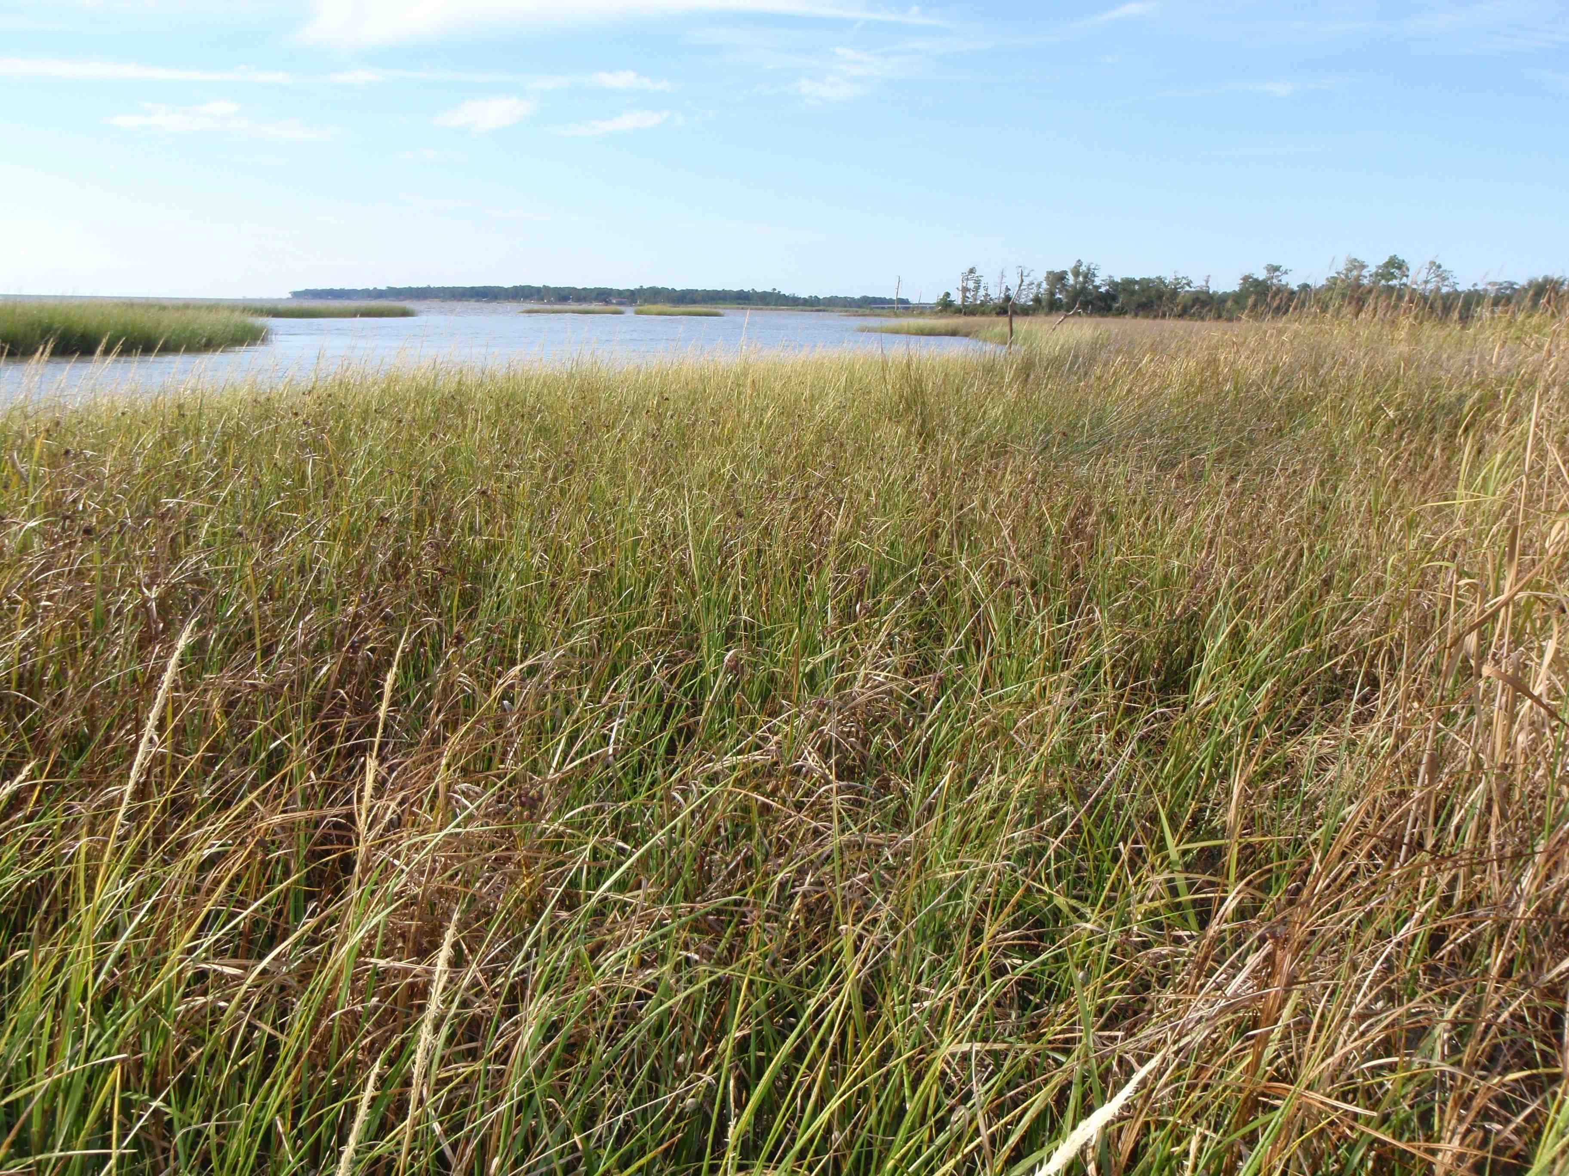
West Bank
Notes:
On the west side, terraces do occur but are slightly inland and do not crop out as frequently as they do on the west side. Interior freshwater marshes are a little more common within the bay-head delta and along the bay shoreline.

Slide 23
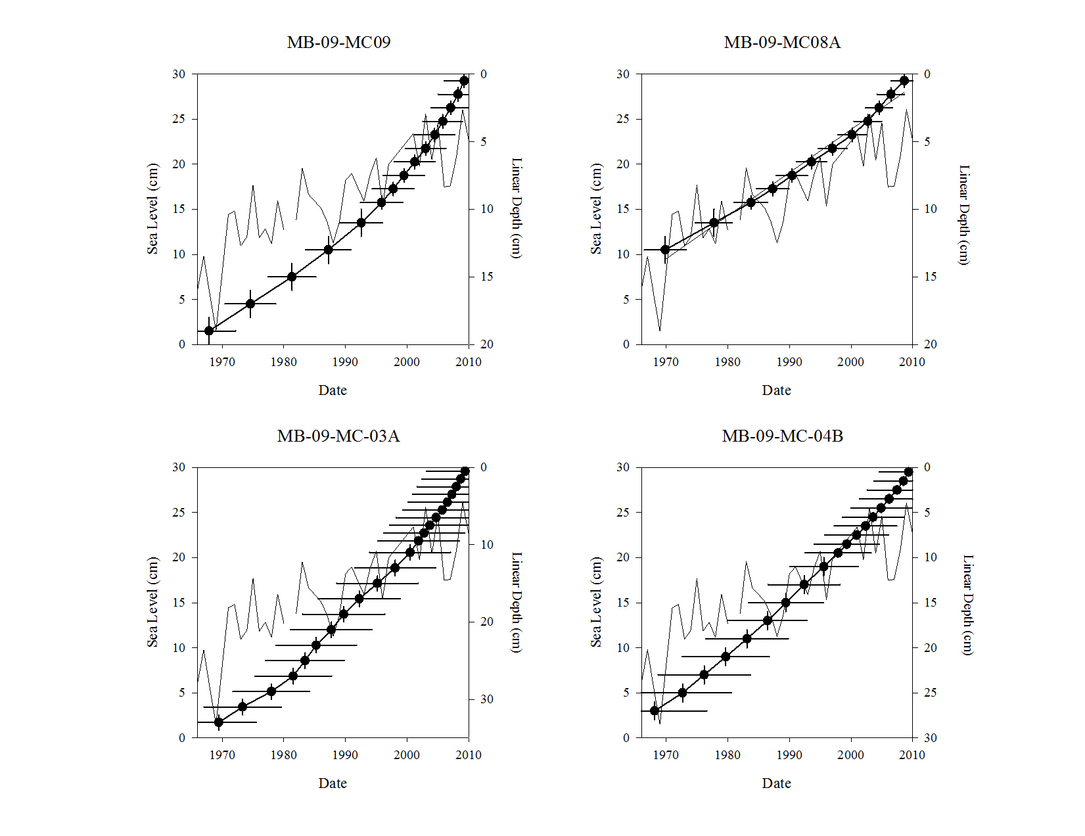
LSR = 0.65 cm y⁻¹
LSR = 0.74 cm y⁻¹
LSR = 1.16 cm y⁻¹
LSR = 0.48 cm y⁻¹
LSR = 0.75 cm y⁻¹
LSR = 0.28 cm y⁻¹
LSR = 0.37 cm y⁻¹
LSR = Linear Sedimentation Rate

