Slide 1
An Assessment of Sr Isotopes as an Anthropogenic
Tracer in Stream Water from the Austin, Texas, Area

Slide 2
Objectives
What are the sources contributing to stream water in urban watersheds versus natural (‘less developed’) systems?
Are the input sources isotopically distinguishable from one another?
Are strontium isotopes an effective environmental tracer in Austin-area urban watershed systems?
Why use Sr isotopes?

Slide 3
Outline of Presentation
Site Description
Sampling Methodology
Results
Modeling
Stream Water/Urban Data Analysis
Conclusions and Implications

Slide 4
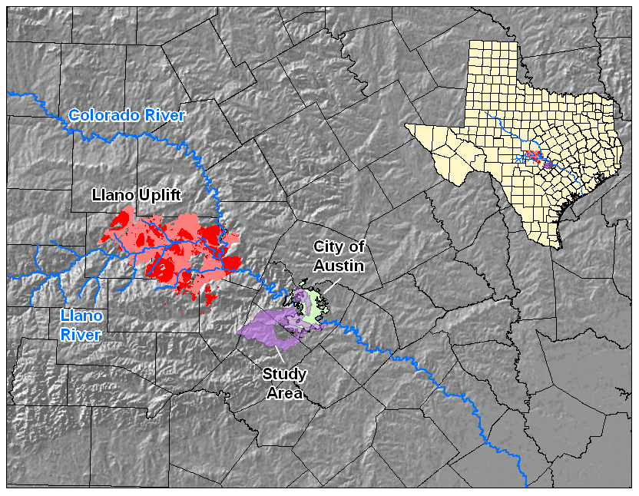
Physographic Setting

Slide 5
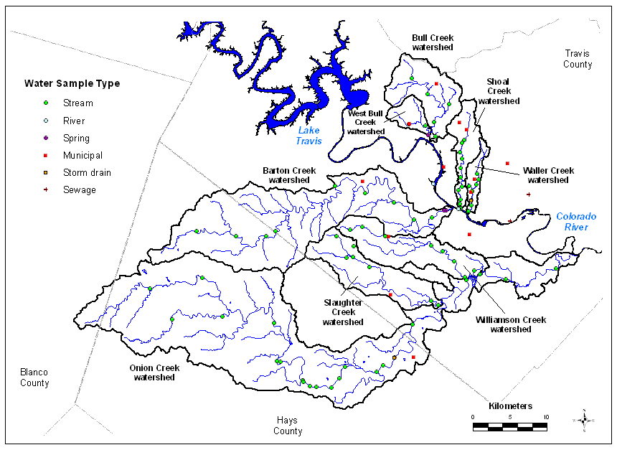
Sample Sites

Slide 6
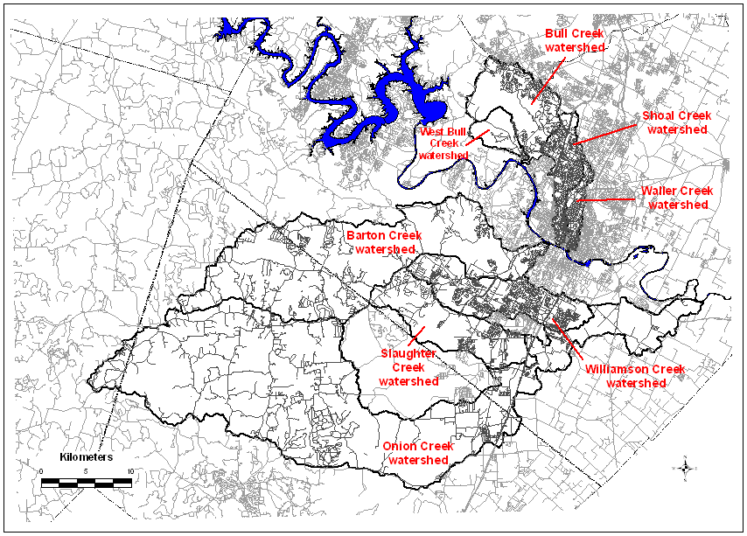
Distribution of Development

Slide 7
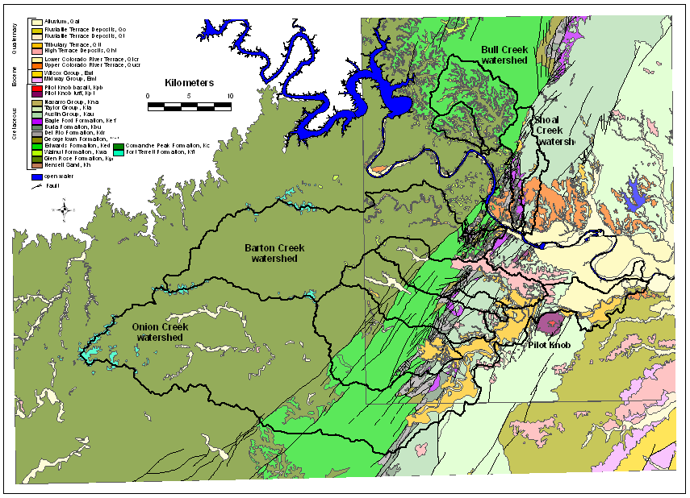
Geologic Setting

Slide 8
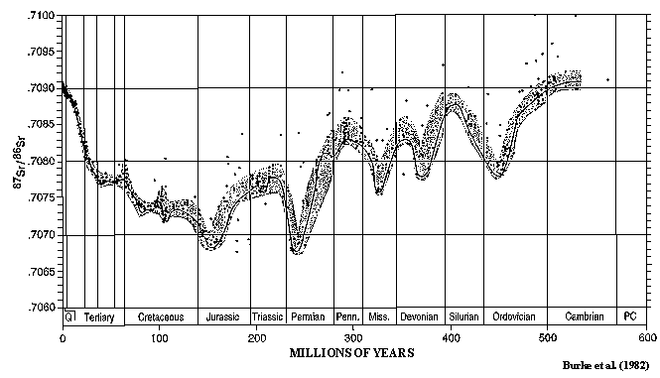
Strontium Seawater Curve

Slide 9
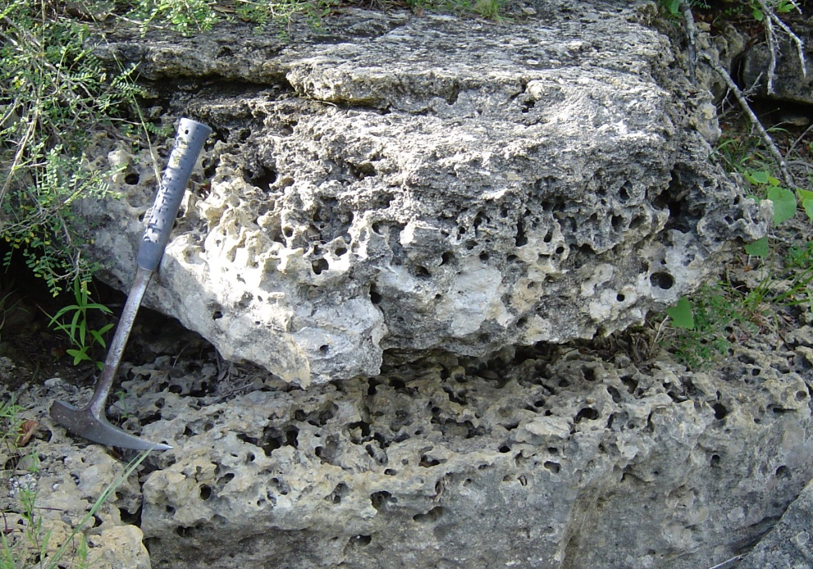
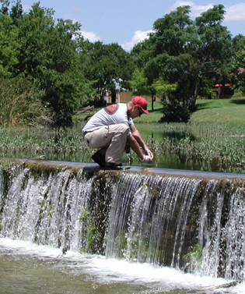
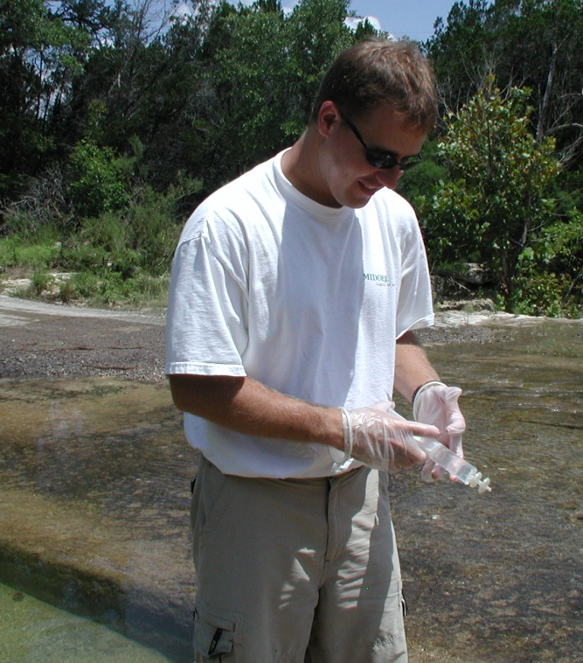
Sampling Methodology
Well flowing areas
Center stream
Acid-cleaned
bottles and syringes
Gloved hands

Slide 10
Geochemical Reservoirs

Slide 11
Geochemical Results

Slide 12
Geochemical Results

Slide 13
Geochemical Results

Slide 14
Geochemical Results

Slide 15
Geochemical Modeling

Slide 16
Geochemical Modeling

Slide 17
Geochemical Modeling

Slide 18
Geochemical Modeling
Calcite
Dissolution
Calcite
Precipitation

Slide 19
Summary of Geochemistry

Slide 20
Building Area Index

Slide 21
Building Area Index

Slide 22
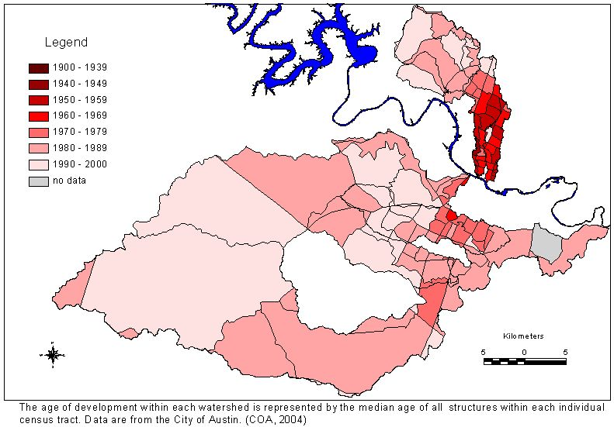
Age of Development

Slide 23
Age of Development

Slide 24
Stream Water-Urban Indices Analysis
Index R² Value
Percent Urbanized Areaª 0.95
Percent Urbanized Area^{b} 0.97
Population Density 0.93
Median Structure Age 0.95
Roadway Index 0.95
Municipal-water Pipe Index 0.86
Sewage Pipe Index 0.86
Percent Impervious Cover 0.86
ª City of Austin (2001) Land Use-Land Cover Digital Dataset
^{b} United States Geological Survey (1990) Land Use-Land Cover Digital Dataset

Slide 25
Conclusions
All seven watersheds display a downstream increase in ⁸⁷Sr/⁸⁶Sr.
Urbanized watersheds have higher average ⁸⁷Sr/⁸⁶Sr values compared to ‘less developed’ watersheds.
Urbanized watersheds have steeper-sloped linear regression trendlines indicating a larger ⁸⁷Sr/⁸⁶Sr gradient from upstream to downstream.
There is a strong correlation between high ⁸⁷Sr/⁸⁶Sr ratios and several indices of urbanization.

Slide 26
Implications
Strontium isotopes are effective in distinguishing anthropogenic inputs in the Austin, Texas area.
The strontium isotope system can be potentially applied as an isotopic tracer to other areas where a differentiation in the various sources to the hydrological system exists.

Slide 27
Acknowledgements
Jackson School of Geosciences, University of Texas at Austin
Environmental Science Institute, University of Texas
Dr. Larry Mack
Field Assistants: Julia Guerrero, Danielle Bailey, Amy Hobbs
City of Austin: Nico Hauwert, PhD., David Johns
Bureau of Economic Geology: Dr. Steve Ruppel
Dr. Jay Banner

