Slide 1
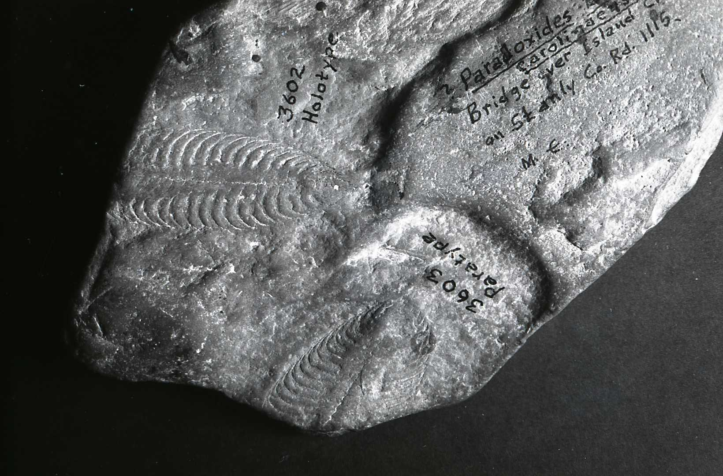
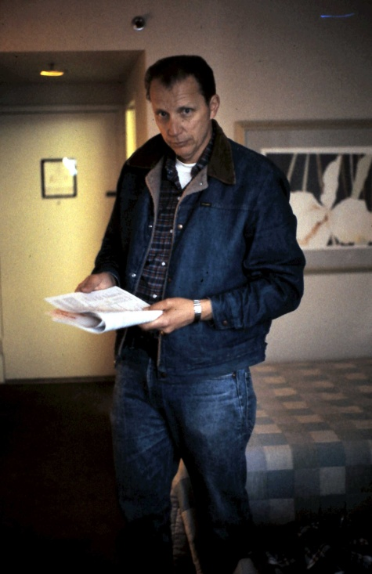
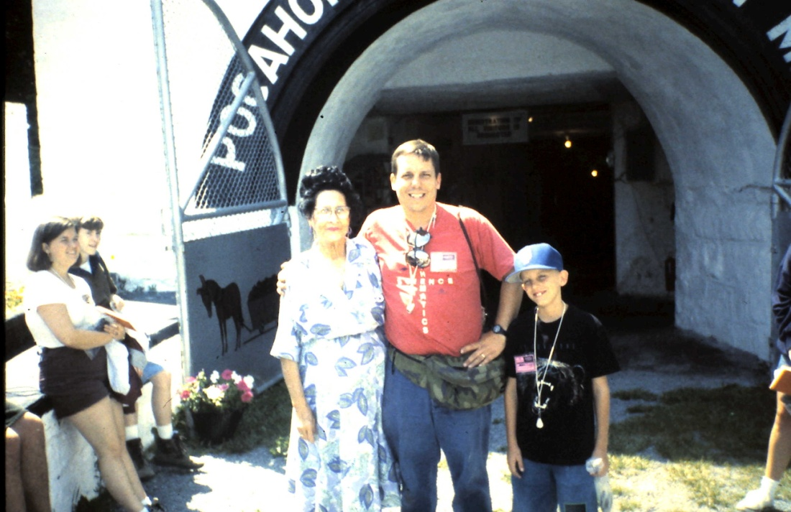
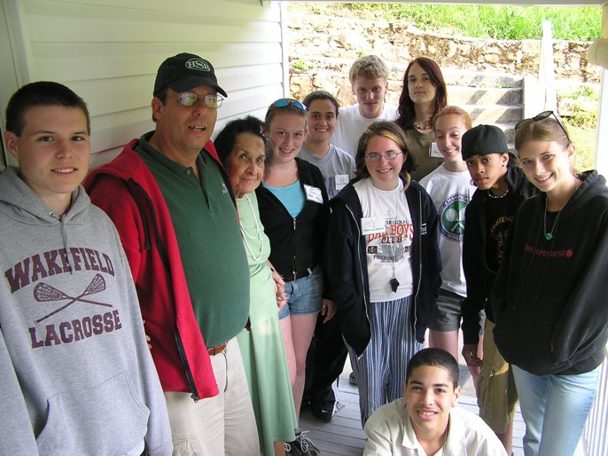
Significance of Ediacaran Fossils, Stanly County, NC:
Geological & Pedagogical
Gail G. Gibson – The Geologist
Steven A. Teeter – The Science Teacher
Notes:
This is a two-part saga of Ediacaran fossils in Stanly County NC……..a saga that began with the discovery of body fossil impressions on a stream-worn cobble of argillite in the bed of Island Creek, Stanly County……….a saga that continued via the recovery of another body fossil impression in 1980 -- from what would now have been a 200-year-old native rock chimney – rock that was originally quarried along Little Bear Creek……… then yet another impression on a stream-worn argillite cobble discovered in Rock Hole Creek in the early 1980s…………………and the unexpected discovery of body fossils in excavated rock from a construction project at the Gleaning Mission Church, in Oakboro.

Slide 2
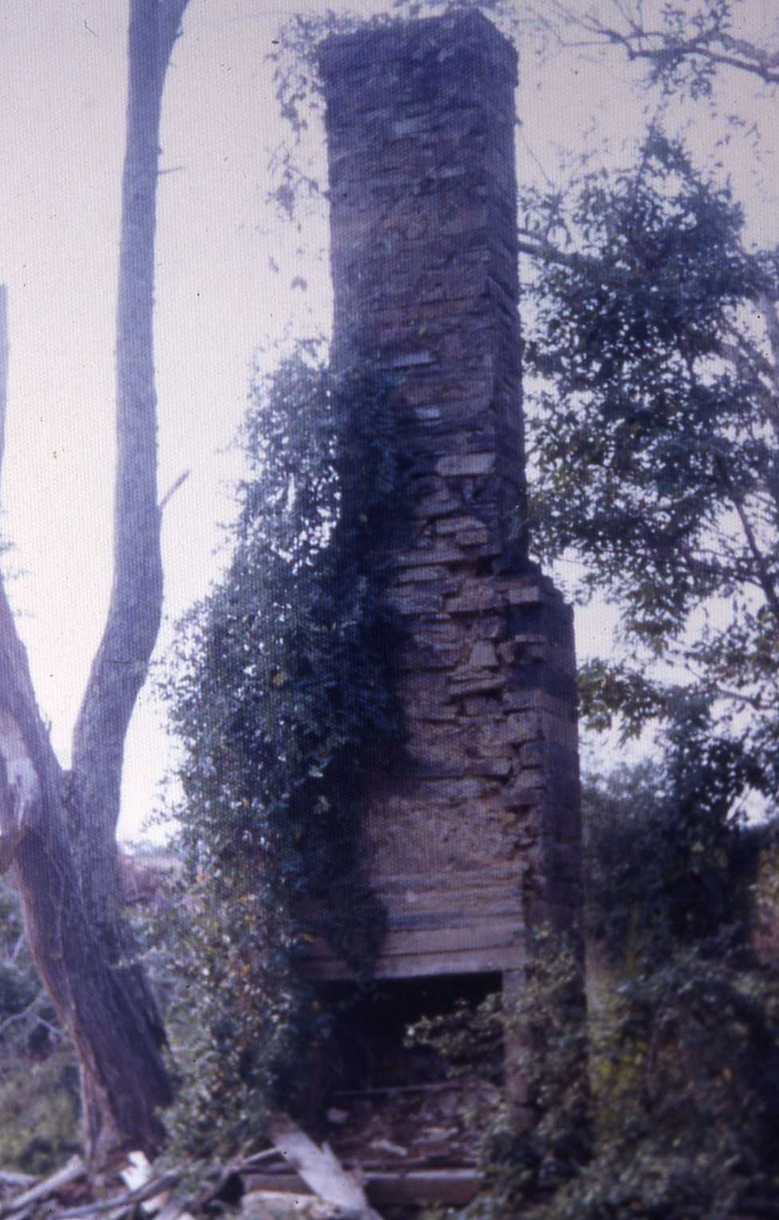
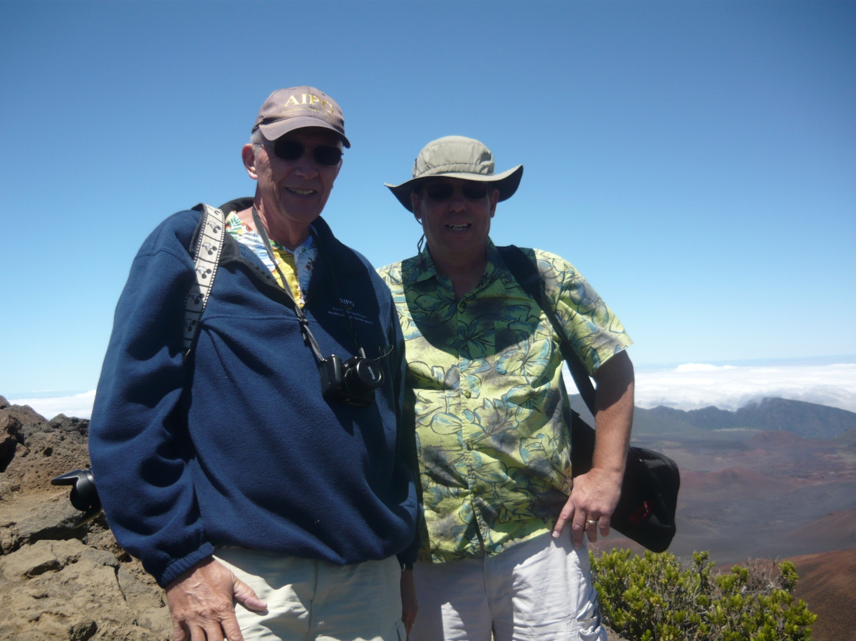
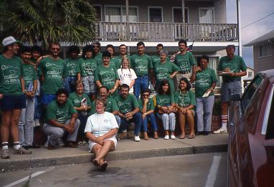
GAIL G. GIBSON, Ph.D., PG, CPG, REP STEVEN A. TEETER, M.A., Geology
Significance of Ediacaran Fossils from Stanly County, NC:
Geological & Pedagogical
Notes:
The second part of this saga began with this lonesome chimney…………that in turn resulted in these two guys getting together……………..and the pedagogical aspect of the saga………………. So, Steve & I will ‘tag team’ this presentation. Scientific method inquiry, information gathering,. etc. So here we are in 2009, with a group of high students, teachers, & parents island-hopping in Hawaii; and one of our geological – biological – oceanographic – meteorological teacher workshops in Puerto Rico.

Slide 3
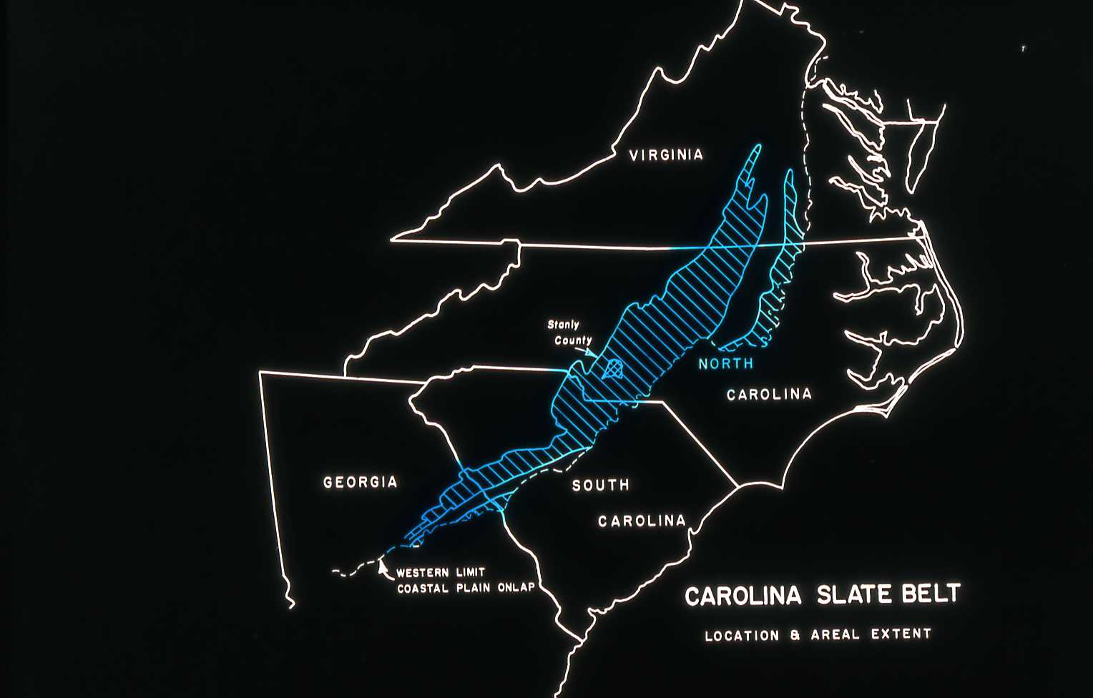
Notes:
Some orientation --- Stanly County within the Carolina Slate Belt (Carolina Terrane)

Slide 4
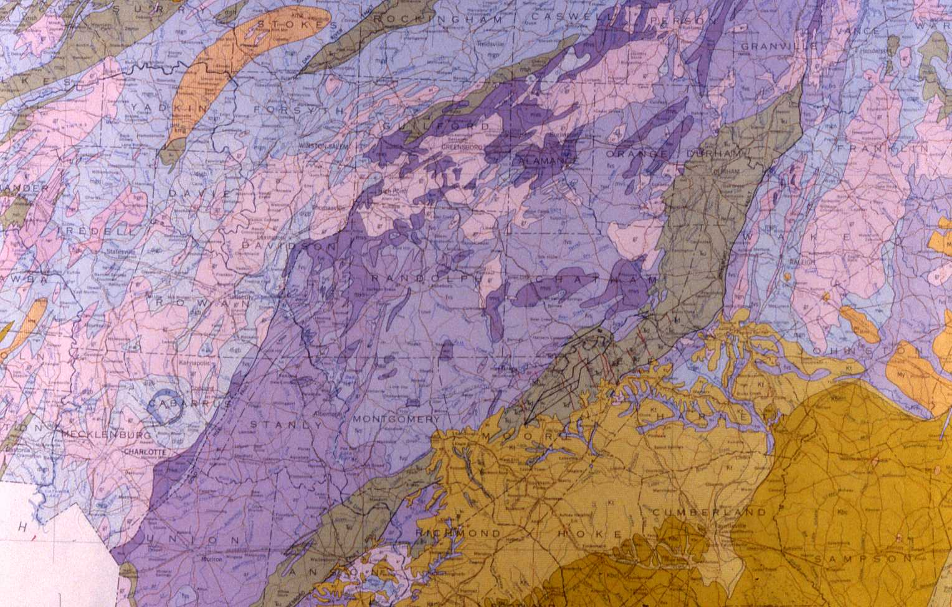
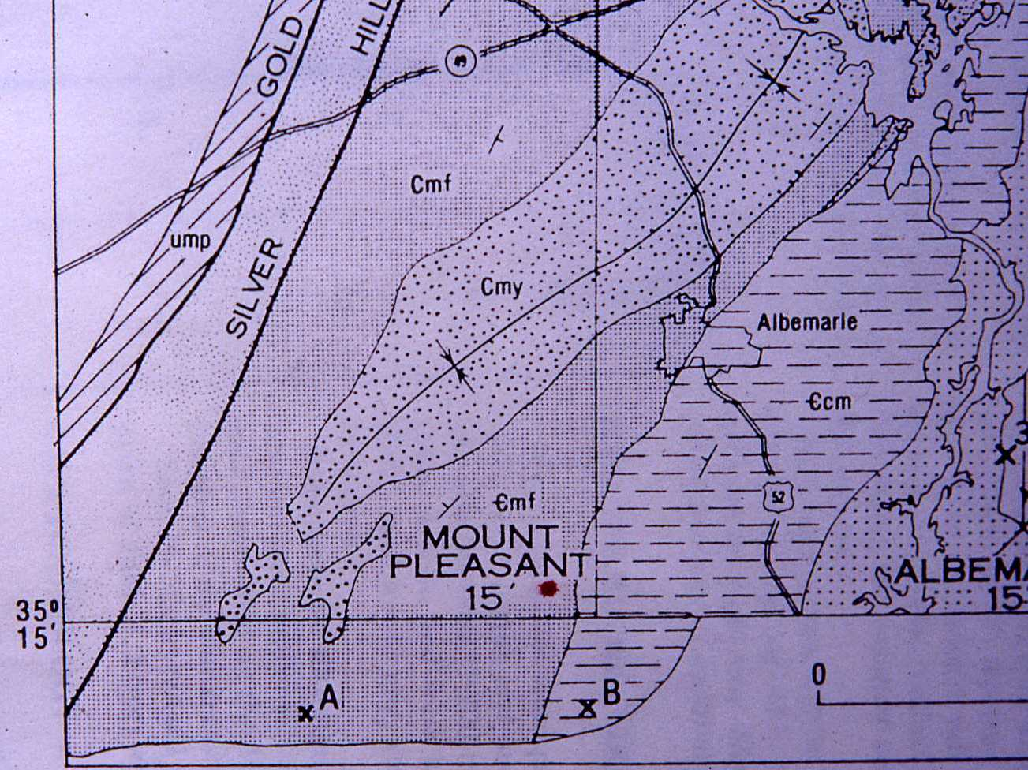
Notes:
Pertinent part of NC Geologic Map…………………….a bit more detail, though the geologic time symbols are incorrect

Slide 5
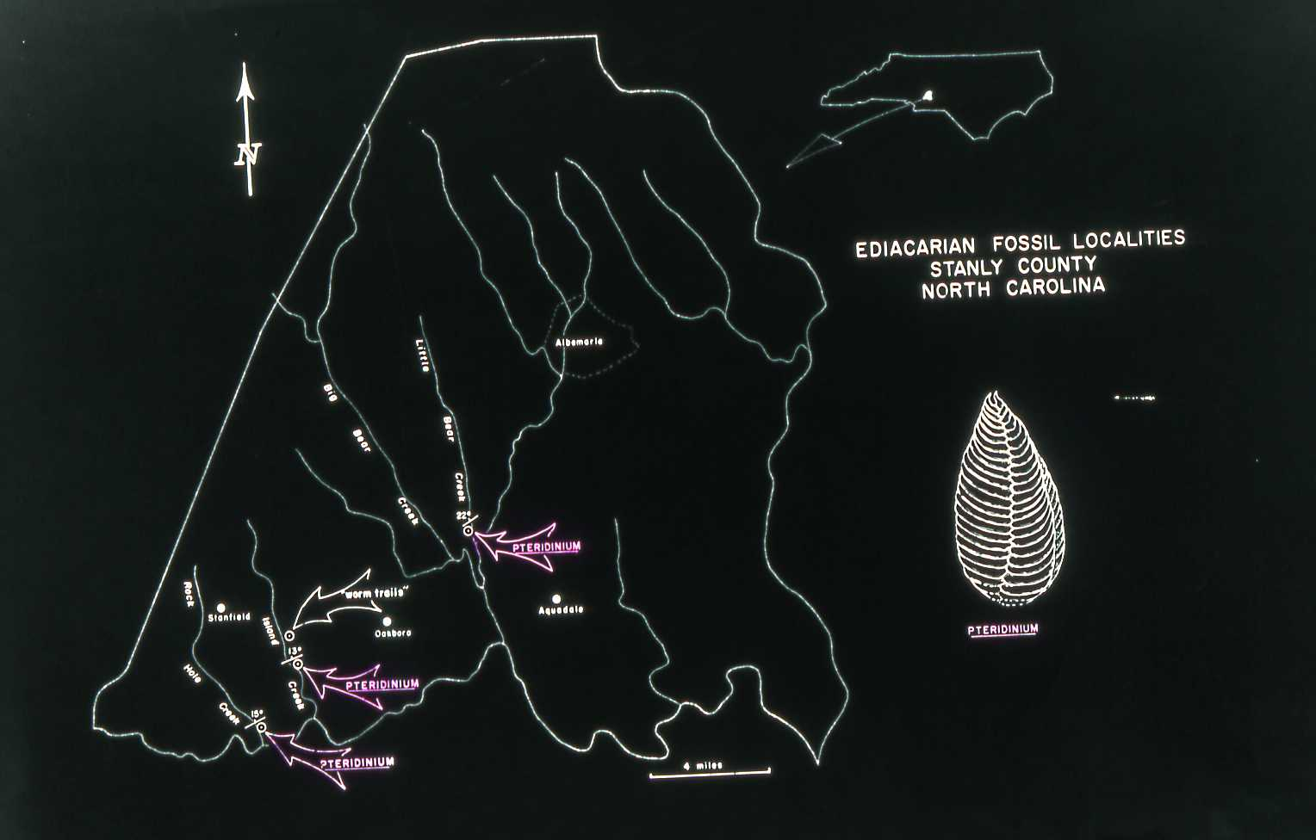
Notes:
Known Pteridinium locations in Stanly County

Slide 6
Impressions of Pterindinium (?)carolinaesis, stream worn, flattened boulder
Notes:
This stream worn, flattened boulder with impressions of body fossils was discovered in Island Creek in 1966, by Johnny Brattain, a West Stanly High School student. The initial publication in AJS, 1973, tentatively classified these fossils as the Cambrian trilobite ?Paradoxides, with possible age range of earliest Early Cambrian to middle Middle Cambrian…..an identification that generally corroborated thinking and radiometric dates in the area at the time……………………….significant effort was expended to correlate the lithology of this boulder with lithologies in the Island Creek drainage basin.

Slide 7
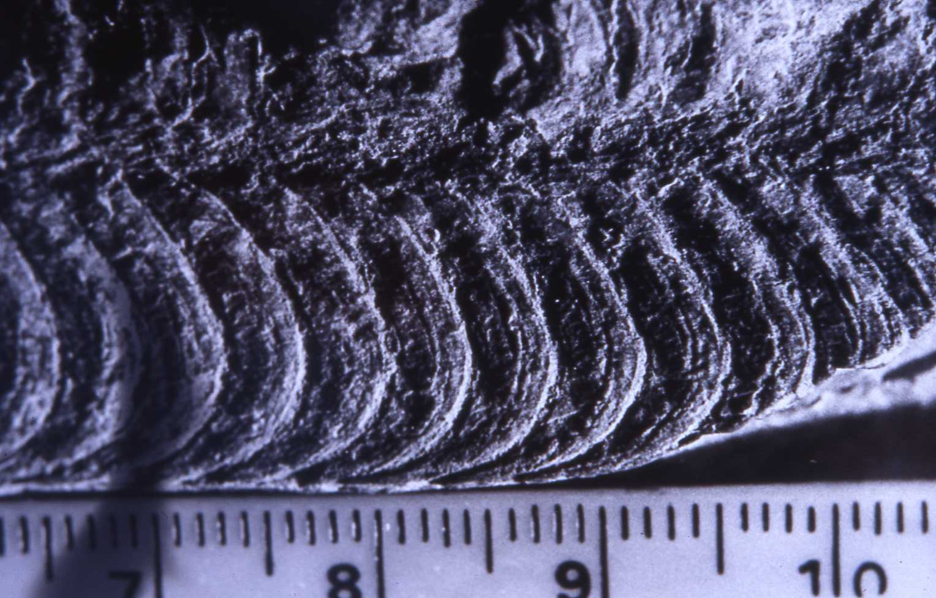
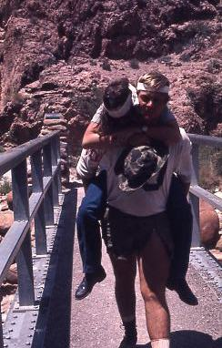
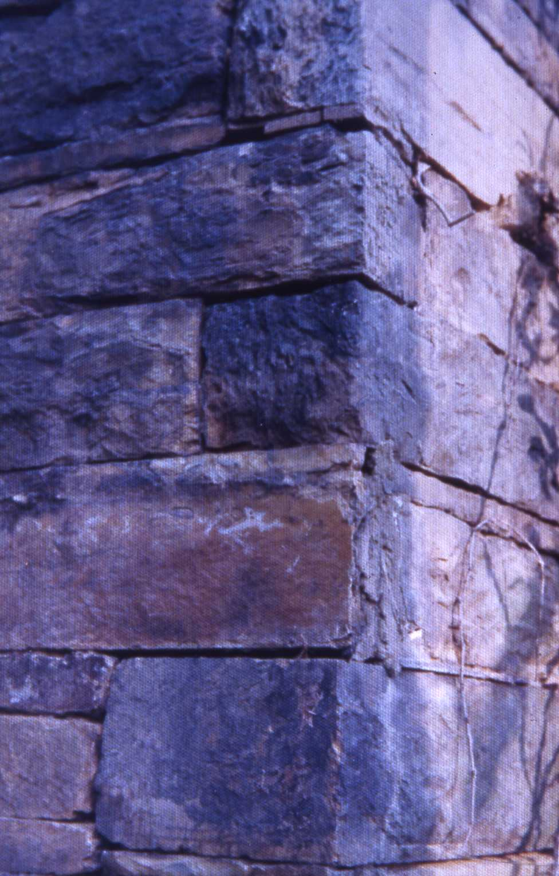
“Chimney fossil”
Notes:
The chimney? This is one of two chimneys that marked the location of Steve’s ancestral homestead in Stanly County. Having a sense of history, Steve gained permission from the landowner to raze the chimneys…….utilizing the stone to construct a chimney and fireplace in a home he and his wife were building in Oakboro. This was in 1980. Steve learned more than he wanted to know about sizing stone for his new chimney…………………….., but remembering the comment of one of his geology faculty at UNCC “……..a case of beer to anyone who finds a fossil in the slate belt…..” he kept an eye out for fossils. Late one day, one of the rocks split along a bedding surface and ……………………………………the ‘chimney fossil’……. In the spring of 1982, my telephone rang…………………..did I know anything about fossils?………yes………….what about the Carolina Slate Belt?……………………..very little……………….after all I had recently moved from West Texas, where I worked Cretaceous carbonates……………………….and………………… by the way, would I be willing to conduct a workshop for some elementary grades teachers?………………….Most definitely…………….The first teacher field-oriented in-service I conducted was in 1971……………a couple of our young teachers crossing the Colorado River at Phantom Ranch……………. Anyway, for the CSB, another fossil, not in place……………………after searching historic records…………..we were able to identify the quarry site for rock used in construction of the homestead, along Little Bear Creek, about 0.25 miles from the chimney site.

Slide 8
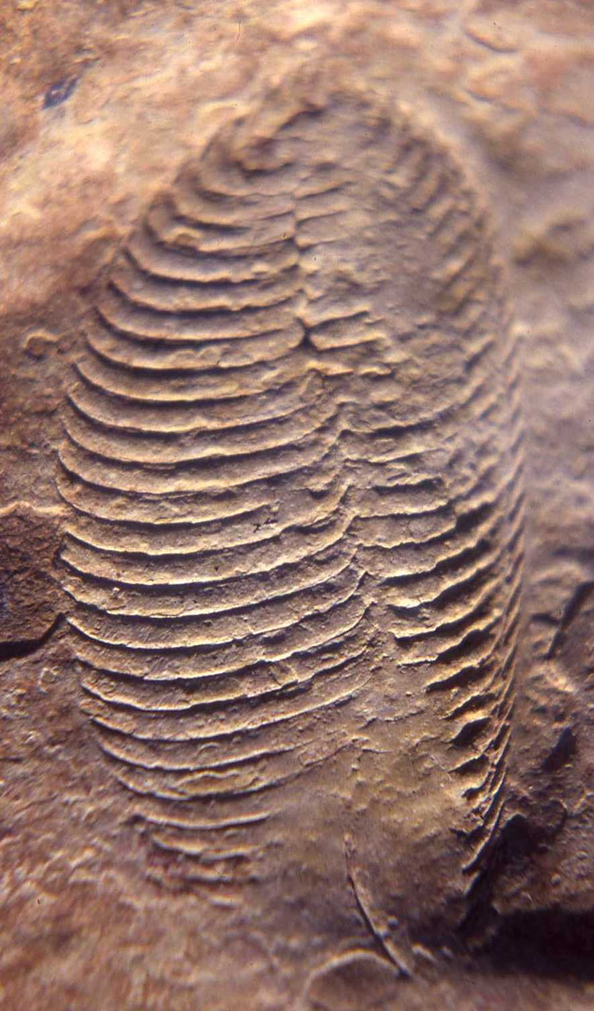
Rock Hole Creek, another flattened,
and rounded stream cobble – found by
a middle school student
Notes:
Shortly after the “Chimney Fossil” made the local newspapers, the telephone rang……………another creek, another stream-worn, flattened boulder……..another body fossil impression……….this time from Rock Hole Creek………………………a find made by a middle school student investigating a creek.

Slide 9
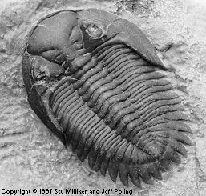
….....but what……...?
Notes:
So, the comparisons……….the Rock Hole Creek example……………..the Island Creek samples…………….the “Chimney Fossil” from Little Bear Creek…………………..at this point the evidence was overwhelming that these body fossil impressions definitely did not represent trilobites…………………but what?....................this was 1982, no computers or internet at that time. And no fossils exposed in outcrop…….so still questions about their provenance.

Slide 10
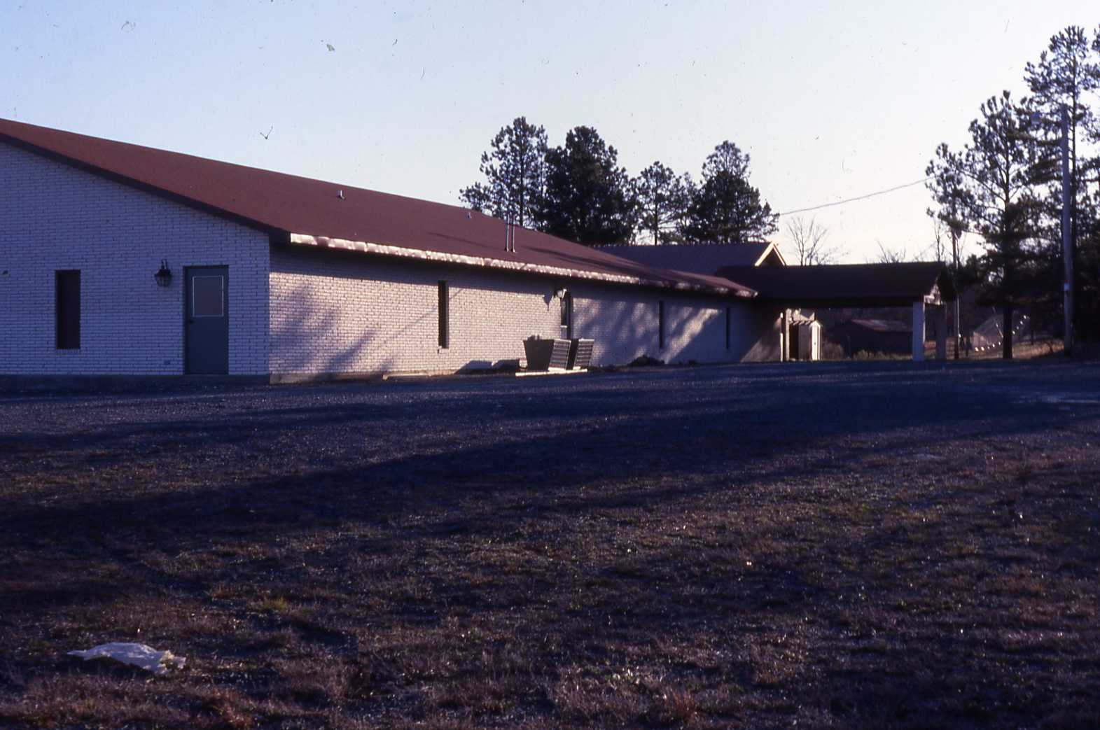
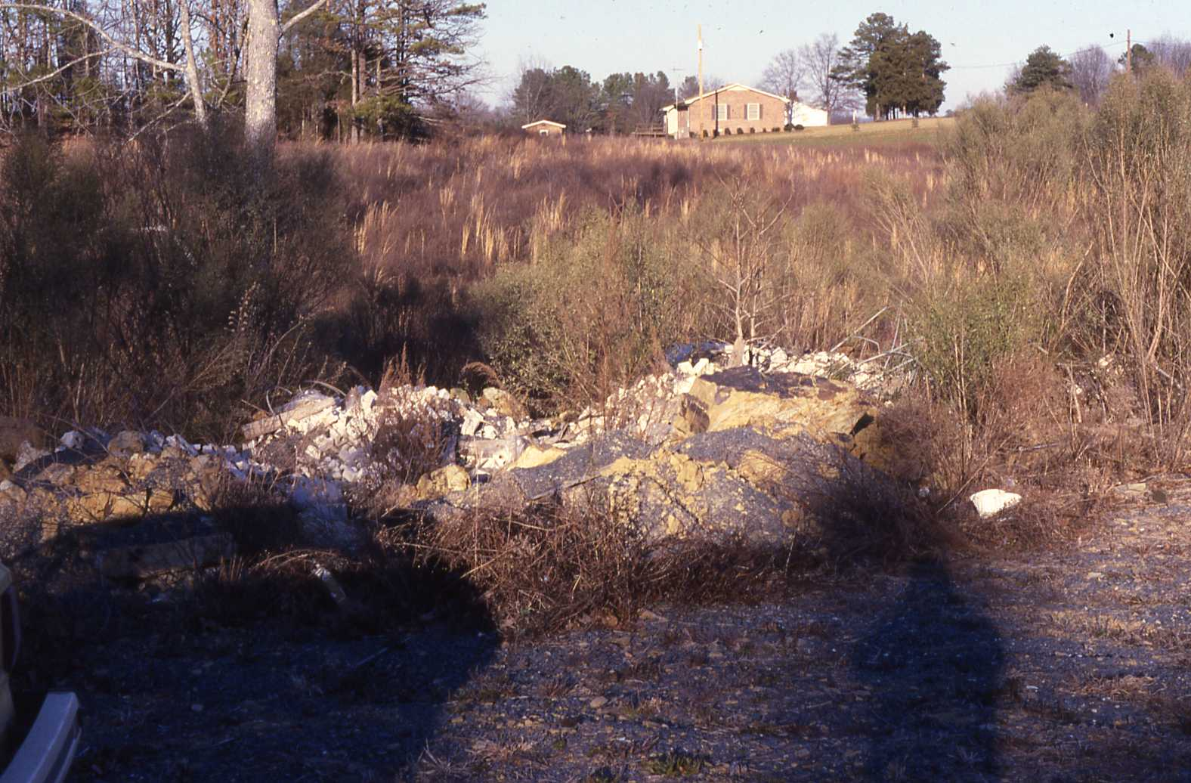
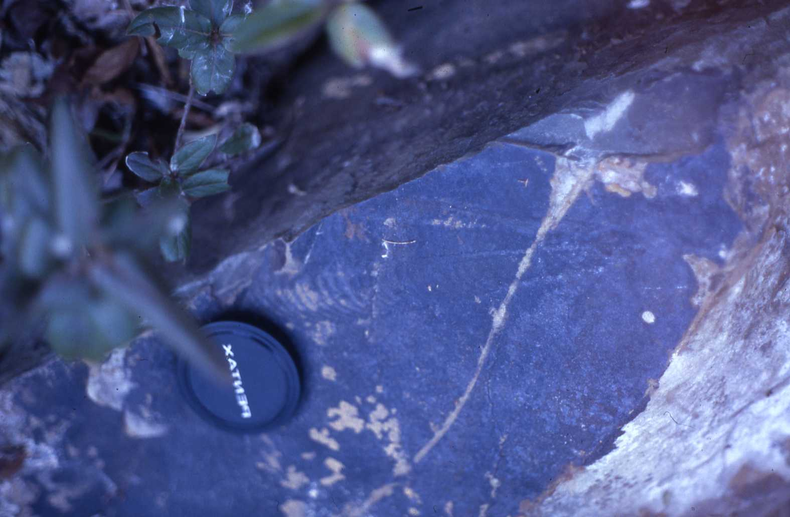
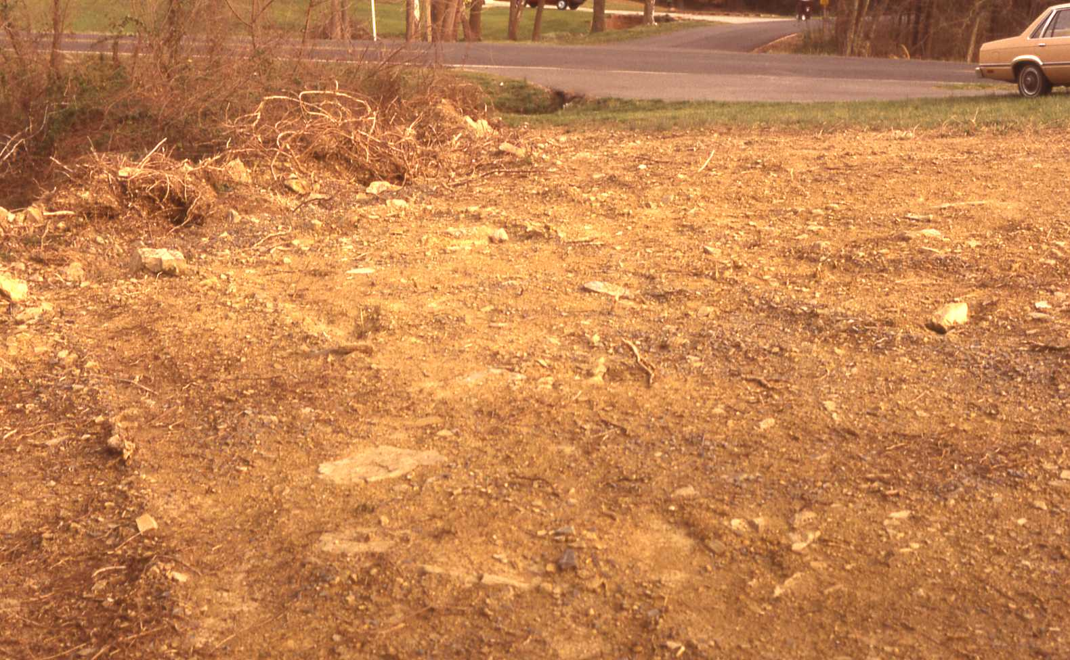
Notes:
The closest “we” came to finding Ediacaran fossils in outcrop in Stanly County is at Gleaning Mission Church, Oakboro. The church had built a meeting room addition ……………………site prep ripped up some of the bedrock, pushing it into an adjacent topographic low to create additional parking space…………..still no fossils in place, but the source of the angular boulders was well documented…………………so the question of local provenance was addressed.

Slide 11
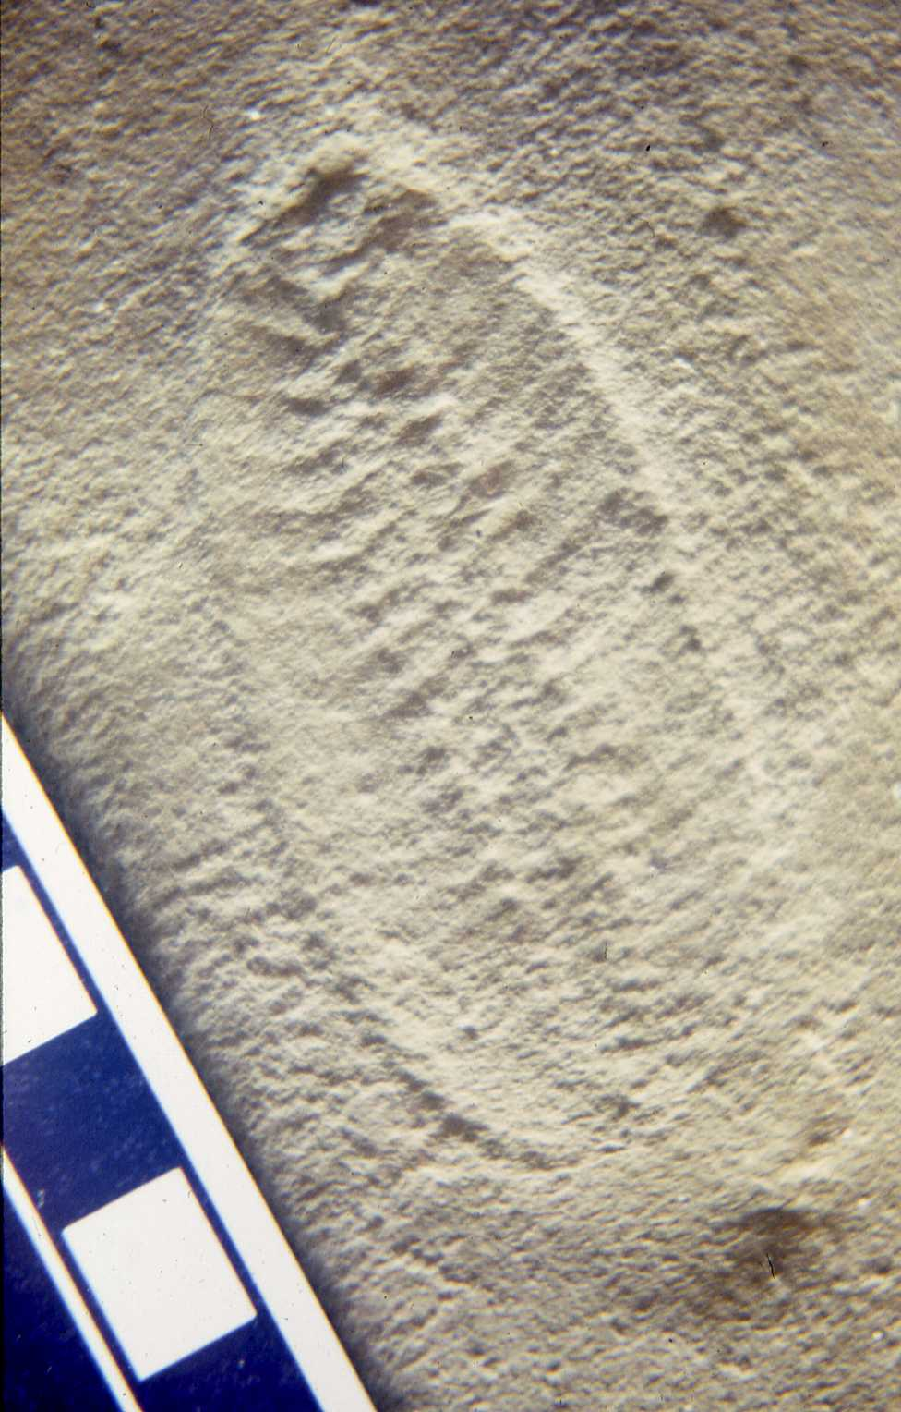
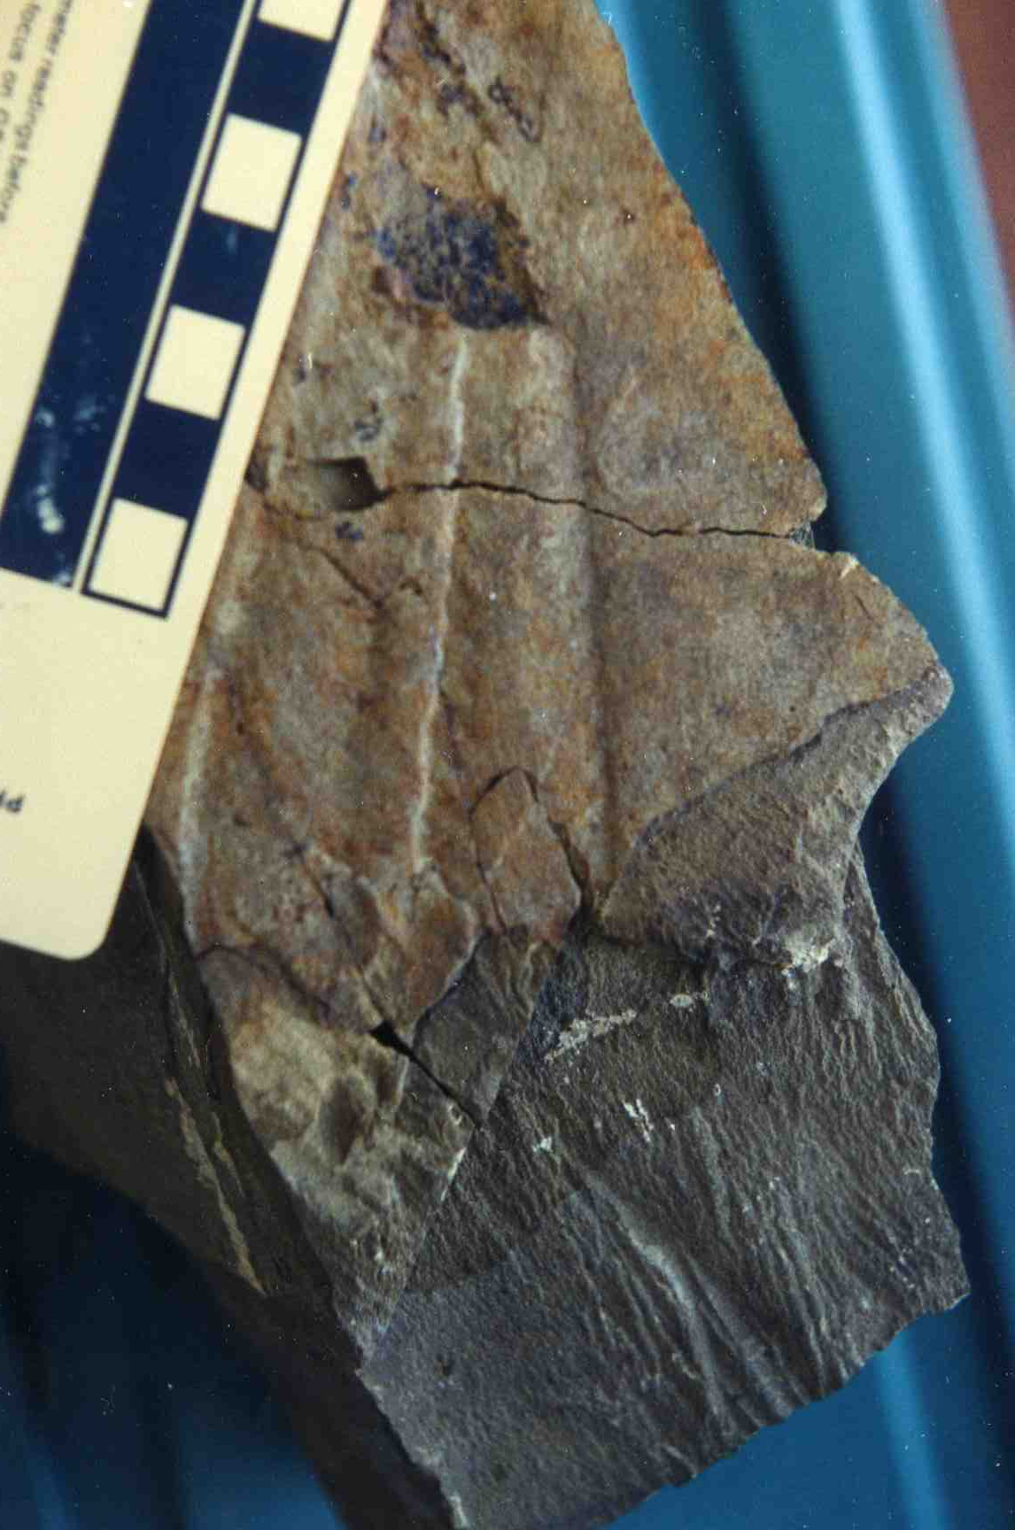
Gleaning Mission Church, Oakboro, NC
Finder? Ruffin Tucker, in his
wedding finery
Notes:
The Christmas tree shaped impression is one of two such impressions collected by Teeter & Gibson, from the argillite……….. The ovoid example is on a very thin layer of water laid tuff was discovered in 1987, by Ruffin Tucker, a wedding guest at the church

Slide 12
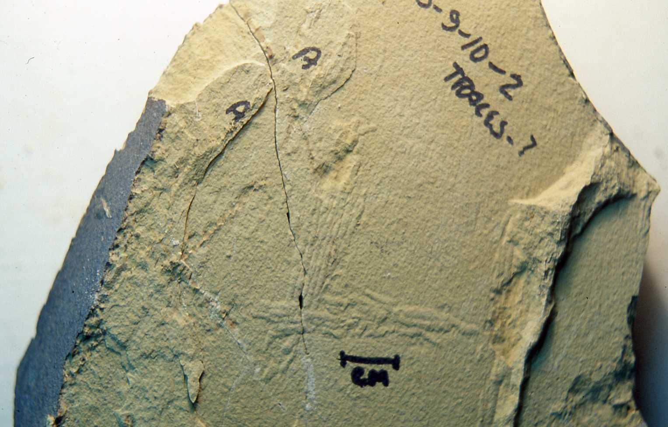
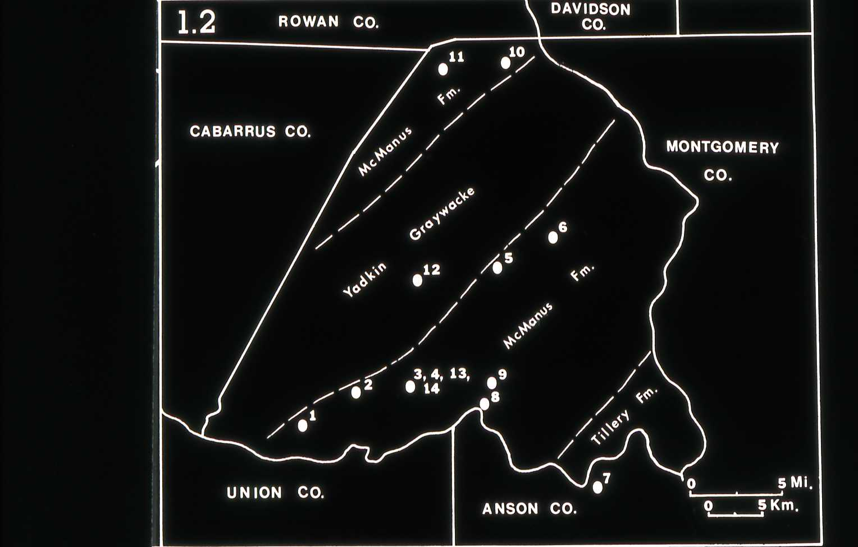
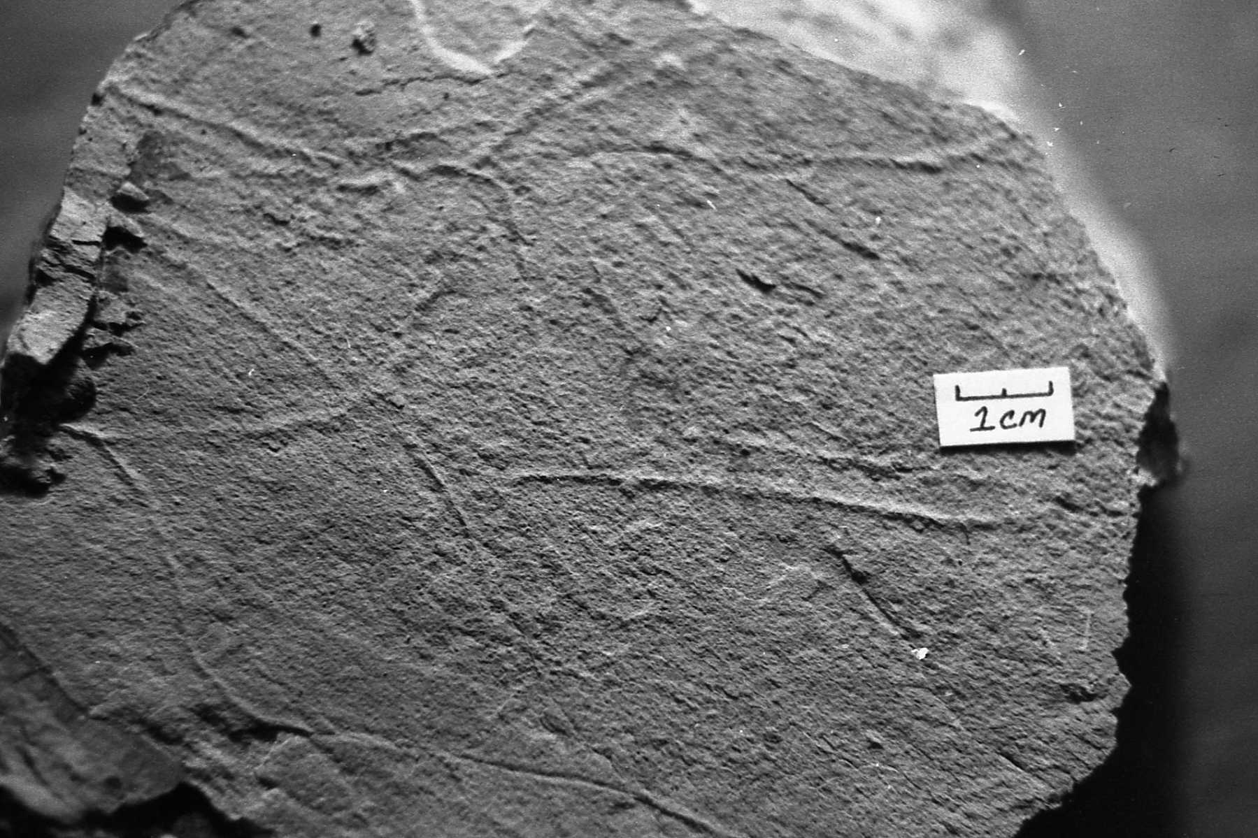
Subsequent to finding Pteridinium, Teeter &
Gibson discovered ichnofossils, late one
afternoon, when the sun angle was just right
Notes:
Subsequent to the discovery of the “chimney fossil”, we also discovered ichnofossils at several localities in Stanly County.

Slide 13
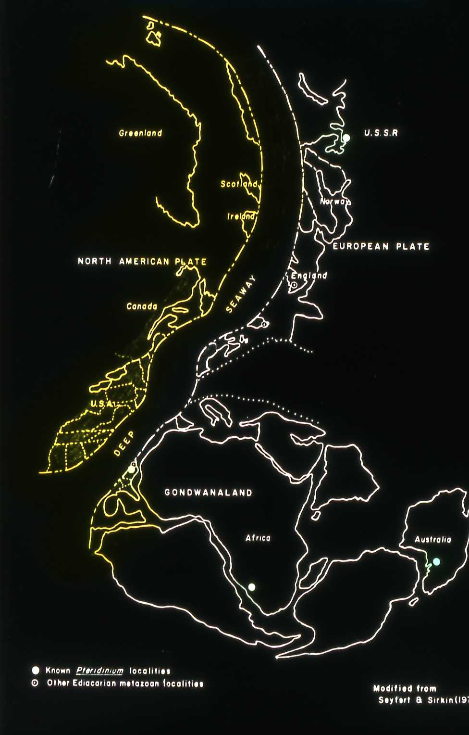
Significance of Late Precambrian Fossil Locations in Stanly Co?
Geologic age of the CSB
Regional Correlations
Intercontinental Correlations
Reinterpretations of depositional environments
Paleogeographic reconstructions
Renewed geologic interest in CSB
Cooperative research – Professional enhancement – K – 12 sharing
Notes:
Geologic significance

Slide 14
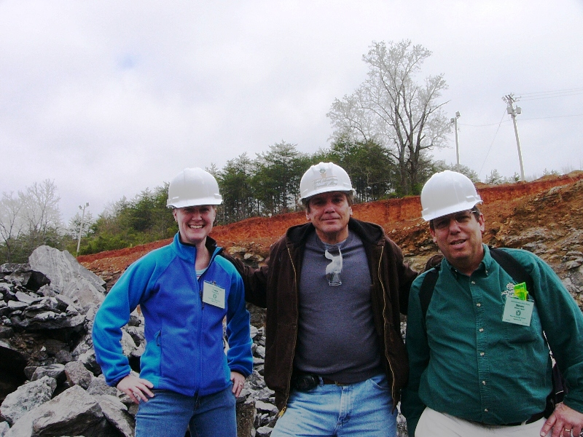
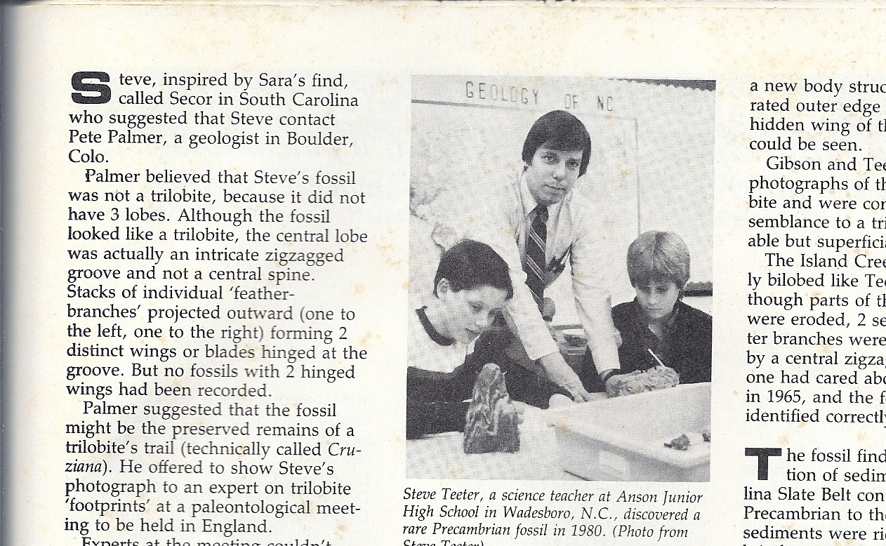
Part Two of the Saga -- Pedagogical Significance of Ediacaran Fossils,
Stanly County, NC
Notes:
For a middle school science teacher with an intense interest in geology, the “Chimney Fossil” led to the research effort to earn the Masters Degree in Geology………………..and fueled a thirst to continue that research, translating the results into the classroom & to instill similar interests for learning in my students and my colleagues (field-oriented, hands-on teacher in-service) ---------------------------STEVE, someplace, we had a pic of you and friend standing next to a slab of rock next to Island Creek. We were looking for trace fossils at the time ------------- I am thinking of that image in terms of continuing research.

Slide 15
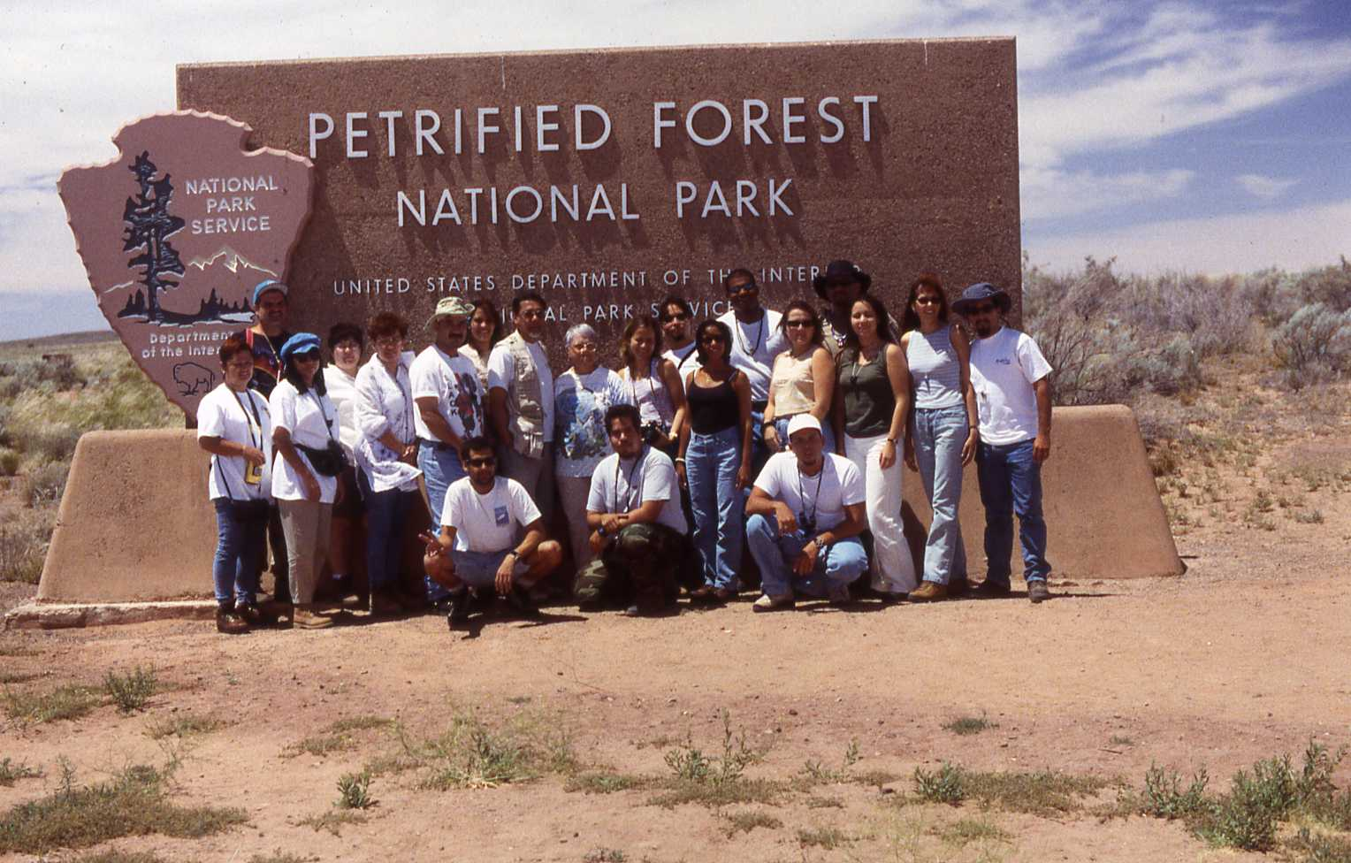
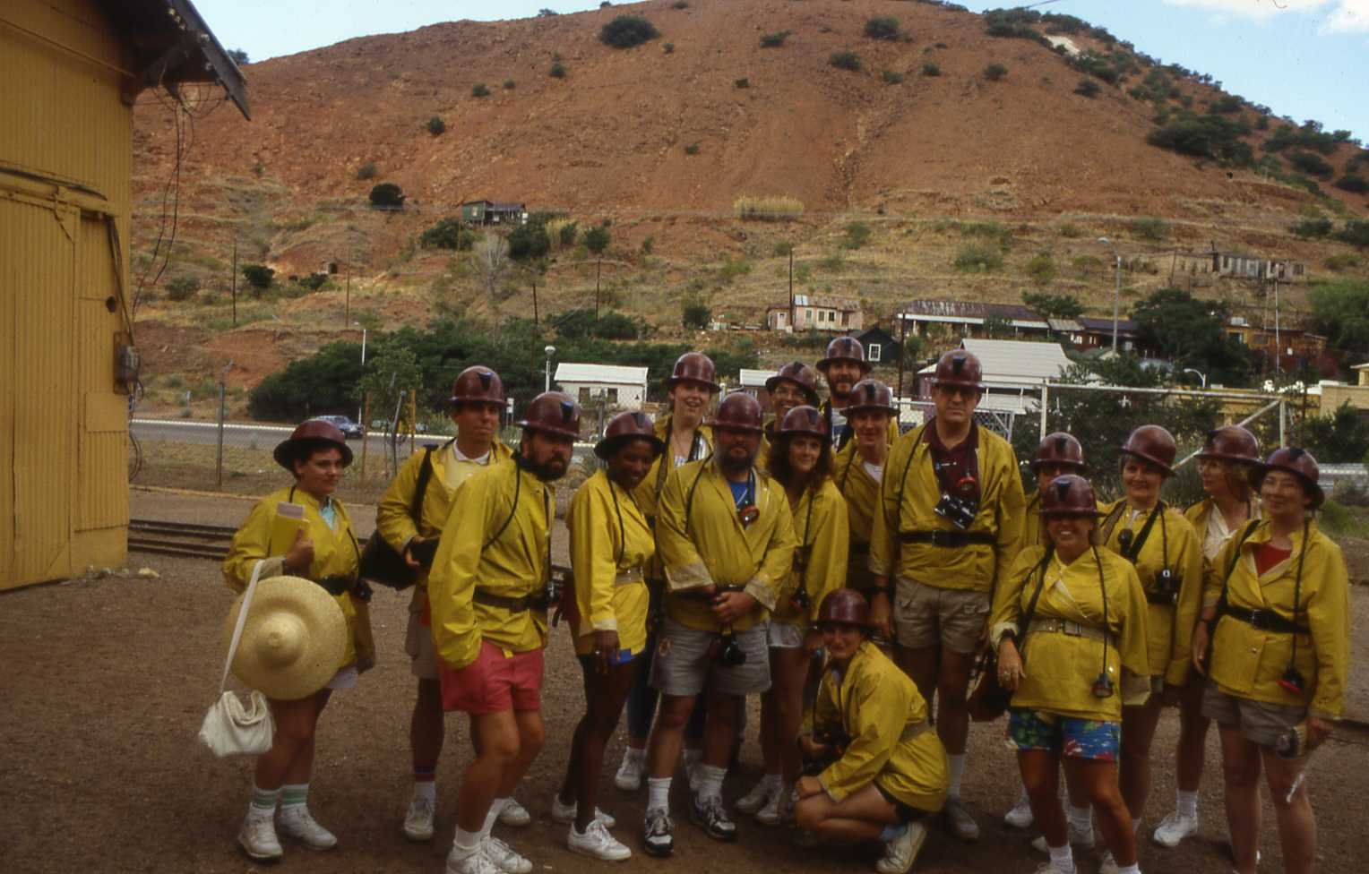
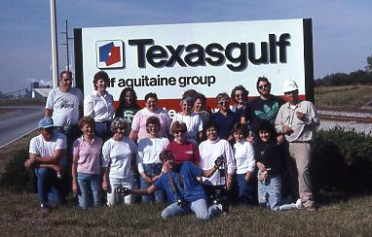
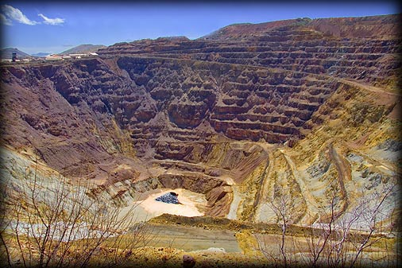
Notes:
Hands-on; going places, seeing things; learning by doing; field-oriented teacher in-service…….. Helping to organize, present information in format teacher participants could use, and conduct teacher in-service programs?

Slide 16
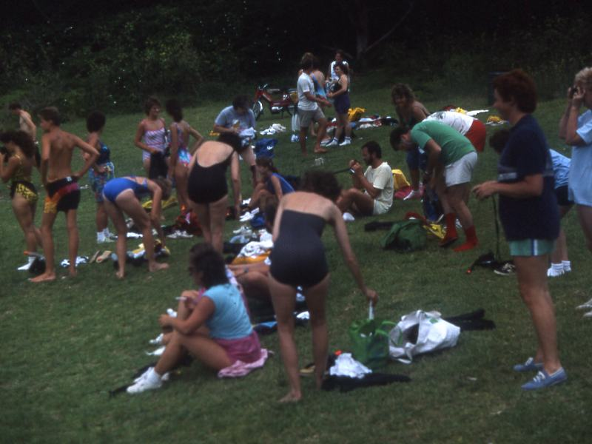
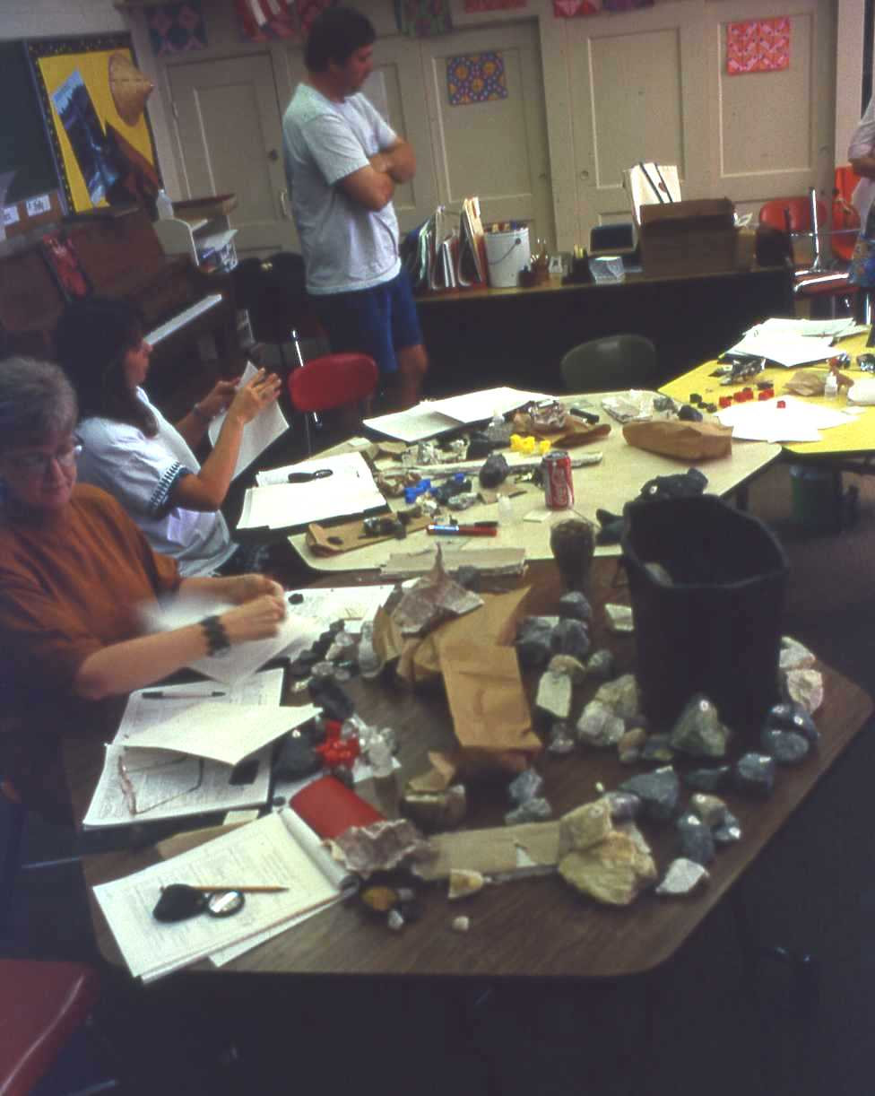
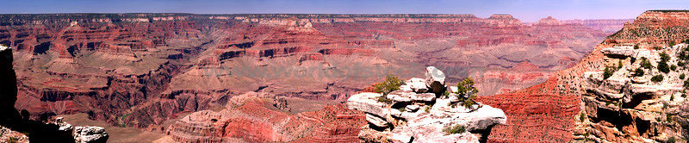
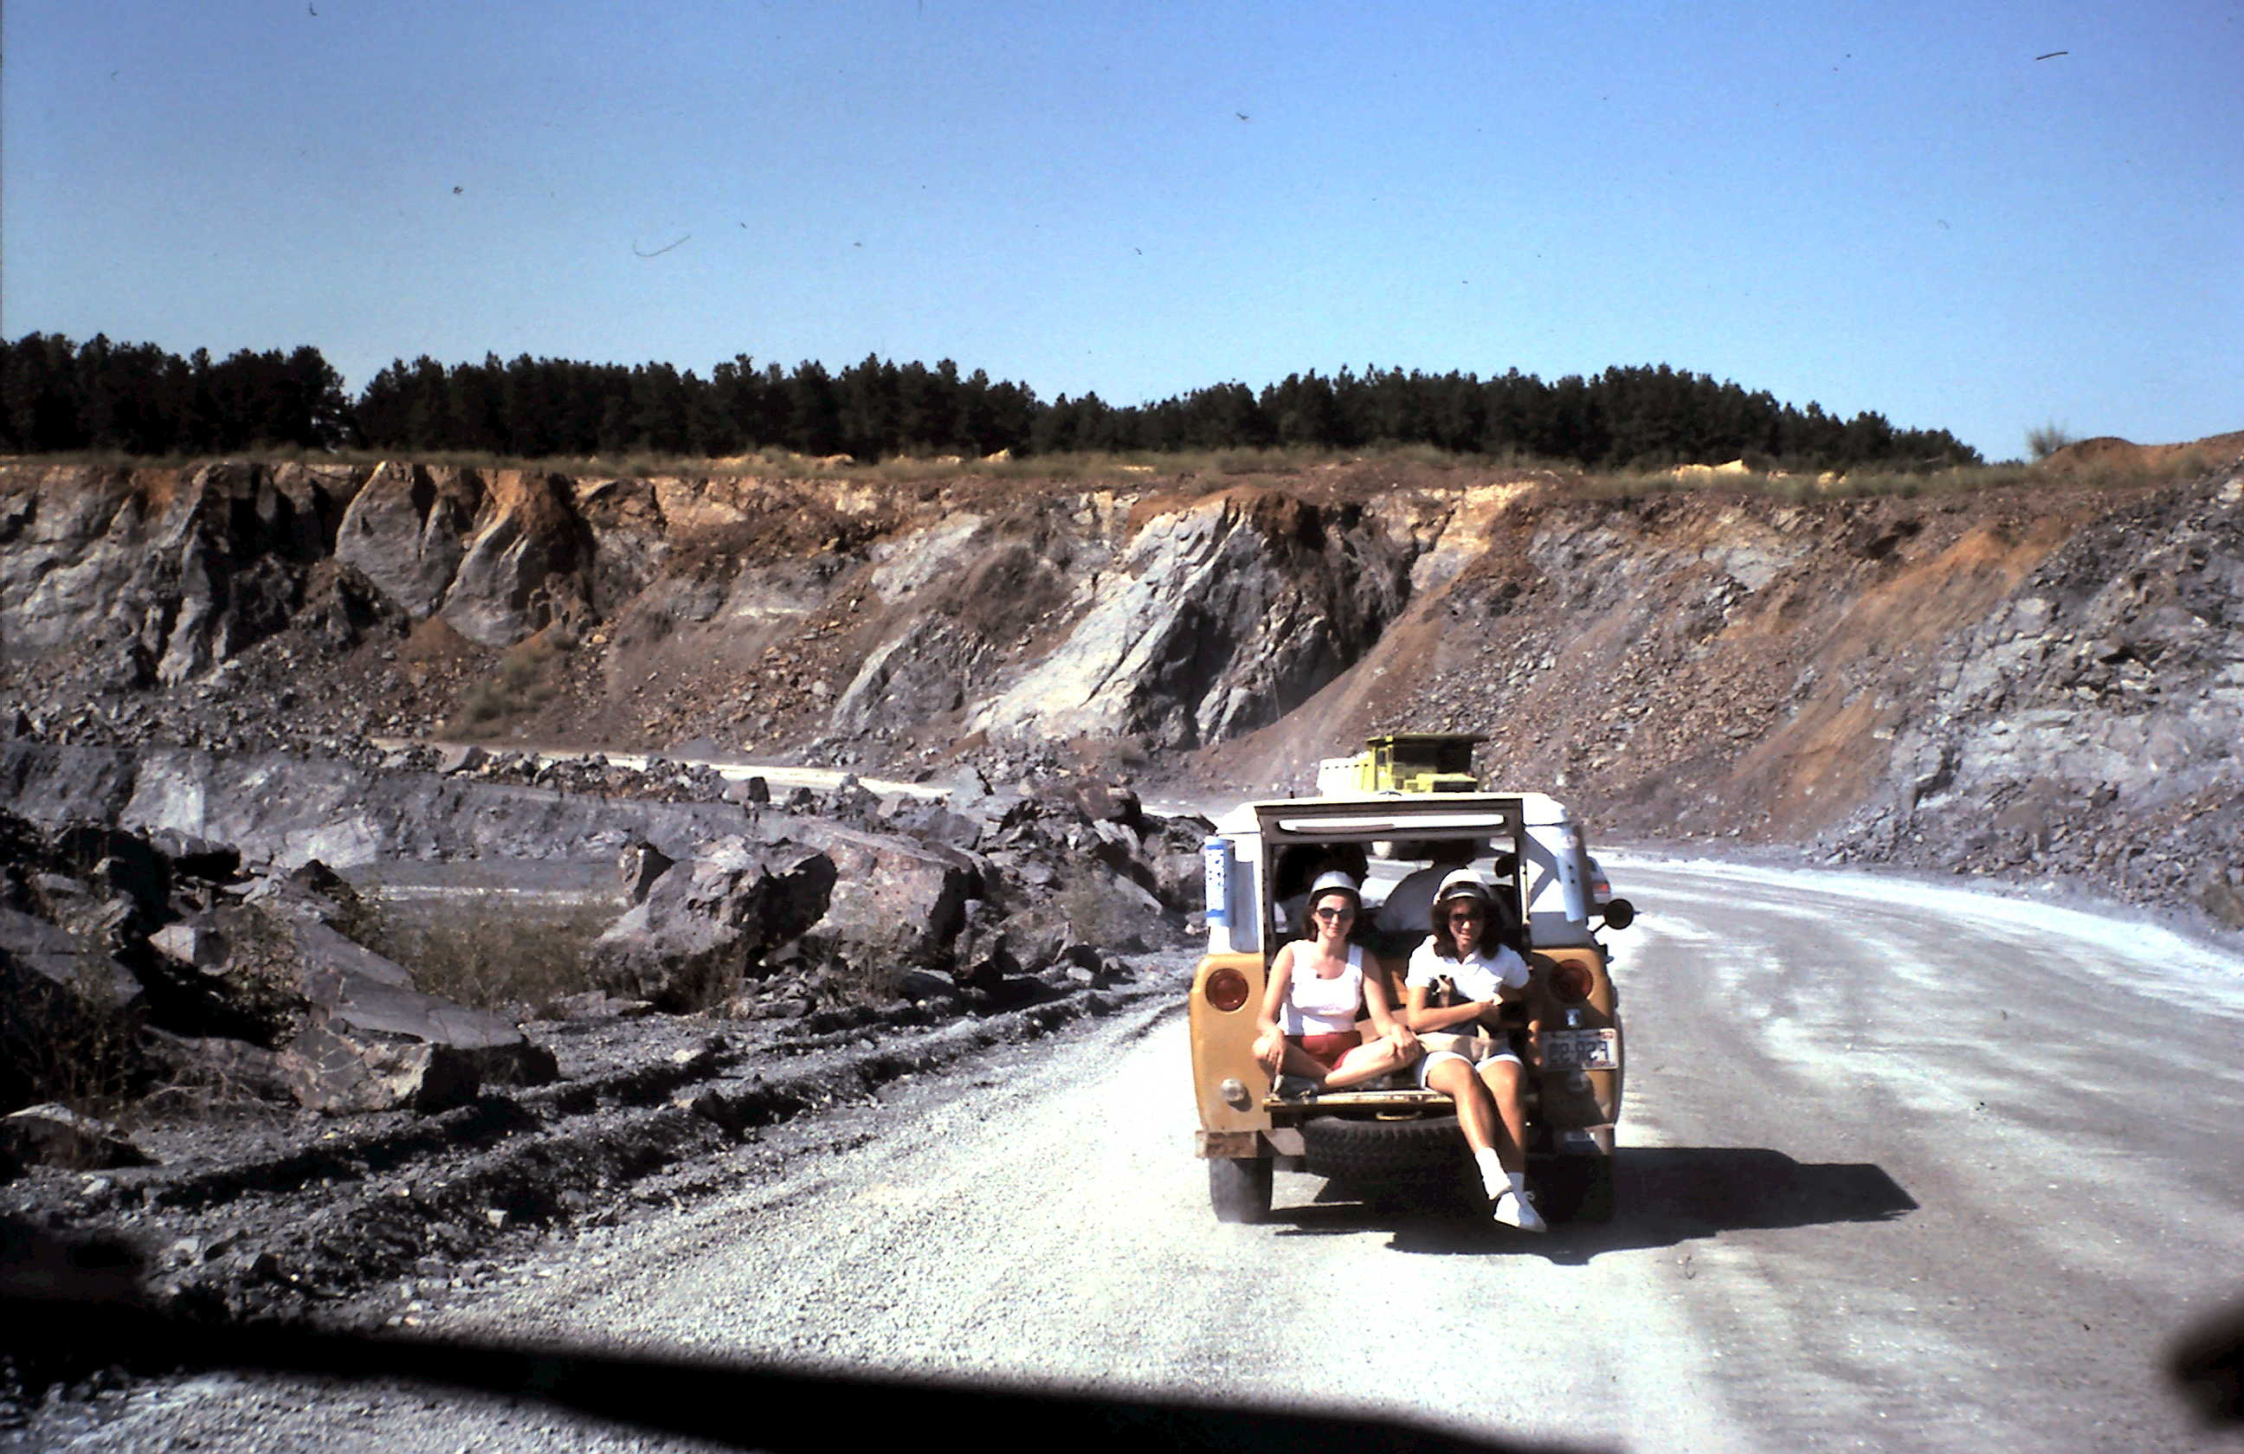
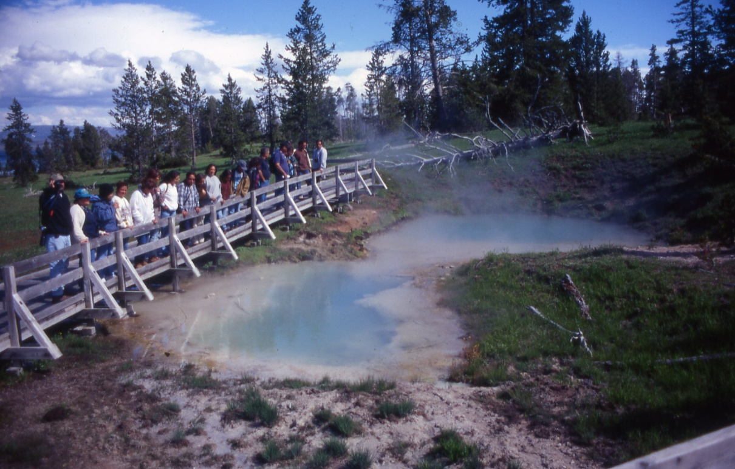
Notes:
Learning by being in a place and learning by doing – coast environments? preparing to snorkel at Whalebone Bay, Bermuda; volcanics and groundwater? West Thumb, Yellowstone; minerals & rocks? Quarries. Learning by doing and visiting and collecting (Martin Marietta Baker Quarry); The Grand Canyon

Slide 17
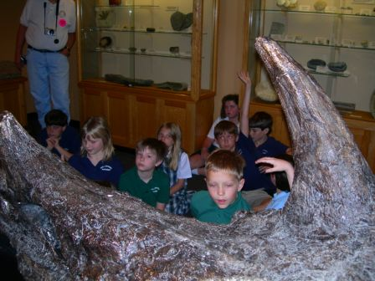
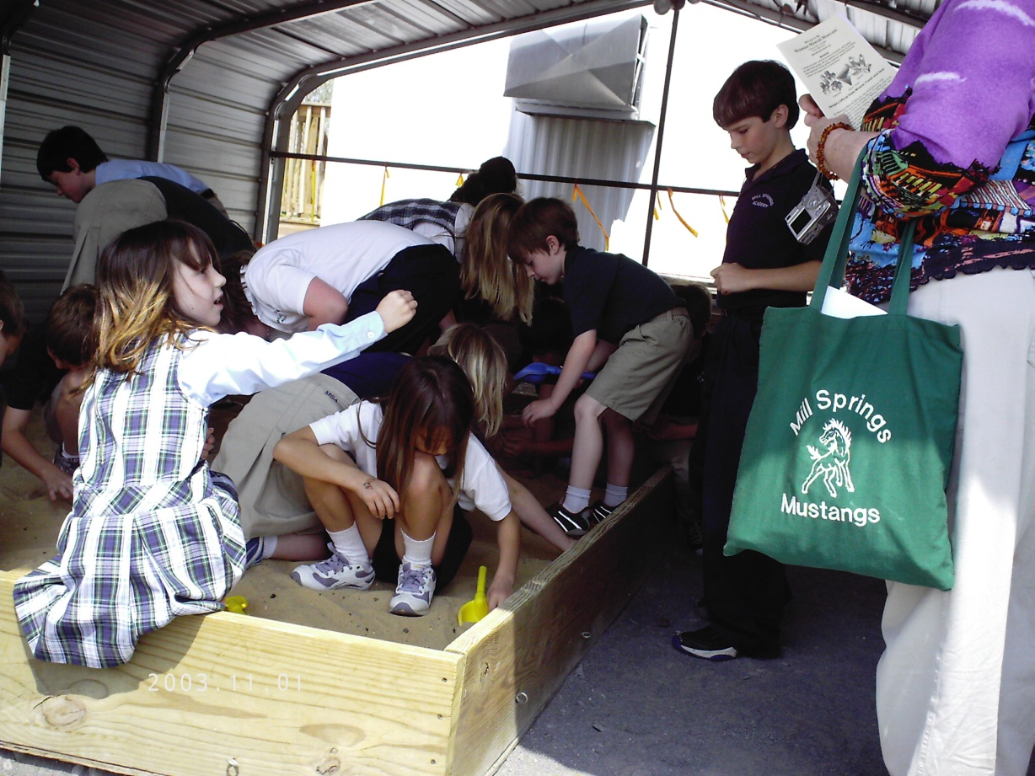
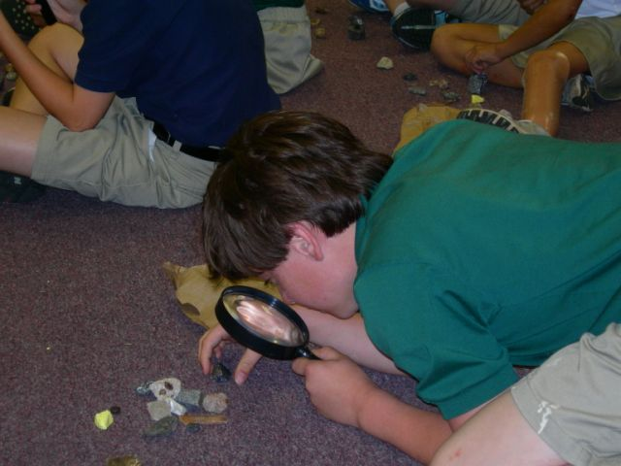
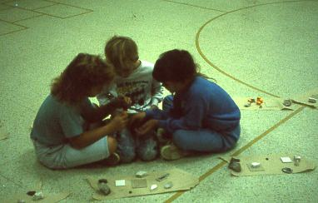
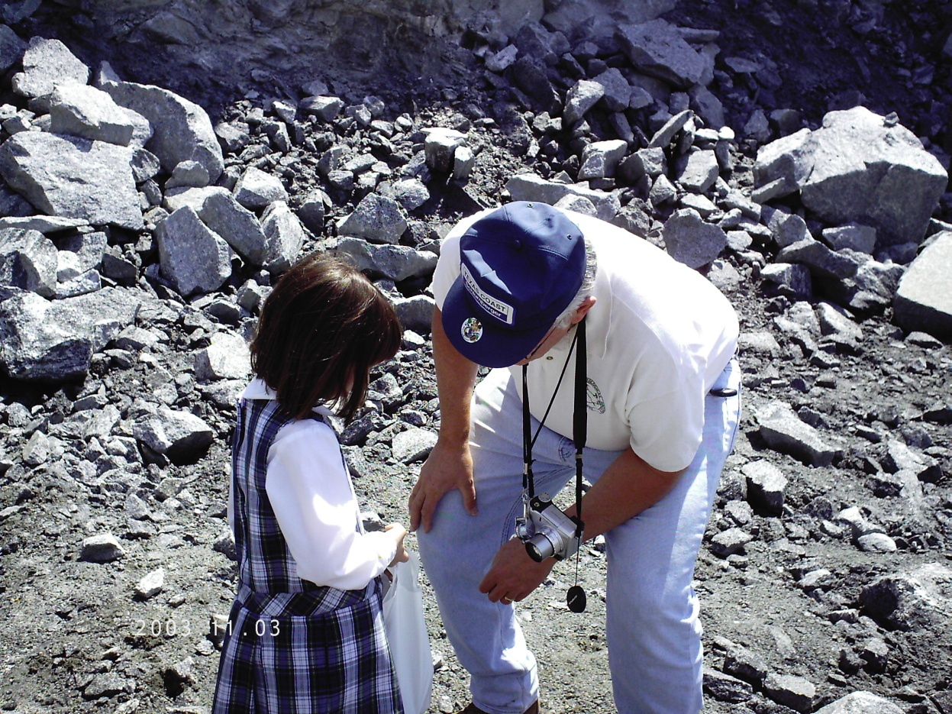
This is where interest is
fostered……

Slide 18
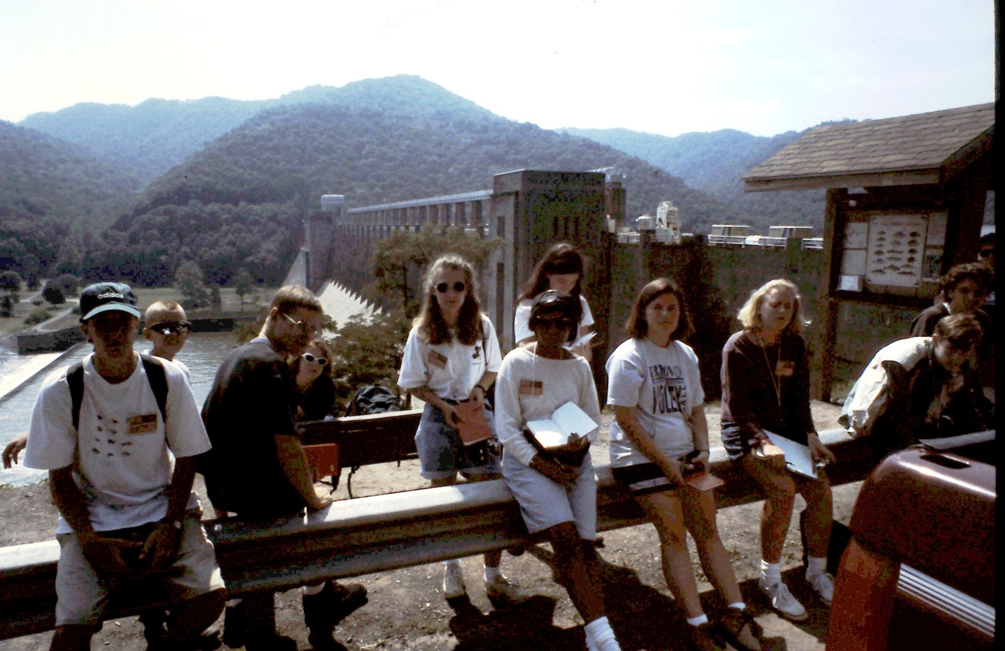
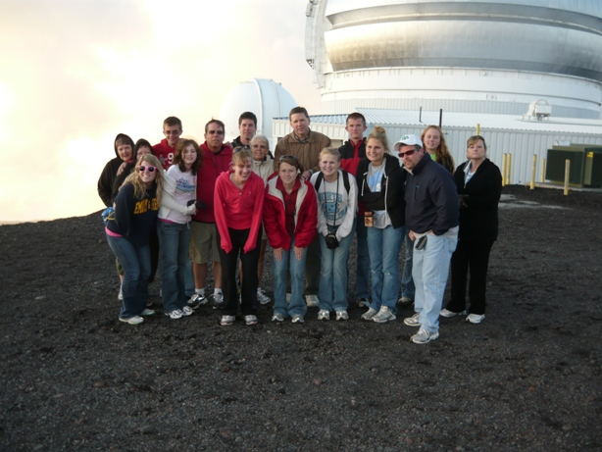
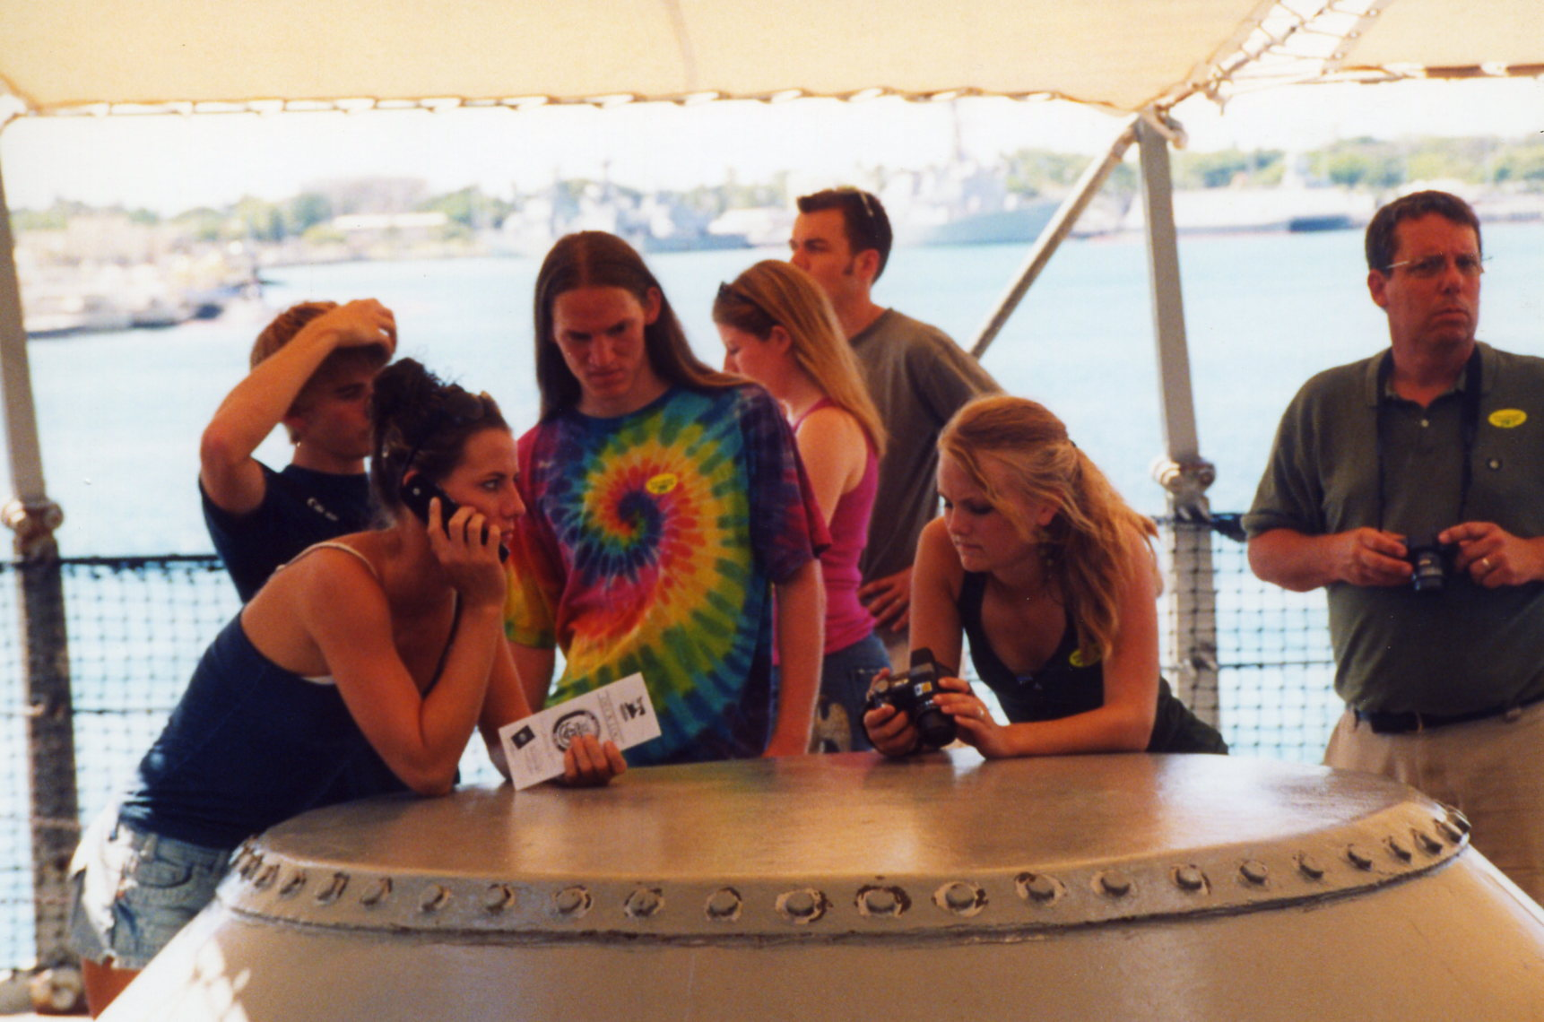
This is the age where futures
are encouraged………

Slide 19
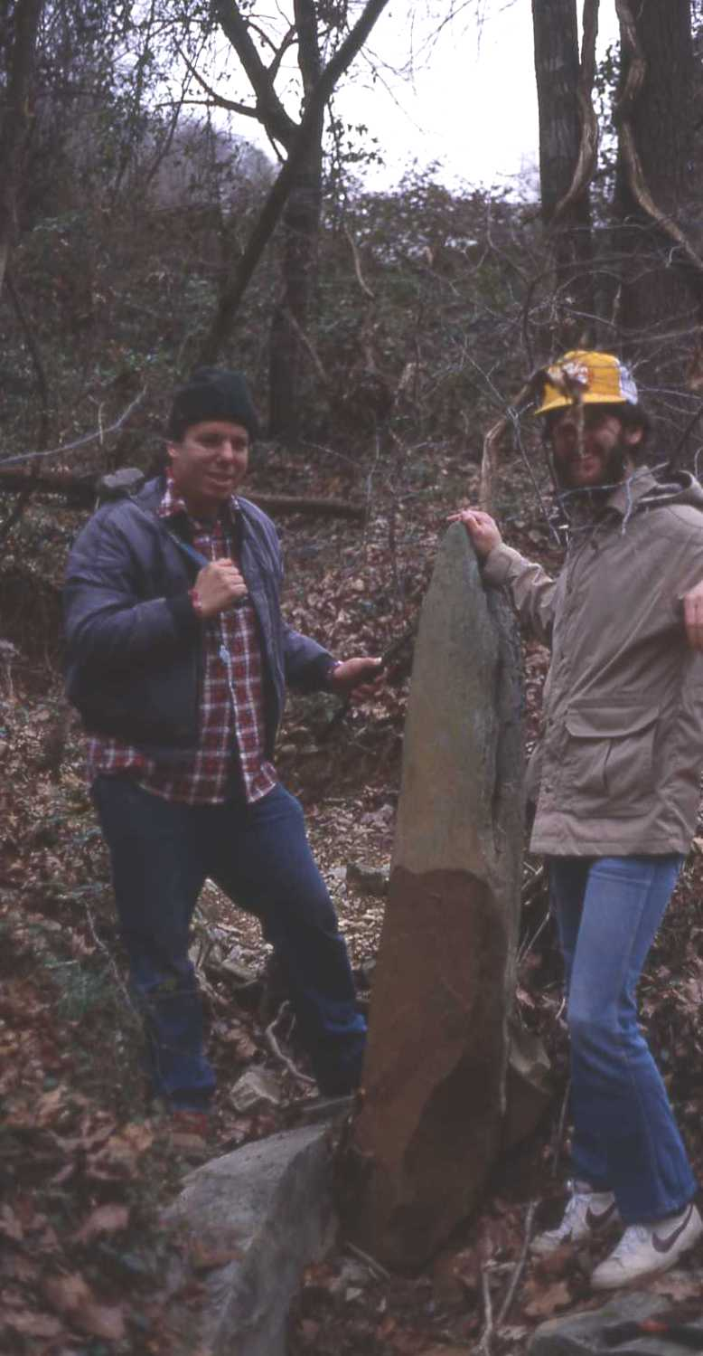
…….And involving students
in research is where future
professionals are groomed……

Slide 20
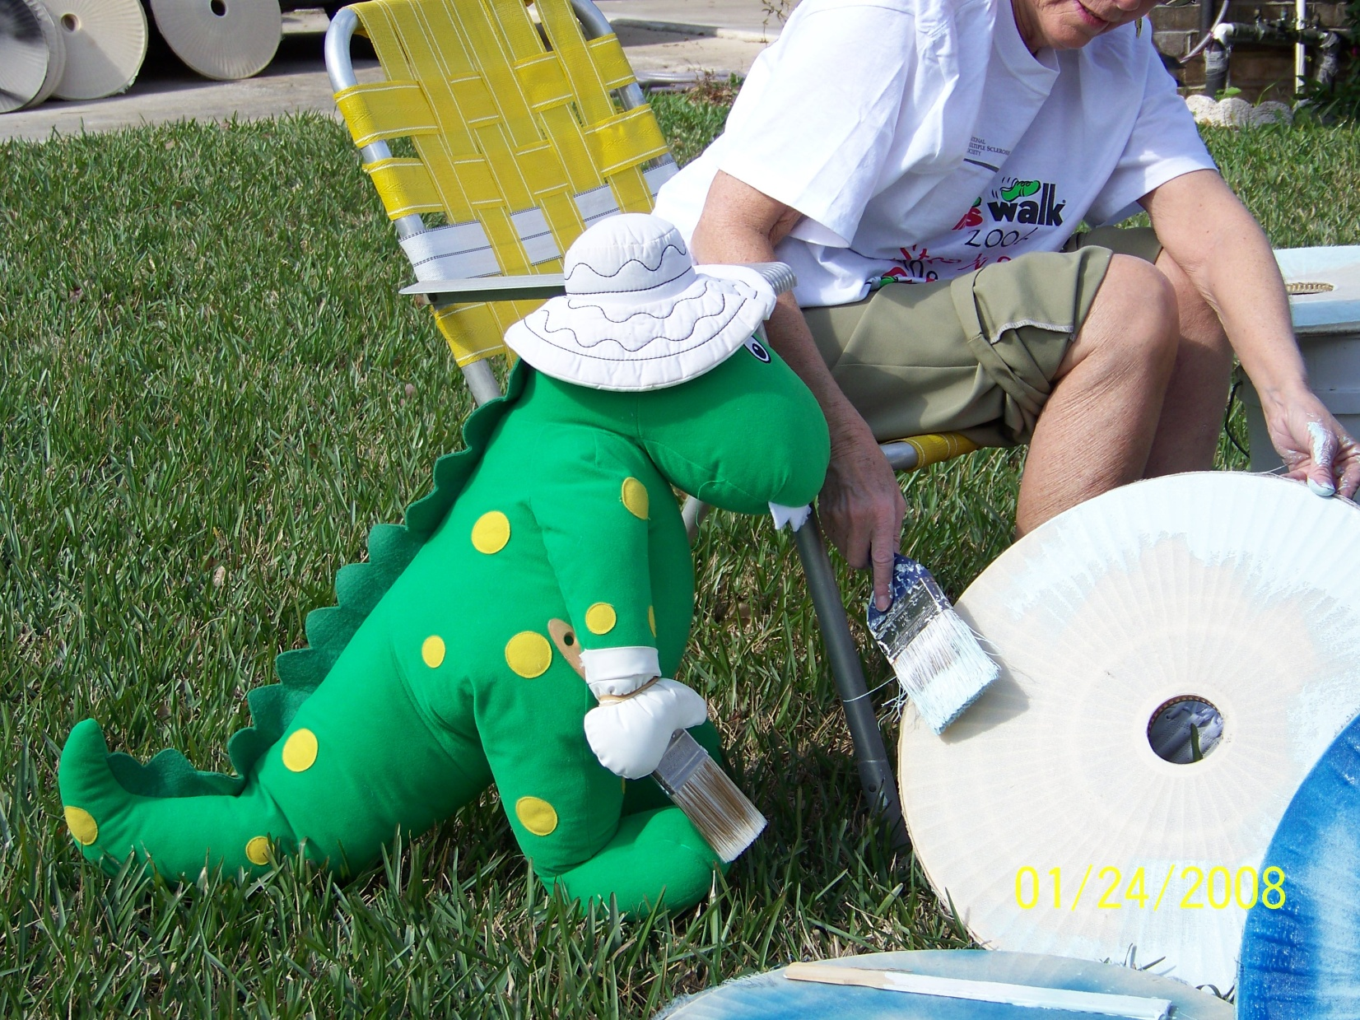
Good help is often difficult to find when pulling materials
together for K-6 classroom programs

Slide 21
For this teacher, some of the pluses of this partnership, over the years ---
Earned National Board Certification
Earned Masters degree in geology
Membership, professional geological groups
Opportunities ---
for continued interaction with geologic
professionals
to conduct & publish / present geologic research
to interact with geologic professionals, &
educators to establish Earth Science as one of
required high school sciences in NC
to share knowledge & enthusiasm with peers &
students

Slide 22
Keys to our Success?
Ongoing partnership – geologic professional & teacher
with common interests (1982 – Present)………….
A “Hook” – in our case the “Chimney Fossil”………….
Ability & willingness to learn from & support each other..
Dedication; long term , ongoing commitment……………..
And a few other fortuitous circumstances, we latched onto.
……..MAHALO…..
Notes:
The keys to our successes? Ongoing partnership between professionals & teachers with mutual interests and dedication; A hook – our case the “Chimney Fossil”; Ability & willingness to learn from each other; Dedication and long term commitment;

