Slide 1
“Self-guided mineral identification kits” as an alternative / supplemental teaching tool
Dion Stewart
Gerald D. Pollack
Georgia Perimeter College
Geological Society of America
Southeast Regional Meeting
Wilmington, NC

Slide 2
Project Summary
Target: College students and K-12 teachers interested in mineral identification tools
Mode of Delivery: Passive; self-movitated
Goal: Enable exploration and practice of basic mineral identification tools and techniques

Slide 3
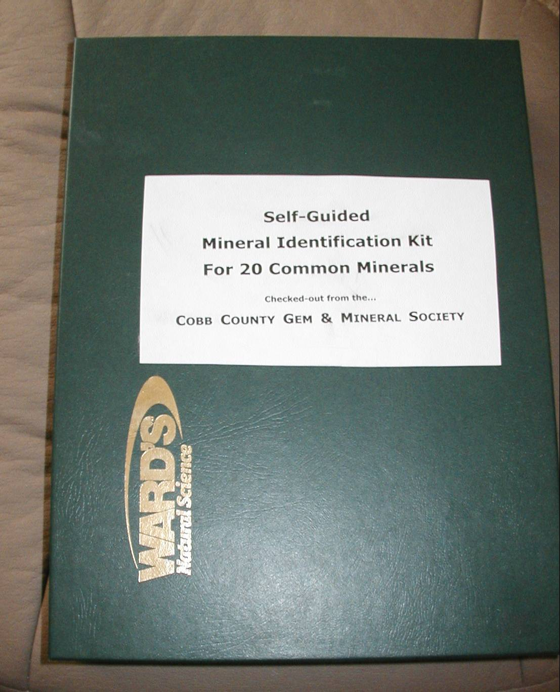
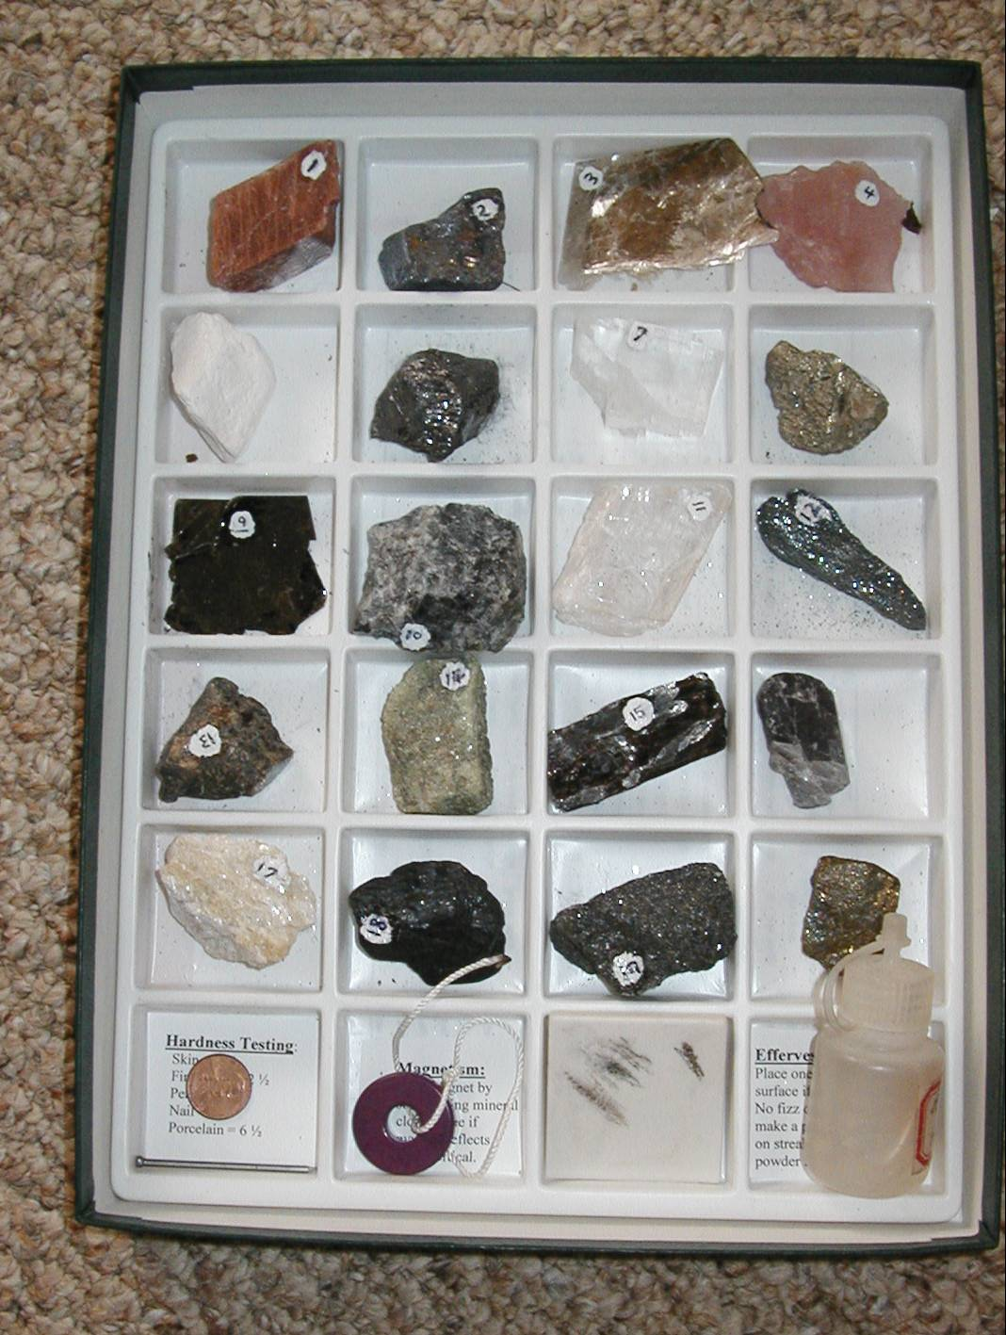
Kit Design

Slide 4
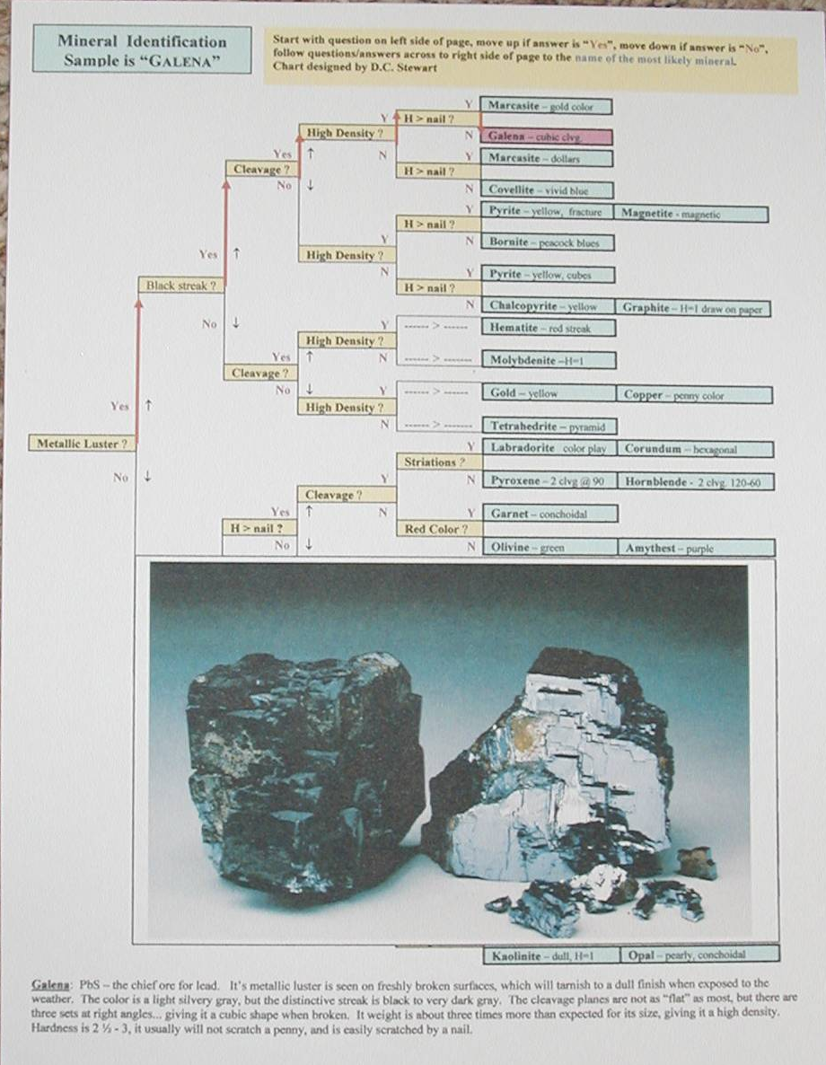
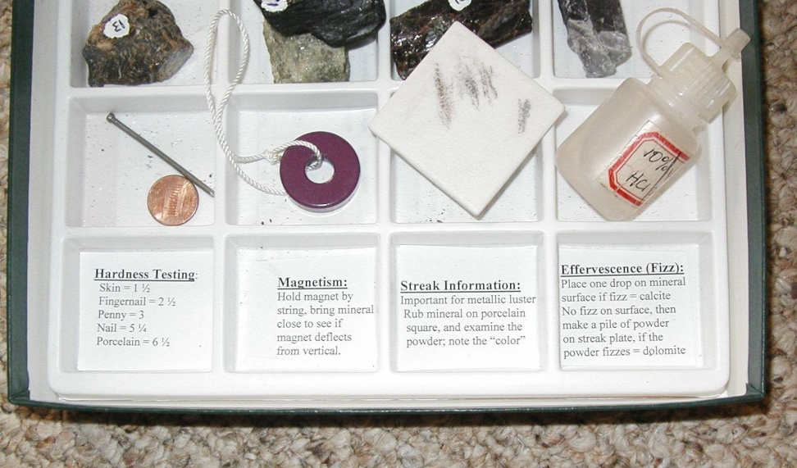
Identification Techniques and Tools

Slide 5
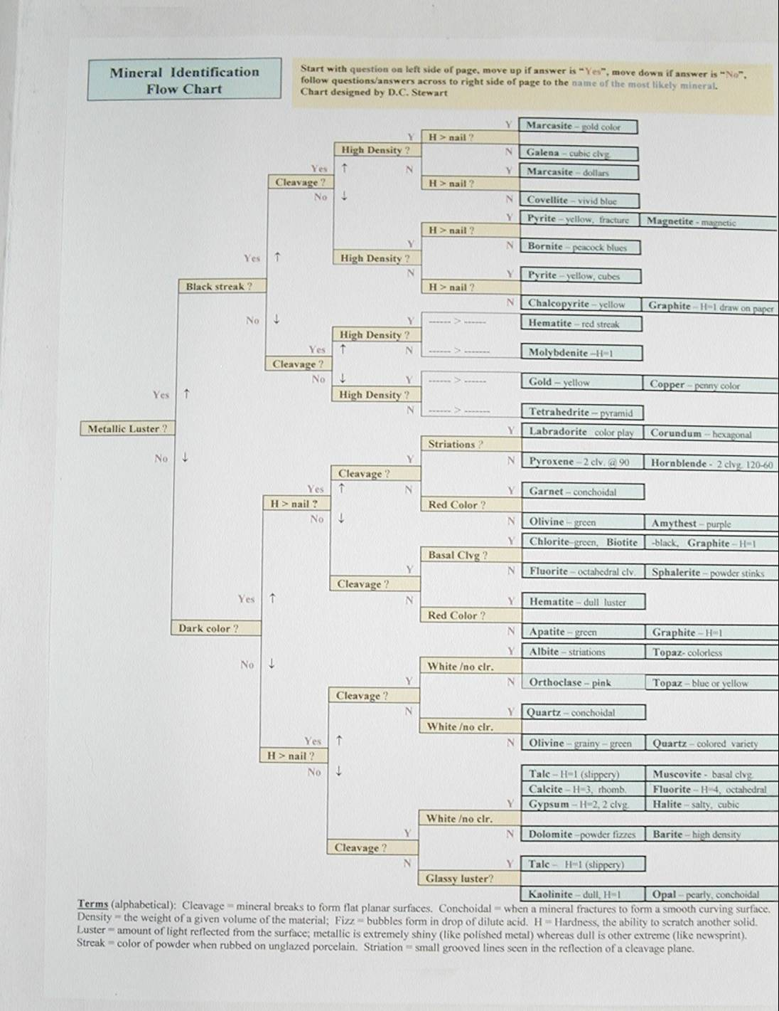
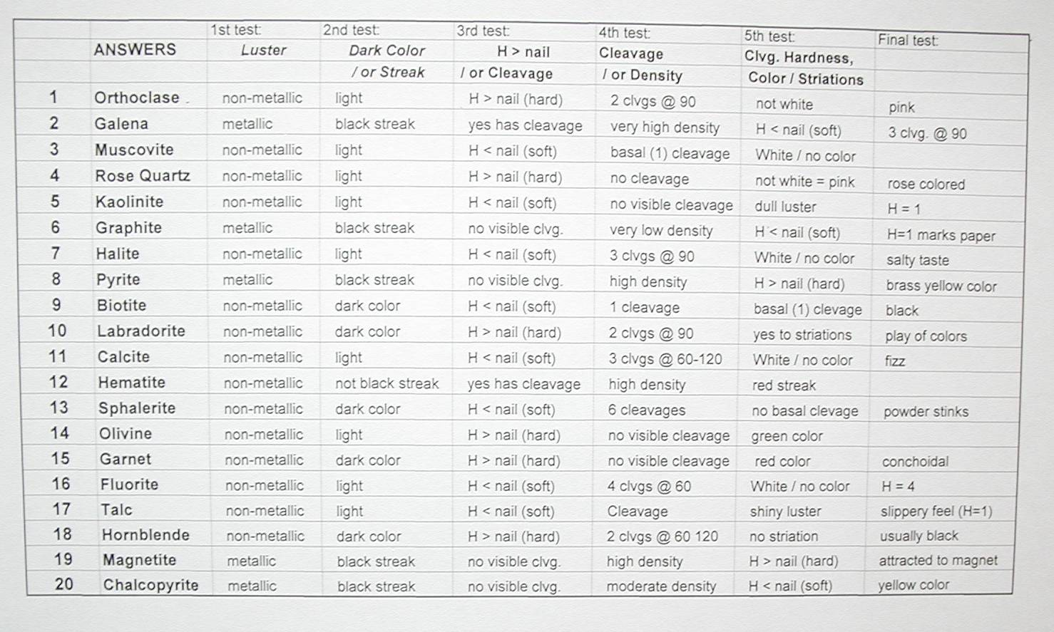
Identification Flow Chart and Answer Sheet

Slide 6
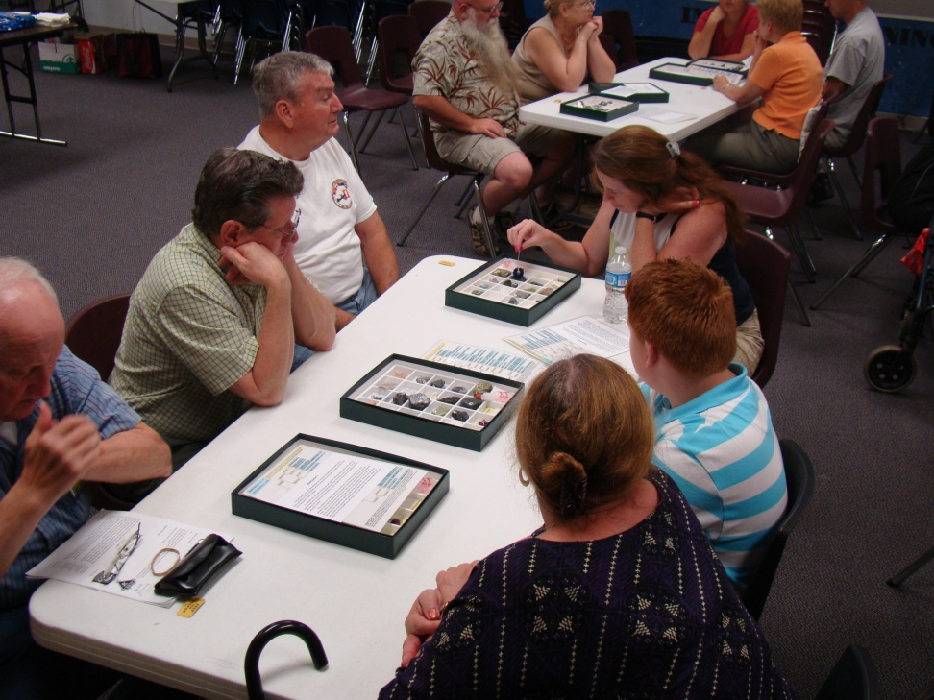
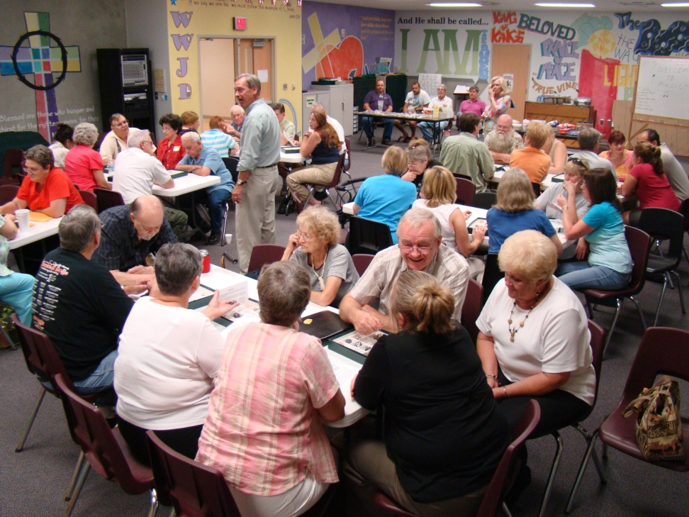
Participant Activities

Slide 7
Qualitative Results
Surveys completed by teachers, students, and club members
“The mineral kits was very helpful as a study aid…I worked with the mineral kit about 3 hours, and my 10 year old son worked [on] it with me.”
“Well put together. Rock sample kit would be helpful as well.”
“Very helpful.”

Slide 8
Quantitative Results
Most student participants used kits for more than one and a half hours (Mean = 103 minutes).

Slide 9
Current Project Status
Self-guided mineral identification kits permit practice at a slower pace
Our kits increase student success by one letter grade
Teachers and members of the general public can benefit with the use of these kits too

Slide 10
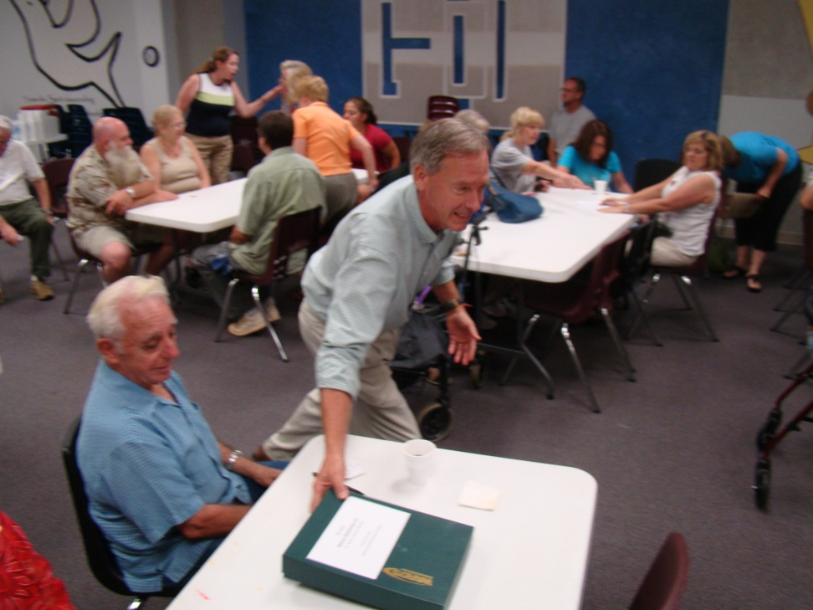
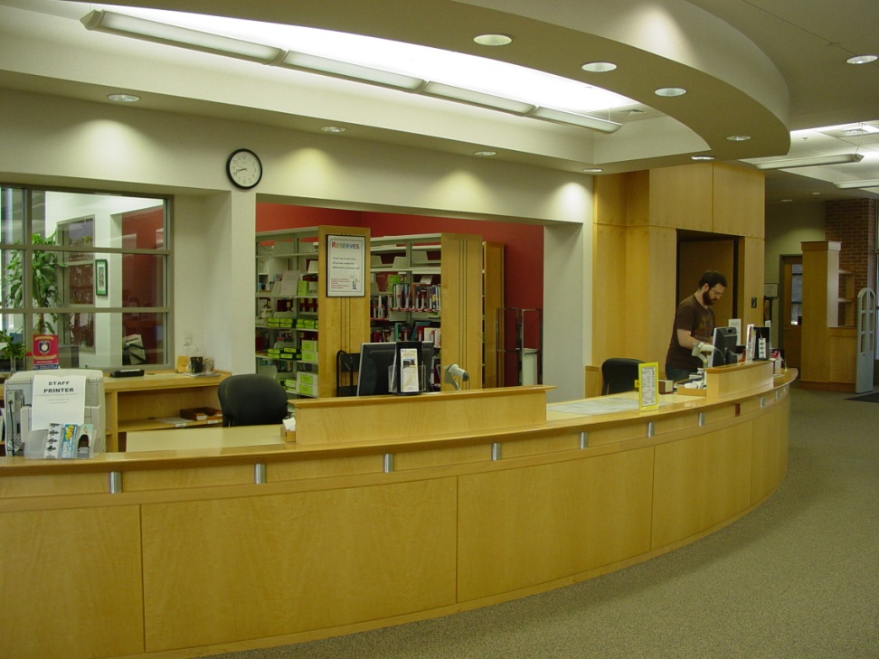
Next Steps

Slide 11



Acknowledgements and Thanks

