Slide 1
Balancing Act: A study in high school earth science education
Michael LeBaron
Lake Norman High School
Mooresville, North Carolina
mlebaron@iss.k12.nc.us

Slide 2
Introductions
Mike LeBaron
Lateral entry high school teacher with 9 years in the classroom
Education: BS and MS in Geology
Prior work experience has included:
6 years as a minerals exploration geologist
13 years in oil and gas exploration and production and data management
A few years in the banking industry I’d rather forget about
Currently teaching Earth/Environmental Science and AP Environmental Science
Notes:
Some basic background

Slide 3

The School
1950 Students.
9 years old; started with 1200 students.
On the northern edge of the Charlotte metro area in an otherwise predominately rural county.
#1 in the state for graduation rate of schools graduating 400-500 students.
NC School of Excellence (> 90% of students at or above grade level based on state tests)
Notes:
Basic Background

Slide 4
Why Am I Here?
In a word – Frustration
Earth Science tends to be the “orphan” science
Our students need it to graduate, but there are very few well qualified teachers who honestly know the subject.
The Geology elements probably suffer the most.

Slide 5
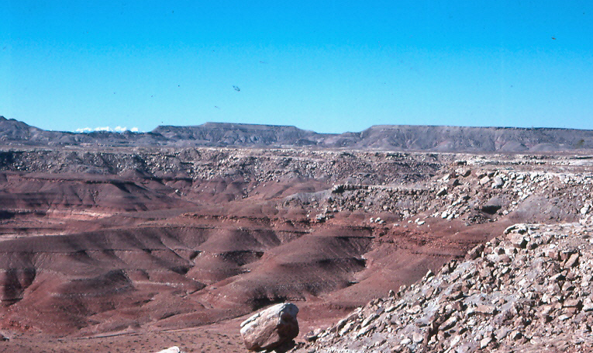
Historical Geology (of sorts)
At Lake Norman High School
We average 10 sections of Earth Science per semester
Normally 4 teachers are assigned to those classes
Only 2 of the teachers have training or experience in the Earth Sciences.
Typically the other teachers are biologists with a General Science Certification
But we’re all “highly qualified” – and that’s the problem!

Slide 6
Expectations
Earth Science is required for all high school students
North Carolina Standard Course of Study
Defines high-level student learning objectives
Is updated every 6-8 years
Tends toward breadth of knowledge, not depth of learning
Teachers are expected to teach anything – regardless of training and background
Notes:
This is a brief look at what the state of North Carolina expects and how it affects teaching. I’m not going to dwell on this, but focus more on how to prepare teachers to meet these expectations. Luckily there is not a state test which allows teachers to inject material or focus on elements of student interest without the concern of meeting testing needs.
How teachers meet these expectations may be specifically directed by their school or district or may be up to the teacher(s) who teach the subject.
The lack of a state test is generally a good thing because it does allow greater teacher flexibility. It also implies a lack of credibility that goes with the EOC tests – this is bad.
The biggest issue from my point of view is the NCSCOS – it lacks depth and covers too many topics to be effective. It can also limit student success.

Slide 7
Off Balance
Teachers
Expectations
State Curriculum
Budget/Staff Allocation
Student Preparation
Parents
Assignment vs. Training
Professional Development
Salary
Notes:
Most teachers agree that what we are expected to do versus the time and our professional background don’t balance.

Slide 8
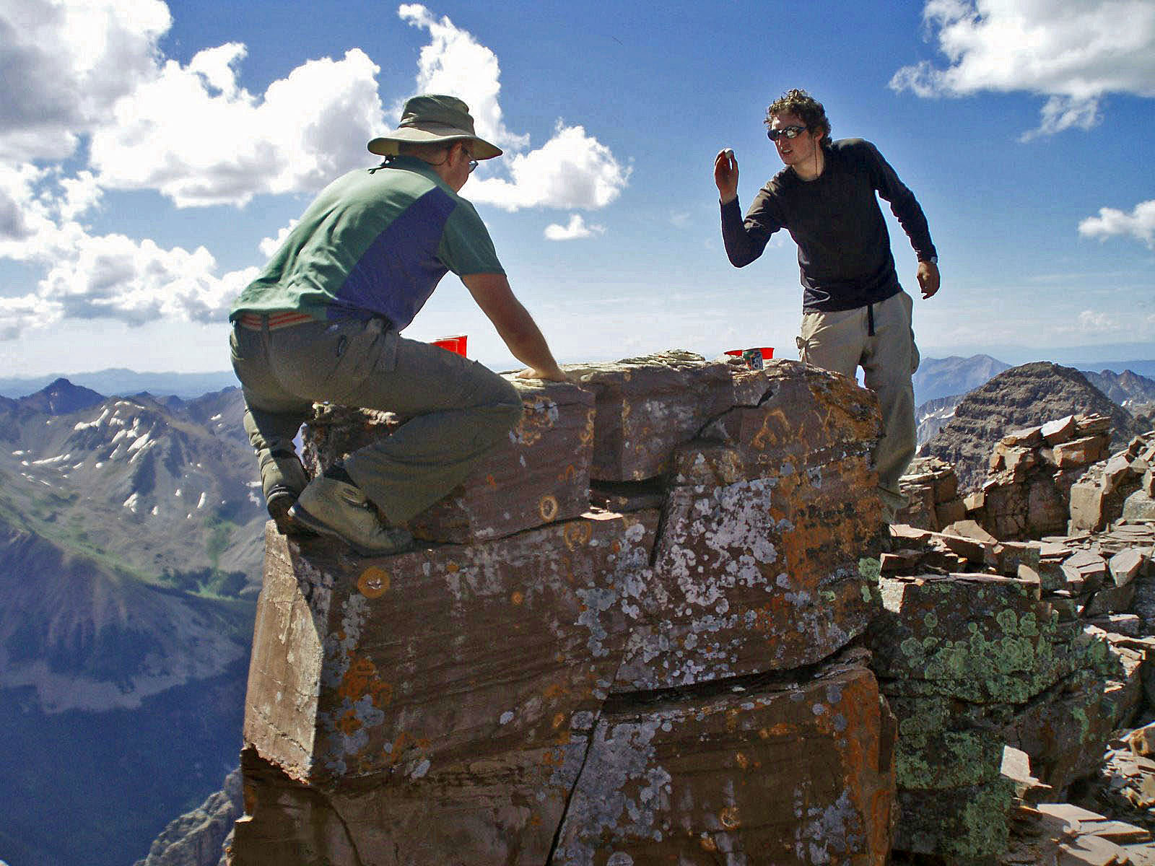
Feeling a little exposed?
Notes:
Pyramid Peak, 14018 feet, but a challenging route.
Many teachers feel like the guy on the left – they are hanging on with their backside exposed while the rest of the world takes pot-shots at them! (Anthony on right)

Slide 9
Teacher Assignment
Budgets and student enrollment determine the number of teachers allocated to each school
Student enrollment determines the number of sections of a class that are needed.
Teachers may be assigned year-to-year based on need, not expertise or training.

Slide 10
Teacher Preparation
NSF-2010 - Subject Area Preparation
High School Science
93% of High School Biology Teachers taught within their field of preparation
82% of Physical Science Teachers taught within their field of preparation
Earth Science was not specifically broken out.
National Science Board. 2010. Science and Engineering Indicators 2010. Arlington, VA:
National Science Foundation (NSB 10-01)

Slide 11
Teacher Assignment
U.S. Teacher Assignments (2005 Data) |  |  |  | Teaching in Field
Subject | # of Teachers | Percent |  | Teachers | Percent
Biology | 52697 | 33% |  | 34253 | 65%
Cemistry | 27947 | 18% |  | 16768 | 60%
Physics | 16301 | 10% |  | 7498 | 46%
Earth Science | 15611 | 10% |  | 8898 | 57%
General Science | 13813 | 9%
Physical Science | 25499 | 16%
Integrated Science | 5720 | 4%
Total | 157588 | 100%
http://www.nsta.org/about/olpa/faq.aspx#3
( http://www.ccsso.org/projects/science_and_mathematics_education_indicators )
Notes:
Not entirely consistent with prior slide, but provides a snapshot of some of the issues in Earth science education.

Slide 12
The issue becomes . . .
How do we provide the approximately 45% of the Earth Science teachers who are teaching outside of their area of preparation the familiarity they need to be knowledgeable in this highly complex field of science?

Slide 13
Professional Development Options
Mentoring – formal and informal
Targeted Professional Development Classes and Educational Opportunities
School-based Professional Learning Communities (PLC’s)
Which one works best depends on individual knowledge, staff availability, time, budget limitations, and instructional climate at a school.
Notes:
Ways to ramp up learning
Each one has a different time frame and may meet part but not all of the learning needs for an individual
Cost may be a factor.

Slide 14
Issues - Mentoring
Commonly provided for new teachers, but rarely for experienced teachers who are teaching in a new area.
Mentors may be assigned who have no knowledge of the assigned course.
Mentors may not be available at all because there is no money to pay them!

Slide 15
Mentoring Options
In Person Mentors
Best option if local expertise, time, and budget are available.
On-Line Mentors
Supports teachers when no local expertise is available
Provides structure and focus that meets the newly assigned teachers needs
Could be other educators or industry professionals with specific expertise.
Opportunity for industry and higher education to help support and grow K-12 expertise.

Slide 16
Issues - Professional Development
Often done before and after school with limited focus and implementation time
Often of a very general nature and does not support new content knowledge.
May be limited by availability of funds or time.
Many teachers don’t take advantage of the free and low-cost development opportunities that already exist.

Slide 17
Professional Development Opportunities
Targeted Learning
specific age groups
specific learning topics
Expert Instruction
Make it easy to participate
Low Cost
Provide avenue for follow-up, reinforcement
On-line is good

Slide 18
Professional Learning Communities
PLC’s - a peer group in a school who teach the same subject and meet regularly to share ideas and challenges.
They can be highly supportive of new teachers and experienced teachers new to a subject area
They can be “virtual” if there is only one teacher of a subject at a given school.

Slide 19
Ask the Expert
This is an opportunity for universities, professional organizations, and industry to provide real-time help to new Earth Science educators.
Work together to create an umbrella facility that connects Earth Science teachers with experts so that they have access to real-time expertise.
Keep an “FAQ” of past questions and responses.
Don’t let it be a lesson plan repository.

Slide 20
Where do we go?
Earth Science is a complex and evolving course area in K-12 schools.
± 40% of Earth Science educators are teaching outside of their area of expertise
Opportunities: Support the ongoing development of these educators through:
Mentoring
Targeted Professional Development
Professional Learning Communities
Innovative near-real time support

Slide 21
Our schools need help
Earth Science courses need to be credible.
Teachers need to feel that it’s important to expand their knowledge, even for occasional assignments.
There are great opportunities to open up an ongoing dialogue and gain support from professional organizations, industry, and higher education as well as from within the K-12 community itself.

Slide 22
Select References
College Board, New Teacher Center, Teachers are the Center of Education, 2010
Connecting and Learning Through Online Mentoring, NSTA Reports, Vol. 22 No. 7, March 2011
nsta.org/about/olpa/faq.aspx#3
National Center for Educational Statistics, nces.ed.gov/fastfacts/display.asp?id=58
National Science Board. 2010. Science and Engineering Indicators 2010. Arlington, VA:National Science Foundation (NSB 10-01)

