Slide 1
Engaging Students and Teachers in Earth Science Education: Several Methods Employed in Western Georgia
Randa R. Harris
University of West Georgia
rharris@westga.edu

Slide 2
Outline
Earth Science at the University of West Georgia
Are undergraduate students coming to us less prepared?
Ways we do Earth Science outreach:
IMPACT
Globe program
School visits

Slide 3
Earth Science at UWG:
Earth Science Education is one of the majors offered in Geosciences at UWG
From 2004-2010, we graduated 79 majors in the Geosciences
6 of those were Earth Science Education

Slide 8
Student Learning
Introductory students seem to be coming to us less prepared
Could these factors be playing into that?
No Child Left Behind (2001)
100% graduation rate by 2014
Graduation rates in Georgia were 65.4% in 2004 and 78.9% in 2009
Georgia’s HOPE program
Available for Georgia students with 3.0 GPA
Full tuition, with some fees & books

Slide 10
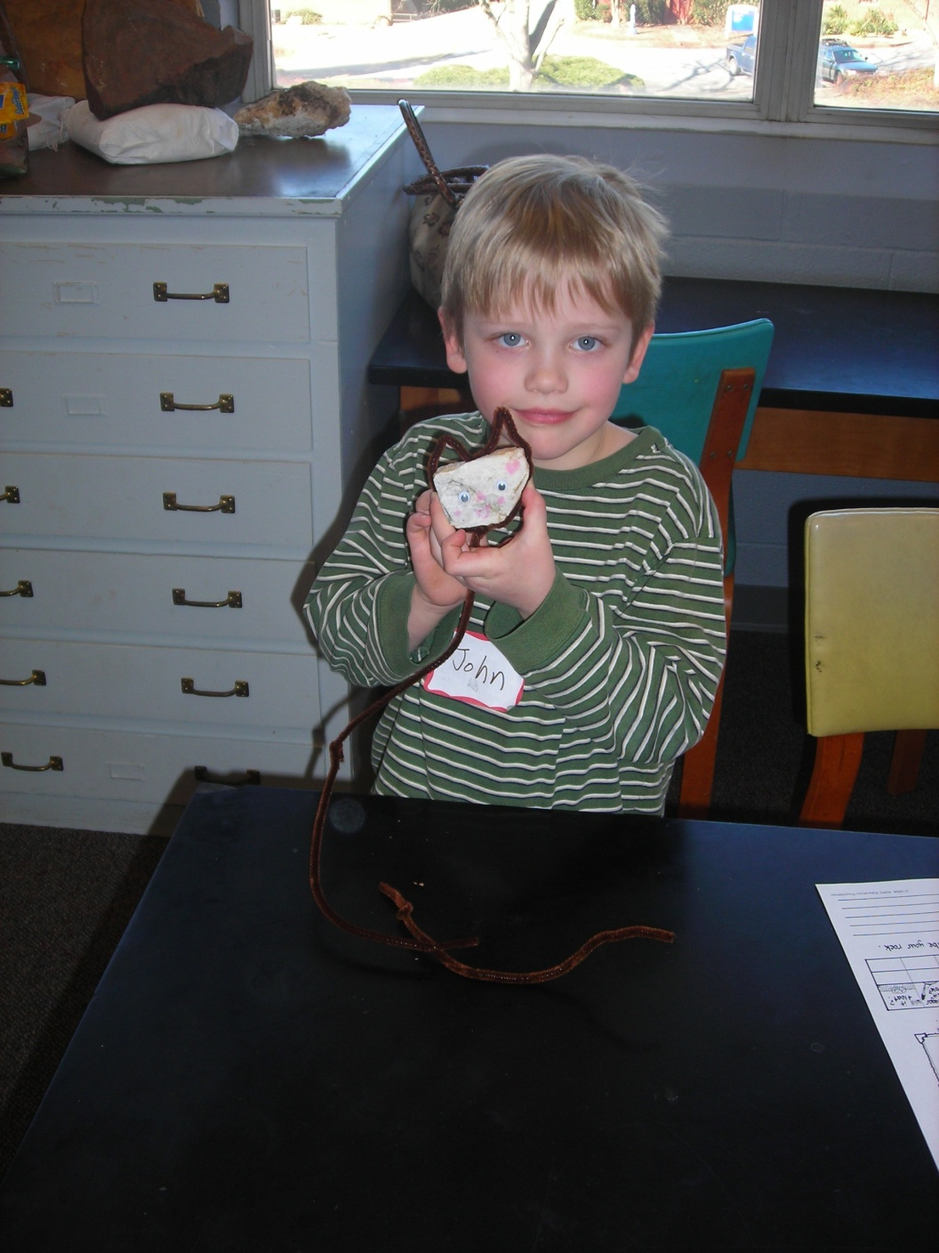
IMPACT
Improving
Motivation,
Performance, &
Attitudes of
Children and
Teachers

Slide 11
IMPACT
Grant-funded program offering a wide range of courses in science, technology, engineering, & mathematics to children and educators in grades K-8.
Grant written by Dr. Sharmistha Basu-Dutt (Chemistry) and Dr. Gail Marshall (Education).
Funded by the Alice Huffard Richards Fund ($100,000 in year 1, which has been renewed for a 3 year cycle).

Slide 12
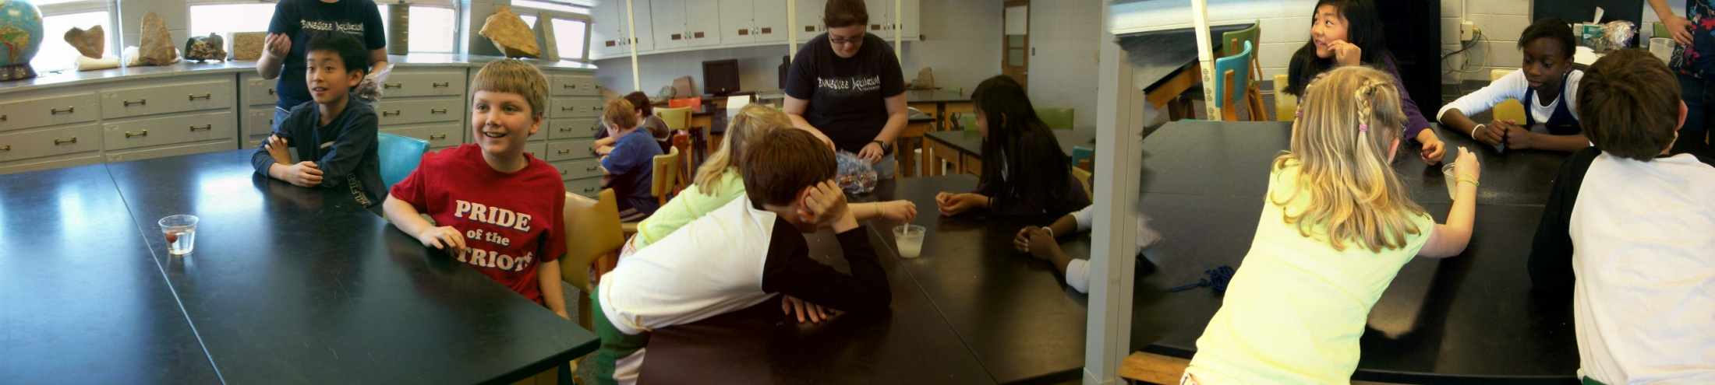
Camps I’ve led:
Saturday Camps
Summer Camps
Rocking Science (2-3)
Play in the Dirt (3-5)
Geology Rocks (K-2, 2-3)
Water Wonders (4-5)
Aqua World (6-8)
Soaking Science (3-5)

Slide 13
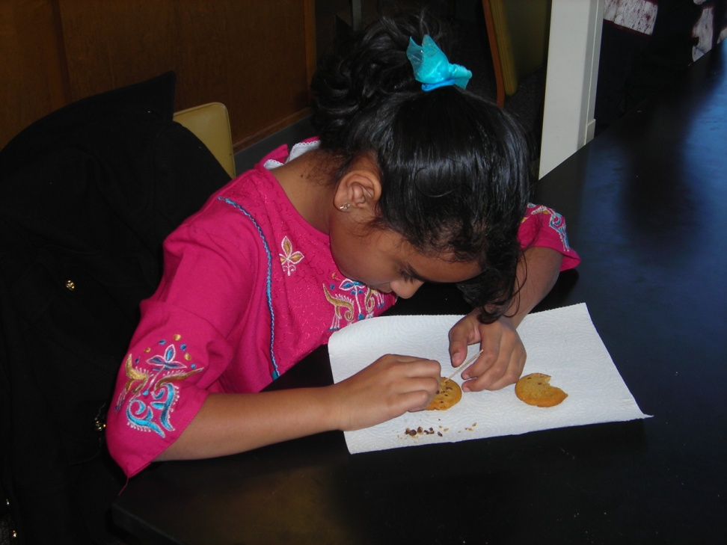
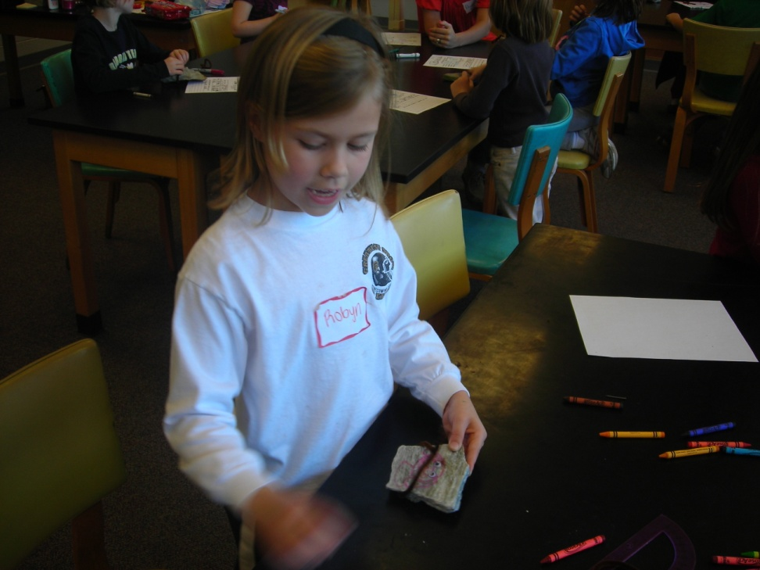
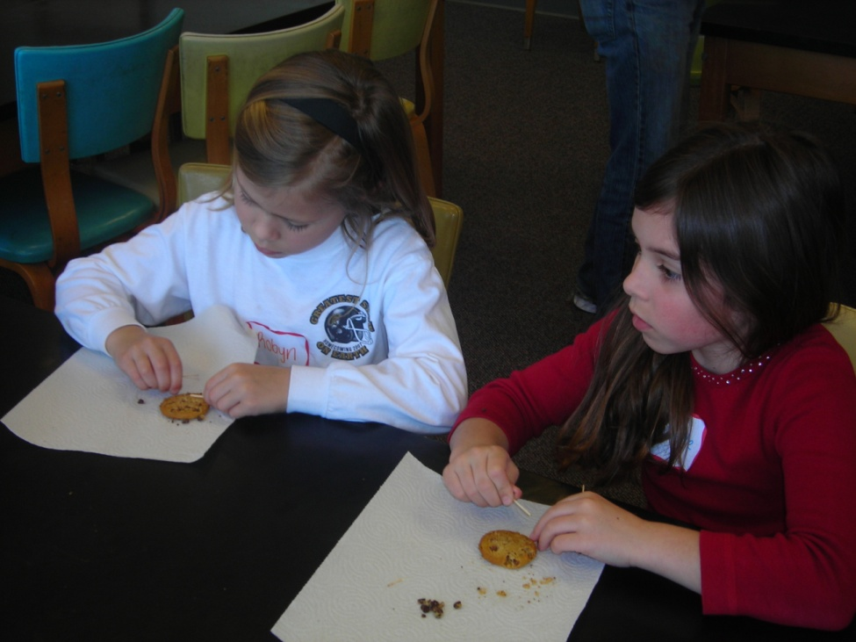
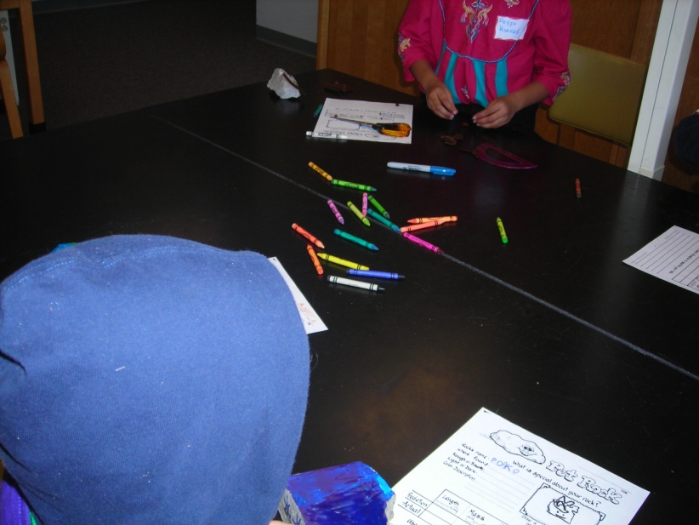
Cookie Mining
Making pet rocks

Slide 14
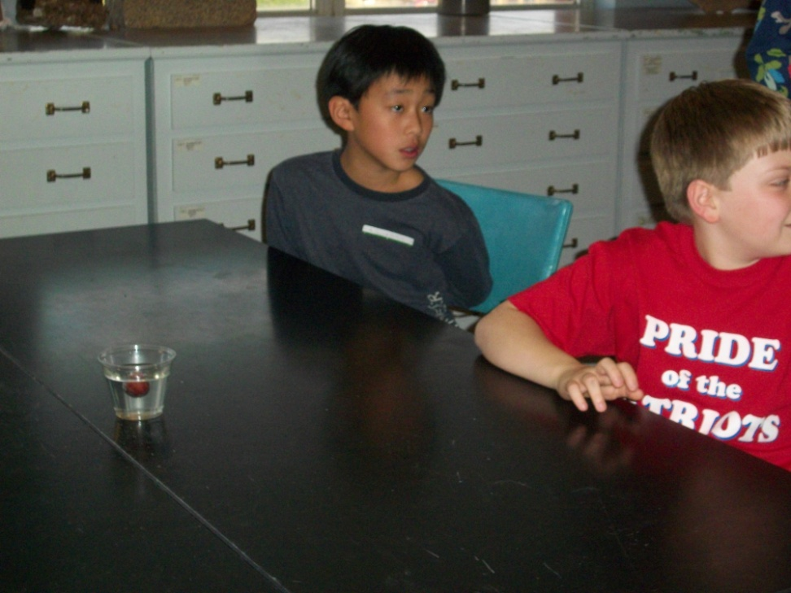
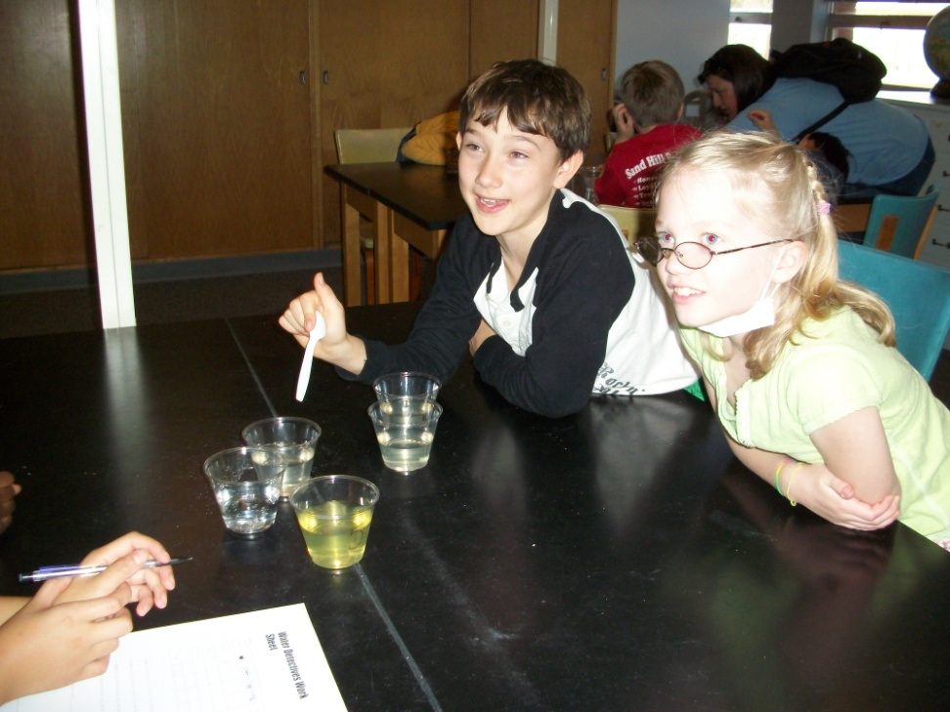
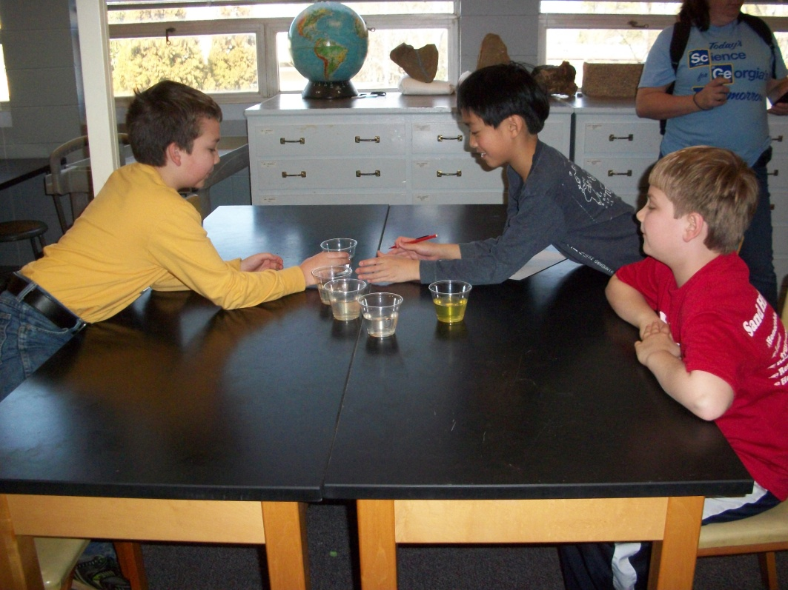
Density Experiments
Water Detectives

Slide 15
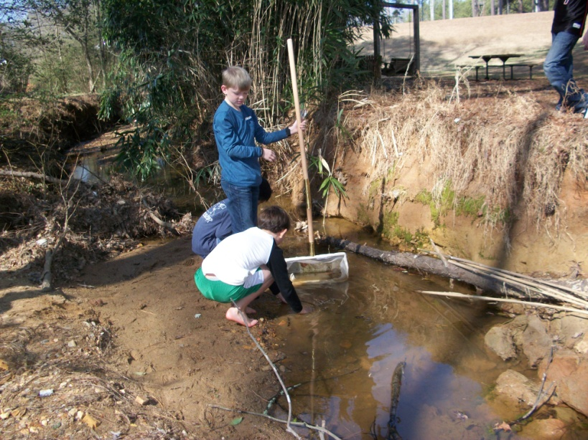
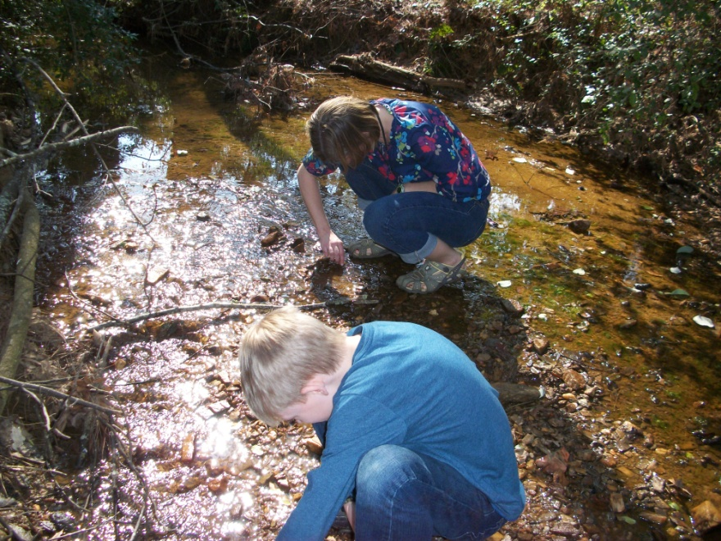
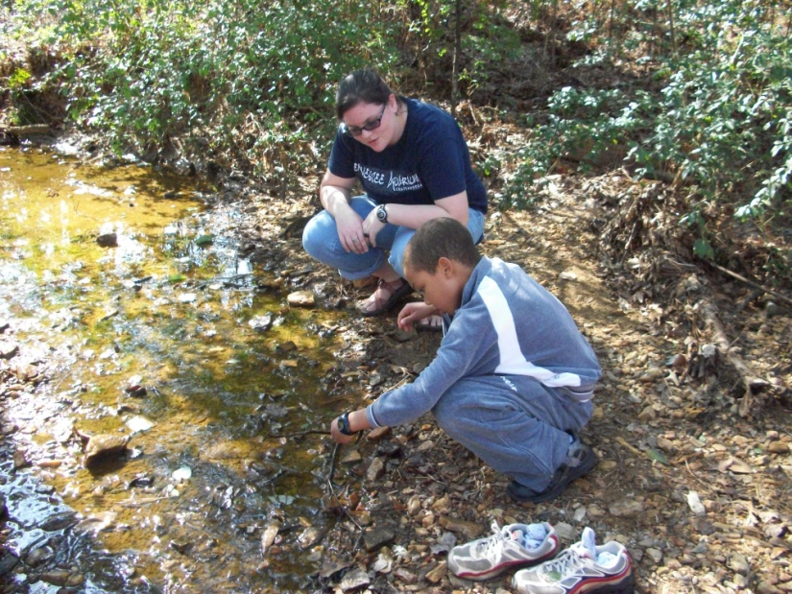
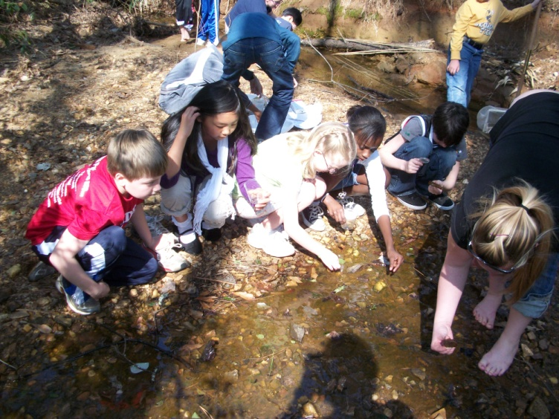
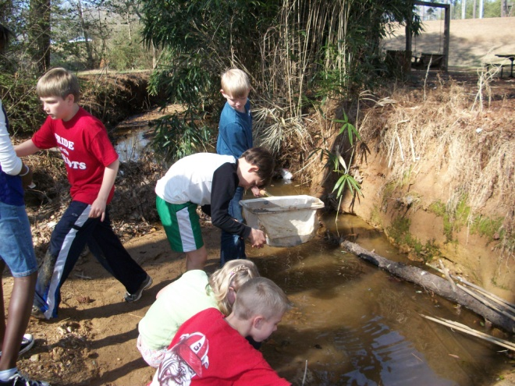
Macroinvertebrate Surveys

Slide 16
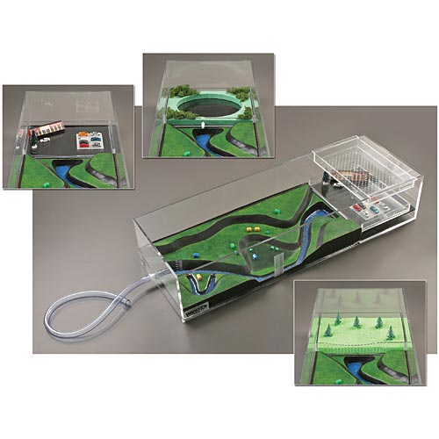
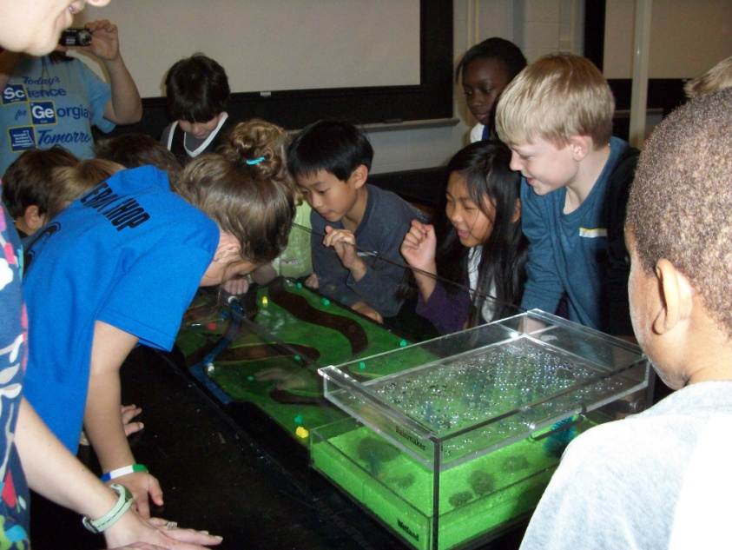
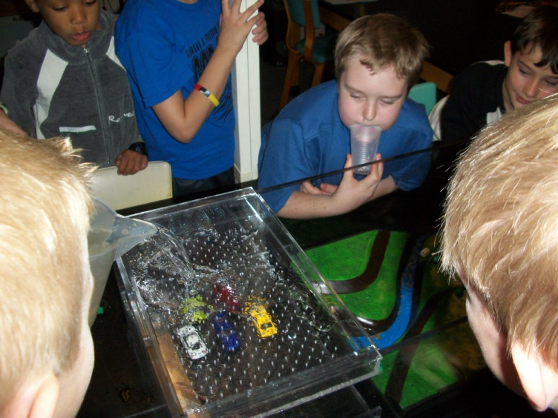
Stormwater Floodplain Simulator

Slide 17
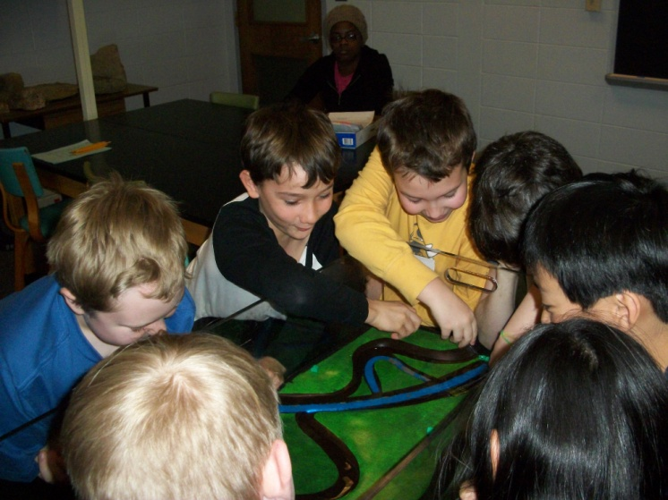
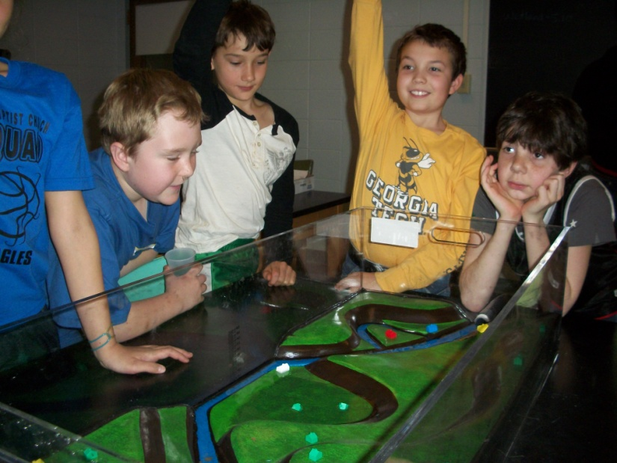
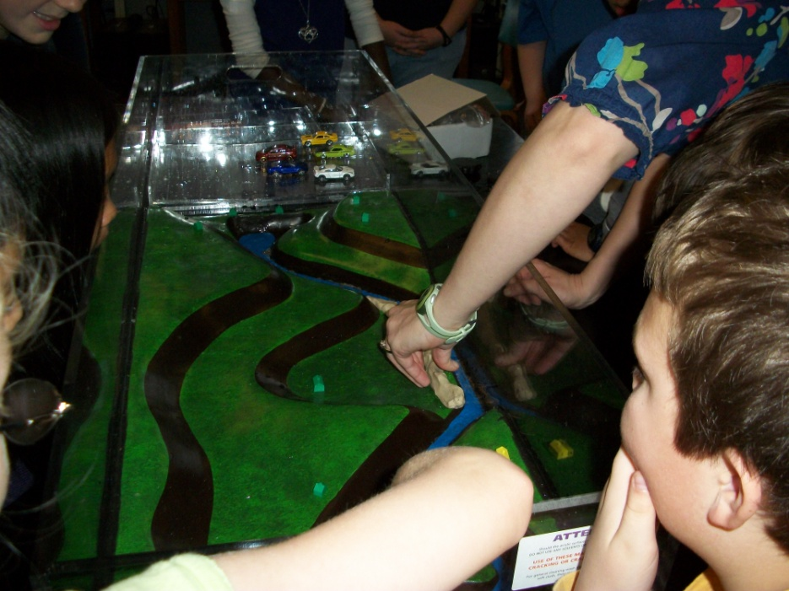
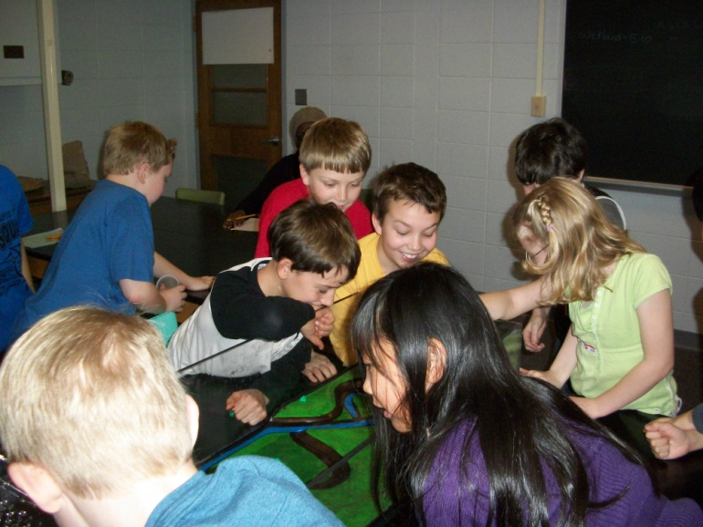
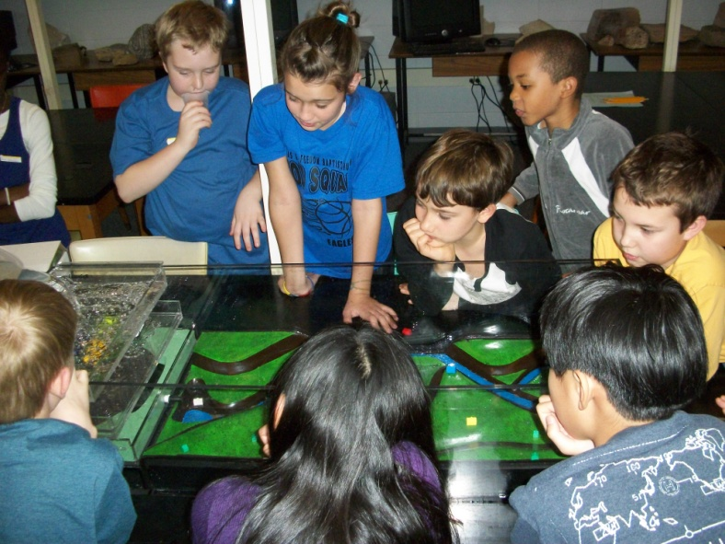

Slide 18
IMPACT Results
Attitudinal Surveys
52.8% of participants had positive changes in attitudes, while 18% shifted more negatively
Engagement in Learning Opportunities
Recorded by an observer
Engagement rates ranged from 88-100%, with 92% & 100% for my 2 summer camps
Knowledge Gains

Slide 19
Knowledge Gains
A 5 question pre- & post-test is given at each session
Students increased their content knowledge by 6-63%.
Increases in average scores for my camps were 26.7, 41.6, 50.0, & 35.0.

Slide 20
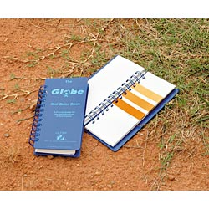
Teacher Workshops
Teacher Quality Grants received by the College of Education
In 1 day workshop, I covered Physiographic Provinces and Soils.
Teachers were given powerpoint on provinces for their use.
We performed hands on activities for soils that are easily repeatable.

Slide 21

The Global Learning and Observations to Benefit the Environment (GLOBE) program is a worldwide hands-on, primary and secondary school-based science and education program.
Promotes collaborations on inquiry-based investigations of the environment and the Earth system working in close partnership with NASA, NOAA and NSF Earth System Science Projects in study and research about the dynamics of Earth's environment.
Started on Earth Day, 1995.
GLOBE by the numbers: 111 participating countries, 54,000 Globe-trained teachers, 23,000 schools, 1.5 million students, and 21 million measurements in the Globe database!!

Slide 22
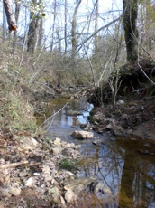
GLOBE workshops
Along with Gail Marshall in the College of Ed, I hosted 2 training events and several on-site visits for 8 local teachers.
They implemented the GLOBE program in their schools and are actively using it, with 897 data points to date.
They created an outdoor classroom at their school.

Slide 23
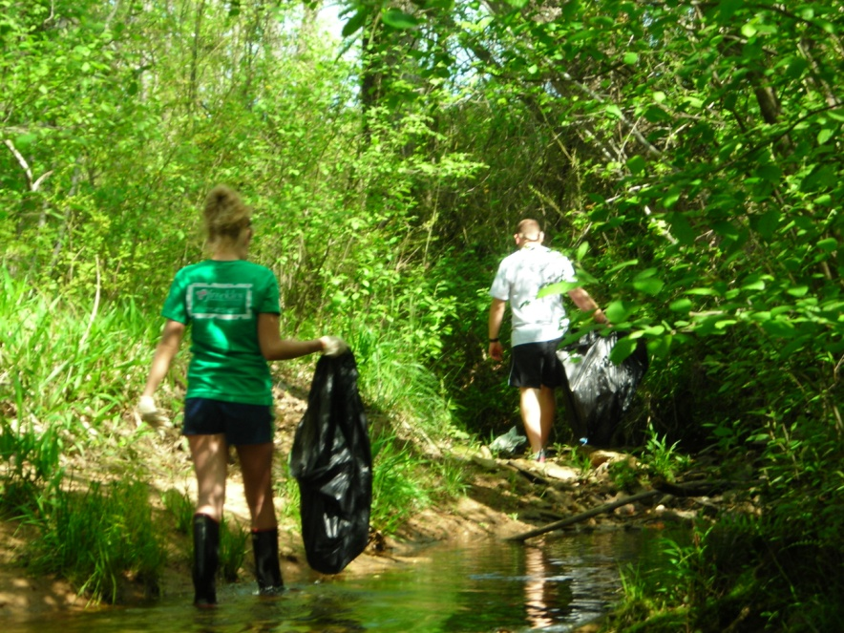
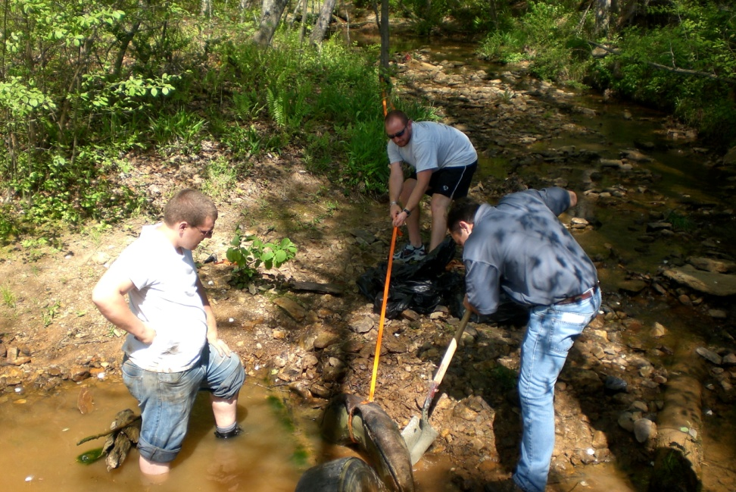
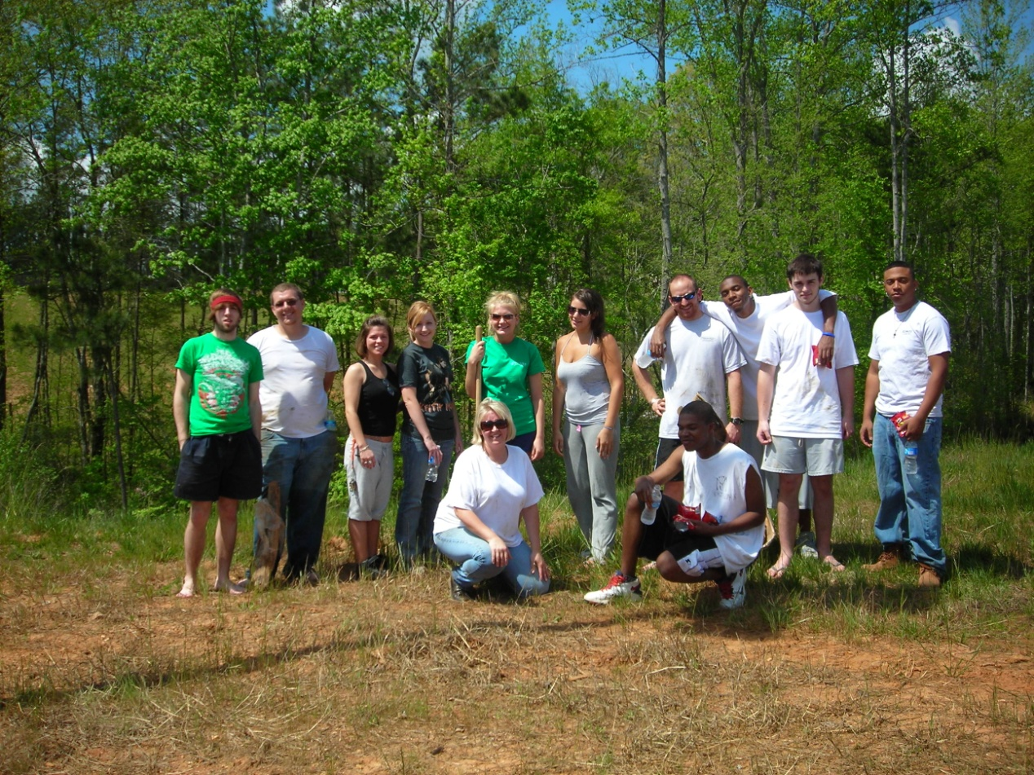
Bremen Academy Outdoor Classroom

Slide 24
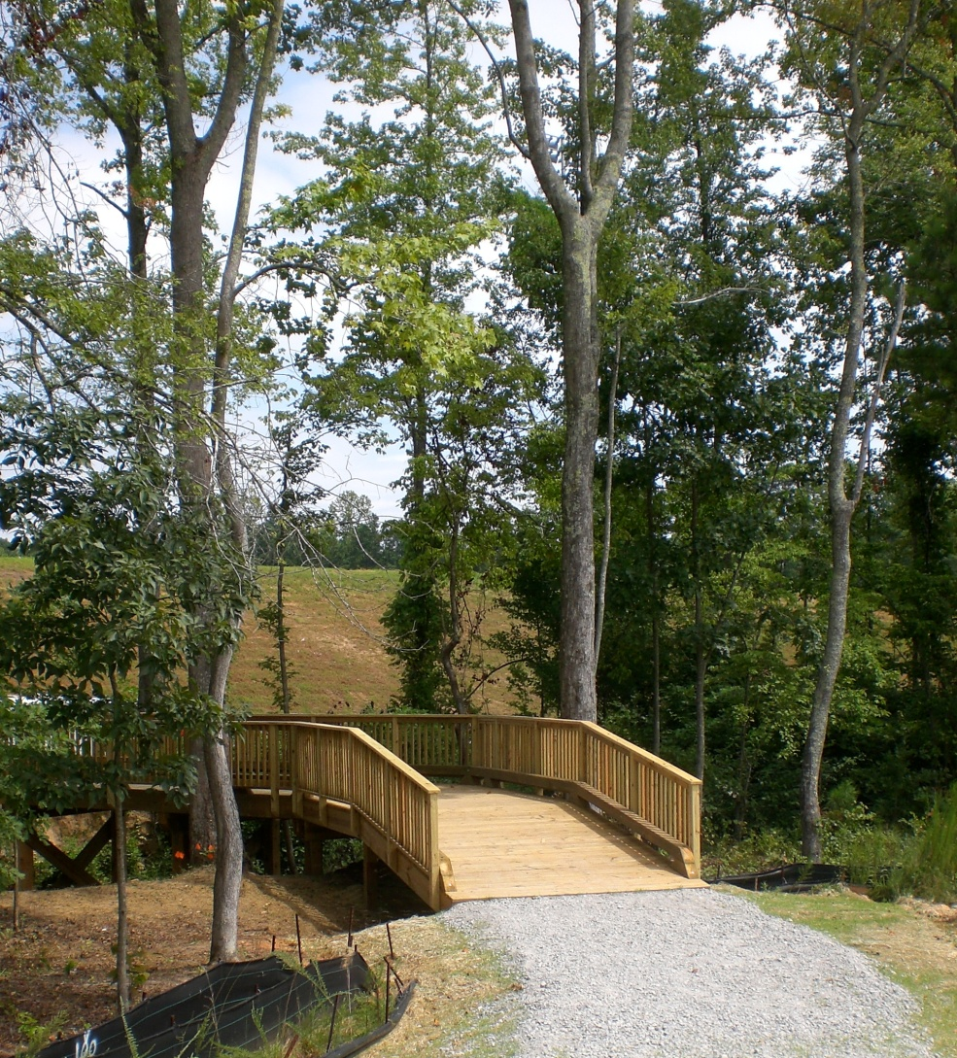
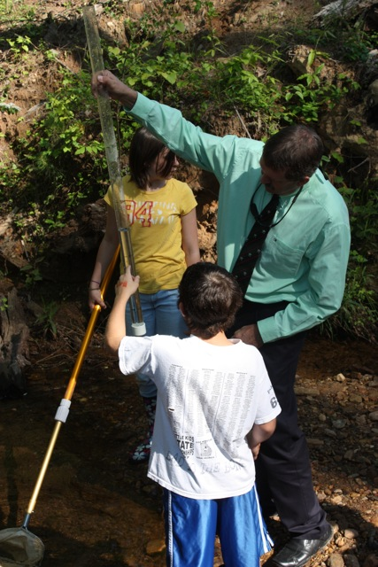

Slide 25
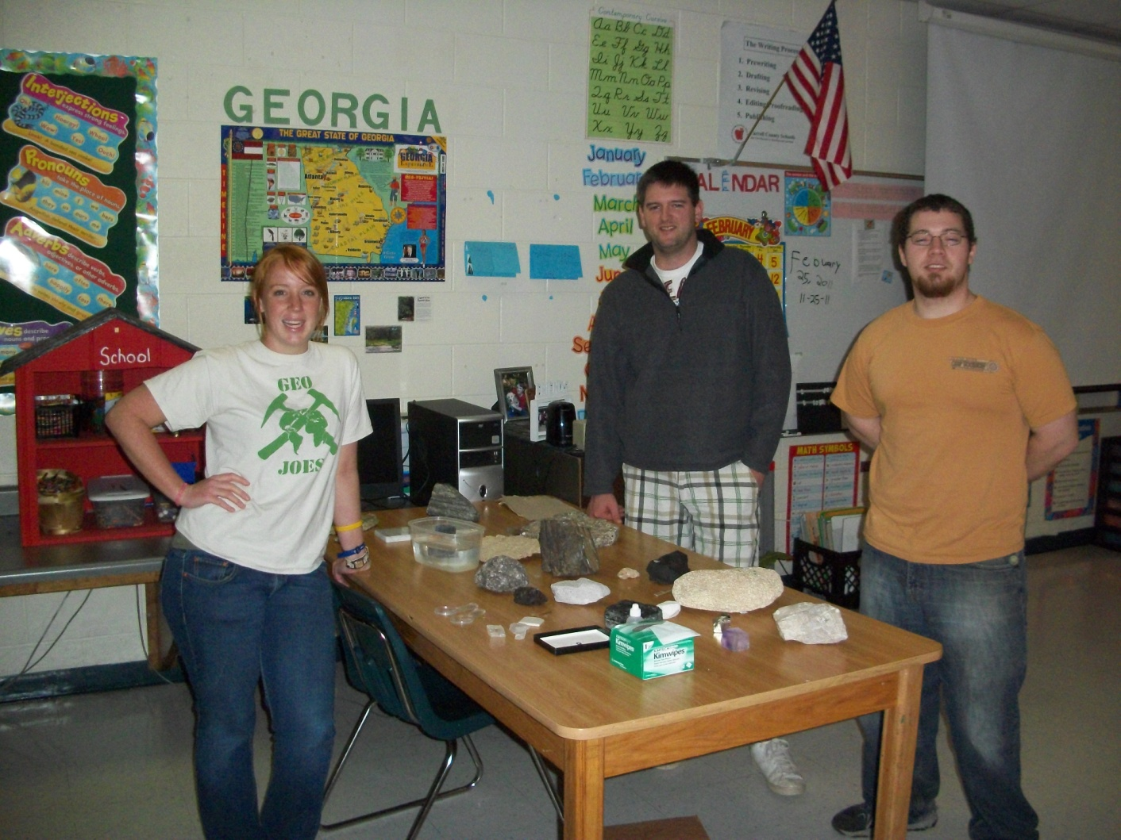
School Visits
-Four separate visits in 2010-2011 so far, reaching ~400 students total.

Slide 26
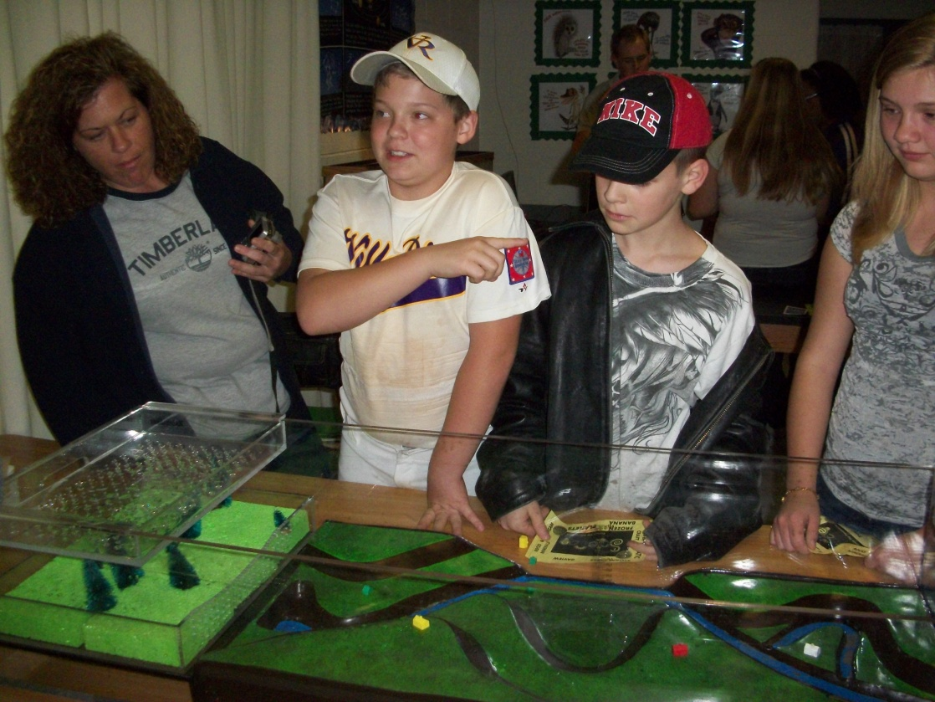
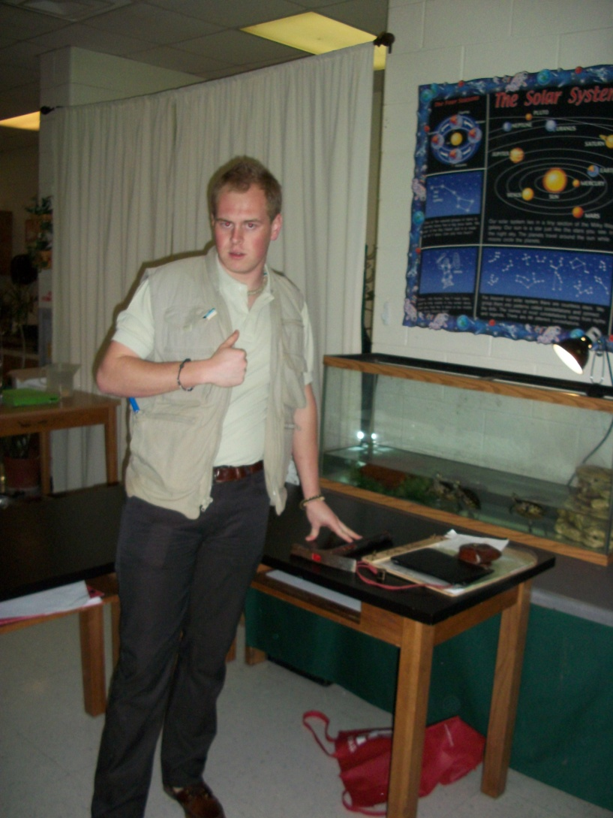
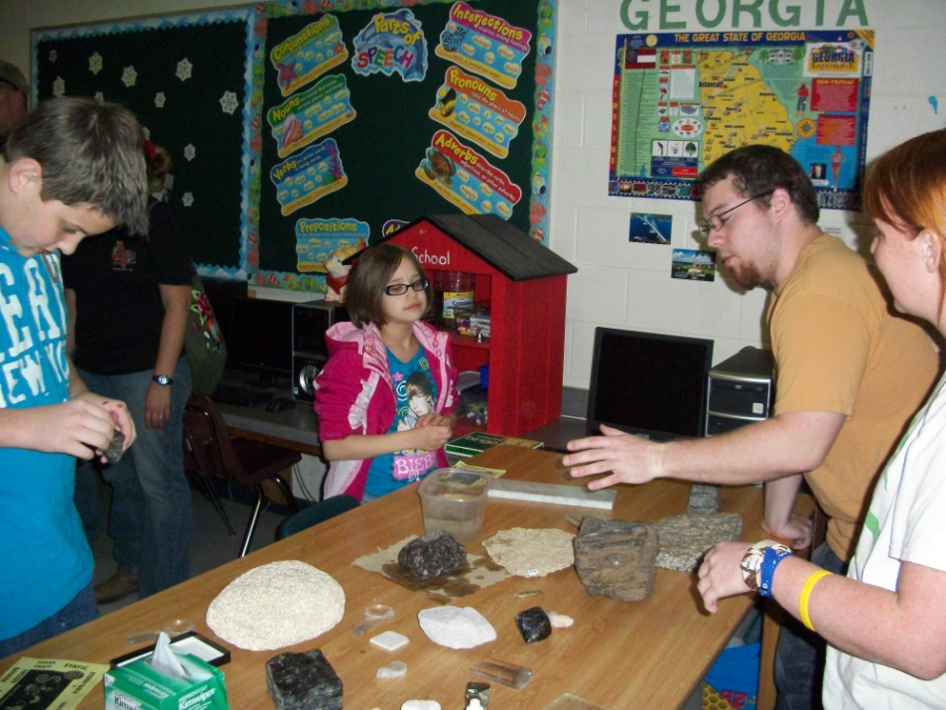

Slide 27
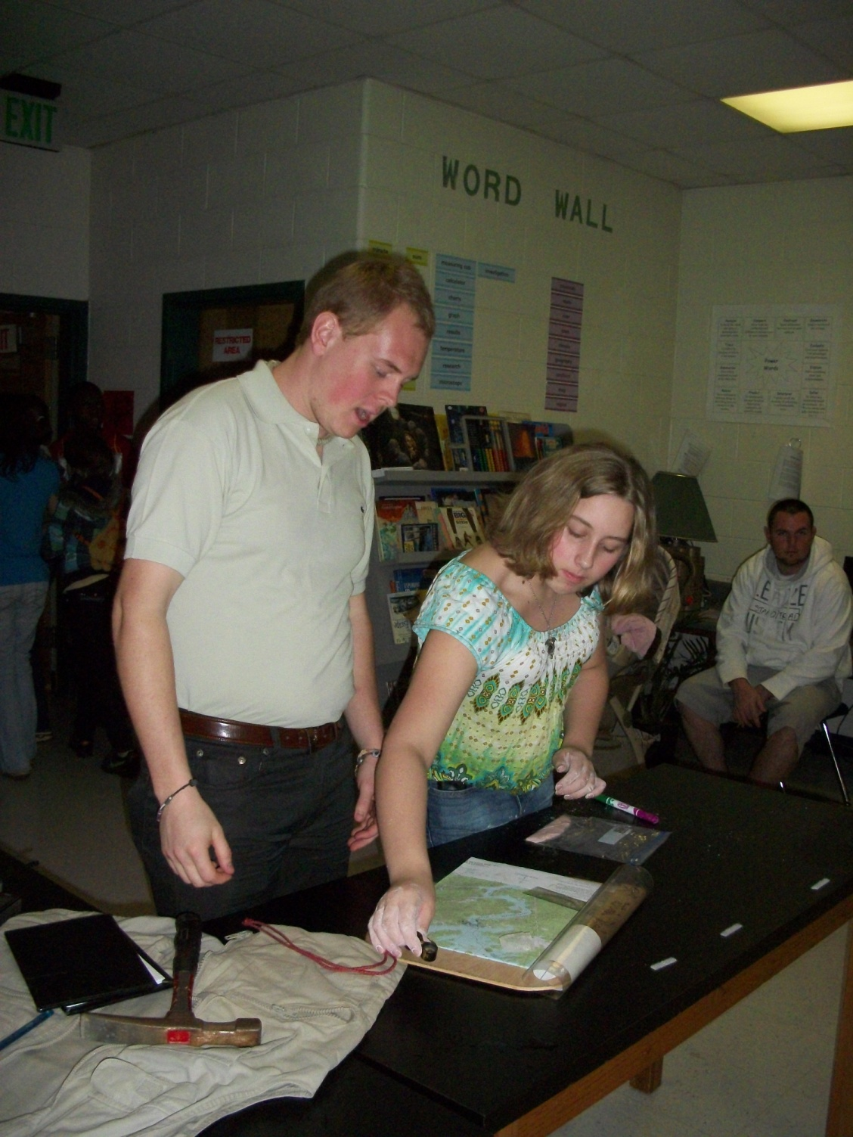
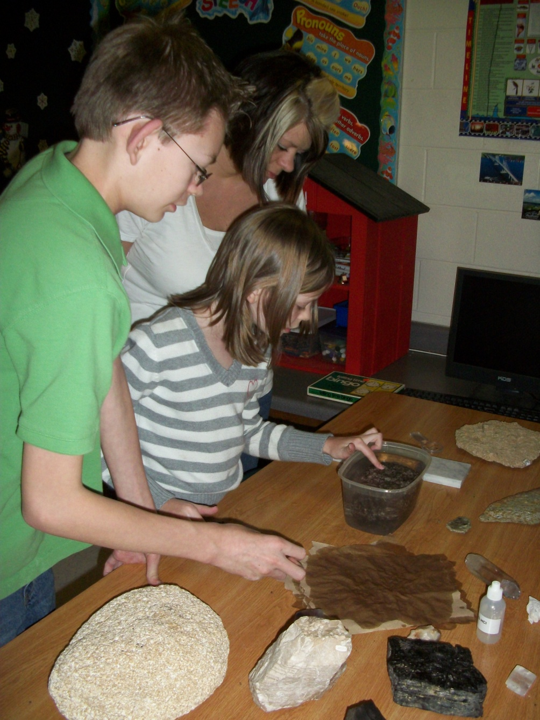

Slide 28
