Slide 1
UNC-BEST: A PROGRAM AT UNC-CHAPEL HILL TO TRAIN HIGHLY QUALIFIED EARTH SCIENCE TEACHERS
Kevin Stewart
Department of Geological Sciences

Slide 2
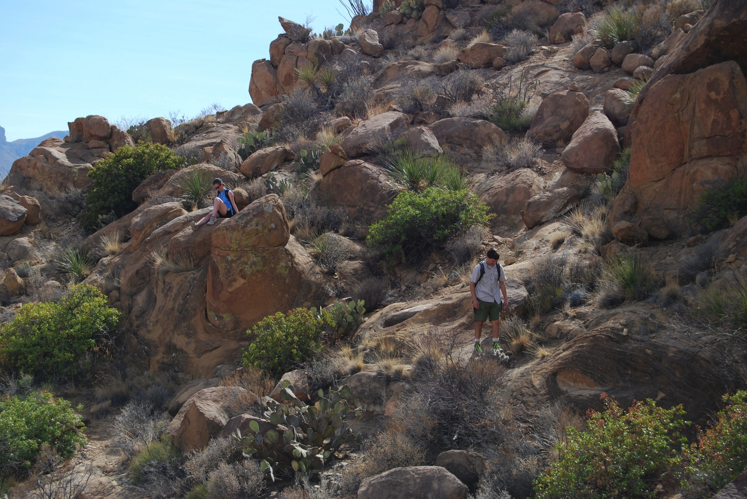
Grapevine Hills laccolith, Big Bend National Park

Slide 3
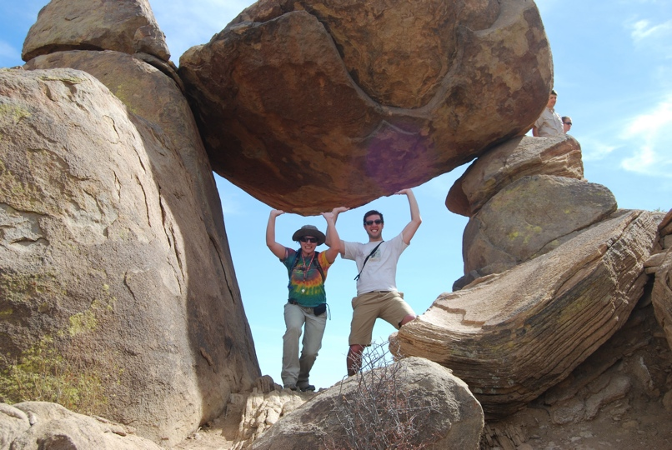
“Balanced Rock”, Big Bend National Park

Slide 4
“Balanced Rock”, Big Bend National Park
1. “What is the geologic term for a balanced rock?”

Slide 5
“Balanced Rock”, Big Bend National Park
1. “What is the geologic term for a balanced rock?”
2. “How do you pronounce ‘syenite’?”

Slide 6
UNC-BEST
UNC Baccalaureate Education in Science and Teaching

Slide 7
UNC-BEST
UNC Baccalaureate Education in Science and Teaching
Available to students in Geological Sciences, Biology, Physics, Chemistry, and Mathematics

Slide 8
UNC-BEST
UNC Baccalaureate Education in Science and Teaching
Available to students in Geological Sciences, Biology, Physics, Chemistry, and Mathematics
Students earn a Bachelor’s degree in their major department and graduate with concurrent NC teacher licensure.

Slide 9



TCT funding
In 2008, UNC submitted a proposal (led by Geol. Sci.) to the US Department of Education Teachers for a Competitive Tomorrow (TCT) program.
Proposal was successful (5 years @ 250K/year).
www.unc.edu/uncbest/
9

Slide 10
TCT-funded Instructors
TCT-B funding has allowed us to hire two lecturers (Mathematics and Geological Sciences) and a clinical Assistant Professor in the School of Education
www.unc.edu/uncbest/
10

Slide 11
TCT-funded Instructors
TCT-B funding has allowed us to hire two lecturers (Mathematics and Geological Sciences) and a clinical Assistant Professor in the School of Education
In addition TCT funding allowed us to hire three instructors in the SOE to supervise UNC-BEST student teachers
www.unc.edu/uncbest/
11

Slide 12
UNC-BEST
In addition to their required major courses, UNC-BEST students take four additional courses:

Slide 13
UNC-BEST
In addition to their required major courses, UNC-BEST students take four additional courses:
A pedagogy course, taught by the UNC-BEST lecturer in their home department

Slide 14
UNC-BEST
In addition to their required major courses, UNC-BEST students take four additional courses:
A pedagogy course, taught by the UNC-BEST lecturer in their home department
EDUC 532: Understanding Learners (3)
EDUC 533: Diversity and Teaching (3)
EDUC 535: Teachers and Schools (3)

Slide 15
Recruitment
Recruiting
www.unc.edu/uncbest/
15

Slide 16
Current UNC students
Pedagogy instructors present UNC- BEST to students enrolled freshman level courses
Distributed Posters
New Student orientation
Website
Personal email inquiries followed up with one-on-one student advising
www.unc.edu/uncbest/
16
Notes:
Ramona Cox staffed the new student orientation sessions – Summer 2009

Slide 17
UNC-BEST Website
www.unc.edu/uncbest/
17

Slide 18
Non- UNC students
Recruiting high school and community college students
Carolina Advising Corps
Promo materials (posters and post cards)
www.unc.edu/uncbest/
18
Notes:
Caution is being taken when recruiting new students. Utilizing the Carolina advising core staff because they have internal information to target students who meet UNC-CH entrance requirements. Also have access to hard to reach high schools.

Slide 19
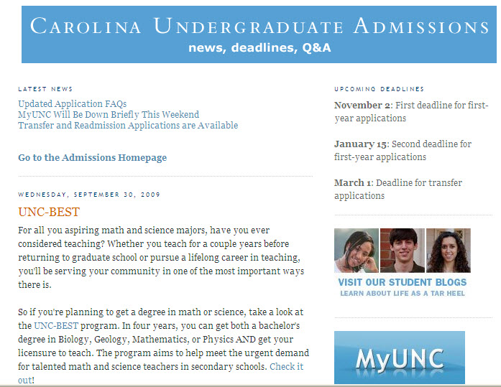
Admissions Blog
www.unc.edu/uncbest/
19
Notes:
Hyperlink to admissions blog
http://unc-admissions.blogspot.com/2009/09/unc-best.html

Slide 20
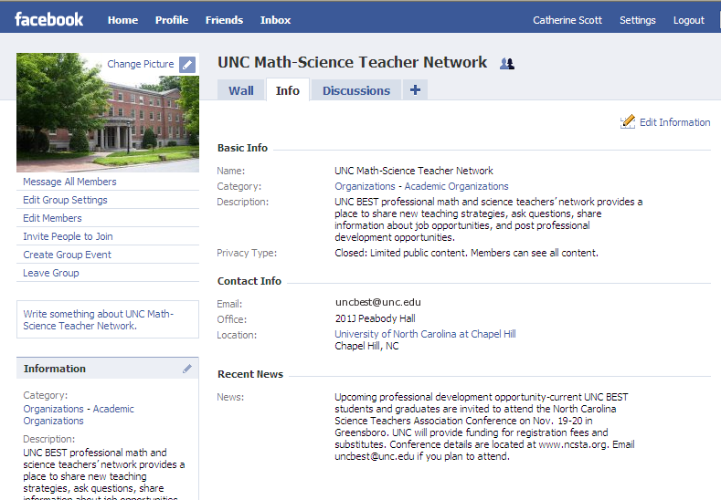
facebook
www.unc.edu/uncbest/
20
Notes:
The purpose of this social networking group is to provide support of UNC BEST students/graduates. This forum allows participants to ask questions, learn about professional development opportunities, share job opportunities, and network with other UNC Math and Science teachers. The digital newsletter will be distributed through this forum.

Slide 21
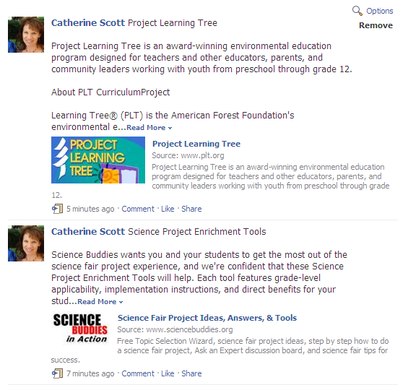
Digital Newsletter
www.unc.edu/uncbest/
21

Slide 22
Student Enrollment
 | Fall 2008 | Fall 2009 | Fall 2010
Biology | 2 | 18 | 22
Math | 0 | 0 | 5
Physics | 0 | 1 | 2
Geology | 0 | 2 | 5
Chemistry | 0 | 0 | 9
TOTAL | 2 | 21 | 43

Slide 23
Graduates
 | May 2009 | Dec 2009/May 2010 | Dec 2010/May 2011 (projected)
Biology | 7 | 11 (2 lateral entry) | 10 (1 lateral entry)
Math | 0 | 0 | 0
Physics | 1 | 0 | 2
Geology | 0 | 0 | 3
Chemistry | 0 | 0 | 4
TOTAL | 8* | 11* | 19
*28% serve in high needs school districts
Notes:
Expect to have 33 program alumni by May 2011.
28% of 2009 and 2010 alumni serve in high-needs school districts.

Slide 24
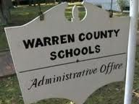
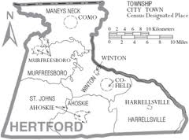


Partner Districts
Notes:
Our engagement with partner districts has grown over the past year into a collaborative network of educators involving university faculty, district supervisors, in-service and pre-service teachers. It began with site visits to each of our partner districts initiated by the Dean of the School of Education and included the UNC BEST program coordinator and some faculty members. This resulted in several well attended events: a Symposium for UNC BEST students to present their model lessons to local teachers, professors and students; a professional development workshop for Guilford County teachers lead by our Biology professor; and “A Day in the Life” site visit for UNC students to visit classrooms. Guilford County is very eager to engage our students and provided them a day tour of several schools along with a training workshop on navigating the hiring process. The Science curriculum specialist provided students with her personal contact information so graduates can get information on teaching vacancies at specific school sites. Partnerships with our other school districts have taken a different direction. Hertford County is located three hours from our campus so our collaboration with them will be in the form of virtual communication. At this school district we plan to pilot a virtual tutoring and mentoring program between university and high school students using Elluminate. Hertford is offering an employment incentive to our graduates by proving housing for first year teachers. We plan to engage Warren and Vance counties in a similar pilot program.

Slide 25
Partner Districts
UNC-BEST graduates teaching in high-needs schools receive salary supplements
Notes:
Our engagement with partner districts has grown over the past year into a collaborative network of educators involving university faculty, district supervisors, in-service and pre-service teachers. It began with site visits to each of our partner districts initiated by the Dean of the School of Education and included the UNC BEST program coordinator and some faculty members. This resulted in several well attended events: a Symposium for UNC BEST students to present their model lessons to local teachers, professors and students; a professional development workshop for Guilford County teachers lead by our Biology professor; and “A Day in the Life” site visit for UNC students to visit classrooms. Guilford County is very eager to engage our students and provided them a day tour of several schools along with a training workshop on navigating the hiring process. The Science curriculum specialist provided students with her personal contact information so graduates can get information on teaching vacancies at specific school sites. Partnerships with our other school districts have taken a different direction. Hertford County is located three hours from our campus so our collaboration with them will be in the form of virtual communication. At this school district we plan to pilot a virtual tutoring and mentoring program between university and high school students using Elluminate. Hertford is offering an employment incentive to our graduates by proving housing for first year teachers. We plan to engage Warren and Vance counties in a similar pilot program.

Slide 26
Partner Districts
UNC-BEST graduates teaching in high-needs schools receive salary supplements
This year’s supplements range from $800-$3,500
Notes:
Our engagement with partner districts has grown over the past year into a collaborative network of educators involving university faculty, district supervisors, in-service and pre-service teachers. It began with site visits to each of our partner districts initiated by the Dean of the School of Education and included the UNC BEST program coordinator and some faculty members. This resulted in several well attended events: a Symposium for UNC BEST students to present their model lessons to local teachers, professors and students; a professional development workshop for Guilford County teachers lead by our Biology professor; and “A Day in the Life” site visit for UNC students to visit classrooms. Guilford County is very eager to engage our students and provided them a day tour of several schools along with a training workshop on navigating the hiring process. The Science curriculum specialist provided students with her personal contact information so graduates can get information on teaching vacancies at specific school sites. Partnerships with our other school districts have taken a different direction. Hertford County is located three hours from our campus so our collaboration with them will be in the form of virtual communication. At this school district we plan to pilot a virtual tutoring and mentoring program between university and high school students using Elluminate. Hertford is offering an employment incentive to our graduates by proving housing for first year teachers. We plan to engage Warren and Vance counties in a similar pilot program.

Slide 27
Induction Program
UNC BEST Alumni summer 2010 retreat
NASA workshop
Workshop and Biotechnology class.
North Carolina Science and Math Teachers Association Conferences
Summer Internship designing lessons for an “Outdoor Classroom”
Poster presentation at Biennial Conference on Chemical Education (BCCE) at U of North Texas.
Notes:
The beginning components of the professional development (induction) program are in place. During their first year of teaching, our graduates were engaged with our program in several ways; they networked through our social networking group on face book; they were provided with substitute pay and travel to attend several professional teachers’ conferences; and served on a new teacher panel during one of our seminars where they answered questions and shared some of their experiences with current students. The Texas Instrument T^3 conference we attended provided our pre-service and in-service teachers with instruction on implementing instructional technology in the classroom. The North Carolina Council of Teachers of Mathematics Conference and North Carolina Science Teachers Association Professional Development Institute provided students and new teachers’ with an opportunity to network with other professional educators, exposed them to new science materials and equipment, and provided them with free hands-on inquiry based activities for their classrooms. Three of our Chemistry students have been selected to do poster presentations at the Biennial Conference on Chemical Education at University of North Texas. Our Chemistry professor will accompany these students to the conference in August 2010. Science students attended the North Carolina Science Teachers Association (NCSTA) conference, November 2010. Math students attended the North Carolina Council of Teachers of Mathematics (NCCTA), October 2010. We also developed the first UNC BEST summer retreat.

Slide 28
Retention Rate
Notes:
Percentage of UNC BEST alumni still teaching. Year 1 (class of 2010) = 91% employed as full time classroom teachers. Year 2 (class of 2009) = 88% employed as HS teachers.

Slide 29
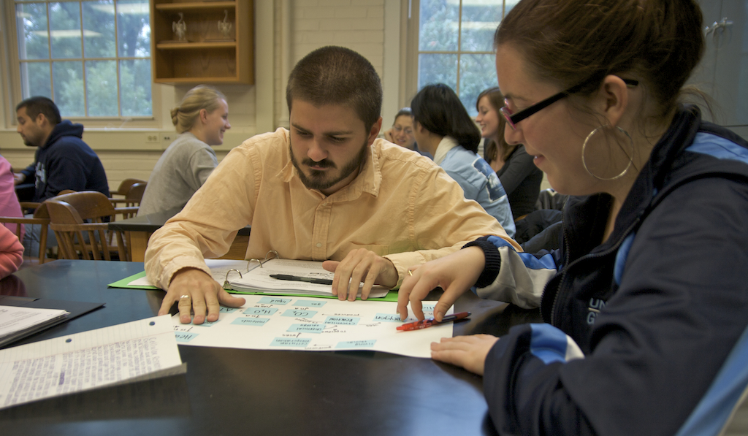
Services provided to pre-service teachers
Notes:
Services provided to pre-service teachers:
Education in strategies to improve student literacy
Training in the use of and integration of educational technology
Clinical classroom experiences
Laboratory experience
Encouragement to teach in schools determined by the partnership to be most in need
Active assistance to find employment in schools determined by the partnership to be most in need

Slide 30
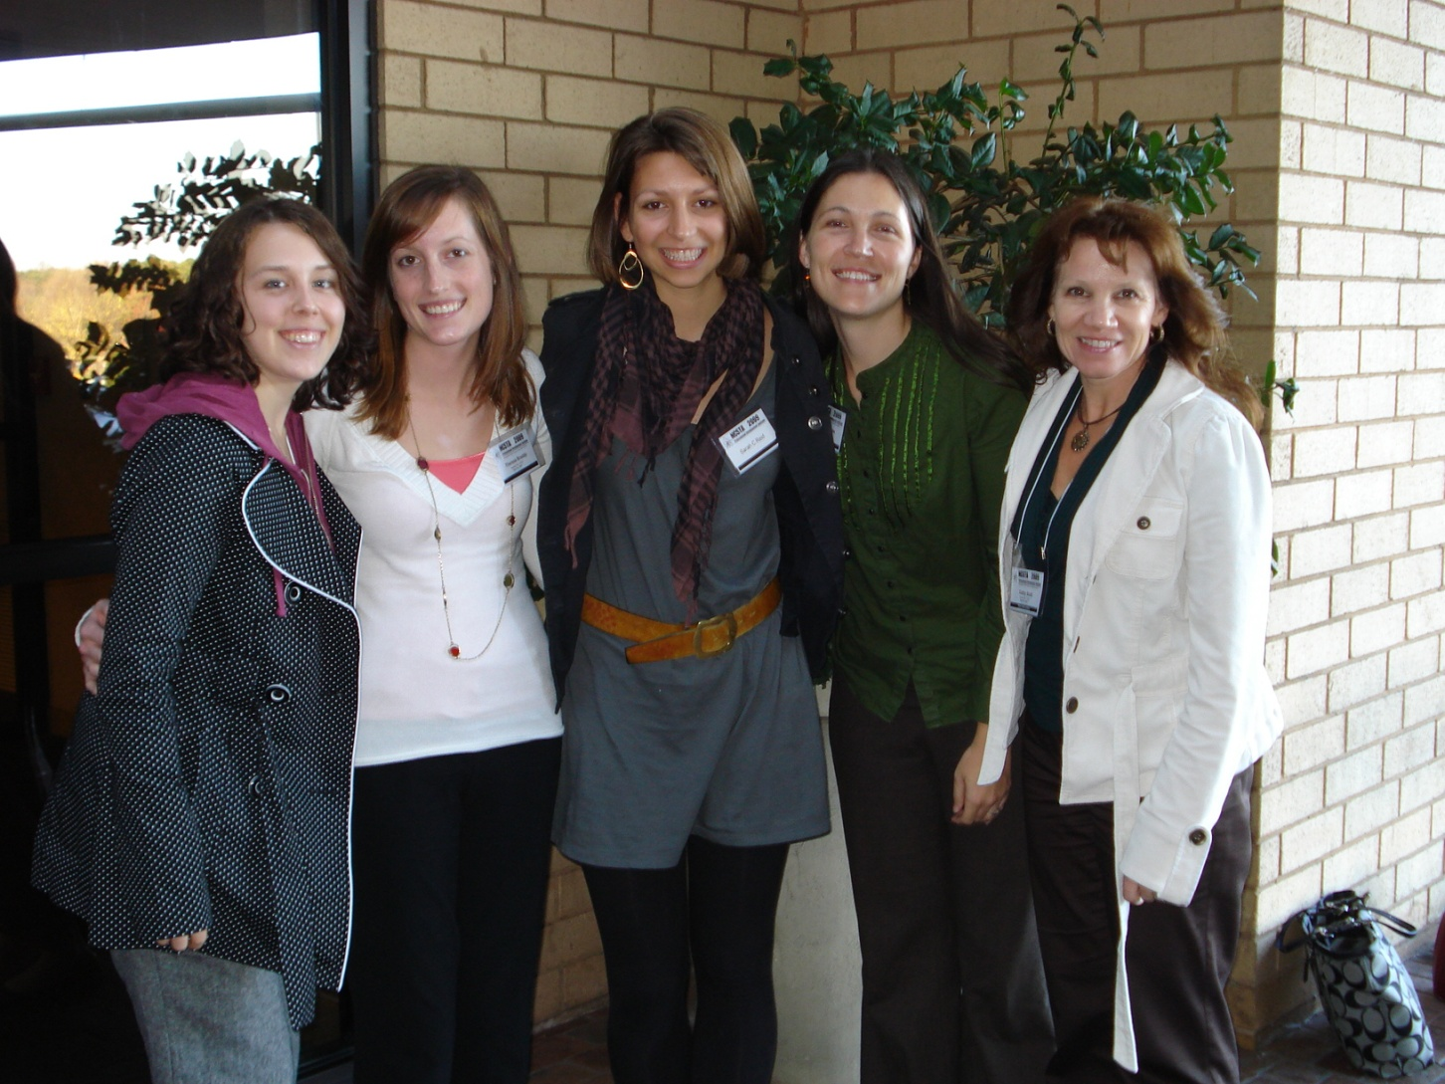
Activities for in-service teachers
Notes:
http://www.facebook.com/?ref=home#!/group.php?gid=173722599007
Assistance in using and integrating technology in the classroom
Receiving “teacher mentoring”
Mentoring other program participants
Interdisciplinary collaboration
We have designed a multi-pronged induction program for our graduates. Support for our graduates is a career-development continuum, leading to National Board Certification as exemplary mathematics and science teachers. The induction program has three components: 1) providing resources to all graduates to support them in delivering effective instruction, 2) establishing a supportive network of mentors and UNC-BEST colleagues, and 3) providing graduates with an array of professional development opportunities. The UNC BEST coordinator manages the induction program, including establishing a coordinated timeline for implementation of each induction component. A facebook group was developed for all graduates providing resources and information related to each component of the induction program.
First, to support our graduates in delivering student-centered and inquiry-based instruction, we provided teachers with online curriculum modules designed by students in the UNC-BEST content-area pedagogy courses. These modules include inexpensive, inquiry-based lesson plans aligned with the North Carolina Standard Course of Study, discussions of the science content including cutting edge research findings, literacy resources and student assessments. For example, biology teachers who download the photosynthesis curriculum module will be able to view a video showing the set up, procedure and expected results of an inexpensive experiment to measure the rate of photosynthesis under multiple conditions. The module will also include a discussion of the big ideas of photosynthesis, common student misconceptions, and a PowerPoint presentation detailing scientific research on the use of algal cultures to supply oils for biofuel. The curriculum modules developed each semester will be showcased in the UNC-BEST newsletter and will be shared with teachers through an existing teacher support website (Learn NC) housed in the School of Education.
Second, UNC-BEST graduates will have access to a rich network of mentors and peers for collegial support. The UNC-BEST group was created in the popular social networking site Facebook.com so graduates can remain connected and offer support to one another. This site allows us to maintain up-to-date contact with graduates allowing us to tract schools where UNC-BEST graduates are employed and to maintain connections within and between cohorts.
Summer 2010 alumni retreat was a face-to-face week long program developed by program faculty to address needs of beginning teachers. Workshops included classroom management strategies, inquiry based instruction, flexible unit plans, alumni sharing of materials and resources.

Slide 31
Program Evaluation

Slide 32
External Evaluation
Focused on three types of evaluation:
Monitoring (measuring the level, degree, and quality of project activity),
Measurable Objectives and Benchmarks (assessing the degree of results) and
Process Evaluation (gathering data to promote project improvement).
Notes:
External evaluators worked with UNC BEST project staff to design instruments, focus group protocols, and surveys for evaluating the UNC BEST program, services, and activities. Key stakeholders reviewed the plan to ensure that evaluation questions were relevant and that data collection strategies were relevant. Progress was made during the 2009-2010 reporting year in implementing each evaluation area.
Monitoring evidence was collected to determine the extent to which project activities met objectives. To this end, the number of participants, information on academic majors, race, gender, income, and disability status of program participants, as well as employment placement were all tracked by the external evaluator and shared with project staff. Additional data were gathered regarding high-need schools in North Carolina. Beyond providing data regarding program participants, data were also compiled regarding the larger UNC-Chapel Hill math and science community to allow for comparison. To monitor program activity, online surveys were developed and administered to key stakeholders (current students, graduates, and coordinators) to determine level of involvement.
Program participants (current students and graduates) were surveyed and graduates from 2009 and 2010 participated in focus group interviews. The pedagogy instructors and coordinator also participated in a focus group interview. During these evaluation activities, external evaluators were able to gather data regarding project participants’ experiences, feedback, and gather suggestions for program improvement and sustainability.

Slide 33
New research opportunity
Howard Hughes Medical Institute grant
8 UNC-BEST students per year will receive $5000 for a ten-week summer research internship
Students will work with UNC faculty to produce lessons for high-school teachers based on their research experience
Notes:
Program has attracted the attention of other researchers who have provided grant funding for UNC BEST students.
Howard Hughes Medical Institute (HHMI) grant will provide UNC BEST students with Undergraduate Research Internships.
Students will work with UNC researchers for 10 weeks to produce lessons for high school teachers.
8 students will be selected each summer for 4 years, students will receive $5000 stipends.

Slide 34
“Balanced Rock”, Big Bend National Park
Metastable Petrologic Anomaly?

