Slide 1




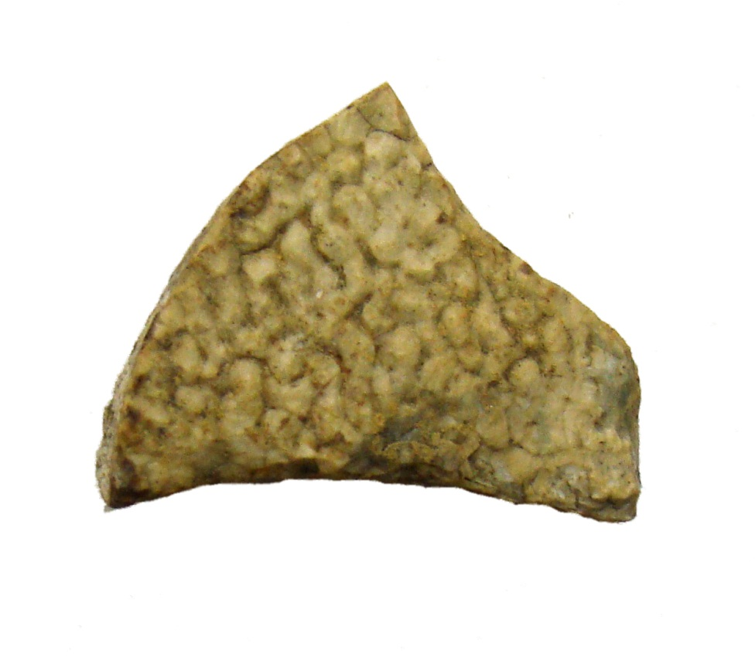

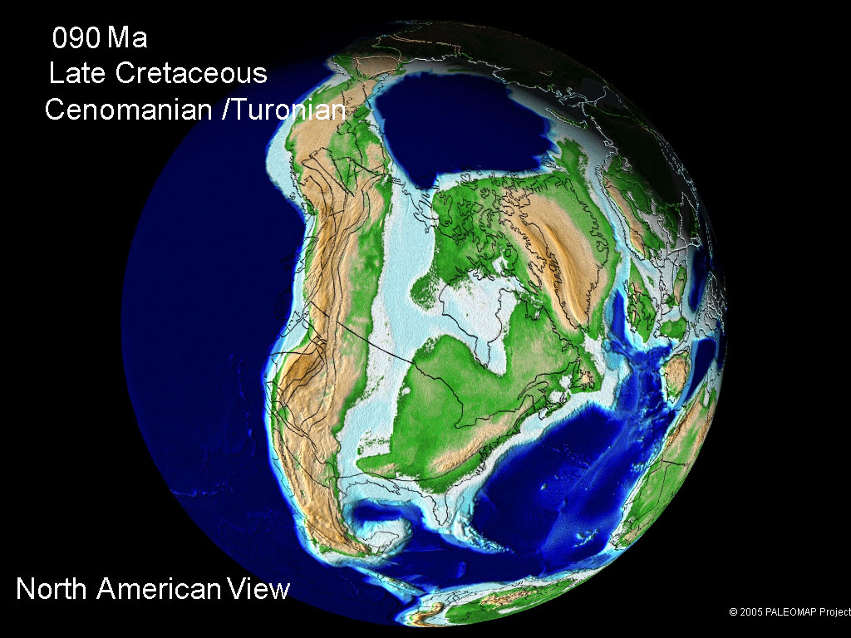
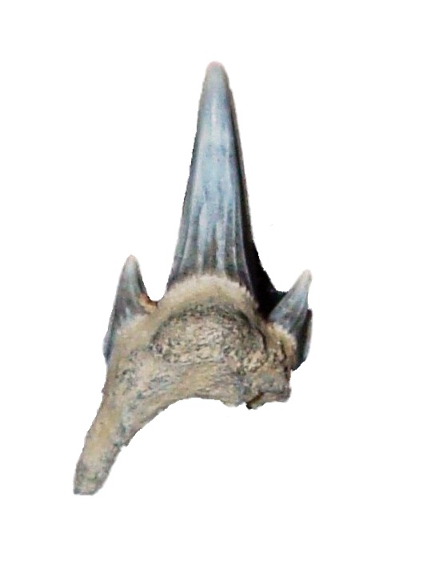
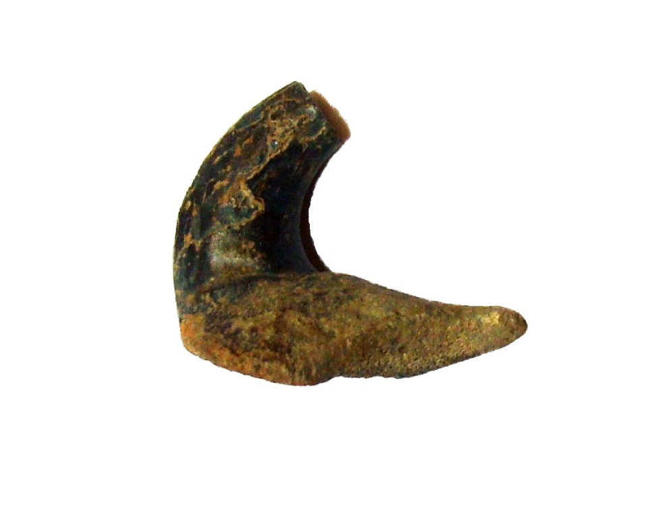
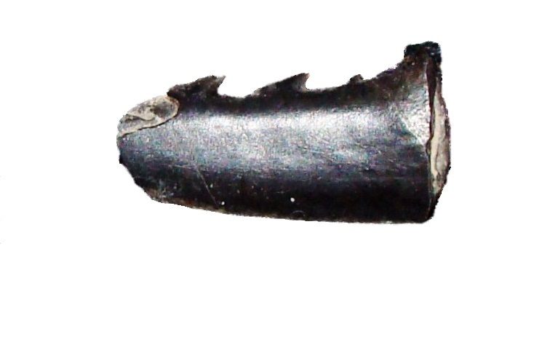
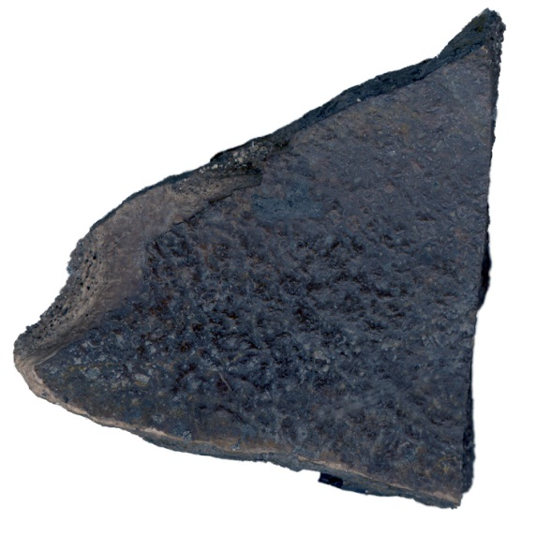
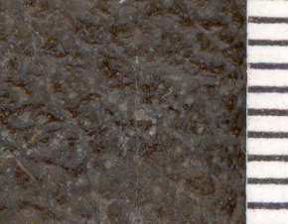
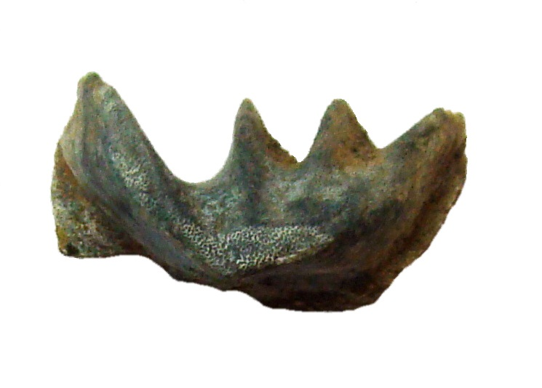
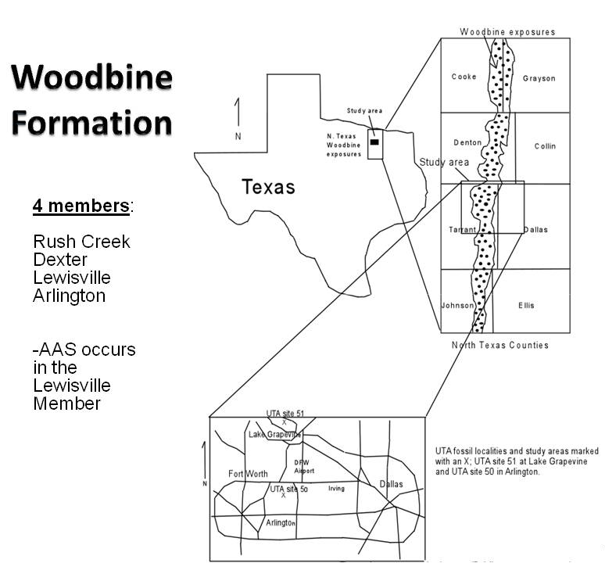
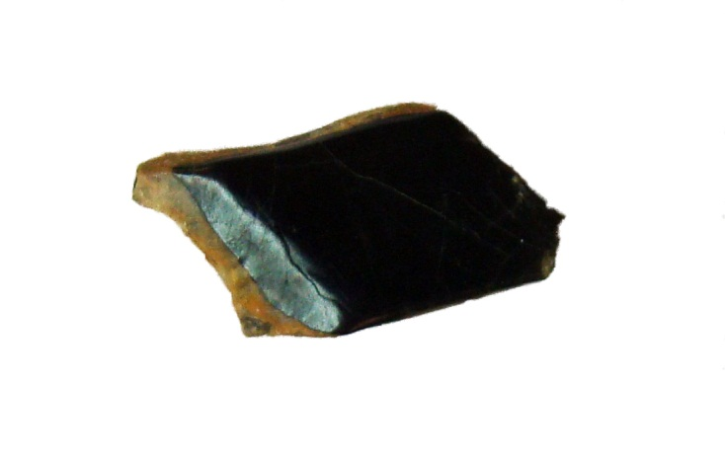
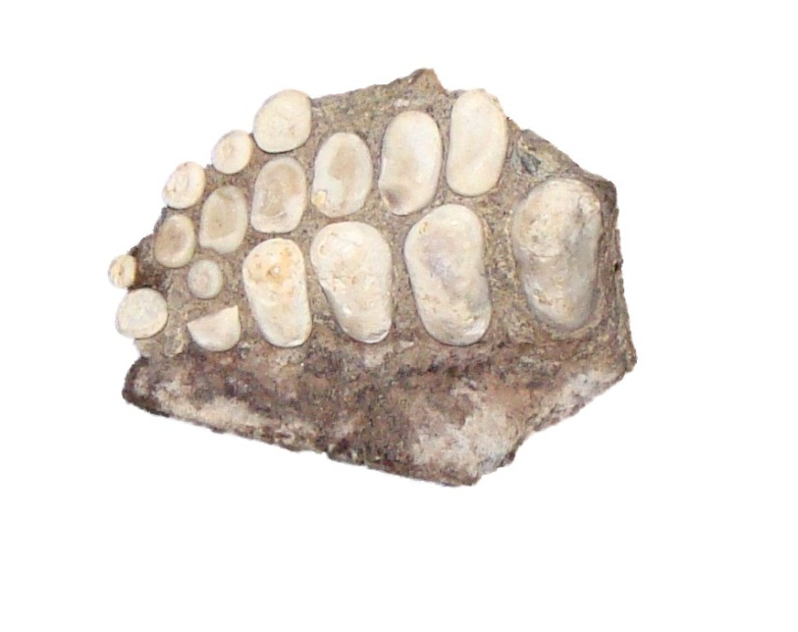
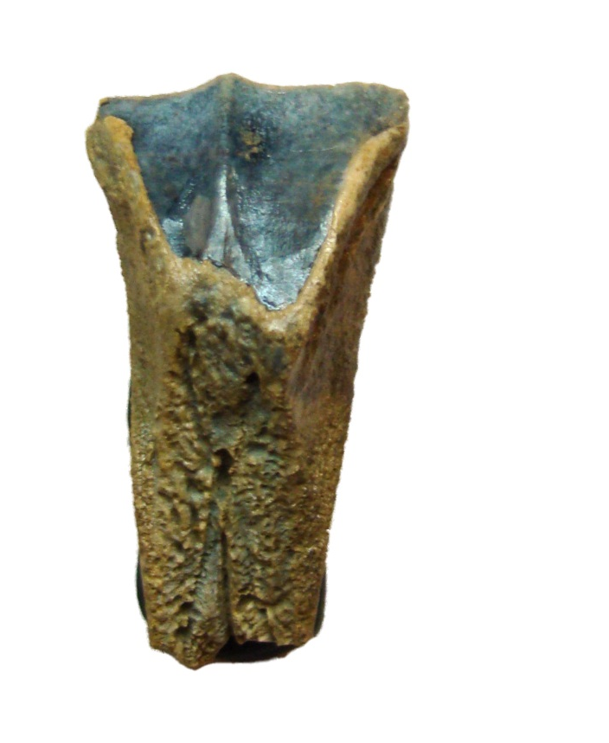
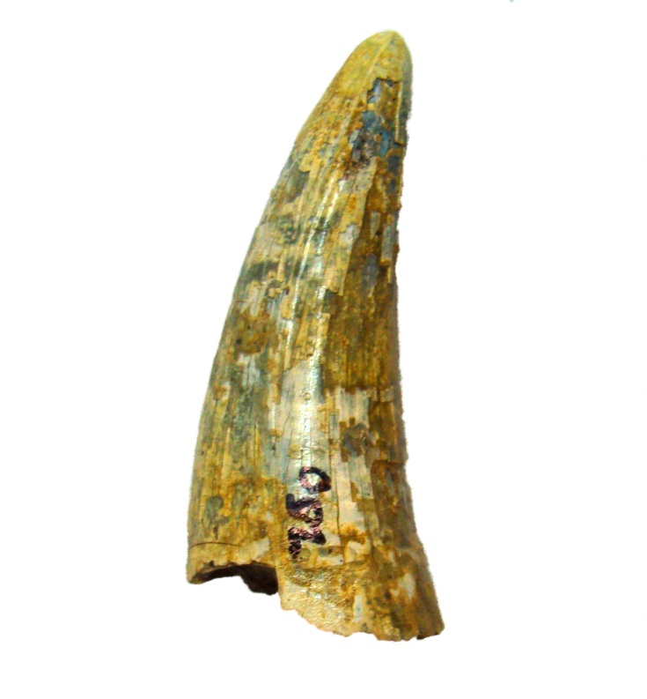
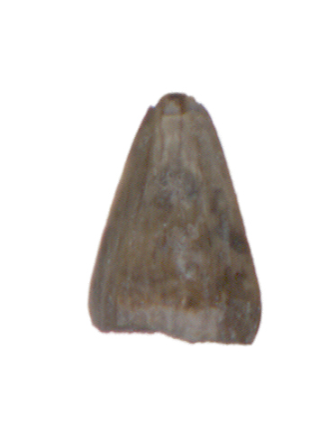
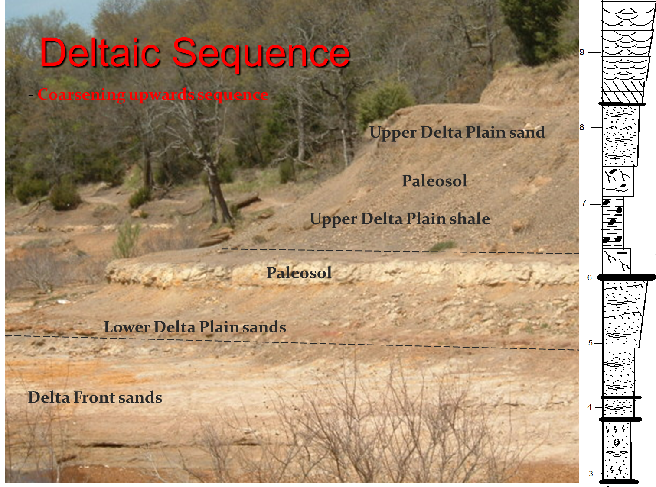
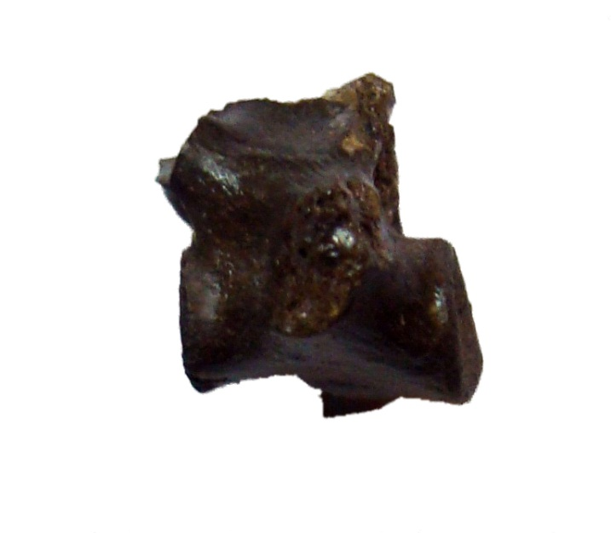
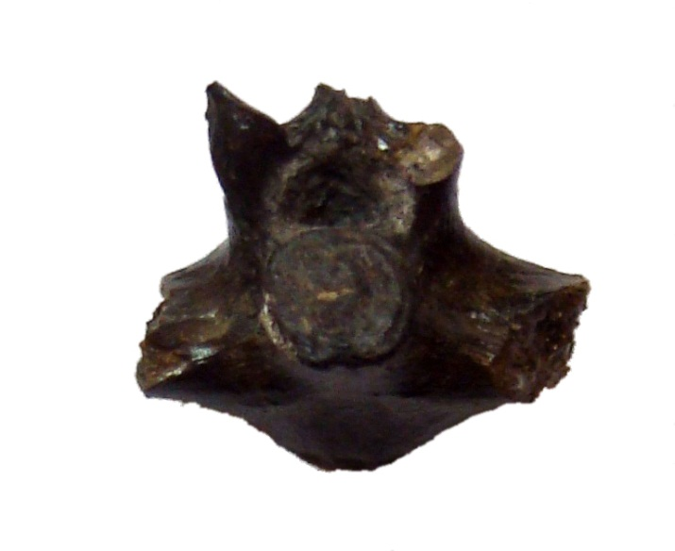
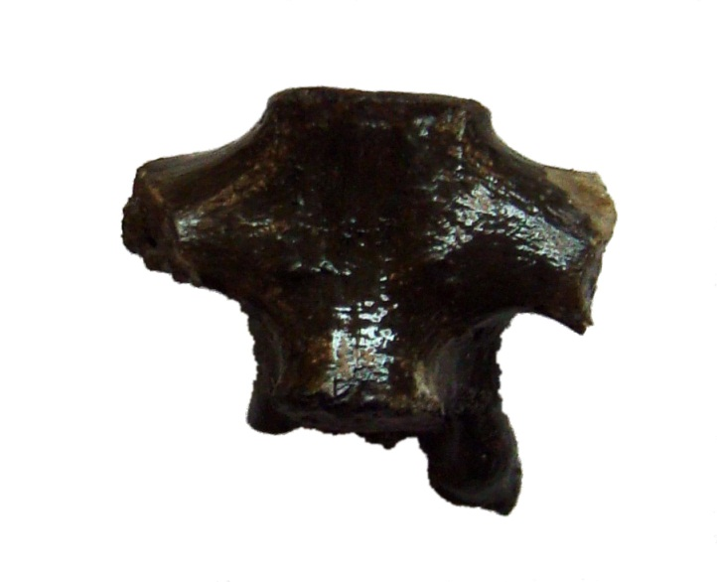
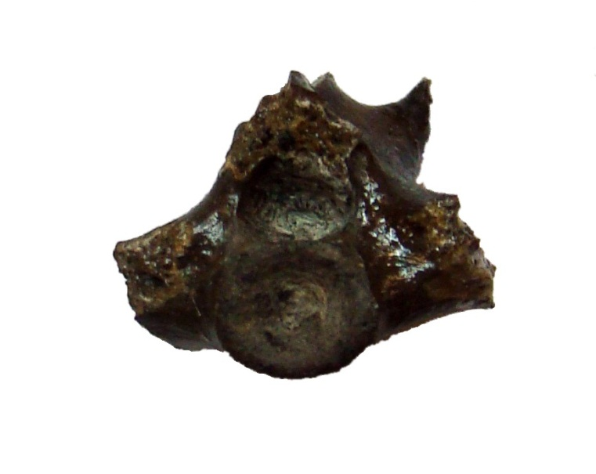
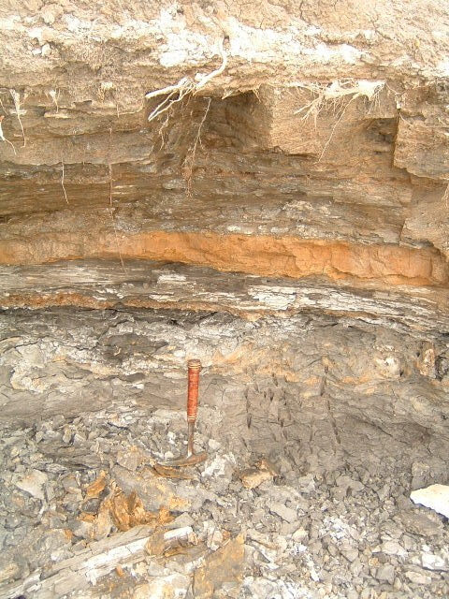
Presented at the Geological Society of America Southeastern Section 60th Annual Meeting, March 23-25, 2011
MICROVERTEBRATE PALEOECOLOGY OF THE CRETACEOUS WOODBINE
FORMATION (CENOMANIAN) AT THE ARLINGTON ARCHOSAUR SITE, NORTH-CENTRAL TEXAS
GEORGE E. BENNETT, III, George Mason University, Fairfax, VA, and Shenandoah Valley Discovery Museum, Winchester, VA; DEREK J. MAIN;
B. KEVIN ANDERSON; RACHELL PETERSON, Scotese Museum of Paleontology, University of Texas at Arlington
ABSTRACT
Cenomanian terrestrial vertebrate communities are poorly known in North America. The mid-Cenomanian
Woodbine Formation in north-central Texas was deposited in a coastal setting on the southeastern margin of the Cretaceous intercontinental seaway. Sedimentolo-gical, paleobotanical, and microvertebrate evidence indicates the Arlington Archosaur Site (AAS) represents an intermittently inundated delta plain environment. The AAS preserves, in ascending order: a peat bed repre-senting a low growth understory; a vertebrate-rich mudstone; a paleosol (histic gleysol) with a heavily rooted zone containing calcareous concretions associated with burned logs and tree stumps, indicating seasonal dryness and wildfires; and a fossil rich siderite sand transgressive lag.
Collection activities at the AAS initially focused on quarrying macrovertebrates, i.e. crocodilians and the
ornithopod dinosaur ?Protohadros. The complete plastron and carapace of a large indeterminate turtle have been collected, as well as the disarticulated remains of adult and juvenile crocodilians and ?Protohadros.
Numerous crocodilian teeth (Woodbinesuchus et al.) are present throughout the section and are more common
in the bone bearing basal peat layer. Ornithopod teeth attributed to ?Protohadros are present in the bone
producing mudstone-paleosol horizon, but are rare in the basal peat bed and overlying lag deposits.
Intensive surface collecting and a program of screen washing initiated in 2009 have revealed a diverse
ichthyofauna, including chondrichthyans (an indeterminant hybodont, Cretodus, Pseudohypolophus, and Onchopristis), the semionotiform Lepidotes, an indeterminate pycnodont, the tetraodontiform Stephanodus, and the lungfish Ceratodus sp. nov. Theropod dinosaur teeth and salamanders are also present. The fauna suggests changing environmental conditions at the AAS. Many chondrichthyans are tolerant of fresh water, yet the ray Pseudohypolophus is brackish to marine. Although the presence of disarticulated dinosaur remains in marine sediments can be explained by the ‘bloat and float’ model, the permeable skin of salamanders requires that they inhabit fresh water. The stratigraphy and fauna suggests a terrestrial setting followed by a transgressive lag and more dominant marine conditions.
Trionychidae indet. Turtle shell fragments with characteristic sculpture pattern. Trionychids are carnivorous, freshwater, extant, cosmopolitan taxa originating in the Berriasian (Evans et al., 1998) (scale bar = 1cm).
?Glyptops sp. shell fragment. (Langston, 1974) (scale bar = 1mm).
DISCUSSION
The Woodbine Formation is interpreted as a coastal environment based on geology and fauna. The outcrops of the Woodbine Formation at the AAS range from near shore marine environments, to brackish embayments and more terrestrial delta plain facies (Main 2005). This mid-Cretaceous coastal ecosystem was situated along the southeastern margin of the Western Interior Seaway. The vertebrate fauna contains a mixture of marine, brackish and freshwater taxa. The Woodbine chondrichthyans Ptychodus, Carcharias, Squalicorax, and Pseudohypolophus, and the bony fish Stephanodus and Enchodus are marine to brackish. Of these, Pseudohypolophus is present at AAS, while teeth referred to Stephanodus are essentially identical to the pycnodont Hadrodus, and may be referable to that genus. The chondrichthyans Hybodus, Cretodus and Onchopristis, and the osteichthyans Palaeobalistum, Lepidotes and indeterminate amiiformes are known to range from marine to fresh water. Crocodilians are also typically tolerant of a range of salinities, although AAS taxa have not presently been recovered from fully marine facies. Caudates, turtles, dinosaurs, birds and mammals recovered from the Woodbine give the formation a definitive terrestrial aspect. A single cryptobranchid(?) vertebra from the AAS is strong evidence of aquatic influence because salamanders are intolerant of even moderate salinity levels.
Arlington, Texas
Hybodus sp. cephalic spine, lateral view. This benthic chondrichthyan genus had an extensive Laurasian distribution (Williamson et al., 1993) as well as a wide temporal range from the Permian through the latest Cretaceous (Beavan & Russell, 1999; Becker et al., 2004; Romer, 1958). It is known from the Aptian-Albian of north-central Texas (Winkler et al., 1989) and is common in marine and freshwater near shore environments (Thurmond, 1971; Winkler et al., 1990) (scale bar = 1cm).
Onchopristis dunklei rostral tooth. The presence of 3 to 5 distal barbs on the posterior margin distinguishes this species from O. numidus (McNulty & Slaughter, 1962) (scale bar = 1cm).
Cf. Cretodus semiplicatus tooth in labial view. This lamniform shark is recognized from the Cenomanian to Turonian of Texas, and is widespread in North America, Europe, and Asia. (Schwimmer et al., 2002; Williamson et al., 1993) (scale bar = 1cm).
Lepidotes sp. flank scale. A holostean fish common in the Aptian-Albian Twin Mountains and Antlers Formations (Winkler et al., 1989) (scale bar = 1cm).
Ceratodus nov. sp. lungfish tooth plate (Main et al., in press) (scale bar = 1cm).
Comparison of vertebrates in the AAS local fauna with taxa previously reported from the Woodbine Formation
Cf. Palaeobalistum geiseri prearticular. A pycnodont fish with flat, low-crowned crushing teeth. P. geiseri is previously known from the Albian-Albian Twin Mountains Formation in Texas (Thurmond, 1974) (scale bar = 1cm).
 |  |  | AAS local fauna |  | Previously reported taxa
Chondrichthyes
 | Hybodontiformes
 |  | Hybodus sp. | X |  | McNulty & Slaughter, 1968
 |  | Ptychodus sp. |  |  | McNulty & Slaughter, 1968
 | Lamniformes
 |  | Cretodus semiplicatus | X |  | McNulty & Slaughter, 1968
 |  | Carcharias amonensis |  |  | McNulty & Slaughter, 1968
 |  | Squalicorax sp. |  |  | McNulty & Slaughter, 1968
 | Rajiformes
 |  | Onchopristis dunklei | X |  | McNulty & Slaughter, 1962; 1968; Slaughter & Steiner, 1968
 | Myliobatiformes
 |  | Pseudohypolophus (=Hypolophus) mcnultyi | X |  | McNulty, 1964; McNulty & Slaughter, 1968; Thurmond, 1971
Osteichthyes
 | Ceratodontiformes
 |  | Ceratodus n. sp. | X
 | Pycnodontiformes
 |  | cf. Palaeobalistum geiseri | X
 |  | Pycnodontidae indet. | X |  | McNulty & Slaughter, 1968; Winkler & Jacobs, 2003
 | Semionotiformes
 |  | Lepidotes sp. | X |  | McNulty & Slaughter, 1968; Winkler & Jacobs, 2003
 | Amiiformes
 |  | Amiiformes indet. |  |  | Winkler & Jacobs, 2003
 | Tetraodontiformes
 |  | ?Stephanodus sp. | X
 | Salmoniformes
 |  | Enchodus sp. |  |  | McNulty & Slaughter, 1968
Lissamphibia
 | Caudata
 |  | ?Cryptobranchidae | X
 |  | Caudata indet. |  |  | Winkler & Jacobs, 2003
 | Anura
 |  | Anura indet. |  |  | Winkler & Jacobs, 2003
Reptilia
 | Chelonia
 |  | ?Glyptops sp. | X
 |  | Trionychidae indet. | X
 | Squamata
 |  | Lacertilia indet. |  |  | Winkler & Jacobs, 2003
 |  | Serpentes indet. |  |  | Winkler & Jacobs, 2003
 | Crocodylia
 |  | Woodbinesuchus byersmauricei | X |  | Lee, 1997a
 |  | ?Bernessartia sp. |  |  | Lee, 1997a
 |  | Terminonaris cf. T. robusta |  |  | Adams et al., 2010
 |  | Crocodylia n. sp. | X
Dinosauria
 | Theropoda
 |  | cf. Richardoestesia | X |  | Lee, 1997a
 |  | Dromaeosauridae indet. | X
 |  | cf. Acrocanthosaurus sp. | X
 |  | Theropoda indet. | X |  | Lee, 1997a
 |  | Fuscinapedis woodbinensis* |  |  | Lee, 1997b
 | Ornithischia
 |  | Nodosauridae indet. |  |  | Lee, 1997a
 |  | Protohadros sp. | X |  | Head, 1998
 |  | Hadrosauridae indet. |  |  | Lee, 1997a
 |  | Caririchnium protohadrosaurichnos* |  |  | Lee, 1997b
Aves
 | Enantiornithes
 |  | Flexomornis howei |  |  | Tykoski & Fiorillo, 2010
 |  | Magnoavipes lowei* |  |  | Lee, 1997b
Mammalia
 | Multituberculata
 |  | Taeniolaboidea indet. |  |  | McNulty & Slaughter, 1969; Krause & Baird, 1979
 | Marsupialia
 |  | Marsupialia indet. |  |  | Winkler et al., 1995
 | Eutheria
 |  | Eutheria indet. |  |  | McNulty & Slaughter, 1969; Krause & Baird, 1979
 |  | *Ichnotaxon
Cf. Protohadros byrdi shed tooth. Currently all diagnostic hadrosaur skeletal material from the Woodbine is attributed to Protohadros (Weishampel et al., 2004) but teeth from two distinct morphotypes are present (Lee, 1997, a) (scale bar = 1cm).
Crocodylia n. sp. Teeth and osteoderms from a large crocodilian are associated with cranial and postcranial material from a new gonio-pholid. (scale bar = 1cm).
Woodbinesuchus byersmauricei tooth. Longitudinally striated, laterally compressed with distinct carinae lacking denticles. Previously known from the holotype in Tarrant County, Texas (Lee, 1997a) (scale bar = 1mm).
A B
ACKNOWLEDGMENTS
We thank the Huffines family for granting land access to conduct work at the Arlington Archosaur Site. C. R. Scotese and the PaleoMap Project provided research funds and facilities. The Dallas Paleontological Society provided a scholarship to DJM, and the Jurassic Foundation and the Western Interior Paleontological Society provided research grants to support this work. We thank AAS project members B. Carter, R. Fry, R. Zack, A. Camp, R. Colvin, for their assistance, and GEB thanks M. Lawson for assistance with images.
C D
Carboncaeous clay beds, rich in plant debris (mud plug).
HISTORY
The Arlington Archosaur Site was discovered in 2003, but land access was not granted until 2008, when the University of Texas at Arlington (UTA) began a program of surface collecting, quarrying in situ material, and screen washing. The AAS consists of 1700 acres of Cenomanian marginal marine Woodbine Formation exposures in the heart of the DFW Metroplex. The main quarry lies in a hillside outcrop exposing 6 meters of section. The main bone layer has produced the disarticulated remains of cf. Protohadros, and a new, large goniopholid crocodile, in addition to a complete turtle carapace and plastron still awaiting preparation.
Interbedded lenses of sand (sand bar).
?Cryptobranchidae indet. vertebra in (A) left lateral, (B) anterior, (C) ventral, and (D) posterior views. (scale bar = 1cm).
Dromaeosauridae indet. tooth (scale bar = 1cm; inset in mm).
REFERENCES
Adams, T, M. Polcyn, O. Mateus, D.A. Winkler and L.L. Jacobs. 2010. New occurrence of the long-snouted crocodyliform, Terminonaris cf. T. robusta, from the Woodbine Formation (Cenomanian) of Texas. In: Program and Abstracts of the 70th Annual Meeting of the Society of Vertebrate Paleontology, October 10-13, Pittsburgh, Pennsylvania:52A.
Beavan, N.R. and A.P. Russell. 1999. An Elasmobranch Assemblage from the Terrestrial-Marine Transitional Lethbridge Coal Zone (Dinosaur Park Formation: Upper Campanian), Alberta, Canada. Journal of Paleontology 73(3):494-503.
Becker, M.A., J.A. Chamberlain, Jr. and D.O. Terry Jr. 2004. Chondrichthyans from the Fairpoint Member of the Fox Hills Formation (Maastrichtian), Meade County, South Dakota. Journal of Vertebrate Paleontology 24(4):780-793.
Evans, S.E., M. Manabe, E. Cook, R. Hirayama, S. Isaji, C. J. Nicholas, D. Unwin and Y. Yabumoto. 1998. An Early Cretaceous assemblage from Gifu Prefecture, Japan. In S. G. Lucas, J. I. Kirkland, and J. W. Estep (eds), Lower and Middle Cretaceous Terrestrial Ecosystems, New Mexico Museum of Natural History and Science Bulletin 14:183-186.
Head, J.J. 1998. A new species of basal hadrosaurid (Dinosauria, Ornithischia) from the Cenomanian of Texas. Journal of Vertebrate Paleontology 18(4):718-738.
Krause, D.W. and D. Baird. 1979. Late Cretaceous Mammals East of the North American Western Interior Seaway. Journal of Paleontology 53(3):562-565.
Langston, W. 1974. Nonmammalian Comanchean tetrapods. Geoscience and Man 8:77-102.
Lee, Y.-N. 1997a. The Archosauria from the Woodbine Formation (Cenomanian) in Texas. Journal of Paleontology 71(6):1147-1156.
Lee, Y.-N., 1997b. Bird and dinosaur footprints in the Woodbine Formation (Cenomanian), Texas. Cretaceous Research 18:849-864.
Main, D. J. 2005. Paleoenvironments and Paleoecology of the Cenomanian Woodbine Formation of Texas, Paleobiogeography of the Hadrosaurs (Dinosauria: Ornithischia). Unpublished M.S. Thesis, University of Texas at Arlington. 304 p.
Main, D.J., D. Parris, B. Grandstaff and B. Carter. In press. A new lungfish (Dipnoi: Ceratodontidae) from the Cretaceous Woodbine Formation, Arlington Archosaur Site, north Texas. Journal of Texas Science.
McNulty, C.L. 1964. Hypolophid teeth from the Woodbine Formation, Tarrant County, Texas. Eclogae Geologicae Helvetiae 57(2):537-541.
McNulty, C.L. and B.H. Slaughter. 1962 A new sawfish from the Woodbine Formation (Cretaceous) of Texas. Copeia 1962(4): 775-777.
McNulty, C.L. and B.H. Slaughter. 1968. Locality 3. In: C. F. Dodge (ed), Fieldtrip Guidebook, South-Central Section, Stratigraphy of the Woodbine Formation, Tarrant County, Texas. The Geological Society of America. Pp. 68-73.
Romer, A.S. 1958. The Texas Permian redbeds and their vertebrate fauna. In: T.S. Westoll (ed). Studies on Fossil Vertebrates. Essays presented to D. M. S. Watson. University of London, Athlone Press, London. Pp. 158–180.
Slaughter, B.H. and M. Steiner. 1968. Notes on rostral teeth of ganopristine sawfishes, with special reference to Texas material. Journal of Paleontology 42(1):233-239.
Schwimmer, D.R., G.E. Hooks, III and B. Johnson. 2002. Revised taxonomy, age, and geographic range of the large lamniform shark Cretodus semiplicatus. Journal of Vertebrate Paleontology 22(3):704-707.
Thurmond, J.T. 1971. Cartilaginous fishes of the Trinity Group and related rocks (Lower Cretaceous) of north central Texas. Southeastern Geologist 13(4):207-227.
Thurmond, J.T. 1974. Lower vertebrate faunas of the Trinity Division in north central Texas. Geoscience and Man 8:103-129.
Tykoski, R.S. and A.R. Fiorillo. 2010. An enantiornithine bird from the lower Middle Cenomanian of Texas. Journal of Vertebrate Paleontology 30(1)-288-292.
Weishampel, D.B., P.M. Barrett, R.A. Coria, J. Le Loeuff, X. Xing, Z. Xijin, A. Sahni, E.M.P. Gomani and C.R. Noto, 2004. Dinosaur Distribution. In: D.B. Weishampel, P. Dodson, & H. Osmolska (eds). The Dinosauria. University of California Press, Berkeley. Pp. 517-606.
Williamson, T.E., J.I. Kirkland and S.G. Lucas. 1993. Selachians from the Greenhorn Cyclothem (“middle” Cretaceous: Cenomanian-Turonian), Black Mesa, Arizona, and the paleogeographic distribution of the Late Cretaceous selachians. Journal of Paleontology 67(3):447-474.
Winkler, D.A. and L.L. Jacobs. 2003. Cenomanian vertebrate faunas of the Woodbine Formation, Texas. Journal of Vertebrate Paleontology 23(Supplement to number 3):120A.
Winkler, D.A., P.A. Murry and L.L. Jacobs. 1989. Vertebrate paleontology of the Trinity Group, Lower Cretaceous of central Texas. In: D.A. Winkler, P.A. Murry and L.L. Jacobs (eds) Field guide to the vertebrate paleontology of the Trinity Group, Lower Cretaceous of central Texas. In: Field Guide for the 49th Annual Meeting of the Society of Vertebrate Paleontology, Austin, Texas, November 1, 1989.
Winker, D.A., P.A. Murry and L.L. Jacobs. 1990. Early Cretaceous (Comanchean) vertebrates of central Texas. Journal of Vertebrate Paleontology 10(1):95-116.
Winkler, D.A., L.L. Jacobs, Y.-N. Lee, and P.A. Murray. 1995. Sea Level Fluctuation and Terrestrial Faunal Change in North-Central Texas, pp.175-177. In: Ailing Sun and Yuanqing Wang (eds.) Sixth Symposium on Mesozoic Terrestrial Ecosystems and Biota.
Conglomerate bed, channel base (lag deposit)
Dinosaur bone bed.
Base of section is a
clay bed; oxbow lake.
Cf. Acrocanthosaurus sp. Partial tooth (scale bar = 1cm; inset in mm).

