Slide 1
Petrography of Crystalline Rocks: Stimulus of Abrasion Resistance
Presented by
Ademeso, Odunyemi Anthony,
Adekunle Ajasin University, Nigeria
to the
2012 Meeting of the Geological Society of America
at
The Charlotte Convention Centre,
Charlotte, North Carolina, USA
on
Nov. 7, 2012

Slide 2
CONTENT
Introduction
Geological Setting
Method of Study
Presentation and Interpretation of Result
Discussion and Conclusions

Slide 3
INTRODUCTION
Preamble (Justification)
Aim & Objectives
Study Areas

Slide 4
Justification
Crystalline rocks are of immense benefit to engineering: chippings, dimension stones, decorative slabs and tiles.
The strength of the rocks is the major dynamic upon which their usage is based but the determination of the strength parameters is tedious, time consuming and expensive (Teme, 1983; Aydin and Basu, 2005).
Need to estimate strength characteristics particularly at the reconnaissance stage: anisotropy and large area to be tested.

Slide 5
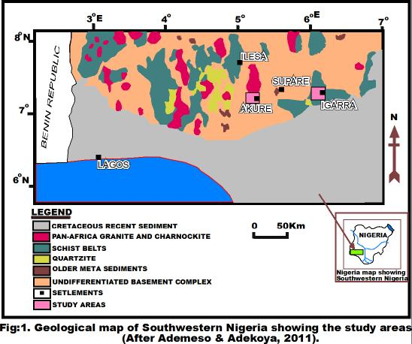
Study Areas
Fig. 1: Geological Map of Southwestern Nigeria showing the study Areas (after Ademeso and Adekoya, 2011).

Slide 6
Method of Study
Petrographic Study
Determination of Abrasion Resistance

Slide 7
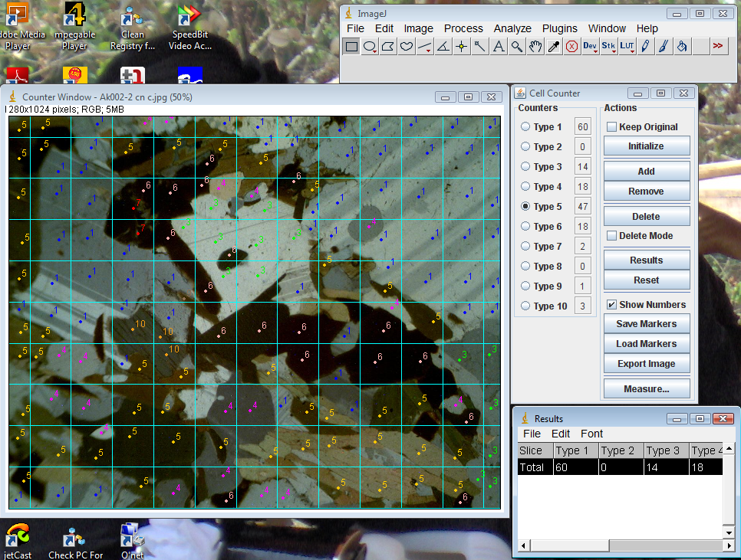
(1)
(2)
(3)
(4)
Fig. 2: Cell count with ImageJ. [Software (1), Counter window with photomicrograph (2), Cell counter (3) and the table of results (4)].

Slide 8
CELL COUNTER LEGEND
Type 1 is plagioclase;
Type 2 is orthoclase;
Type 3 is quartz;
Type 4 is biotite;
Type 5 is hornblende;
Type 6 ishypersthene;
Type 7 ismymerkite;
Type 8 is muscovite; and
Type 9 is pyroxene.

Slide 9
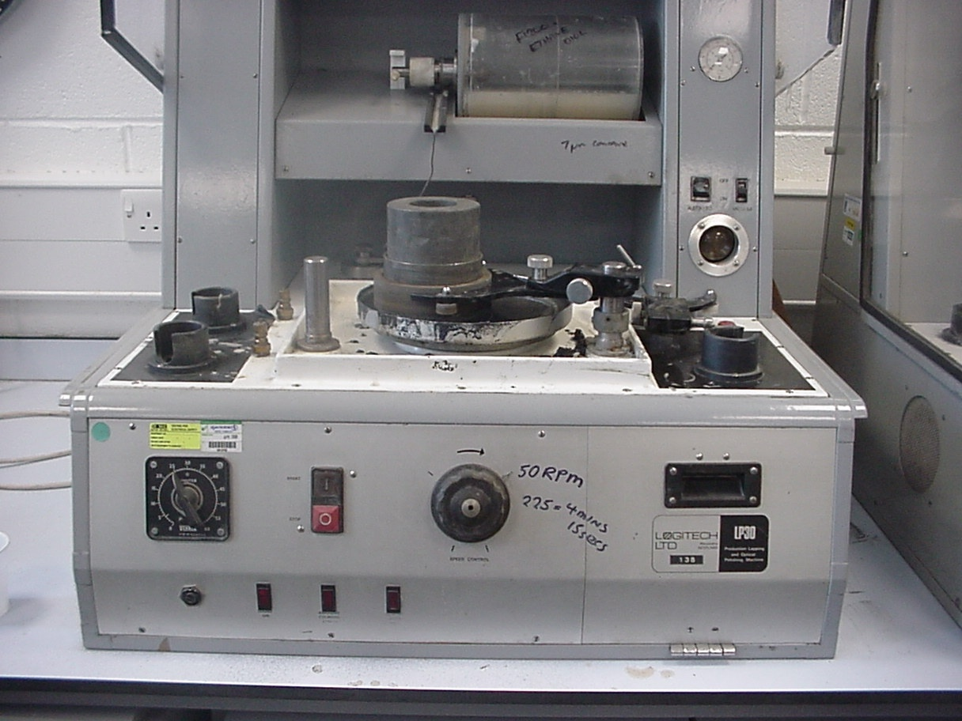
Fig. 3: Abrasion tester (Cambourne school of Mines, UK).

Slide 10
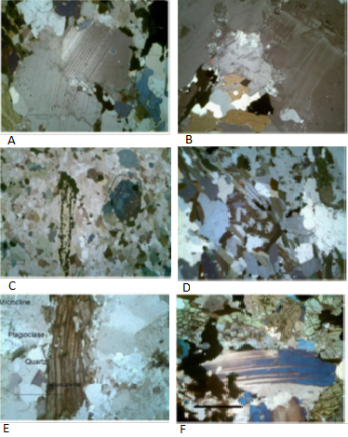
Presentation and Interpretation of Result
(A) Texture
(Gneiss)
(Porphyritic Biotite Granite)
(B) Mineralogy
(Lamprophyre)
(Granite Gneiss)
(C) Micro-
structures
(Biotite Granite)
(Charnockitic Rock)
Fig. 4: Photomicrographs of rock types

Slide 11
Table 1: Summary of modal analyses of rock samples.
S/No | Sample No | Modal (%) Content of Minerals
 |  | Qtz | Pla | Mic | Ort | Bio | Hyp | Mus | Hnb | Pyx | Zir | Mym | Opa | Total
1. | Gn(Ak001) | 25 | 36 | - | 6 | 21 | 3 | 1 | 7 | 1 | - | 0.3 | 0.1 | 100.4
2. | Ggn(Ak002) | 29 | 21 | 18 | - | 23 | - | - | 8 | - | - | 1 | - | 100
3. | Chk (Ak003) | 16 | 32 | - | 3 | 16 | 16 | 4 | 11 | - | 1 | - | 1 | 100
4. | Pgr(Ig001) | 23 | 30 | 10 | - | 31 | - | - | 4 | - | 1 | 4 | - | 100
5. | Gr(Ig002) | 27 | 30 | 37 | - | 5 | - | - | - | - | 1 | - | - | -
6. | Lam(Ig003) | 23 | 21 | 4 | - | 41 | - | - | 6 | - | - | - | 5 | 100

Slide 12
Table 2: Results of abrasion resistance (Ha) tests.
S/No | Rock Type | Initial weight | Final weight | Average | Loss in weight | Abrasion Res.(Ha) | Average (Ha)
1. | Gneiss (Ak001) | 255.62 | 254.52 | 255.070 | 1.10 | 27.09 | 27.80
 |  | 219.97 | 219.04 | 219.505 | 1.00 | 29.36
 |  | 235.41 | 234.31 | 234.860 | 1.10 | 26.90
2. | Granite gneiss (Ak002) | 288.84 | 288.20 | 288.520 | 1.15 | 26.46 | 26.50
 |  | 305.93 | 304.78 | 305.355 | 1.15 | 26.66
 |  | 276.61 | 275.46 | 276.035 | 1.15 | 26.27
3. | Charnockitic rock (Ak003) | 325.29 | 324.36 | 324.825 | 0.93 | 33.97 | 33.40
 |  | 277.07 | 276.13 | 276.600 | 0.94 | 32.98
 |  | 249.67 | 248.75 | 249.210 | 0.92 | 33.19
4. | Porphyritic biotite granite (Ig001) | 305.90 | 304.75 | 305.325 | 1.15 | 26.55 | 26.65
 |  | 305.08 | 303.98 | 304.530 | 1.10 | 27.78
 |  | 226.28 | 225.13 | 225.705 | 1.15 | 25.62
5. | Biotite granite (Ig002) | 237.99 | 236.99 | 237.490 | 1.10 | 26.50 | 27.15
 |  | 238.09 | 237.02 | 237.555 | 1.07 | 27.33
 |  | 234.31 | 233.25 | 233.780 | 1.06 | 27.63
6. | Lamprophyre (Ig003) | 272.22 | 271.32 | 271.770 | 0.90 | 34.53 | 34.40
 |  | 243.59 | 242.69 | 243.140 | 0.90 | 34.26

Slide 13
Table 3: Correlation of Abrasion Resistance (Ha) with percentages of Q+F, M, Q, X and F for the six rock types.
(A)
S/No |  | Rock Type |  |  | Sample No | Ha | Q+F(%) | M(%) | Q(%) | F(%) | X(%)
1 |  | Gn |  |  | Ak001 | 27.78 | 67 | 22 | 25 | 42 | 78
2 |  | Ggn |  |  | Ak002 | 26.46 | 69 | 23 | 29 | 40 | 76
3 |  | Chk |  |  | Ak003 | 33.38 | 51 | 21 | 16 | 35 | 78
4 |  | Pgr |  |  | Ig001 | 26.65 | 63 | 31 | 23 | 40 | 67
5 |  | Gr |  |  | Ig002 | 27.15 | 94 | 5 | 27 | 67 | 95
6 |  | Lam |  |  | Ig003 | 34.40 | 49 | 41 | 26 | 23 | 55
(B)
Ha | R² |  | r
Q+F(%) | 0.5192 |  | -0.7206
M(%) | 0.2285 |  | 0.4780
Q(%) | 0.2635 |  | -0.5133
F(%) | 0.4211 |  | -0.6490
X(%) | 0.2478 |  | -0.4978
Note: (1) (i) R² = the square of Pearson product moment correlation coefficient.
(ii) r = the correlation coefficient between two sets of data.
(2) (A) is the table of values and (B) is the table of correlations (R² and r).
(3) Q+F = quartz plus feldspar; M = mica; Q = quartz; F = feldspar; X = minerals harder than 5 on the Mohs’ scale of hardness.

Slide 14
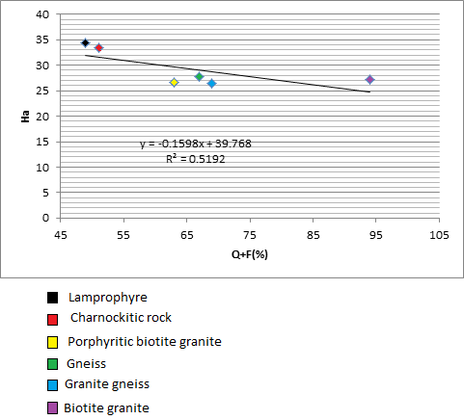
Fig. 5: Spider diagram relating percentages of quartz plus feldspar, mica, quartz, feldspar and minerals harder than 5 on the Mohs' scale with abrasion resistance for the rock types.
Fig. 6: Scatter diagram with regression line correlating Abrasion Resistance (Ha) with (Q+F)%

Slide 15
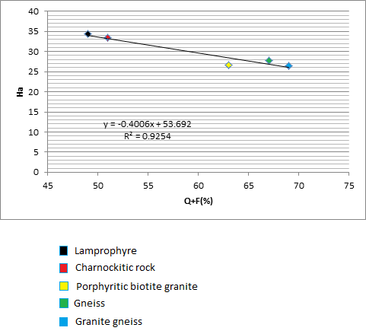
Fig. 7: Scatter diagram with regression line correlating Abrasion Resistance (Ha) with (Q+F)% [outlier (biotite granite) removed].
Note: A mathematical model, Ha = -0.4006(Q+F) + 53.692, was derived from the relationship between Ha and Q+F after the outlier was removed

Slide 16
Table 4: Statistical Relationship Between Laboratory Determined and
Estimated (with Model) Abrasion Resistance.
S/No | Rock Type (Sample Code) | Ha | Ha¹ | Ha-Ha¹ | [Ha–Ha¹]²
1. | Gn (Ak001) | 27.78 | 26.85 | 0.93 | 0.87
2. | Ggn (Ak002) | 26.46 | 26.05 | 0.41 | 0.17
3. | Chk (Ak003) | 33.38 | 33.26 | 0.12 | 0.01
4. | Pgr (Ig001) | 26.65 | 28.45 | -1.80 | 3.24
5. | Lam (Ig003) | 34.40 | 34.06 | 0.34 | 0.12
Sum |  | 148.67 | 148.67 |  | 4.41
Mean |  | 29.73 | 29.73
Var |  |  |  |  | 0.882
Std |  |  |  |  | 0.94
Note: (1) Outlier [Biotite granite, Ig(002)] removed.
(2) Ha = Laboratory determined Abrasion resistance; Ha¹ = Abrasion resistance Estimated with model; Var = Variance; Std = Standard deviation.

Slide 17
Discussion and Conclusions
The correlation coefficient (r) for the relationship between abrasion resistance (Ha) and the contents of minerals shows that the highest value of -0.7206 is with quartz plus feldspar (Q+F).
The implication is, the higher the abrasion resistance, the lower the content of quartz plus feldspar and vice-versa.
The correlation is consistent with the findings of Merriam et al. (1970) and Tug rul and Zarif (1999) who reported a negative correlation coefficient between the quartz content and the mechanical properties of some granitic rocks. They attributed the negative correlation to the fact that textural characteristics have more influence on mechanical parameters than the content of minerals.
Although, the lamprophyre exhibited very fine texture consistent with the high abrasion resistance it possessed (Onodera and Asoka, 1980), most of the other rock types possessed textural characteristics that are not in consonance with their abrasion resistance.

Slide 18
It was noted however that virtually all the rock types contained mineral grains that had sutured boundaries (meaning that they are strongly interlocked) implying that this might be partly responsible for the abrasion characteristics displayed by them.
The study further revealed that charnockitic rocks displayed various micro-structural characteristics which are expected to cause a reduction in strength but on the contrary, the rock possessed a very high abrasion resistance. Gneiss, granite gneiss and porphyritic biotite granite with fewer micro-structures revealed lower abrasion resistance. This is an indication that the micro-structural characteristics of crystalline rocks do not have any serious impact on abrasion resistance.
The strong interlock of the minerals grains being common to all the rock types is therefore believed to play significant role in relation with other characteristics to give the rock types their abrasion resistance characteristics.

Slide 19
The lamprophyre for example combined the strong interlock of minerals with fine grains to display very high abrasion resistance. In the case of the charnockitic rocks, the strong mineral interlock was mostly responsible noting that even the presence of lots of micro-structures as well as the low content of (Q+F) that are expected to lead to a reduction in the abrasion resistance did not have any serious negative impact.
The texture exhibited by the porphyritic biotite granite, biotite granite, gneiss and granite gneiss seemed to work on the grain interlock to impact the revealed abrasion resistance for the rocks.
As also observed, the derived model with a standard deviation of 0.94 did not seem to give a very good estimation implying that the impact of the mineral content on the abrasion resistance might have been subsumed probably by those of grain interlock and texture.
Therefore, grain interlock and texture of the rock types have more influence on the abrasion resistance than the content of minerals and the micro-structural characteristics.

Slide 20
Conclusion
Conclusively, it has been observed that:
the petrography of the rock types account for the abrasion resistance characteristics and therefore it is believed that the abrasion resistance characteristics are stimulated by it.
the grain interlock and texture have greater influence on the abrasion resistance of rocks than mineral content and micro-structural characteristics.

Slide 21
Thank You For Listening

