Slide 1
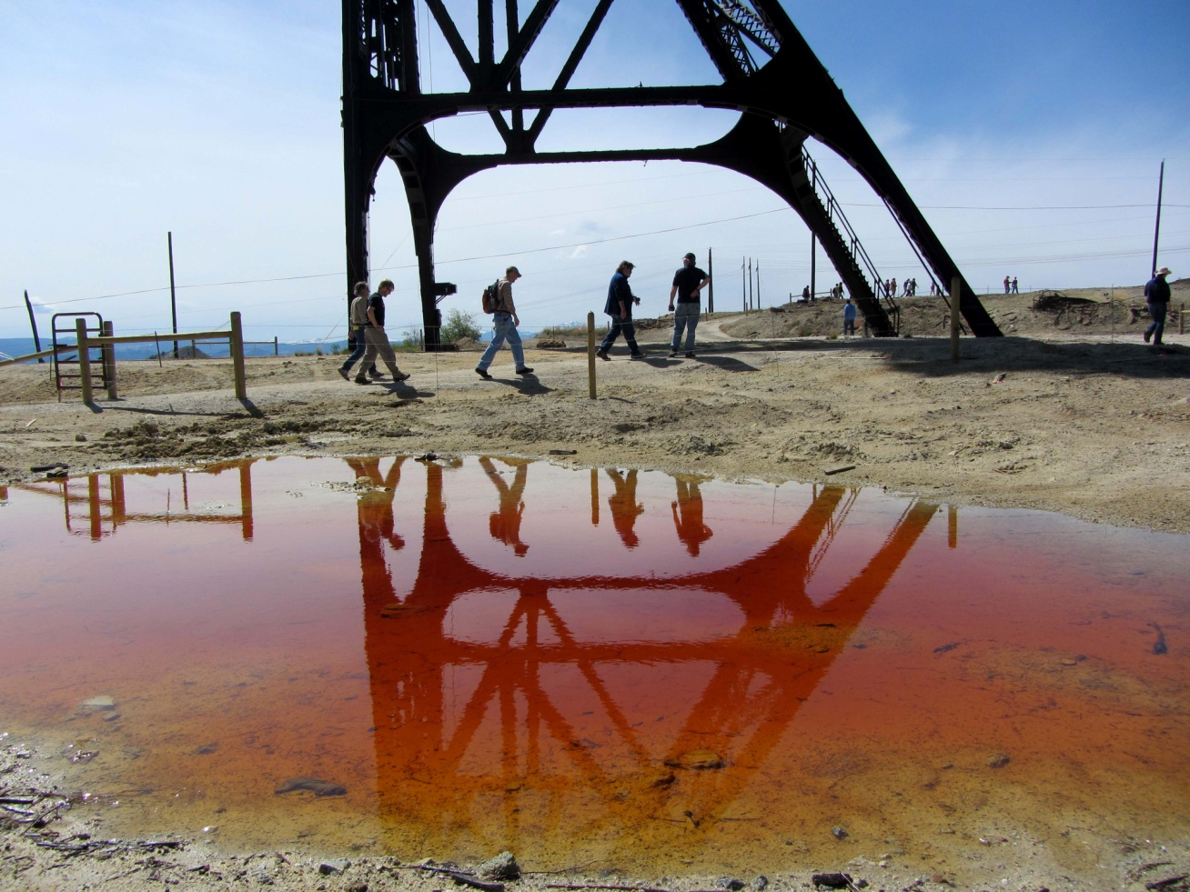
TEACHING GEN ED COURSES TO MOTIVATE AND INFORM FUTURE DECISION MAKERS
T77. Innovations and Challenges in Non-Major Instruction in Two- and Four-Year Colleges
By Janis D. Treworgy
Principia College
Elsah, Illinois

Slide 2
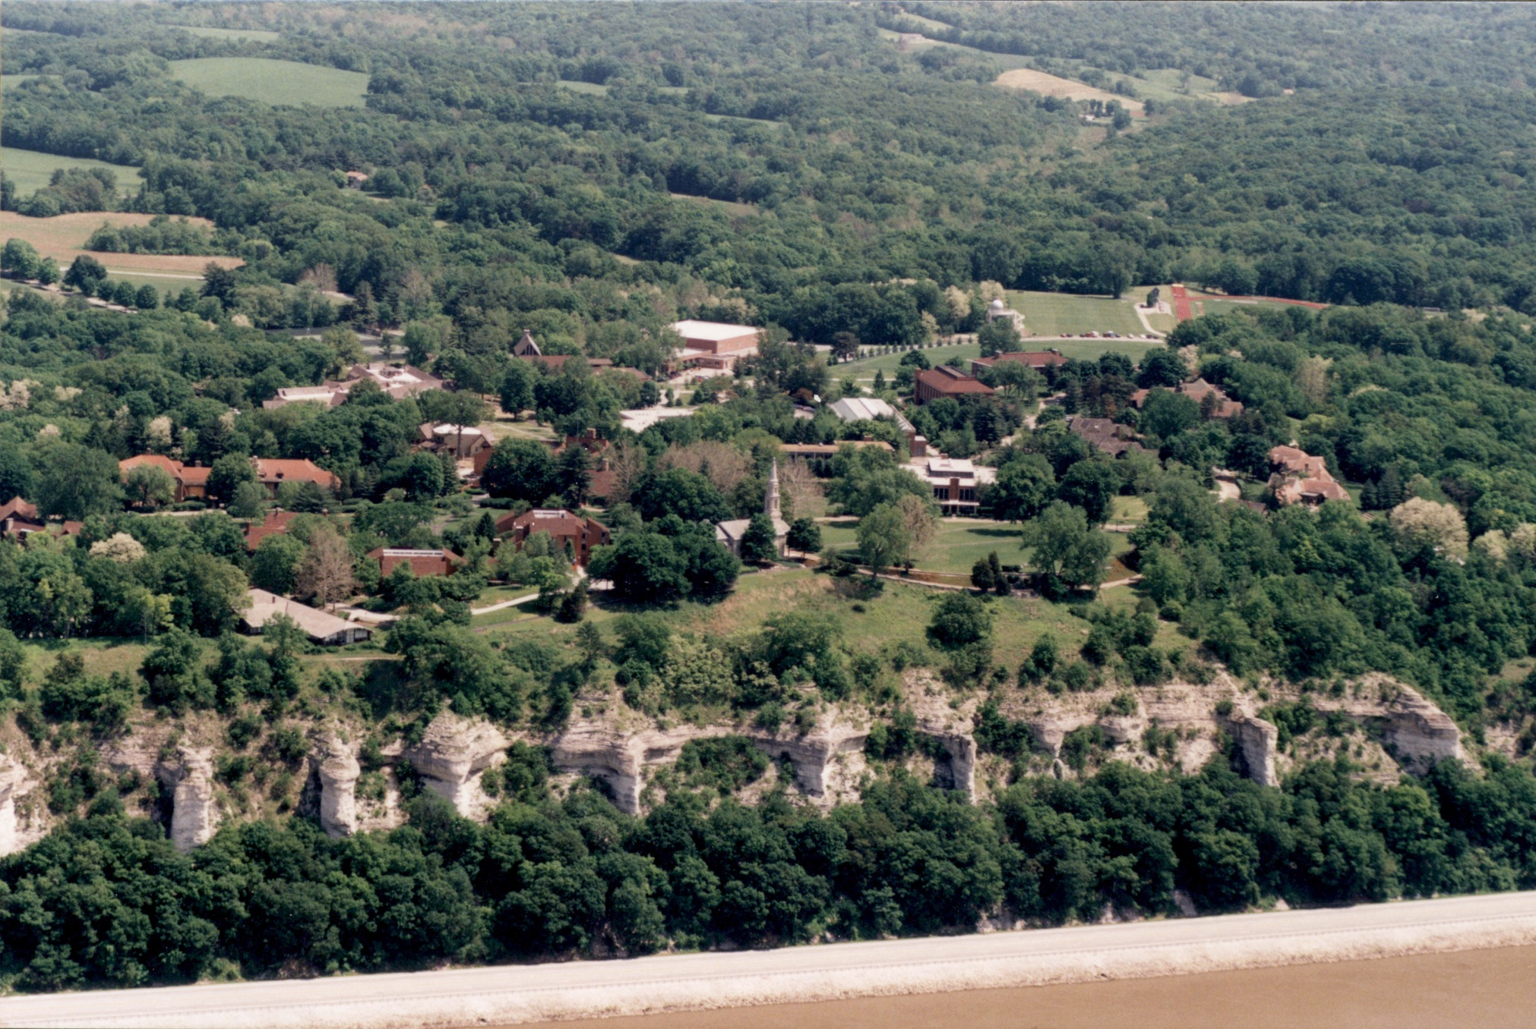
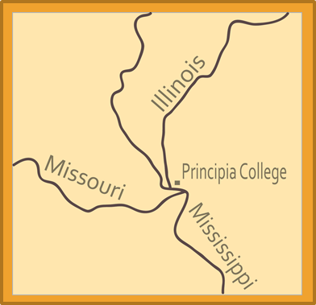
Principia College
Small liberal arts college
Class sizes of ~16 students
No geology major
Geology minor
Sustainability minor

Slide 3
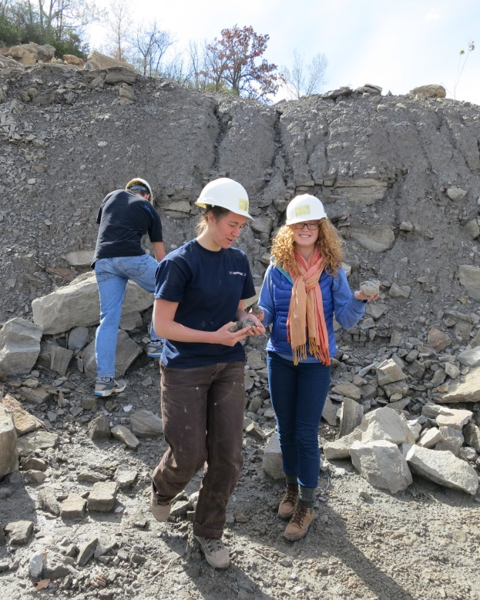
Why do students take my courses?
Fulfill general education requirements (most)
2 science courses
Fulfill minor requirements (a few)

Slide 4
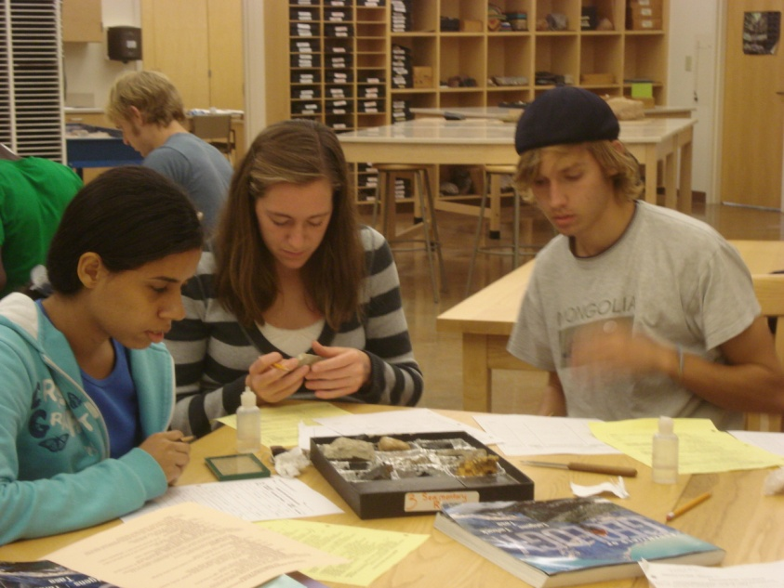
Who are these students?
New tax payers
New voters
Our future decision makers
Domestic students from all over the U.S.
High percentage of international students

Slide 5
My goal in teaching gen ed courses
Open their eyes to the world around them:
Outcrops & landforms
Mineral resources
Energy resources
Water resources
Natural hazards
Waste management
Anthropogenic impacts

Slide 6
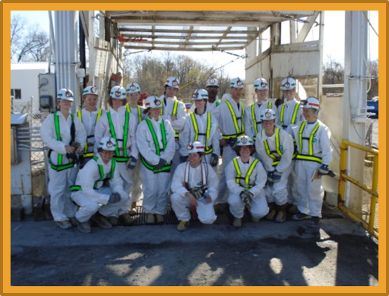

Classes that cover some of these topics:
Environmental Geology
Nonrenewable Resources
Integrated Learning Course
Part of a First Year Experience Program
Read Limits to Growth
On the Cutting Edge workshop on Teaching Environmental Geology
Research project

Slide 7
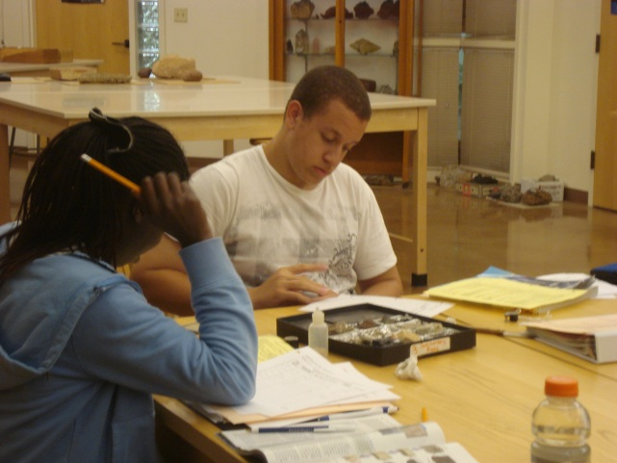
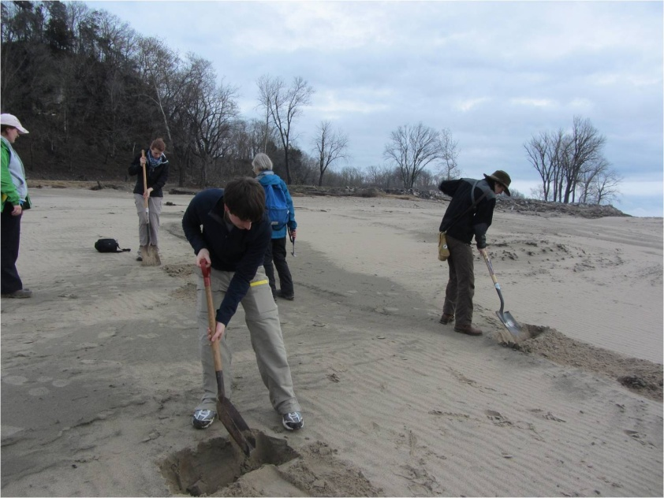
Toolbox of strategies
Model enthusiasm for the subject
Engage the students in class
Hands-on activities
Small-group discussions
Audience response system
Photo-rich PowerPoint lectures
Give assignments that involve some degree of:
Research
Writing
Presentation
Reading a textbook
Expose them to field experiences
Community service

Slide 8
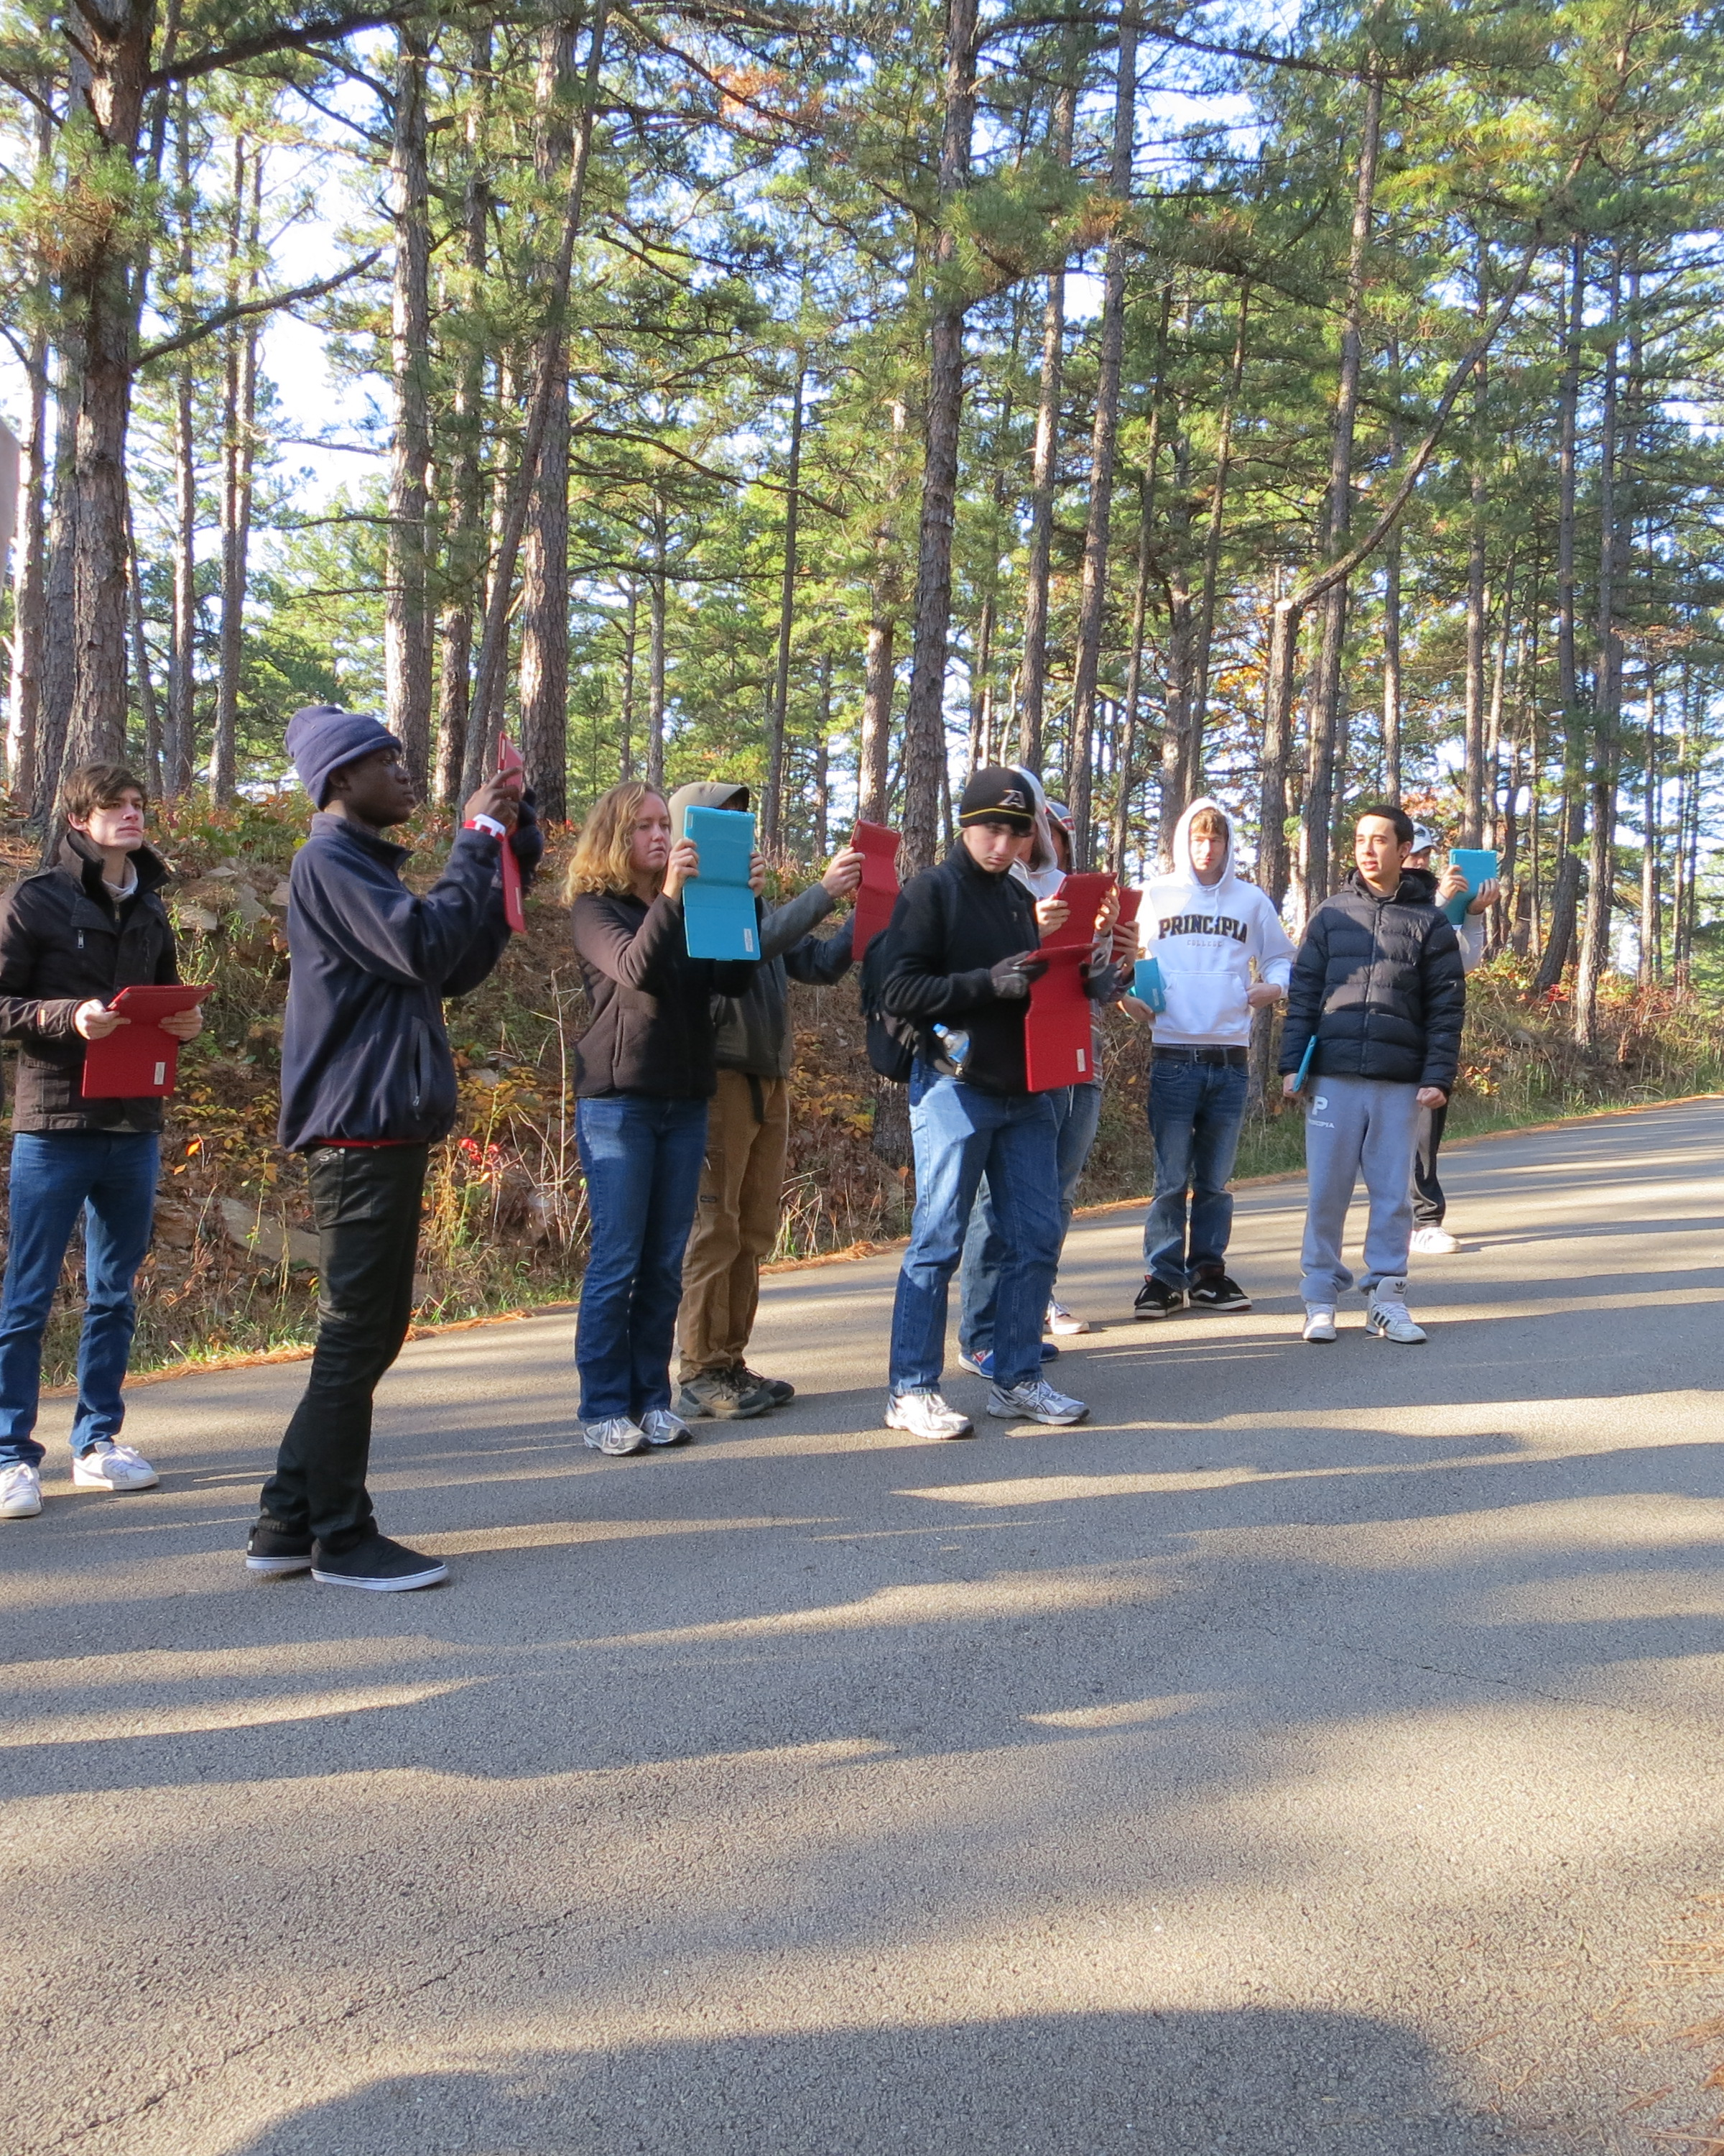

Slide 9
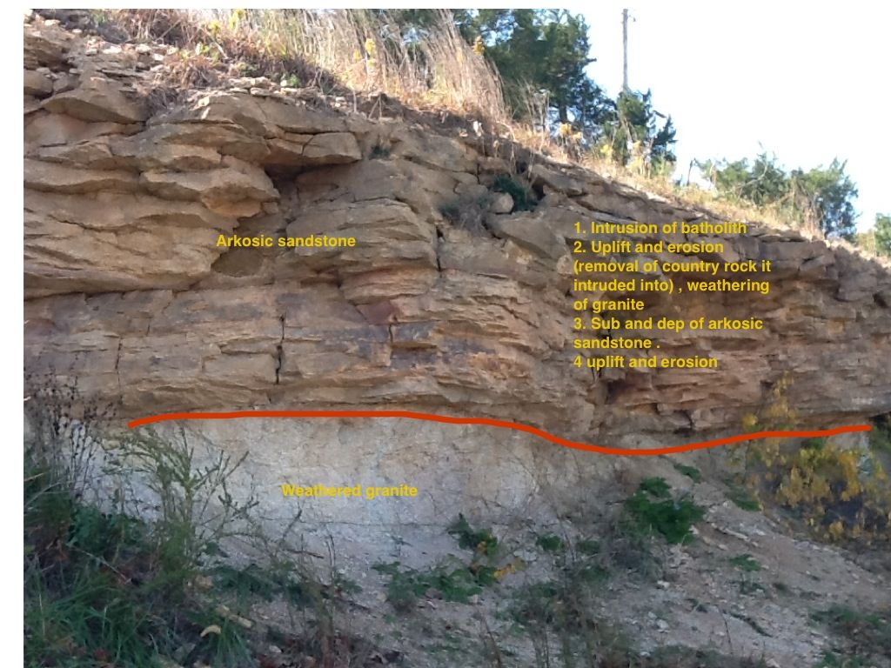

Slide 10
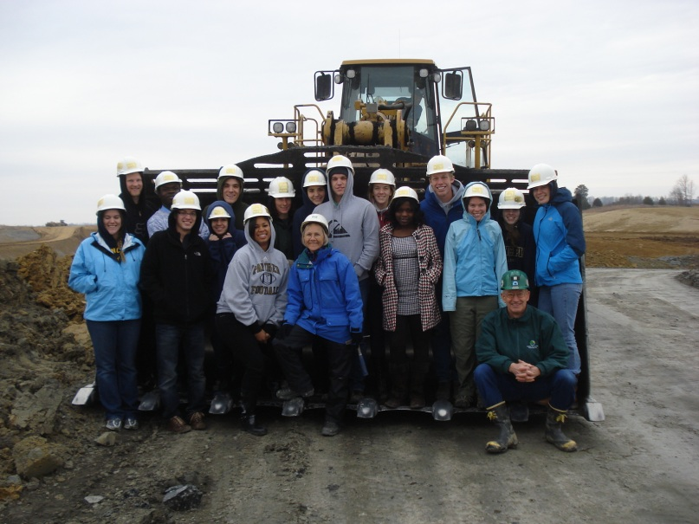
Environmental Geology Course
200 level
Non-lab
3 field trips
Mass wasting and karst features on and near campus
Waste water treatment plant
Surface coal mine w/ reclamation and a pre-law area
Term-long Environmental Site Assessment Project

Slide 11
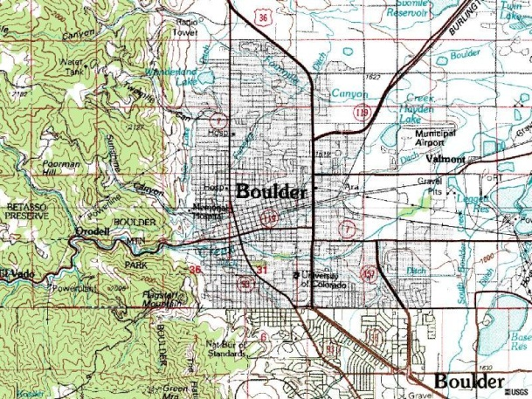
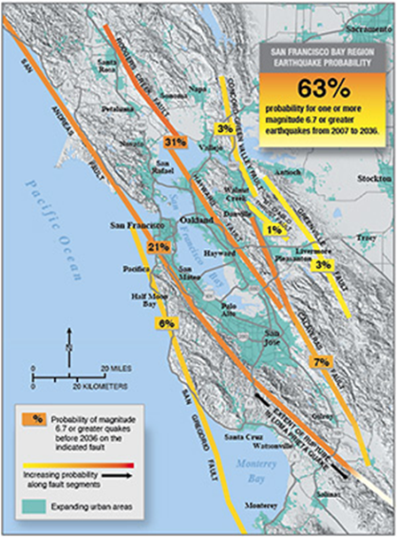
Environmental Site Assessment (ESA) Project
Research and write an ESA (6-8 page paper) for a city of their choice
Scenario: future home owner
Assignment is scaffolded
Annotated bibliography for each topic
Multiple drafts
Peer review
Poster
Website
Blog

Slide 12
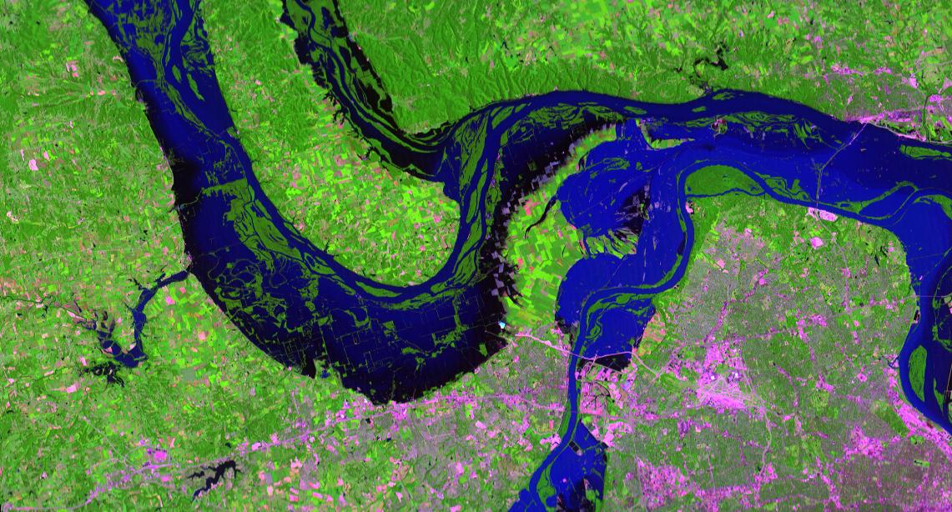
ESA Project
Learning Outcomes / Goals
Engage students to the point of understanding
Add significance to content by applying what they learn to their own lives
Learn what information is available and where to find it

Slide 13
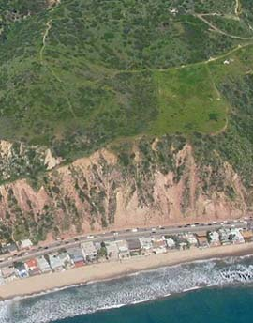
ESA Project
Outline is provided
BACKGROUND – Geographic and Geologic factors
NATURAL HAZARDS
WATER
WASTE WATER TREATMENT
SOLID WASTE DISPOSAL
CONCLUSION
REFERENCE LIST
FIGURES WITH CAPTIONS

Slide 14
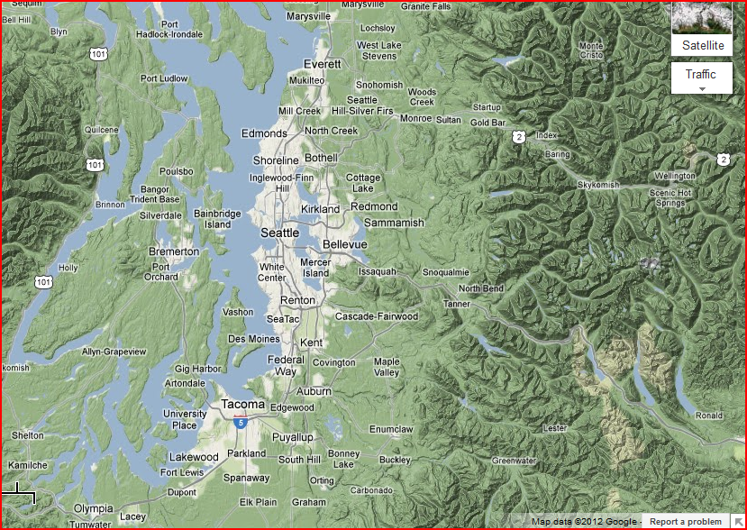
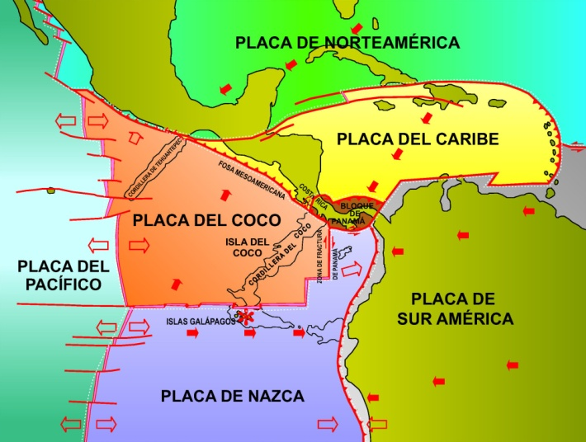
ESA Outline
Background – gives context for rest of paper
Purpose
Geographic features, terrain
Topography
Drainage
Geology
Position relative to plate boundaries
Key rock types at/near surface

Slide 15
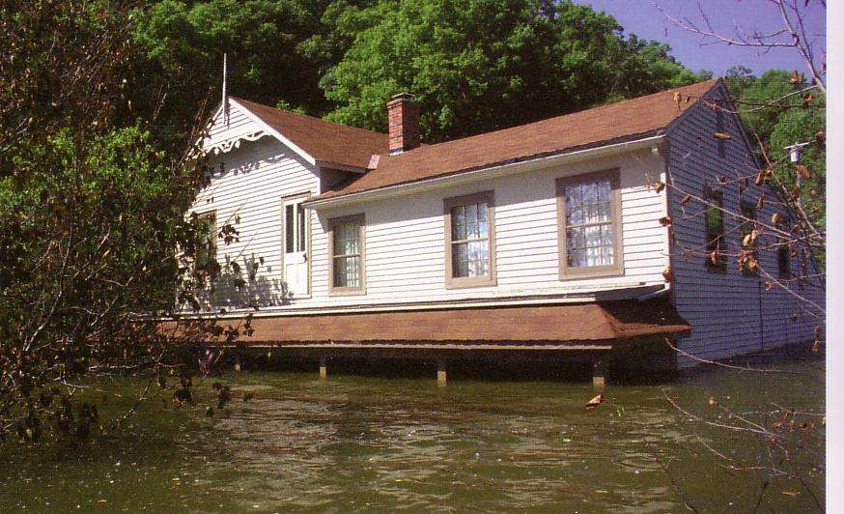
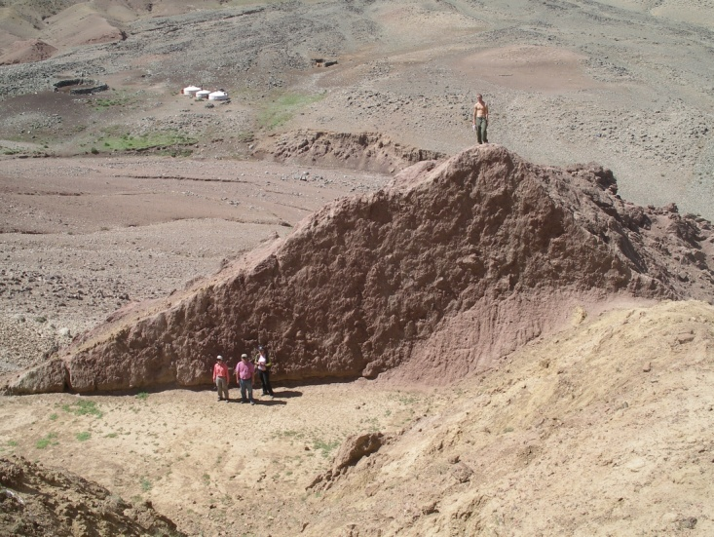
ESA Outline
Natural hazards
Earthquakes, volcanoes, flooding, mass wasting, coastal hazards, swelling soils, indoor radon
Explain why they have or don’t have each type of hazard
Example events
Mitigation efforts

Slide 16
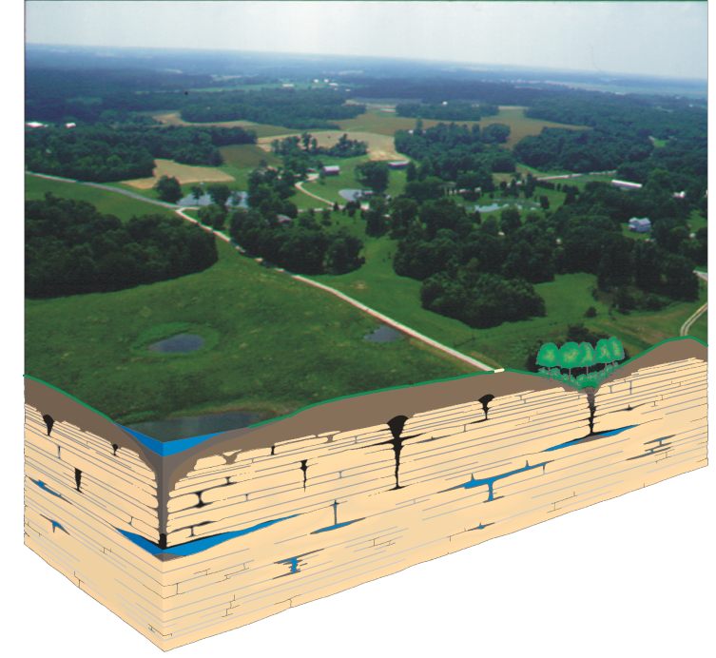
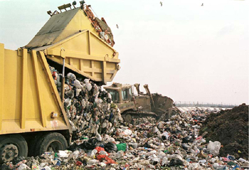
ESA Outline
Water supply and treatment
Potential water contamination
Waste management
Waste water
Gray water usage
Sludge usage
Solid waste
Hazardous and radioactive waste

Slide 17
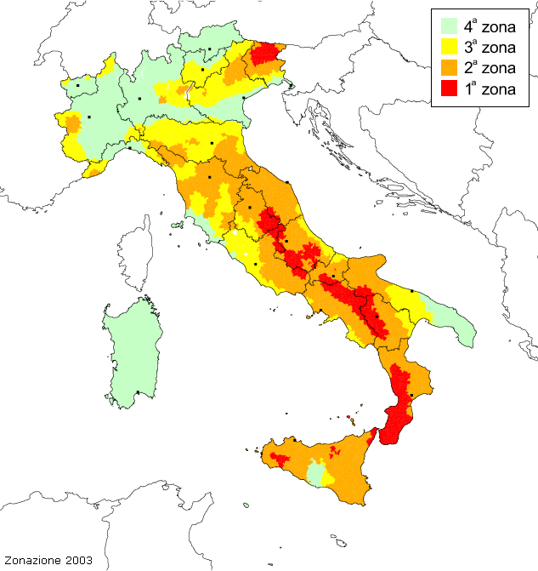
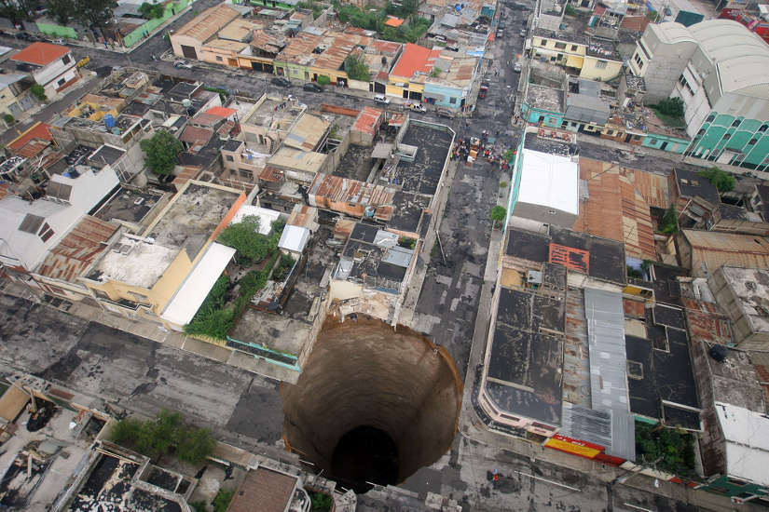
ESA Outline
Conclusion
References
Mike Phillips’s web page of online resources http://www2.ivcc.edu/phillips/geology/environmental_research.htm
Figures – maps, photos, etc.

Slide 18
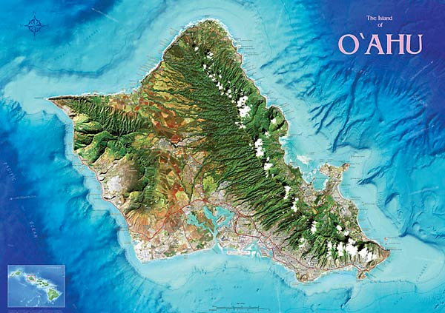
ESA Project Assessment
How assignment is graded
Paper
25% of final grade
Rubric
Drafts graded as part of homework grade
Peer review graded as part of homework grade
Student feedback

Slide 19
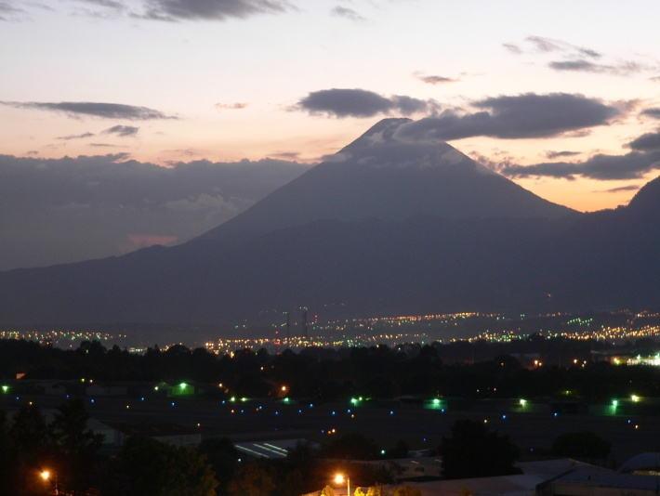
Annecdotal Feedback
Improved interest in learning
“This was the most useful class I’ve taken in college.”
“I appreciated the real life application. I feel like my time was not wasted.”
“The ESA report helped me understand the subjects we were covering.”
Improved interest in teaching
Students are more engaged
I enjoy learning specifics about areas
I often remember the students by the site they did.
Students remember the course through their site.
A student who did not have the project did not remember the course content.

