Slide 1
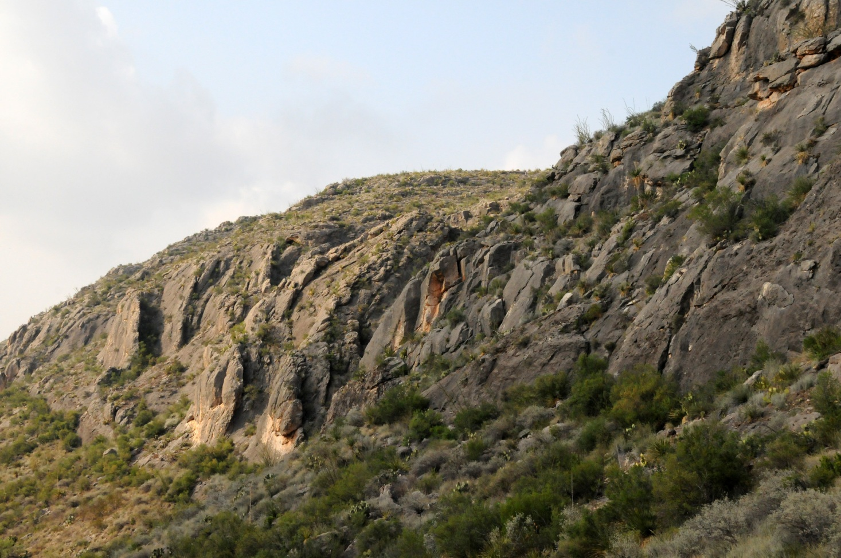
Kinematic evolution of the Stillwell anticline system, west Texas: implications for fluid flow within subsurface systems
Ben Surpless, Brett Mays, and Daniel Hoin
Department of Geosciences
Trinity University
San Antonio, TX

Slide 2
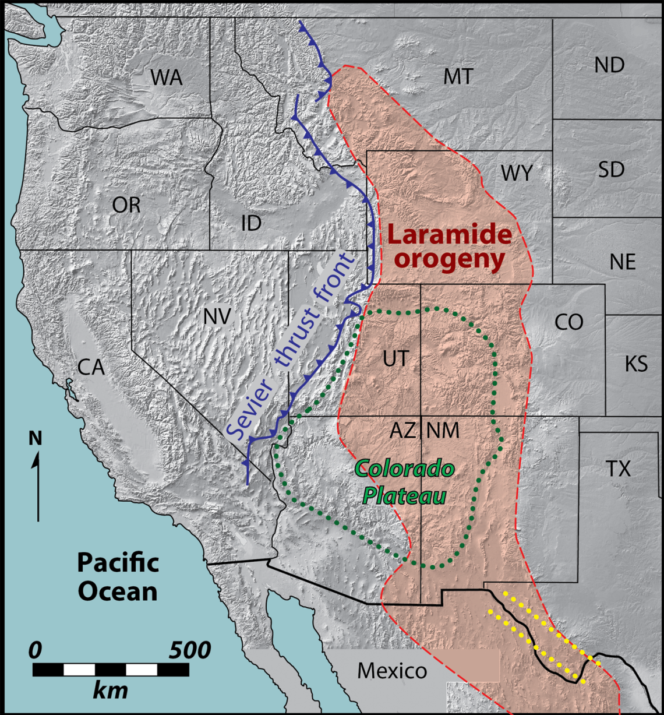
Tectonic Setting
Pre-Laramide tectonics and the Texas lineament
The Laramide Orogeny
The Big Bend region
Texas
Lineament
Modified from Muehlberger (1980) and Miller et al., (1992)

Slide 3
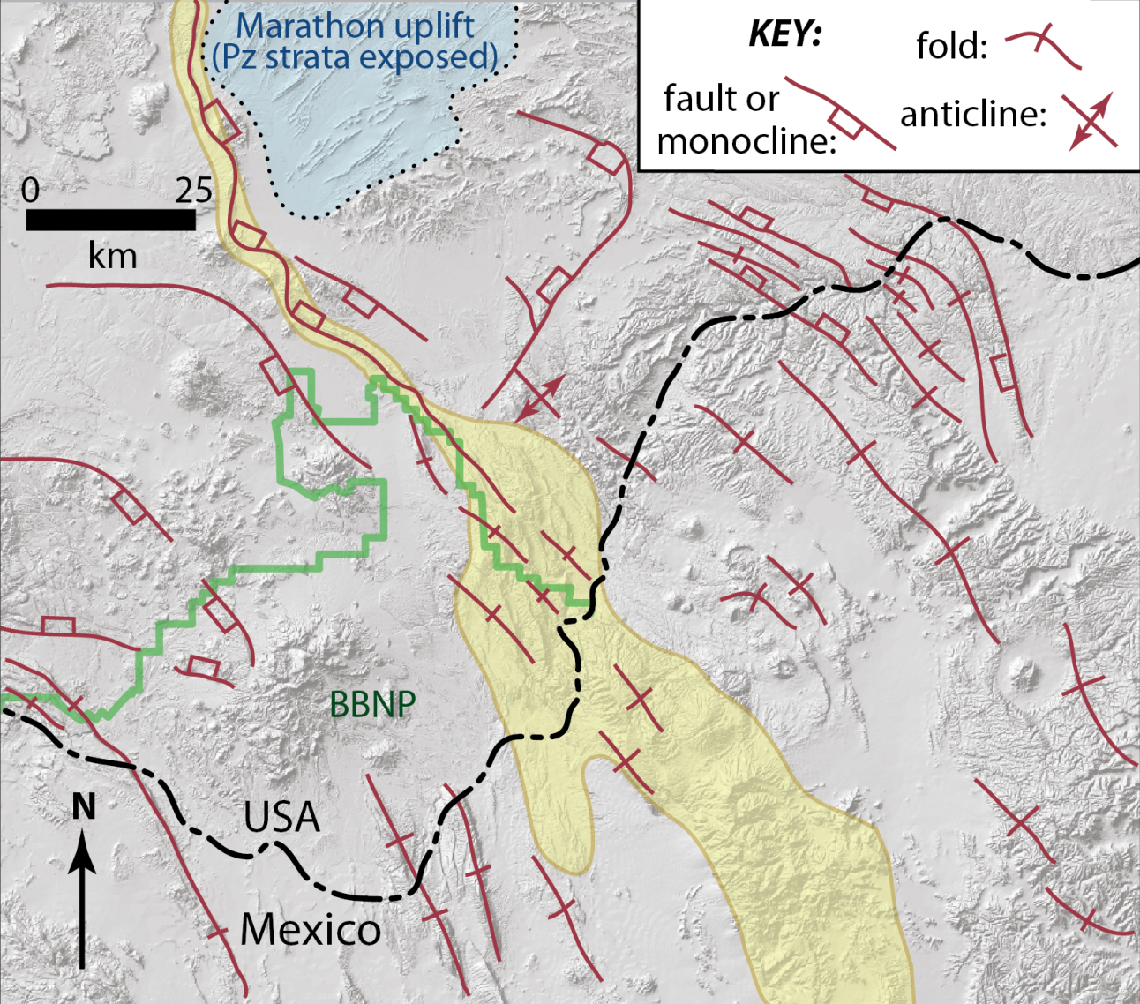
Regional Geology
Stillwell anticline
Sierra del Carmen
Modified from Muehlberger and Dickerson (1989)

Slide 4
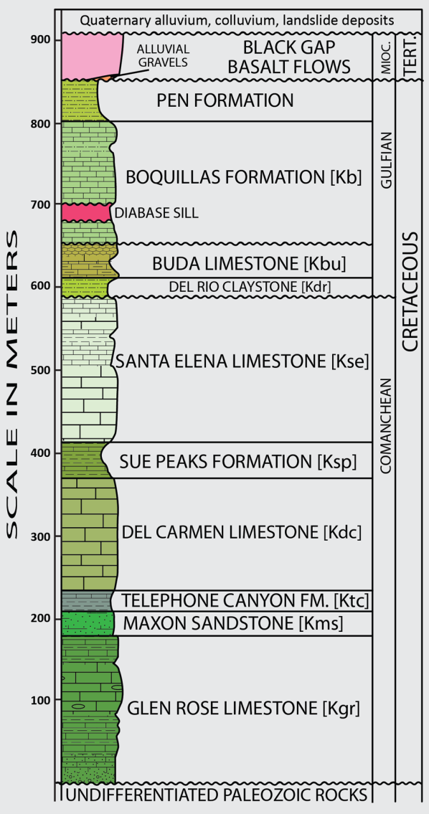
Local stratigraphy and
relative mechanical strength
Locally exposed units (adjacent to the Stillwell anticline)
Dominated by K marine units
Thick and strong vs. thin and weak
Importance of the Sue Peaks Fm.
Modified from Cobb and Poth (1980), based on St. John (1965), Maxwell et al. (1967), and reconnaissance field data.

Slide 5
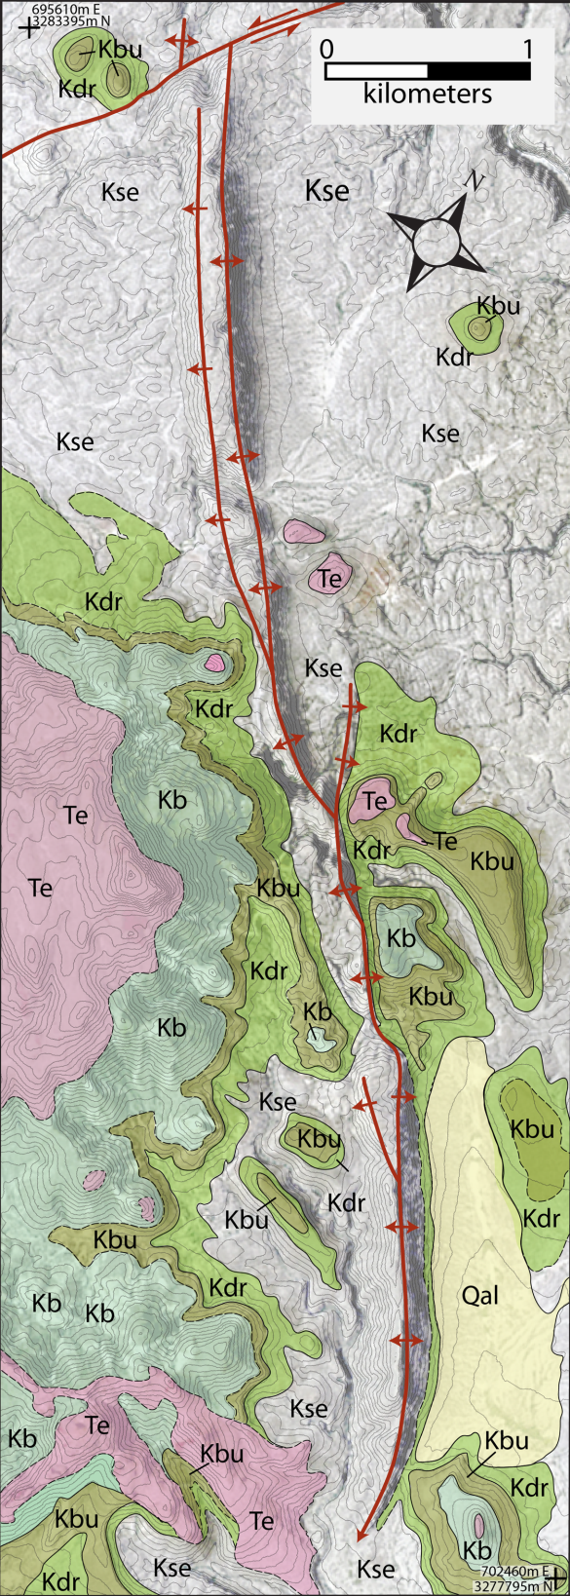
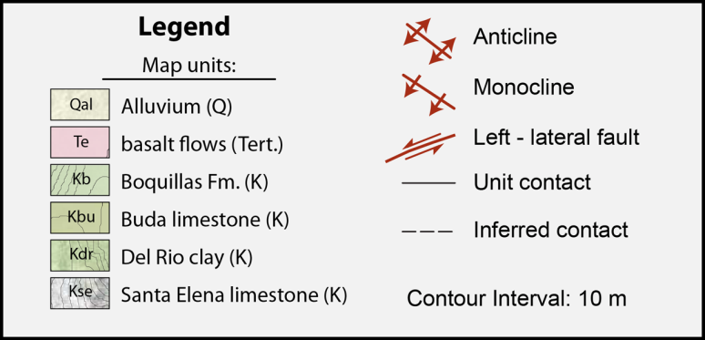
The Stillwell anticline system
NW-trending, NE-vergent system
Changes in geometry parallel to axis
Complexities of the central anticline

Slide 6
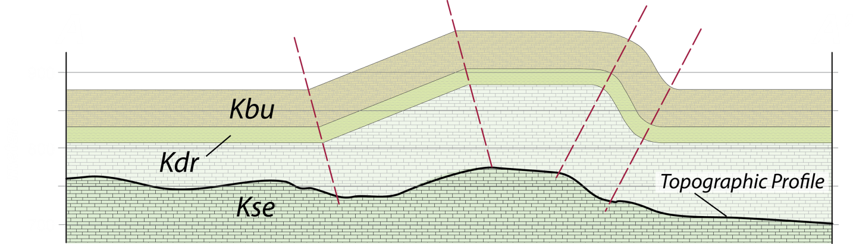
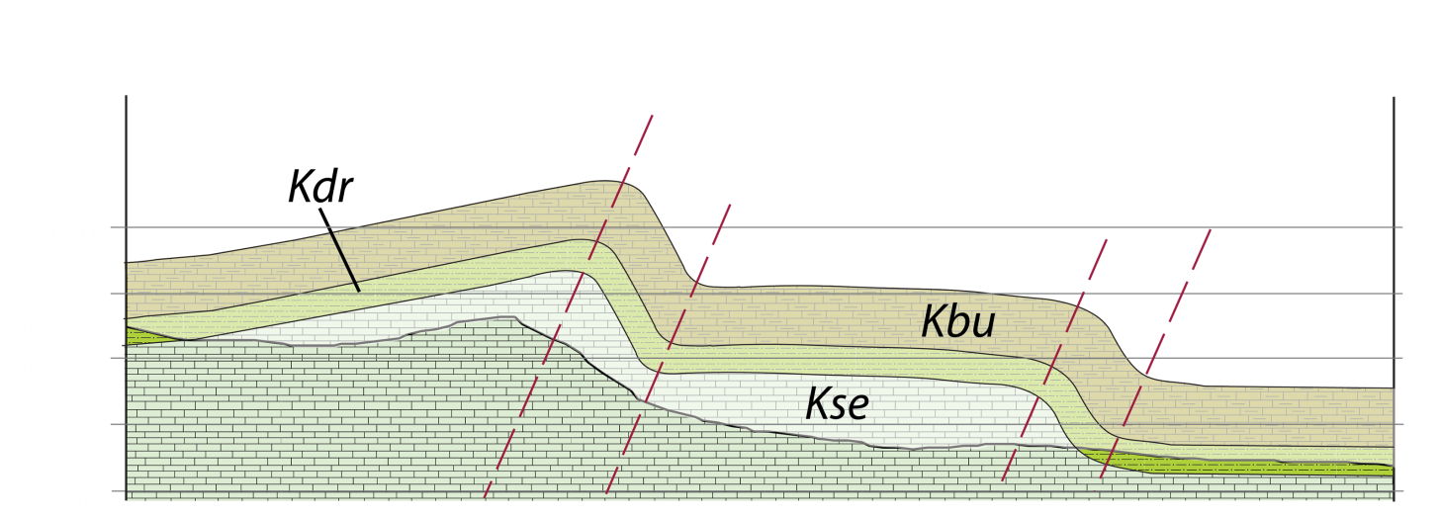
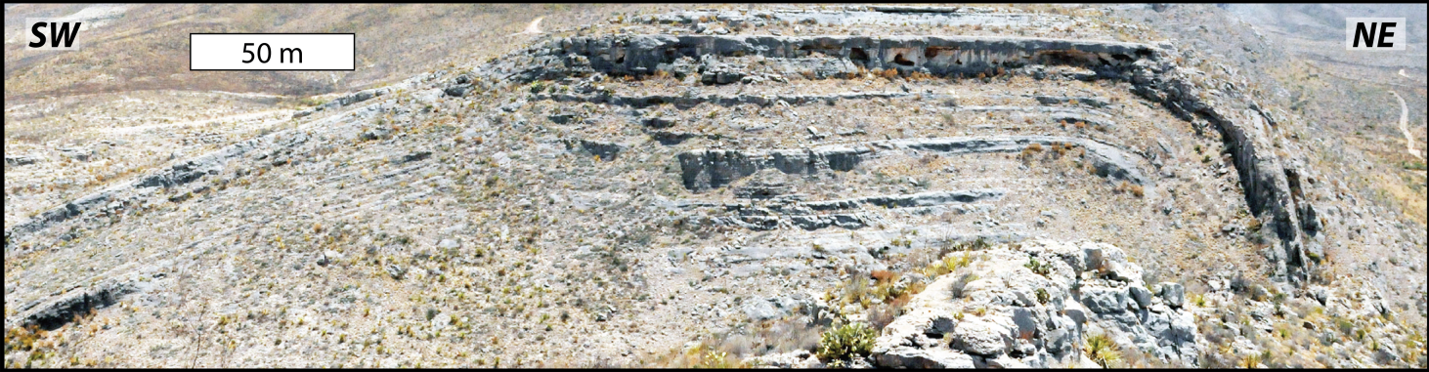
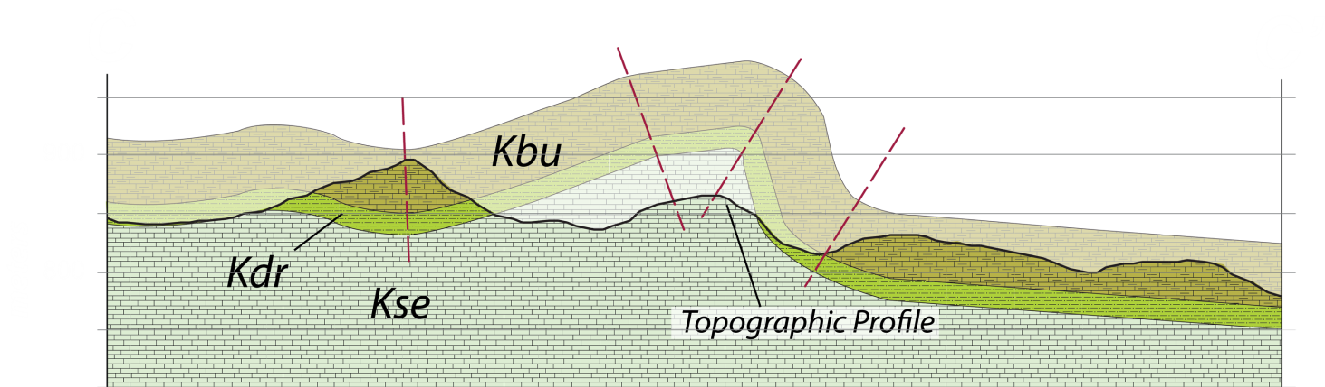
The Stillwell anticline system
A
A’
B
B’
C
C’
Important points

Slide 7
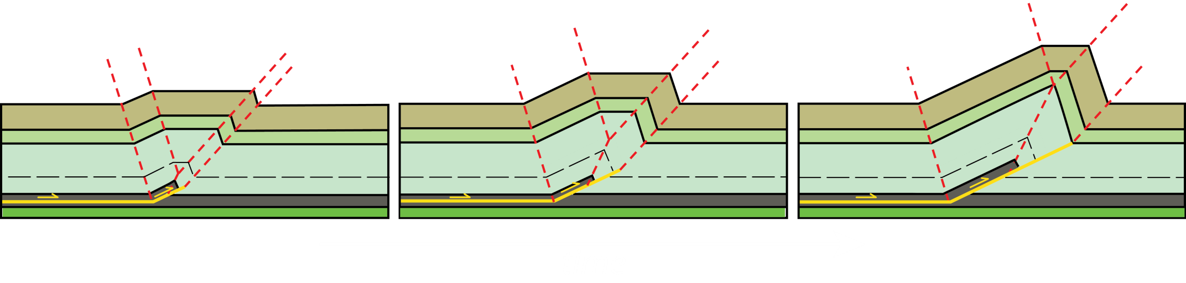
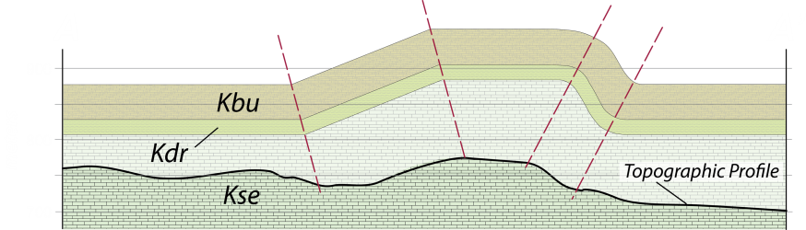
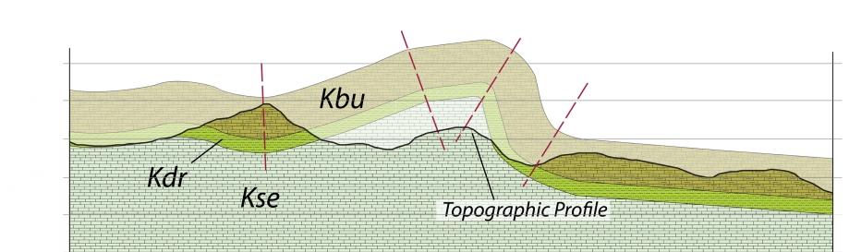

Fault propagation fold evolution
Fault tip
Fault tip
Fault tip
Modified from Erslev, 1991

Slide 8
Preliminary computer kinematic modeling
Why modeling?
Well-constrained fold shapes
Well-known and described stratigraphy
No subsurface information
Permits prediction of strain distribution during fault propagation
Trishear kinematics*
Accounts for realistic tightening of folds towards propagating fault
Software permits testing of realistic range of variables during fault propagation (e.g., decollement depth, ramp dip)
*FaultFold 2D modeling: Allmendinger, 1998; Zehnder & Allmendinger, 2000

Slide 9
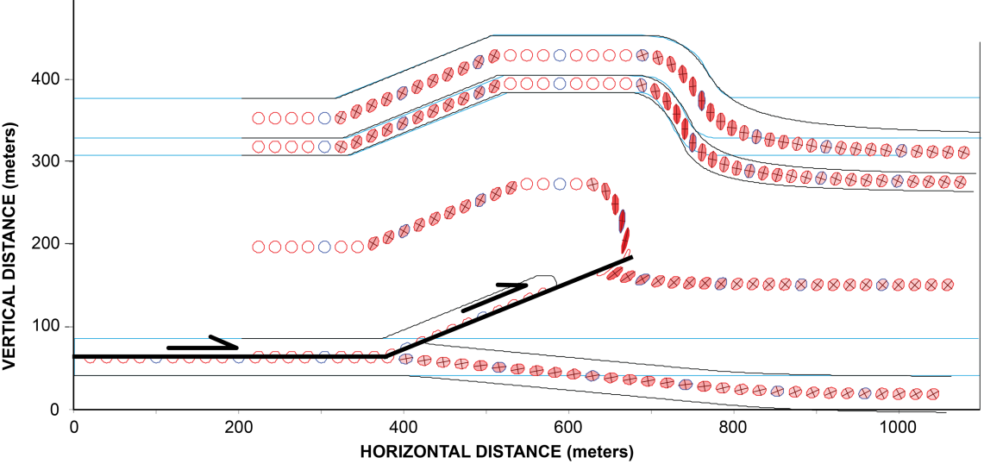
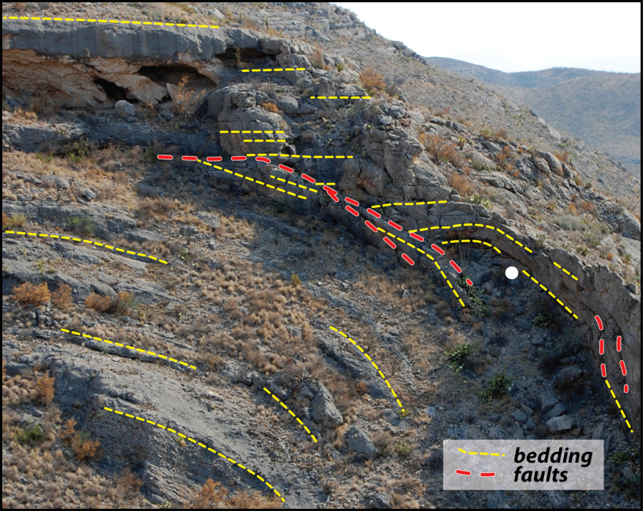
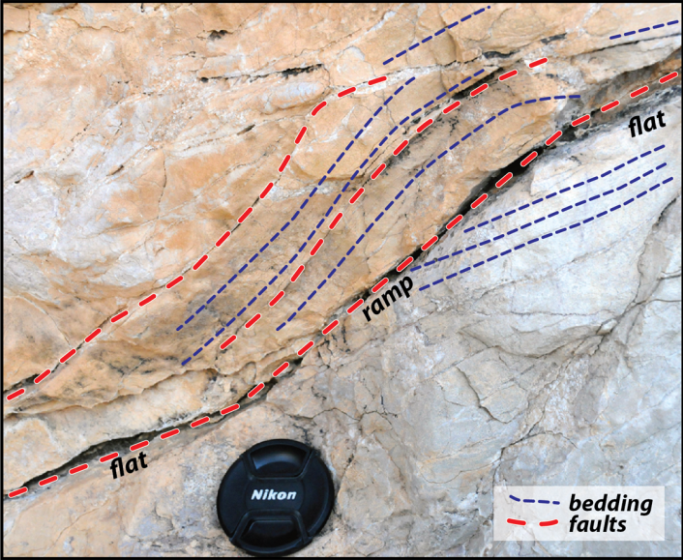
Results of preliminary kinematic modeling
Best-fit model:
Ksp decollement depth
Ramp angle = 22 degrees Propagation = 321 m
Slip = 204 m
P/S ratio = 1.575
Forelimb = max. strain
Kbu
Kdr
Kse
Ksp
0
5
meters

Slide 10
Lateral fault-propagation,
anticline evolution, and
potential fluid flow
Left steps in anticline axial trace likely related to linked, originally separate faults

Slide 11

Results and future research
Fold geometries support fold formation by fault propagation
Kinematic modeling and field data support maximum strain in forelimb
Significant macro-scale fracturing focused in the forelimb zone
Anticline system likely cored by en echelon fault system
Well-constrained folds permit structural position/fracture intensity analysis and 3D modeling
Acknowledgements:
NSF award #1220235
Black Gap WMA and Dir. Mike Pittman
Trinity University Ed Roy Fund
Trinity University Summer Research Award

