Slide 1
EFFECT OF SOME COMMON ORGANIC CONTAMINANTS ON HYDRAULIC CONDUCTIVITY OF AQUIFER SAND
Qays Jasim Saud
Syed E. Hasan
Department of Geosciences
University of Missouri-Kansas City
November 5, 2012
qjsfgd@mail.umkc.edu
hasans@umkc.edu

Slide 2
Research Question
How do some common and widespread organic contaminants affect the hydraulic conductivity of aquifer sand?
Notes:
* EPA-NPL listed 1305 contaminated sites in the U.S as of May 2012, 275 common chemicals found in contaminated aquifers at many locations across the U.S.
* Groundwater is a drinking-water source for about one-half of the Nation’s population, including almost all residents in rural areas.
Ground water is important as a drinking-water supply in every State.
in both developed and developing countries.
Some water treatment plant in Kansas depends on groundwater within 95%

Slide 3
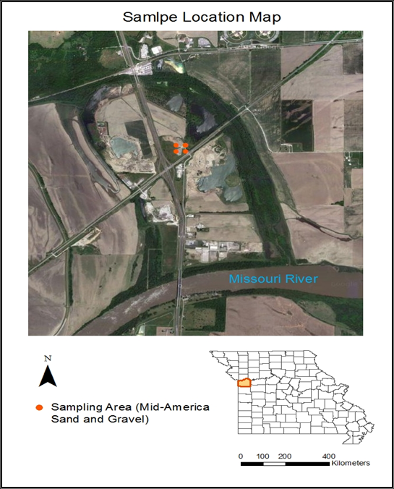
Test material
Sand deposits are the most common geological formation for most aquifers
Missouri River alluvial aquifer from the Mid America Sand and Gravel Co. site, in Jackson County, MO was selected for bulk sampling of the aquifer material

Slide 4
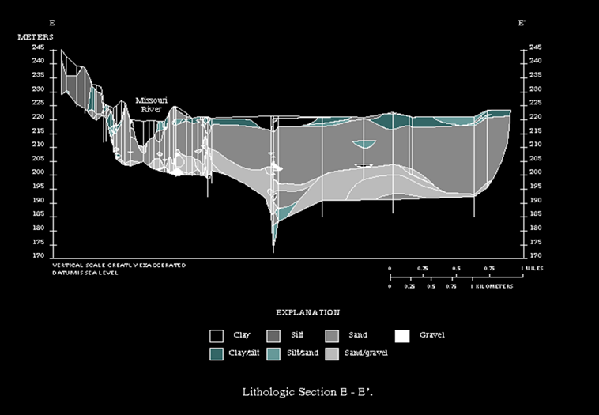
Sampling area location map and cross section
N
USGS (Kelly, 2003)
http://mo.water.usgs.gov/indep/kelly/mo-alluvial-gw/geology/images/excplot.gif

Slide 5
Selected chemicals
Three commonly occurring chemical pollutants were selected for this study:
Trichloroethylene (TCE)
BTEX- one of 15 hazardous chemicals occurring in gasoline
Gasoline
All occur at many NPL sites
Notes:
I selected three commonly occurring widespread chemicals pollutants for my study because:
* (TCE), is a common contaminant that identified at Superfund sites, over 700 hazardous waste sites.
* BTEX. One of 15 hazardous chemicals occurring in gasoline.
BTEX benzene, toluene, ethylbenzene, and xylenes which makes up one of the main groups of soluble organic compounds that find their way into our soil and groundwater.
* USGS in nationwide study, 2006 found that the gasoline compounds are the third most commonly detected class of organic contaminants in groundwater. Gasoline Contains more than 150 chemicals , many of them are highly toxic.
There are many chemicals consists in or added to gasoline make it toxic.

Slide 6
ATSDR Priority List of Hazardous Substances, 2011
2011 Rank (out of 275) | Substance name | Toxicological effects
6 | Benzene | Nervous system changes Liver, lungs, kidney damage, and leukemia EPA listed TCE as a known human carcinogen
16 | TCE
62 | Xylenes
74 | Toluene
ATSDR. Agency for Toxic Substances and Disease Registry; http://www.atsdr.cdc.gov/SPL/index.html
http://www.atsdr.cdc.gov/PHS/index.asp
Notes:
* Nervous system changes
* liver, lungs, kidney damage, and leukemia.
*EPA listed TCE as a known human carcinogen in 2011. EPA Releases Final Health Assessment for TCE" on 09/28/2011.
* MTBE, potential human carcinogen at high doses.
0.02 and 0.04 ppm in drinking water would cause negative health effects.
Ranking of substances based on a combination of their frequency, toxicity, and potential for human exposure at NPL sites.

Slide 7
Methodology
Fifty-six sand samples comprising the -2.36 mm and -0.425 mm fractions were contaminated with TCE and gasoline at different levels of saturation (v/v %) 25, 50 and 100% for 2, 4, 8, 16, and 32 weeks
Five sand samples (-2.36 mm fraction) were fully saturated for four weeks with BTEX and isooctane, the main constituents of gasoline, to compare the results of hydraulic conductivity of sand contaminated with gasoline
Ten sand samples (-2.36 mm fractions) were exposed to aqueous solution contaminated with 1,2,3….10% of gasoline for four weeks, as well as with TCE
All sand samples were fully saturated
Notes:
benzene, toluene, ethylbenzene, xylenes (BTEX)

Slide 8
Methodology (2)
Geotechnical properties (void ratio, porosity, dry unit weight and saturated unit weight) were determined before and after exposing sand samples to the chemicals
Hydraulic conductivity was determined before and after contaminating all sand samples, following the ASTM test method D2434–68
Notes:
Constant Head, using permeameter device.
Samples are repacked into the permeameter, samples has been compacted approximately to the same density to assure that all results will represent the same condition.

Slide 9
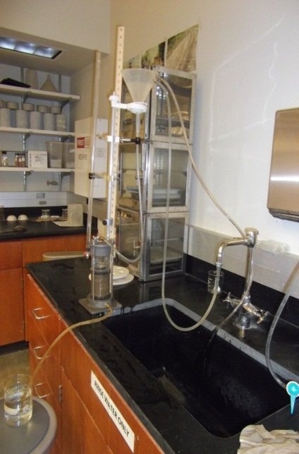
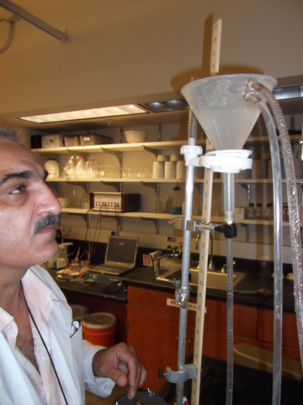
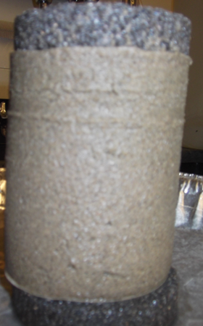

Permeameter set up

Slide 10
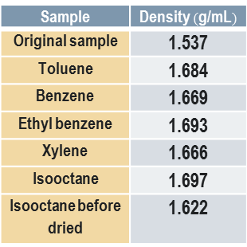
RESULTS OF HYDRAULIC CONDUCTIVITY(m/d) OF SATURATED SAND SAMPLES (-2.36mm) CONTAMINATED WITH PURE HYDROCARBON after four weeks
Sample | Density $(\text{g}\text{/}\text{mL})$
Original sample | 1.537
Toluene | 1.684
Benzene | 1.669
Ethyl benzene | 1.693
Xylene | 1.666
Isooctane | 1.697
Isooctane before dried | 1.622
Notes:
The results show a decrease of up to 48% in the hydraulic conductivity of sand upon contamination

Slide 11
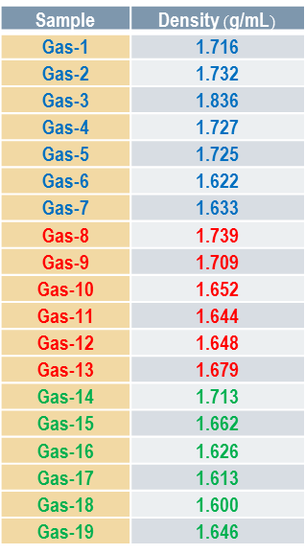
RESULTS OF HYDRAULIC CONDUCTIVITY (m/d) OF SAND SAMPLES (-2.36 mm) CONTAMINATED WITH GASOLINE (v/v %)
Sample | Density $(\text{g}\text{/}\text{mL})$
Gas-1 | 1.716
Gas-2 | 1.732
Gas-3 | 1.836
Gas-4 | 1.727
Gas-5 | 1.725
Gas-6 | 1.622
Gas-7 | 1.633
Gas-8 | 1.739
Gas-9 | 1.709
Gas-10 | 1.652
Gas-11 | 1.644
Gas-12 | 1.648
Gas-13 | 1.679
Gas-14 | 1.713
Gas-15 | 1.662
Gas-16 | 1.626
Gas-17 | 1.613
Gas-18 | 1.600
Gas-19 | 1.646
Original sample: density =1.717g/ml and k = 8.9m/d

Slide 12
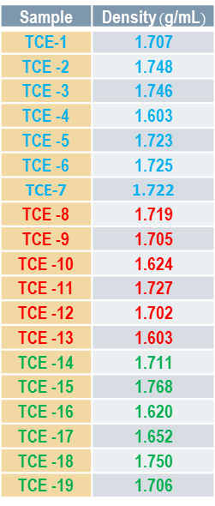
RESULTS OF HYDRAULIC CONDUCTIVITY (m/d) OF SAND SAMPLES (-2.36 mm) CONTAMINATED WITH TCE (v/v %)
Sample | Density $(\text{g}\text{/}\text{mL})$
TCE-1 | 1.707
TCE -2 | 1.748
TCE -3 | 1.746
TCE -4 | 1.603
TCE -5 | 1.723
TCE -6 | 1.725
TCE-7 | 1.722
TCE -8 | 1.719
TCE -9 | 1.705
TCE -10 | 1.624
TCE -11 | 1.727
TCE -12 | 1.702
TCE -13 | 1.603
TCE -14 | 1.711
TCE -15 | 1.768
TCE -16 | 1.620
TCE -17 | 1.652
TCE -18 | 1.750
TCE -19 | 1.706
Original sample: density =1.717g/ml and k = 8.9m/d

Slide 13
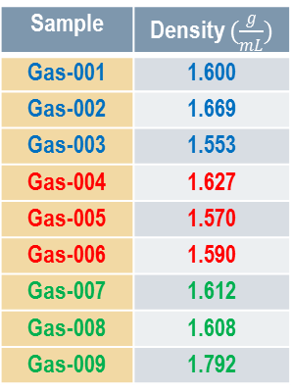
RESULTS OF HYDRAULIC CONDUCTIVITY (m/d) OF SAND SAMPLES (-0.425 mm) CONTAMINATED WITH GASOLINE (v/v %)
Sample | Density $(\frac{g}{mL})$
Gas-001 | 1.600
Gas-002 | 1.669
Gas-003 | 1.553
Gas-004 | 1.627
Gas-005 | 1.570
Gas-006 | 1.590
Gas-007 | 1.612
Gas-008 | 1.608
Gas-009 | 1.792
Original sample: density =1.537g/ml and k = 1.81m/d

Slide 14
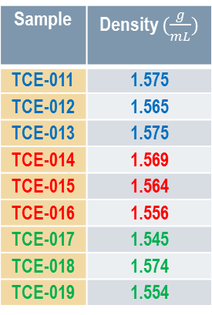
RESULTS OF HYDRAULIC CONDUCTIVITY (m/d) OF SAND SAMPLES (-0.425 mm) CONTAMINATED WITH TCE (v/v %)
Sample | Density $(\frac{g}{mL})$
TCE-011 | 1.575
TCE-012 | 1.565
TCE-013 | 1.575
TCE-014 | 1.569
TCE-015 | 1.564
TCE-016 | 1.556
TCE-017 | 1.545
TCE-018 | 1.574
TCE-019 | 1.554
Original sample: density =1.537g/ml and k = 1.81m/d

Slide 15
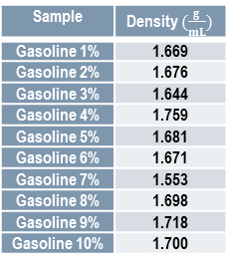
RESULTS OF HYDRAULIC CONDUCTIVITY OF SATURATED SAND SAMPLES (-2.36 mm) CONTAMINATED WITH AQUEOUS SOLUTION (VARYING CONCENTRATION OF GASOLINE )
Original sample: density =1.717g/ml and k = 8.9m/d
Sample | Density $(\frac{g}{mL})$
Gasoline 1% | 1.669
Gasoline 2% | 1.676
Gasoline 3% | 1.644
Gasoline 4% | 1.759
Gasoline 5% | 1.681
Gasoline 6% | 1.671
Gasoline 7% | 1.553
Gasoline 8% | 1.698
Gasoline 9% | 1.718
Gasoline 10% | 1.700

Slide 16
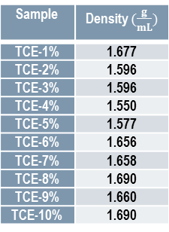
RESULTS OF HYDRAULIC CONDUCTIVITY OF SATURATED SAND SAMPLES (-2.36 mm) CONTAMINATED WITH AQUEOUS SOLUTION (VARYING CONCENTRATION OF TCE)
Original sample: density =1.717g/ml and k = 8.9m/d
Sample | Density $(\frac{g}{mL})$
TCE-1% | 1.677
TCE-2% | 1.596
TCE-3% | 1.596
TCE-4% | 1.550
TCE-5% | 1.577
TCE-6% | 1.656
TCE-7% | 1.658
TCE-8% | 1.690
TCE-9% | 1.660
TCE-10% | 1.690

Slide 17
Discussion
Microscopic examination did not reveal any change in the physical features of sand which leads to the conclusion that the decrease in hydraulic conductivity is controlled by the retention characteristic of the chemicals
Adsorption creates a film of fluids (adsorbate) on the surface of the solids (adsorbent). This increases the surface tension on sand grains which, in turn, increases the cohesion resulting in a decrease in hydraulic conductivity
Further work is in progress

Slide 18
Thank you
Questions?

