Slide 1
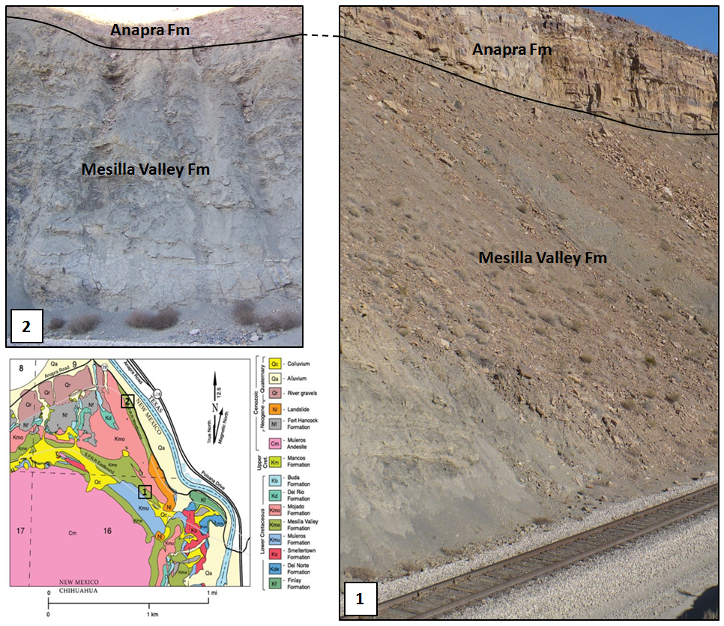
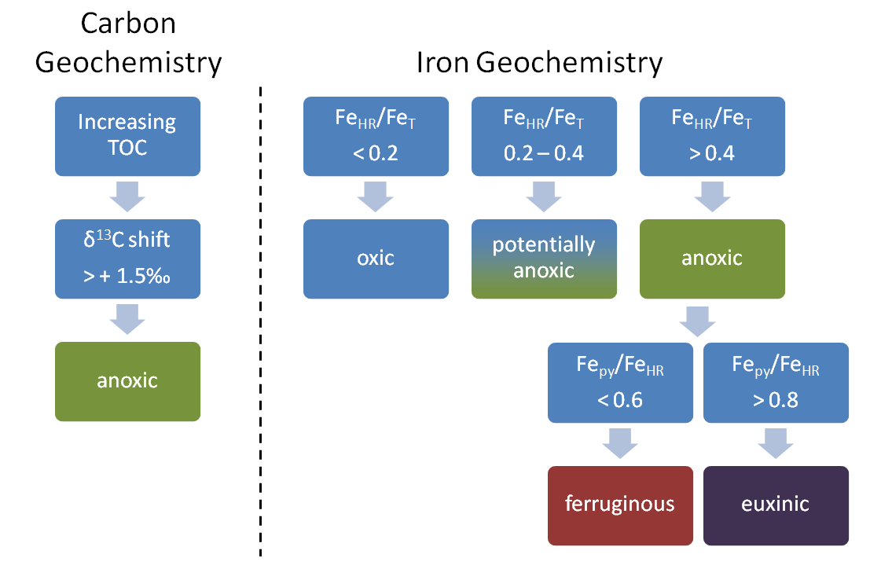
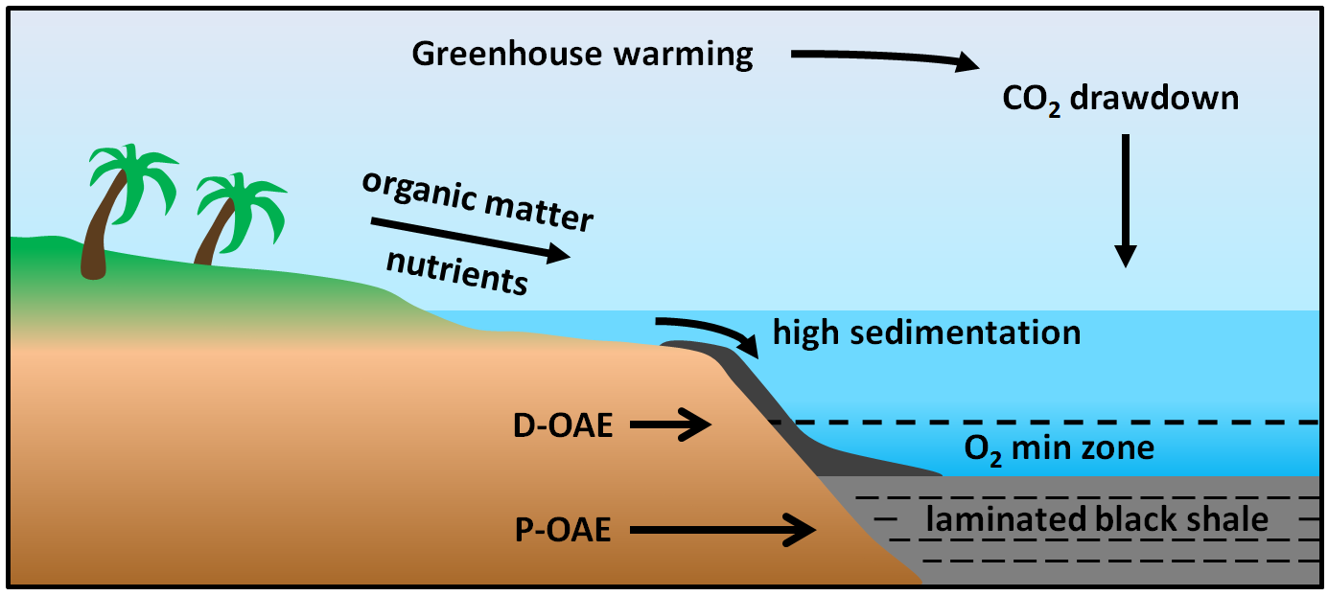
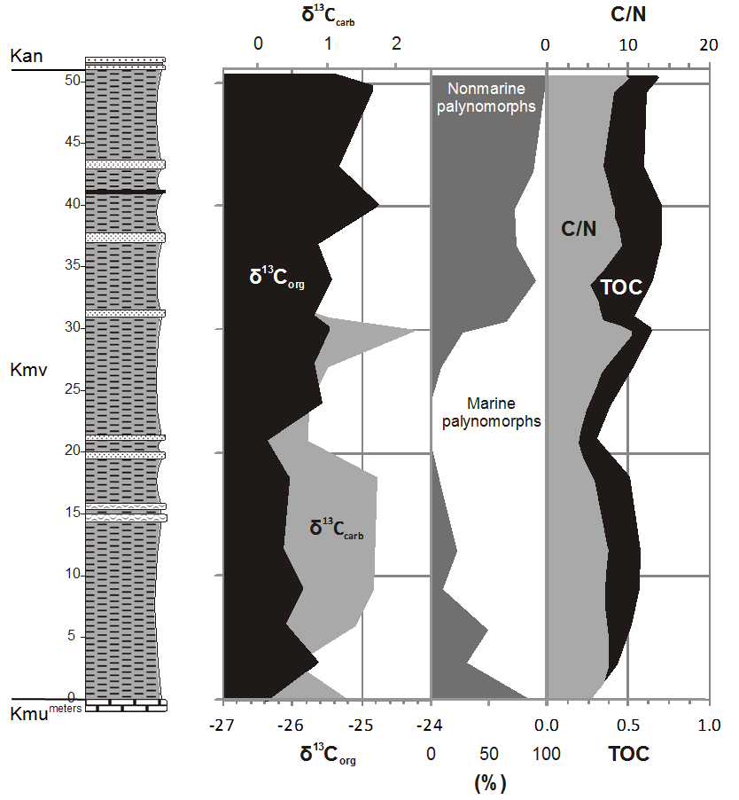
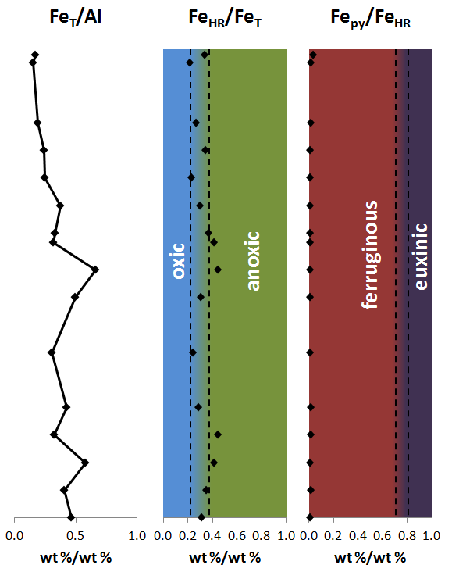

Upper Albian Oceanic Anoxia in Chihuahua Trough, south-central New Mexico
Natalie K. Rush¹, Michael J. Formolo¹, Robert W. Scott^{1,2}, Franca Oboh-Ikuenobe³, and Jeremy Owens⁴
¹Department of Geosciences, University of Tulsa, Tulsa, OK 74104; ²Precision Stratigraphy Associates, Cleveland, OK 74020;
³Missouri University of Science & Technology, Rolla, MO 65409, ⁴Department of Earth Sciences, University of California, Riverside, CA 92521
Introduction
Few Cretaceous global oceanic anoxic events (OAEs) have been identified in the Gulf Coast of North America. The Upper Albian Mesilla Valley Formation is exposed on the NE flank of Cerro de Cristo Rey, Doña Ana County, south-central New Mexico. This shale is tested for evidence of Oceanic Anoxic Event 1d (OAE 1d-97.38-96.98 Ma). OAEs represent increased burial of organic matter through preservation and/or productivity, and are recognized by increased δ¹³C values (Schlanger and Jenkyns 1976) (Fig. 1). The Mesilla Valley Formation was deposited in a nearshore shelf environment along the NE edge of the Chihuahua trough and correlates with Late Albian Washita transgressive depositional cycle WA5 (98.75-97.03 Ma) in central Texas (Scott et al. 2003; Lucas et al. 2010). Deposition began in a relatively deep marine environment, shoaling upward into basal sands of the overlying Anapra Formation. Eocene andesitic intrusion caused upwarping, exposing the older Cretaceous beds at the surface.
Sampled Sections
Determination of Redox Conditions
Results
Mesilla Valley Formation samples exhibit a positive 1.6‰ shift in δ¹³C_{org} and TOC increase of 0.4% from 21m to 40m above base (Fig. 3). Increasing C/N and shift from exclusively marine to increasingly non-marine palynomorphs indicate a change in source of organic matter from primarily marine to progressively more terrigenous due to shoaling deposition. Comparison of highly reactive iron (Fe_{HR}) to total iron (Fe_{T}) indicates depositional conditions oscillated between anoxic and potentially anoxic. The ratio of pyrite iron (Fe_{py}) to Fe_{HR} indicates ferruginous, rather than euxinic depositional environment. The lack of a positive δ¹³C_{carb} shift during this event is characteristic of OAE 1d (Erbacher et al. 1996). The association of Mesilla Valley deposition with OAE 1d is strengthened through correlation with Washita depositional cycle Al TS WA5 in central Texas (Scott et al. 2003; Lucas et al. 2010), placing the Mesilla Valley in the O. verrucosum dinoflagellate zone, and by graphic correlation of published biostratigraphic data (Scott, 2012, personal communication).
Fig. 2: Location of sampled outcrops at Cerro de Cristo Rey, modified from Lucas et al. (2010).
Fig. 3: Geochemical determination of oceanic redox conditions based on carbon and iron data (Leckie et al., 2002; Poulton and Canfield, 2011).
Model of OAE Conditions
Chemostratigraphy of Mesilla Valley Formation
Conclusions
Carbon and iron data from the Mesilla Valley Formation indicate a shoaling-upward suboxic-anoxic ferruginous depositional environment. Increasing TOC in conjunction with unchanging δ¹³C_{carb} is characteristic of OAE 1d. Correlation of geochemical data with existing biostratigraphic data substantiates the association of the Mesilla Valley event with OAE 1d. Sampling the entire Cretaceous section at Cerro de Cristo Rey, as well as locations deeper in the Chihuahua Trough, might further strengthen the association with OAE 1d.
Fig. 1: Mechanisms of anoxic deposition. Productivity OAE (P-OAE) is driven by primary production. Detrital OAE (D-OAE) is driven by preservation of organic matter (as in Mesilla Valley Formation). Modified from Erbacher et al., 1996.
Ovoidinium verrucosum
OAE
Acknowledgements
Funding provided by the AAPG Foundation: Frank Kottlowski Memorial grant, the University of Tulsa Graduate School and Geosciences Dept., and Precision Stratigraphy Associates. Laboratory work performed by W. Cornell (University of Tulsa), E.D. Pollock (University of Arkansas Stable Isotope Laboratory), S.M. Bates and J.D. Owens (University of California-Riverside), F.E. Oboh-Ikuenobe (Missouri University of Science and Technology), and Activation Laboratories Ltd. Information about outcrops provided by G.F. Cudahy (American Eagle Brick).
Methods
A multi-proxy geochemical approach constrained the oceanic redox conditions at the time of deposition of the Mesilla Valley Formation. Samples were collected approximately every 3 m over 30 cm intervals at two outcrops that were spliced together into one stratigraphic column (Fig. 2). Total organic carbon (TOC) and stable carbon isotope analyses distinguish oxic and anoxic depositional conditions (Fig. 3). Sequential iron extraction, chromium reduction, and trace metal analyses corroborate the carbon data and further differentiate between non-sulfidic anoxia and euxinia (anoxic and sulfidic). Geochemical data were integrated with biostratigraphic data for accurate timing of the event and correlation with standard zonal schemes (Fig. 4).
LO Texigryphaea washitaensis
LO Peilinia quadriplicata
Fig. 4: Stratigraphic column of Mesilla Valley Fm. (Kmv) with geochemical data. Base of Anapra Fm. (Kan) and top of Muleros Fm. (Kmu) indicated. Palynomorph data by F.E. Oboh-Ikuenobe.
Ages at precisionstratigraphy.com: O. verrucosum 99.70-95.95; P. quadriplicata 100.65-97.28 Ma; T. washitaensis 102.16-97.16 Ma.
Further Information
For additional information, please contact Natalie Rush: natalie-rush@utulsa.edu, Robert Scott: rwscott@cimtel.net; Michael Formolo: Michael-formolo@utulsa.edu.

Slide 2
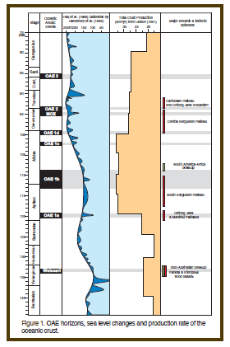
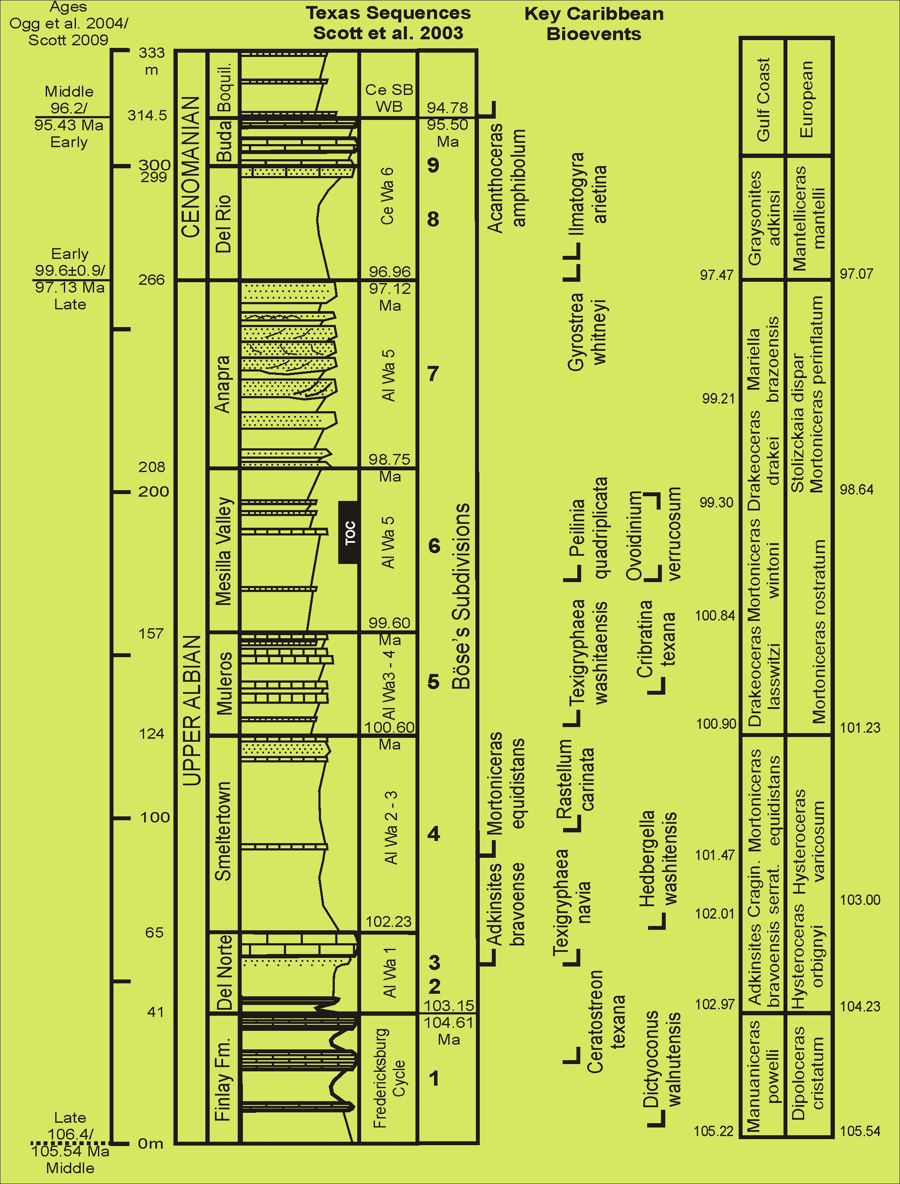
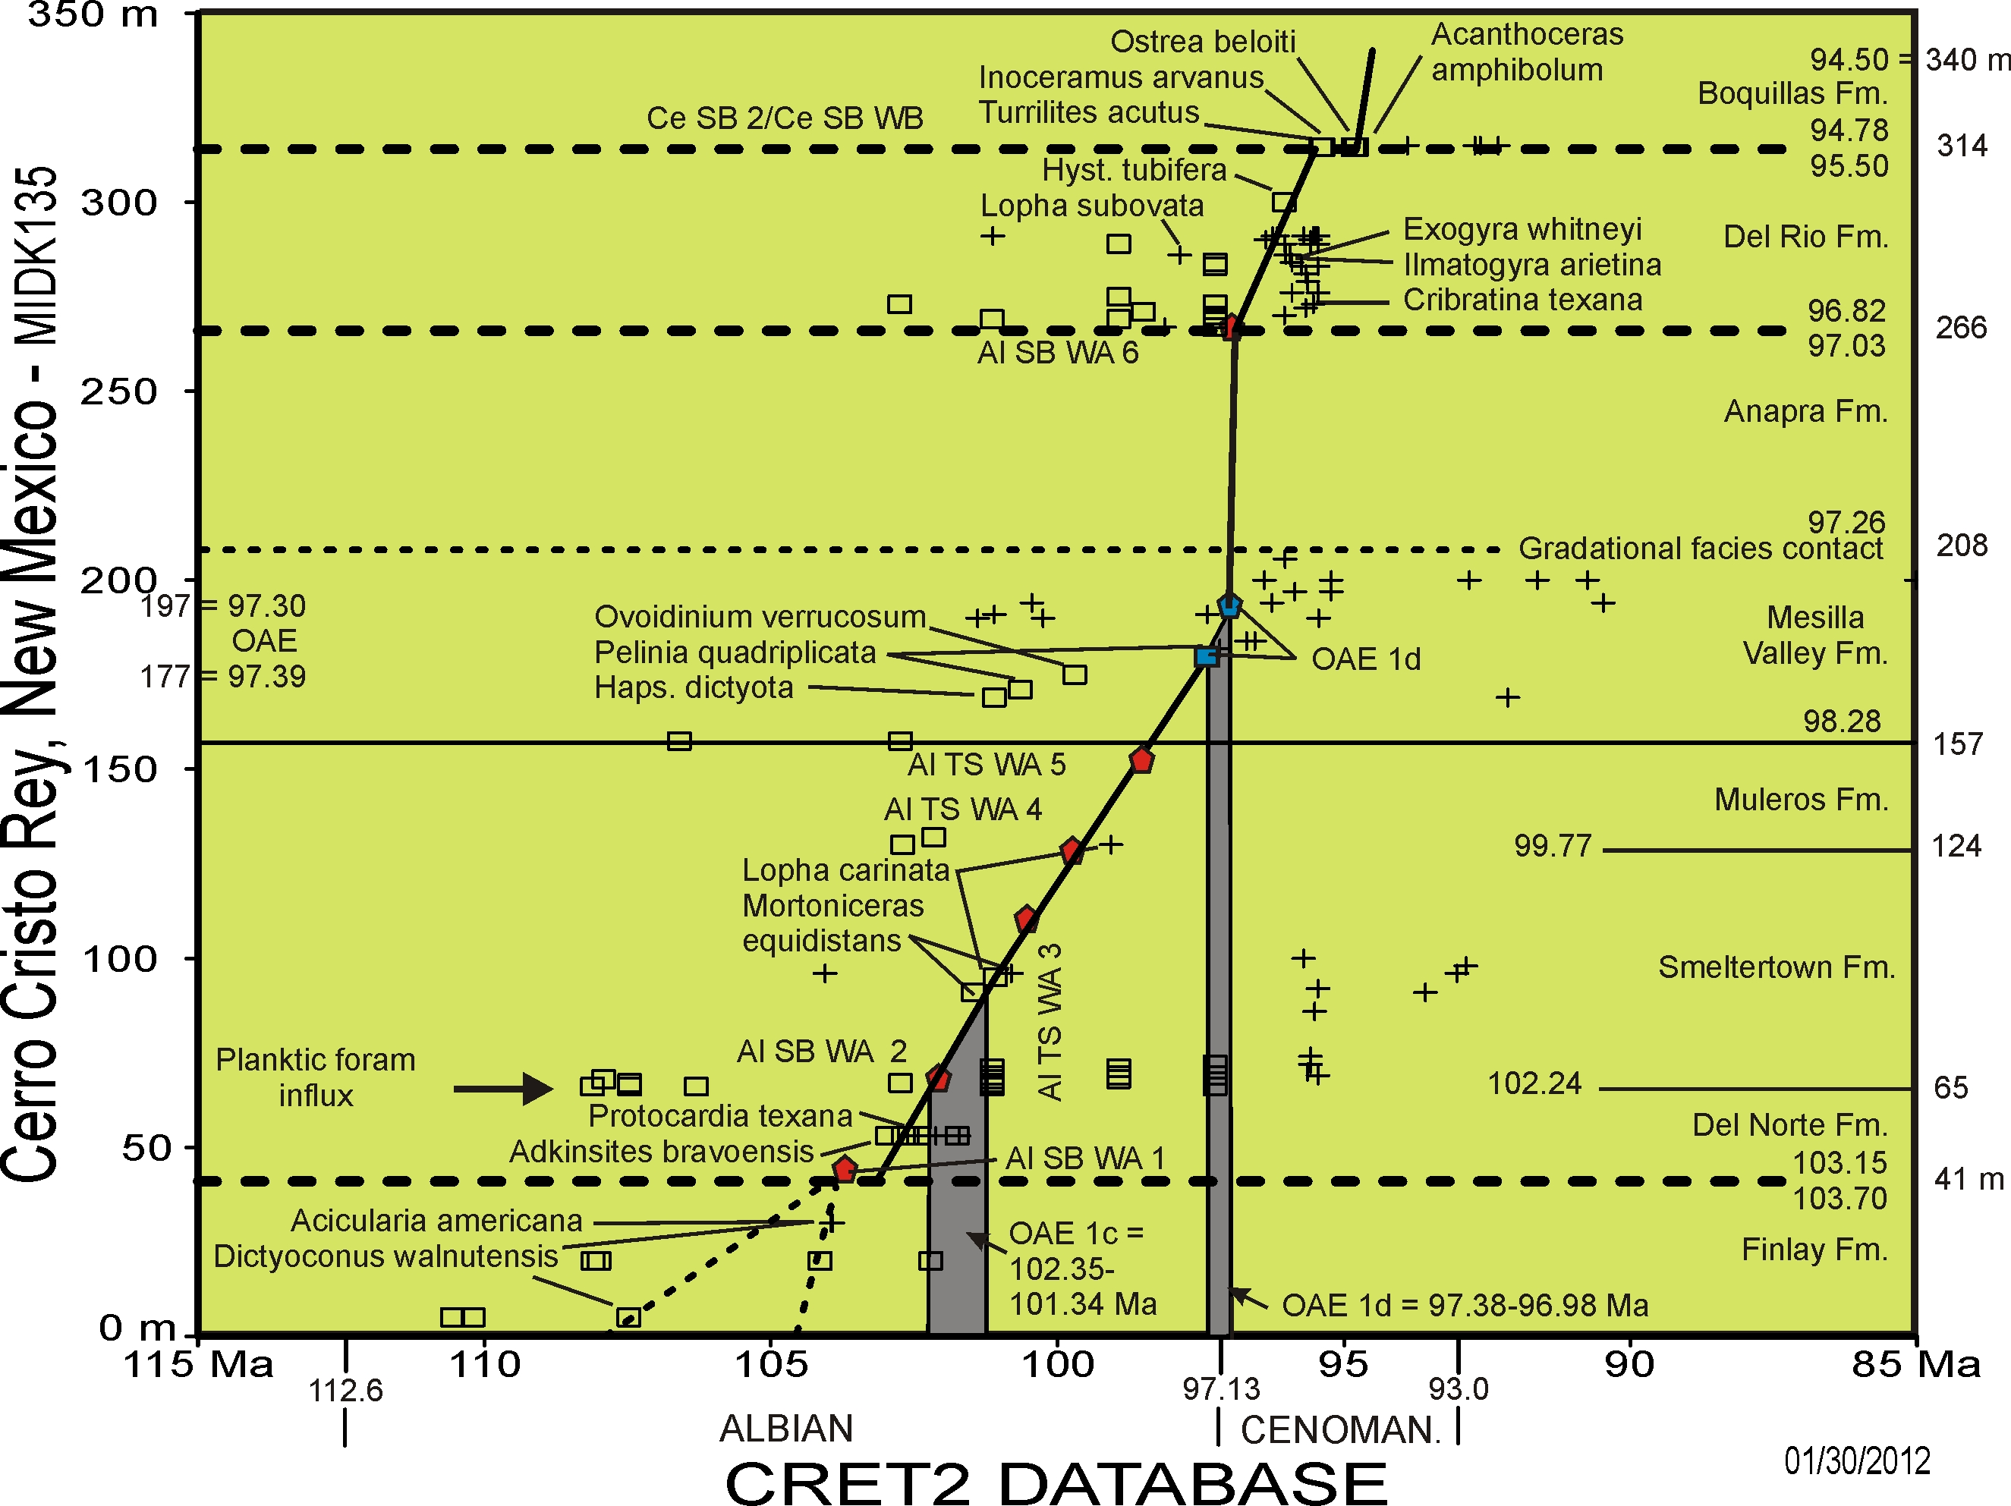
Chronostratigraphic Analysis
Paleogeographic Setting
Chonostratigraphic Models of Cretaceous Oceanic Anoxic Events
Late Albian paleogeography southwestern United States
And northwestern Mexico (Lucas et al., 2010; Scott et al., 2003).
Takashima et al., March 2006, Workshop Reports,
Scientific Drilling, No. 2, p. 50-51
Mid-Cretaceous black shale units and oceanic anoxic events.
Oceanic strontium isotopes, carbon isotopes and Haq sea level
related to emplacement of large igneous volcanism (Leckie et al. 2002, Fig. 2).
Plankton evolutionary events of speciation first appearances and
Extinction last occurrences in 1myr increments. Greatest turnover
Correlates with major OAEs (Leckie et al., 2002, Fig. 7).
References
Erbacher, J., Thurow, J., and Littke, R., 1996, Evolution patterns
of radiolarian and organic matter variations: a new approach
to identify sea-level changes in mid-Cretaceous pelagic
environments: Geology, V. 24, no. 6, p. 499-502.
Leckie, R.M., Bralower, T.J., and Cashman, R., 2002,
Oceanic anoxic events and plankton evolution: biotic response
to tectonic forcing during the mid-Cretaceous:
Paleoceanography, v. 17, no. 3, doi: 10.1029/2001PA000623.
Lucas, S.G., 2010, Cretaceous stratigraphy, paleontology,
petrography, depositional environments, and cycle stratigraphy
at Cerro de Cristo Rey, Doña Ana County, New Mexico:
New Mexico Geology, v. 32, no. 4, p. 103-130.
Poulton, S.W. and Canfield, D.W., 2011, Ferruginous conditions:
a dominant feature of the ocean through Earth’s history:
Elements, v. 7, p. 107-112.
Schlanger, S.O. and Jenkyns, H.C., 1976, Cretaceous oceanic anoxic events: causes and consequences: Geologie en Mijnbouw, v. 55, no. 3-4, p. 179-184.
Scott, R.W., Benson, D.G., Morin, R.W., Shaffer, B.L.,
Oboh-Ikuenobe, F.E., 2003, Integrated Albian-lower Cenomanian chronostratigraphy standard, Trinity River section, Texas. In Scott, R.W. (ed.), Cretaceous stratigraphy and paleoecology, Texas and Mexico: Perkins Memorial volume, GCSSEPM Foundation, Special Publications in Geology, v. 1, p. 277-334.
Cretaceous strata at Cerro Cristo Rey comparing modern lithostratigraphy
with 1910 numbered scheme; comprehensive biostratigraphic data
correlates this section with European ammonite zones. Numeric
ages by graphic correlation (CRETCSDB1 @ precisionstratigraphy.com).
Graphic stratgraphic plot of Cerro Cristo Rey data with global database shows that OAE 1d
defined in DSDP and Italian sections correlates with Mesilla Valley Formation.

