Slide 1





2012 GSA
ANNUAL MEETING & EXPOSITION
4-7 November ⏐ Charlotte, North Carolina, USA
Deformation Processes
In Lithospheric
High-Strain Zones
A standardized protocol to test oblique transpression models in heterogeneous high-strain zones (the Torcal de Antequera massif, southern Spain)
Díaz-Azpiroz, M.¹, Barcos, L.¹, Balanyá, J.C.¹, Fernández, C.², Expósito, I.¹, Czeck, D.³
¹ - Dpt. Sistemas Físicos, Químicos y Naturales, U. Pablo de Olavide, Seville (Spain)
² - Dpt. Geodinámica y Paleontología, U. de Huelva, Huelva (Spain)
³ - Geosciences, U. of Wisconsin, Milwaukee (USA)

Slide 2


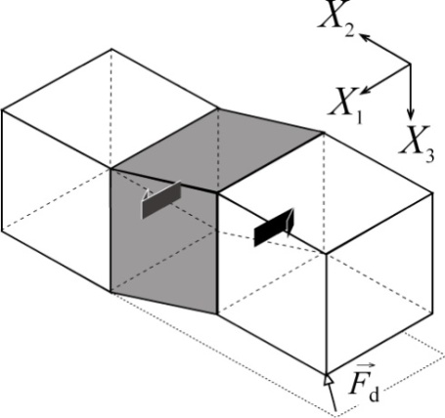
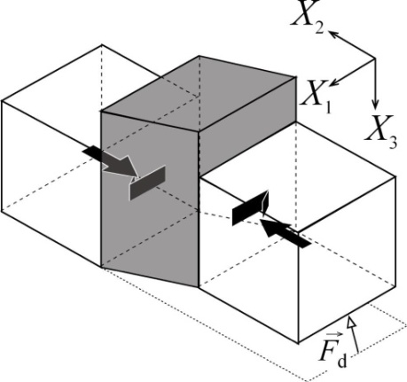
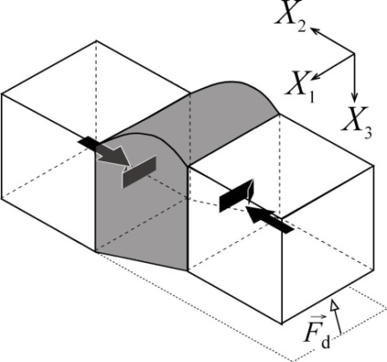
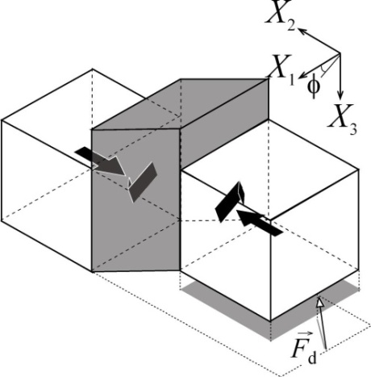
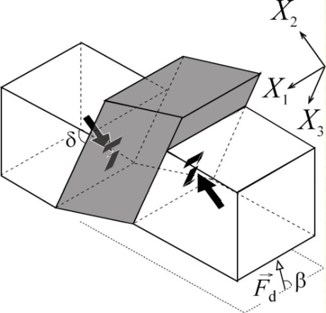
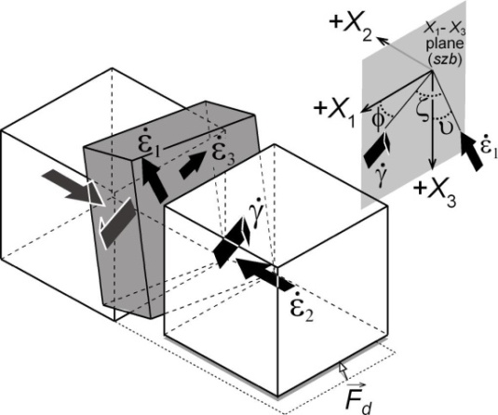
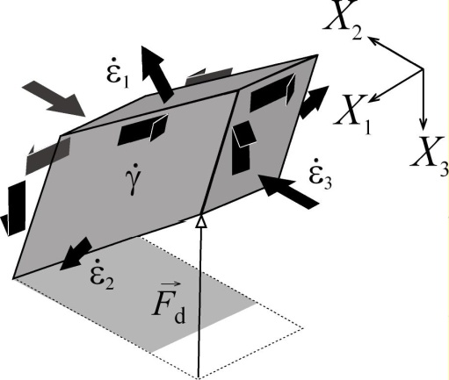
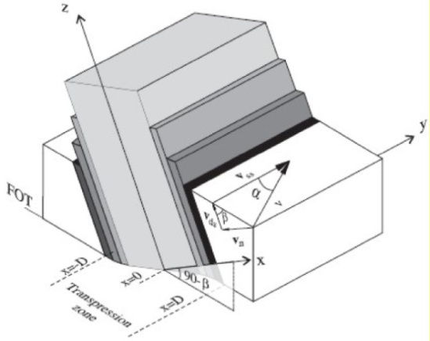
A standardized protocol to test oblique transpression models in heterogeneous high-strain zones (the Torcal de Antequera massif, southern Spain)
1. Introduction
2. The Torcal Massif
3. The Protocol − Results
5. Conclusions & Further questions
γ/ε
t
No-slip
φ
Ramsay & Graham (1970)
Sanderson & Marchini (1984)
Fossen & Tikoff (1993)
Robin & Cruden (1994)
Dutton (1997)
Lin et al. (1998)
Jiang & Williams (1998)
δ
β
υ
ε_{v}
Jones et al. (2004)
Fernandez & Diaz Azpiroz (2009)
Tikoff & Fossen (1993)
Soto (1997)
Jiang (2007)
+ non-isochoric (Ebner & Graseman, 2006); non steady-state (Horsman & Tikoff, 2007); heterogeneous simple and pure shear (Jiang, 2007; Iacopini et al., 2009); rheology…

Slide 3
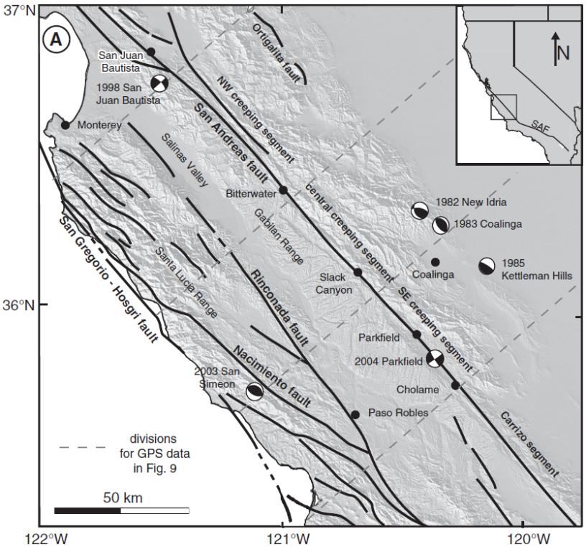
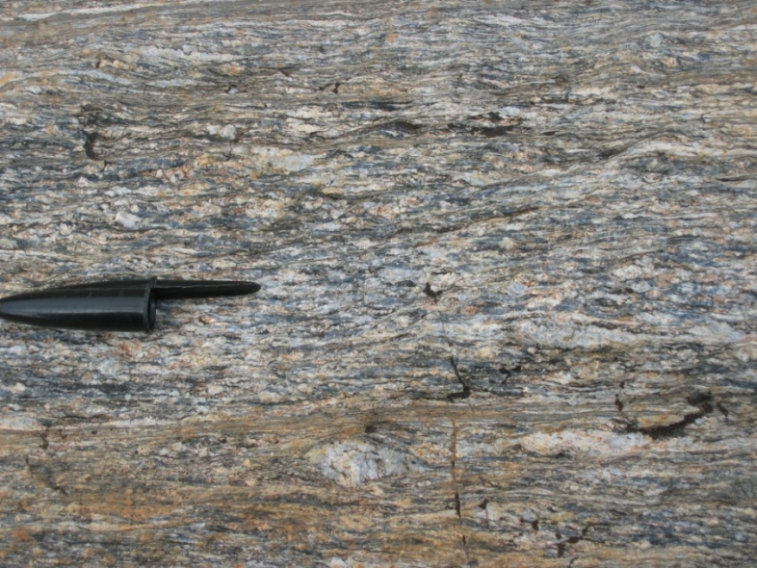
A standardized protocol to test oblique transpression models in heterogeneous high-strain zones (the Torcal de Antequera massif, southern Spain)
1. Introduction
2. The Torcal Massif
3. The Protocol − Results
5. Conclusions & Further questions
Are these models suitable for brittle-ductile def.?
Protocol applicable to heterogeneous zones
Better knowledge of upper crust transpression
Titus et al. (2011)
Standardized Procedures
Czeck & Hudleston (2003)
Fernandez et al. (submitted to JSG)

Slide 4
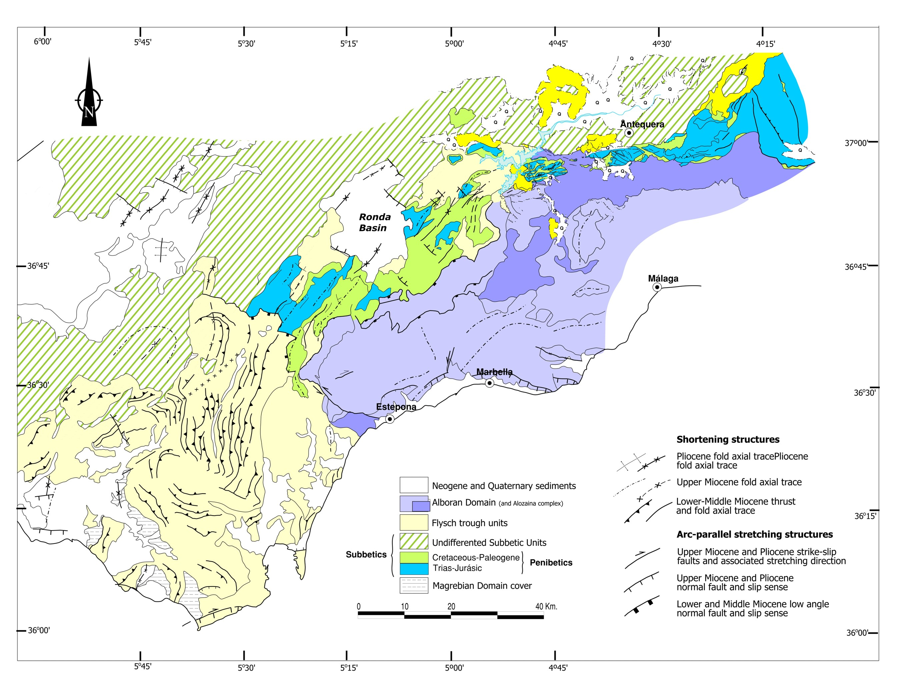
A standardized protocol to test oblique transpression models in heterogeneous high-strain zones (the Torcal de Antequera massif, southern Spain)
1. Introduction
2. The Torcal Massif
3. The Protocol − Results
5. Conclusions & Further questions
A case study from the
Betics (Betic – Rif Orogen)
Western Mediterranean

Slide 5
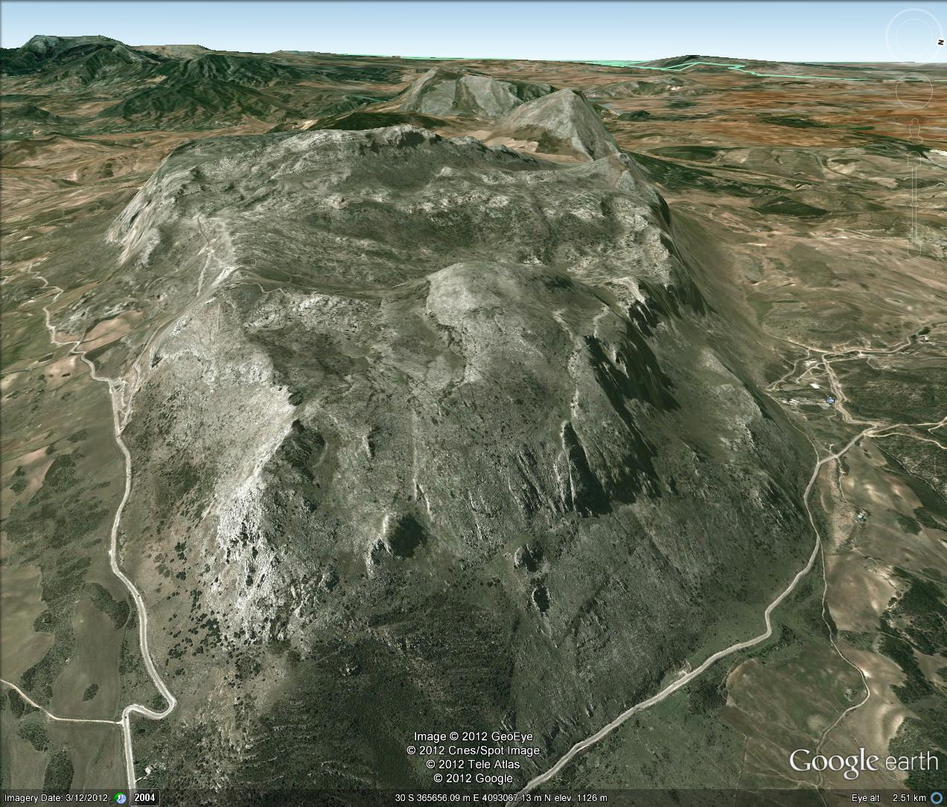
A standardized protocol to test oblique transpression models in heterogeneous high-strain zones (the Torcal de Antequera massif, southern Spain)
1. Introduction
2. The Torcal Massif
3. The Protocol − Results
5. Conclusions & Further questions
Cretacic marly
limestones
Tabular shaped
≈ 4 km
Slip at boundaries
No bias in sampling
Volume constant
Steady −state
“Homogeneous” def.
Jurassic limestones
≈ 10 km
The Torcal de Antequera Massif (TAM)

Slide 6
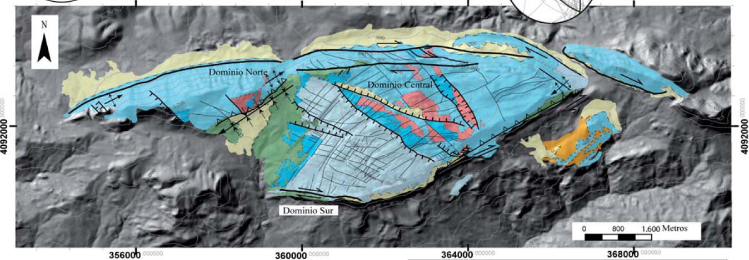
A standardized protocol to test oblique transpression models in heterogeneous high-strain zones (the Torcal de Antequera massif, southern Spain)
1. Introduction
2. The Torcal Massif
3. The Protocol − Results
5. Conclusions & Further questions
Strain partitioning within the TAM
Outer domains:
~ E-W dextral strike-slip dominated transpressional bands
Northern Outer Domain
Inner Domain
Southern Outer Domain
NE-SW directed, SE-vergent folds and reverse faults
Inner domain
NW-SE directed, NE-SW dipping normal faults

Slide 7
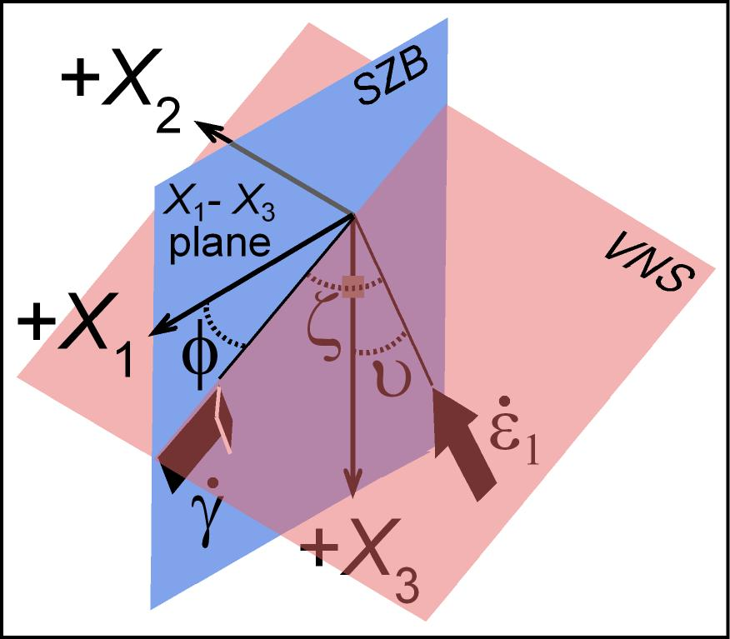
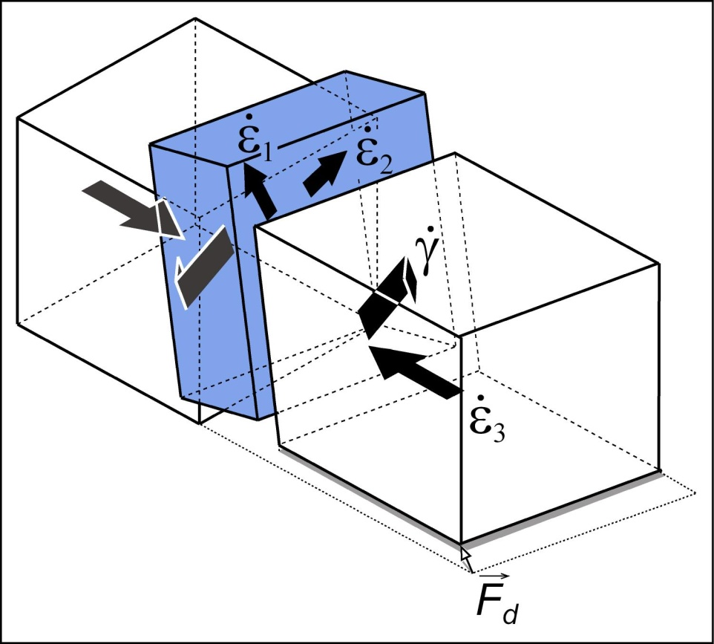
A standardized protocol to test oblique transpression models in heterogeneous high-strain zones (the Torcal de Antequera massif, southern Spain)
1. Introduction
2. The Torcal Massif
3. The Protocol − Results
5. Conclusions & Further questions
Protocol for testing transpression models in brittle high-strain zones
Analyze each domain separately
Triclinic transpression with oblique extrusion (φ, υ, W_{k})
Up to five consequtive steps
Constraining φ and υ
Orientation of the FSE
Shape of the FSE
Oblique convergence (α) ⇨ φ and W_{k}
GPS plate displacement ⇨ Vel. field
φ , υ and W_{k}

Slide 8
A standardized protocol to test oblique transpression models in heterogeneous high-strain zones (the Torcal de Antequera massif, southern Spain)
1. Introduction
2. The Torcal Massif
3. The Protocol − Results
5. Conclusions & Further questions
Constraining φ and υ
Slip on faults ⇨ simple shear direction ⇨ φ
In principle (specially at the upper crust), dip-parallel extrusion ⇨ υ ≈ 0º
Watch out for consistently dipping fold axes ⇨ non dip-parallel facing directions
Feed-back: estimated values ⇨ unreasonable results ⇒ Back to step 1
Fold axes
Facing directions
SZB Dip direction
υ < 15º
Stretched fold hinges
⇩
strike-slip simple shear ⇒ low φ
Reverse faults
⇩
dip-parallel simple shear ⇒ high φ
φ < 70º

Slide 9
A standardized protocol to test oblique transpression models in heterogeneous high-strain zones (the Torcal de Antequera massif, southern Spain)
1. Introduction
2. The Torcal Massif
3. The Protocol − Results
5. Conclusions & Further questions
2 - 3. Orientation and shape of the FSE ⇨ φ , υ and W_{k}

Slide 10
A standardized protocol to test oblique transpression models in heterogeneous high-strain zones (the Torcal de Antequera massif, southern Spain)
1. Introduction
2. The Torcal Massif
3. The Protocol − Results
5. Conclusions & Further questions
2 - 3. Orientation and shape of the FSE ⇨ φ , υ and W_{k}
NW
SE
e = 0.18-0.3
e = - 0.2

Slide 11
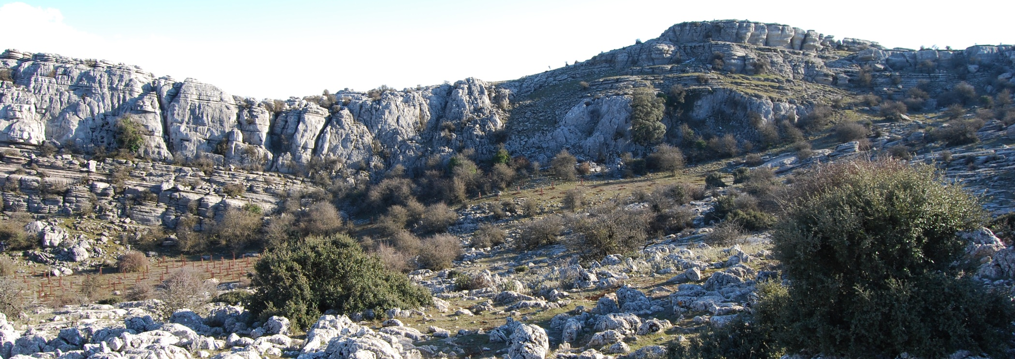
A standardized protocol to test oblique transpression models in heterogeneous high-strain zones (the Torcal de Antequera massif, southern Spain)
1. Introduction
2. The Torcal Massif
3. The Protocol − Results
5. Conclusions & Further questions
2 - 3. Orientation and shape of the FSE ⇨ φ , υ and W_{k}
40.5 m

Slide 12
A standardized protocol to test oblique transpression models in heterogeneous high-strain zones (the Torcal de Antequera massif, southern Spain)
1. Introduction
2. The Torcal Massif
3. The Protocol − Results
5. Conclusions & Further questions
2 - 3. Orientation and shape of the FSE ⇨ φ , υ and W_{k}
e = 0.07

Slide 13
A standardized protocol to test oblique transpression models in heterogeneous high-strain zones (the Torcal de Antequera massif, southern Spain)
1. Introduction
2. The Torcal Massif
3. The Protocol − Results
5. Conclusions & Further questions
2 - 3. Orientation and shape of the FSE ⇨ φ , υ and W_{k}
Good
Poor
Adjustment quality
Fair
No adjust

Slide 14
A standardized protocol to test oblique transpression models in heterogeneous high-strain zones (the Torcal de Antequera massif, southern Spain)
1. Introduction
2. The Torcal Massif
3. The Protocol − Results
5. Conclusions & Further questions
2 - 3. Orientation and shape of the FSE ⇨ φ , υ and W_{k}
Good
Poor
Adjustment quality
Fair
No adjust

Slide 15
A standardized protocol to test oblique transpression models in heterogeneous high-strain zones (the Torcal de Antequera massif, southern Spain)
1. Introduction
2. The Torcal Massif
3. The Protocol − Results
5. Conclusions & Further questions
2 - 3. Orientation and shape of the FSE ⇨ φ , υ and W_{k}
No adjustment
fair
good
poor
fair

Slide 16
A standardized protocol to test oblique transpression models in heterogeneous high-strain zones (the Torcal de Antequera massif, southern Spain)
1. Introduction
2. The Torcal Massif
3. The Protocol − Results
5. Conclusions & Further questions
2 - 3. Orientation and shape of the FSE ⇨ φ , υ and W_{k}

Slide 17
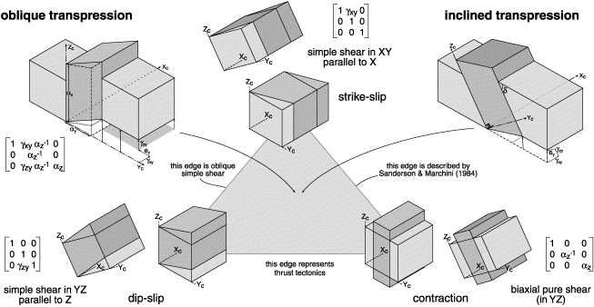
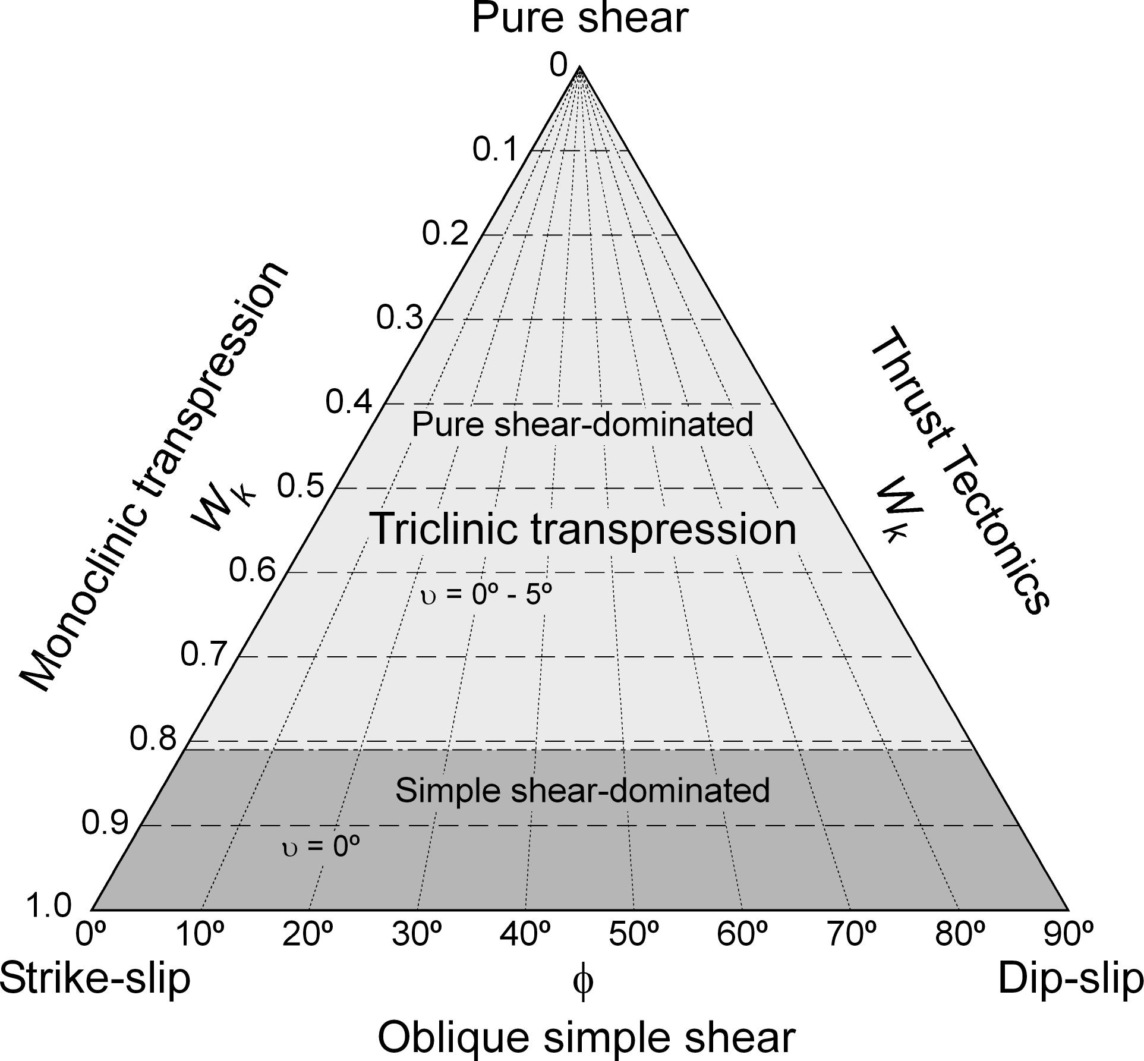
A standardized protocol to test oblique transpression models in heterogeneous high-strain zones (the Torcal de Antequera massif, southern Spain)
1. Introduction
2. The Torcal Massif
3. The Protocol − Results
5. Conclusions & Further questions
2 - 3. Orientation and shape of the FSE ⇨ φ , υ and W_{k}
Strain triangle
Jones et al. (2004)

Slide 18
A standardized protocol to test oblique transpression models in heterogeneous high-strain zones (the Torcal de Antequera massif, southern Spain)
1. Introduction
2. The Torcal Massif
3. The Protocol − Results
5. Conclusions & Further questions
4. Angle of oblique convergence ⇨ φ , υ and W_{k}
SZB
W
F_{d} - P
φ
α
VNS
α ≈ 17 – 35º
F_{d} - N
F_{d}
Θ

Slide 19
A standardized protocol to test oblique transpression models in heterogeneous high-strain zones (the Torcal de Antequera massif, southern Spain)
1. Introduction
2. The Torcal Massif
3. The Protocol − Results
5. Conclusions & Further questions
The main results of this study show that…
A protocol to test triclinic transpression with oblique extrusion on brittle-ductile heterogeneous high-strain zones is proposed. Applied to the TAM, it has permitted to constrain the main transpression parameters
The outer domains accommodated dextral strike-slip simple shear dominated transpression. The Inner Domain accommodated pure shear dominated transpression. The likely far-field vector responsible for bulk strain within the TAM ranges17 – 35º
Complex kinematic models yield reasonable approximations to nature (even in brittle-ductile conditions), but a standardized procedure is recommended
However…
We have not included GPS measurements , which would give an independent way to get transpression parameters (work in progress: TOPOIBERIA Project)
Several aspects that need to be integrated: migrating boundaries, volume change…
These are kinematic models. Rheology needs to be involved. Brittle-ductile deformation gives a good chance via analogue modeling. The proposed protocol may be used previously to contrain some parameters (work in progress)

Slide 20
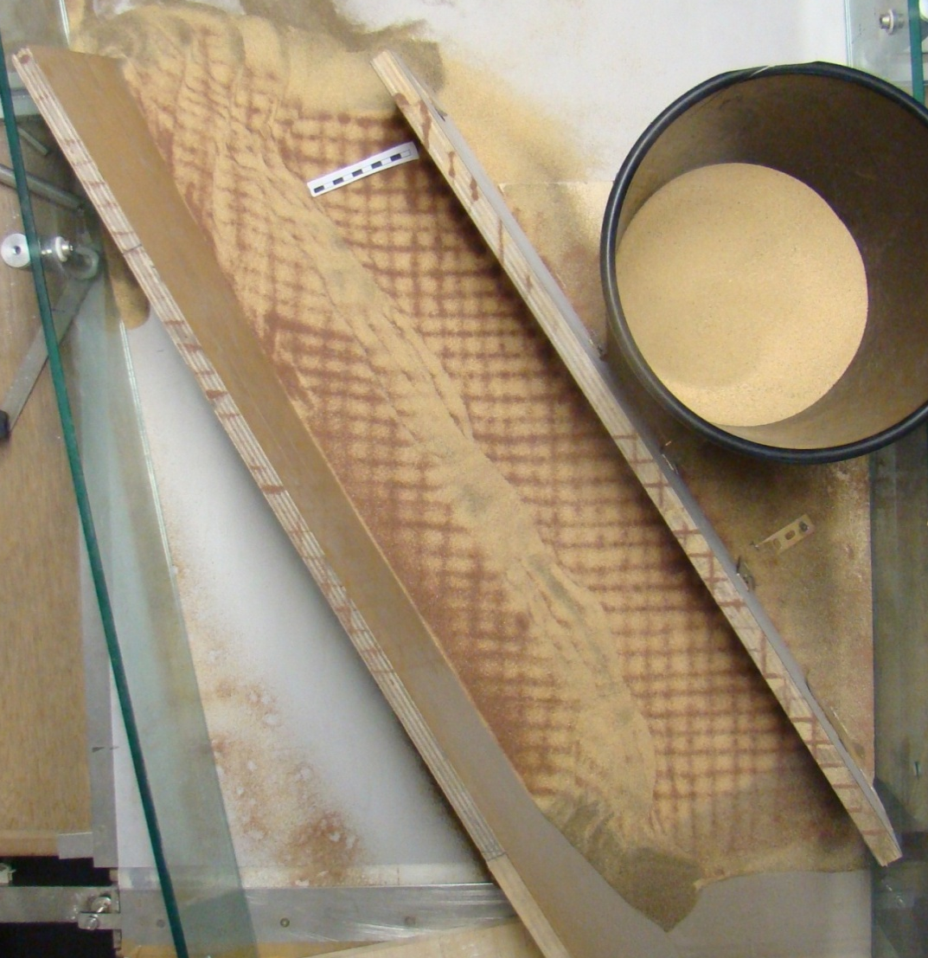
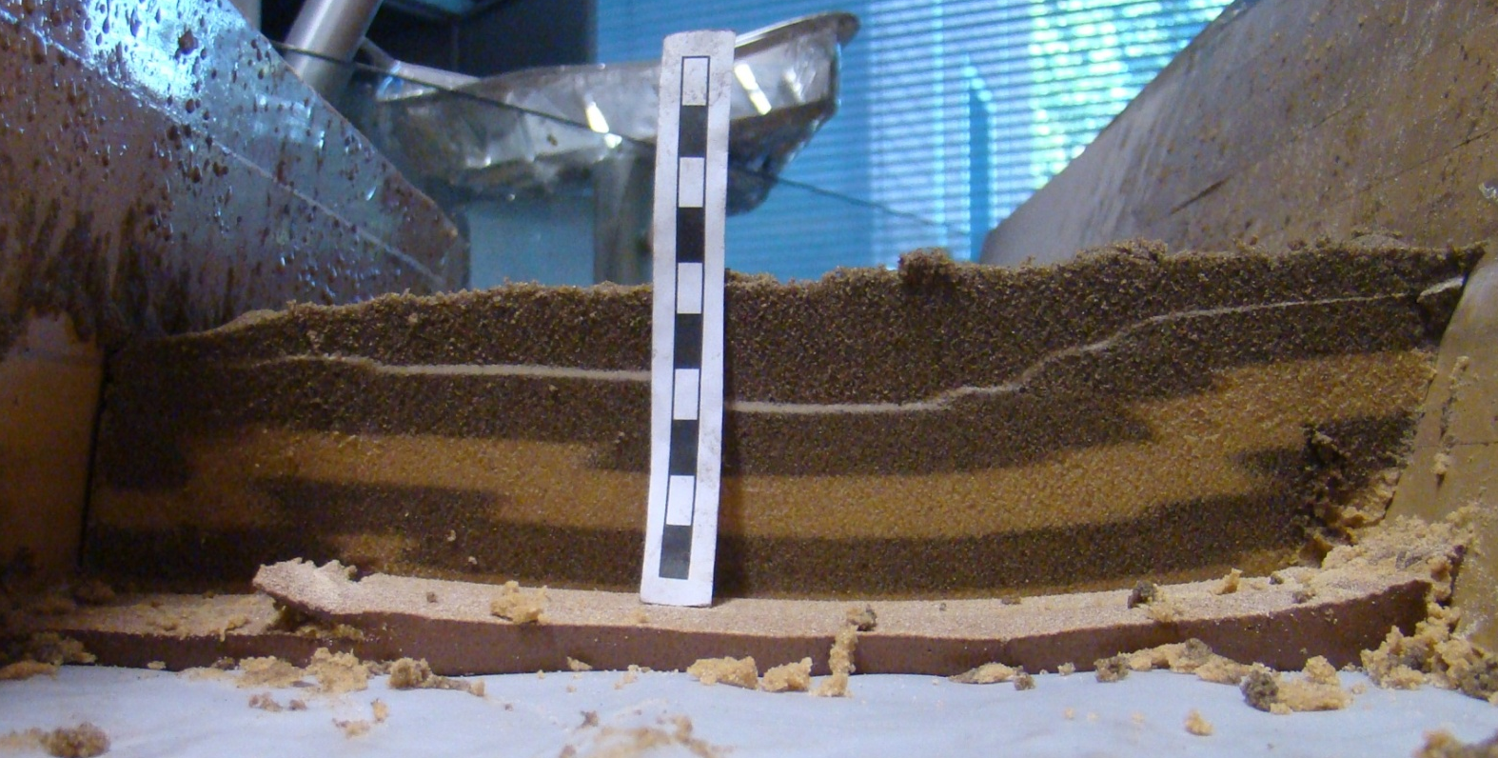
L. Barcos at Roma 3 University (Italy)
First experiments – Work in Progress

Slide 21
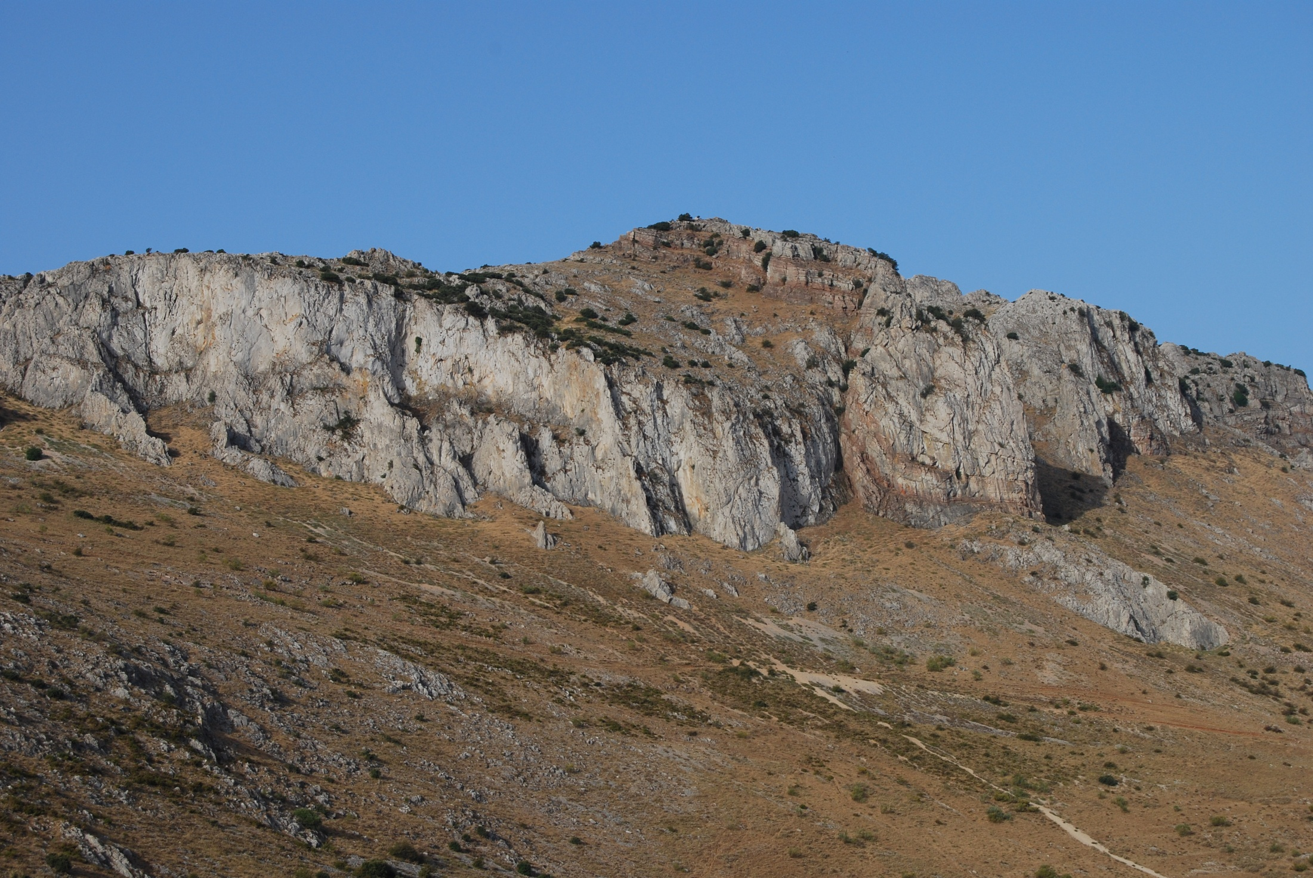
Thank you for your attention
Financial support from projects: CGL2009-11384, CGL2010-22022-CO2-01 RNM 215, RNM3713, CONSOLIDER INGENIO 2010-CSD2006-00041

