Slide 1
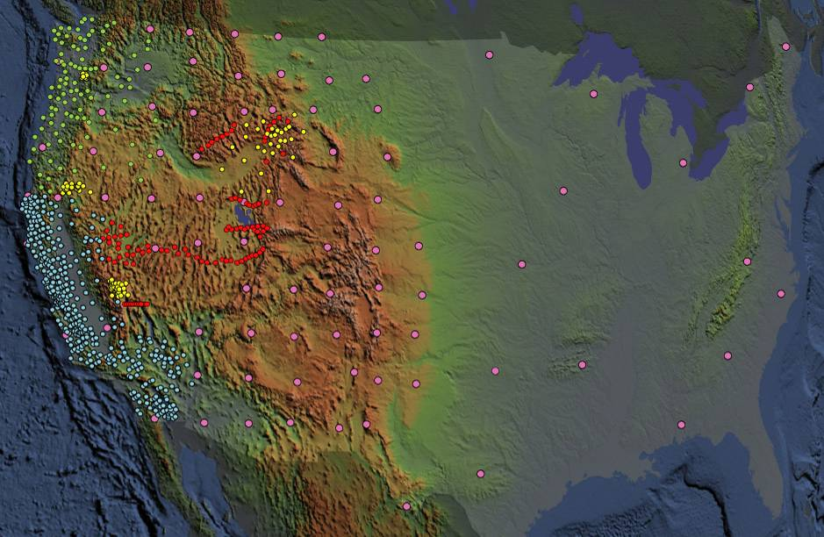




Engaging Novice Earth Science Learners in EarthScope Science
Robert Butler, Frank Granshaw, Roger Groom, Chris Hedeen, Jenda Johnson, Bonnie Magura, Beth Pratt-Sitaula, Denise Thompson, and Jill Whitman

Slide 2




EarthScope Education Programs
OSU EarthScope National Office, 2007 – 11
ASU EarthScope National Office, 2011 – 14
IRIS Education and Public Outreach
UNAVCO Education and Outreach
Teachers on the Leading Edge (TOTLE), 2008-10
US Geological Survey
John Wooden: “It’s amazing how much can be accomplished if nobody cares who gets the credit.”

Slide 3
A Deadly Dozen Recent Earthquakes
1. Japan March, 2011
20,894 killed or missing
11. Pakistan October, 2005
80,000 killed
8. China May, 2008
60,000 killed
5. Haiti January, 2010
46,000 – 85,000 killed
12. Sumatra December, 2004
230,000 killed
Earthquakes and hurricanes are the most deadly natural disasters.
Notes:
The relevance of teaching about earthquakes.

Slide 4
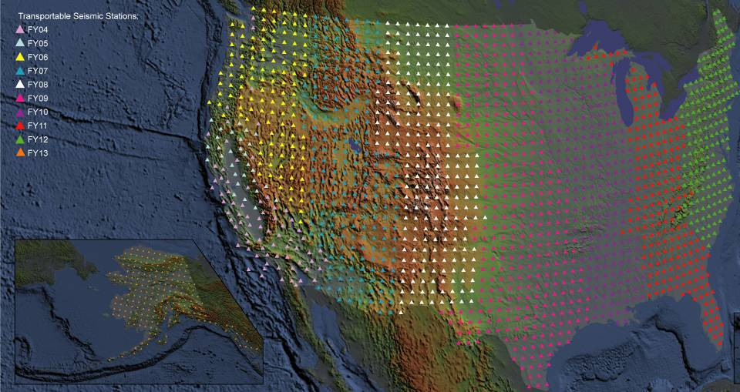
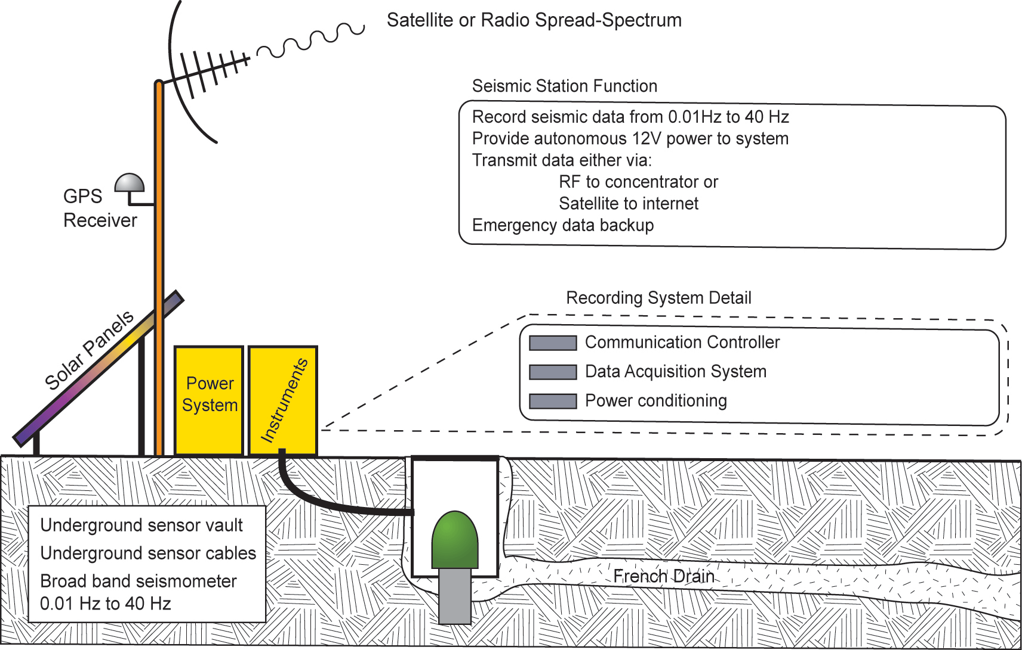
USArray:
Transportable Array (TA)
400 Transportable Array (TA) Seismometers
Spaced every 70 km
Each station occupies a site for 1½ to 2 years
10 years to leap-frog across the country

Slide 5
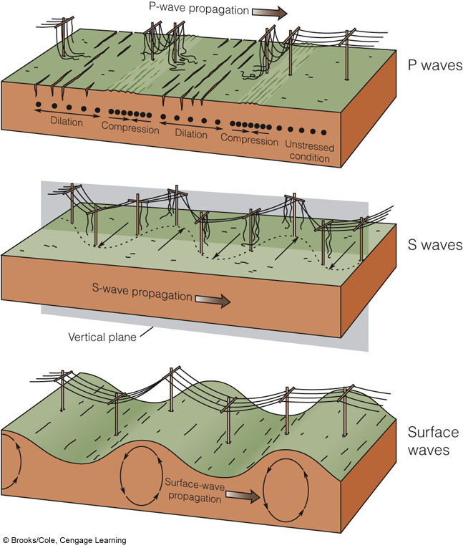
Types of Seismic Waves
Primary Waves
Pressure Waves
Fast
Small amplitude
Secondary Waves
Shear Waves
Intermediate,
Larger amplitude
Surface Waves
Slow
Largest amplitude

Slide 6
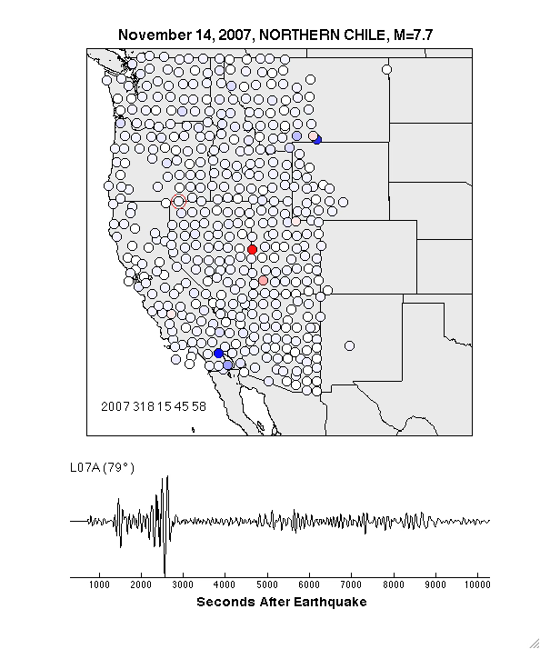
USArray Wave Visualizations
P waves
~700 sec
S waves
~1300 sec
Surface waves
~2200 sec
Thanks to Charles Ammon, Bob Woodward, and IRIS DMC
Notes:
USArray animations provide unusually effective visual reinforcement of relative speed of P, S, and surface waves.
In a different window, show USArray animation of Nov 14, 2007 M7.7 EQ in northern Chile.

Slide 7
IRIS Home Page
Wave Visualizations

Slide 8
USArray Wave Visualizations
Search
Tutorials

Slide 9
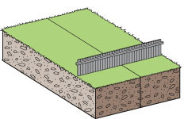
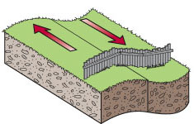
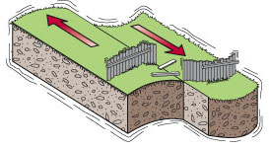
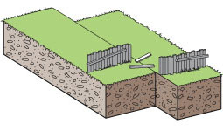
Elastic Rebound Theory
(a) Original position
(b) Deformation
Earthquake!
(c) Rupture and release of energy
(d) Rocks rebound to original
undeformed shape
Three Fs of earthquakes: forces, faults, and friction.
Slow accumulation and rapid release of elastic energy.
Notes:
The mechanics of earthquakes. Basically earthquakes result from the “jerky” motion of rocks along faults. Slip on faults generally does not occur in a smooth, steady fashion but rather as a series of jerks. “Elastic rebound theory” was developed by J.R. Reid during his studies of the San Andreas Fault after the disastrous 1906 San Francisco earthquake. This four-part diagram presents the essence of elastic rebound theory. Between A and B, forces slowly bend rocks adjacent to the fault. Strain energy is stored in the rocks as they are bent. C. When stress along the fault exceeds the strength of rocks on the fault, the rocks on opposite sides of the fault suddenly snap producing an earthquake. D. The rocks on opposite sides of the fault end up in a new position with much of the stored strain energy released by the earthquake. Then the “earthquake cycle” starts again. The interaction of forces, faults, and friction (the 3 Fs) controls earthquakes.

Slide 10
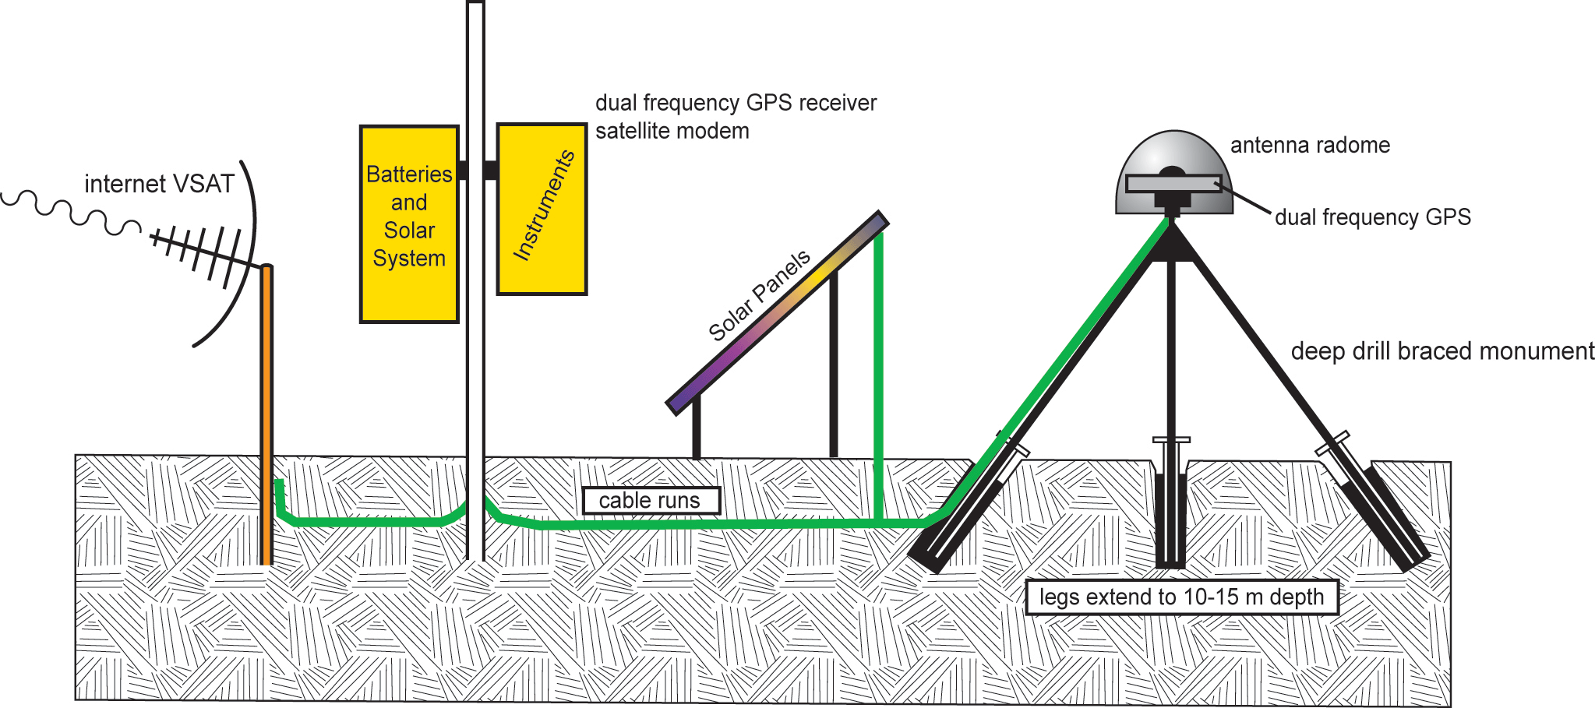
Plate Boundary Observatory (PBO)
-1100 permanent Global Positioning System (GPS) stations
-78 Borehole Seismometers
-74 Borehole Strainmeters (BSM)
-26 Tiltmeters
-6 Laser Strainmeters (LSM)
Measure the broad temporal and spatial spectrum of plate boundary deformation

Slide 11
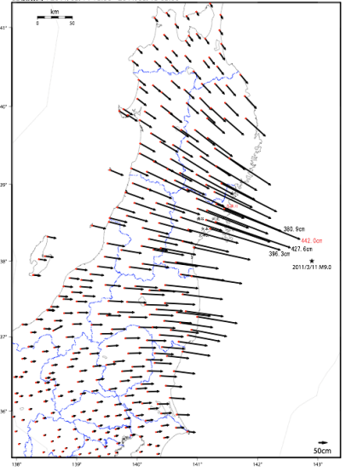
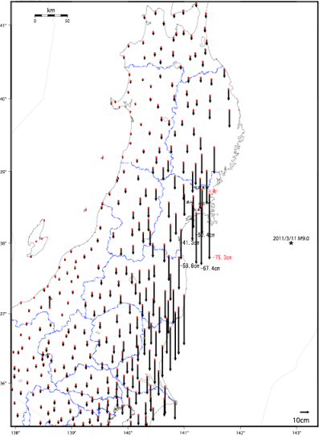
Tohoku Earthquake GPS Displacements
4.42 meters (14.5 feet)
of horizontal displacement
0.75 meters (2.5 feet)
of subsidence

Slide 12
Subsidence at Yuriage
Before
After
Some areas that were above sea level on March 10 dropped below sea level on March 11.
This also happened along the Washington - Oregon coast during the 1700 AD great Cascadia earthquake.

Slide 13
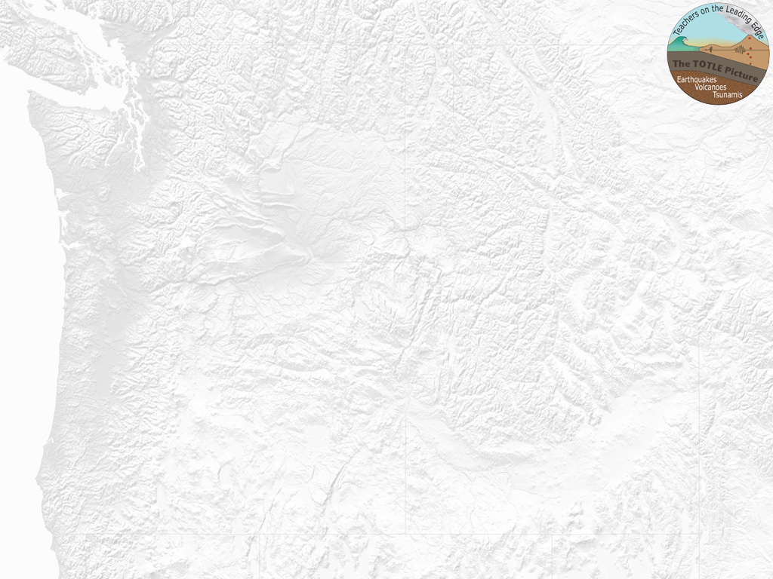
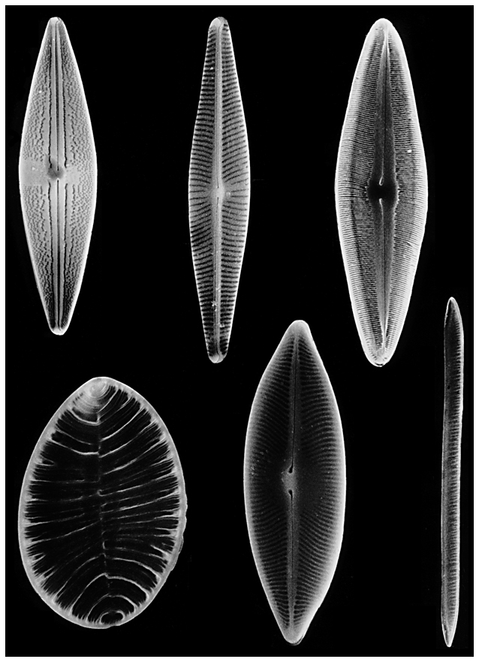
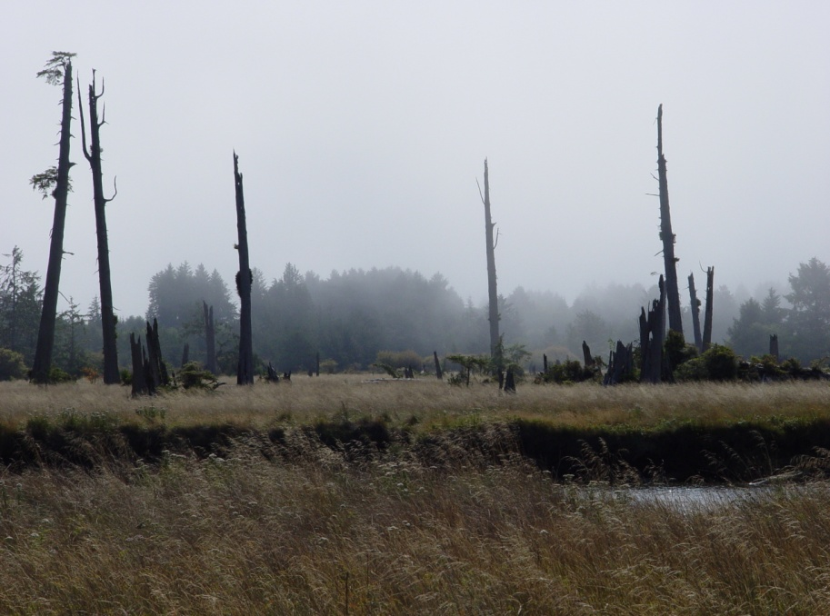
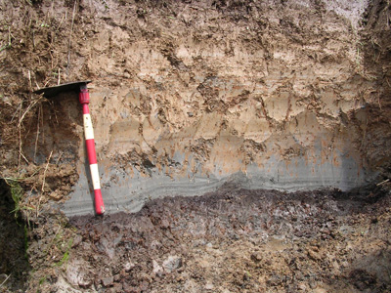
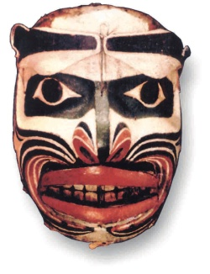
How Science Really Works
Cascadia Tsunami Geology Storyline
Do Great (Gianormous) Earthquakes Happen in Cascadia?
→ Great earthquake January 26, 1700 @ 9 PM
Ghost forests, buried soils, diatoms, tsunami sand sheets, liquefaction, turbidites, Native American oral history, and written Japanese history
Intertidal mud & clay
Tsunami sand
Forest soil
Notes:
Make the point that case histories of scientific discovery are an effective method for teaching the scientific method that are endorsed by the Next Generation Science Education Standards. Cascadia tsunami geology can be crafted into a crime-scene investigation.

Slide 14
Making a Ghost Forest
Notes:
Show Ghost Forest animation of discovery of the 1700 AD great Cascadia earthquake as illustration of scientific discovery.

Slide 15
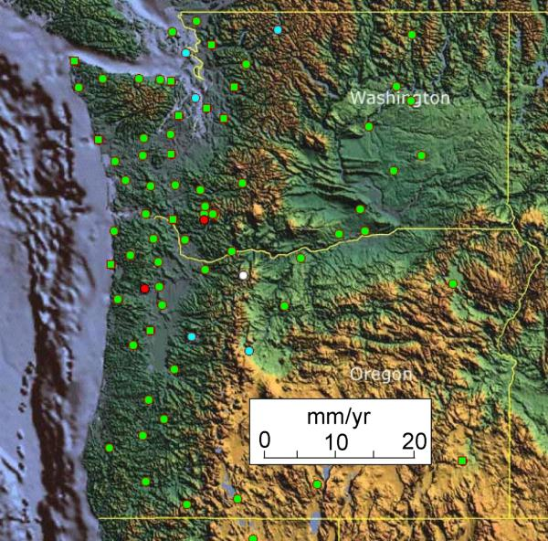
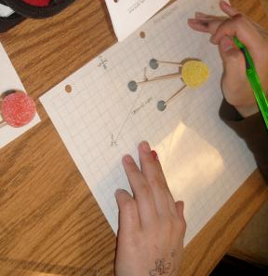
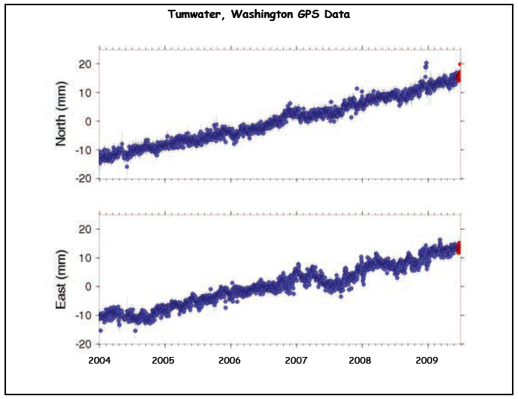
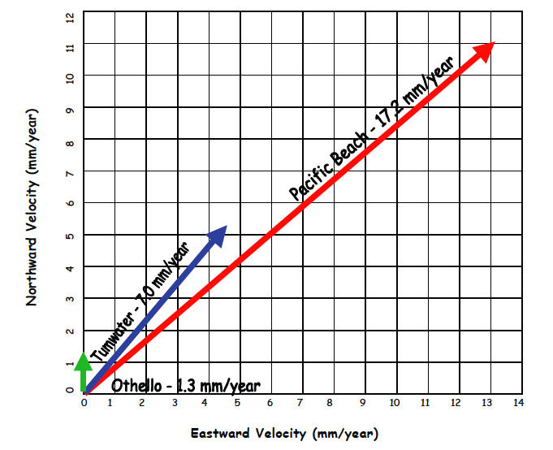

GPS Activities
Build gumdrop GPS receiver.
Determine motions of three stations from GPS time series.
Link to PNW crustal block model.
Scaffold with video of teacher explaining the classroom setup and teacher introduction (Roger Groom, Shelley Olds, and Becca Walker).
Provide ETS activity as an enhancement.
Pacific
Beach
Tumwater
Othello
Juan de Fuca
Notes:
How to engage middle school students in PBO data analysis.

Slide 16
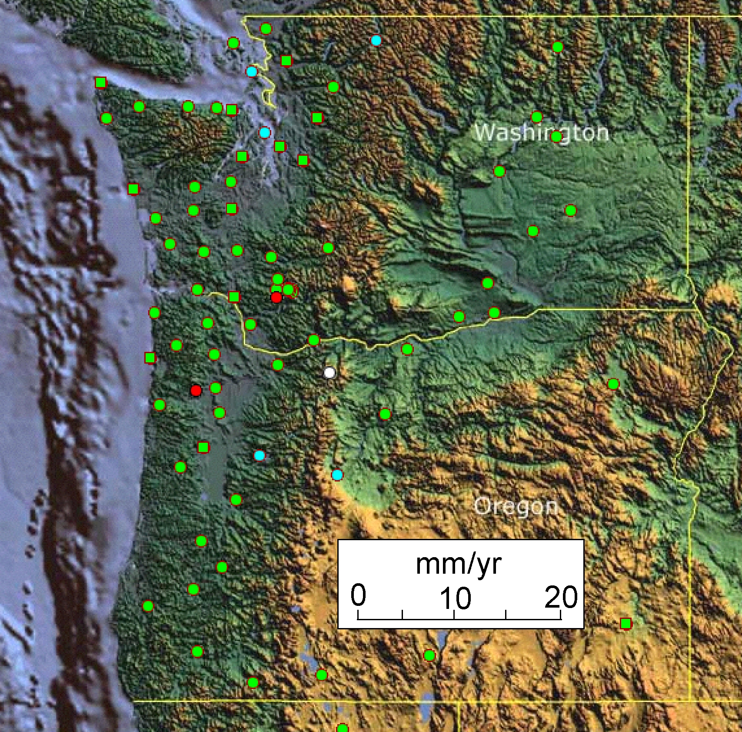
Cascadia Locked and Loading
Episodic Tremor and Slip
Stations on coast are moving NE faster than stations in urban corridor.
Cascadia subduction zone boundary is “locked and loading” as it stores elastic energy that will be released in the next great Cascadia earthquake.
If the next great Cascadia earthquake happens tomorrow, Pacific Beach will jump 5.35 meters (17.5 feet) southwest.
Neah
Bay
Pacific
Beach
Tumwater
Othello
Kelso
Tillamook
Wasco
La Grande
Newport
Corvallis
Juan de Fuca Plate
Notes:
Implications of Cascadia PBO data. Cascadia is locked and loading during the slow accumulation of elastic energy that will be rapidly released in the next Cascadia great subduction zone earthquake.
Outlined zone experiences Episodic Tremor and Slip, a newly discovery resulting from invention of high-precision differential GPS technology.

Slide 17
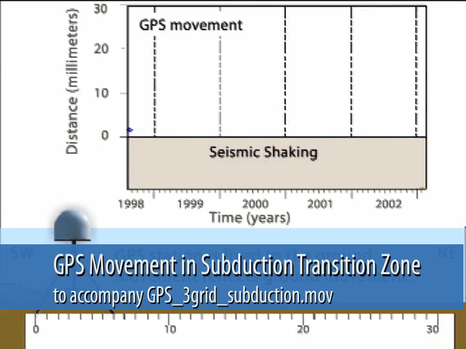

Episodic Tremor and Slip
Animations by JENDA JOHNSON

Slide 18
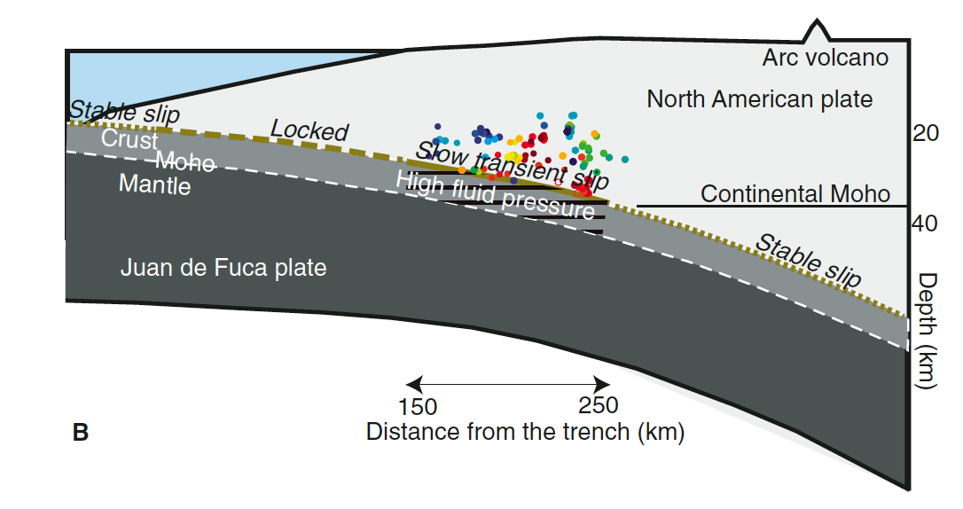
Episodic Tremor and Slip
Slow slip between North American and Juan de Fuca plates at 20 – 40 km depth. A transitional behavior between the shallow locked zone and the continuously slipping zone deeper than 40 km.

Slide 19
Episodic Tremor and Slip
Animations by JENDA JOHNSON
Notes:
Show 3-grid ETS animation is separate window.

Slide 20
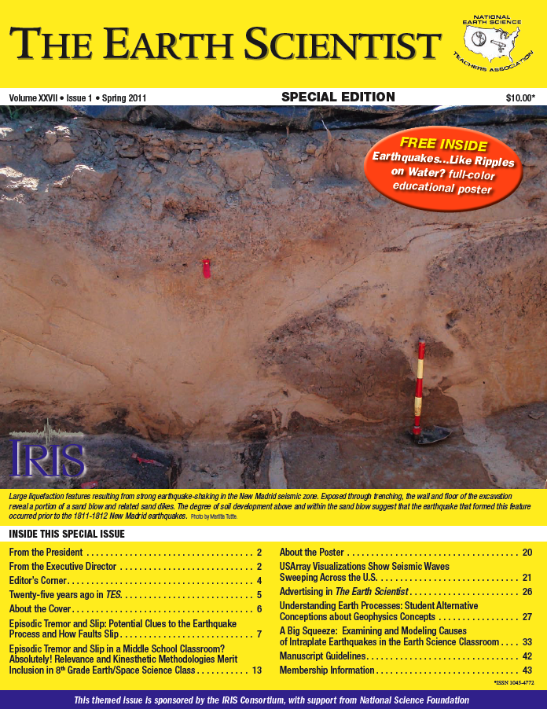
The Earth Scientist
Spring 2011
Michael Hubenthal, IRIS Guest Editor of special issue on seismology.
Two articles on teaching about ETS.
Articles on USArray, alternative conceptions about geophysics, and intraplate earthquakes.
http://www.iris.edu/hq/resource/tes_spring_2011

Slide 21
IRIS Home Page
For Educators

Slide 22
IRIS “For Educators” Page
IRIS: InClass Coming Soon
Animations
Lesson Plans
IRIS: InClass

