Slide 1
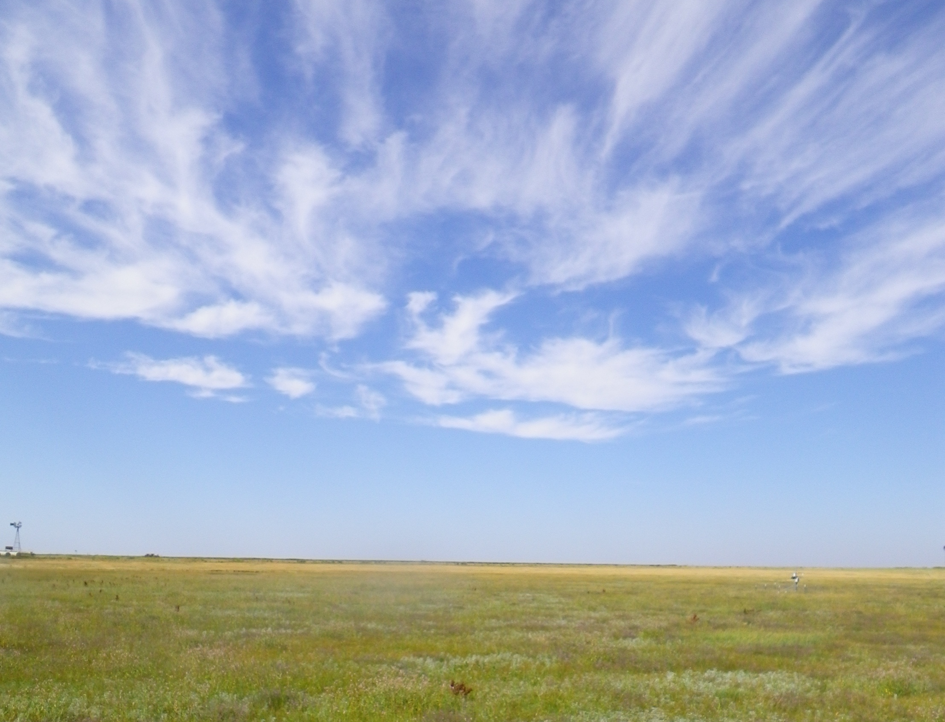
A Thousand Points of Recharge:
Can alternative management strategies increase recharge from the playa lakes of the Southern High Plains to the Ogallala Aquifer?
Preliminary results
Texas Water Development Board
USDA Agricultural Research Service
Texas Tech University

Slide 2
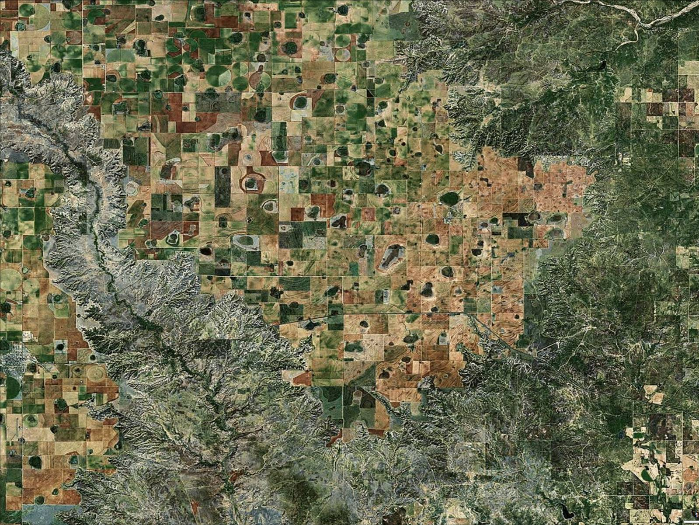
Outline
Playa geography
TWDB playa research program
Monitoring strategy
Preliminary 2012 results
Water balance issues
Conclusions
Plans for continued research

Slide 3
Scope of TWDB Playa Program
Research goal: develop and test alternative playa management strategies to increase recharge to the Ogallala Aquifer
  Phase 1: Monitor playas to determine overall volume of water collected and current recharge rates
  Phase 2: Modify selected playas, assess cost and performance issues

Slide 4
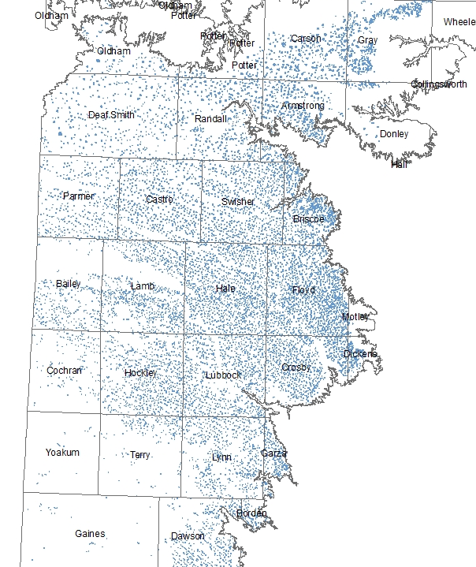
What’s a playa?
Small, internally drained wetlands
Collect runoff from 80% of High Plains land area
Over 19,000 mapped playas in Texas High Plains
Resource for migratory waterfowl
Source of recharge to Ogallala
Notes:
Playas primarily mapped on basis of characteristic Vertic soil type in playa bottoms

Slide 5
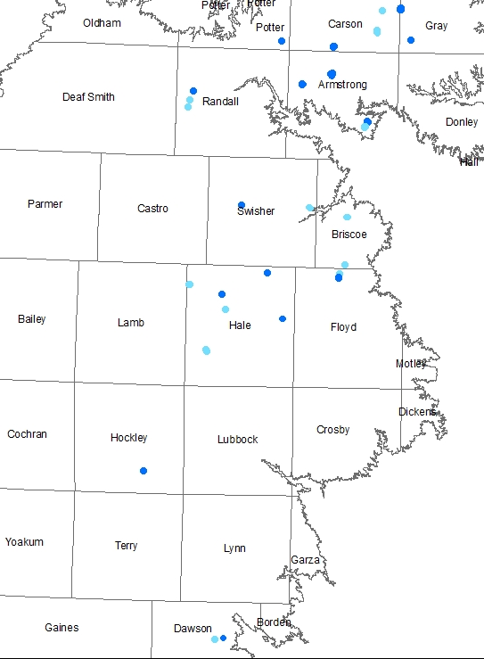
TWDB playa monitoring
17 sites with weather stations and soil moisture monitoring
16 sites with water level monitoring only
LEGEND
Met station
Water level only
Notes:
Locations determined largely by landowner interest and willingness to participate
First station installed April 2011; installation continues as landowners sign up
Project area cover ~14,000 square miles and is 400 miles from TWDB headquarters

Slide 6
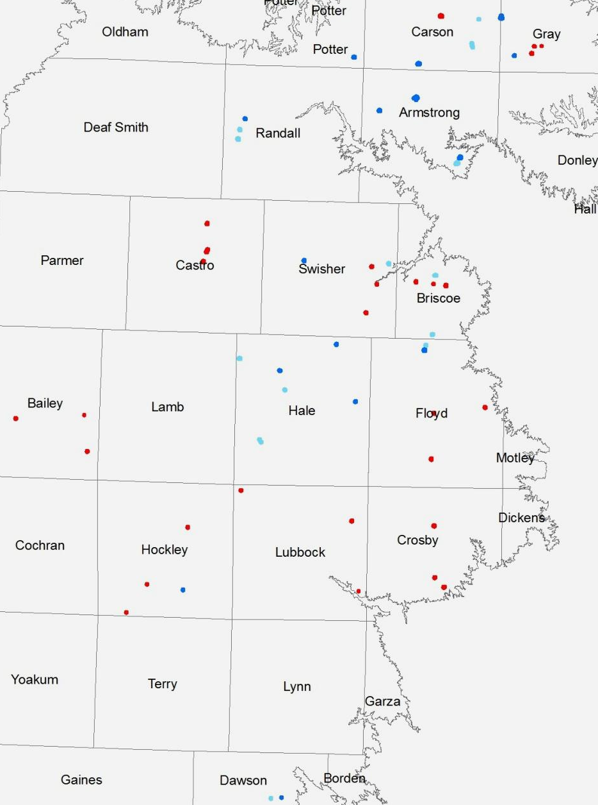
TWDB playa monitoring
17 sites with weather stations and soil moisture monitoring
16 sites with water level monitoring only
30 additional sites monitored by USDA-ARS and Texas Tech University playa project
2012 flooding in approximately one half of monitored sites
LEGEND
Met Station
Water level only
ARS-TTU site
Notes:
The distribution of TWDB sites is largely a function of landowner interest.
The ARS-TTU project design includes one playa each in crop, range, and CRP settings in ten counties
ARS-TTU playas have been monitored since 2007
Circles indicate areas where May-June 2012 flooding occurred

Slide 7
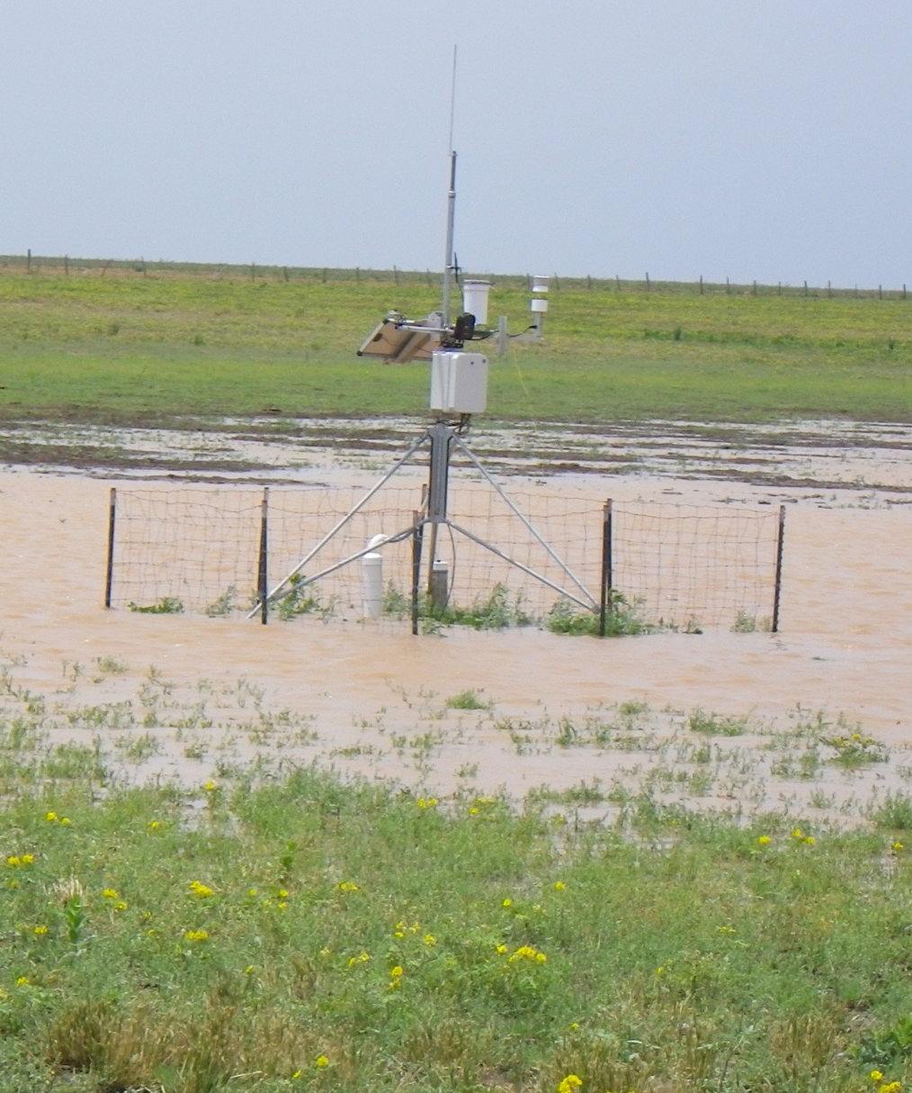
Site instrumentation
Met Station:
  temperature , wind speed, wind direction, RH, Precipitation, Solar radiation, water level, temperature, and conductivity, Subsurface soil moisture tension, Time-lapse imagery
Soil descriptions and moisture content to 20 ft +
Soil resistivity profiles at selected sites
Groundwater monitor wells at select sites
Notes:
High resolution topographic surveys completed at all playas with adequate access
ARS-TTU playas are monitored for generally similar parameters, but have limited capacity to measure subsurface moisture

Slide 8
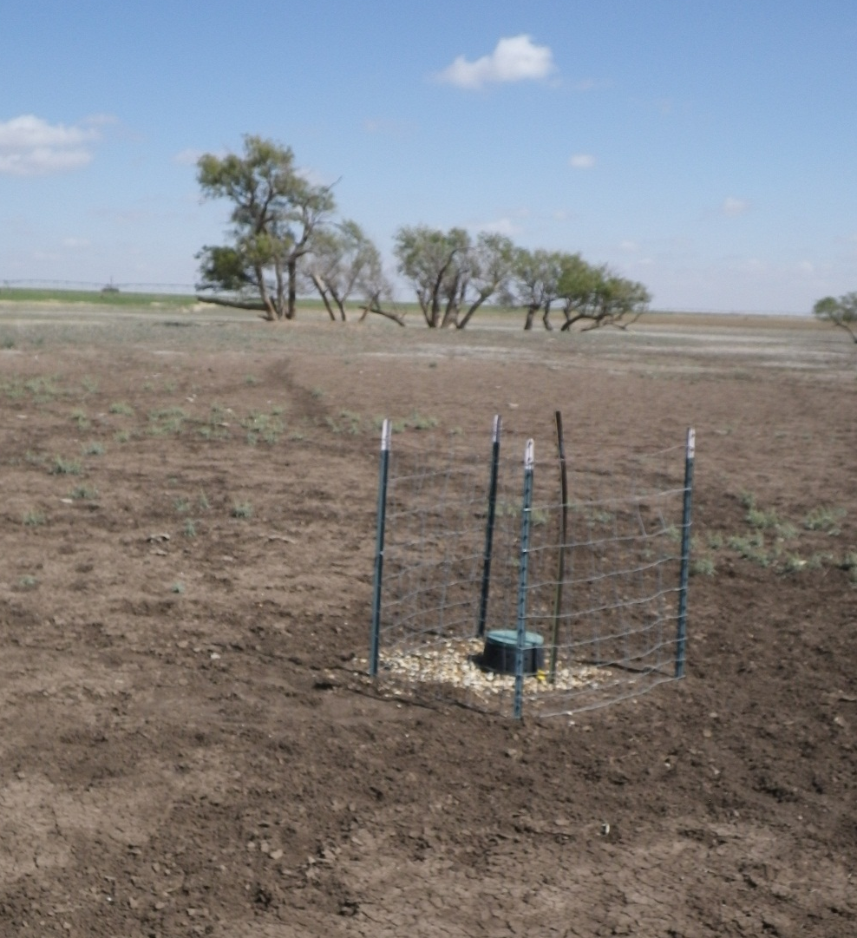
Site instrumentation
Water level only sites:
  Unvented pressure transducer/data logger
  Barometric compensation from nearest weather station
Notes:
The data from these stilling wells also shows the drop in saturation depth after surface water disappears. Additional stilling wells are planned at greater depths to track the subsurface movement of the saturation front in selected playas.

Slide 9
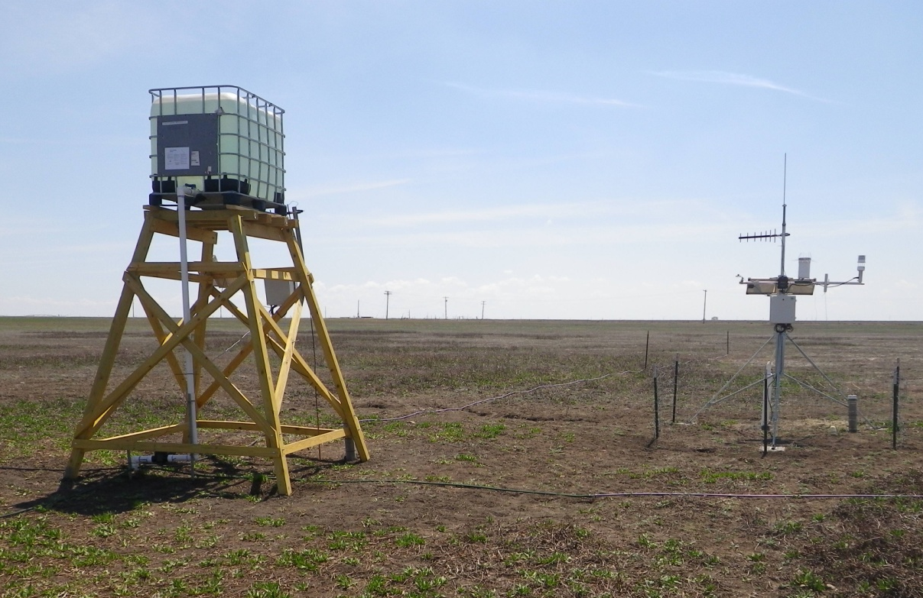
Tracer site
Calcium bromide tracer
Remote alert when water level reaches target depth
Solution diluted and dispersed through 500’ of drip hose
Surface water and lysimeter samples to detect tracer migration
Playa remains dry
Notes:
Target concentration of 20 to 30 ppm bromide in flood water
Three nests of lysimeters at 5, 10, 15, and 20 feet below ground surface
Surface water and lysimeter samples to be analyzed by ion chromotography

Slide 10
Evapotranspiration data quality
Notes:
Infiltration and recharge estimates depend on accurate data for evapotranspiration, which is calculated from meteorological observations.
Left hand graphic shows 2011 ARS-Lubbock pan evaporation data and ET values calculated from a co-located met station using the Penman-Montieth equations.
The right hand graphic compares calculated ET for the ARS-Lubbock site and the calculated ET for the M. Harrell playa, near Plainview. Differences in environmental settings (urban vs. rural, open ground vs. depression, etc.) probably account for most of the differences. Instrumental error may also contribute.

Slide 11
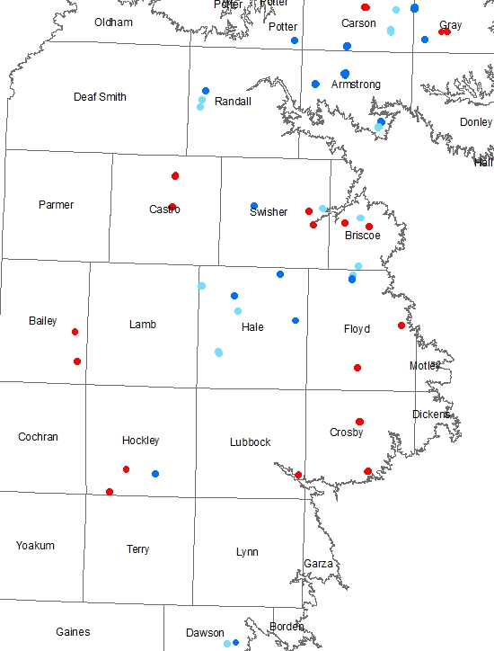
2012 Monitoring
Areas of flooding
Hockley CO
Hale CO
Hale County
Hockley County
LEGEND
Met Station
Water level only
ARS-TTU site
Notes:
During the 2011 drought, virtually all the playas were dry. 2012 remains drier than normal, but playas in Randall, Armstrong, Hale, Hockley, and Dawson Counties were flooded by early summer storms. The following slides provide a quick tour of the results from two of these areas, including geographic setting, basin topography, water level and evaporation, and soil moisture data.

Slide 12
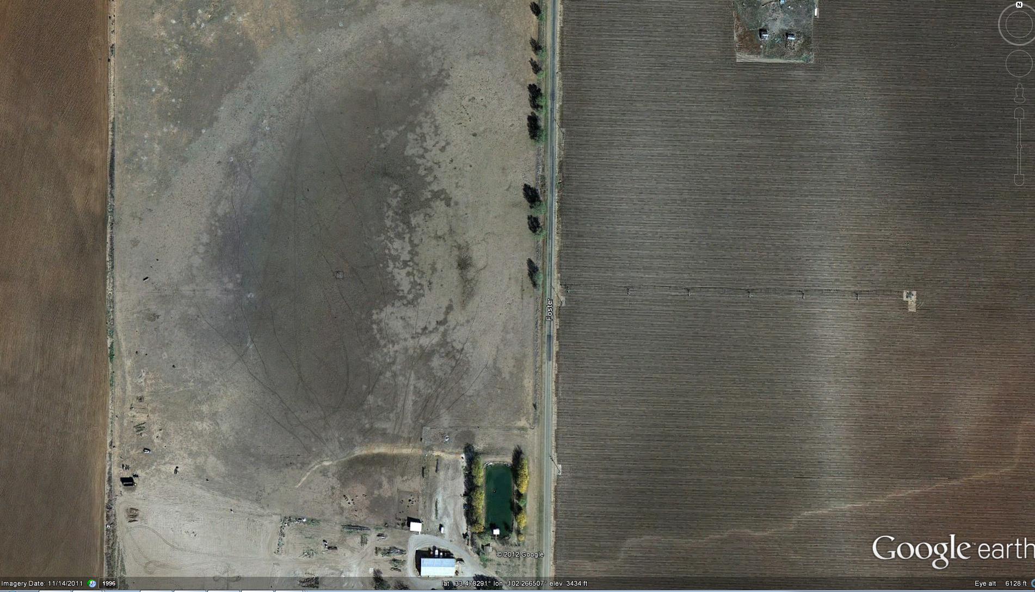
2012 monitoring data
Hockley County, Myatt playa
Notes:
26 acre playa in central Hockley County, about 30 miles SW of Lubbock
Lightly-grazed range-land, with irrigated crops in watershed

Slide 13
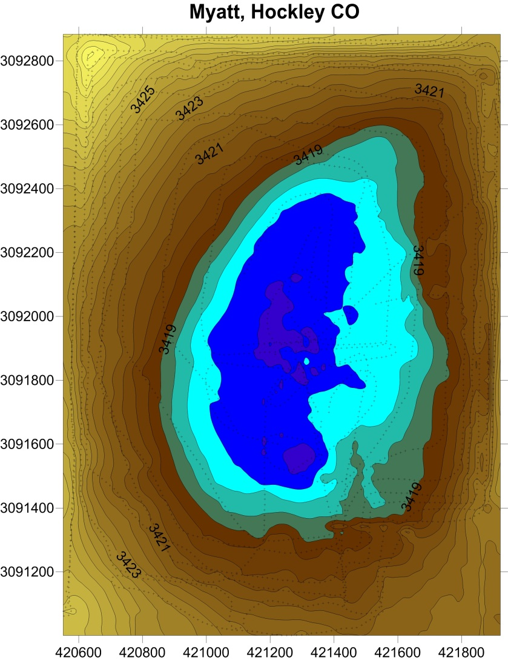
2012 monitoring data
Hockley County, Myatt playa
Notes:
Water flows into this playa from the road bounding the playa to the east. Sediment transported by the floodwaters has built up a delta structure on much of the eastern side of the playa.

Slide 14
2012 monitoring data
Hockley County, Myatt playa
 | WL drop, mm/day | Evaporation, mm/day | Infiltration, mm/day
Initial | 28.95 | 12.36 | 16.59
Late May | 15.20 | 12.95 | 2.15
June - July | 15.44 | 10.13 | 5.31
Notes:
Several storm events maintained flooded conditions in the Myatt playa for three months through the summer of 2012.
The initial storm dropped over 40 mm of rain, with 35.8 mm in one hour
During the first week of inundation in May the infiltration averaged nearly 17 mm/day, but declined to just over 5 mm/day in July

Slide 15
2012 monitoring data
Hockley County, Myatt playa
Notes:
The soil moisture gradient helps explain the changing infiltration rates observed in the Myatt playa. Soil moisture at 4 ft initially saturates as the playa floodwater enters open cracks. The cracks quickly swell shut and the 4 ft moisture re-equilibrates with the dry soil around the cracks over a period of about 2 months. Around June 23 the bulk soil wetting front reaches the 4 ft depth and establishes a downward gradient of soil moisture tension, allowing movement of soil moisture through the profile.

Slide 16
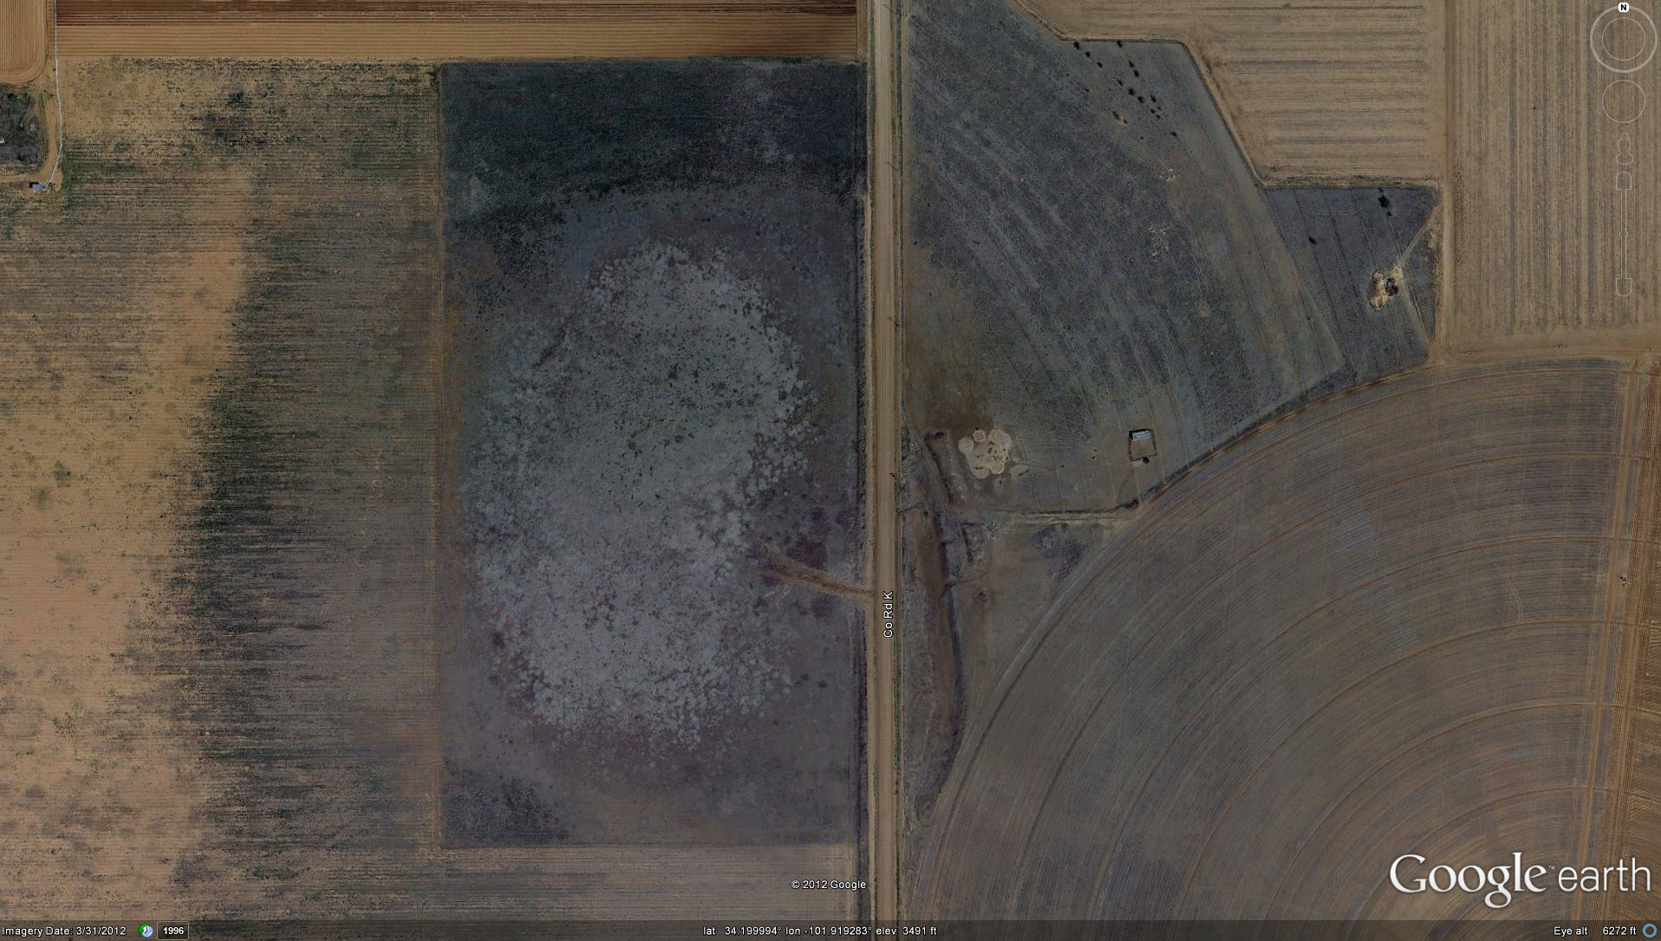
2012 monitoring data
Hale County, M. Harrell playa
Notes:
20 acre playa with lightly grazed native vegetation in playa bottom and irrigated crop land in watershed

Slide 17
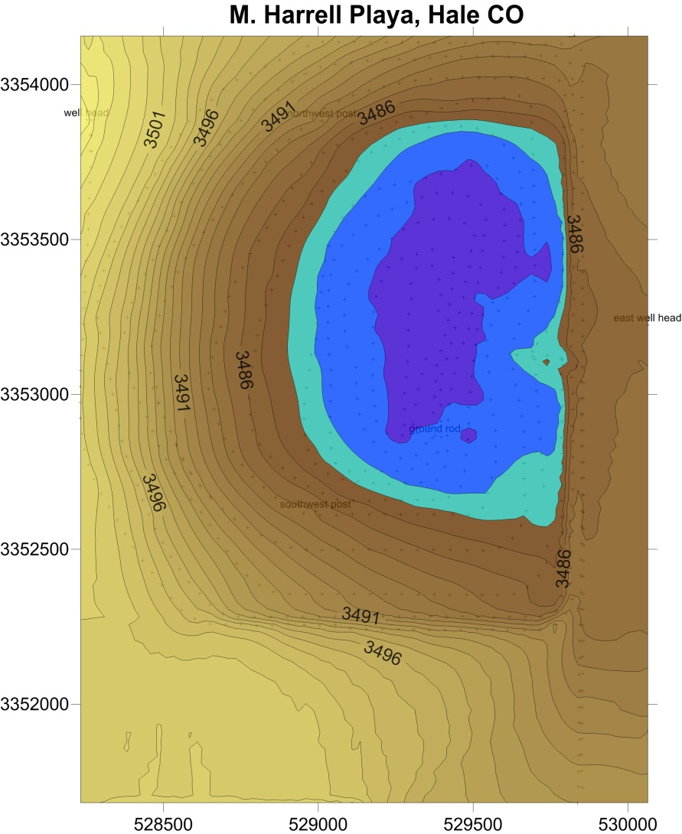
2012 monitoring data
Hale County, M. Harrell playa
Notes:
Approximate extent of 2012 flooding shown in dark blue.

Slide 18
2012 monitoring data
Hale County playas
 | WL drop, mm/day | Evaporation, mm/day | Infiltration, mm/day
M. Harrell | 12.48 | 11.62 | 0.80
Reiff 1 | 11.56 | 11.62 | -0.06
Reiff 2 | 12.11 | 11.62 | 0.49
B. Harrell | 36.88 | 11.62 | 25.26
Notes:
Over 90 percent of the ponded water in the M. Harrell playa was lost to evaporation. The estimated evaporation rate at the M. Harrell location slightly exceeded the measured water level decline at the two Rieff playas, about 30 miles SW of the M. Harrell playa. The only Hale County playa with a substantial infiltration rate is the B. Harrell playa, which had an average estimated infiltration rate of over 25 mm/day, with much higher rates during the first few days after flooding. The B. Harrell playa lies on a wet-weather drainage of interconnected playas, and may be underlain by sandier materials than the other Hale County playas, which are not connected to other wetland areas.

Slide 19
2012 monitoring data
Hale County, M. Harrell playa
Water balance and soil moisture changes
Post-flood core samples at 0 to 8 ft depth average 11.25% moisture gain by weight
Represents over 60 cm of water held in near-surface soil
But estimated infiltration is less than 10% of this amount
What gives?
Preceding rainfall/runoff that does not produce ponding?
Rapid initial infiltration?
clay
v. fine sand
silty clay
silty sand
Soil Type
Notes:
Soil moisture gain equals the entire measured flood depth at the M. Harrell playa, but evaporation rate estimates suggests that 90 percent of the ponded water evaporates.
Rainfall records and soil moisture sensors indicate little or no runoff into playa in the months between July 2011 and the June 2012 flooding
Rapid infiltration by initial stormwater runoff, before measureable flooding occurs, appears to be the best explanation for the discrepancy

Slide 20
Flood sequence details
2012 monitoring data
Hale County, M. Harrell playa
Notes:
The detailed records for rainfall, water level, and soil moisture during the June 2012 flood event show that the soil moisture at a 3 foot depth starts to increase within minutes in response to heavy rainfall. The 3 foot soil moisture increases to saturation within 2 hours, before surface water begins to pond. The surface water level increases more slowly, stabilizing after about 8 hours. The soil moisture at a 6 foot depth starts to increase slowly within hours of the storm event, and then increase more rapidly about the same time that the surface water depth reaches it maximum.
It appears that a large volume of water is taken up by the near-surface soil as storm runoff flows into the dry playa basin. This water volume is not measured and is not reflected in the water balance estimates used to determine infiltration and recharge, but may represent a significant fraction of the overall water budget.

Slide 21
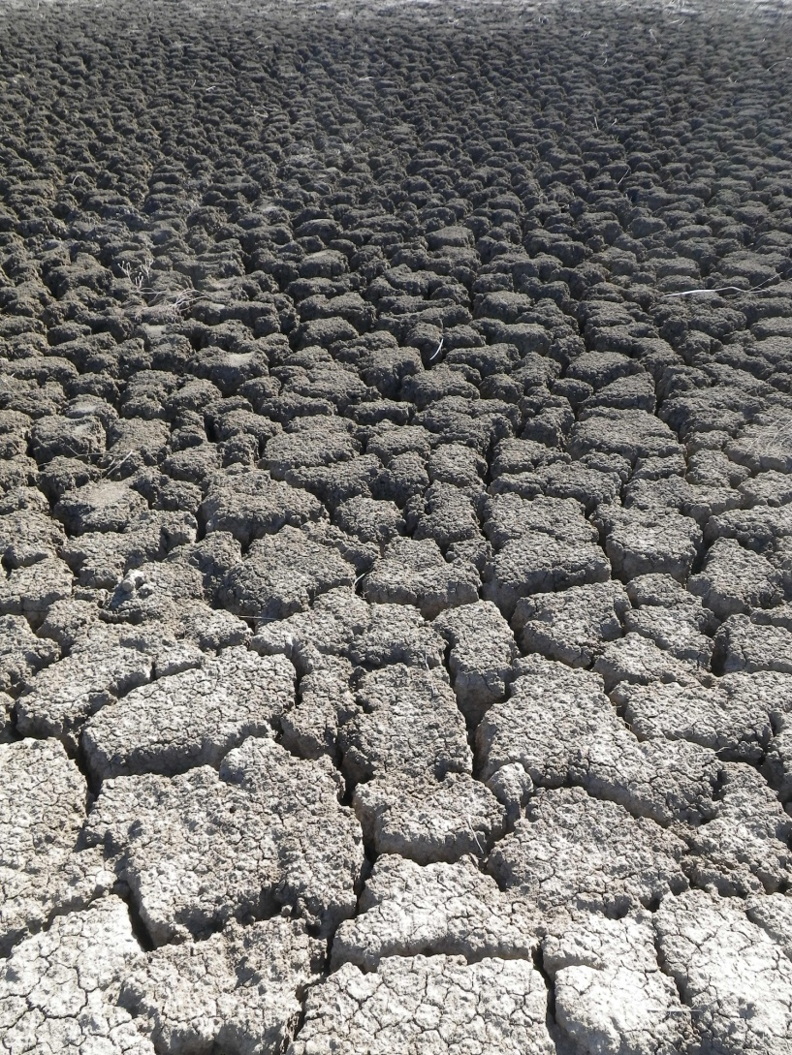
Summary of 2012 findings
Most ponded water evaporates
Rapid initial infiltration in a few playas
Large volumes of water infiltrate prior to ponding, complicating water balance

Slide 22
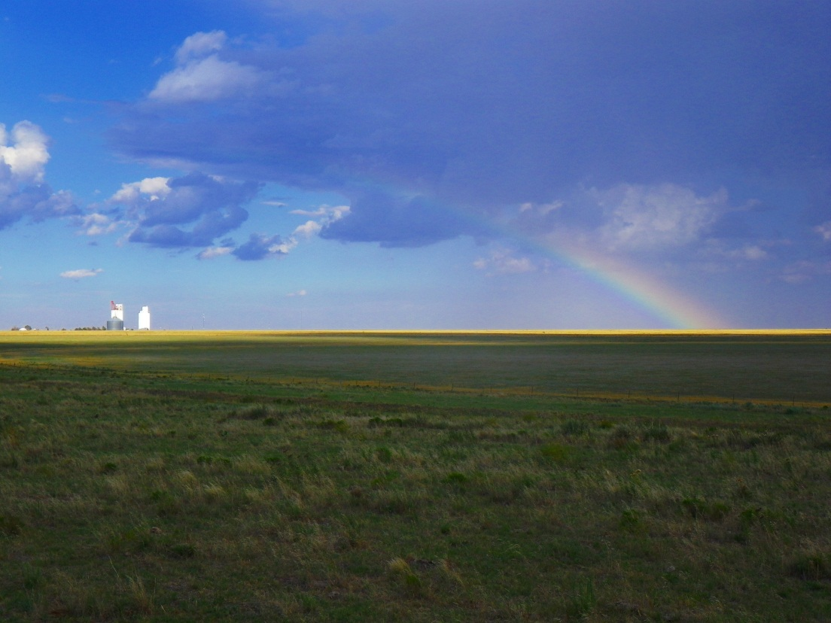
Coming attractions…
Continued monitoring
Modeling
Additional soil moisture sensors?
Tracer study?
Playa behavior in wetter years?
Implications for playa modification?
Notes:
Continued monitoring will help put 2012 results in context with the regions’ climatic variability.
More data on soil moisture is clearly needed. Getting quantitative results at the temporal and spatial scales needed is going to be a challenge.
The tracer study is set up and waiting on the rains…
And we’ll be starting to screen ideas for playa modifications that could be implemented and tested.

Slide 23
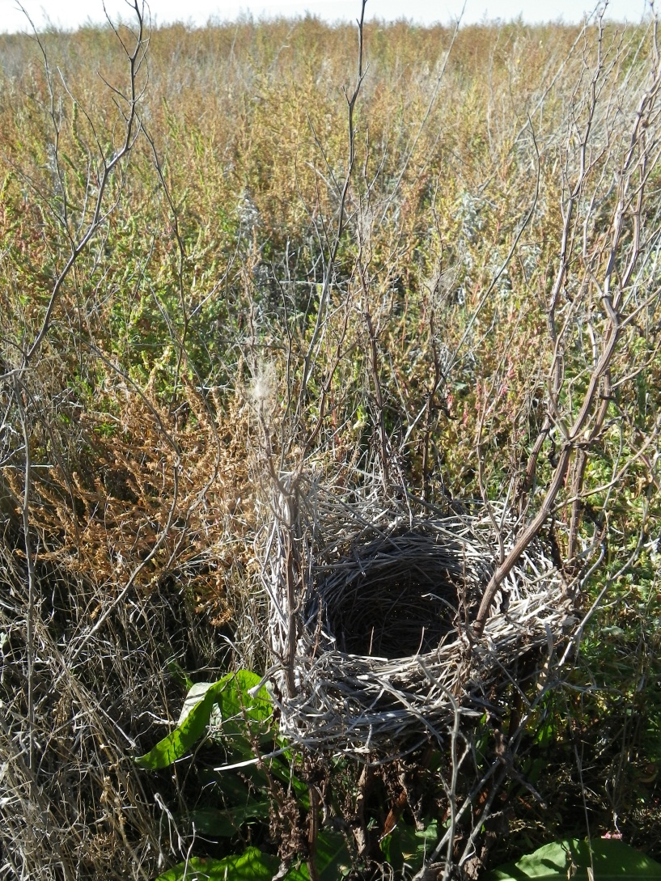
Questions?
Contacts:
Andrew Weinberg
Texas Water Development Board
Andrew.weinberg@twdb.texas.gov
512-463-3210
Dennis Gitz
USDA/ARS – Lubbock
dennis.gitz@ars.usda.gov
806-723 5232
Ken Rainwater
Texas Tech University/ Water Resources Center
ken.rainwater@ttu.edu
806-742-3490

