Slide 1
The AMS Education Program: Raising the Scientific Literacy of All Students
Dr. James Brey
AMS Education Program
Booth #412
2012 GSA Annual Meeting

Slide 2
Investigating the Earth System
1
2
3
AMS Education Program
Undergrad Courses
Diversity Projects
How we raise scientific literacy.

Slide 3

AMS Education Program
2
1
Why we do what we do.

Slide 4

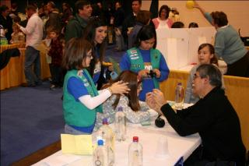
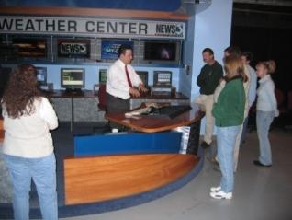
AMS Education Program Mission
To better equip students in science and math through:
Professional development opportunities for teachers nationwide.
Innovative undergraduate course packages licensed to universities, colleges, and community colleges.
Facilitating the development of partnerships among institutions and individuals.

Slide 5
Undergrad Courses
2
Training Tomorrow’s Leaders.

Slide 6

Undergrad Earth Science Courses
AMS
Ocean
Studies
AMS
Weather Studies
AMS
Climate Studies
Introductory courses where students use real-world and real-time data
Emphasis on hands-on investigations and critical thinking skills
Designed by and licensed through the AMS
Can be offered in a variety of learning environments
NASA, NOAA, and NSF-supported Diversity Projects facilitate implementation at Minority Serving Institutions (MSIs) nationwide

Slide 7


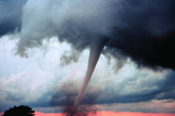
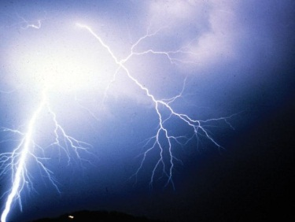
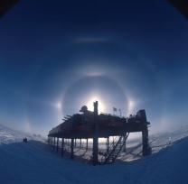
AMS Weather Studies
New 5th edition text features:
Updated case studies
New imagery
QR codes!
Expanded/new coverage of atmospheric rivers, 2011 tornado season, Hurricane Irene, & much more!
Students learn about weather as it happens in near real-time using customized weather products from NOAA
Licensed by more than 470 institutions since implementation in Fall 1999
Course offered to well over 50,000 students

Slide 8

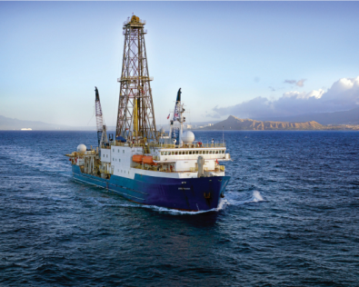
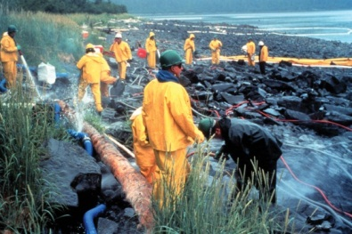
AMS Ocean Studies
Course emphasizes:
Flow and transformations of water and energy into and out of the ocean
Physical and chemical properties of seawater
Ocean circulation
Marine life and adaptations
Human societal impacts on and responses to Earth system interactions
Licensed by more than 170 institutions since implementation in Fall 2005.
NSF-supported Diversity Project facilitated course implementation at MSIs.

Slide 9

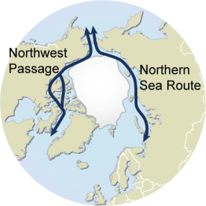
AMS Ocean Studies-Coursework
Current Ocean Studies 3: Arctic Sea Ice: Decades of Melting
The extent of Arctic sea ice has major climate implications.
Sea ice melts -> more solar radiation absorbed by surface waters -> heated sea water warms overlying atmosphere, impacting weather.
The Arctic Ocean’s summer melt season typically runs March through mid-September. September 16, 2012 = lowest sea ice extent in satellite record!
Many enhanced melting impacts, including navigation (Northwest Passage & the Northern Sea Route).
The 2012 melt season saw the Northern Sea Route again opened. Notably, the first Chinese ship made passage across the Arctic Ocean.
Figure 3. Northwest Passage and Northern Sea Routes. [Hugo Ahlenius, UNEP/GRID-Arendal]

Slide 10
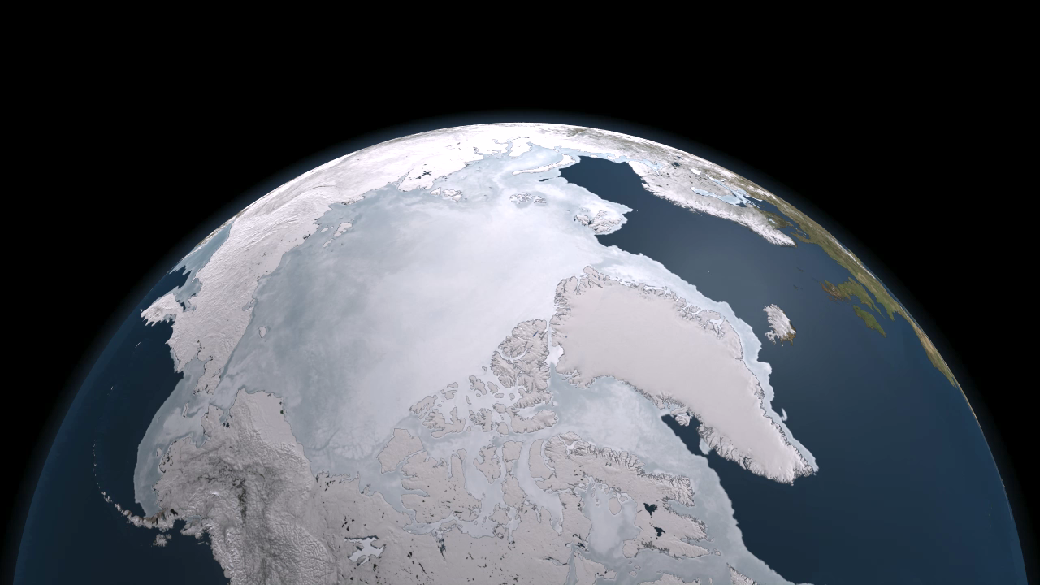
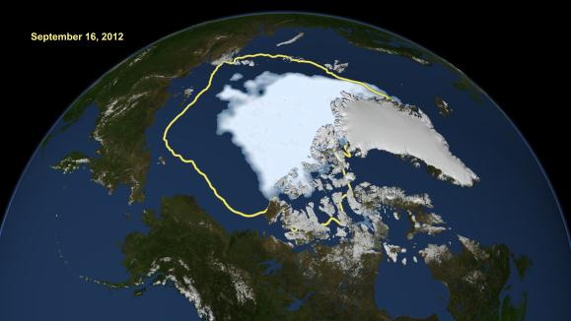
Arctic sea ice from March 7-September 9, 2011. 30-year average minimum extent (in yellow) Northwest Passage (in red)
AMS Ocean Studies-Coursework
New record low Arctic sea ice extent, from Sept. 16, 2012. Average minimum extent over the past 30 years (in yellow).
Credit: NASA/Goddard Scientific Visualization Studio

Slide 11

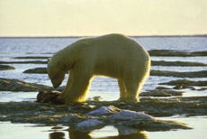
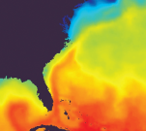
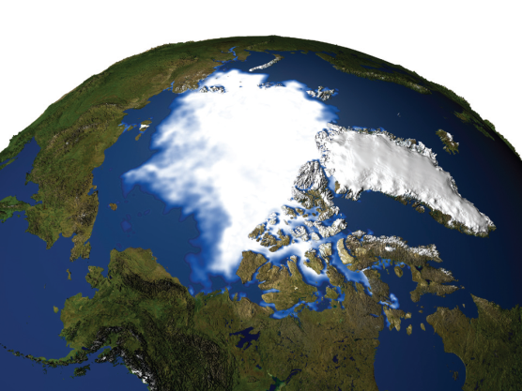
AMS Climate Studies
Focuses on the science, but also on the societal impacts that attract students
Foundations of Earth’s climate system
Basic understandings of climate behavior
Contributions of human activities to climate change
Societal and ecosystem vulnerability and response to climate variability and change
The challenge of achieving sustainable development
The same effective turnkey package as AMS Weather Studies and AMS Ocean Studies
Great primer for students entering technical ‘green’ programs
Licensed by nearly 80 institutions since implementation in Fall 2010

Slide 12
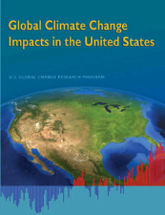
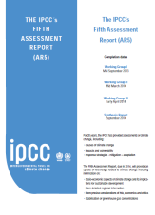
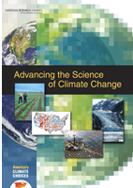
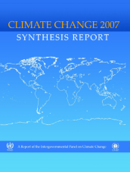
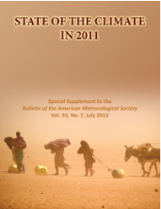
AMS Climate Studies-Coursework
Current Climate Studies 2: Climate Change/Impacts Resources
Fact: “Climate change is occurring, is caused largely by human activities and poses significant risks for – and in many cases is already affecting – a broad range of human and natural systems.”
Introduction to most widely-recognized science-based information sources on climate change and impacts.
U.S. Global Change Research Program (USGCRP), International Panel on Climate Change (IPCC), U.S. National Academies, NASA, NOAA, the most recent AMS/NOAA State of the Climate reports, and the August 2012 AMS Information Statement on Climate Change.

Slide 13
AMS Climate Studies-Coursework
Current Climate Studies 8
The increased concentrations of heat-trapping gases are the primary causes of global warming. CO₂ has an especially large effect…because it lingers for a long time as an atmospheric constituent. Once in the atmosphere, centuries pass before it comes into equilibrium with the carbon reservoirs of the ocean, biosphere, and geosphere.
Retention of CO₂ pulse in Earth’s atmosphere (assuming a lifetime of 100 years).
[Based on CDIAC/ORNL data]

Slide 14
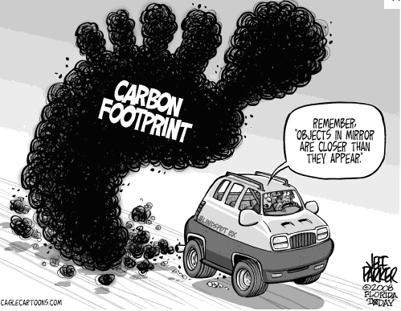
AMS Climate Studies-Coursework
How LARGE is your Carbon Footprint?
A person’s carbon footprint = sum of all CO₂ emissions that are directly and indirectly associated with his/her activities over a given time frame (usually a year).
You, as a resident of the U.S., have on average the largest per capita carbon footprint in the world compared to individuals in most other countries.
To estimate your own carbon footprint, go to the EPA's Climate Change-Greenhouse Gas Emissions website (found on the Course Website!)

Slide 15

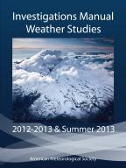
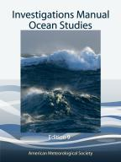
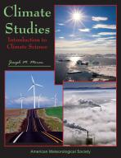
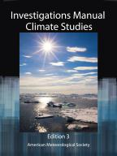
Course Structure & Components
Fully-integrated packages; contain both printed and online learning materials
Comprehensive 15-chapter, full color, hard cover textbook
Investigations Manual with 30 laboratory-style activities
Inflatable globe for complex ocean phenomena (such as tides & El Niño/La Niña) – AMS Ocean Studies only
AMS Conceptual Energy Model (CEM) – AMS Climate Studies only
Course website
Faculty website
Faculty resource CD
Course Management System-compatible files

Slide 16
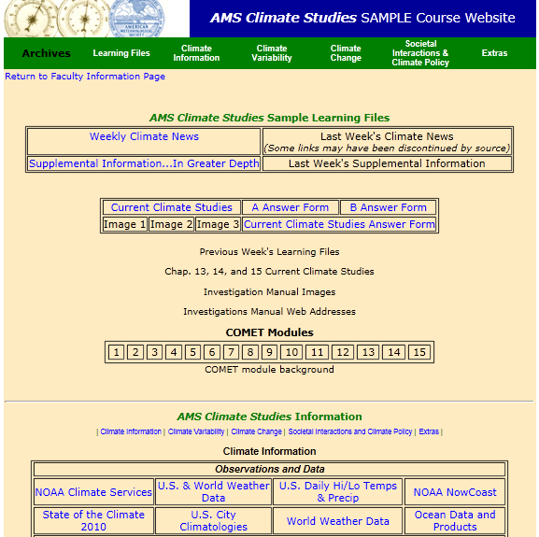
Course Website
Weekly Weather/Ocean/ Climate News
Current Weather/Ocean/ Climate Studies (online lab component)
Current Links to current environmental data

Slide 17




Faculty Materials
Faculty CD
Faculty manual
Textbook images suitable for PowerPoint
Test bank questions
Answers to review & critical thinking questions
Course Management System-compatible files
Investigations Manual
Current Climate, Ocean, and Weather Studies
Test bank questions
Faculty Website
Weekly discussions
Answer keys
Faculty Mentoring
Available by other AMS-trained faculty members

Slide 18

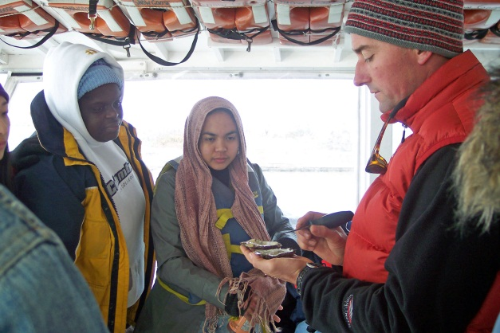
Course Implementation
Instructor
Course offering by experienced science faculty or those new to teaching the subject matter.
Setting
AMS Ocean Studies students at Washington Adventist University on a research boat
Range from traditional lecture-based to totally online.
Students
Receive local institutional credit.
Purchase course materials through local bookstore.

Slide 19
Diversity Projects
3
Reaching all students.

Slide 20
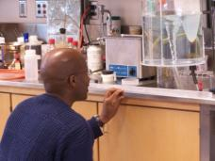
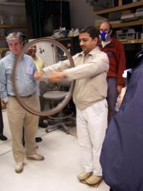
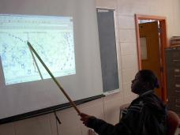
AMS Diversity Projects
Since 2001, AMS has initiated course implementation at MSIs through NSF-supported Geoscience Diversity/National Dissemination Projects.
AMS Weather Studies Diversity Project
145 institutions
More than 13,000 students impacted
1st meteorology course offered for more than 2/3 of the institutions
AMS Ocean Studies Diversity Project
75 institutions
More than 5000 students impacted
About 50 MSIs implemented both AMS Weather Studies and AMS Ocean Studies

Slide 21
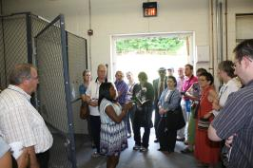
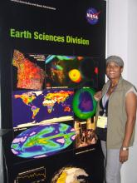
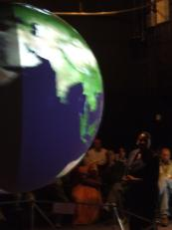


AMS Climate Studies Diversity Project
AMS Climate Studies Diversity Project
Partnered with Second Nature
Targeting 100 MSIs over 5 years
1st workshop-May 2012; next-May 2013
Weeklong workshop in DC with follow-up workshops at AMS Annual Meeting
DC workshops feature scientists from NASA, NOAA, and other DC area educational and research institutions
Participants also receive course materials
Faculty offer AMS Climate Studies in year following workshop attendance
Make revisions to AMS Climate Studies course materials

Slide 22




Conclusions & Future Directions
AMS Weather, Ocean, and Climate Studies have introduced geoscience education to 720 institutions, 329 of which are MSIs.
AMS Water Studies currently in planning phase, developmental funding will be sought.
The inaugural AMS Climate Studies Diversity Project workshop was held in May 2012 with the next offering in May 2013.

Slide 23

Acknowledgements
AMS Weather Studies and AMS Weather Studies Diversity Project were funded by NSF grants GEO-0119740 (OEDG) and DUE-0126032 (CCLI_ND).
AMS Ocean Studies Diversity Project is supported by NSF grant DUE-0442497 (CCLI-ND).
AMS Climate Studies is supported by NASA grants NNX-09AP58G and NNX-08AN53G.
AMS Climate Studies Diversity Project is supported by NSF grant 1107968 “AMS Climate Studies: Fostering Climate Science Literacy and Promoting Minority Participation in the Geosciences.”
DataStreme Atmosphere and Ocean are supported by NOAA award NA12SEC0080020.
DataStreme ECS is supported by NASA grant NNL10ZB1011C.
This presentation was prepared by the American Meteorological Society under award NA12SEC0080020 from the National Oceanic and Atmospheric Administration (NOAA), U.S. Department of Commerce. The statements, findings, conclusions, and recommendations are those of the author(s) and do not necessarily reflect the views of the National Oceanic and Atmospheric Administration (NOAA), the U.S. Department of Commerce., or the National Science Foundation.

Slide 24






?
Jim Brey
Director
AMS Education Program
brey@ametsoc.org
Booth #412
www.ametsoc.org/amsedu
What’s Your Message?
amsedu@ametsoc.org
@AMSeducation AMS Education

