Slide 1
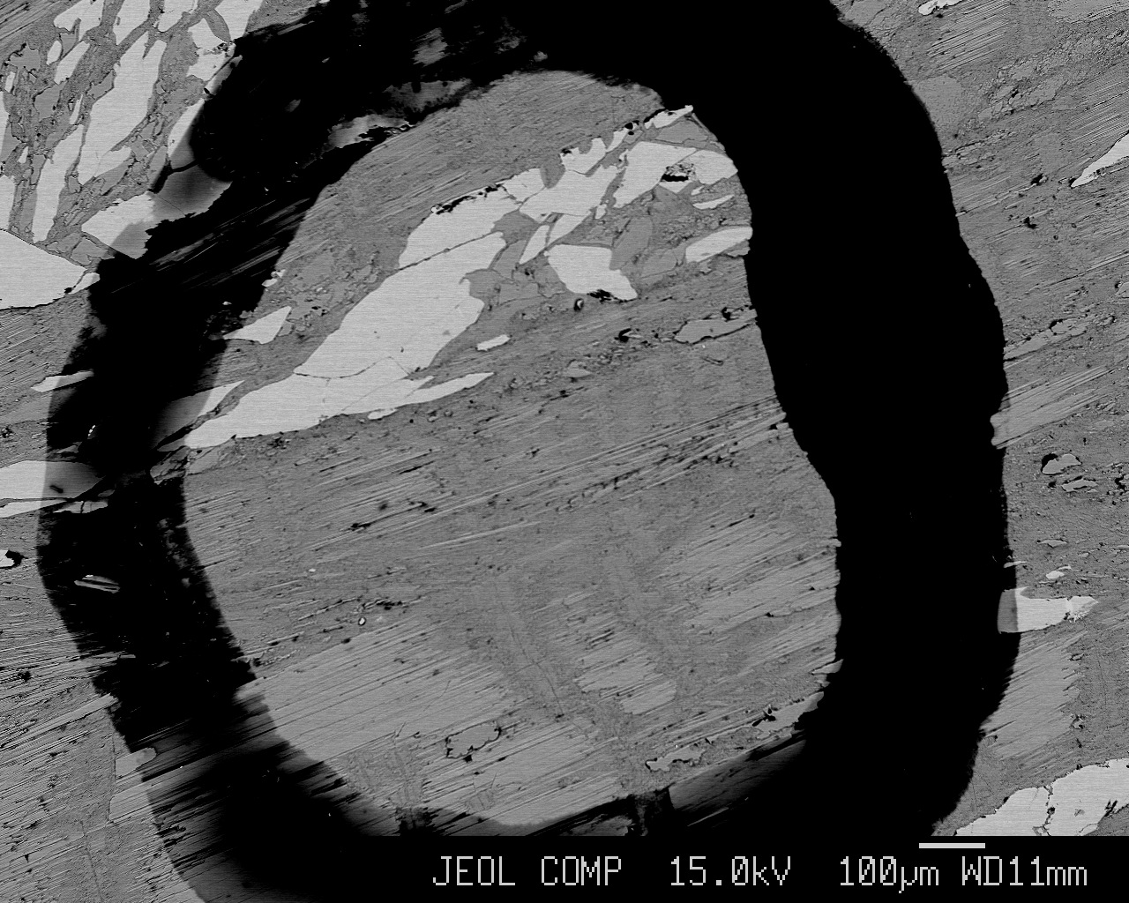
Mineralogical characterization of talc ore and commercial talc products from the Gouverneur Mining District, New York
*Brittani D. McNamee
University of Idaho
Mickey E. Gunter
University of Idaho
André E. Lalonde
University of Ottawa
Michael C. Rowe
Washington State University

Slide 2
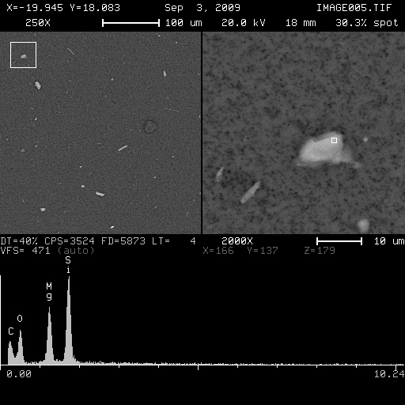
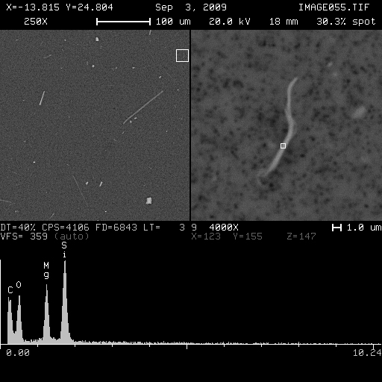
Why?
platy talc
asbestiform talc
Notes:
funky talc picture

Slide 3
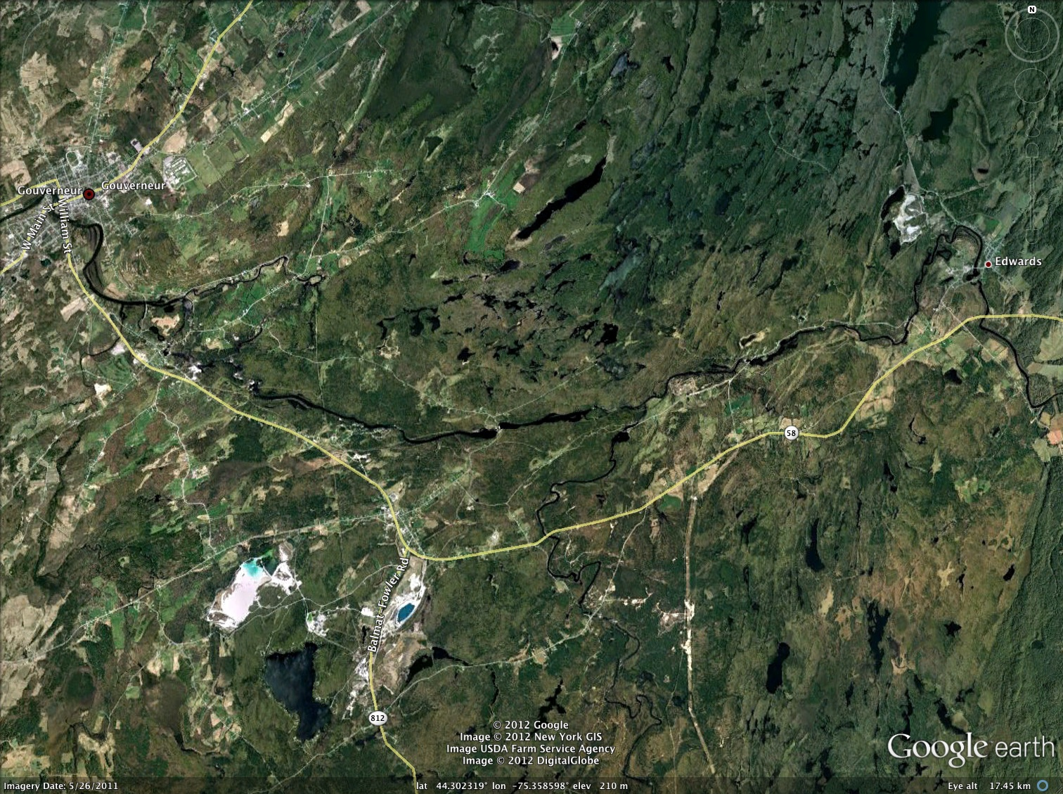
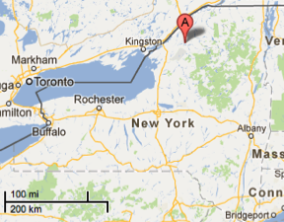
Gouverneur
Talcville
Arnold Pit
Notes:
map of talcville and fowler mines

Slide 4
Overview
Samples
tailing samples from Arnold Pit and Talcville mines
products processed by R. T. Vanderbilt Co.
Museums / Collections
Goals
Bulk composition acquired with XRF
Mineral structures identified with powder XRD
Precise compositional data via WDS and EDS on polished samples in electron microprobe
Asbestiform vs. Non-asbestiform morphology and alteration of minerals observed in electron microprobe and by PLM
Notes:
polished thin sections
polished grain mounts

Slide 5
Minerals of interest: ideal formulas & SiO₂ / MgO ratios
Amphiboles
tremolite Ca₂Mg₅Si₈O₂₂(OH)₂ Wt % SiO₂ / MgO = 2.4
anthophyllite Mg₇Si₈O₂₂(OH)₂ Wt % SiO₂ / MgO = 1.7
Sheet silicates
talc Mg₃Si₄O₁₀(OH)₂ Wt % SiO₂ / MgO = 2.0
serpentine Mg₃Si₂O₅(OH)₄ Wt % SiO₂ / MgO = 1.0
Notes:
Fe in anthophyllite

Slide 6
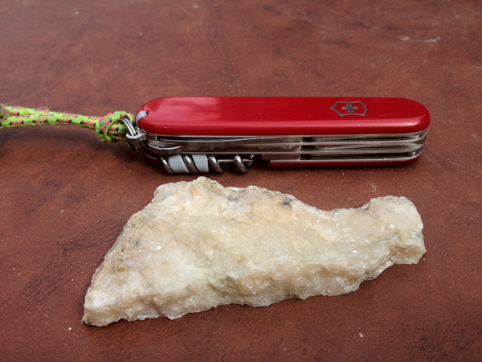
Arnold Pit
Notes:
R1 (AP_mass_amp) rock

Slide 7
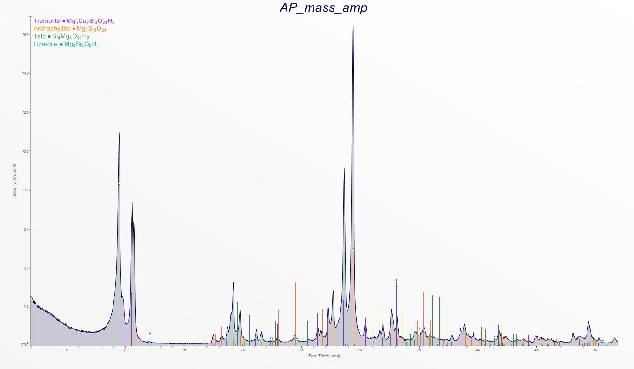
Arnold Pit
Rietveld
tremolite | 29%
anthophyllite | 42%
talc | 29%
serpentine | 0%
XRF Bulk Composition
SiO₂ | 60.14
TiO₂ | 0.01
Al₂O₃ | 0.67
FeO* | 0.08
MnO | 0.21
MgO | 31.04
CaO | 3.73
Na₂O | 0.22
K₂O | 0.03
P₂O₅ | 0.04
Sum | 96.18
LOI (%) | 3.70
Notes:
R1 (AP_mass_amp) rock

Slide 8
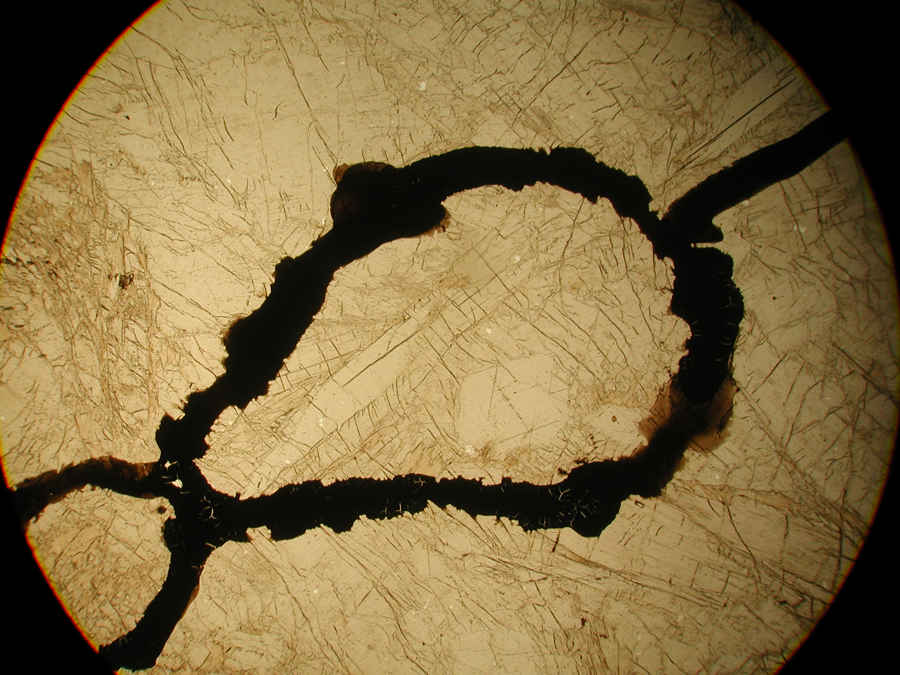
Arnold Pit
Notes:
R1-T6a (AP_mass_amp)

Slide 9
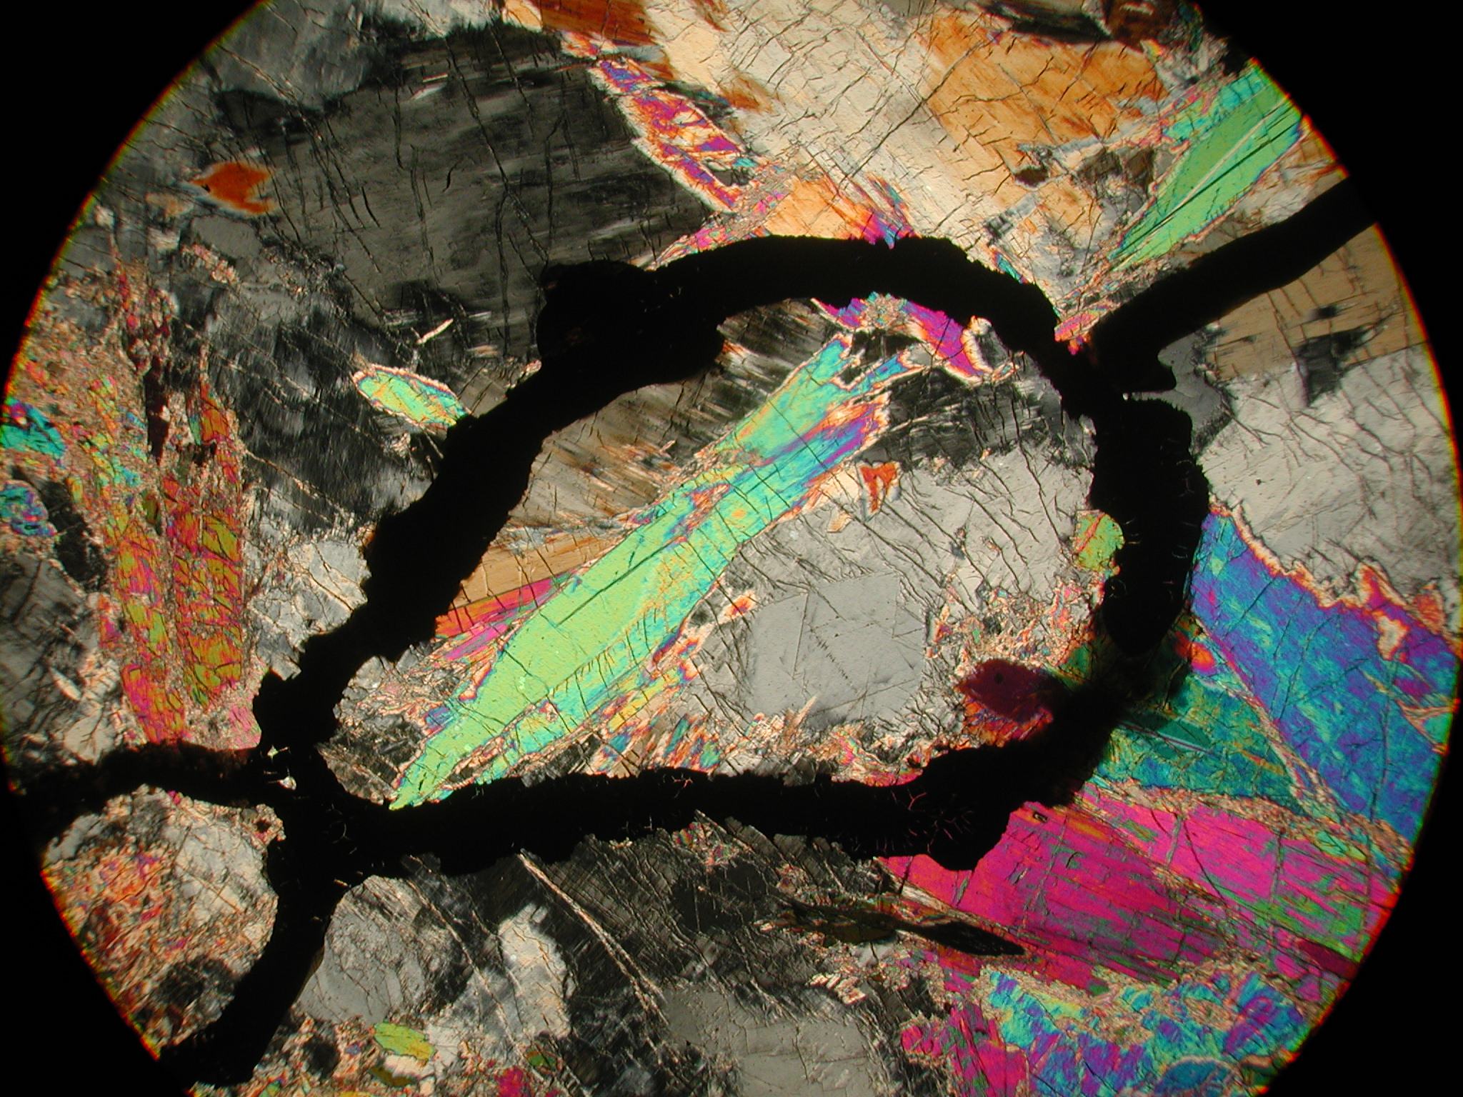
Arnold Pit
Notes:
R1-T6a (AP_mass_amp)

Slide 10
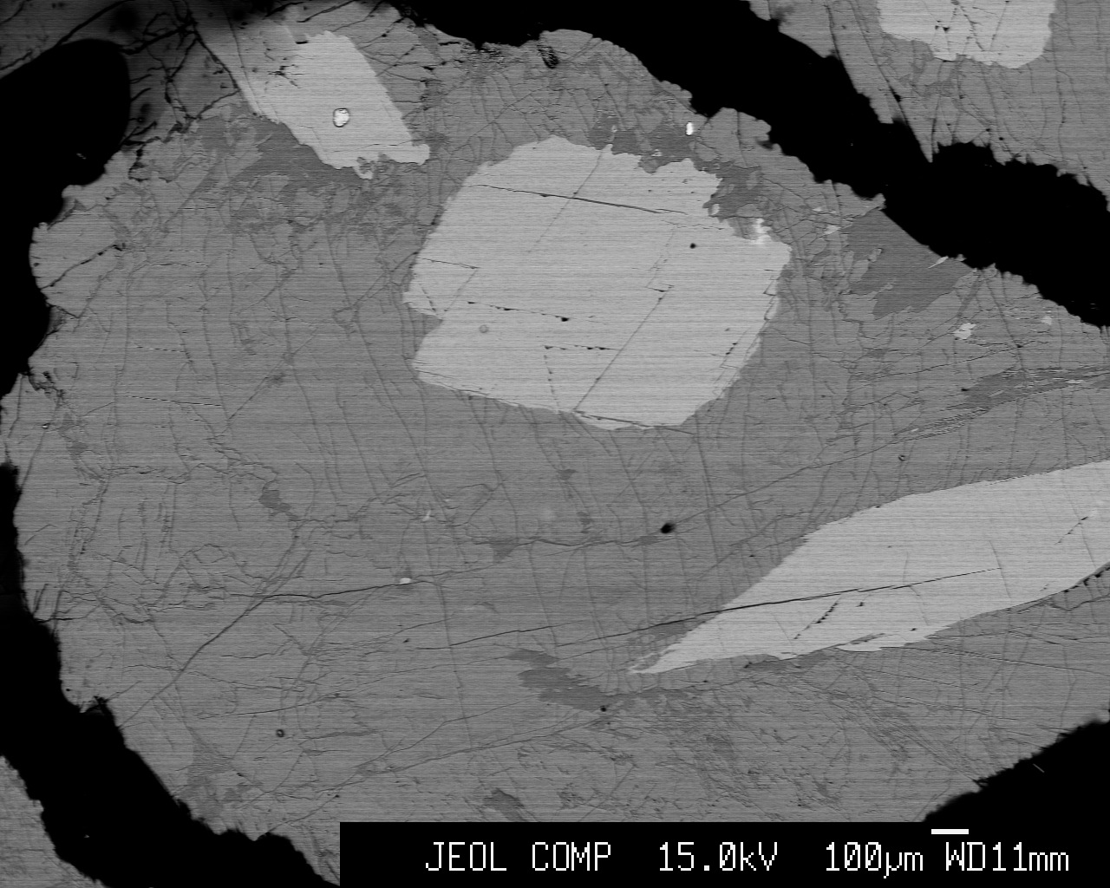
Arnold Pit
tremolite
SiO₂ | 59.78
Al₂O₃ | 0.18
TiO₂ | 0.01
FeO | 0.03
MnO | 0.04
MgO | 26.03
CaO | 12.48
Na₂O | 0.44
K₂O | 0.07
Oxide Totals | 99.72
F | 0.66
Cl | 0.01
anthophyllite
SiO₂ | 61.79
Al₂O₃ | 0.13
TiO₂ | 0.00
FeO | 0.10
MnO | 0.22
MgO | 36.11
CaO | 0.47
Na₂O | 0.15
K₂O | 0.00
Oxide Totals | 99.39
F | 0.41
Cl | 0.00
talc
SiO₂ | 59.35
Al₂O₃ | 0.09
TiO₂ | 0.00
FeO | 0.13
MnO | 0.13
MgO | 33.70
CaO | 0.08
Na₂O | 0.03
K₂O | 0.03
Oxide Totals | 93.81
F | 0.25
Cl | 0.01
Notes:
R1-T6a (AP_mass_amp)

Slide 11
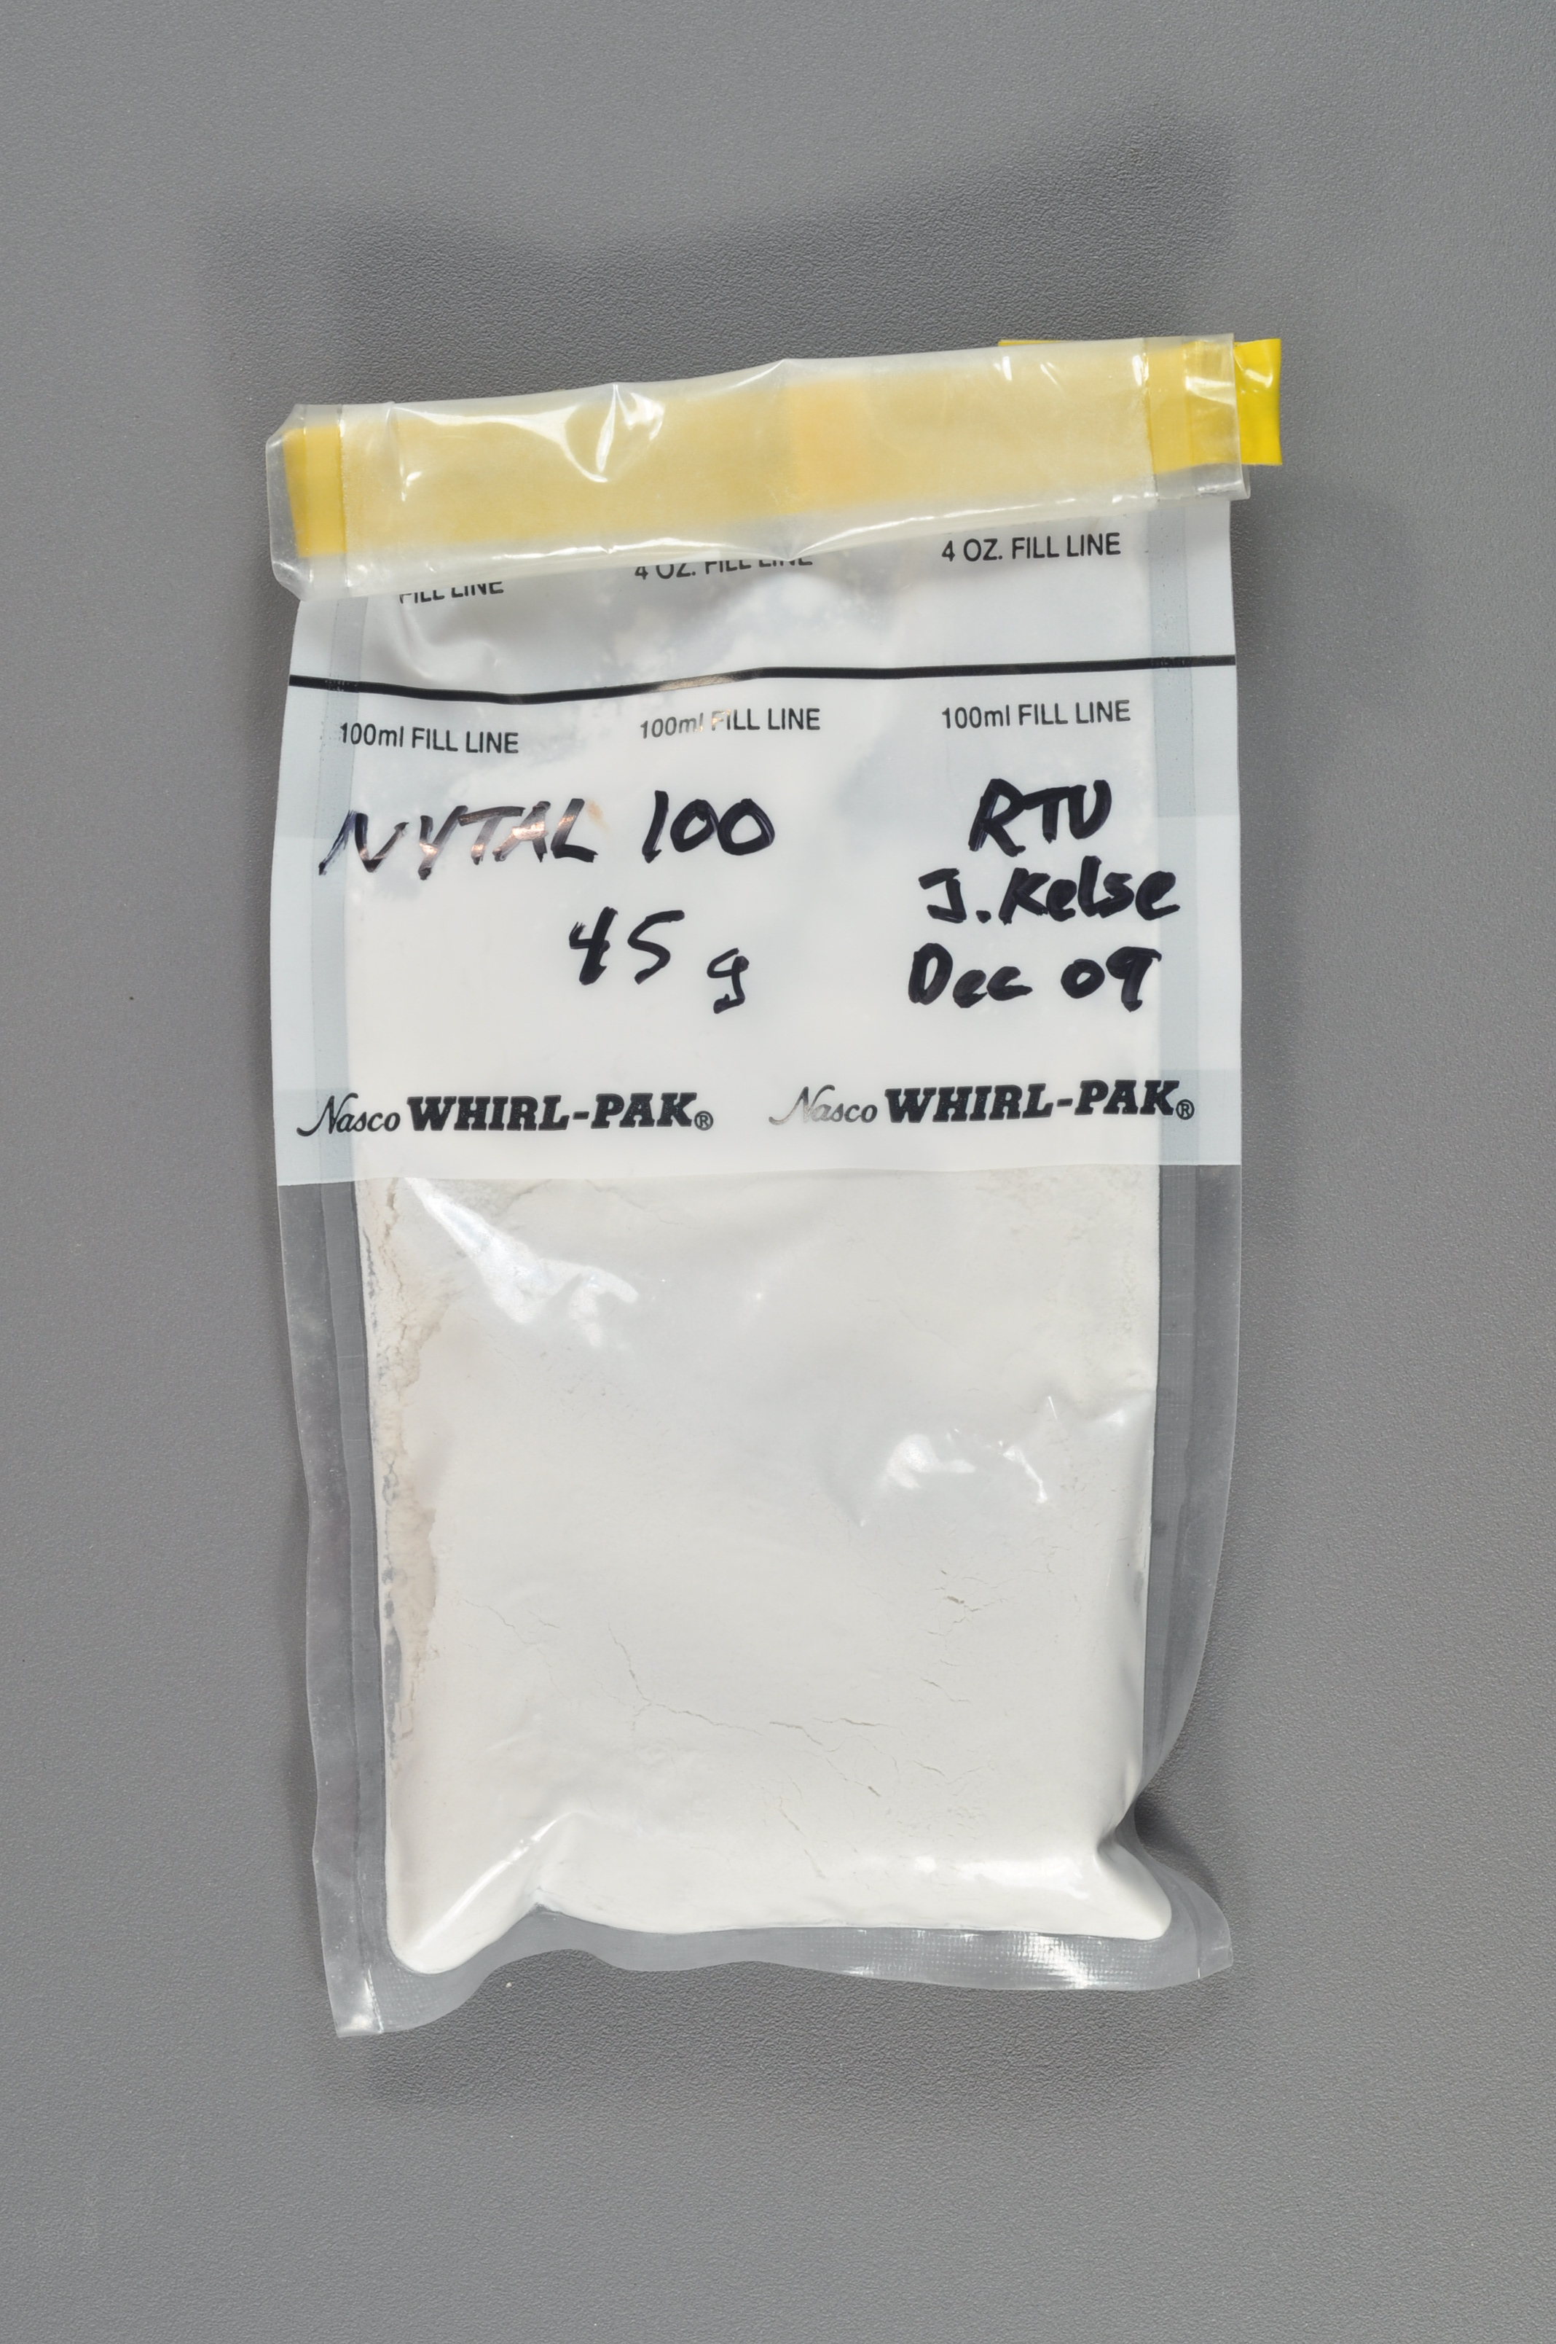
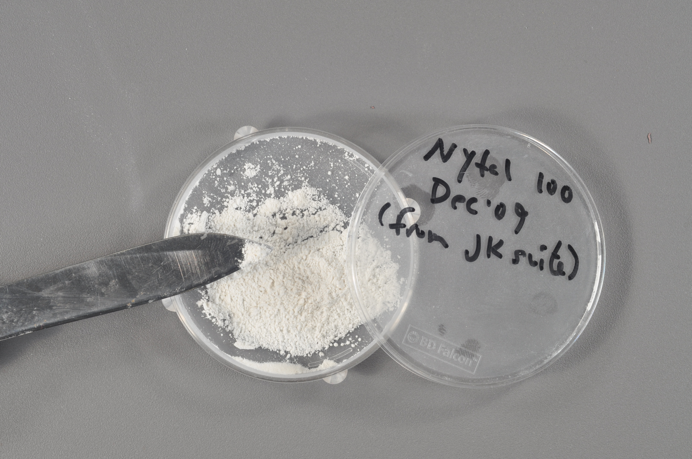
Nytal-100
Notes:
Nytal-100 (GM2-7-longsplinter)

Slide 12
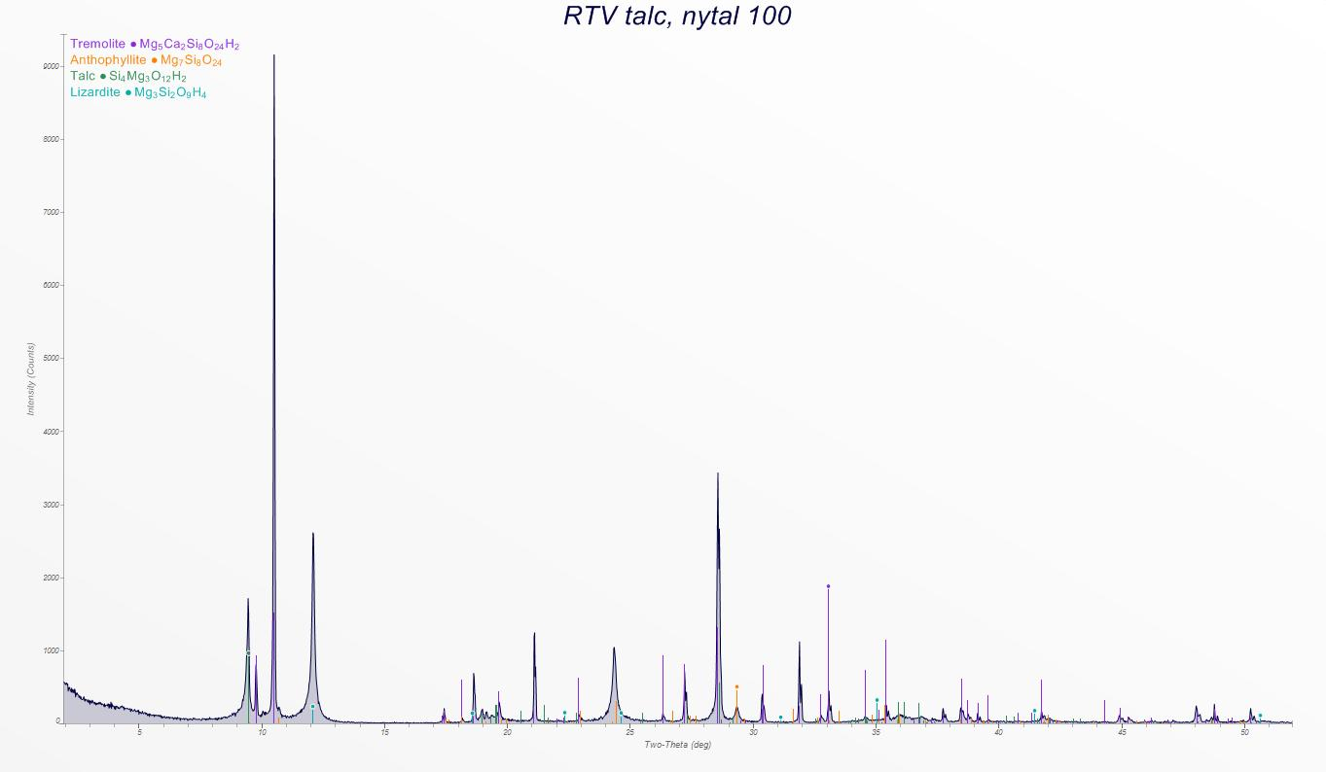
Nytal-100
Rietveld
tremolite | 59%
anthophyllite | 14%
talc | 20%
serpentine | 8%
XRF Bulk Composition
SiO₂ | 54.28
TiO₂ | 0.03
Al₂O₃ | 0.78
FeO* | 0.18
MnO | 0.20
MgO | 28.51
CaO | 8.47
Na₂O | 0.22
K₂O | 0.13
P₂O₅ | 0.03
Sum | 92.84
LOI (%) | 6.01
Notes:
Nytal-100 (GM2-7-longsplinter)

Slide 13
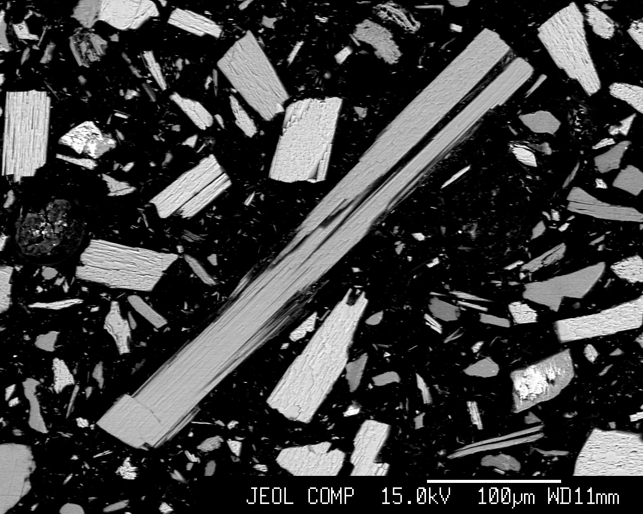
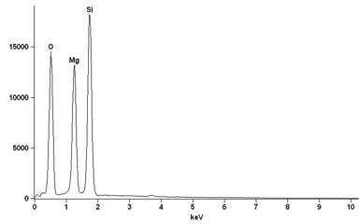
Nytal-100
WDS SiO₂ / MgO → 1.8
non-asbestiform anthophyllite → 1.7
Notes:
Nytal-100 (GM2-7-longsplinter)

Slide 14
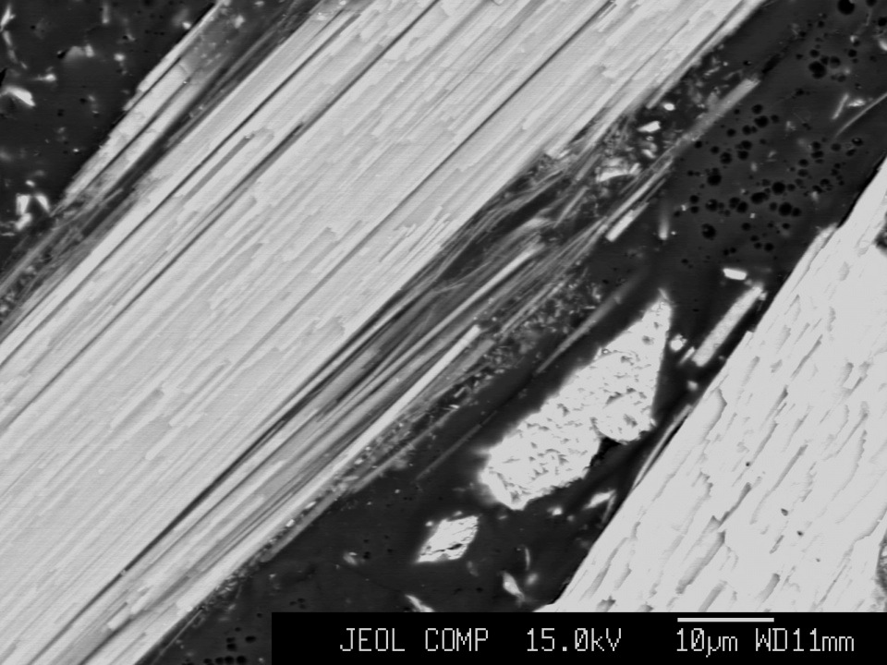
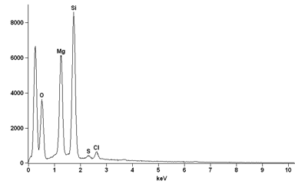
Nytal-100
SiO₂ | 28.4
Al₂O₃ | 0.2
TiO₂ | 0.0
FeO | 0.4
MnO | 0.1
MgO | 13.6
CaO | 0.2
Na₂O | 0.0
K₂O | 0.0
Oxide Totals | 43.8
F | 0.1
Cl | 1.0
WDS SiO₂ / MgO → 2.1
asbestiform talc → 2.0
Mg_{2.9}Si_{4.0}O₁₀(OH)₂
low Total due to particle size/epoxy
Notes:
Nytal-100 (GM2-7-longsplinter-edge)

Slide 15
Conclusions
Asbestiform talc forms as an alteration of non-asbestiform anthophyllite
Talc and anthophyllite have similar low Fe content
Sample prep important for EDS & WDS agreement

Slide 16
Thank You
Questions???

