Slide 1
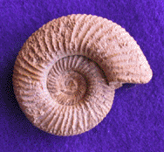
The Age of the Earth: Deep time, mass extinctions and radiometric decay
Tanya Furman
Penn State University
November 4, 2012

Slide 2
Is there even a controversy?
Scientists agree universally on age of Earth
4.56 Ga, based on ages of meteorites
Students struggle to internalize the age
Long time periods are difficult to understand
Meteorites not intuitive to Earth age
Radiometric decay processes is challenging
Creationist arguments
Explaining non-intuitive with non-intuitive

Slide 3
Deep time is difficult to comprehend
Sequences of events, reconstructing environments
Libarkin et al. 2007
Dodick & Orion 2003
Trend 1997, 1998, 2000, 2001
Maturation between grades 7-8 and 9-12
Increased ability to conceptualize deep time
Most high school students don’t take Earth Science

Slide 4
PA teachers exemplify this situation
Self-selected teachers in plate tectonics w’shop
Grades from upper elementary through 9-12
Sequencing of biological events correct overall
Dates of biological events show confusion
Events in correct order: 94% correct
Earth forms: 70%
First life (3-4 Ga): 41%
Humans appear: 29%
Dinosaurs appear: 18%
Guertin et al., 2011 GSA presentation

Slide 5
Earth age: Direct evidence not intuitive
Oldest rocks 3.8-3.9 Ga
Sedimentary minerals 4.1-4.2 Ga
Australia, Africa, N. America, Asia, Greenland (>3.5)
Establishes minimum age only
Meteorites coeval formation but no recycling
Multiple isotopic approaches, ~70 samples
Ages cluster 4.55 Ga
Assume uniform Pb, U distribution in original “stuff”
Individual meteorites don’t look like Earth

Slide 6
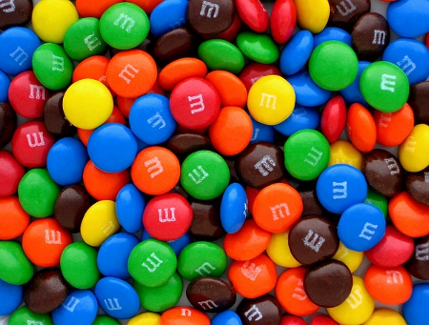
Improve teaching of radiometric decay
Most labs involve candy
Remove “decayed” candy
Half-life concept okay
Radiometric decay not okay
¹⁴C dating more clear
Root element stays constant
Not applicable to most rocks
Not applicable to deep time
Improve by teaching elements, mineral context

Slide 7
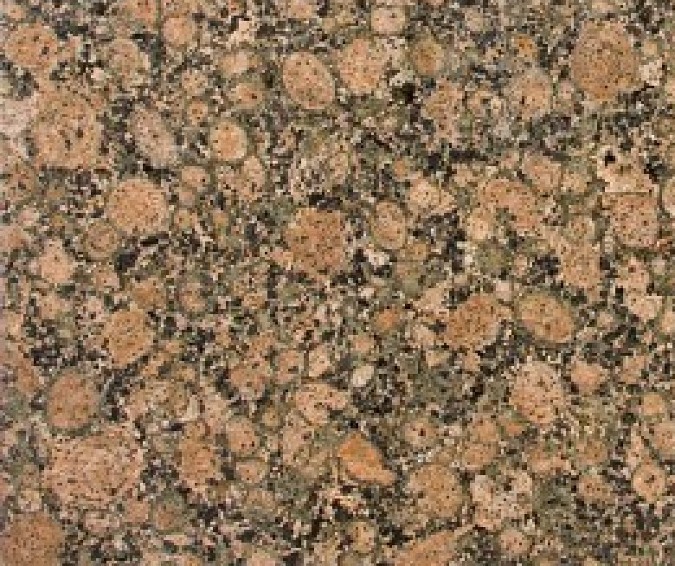
Finally, a use for rocks & minerals
Suitable minerals almost always igneous, met’c
Ages reflect time since cooling (diffusion stops)
Potassium is found in:
K-feldspar
micas
amphibole
Uranium is found in:
zircon
apatite
sphene
From Pam Gore: http://facstaff.gpc.edu/~pgore/geology/geo102/radio.htm

Slide 8
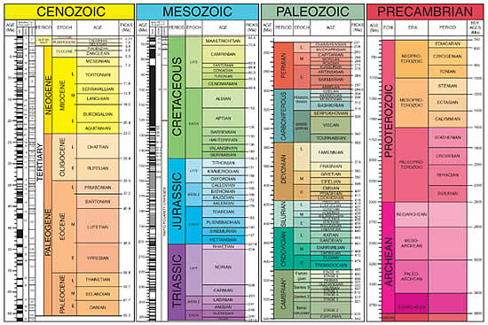
Develop the geological time scale
Interdisciplinary approach by community
Igneous, met’c rocks indicate ages, dates
Sedimentary rocks indicate fossils, extinctions

Slide 9
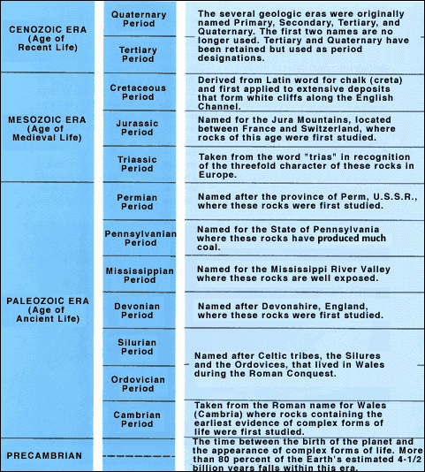
Geological time scale can make sense
Names are explained
Locations have meaning
Dates have meaning
Cross-cutting themes
Literacy
Numeracy
Mass extinctions define every one of the horizontal lines
http://pubs.usgs.gov/gip/geotime/divisions.html

Slide 10
Finding a home in the curriculum
Age of the Earth not just a statement
Meteorites not the easy access point
Key minerals reveal ages of their formation
Mineral compositions, origins important
Geological time scale excellent vehicle
Relative time / sedimentary rocks
Absolute time / igneous & met’c rocks
Integrate literacy, numeracy, history, geography

Slide 11
Closing words and thoughts
Seek buy-in for method, not for result
Younger students cannot comprehend scale
Older students, adults may not have background
Context of mineral compositions
Context of geological time chart

