Slide 1
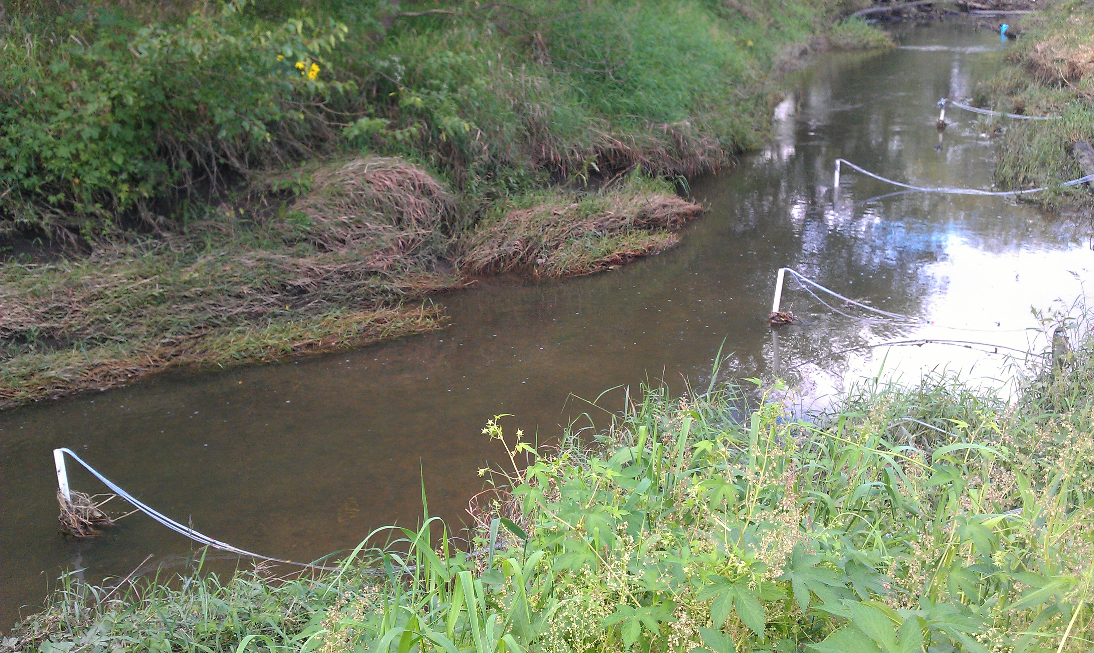
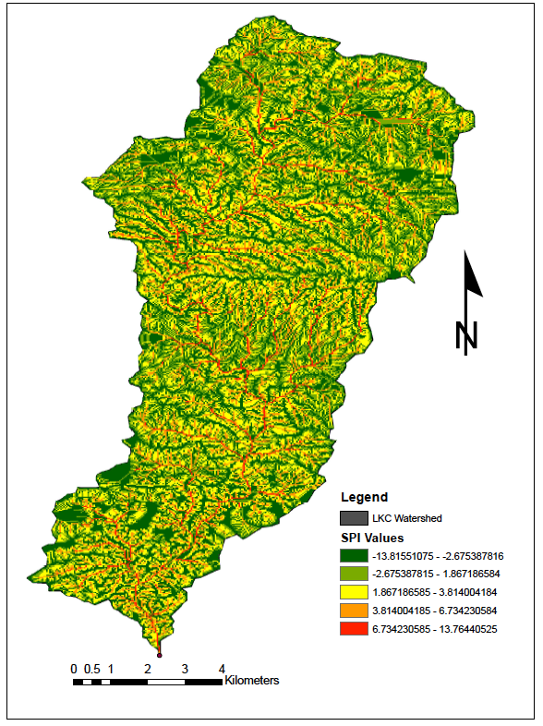
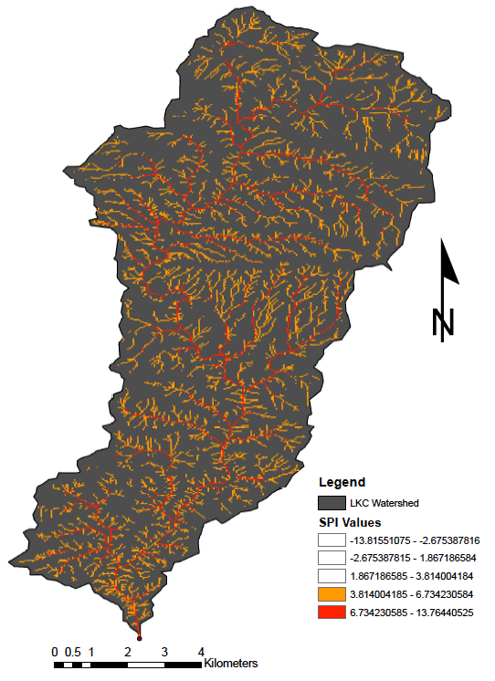
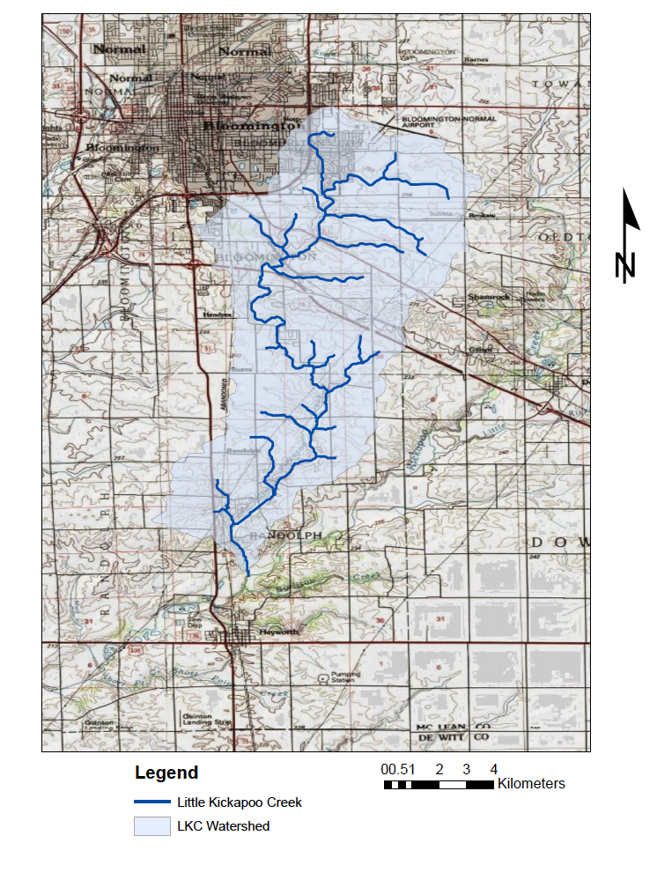
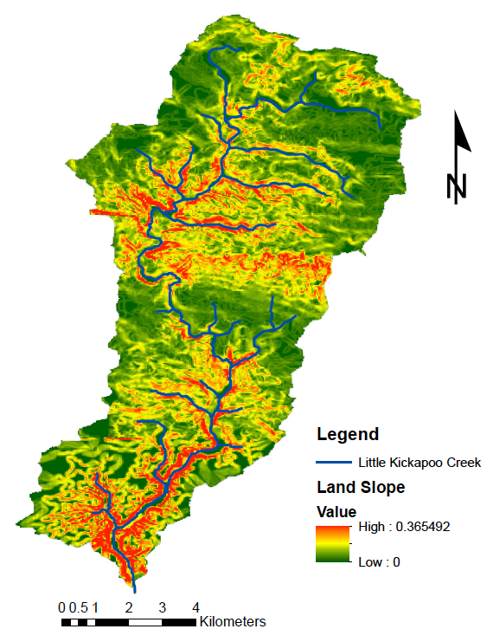
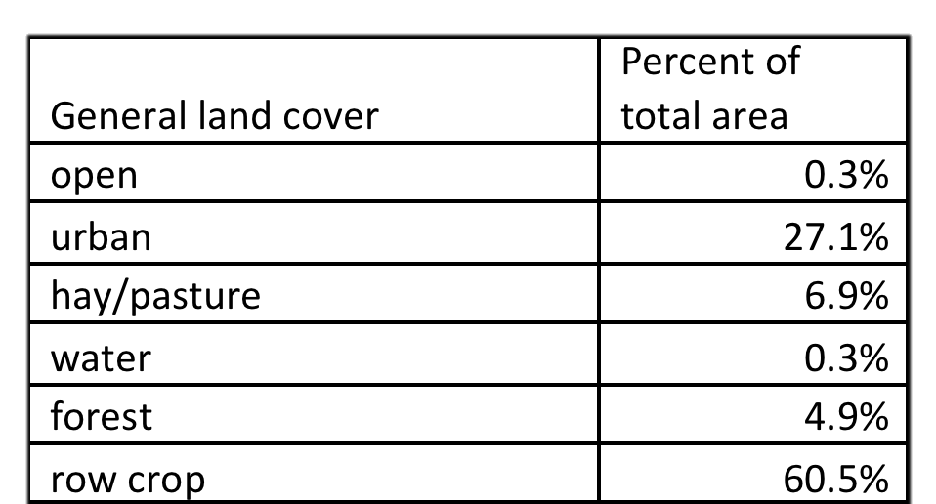
Using GIS to Evaluate Erosion as a Potential Pathway for Nutrient Pollution of Little Kickapoo Creek in Bloomington, Illinois Kelly Hayden Department of Geology-Geography, Illinois State University
Abstract
Since the 1960s, application of fertilizers to agricultural fields has increased significantly, and as a result, nutrient loading of Midwestern streams has degraded water quality and threated aquatic life. Excess nutrients are able to enter stream systems through a variety of pathways, including: erosion of soil from fertilized fields, surface runoff, leaching to groundwater, and agricultural tile drainage systems. This paper examines the potential for erosion as a pathway for nutrients to enter Little Kickapoo Creek (LKC) in Bloomington Illinois. Using GIS, the LKC watershed was delineated, the land cover was determined, and the stream power index (SPI) was calculated for the watershed. SPI measures overland flow and is based on topography. Overland flow can be used as a proxy for erosion, for high levels of overland flow result in high levels of erosion. The results illustrate that the stream’s headwaters are located in an urban environment, but the majority, 60%, of the stream flows through row crops of corn and soybeans. The slope of the land is generally flatter in the urban section of the watershed and increases slightly in the central and southern sections of the watershed. The SPI calculation revealed that the land along the stream channel had the highest risk for erosions. Nutrients may enter streams from urban runoff, but erosion of extensively fertilized agricultural fields contributes significantly more of the stream. nutrients to streams. Higher nitrate concentrations within the stream water correspond to areas along the stream with higher erosion potential. This study determined that due to the majority of erosion occurring in close proximity to agricultural fields, the eroded soil entering LKC will be high in nutrients from the fertilizers, making erosion a likely pathway for nutrient loading of the stream.
Methods
Data
A 10 m resolution DEM of southern Bloomington, Illinois area from the National Elevation Database Provided by the USGS was required to delineate the watershed of Little Kickapoo Creek. Analysis also required Landsat 30 m resolution land cover data from the National Land Cover Dataset, obtainable from the USGS. These data will allow the land cover within the watershed to be categorized and analyzed.
Calculating SPI
The methods used to calculate the SPI using ArcGIS 10 are described by Dogwiler et al. 2010 in the WRC Report 2010-02.
After the DEM of south Bloomington was imported into ArcGIS 10 and the sinks were filled, the watershed was delineated
To delineate the watershed, a flow direction raster was created using the flow direction tool. A pour point was then created using the pour point tool in order to generate the flow accumulation raster. Once the streams are created from the flow accumulation raster, the watershed can be delineated using the watershed tool.
After the watershed is delineated, the percent of the land slope can be calculated from the DEM using the slope tool.
Then using the expression “SPI = flow accumulation * slope” in the raster calculator, a raw SPI raster is created. To find the final SPI values, the following expression should be entered into raster calculator “Ln[RawSPIraster].” This takes the natural log of the raw SPI values and normalizes the values.
The final map displays the SPI values for the watershed; the higher numbers indicate areas that have the highest potential for erosion. The values can be placed in five categories representing the different degrees of erosion potential.
The land use map was then imported to observe the land cover in areas that are at high risk for erosion. The map was clipped to the LKC watershed and the land cover types were classified according to NLCD classification.
Discussion
An increased potential for erosion along the stream was expected due to the higher degree of slope near the channel. Erosion along the stream creates a variety of issues for water quality and land conservation. The SPI map was able to identify areas of high erosion and allow for the assessment of erosion as a potential pathway for nutrient pollution entering LKC.
The SPI map showed that urban areas had as much risk for erosion near LCK as elsewhere along the channel. Erosion in urban areas can increase the amount of sediment entering waterways, but significant nutrient pollution from this sediment is unlikely due to the lack of fertilizers. The SPI calculation only accounts for elevation and flow accumulation, and not land use. A stream flowing through an urban area could have an increased risk for erosion based on several factors. Higher levels of erosion in urban areas result the high volume of runoff. Runoff in urban areas is typically higher than in nonurban areas because of the prevalence of impervious surfaces (Neller, 1988). The increased runoff can lead to failure of the stream bank, which causes large amounts of sediment to enter the waterway (Paul and Meyer, 2001).
Having a high risk of erosion along the stream in agricultural areas increases the possibility of nutrients entering LKC. Millions of tons of nitrate and phosphate fertilizers are applied to agricultural fields annually (Pimentel, et al. 1995). Nitrate contamination enters streams through groundwater, tile drainage, and shallow subsurface water draining into nearby waterways (Mueller and Helsel, 2009). Though nitrate is a considerable issue for stream contamination, phosphate pollution can be directly related to erosion. Phosphate is relatively immobile on land because it binds to soil particles (Mueller and Helsel, 2009), however, soil containing the phosphate can enter streams through erosion. High levels of phosphate in streams can lead to a decrease in dissolved oxygen in the water and result in the death of aquatic life (Alexander et al., 2008).
Both urban and agricultural erosion have the potential to add large quantities of sediment to streams. Sediment that remains suspended in the water column quickly degrades water quality and reduces the amount of nutrients able to be removed through natural processes (Bilotta and Brazier, 2008). Suspended sediments can increase the turbidity of the water which can cause harm to the aquatic life. Sediment in the water column prevents light from penetrating the water, cutting off sunlight to photosynthetic organisms (Bilotta and Brazier, 2008). Temperature changes, filling of stream channels, and lower dissolved oxygen levels are all possible consequences of increased sediment in streams.
Objectives
This project will use Geographic Information Systems (GIS) to delineate the watershed of Little Kickapoo Creek (LKC) in Bloomington, Illinois (Figure X) and evaluate the stream power index (SPI) of the watershed. The SPI will be calculated to determine the overland flow intensity within the watershed and allow the risk for erosion to be inferred. Areas with high levels of overland flow will indicate that there are also high levels of erosion occurring (Galzki, 2009). This method of calculating erosion uses a combination of land slope and flow accumulation within the watershed as a proxy for stream discharge. The primary question of this paper is “Is erosion a possible pathway for nutrients to enter LKC?” It is assumed that agricultural areas contribute more nutrients to waterways than urban areas because of extensive fertilization of fields (Mueller and Helsel, 2009). Therefore, the risk for erosion to contribute nutrients to LKC will be based on whether the areas with high erosion are dominated by urban areas or agricultural fields. To address this question, several sub-questions need to be answered:
What is the extent of LKC and the LKC watershed?
What type of land cover is present in the watershed? And how might the land cover contribute to nutrient loading of LKC?
Where within the Little Kickapoo Creek watershed is there the highest potential for erosion?
Results
The delineated Little Kickapoo Creek watershed includes 76.6 km² and extends from southern Bloomington to the town of Randolph where LKC discharges into Kickapoo Creek (Figure 1). The stream itself is roughly 11 km in length and flows southwest from the southern edge of Bloomington.
The slope of the watershed indicated that the high slopes were mostly located along the stream channel as expected (Figure 2). Though the slope does change throughout the watershed, the range of slope is only 36 degrees. The slope of the land is generally flatter in the northern section of the watershed and increases slightly in the central and southern part of the watershed.
Analysis of the land cover map of the watershed (Figure 3) showed that only a small portion of the land is urban, and the majority of the remainder is row crops. The percentage of the total area of the watershed each land use type covers was calculated for comparison (Table 1). The analysis showed that only 27% of the entire watershed was a developed/urban area, however 60% of the watershed was row crops of corn and soybeans.
The SPI map showed that the majority of areas with high erosion potential were located along LKC (Figures 4 & 5). The Bloomington Moraine was also shown to have a high potential for erosion because of the increase in slope. The number of tributaries contributing to LKC increases downstream from the urban area, therefore the density of zones of high erosion potential increases in the agricultural areas.
Bloomington
Bloomington Moraine
Figures 4 & 5: in figure 4 (right) all SPI values are shown. Red and orange indicate areas of high erosion potential, green and yellow indicate low erosion potential. Figure 5 (left) displays only the areas of high erosion potential. These areas follow the LKC stream channel and the Bloomington Moraine.
Conclusion
LKC watershed extends 76.6 km², with 30% of the area being urban and 60% row crops.
LKC is 11 km long with headwaters in an urban setting, though the majority of the stream flows through row crops.
An SPI map calculated the intensity of overland flow within the watershed as a proxy for erosion potential.
The SPI map showed that the locations most at risk for erosion were located directly along LKC. This is likely because the land near the stream channel has the highest slopes, and the surrounding land is relatively flat.
The Bloomington Moraine also was shown to have a high potential for erosion.
The land use in the areas of high erosion risk was primarily agricultural, indicating that the eroding sediment would be high in nutrients from fertilizers.
This study found that erosion is a likely source for nutrient contamination of LKC because the majority of the stream flows through agricultural fields instead of developed areas, and the fields were found to have a high potential for erosion.
Randolph
Figure 2 (above): Land slope of the LKC watershed shows that the highest slops are located along the stream channel and the Bloomington Moraine.
Figure 3 (top right): Land use within the LKC watershed. About 30 % is urban and about 60% is row crops.
Table 1 (right): Percentage of the total area of the watershed each land cover type covers.
References
Alexander, R. B., R. A. Smith, G. E. Schwarz, E. W. Boyer, J. V. Nolan, and J. W. Brakebill, 2008, Differences in Phosphorus and Nitrogen Delivery to the Gulf
of Mexico from the Mississippi River Basin: Environ. Sci. Technol., v. 42, p. 822-830.
Bilotta, G.S. and Brazier, R.E., 2008, Understanding the influence of suspended solids on water quality and aquatic biota: Water Research, v. 42, p.
2849-2861.
Dogwiler, T., Docker, D., and Omoth, D., 2010, Rush-pine creek watershed digital terrain analysis overview and procedure guidelines: WRC report
2010-02, Southeastern Minnesota Water Resource Center, Winona State University, Winona, MN, 22 p.
Galzki, J. C., 2009, Identifying critical portions of the landscape for water quality protection using GIS terrain analysis, University of Minnesota.
Mueller, D. K., and D. R. Helsel, 2009, Nutrients in the Nation's Waters--too much of a good thing?, USGS.
Neller, R.J., 1988, A Comparison of Channel Erosion in Small Urban and Rural Catchments, Armidale, New South Wales: Earth Surface Processes and
Landforms, v.13, i. 1, p.1-7.
Paul, M. J., and J. L. Meyer, 2001, Streams in the urban landscape. Annual Review of Ecology and Systematics 32:333–365.
Pimentel, D., Harvey, C., Resosudarmo, P., Sinclair, K., Kurz, D., McNair, M., Christ, S. Shpritz, L., Fitton, L., Saffouri, R., and Blair, R., 1995, Environmental
and Economic Costs of Soil Erosion and Conservation Benefits: Science, New Series, v. 267, no. 5201, p. 1117-1123.
Figure 1: Little Kickapoo Creek’s headwaters are located in Bloomington, IL. The stream is 11 km long and flows south, south-west before it discharges into Kickapoo Creek in Randolph, IL. The LKC watershed covers 76.6 km². The Bloomington Moraine is located in the central portion of the watershed.

