Slide 1
Employing GIS to investigate karst regions: A quantitative assessment
Eric W. Peterson
Brianne Jacoby
Illinois State University
Toby Dogwiler
Winona State University

Slide 2
Importance
Landforms provide clues to how a cave developed
Provide insight to paleoenvironments through understanding past base levels and upstream events
Glaciations
Tectonics

Slide 3
Sediment Dating
Sediment accumulates in caves once it is abandoned by flow
Date ²⁶Al and ¹⁰Be to learn the timing of deposition
Timing can correlate with surface events that affected a region’s climate and geomorphology history

Slide 4
Level Studies
Mammoth Cave¹
Cumberland Plateau²
Both studies used sediment dating and found four levels present
Both mentioned the possibility of a fifth level
Similar Geology
Similar Timing
Incision during the Pliocene-Pleistocene Glaciations
¹Granger et al, 2001
²Anthony and Granger, 2004.

Slide 5
Level Development
Passages created at static flow and correlate to passages at similar elevations are collectively considered a level
Form from active dissolution during static base level elevation
Abandoned once incision increases and the base level lowers
Location where horizontal flow transitioned to rapid incision (Piezometric limit)

Slide 6
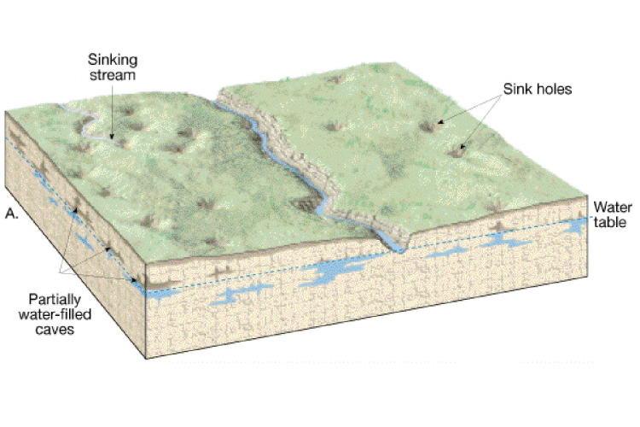
Levels

Slide 7
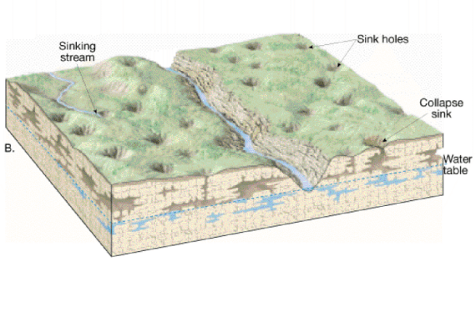
Levels

Slide 8
Objectives
Use GIS to determine time associated with cave level development
Determine if cave levels are correlated to Stream Power Index (SPI)

Slide 9
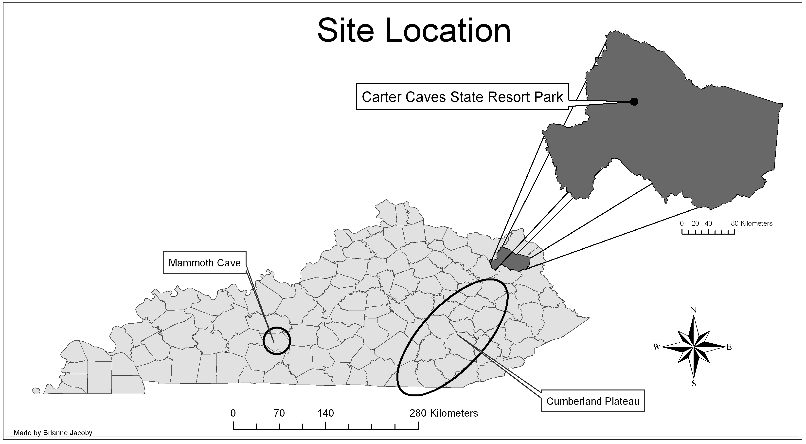
Location of Level Studies

Slide 10
General Geology and Hydrogeology
106 km² of deeply incised valleys
Fluviokarst
3 bedrock formations
Borden Formation (oldest)
Shale
Newman Formation
Limestone
Pennington Formation (capping unit)
Sandstone
Tygarts Creek is the local base level (flows north to the Ohio River)

Slide 11
Levels of CCSRP
Option 1 | number of caves | cave elevation range (m)
level 4 | 52 | 254.8-274.0
level 3 | 44 | 241.3-253.0
level 2 | 37 | 229.2-239.9
level 1 | 13 | 214.3-227.4
Option 2 | number of caves | cave elevation range (m)
level 5 | 27 | 263.6-274.0
level 4 | 25 | 254.8-262.4
level 3 | 44 | 241.3-253.0
level 2 | 37 | 229.2-239.9
level 1 | 13 | 214.3-227.4
The ends of the boxes represent the 25th and 75th percentiles with the solid line at the median and the dashed line at the mean; the error bars depict the 10th and 90th percentiles and the points represent outliers. Mean increases with age level. Numerical values can be found in Table 2.

Slide 12
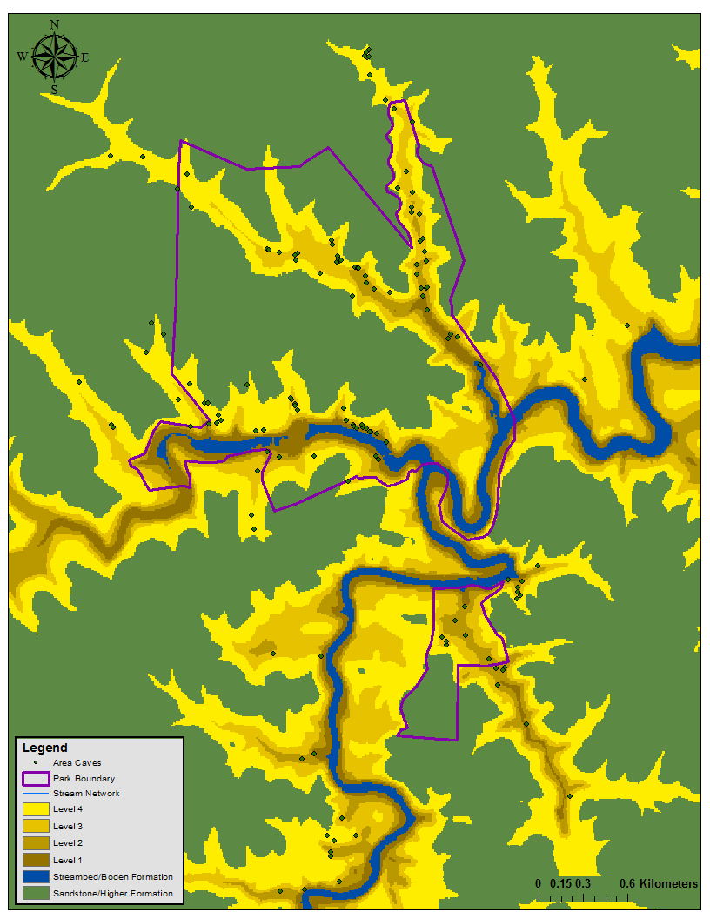
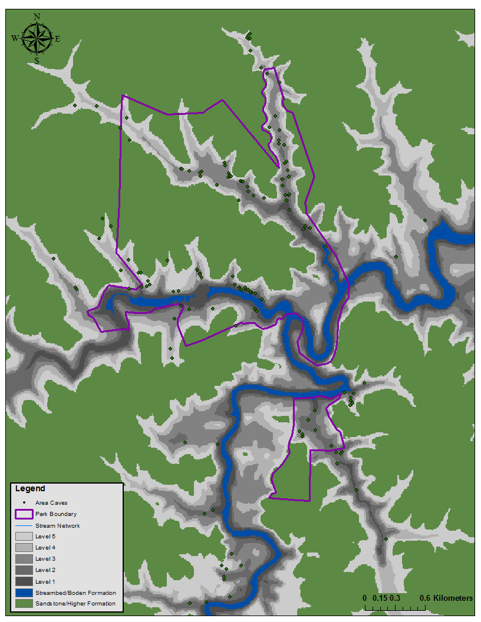
Spatial Distribution
4 Levels (Option 1)
5 Levels (Option 2)

Slide 13
Methods
Materials:
GIS
Cave Opening Data
10-meter DEM
3D Analysis tool used to calculate area and volume
Used denudation rates from the literature to calculate time
Computed SPI coverage results for all levels and stratigraphy in both DEMs

Slide 14
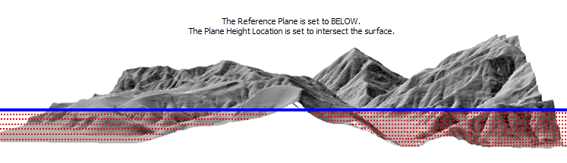
How the 3D Tool Works
Blue Line Represents Level Elevation
Red Stippled Area Represents the area and volume being calculated

Slide 15
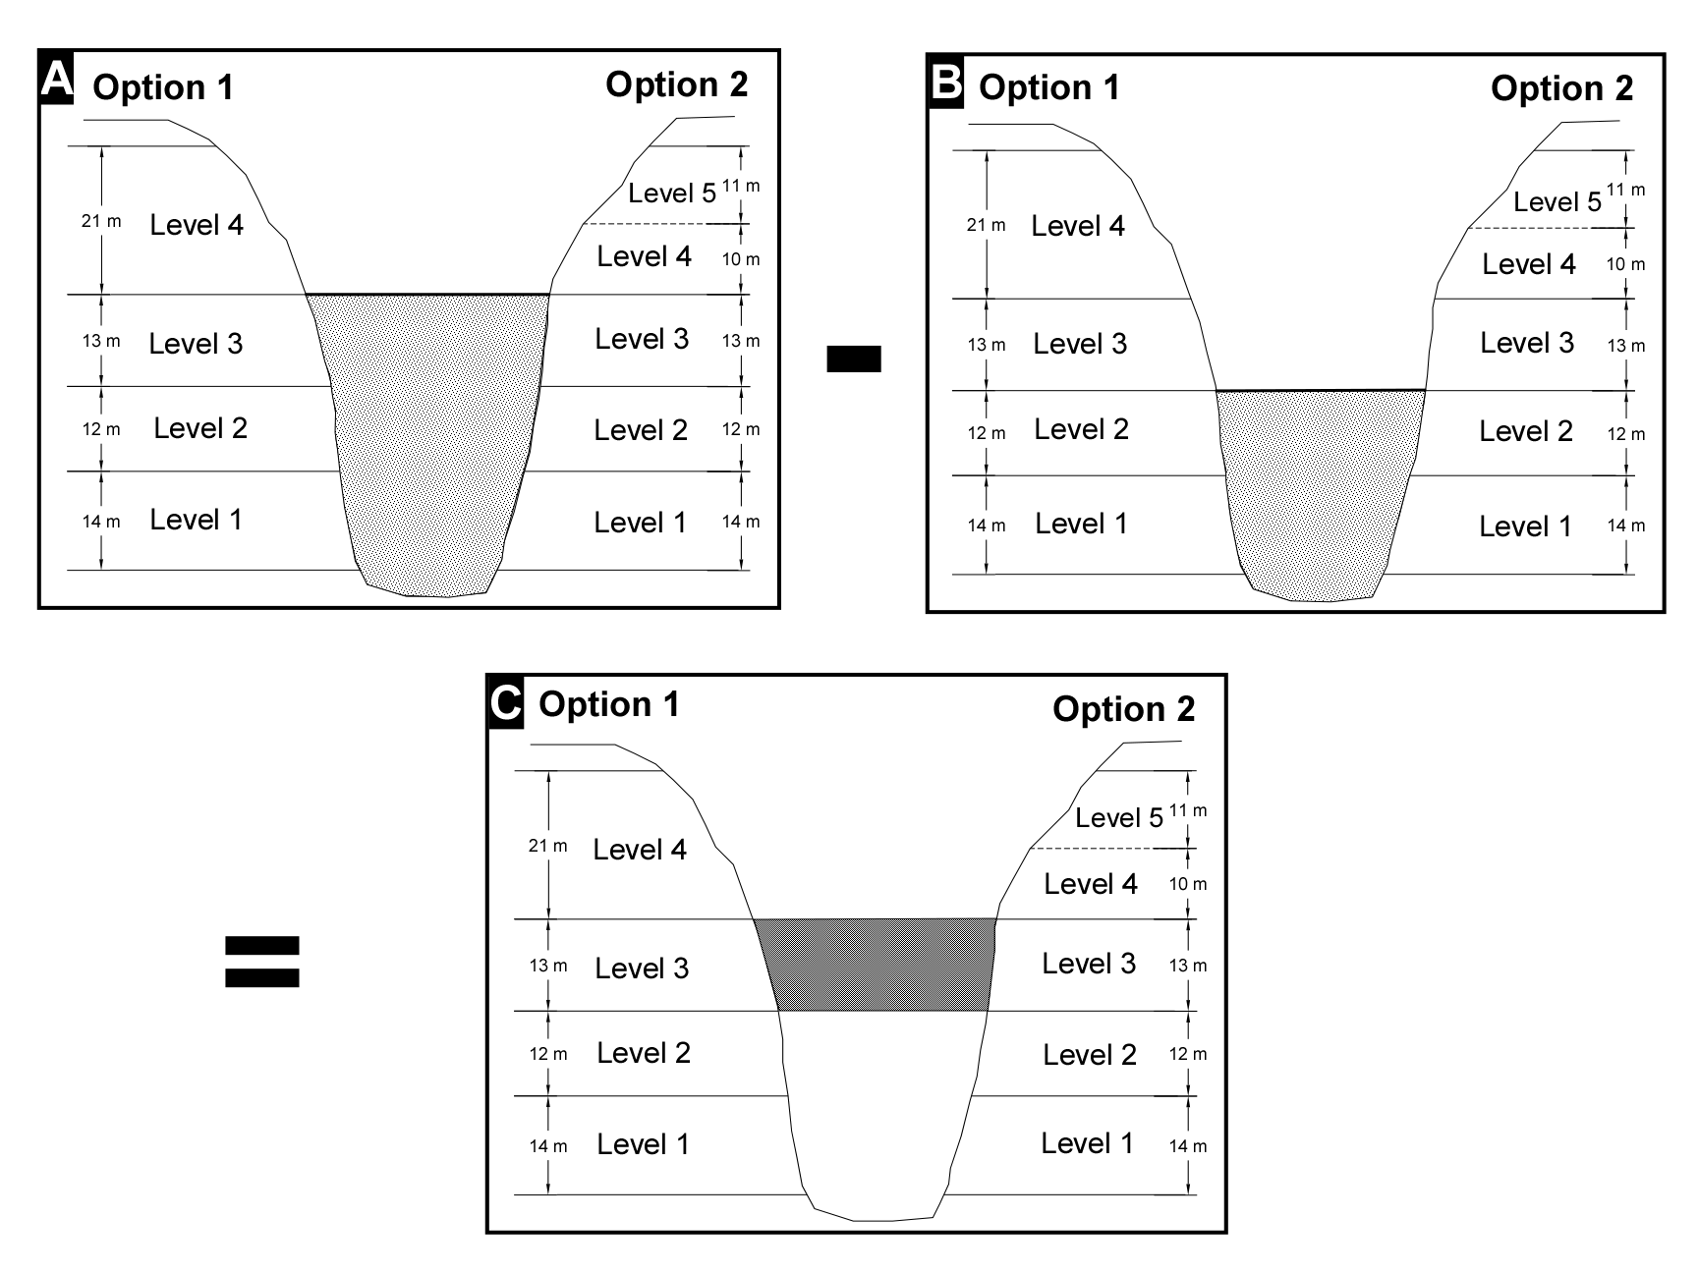
Area and Volume

Slide 16
Area and Volume
Total Level Volume = (volume beneath top of level) – (volume beneath base of level)
Total Thickness Lost =
(Level Volume/Level Area)
Time =
(Thickness Lost)/(Denudation Rate)

Slide 17
Area and Volume
Option 1
 | Volume (m³) | Area (m²) |  | Equivalent thickness lost (m)
Level 4 | 399,196,336 | 14,135,946 |  | 28.2
Level 3 | 120,945,389 | 5,969,867 |  | 20.3
Level 2 | 61,563,967 | 3,052,859 |  | 20.2
Level 1 | 39,026,737 | 2,472,838 |  | 15.8
Option 2
 | Volume (m³) | Area (m²) |  |  | Equivalent thickness lost (m)
Level 5 | 253,014,693 | 8,909,453 |  |  | 28.4
Level 4 | 146,181,642 | 5,226,493 |  |  | 28.0
Level 3 | 120,945,389 | 5,969,867 |  |  | 20.3
Level 2 | 61,563,967 | 3,052,859 |  |  | 20.2
Level 1 | 39,026,737 | 2,472,838 |  |  | 15.8

Slide 18
Denudation Rates
The act of lowering the landscape through erosion
A rate of 30 m/Ma is accepted for the Appalachians
Rate | Geographic Location | Climate Conditions (if provided)
9.5 m/Ma | Logatec Doline, Slovenia (Gams, 1981) | TEMPERATE
12-13 m/Ma | Clare-Galway, Ireland (Jennings, 1985) Poland (Pulina, 1971) Logatec Doline (Gams, 1981) | TEMPERATE TEMPERATE TEMPERATE
20 m/Ma | Krakow Plateau (Corbel, 1965) Aggtelekm, Hungary (Balazs, 1973) | TEMPERATE TEMPERATE
30 m/Ma | Appalachians, USA (White, 2009) Yucatan, Mexico (Corbel, 1959) | TEMPERATE TROPICAL
40 m/Ma | Austrian Alps (L. Plan, 2005) Laboratory derived maximum rate (F. Gabrovsek, 2007) | ALPINE N/A
50 m/Ma | Mendips, England (Smith and Newson, 1974) Poland (Oleksyonowa and Oleksyonowa, 1969) | TEMPERATE TEMPERATE

Slide 19
Time
Option 1
 | Equivalent thickness lost (m) |  | 9.5 m/Ma |  | 12 m/Ma | 20 m/Ma | 30 m/Ma | 40 m/Ma |  | 50m/Ma
 |  |  | Length of Time for Level Development (Ma)
level 4 | 28.2 |  | 2.97 |  | 2.35 | 1.41 | 0.94 | 0.71 |  | 0.56
level 3 | 20.3 |  | 2.13 |  | 1.69 | 1.01 | 0.68 | 0.51 |  | 0.41
level 2 | 20.2 |  | 2.12 |  | 1.68 | 1.01 | 0.67 | 0.5 |  | 0.4
level 1 | 15.8 |  | 1.66 |  | 1.32 | 0.79 | 0.53 | 0.39 |  | 0.32
Total system development time possible (ma) |  |  | 8.89 |  | 7.04 | 4.22 | 2.81 | 2.11 |  | 1.69
 |  | Estimated system development time (ma) based on chosen rates: |  |  |  |  | 3.38
Option 2
 |  | Equivalent thickness lost (m) | 9.5 m/Ma |  | 12 m/Ma | 20 m/Ma | 30 m/Ma | 40 m/Ma |  | 50m/Ma
 |  |  | Length of Time for Level Development (Ma)
level 5 |  | 28.4 | 2.99 |  | 2.37 | 1.42 | 0.95 | 0.71 |  | 0.57
level 4 |  | 28.0 | 2.94 |  | 2.33 | 1.4 | 0.93 | 0.7 |  | 0.56
level 3 |  | 20.3 | 2.13 |  | 1.69 | 1.01 | 0.68 | 0.51 |  | 0.41
level 2 |  | 20.2 | 2.12 |  | 1.68 | 1.01 | 0.67 | 0.5 |  | 0.4
level 1 |  | 15.8 | 1.66 |  | 1.32 | 0.79 | 0.53 | 0.39 |  | 0.32
Total system development time possible (ma) |  |  | 11.85 |  | 9.38 | 5.63 | 3.75 | 2.81 |  | 2.25
 |  | Estimated system development time (ma) based on chosen rates: |  |  |  |  | 5.74

Slide 20
Comparison
Mammoth Cave¹ |  |  | CCSRP² |  |  | Cumberland Plateau³
Cave Level | Age (Ma B.P.)⁴ | Extent (Ma) | Option 1 Age (Ma B.P.) | Cave Level | Option 2 Age (Ma B.P.) | Cave Level | Age (Ma B.P.) | Extent (Ma)
 |  |  | NA | 5 | 5.74 | 1 | 5.7-3.5 | 2.2
A | 3.25 | 0.95 | 3.38 | 4 | 3.37 | 2 | 3.5-2 | 1.5
B | 2.3 | 0.38 |  |  |  | 3 | 2-1.5 | 0.5
C | 1.92 | 0.53 | 1.97 | 3 | 1.97
D | 1.39 | 0.15 | 1.46 | 2 | 1.46 | 4 | 1.5-.8 | 0.7
E | 1.24 | 0.54 | 0.79 | 1 | 0.79 | 5 | 0.8 | 0.8
¹Granger et al, 2001
²Peterson, et al (in review)
³Anthony and Granger, 2004, and White, 2007
⁴Ma B.P. stands for millions of years before present.

Slide 21
What is SPI?
(Stream Power Index)
Digital terrain analysis
Uses a digital elevation model (DEM)
Determines erosive power of flowing water based on slope and flow accumulation
No measurement of discharge required
Relies on quality of digital data and little field work

Slide 22
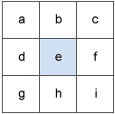
Slope
For each cell, the slope tool calculates the maximum rate of change between it and its neighbors
Identifies the steepest downhill slope
√(dz/dx)² + (dz/dy)²) = slope

Slide 23
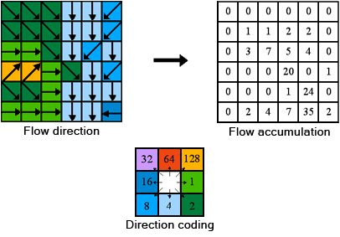
Flow Accumulation and SPI
based on elevation
Sum of cells that flow into a single cell
SPI = Slope * Flow Accumulation

Slide 24
SPI Thresholds
SPI Threshold | Percentile | Filled Raw SPI Value | Unfilled Raw SPI Value
0 | 1st-94th | -13.82 - 2.87 | -13.82-2.49
1 | 95th | 2.87 - 3.06 | 2.49-2.78
2 | 96th | 3.06 - 3.54 | 2.78-3.14
3 | 97th | 3.54 - 4.23 | 3.14-3.62
4 | 98th | 4.23 - 5.41 | 3.62-4.38
5 | 99th | 5.41 - 12.18 | 4.38-8.52

Slide 25
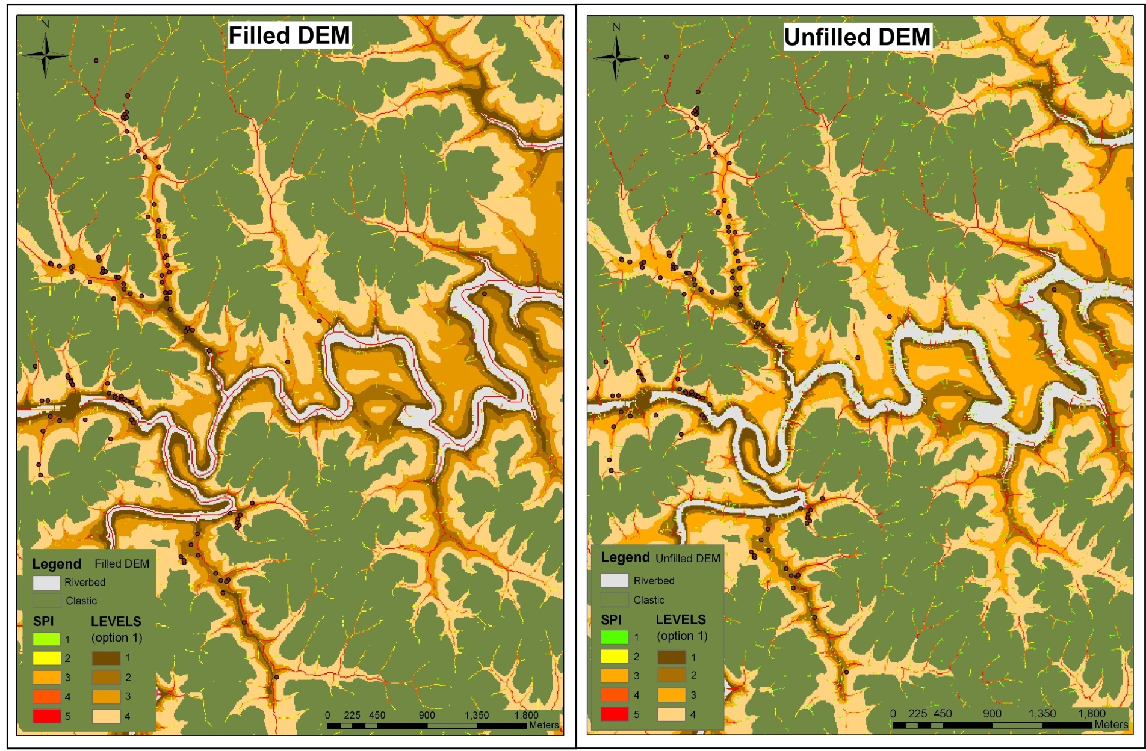
Distribution of SPI

Slide 26
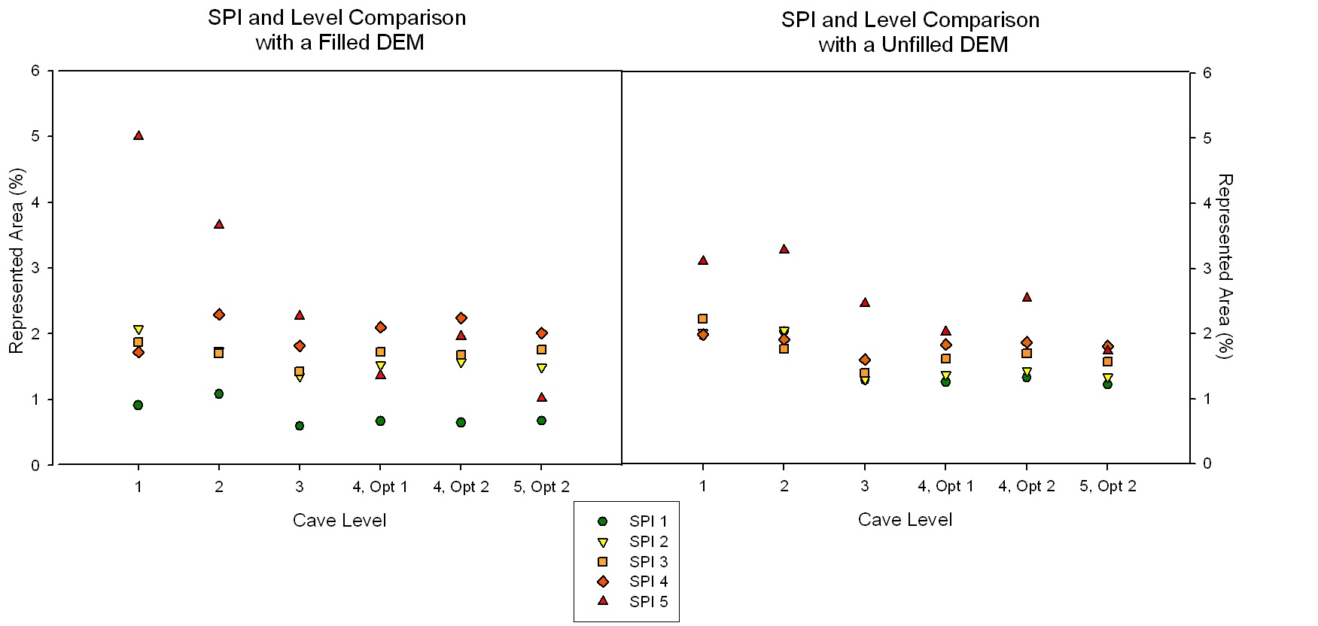
SPI vs Level

Slide 27
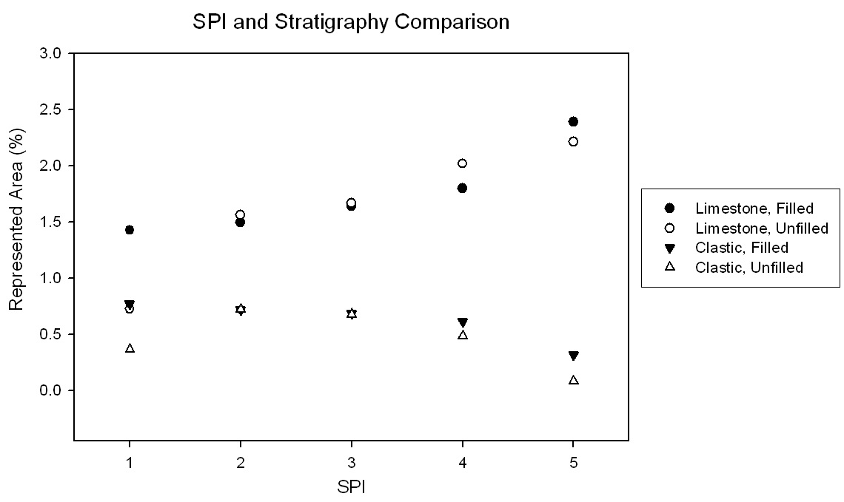
SPI vs Stratigraphy

Slide 28
Conclusions
Greatest volume, area, and material lost in levels at highest elevations and oldest in age. These also took the longest to develop
4 rates between 12 and 40 m/Ma
Average rate is 24 m/Ma
Higher erosion potential at lower elevations
Higher SPI threshold coverage in limestone than clastic rocks

Slide 29
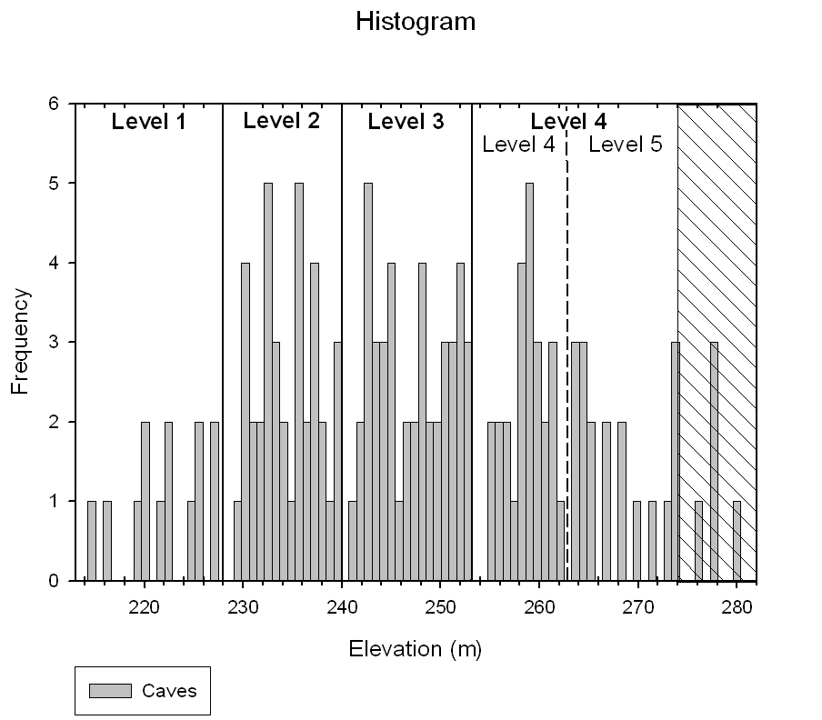
Results

Slide 30
Results
Option 1 | distance from stream range (m) | average stream dist (m)
level 4 | 0-139 | 36
level 3 | 0-78 | 18
level 2 | 0-81 | 17
level 1 | 0-64 | 20
Option 2 | distance from stream range (m) | average stream dist (m)
level 5 | 0-139 | 40
level 4 | 0-71 | 32
level 3 | 0-78 | 18
level 2 | 0-81 | 17
level 1 | 0-64 | 20
The ends of the boxes represent the 25th and 75th percentiles with the solid line at the median and the dashed line at the mean; the error bars depict the 10th and 90th percentiles and the points represent outliers. Mean increases with age level. Numerical values can be found in Table 2.
Notes:
Mean does increase with each cave level. Distance is greatest for caves in oldest level. Lower levels contain steeper valleys and evidence of cave collapse. Rapid incision, water redirected through subsurface, this resulted in cave collapse some places. We have a lack of wide, well developed valleys bc of the short lived baselevel elevations.

