Slide 1
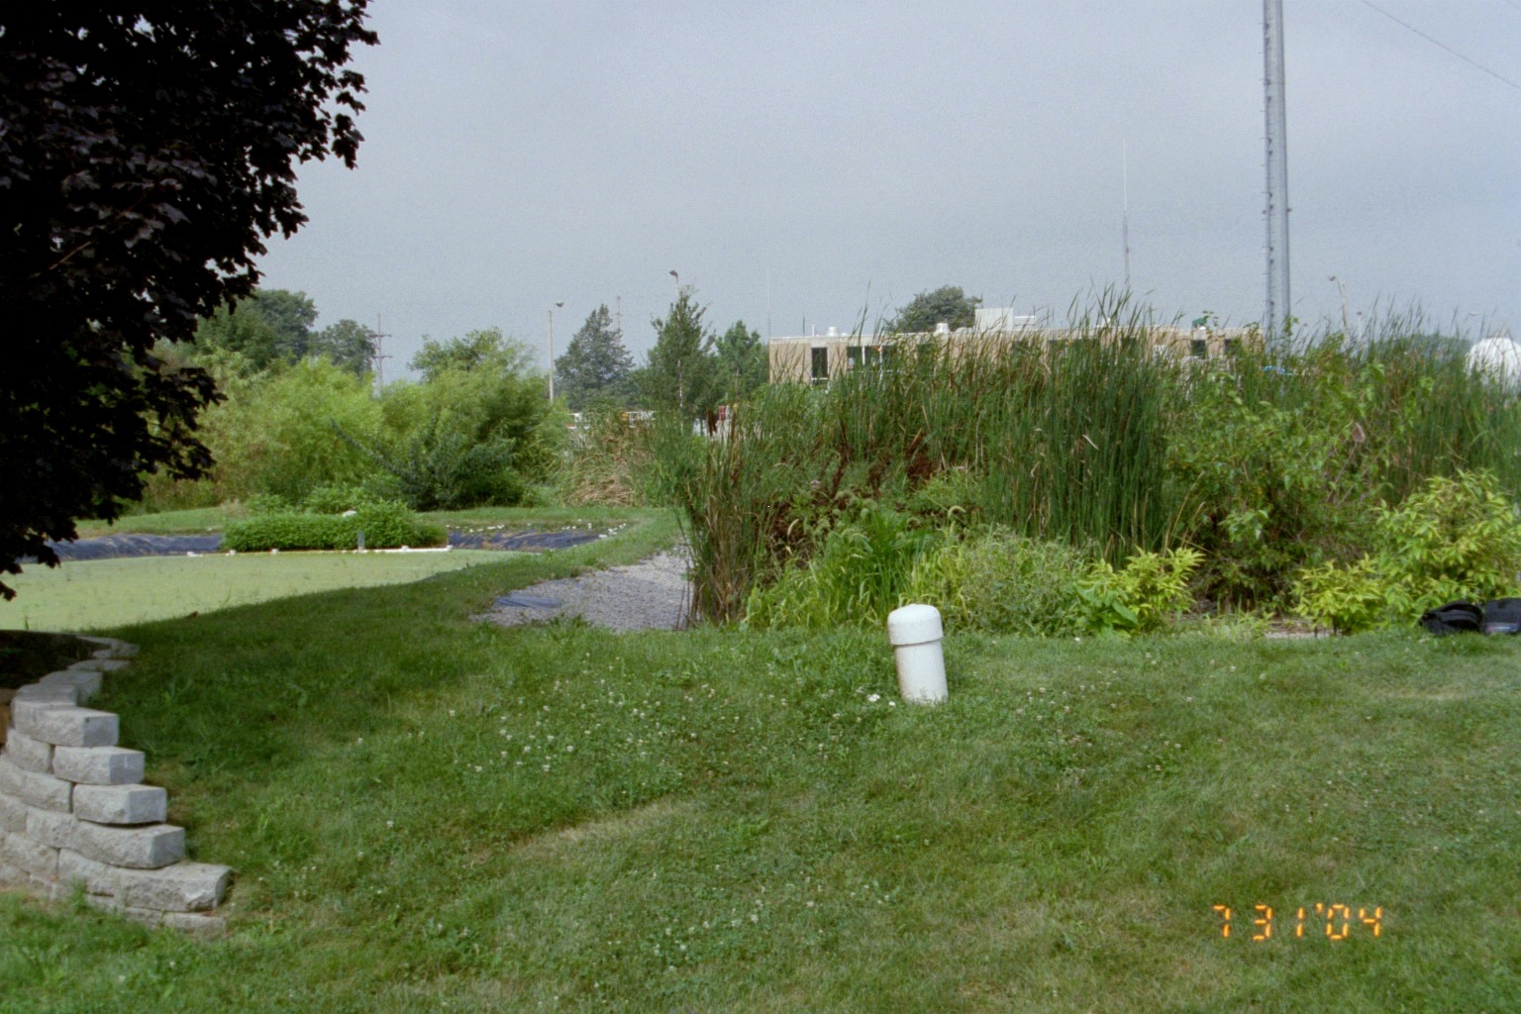
Estrogen reduction in a coupled wetland and ground water flow-through system
Laura Hanna
Eric Peterson
Illinois State University

Slide 2
Environmental Risk
Endocrine-disrupting compounds (EDCs) has been reported in surface water, spring water, and overland flow systems.
EDCs disrupt reproduction in aquatic organisms, increase in the mortality of aquatic organisms, impact on human reproduction.
The most potent EDCs released into the aquatic system are steroid hormones, specifically 17β-estradiol (E2).
E2 is transformed biologically and abiotically to estrone (E1).
As the primary and most potent female hormone, E2 stimulates the growth and development of the female sex organs in vertebrates.
E2 concentrations below 10 ng/L impact fish causing testicular abnormalities, feminization of male fish, and reduced spawning.

Slide 3
Sources of E2 & E1
Human and animal waste serves as both a point and non-point source.
Treated effluent from wastewater treatment plants (WWTPs) serves as a major point source.
Naturally excreted E2, in urine and in feces, accounts for 95% or more of the E2 in wastewater, with the remaining 5% or less associated with E2 used therapeutically (Christensen,1998).
Concentrations of E1 and E2 as high as 180 ng/L and 55 ng/L, respectively, have been observed in treated effluent (Komori et al. 2004, Peterson and Lanning, 2009).

Slide 4
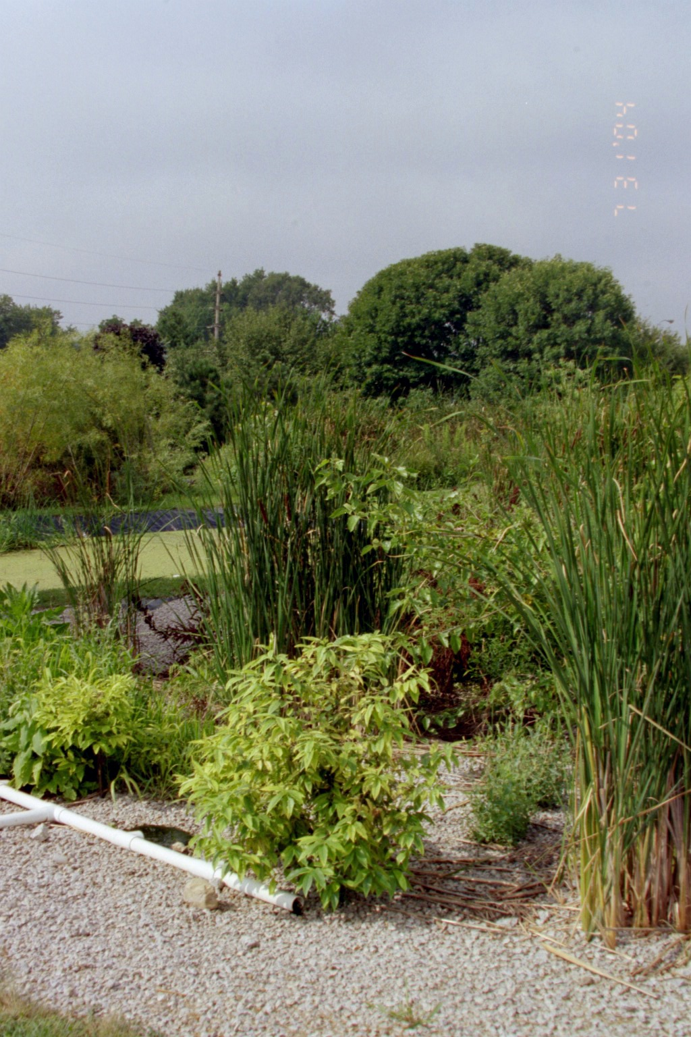
Fate of E2 & E1 in WWTPs
Conventional WWTPs are not designed to remove either E1 or E2.
Primary and secondary treatment of WWTPs remove E1 and E2 from wastewater and have reported removal rates ranging between 64 to 88% depending upon the treatment process (Ternes et al. 1999, Cicek et al., 2007).
WWTPs have been incorporating wetlands as a tertiary treatment step for municipal wastewater.
As a tertiary treatment, wetlands reduced E2 up to 27% (Peterson and Lanning, 2009).
The wetland environment provides two pathways for E2 removal
Sorption of E2 on to sediment.
Transformation of E2 to E1, which may then be degraded to additional by-products.

Slide 5
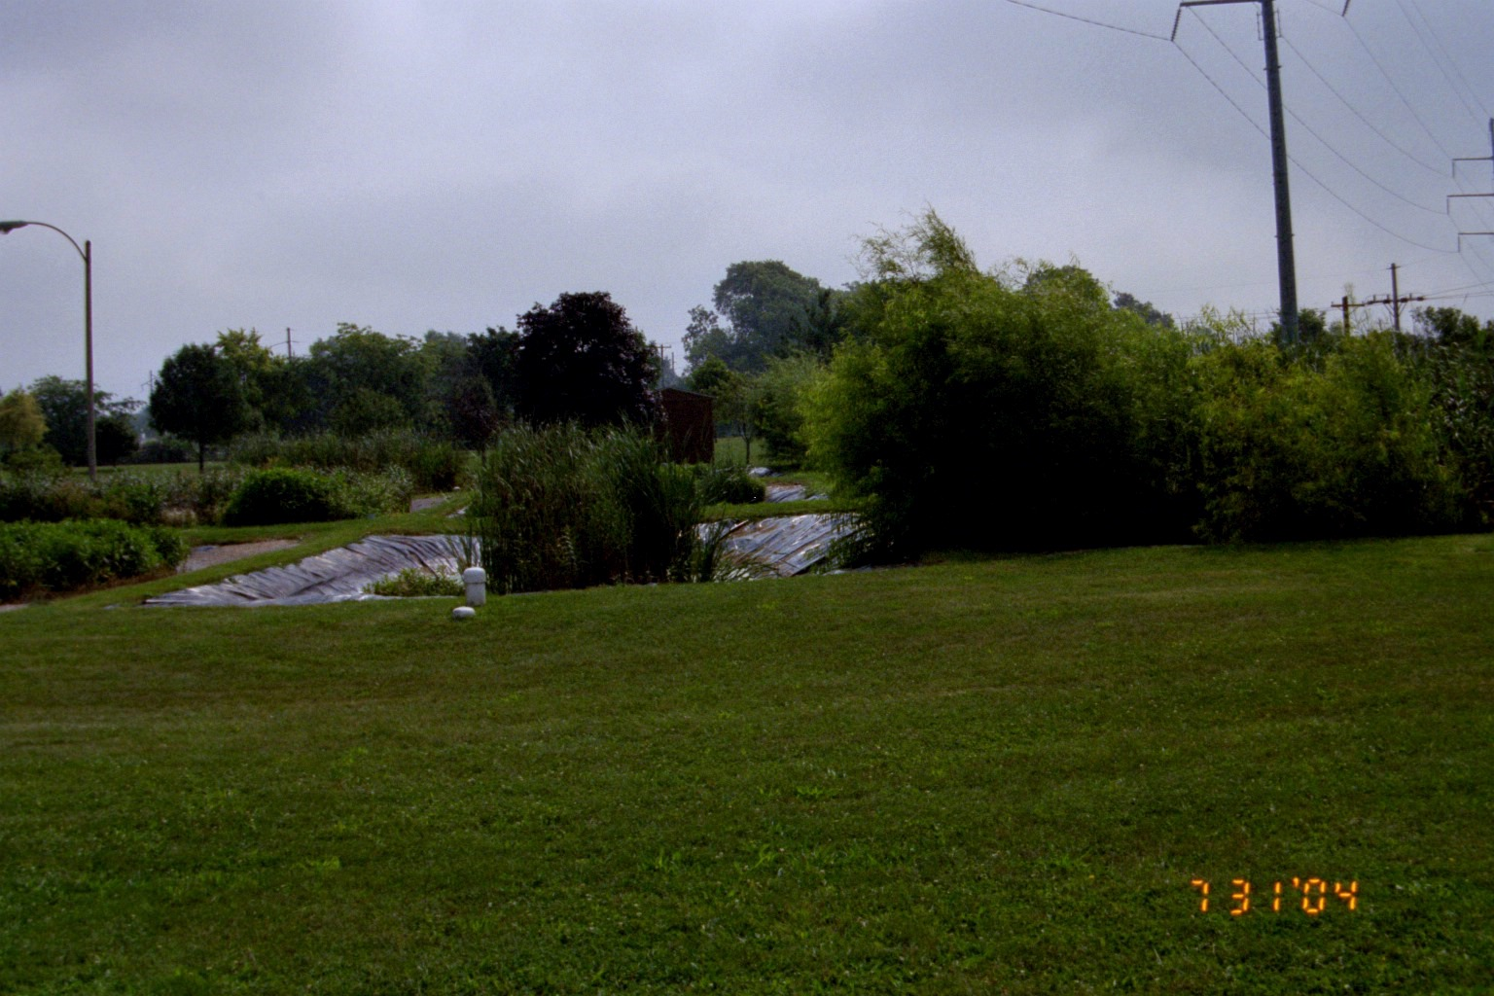
Objectives
Investigate the reduction of 17β-estradiol (E2) and Estrone (E1) in treated wastewaters subjected to a tertiary treatment composed of a coupled wetland and ground water flow through system
Quantify the presence of E2 and E1 in treated wastewater and along ground water pathways from a wetland
Determine the potential reduction of E2 and transformation of E2 to E1 along the ground water pathways.

Slide 6
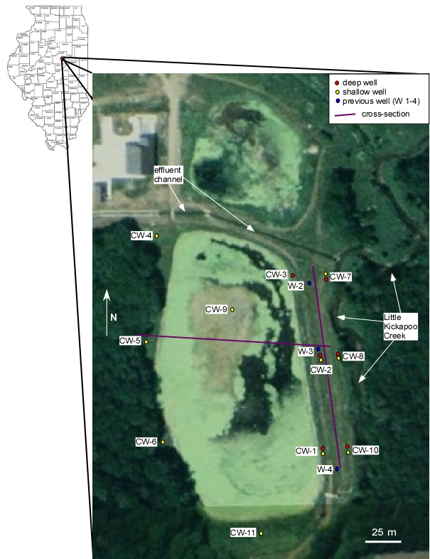
Study Area
Bloomington-Normal Wastewater Reclamation District (BNWRD) facility located south of Bloomington, Illinois.
Houses a wastewater treatment facility, two constructed wetlands, and Little Kickapoo Creek (LKC).
Focus on the southern, and larger, wetland.
Wetland receives a fraction of the treated wastewater effluent.
Wetland constructed by excavating the upper part of the alluvium, grading the area, and then using the alluvium to form the berm around the wetland.
Originally, the wetland sat above the water table.
Series of nested and single wells ring the wetland.

Slide 7
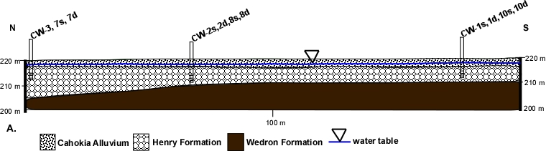
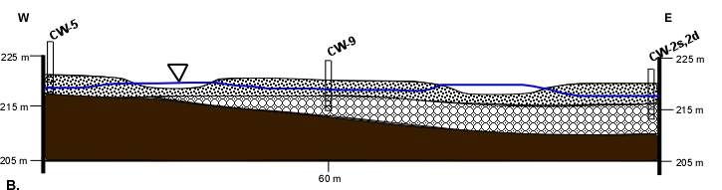
Geology
The geologic units underlying the site are:
Cahokia Alluvium – Holocene flood deposits.
Henry Formation – glacial outwash unit, water table aquifer.
Wedron Formation – glacial till underlying Henry Formation, serves as a lower confining unit.

Slide 8
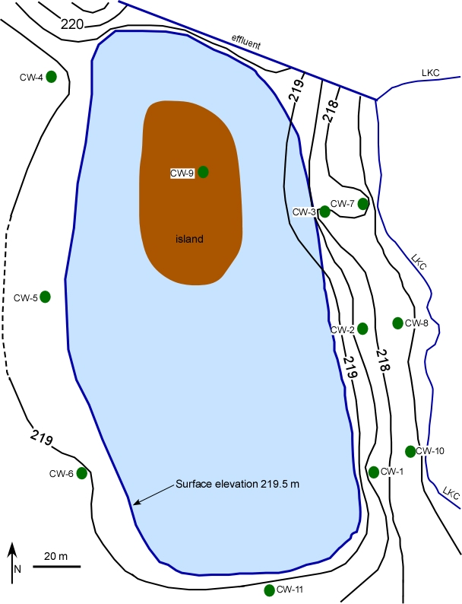
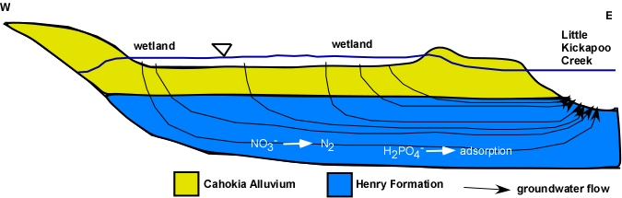
Hydrogeology
Ground water flow is from West to East (LKC) with a horizontal gradient 0.02 – 0.04
111 m³/day of wetland water seeps into the subsurface and flows towards creek along with regular ground water flow.
Figures from Ackerman, 2011

Slide 9
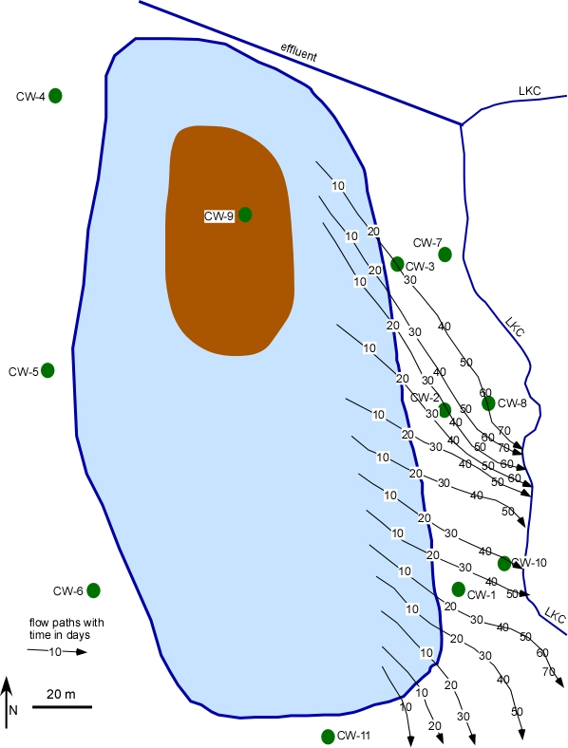
Hydrogeology
Ackerman (2011) simulated travel times of 20 days from wetlands to wells and a more SE movement of water.
50 to 100% of waters in down gradient wells is from the wetlands.

Slide 10
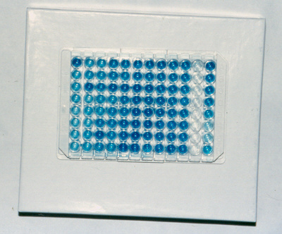
Methods
Eight rounds of samples were collected from the wells, wetland, and effluent channel between July 18 and September 29, 2011.
Wells were first purged until a stable specific conductance was reached.
Samples were drawn using a peristaltic pump and collected HDPE containers (60 mL) and stored at 4ºC until analysis.
Estrogen concentrations were analyzed ELISA kits (Ecologienia ®, Japan EnviroChemicals, Ltd.) with detection limits of 25 ng/L for E2 and 15 ng/L for E1.

Slide 11
Results
Neither E2 nor E1 were measured in the ground water upgradient of the wetland (CW 4 and CW 5).
E2 and E1 were identified in the treated effluent and wetlands during each sampling event.
In only one well, CW 2D, were E2 or E1 measured above the detection limit during more than one sampling.
All of the deep wells witnessed at least one sampling when E2 was above the detection limit.
Only one shallow well, CW 1S, recorded an E2 concentration above the detection limit.

Slide 12
Results - 17β-estradiol and Estrone
Location | 17 β-Estradiol (E2) ng/L |  |  | Estrone (E1) ng/L
 | Minimum | Maximum | Average | Minimum | Maximum | Average
Treated Effluent | B.D.L.# | 60 | 20 | B.D.L.# | 178 | 76
Wetland | B.D.L.# | 20 | 17 | B.D.L.# | 100 | 55
CW 1S | B.D.L.# | 18 | 18 | B.D.L.# | B.D.L.# | —
CW 1D | B.D.L.# | 18 | 18 | B.D.L.# | B.D.L.# | —
CW 2S | B.D.L.# | B.D.L.# | — | B.D.L.# | B.D.L.# | —
CW 2D | B.D.L.# | 762 | 258 | B.D.L.# | 58 | 58
CW 3 | B.D.L.# | B.D.L.# | — | B.D.L.# | B.D.L.# | —
CW 4 | B.D.L.# | B.D.L.# | — | B.D.L.# | B.D.L.# | —
CW 5 | B.D.L.# | B.D.L.# | — | B.D.L.# | B.D.L.# | —
CW 7S | B.D.L.# | B.D.L.# | — | B.D.L.# | B.D.L.# | —
CW 7D | B.D.L.# | 16 | 16 | B.D.L.# | B.D.L.# | —
CW 8S | B.D.L.# | B.D.L.# | — | B.D.L.# | B.D.L.# | —
CW 8D | B.D.L.# | 16 | 16 | B.D.L.# | B.D.L.# | —
CW 10S | B.D.L.# | B.D.L.# | — | B.D.L.# | B.D.L.# | —
CW 10D | B.D.L.# | 17 | 17 | B.D.L.# | 139 | 139
#B.D.L. – Below Detection Limit
* For Average values equal to the maximum value, only one sample was above the detection limit.

Slide 13
Conclusions
Data indicate that the wetland is serving as a sink for E2 and E1.
67% reduction of E2
44% reduction of E1
Data reinforce that the dominant pathway is through the Henry Formation, with limited ground water flow through the alluvium.
The absences of E2 and E1 within the ground water indicate that both are being effectively removed within the ground water system.

Slide 14
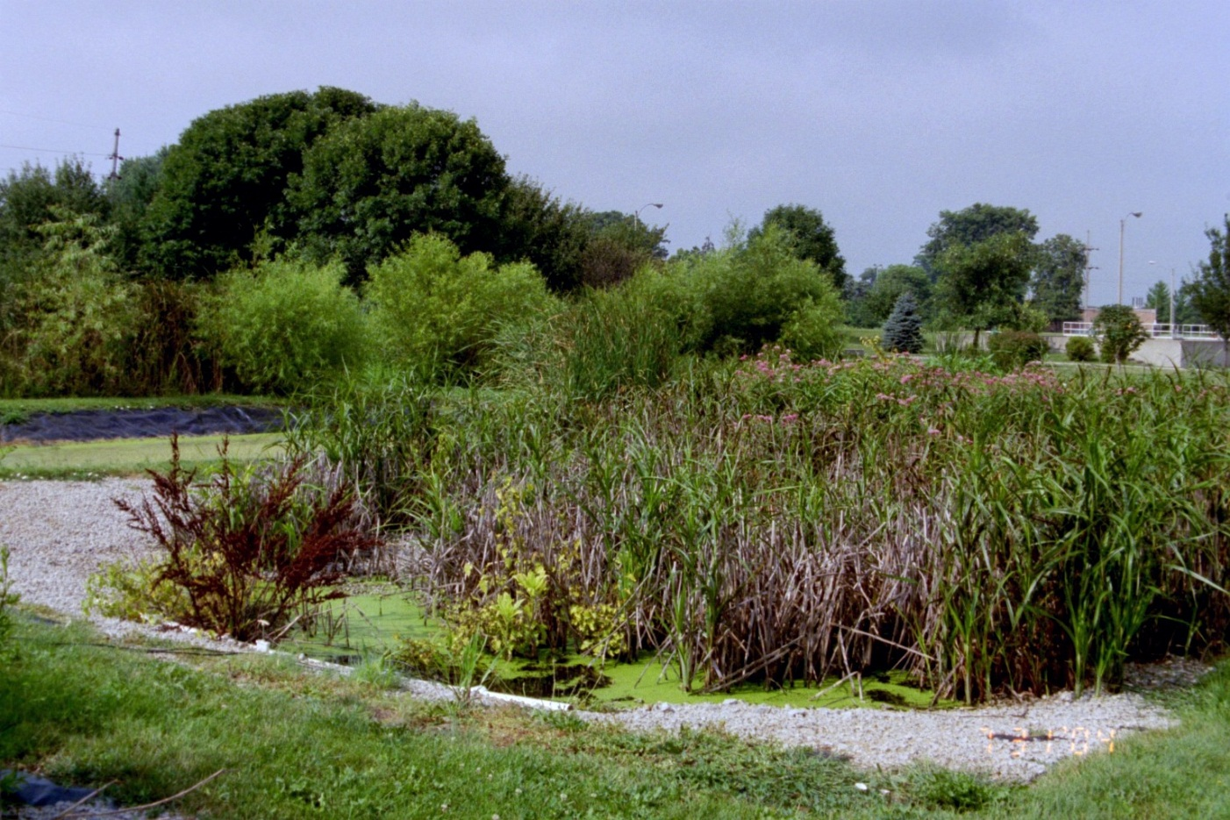
Acknowledgements
Illinois Groundwater Association – Student Research Grant (Hanna)
Illinois-Indiana Sea Grant Program – (Peterson)
Bloomington-Normal Waste Water District

