Slide 1
The effect of flow stripping on submarine levee construction and stratigraphy
Hesham Ezz, Alessandro Cantelli, Enrica Viparelli, and Jasim Imran
2012 GSA Annual Meeting

Slide 2
Introduction
Laboratory experiments are conducted to model turbidity currents building their submarine levees by flow stripping process.
21 consecutive sustained depositional turbidity currents are released in a pre-built sinuous channel with an initial axial slope of 4 %.
Experiments are conducted to investigate:
How turbidity currents deposit sediment in the channel and on the overbank areas;
What’s the vertical sorting inside the channel and on the overbank area;
How the grain size distribution of the deposit changes in the lateral and the downslope direction.

Slide 3
Introduction
How turbidity currents build submarine channels Levees?
Potentially Prospective
Overbank
Confined Channel Flow
Overspill
Flow Stripping
Source: AAPG Presentation by Henry W. Possamintier

Slide 4
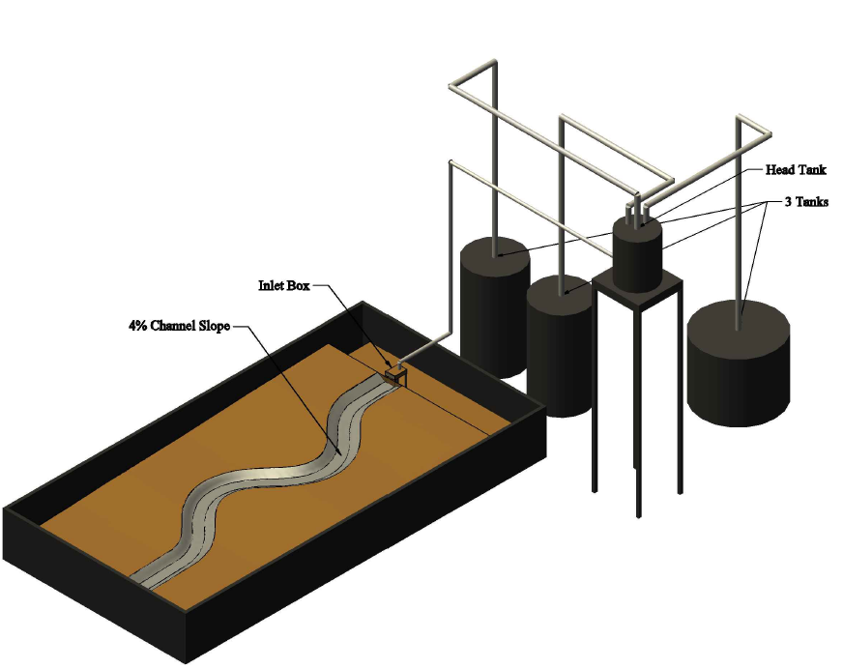
Experimental Setup
Channel length ≈ 11 m.
The released currents have an excess density of 1.5%, relative to the fresh water filling the basin,.
The mixture is made of 1.0% of silt (D50 = 30 μm), 0.5% salt
12 m
6 m

Slide 5
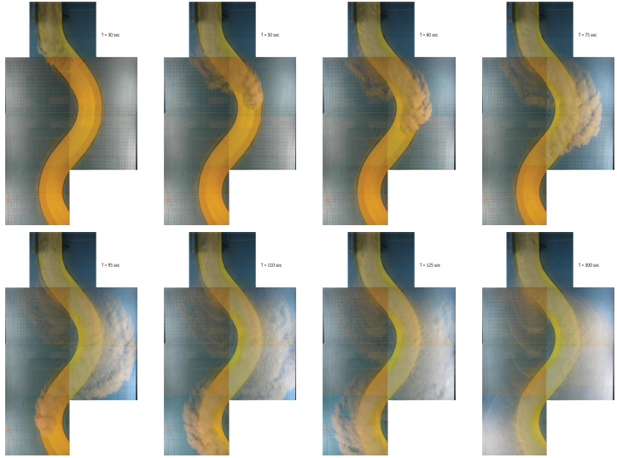
Results
Flow propagation
Flow propagation

Slide 6
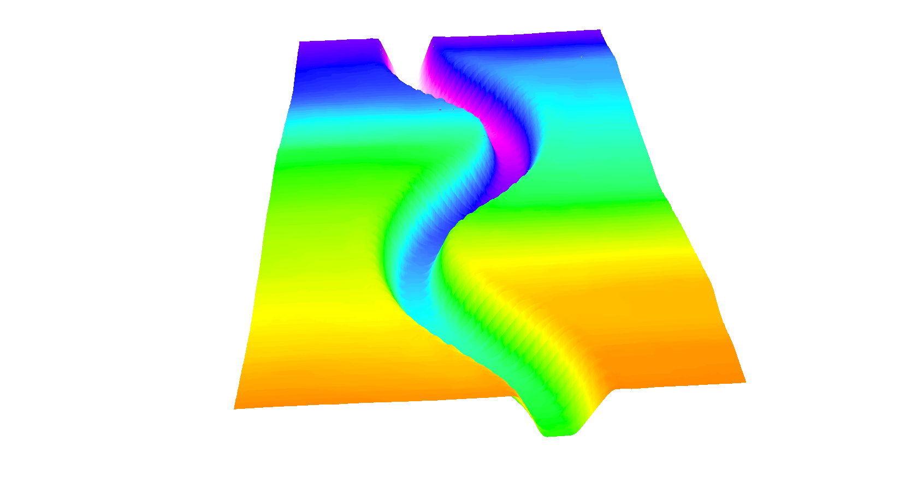
Results
Deposition pattern
Base Elevations
Q = 2.0 L/s
Flow Direction

Slide 7
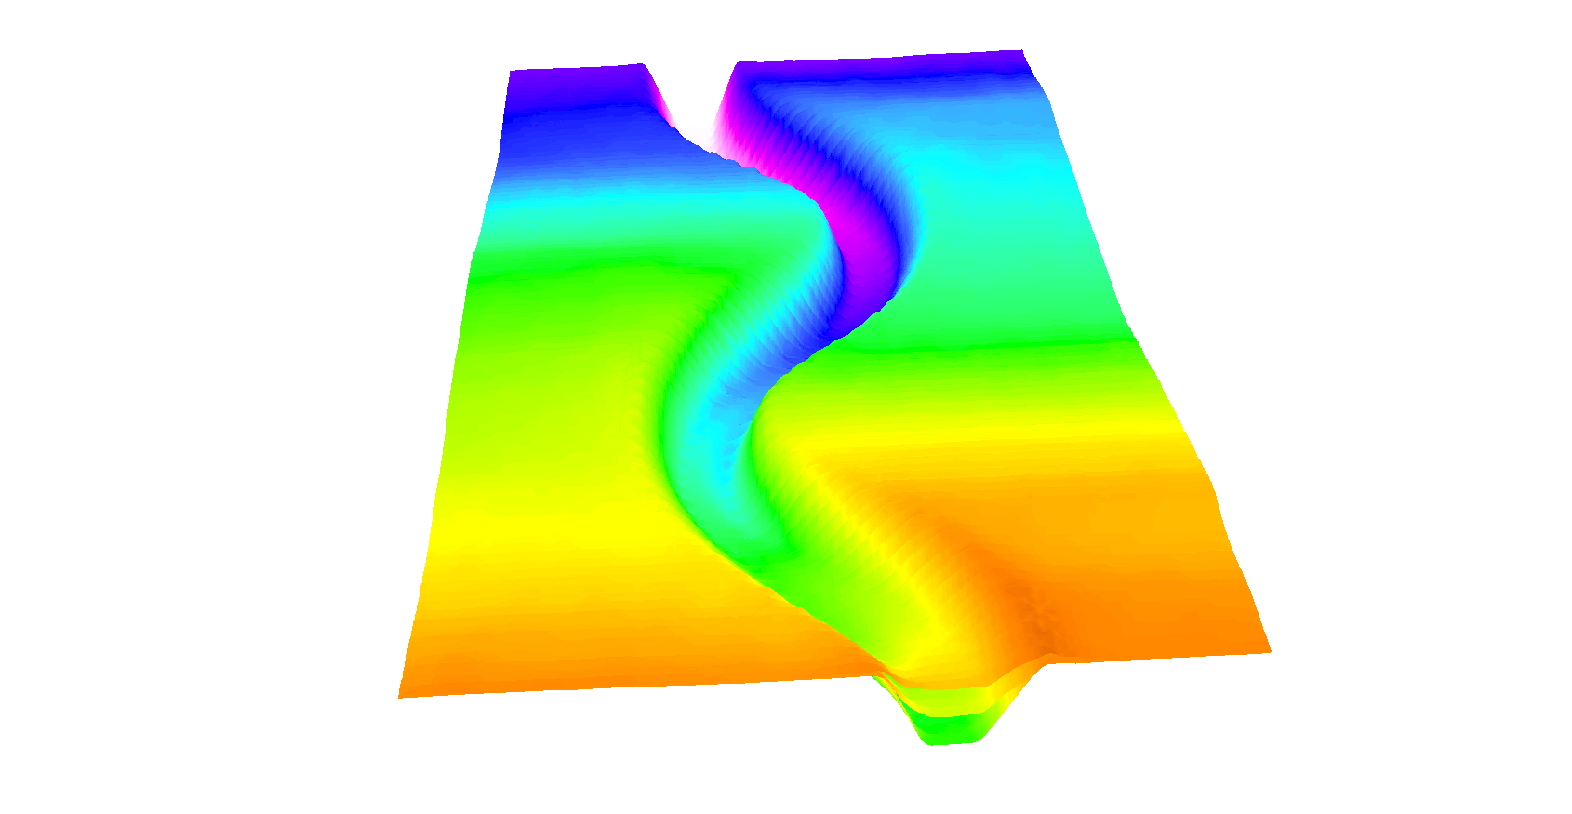
Results
Deposition pattern
After 6 runs
Q = 2.0 L/s
Flow Direction

Slide 8
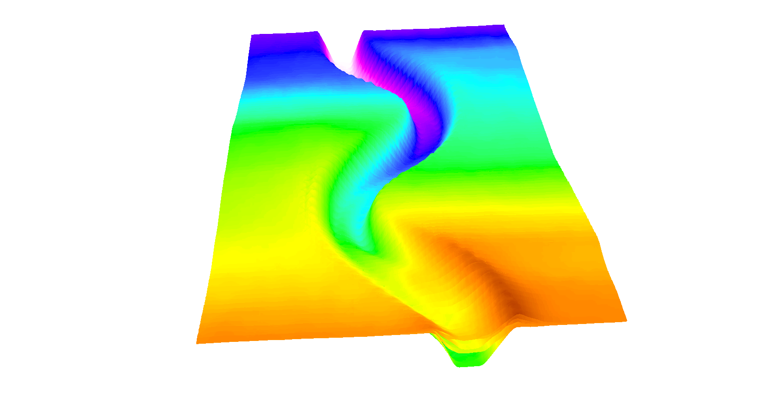
Results
Deposition pattern
After 12 runs
Q = 2.5 L/s
Flow Direction

Slide 9
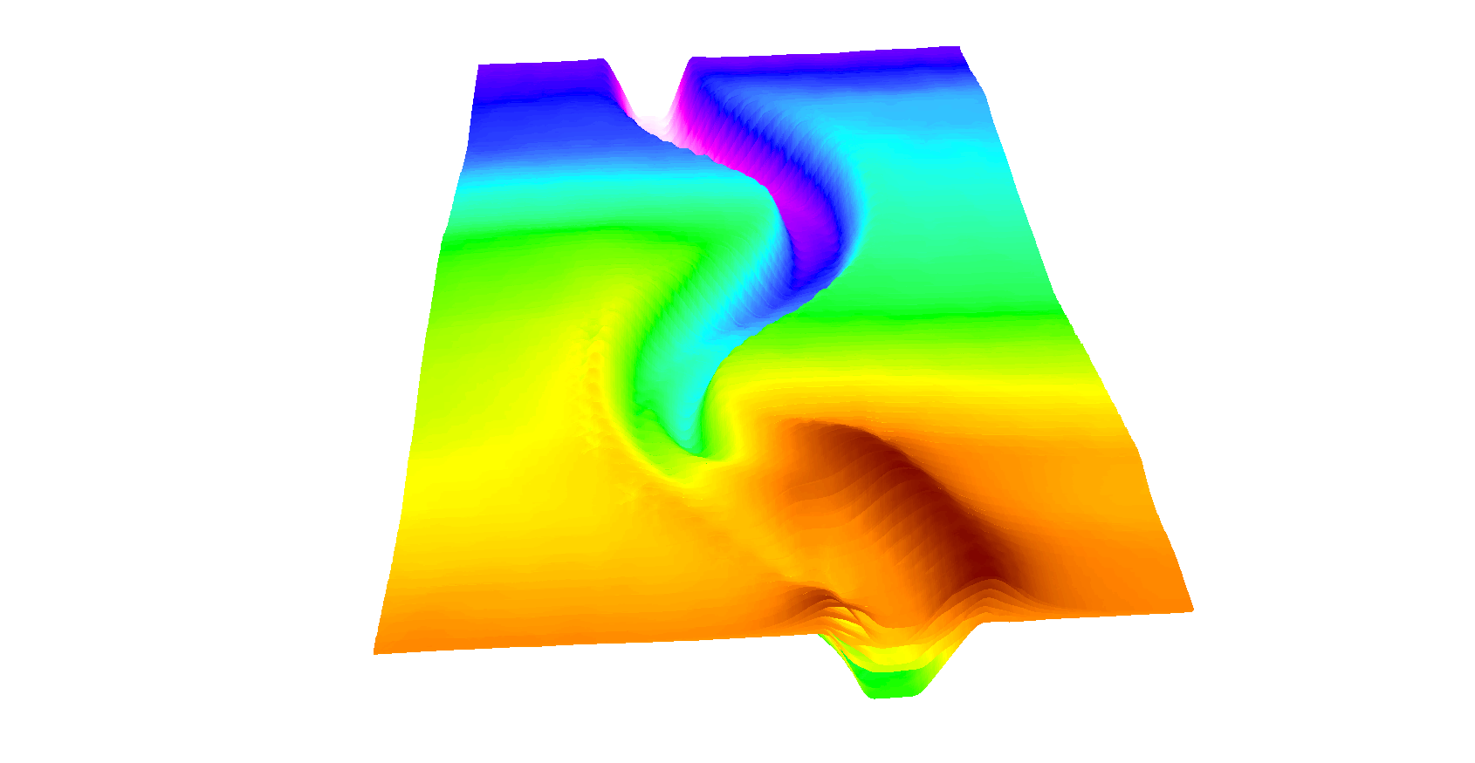
Results
Deposition pattern
After 21 runs
Q = 2.5 L/s
Flow Direction

Slide 10
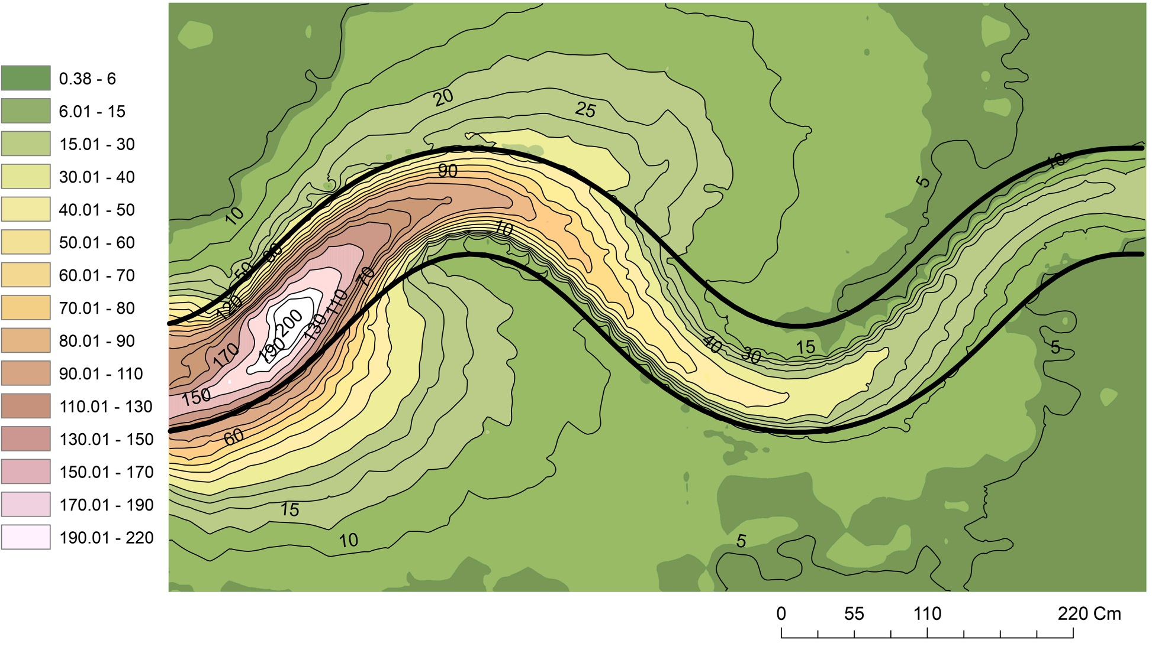
Results
Deposition pattern
mm
Flow Direction

Slide 11
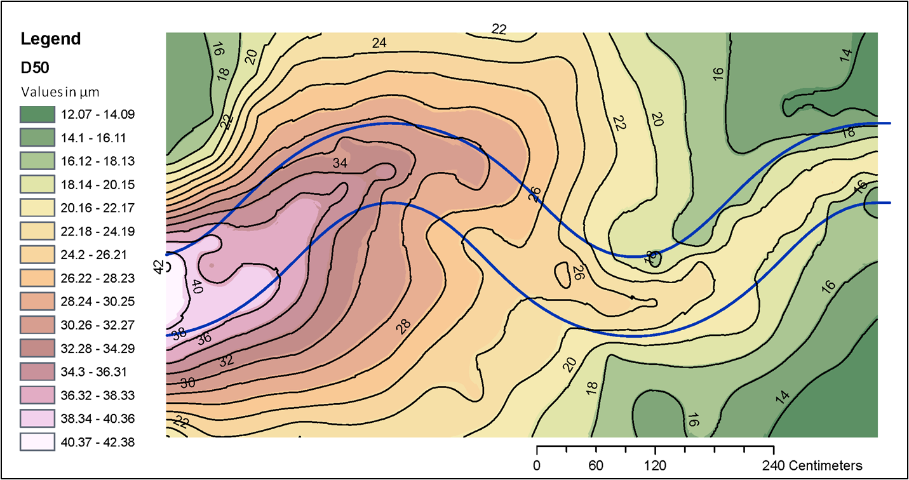
Results
Grain size distribution map (last run)
Flow Direction

Slide 12
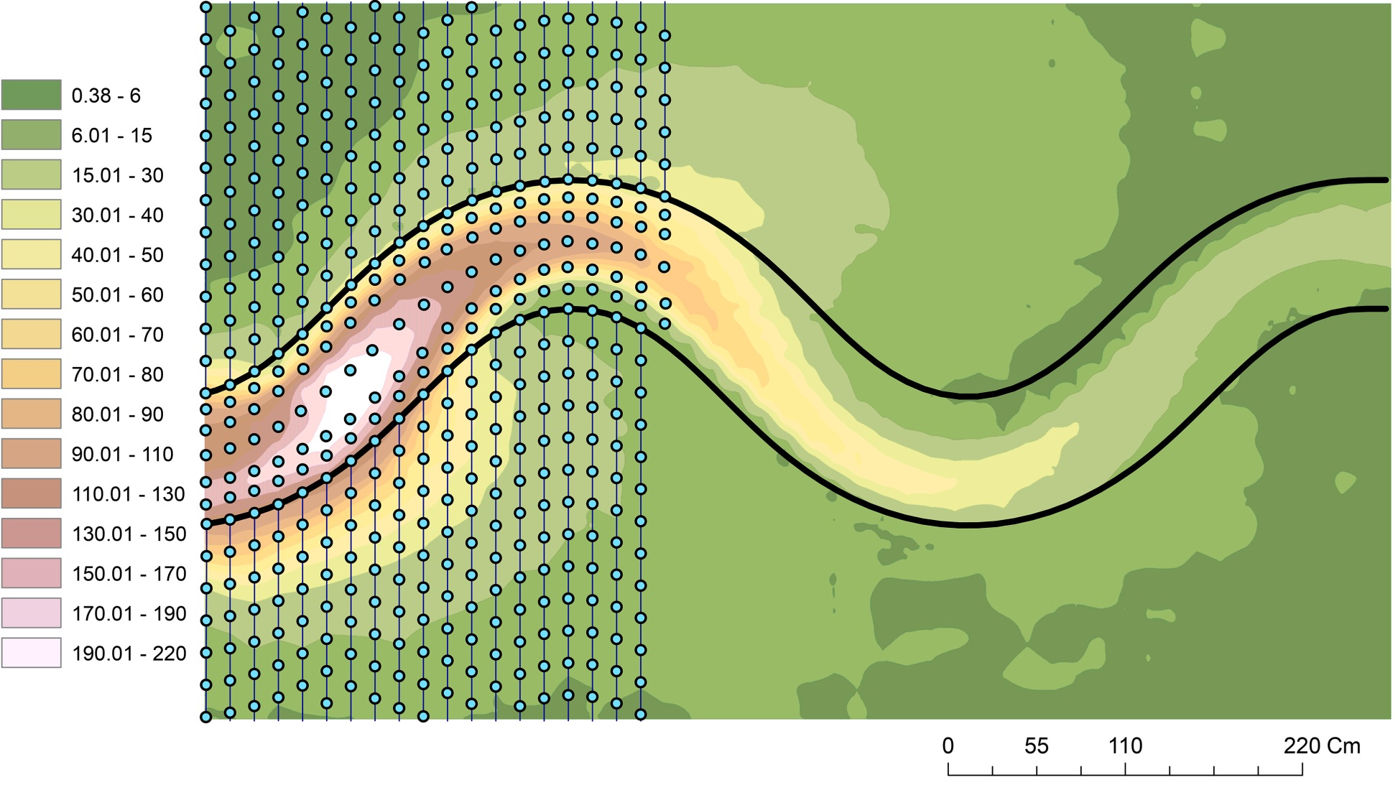
Results
Sample locations
mm
Flow Direction

Slide 13
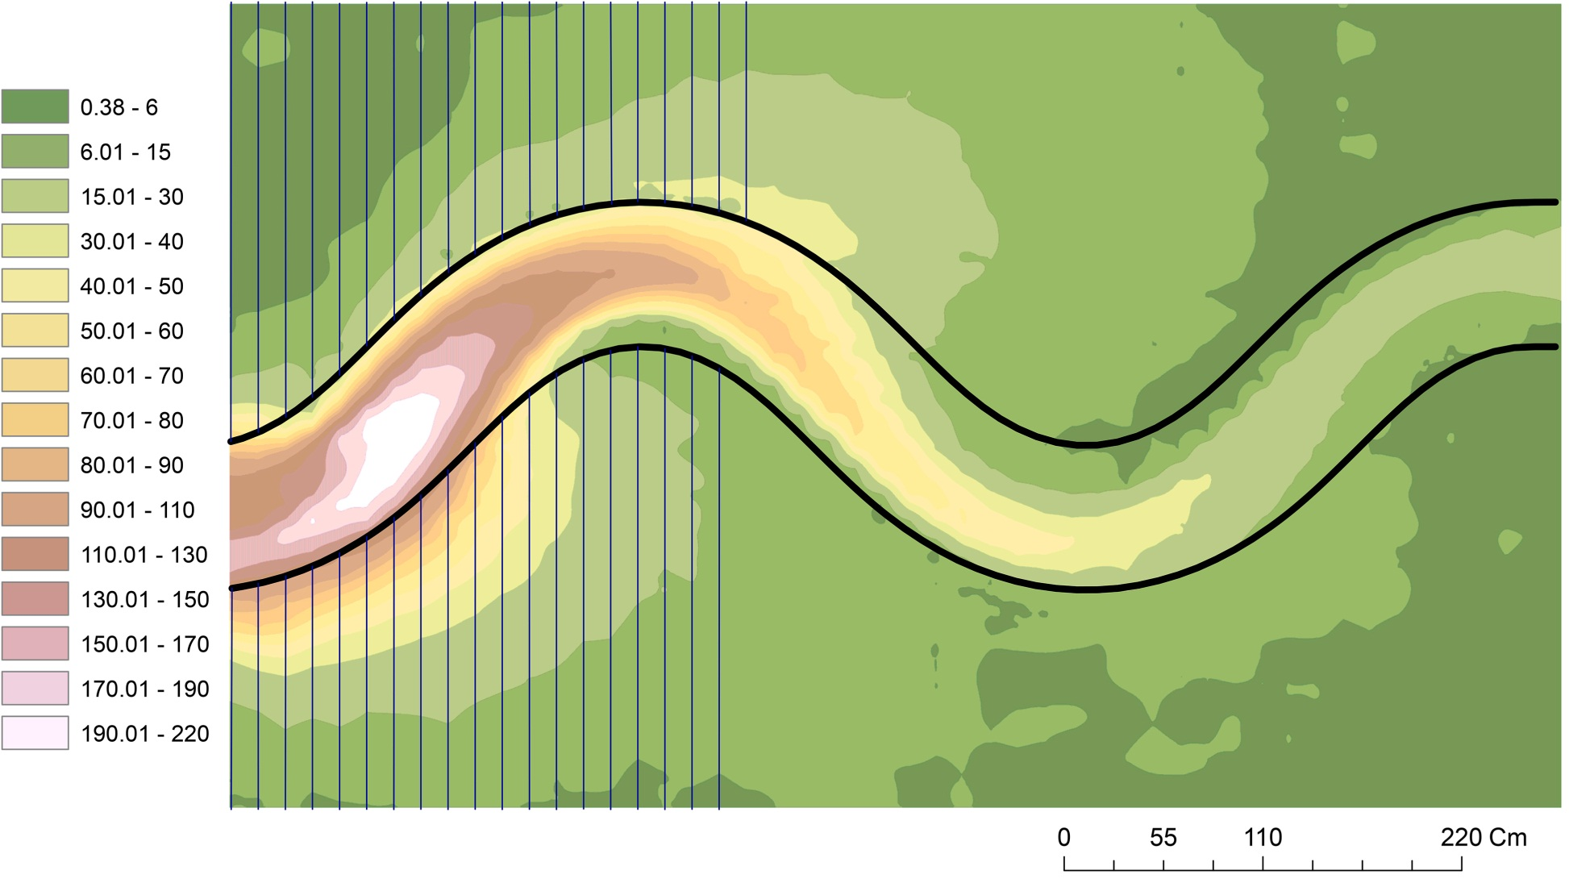
Results
Slices
mm
Flow Direction

Slide 14
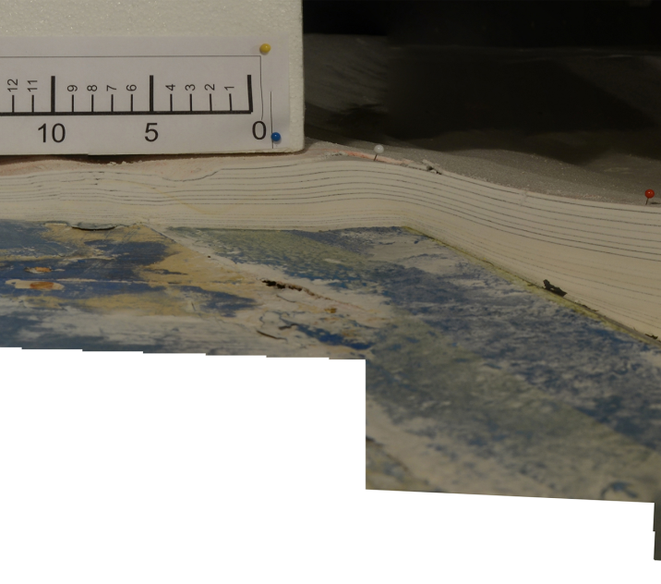
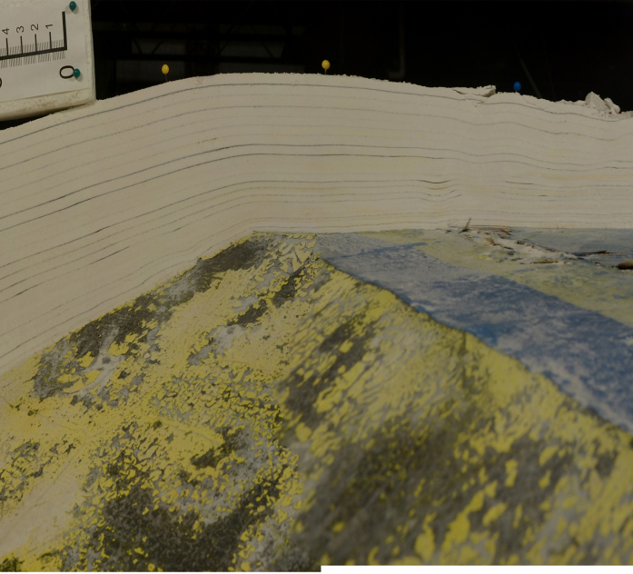
Results
Slices

Slide 15
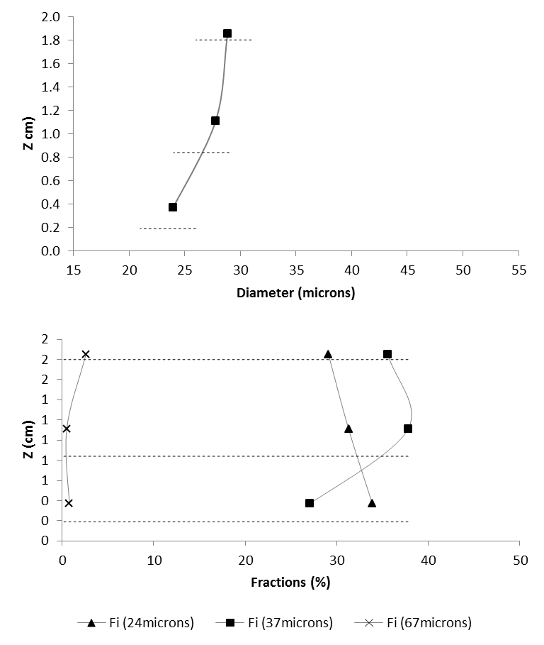
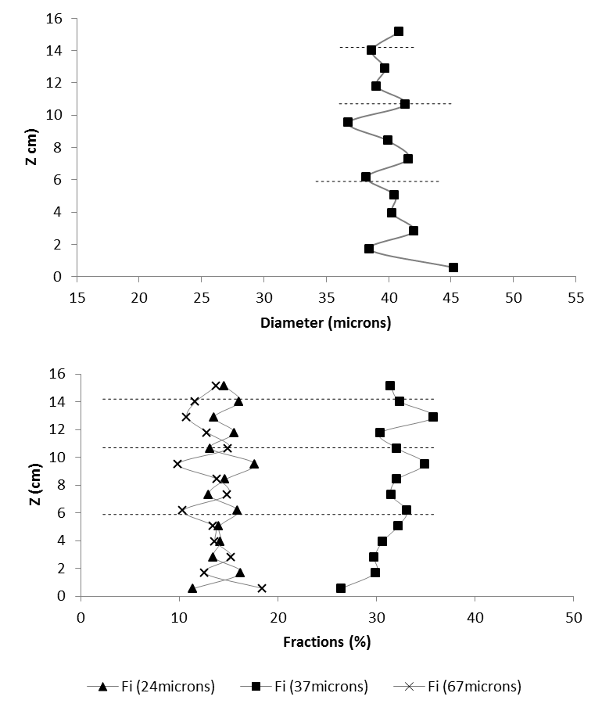
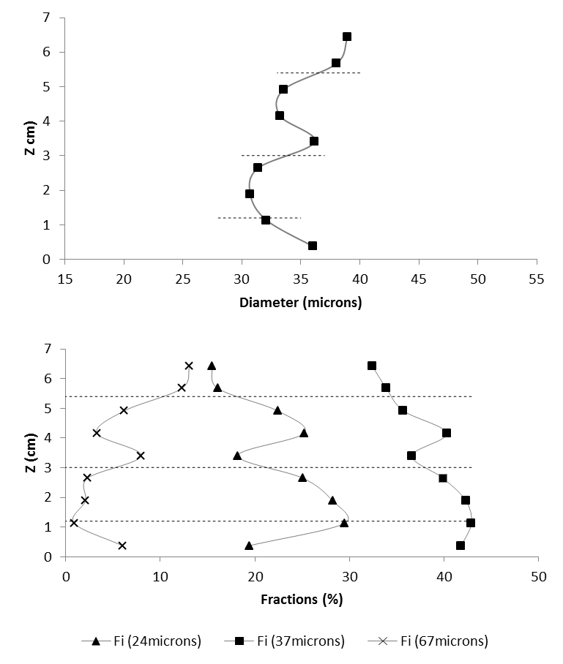
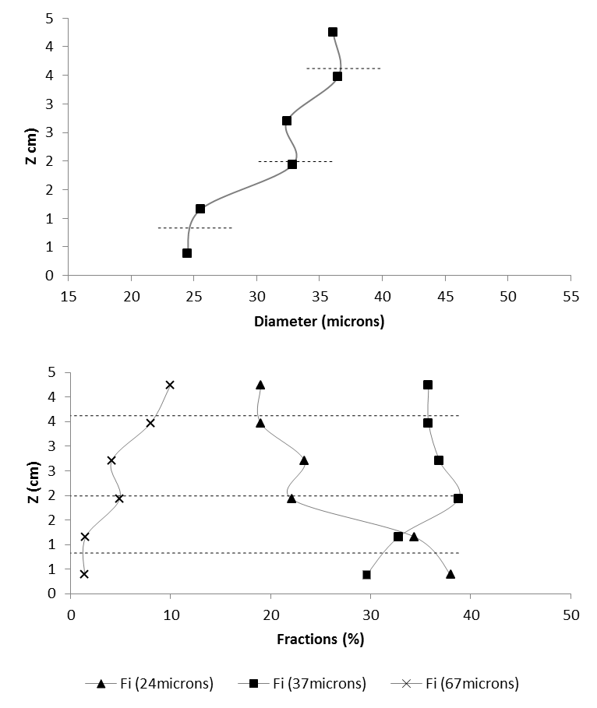
Results
Vertical sorting

Slide 16
Results
Slices
mm
Flow Direction

Slide 17
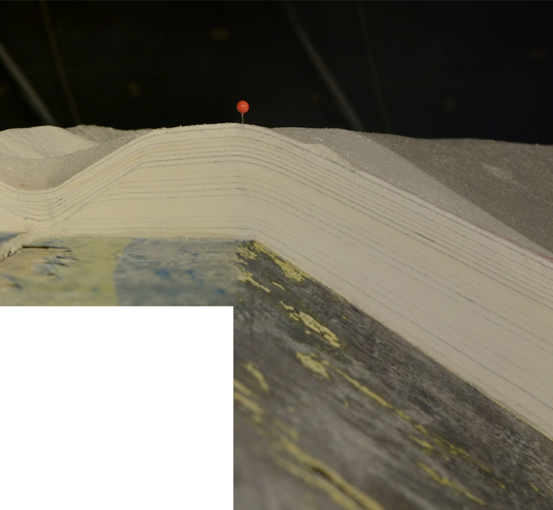
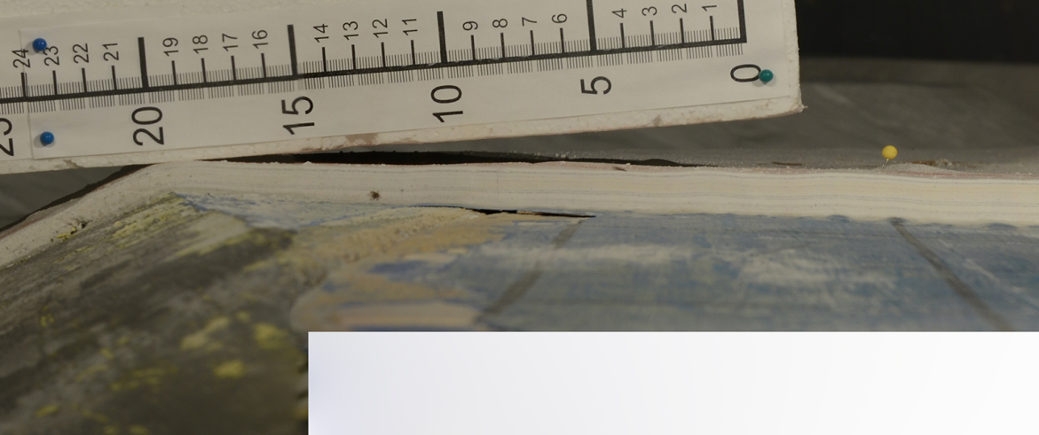
Results
Slices

Slide 18
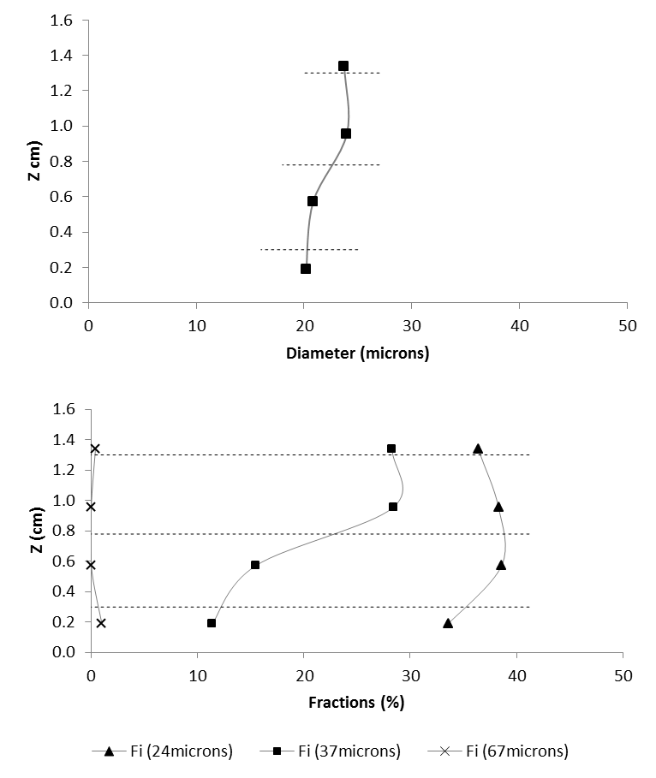
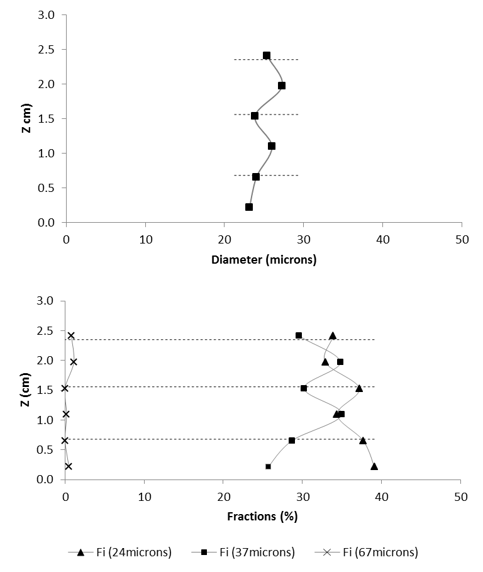
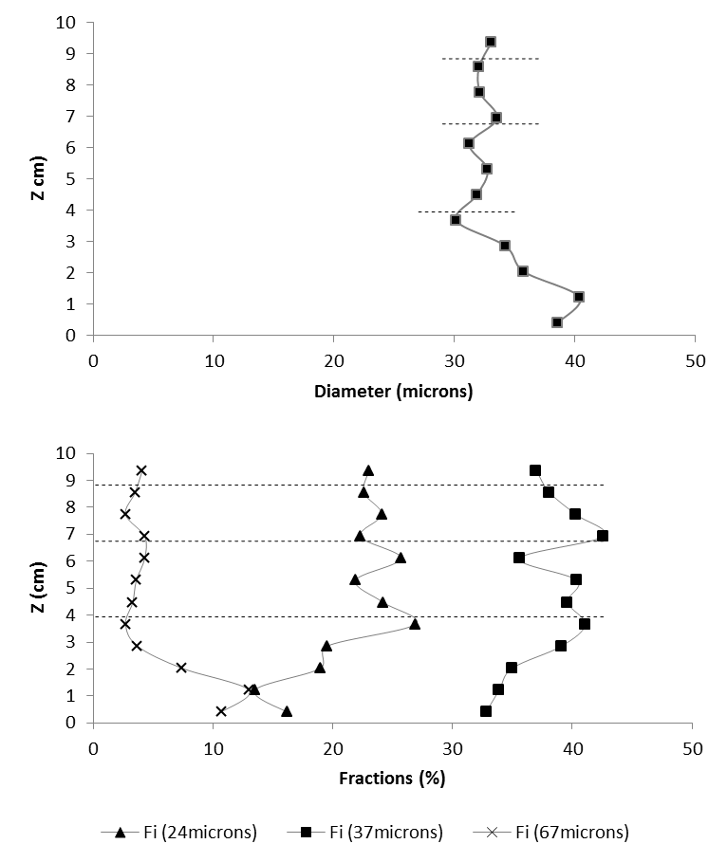
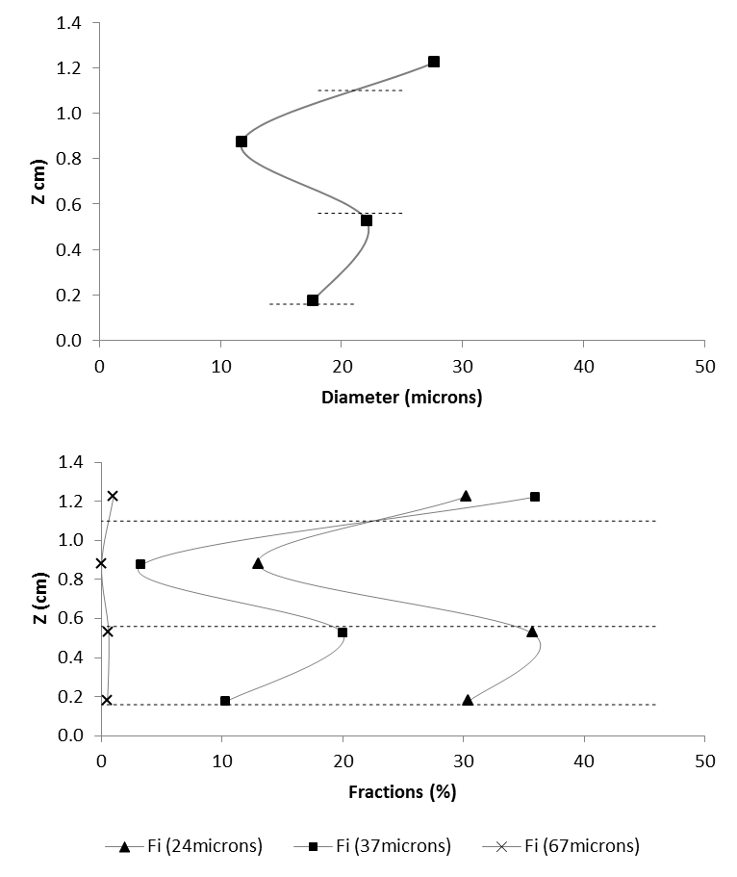
Results
Vertical sorting

Slide 19
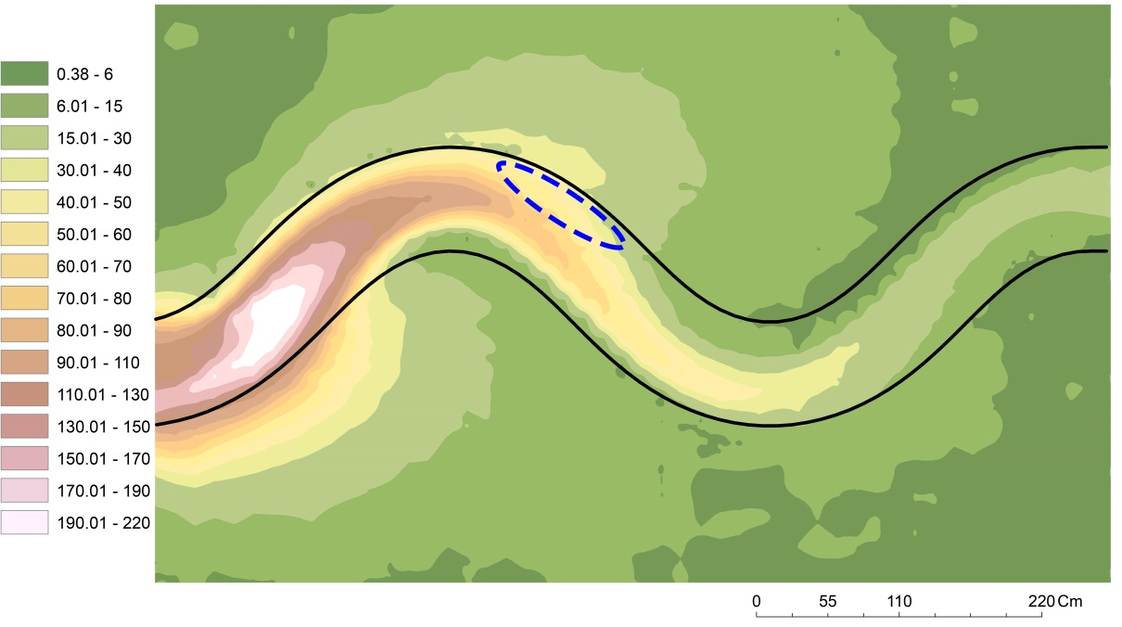
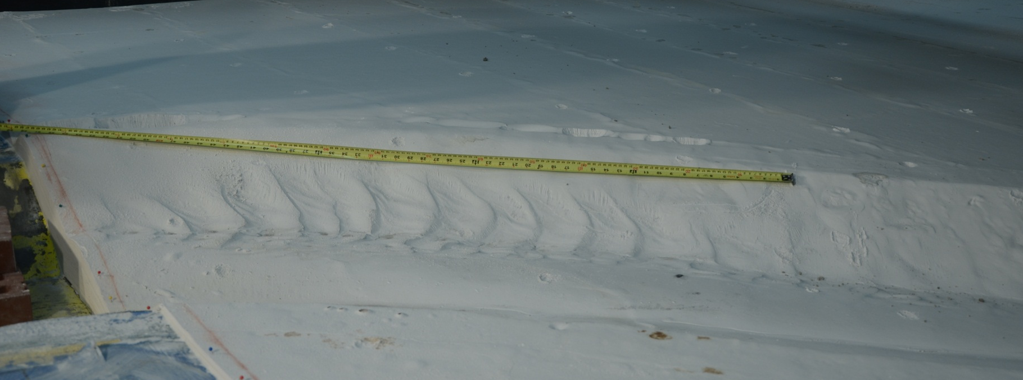
Results
Bed Forms
Flow Direction

Slide 20
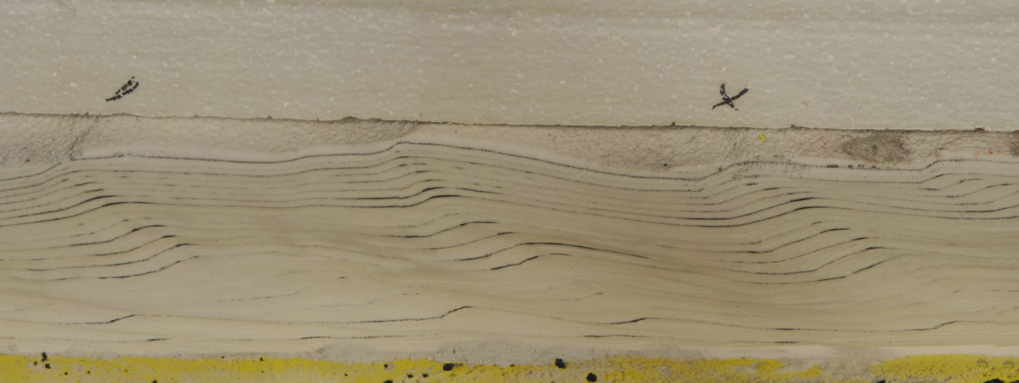
Results
Bed Forms
Flow Direction
Dunes Characteristics:
migrating downstream
wave length ≈ 10 cm
amplitude ≈ 1 cm

Slide 21
Summary
Flow stripping occurred at all the bends during all the runs. It was strongest at the entrance bend and weakened in the downslope direction . This led to the formation of overbank lobes;
Downslope and lateral patterns of sediment fining are observed;
The outer levee grain sizes are nearly as coarse as the in-channel deposits;
The sediment size increases vertically on the levees, while it remains constant inside the channel.

Slide 22
Thanks

