Slide 1
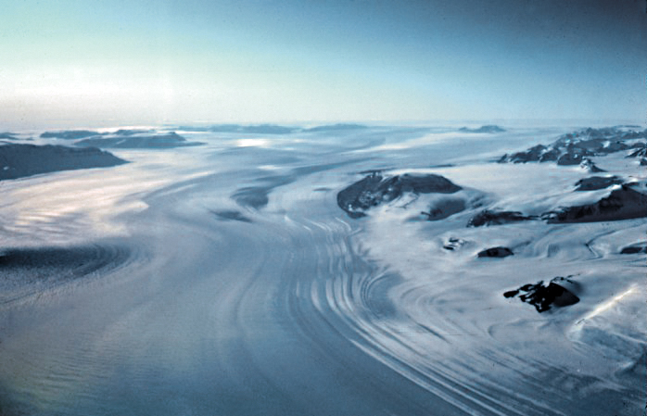
Ice, Cold, Animals
What museum visitors think about glaciers

Slide 2
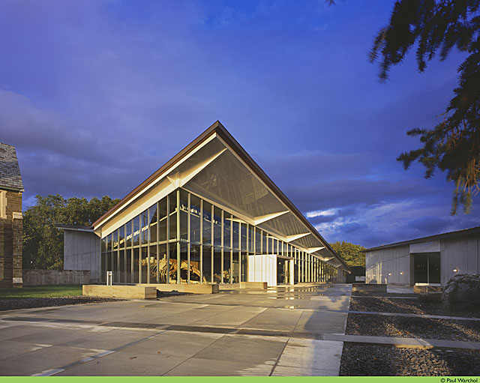
Kelly Cronin, Beth Stricker, Richard Kissel, Rob Ross, Cassie Mundt
cronin@museumoftheearth.org
Paleontological Research Institution and its Museum of the Earth
Notes:
The Museum of the Earth at the Paleontological Research Institution is a natural history museum in Ithaca, New York. We present the history of life on Earth to about 30,000 visitors annually, and we are a community resource for geoscience education, including the geological history of our own Finger Lakes.

Slide 3
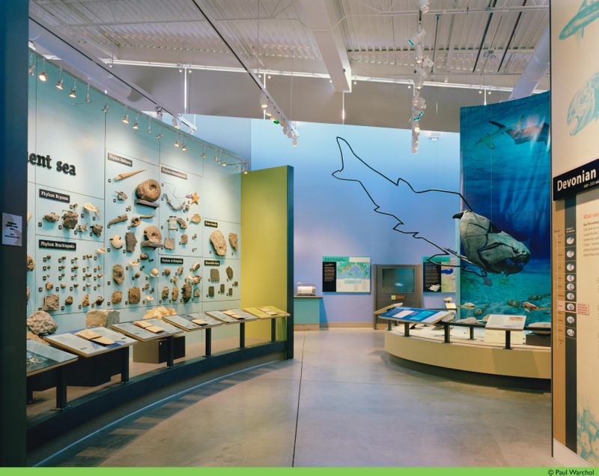
Notes:
A walk through the museum is a walk forward in the history of life. It starts at the Cambrian explosion, then progresses to the Devonian gallery.

Slide 4
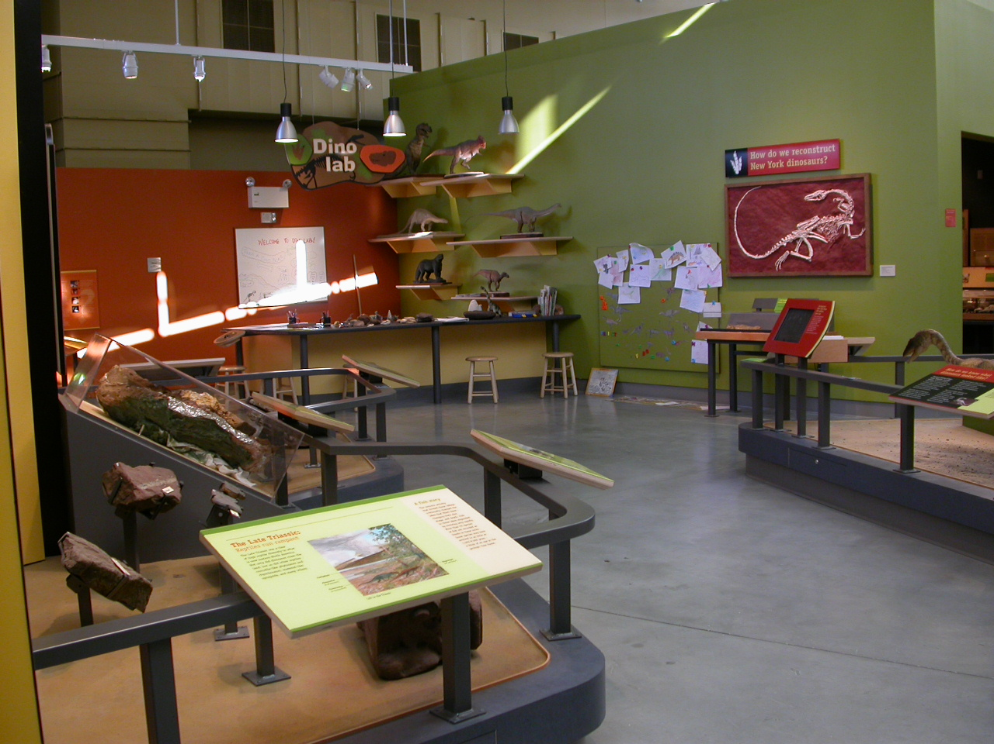
Notes:
After that comes the Mesozoic, and finally

Slide 5
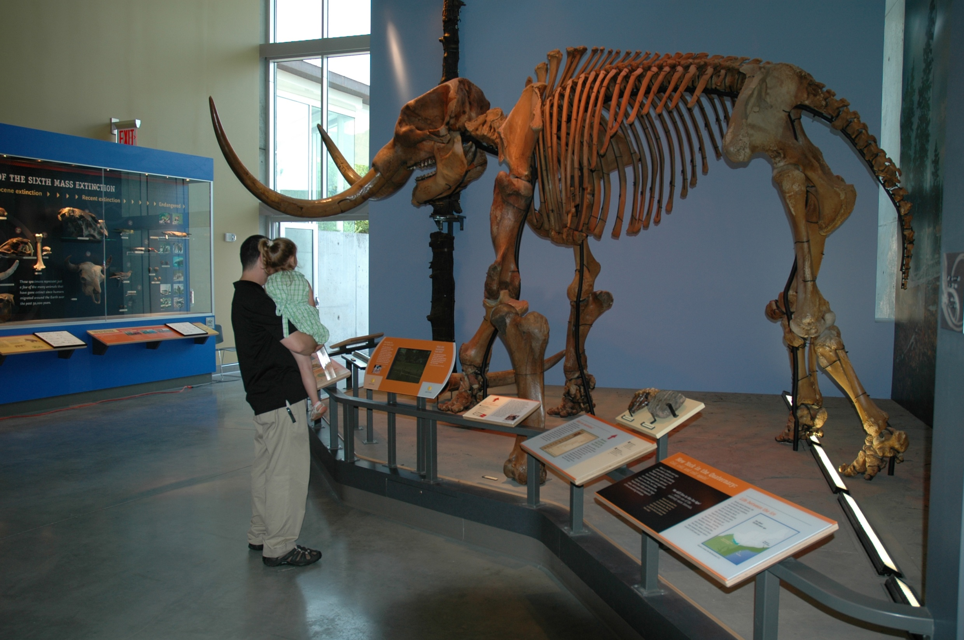
Notes:
Our Ice Age gallery. This is the Hyde Park mastodon, the most complete mastodon skeleton ever found. Opposite the mastodon is:

Slide 6
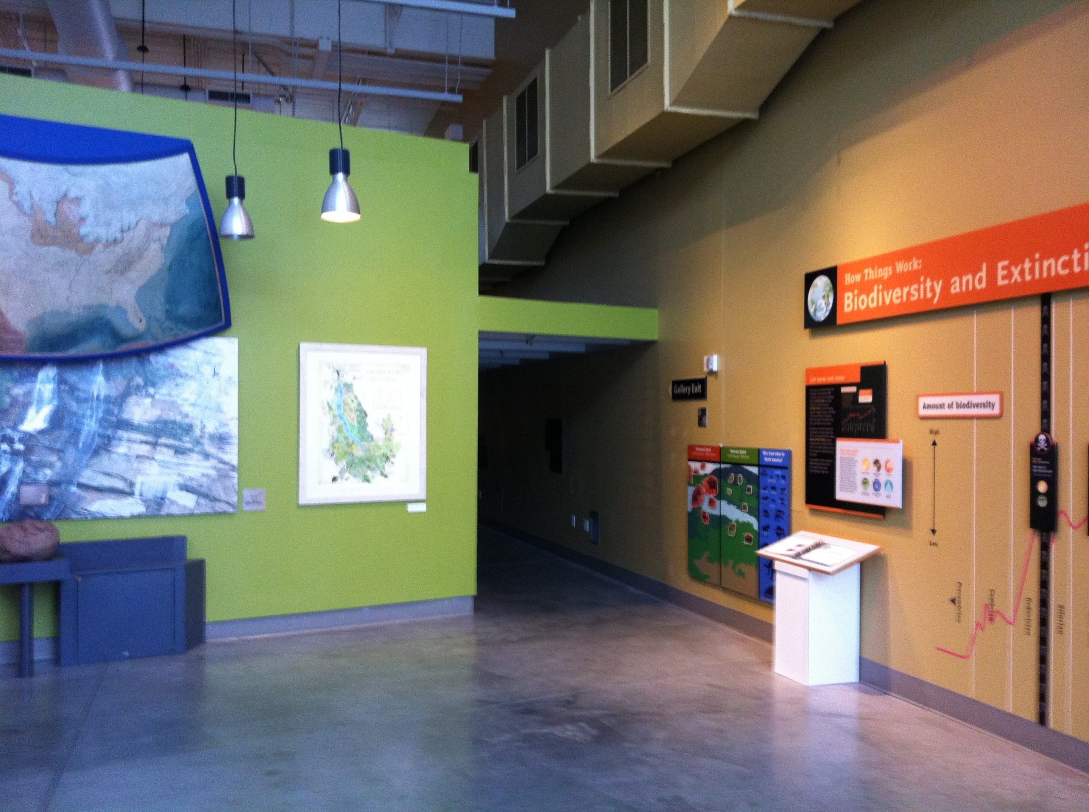
Pic of current exhibit
Notes:
The rest of our ice age gallery and the exit gallery. PRI recently received a grant from the Institute of Museum and Library Services to improve our Ice Age exhibit and exit gallery. The hallway in the center and the walls immediately outside of it are the parts to be renovated. The new exhibit will be an interactive walk-in glacier that will expand the portion of the Museum that deals with the recent geologic past – the glaciations during the late Pleistocene which helped form the landscape of the Finger Lakes region and the impact of Anthropocene climate change on glaciers globally.

Slide 7
A Visitor Survey
Plan A was to go deeper with content.
But before planning got too far along…
Notes:
Plan A for Glaciers was to go deeper with content.
A couple of the scientists we consulted in the very early planning stages thought that the average museum visitor would be very familiar with glaciers and that this exhibit should go deeper with content. In other words, our average visitor would already know what glaciers are, general things about how they work, that they aren’t ice bergs, etc, and the exhibit text should explore more advanced concepts in glacier science.
Our content development team conducted a front-end evaluation to see what our visitors knew about glaciers. This is standard practice before designing an exhibit, and we knew that not all of our visitors have extensive scientific background knowledge.

Slide 8
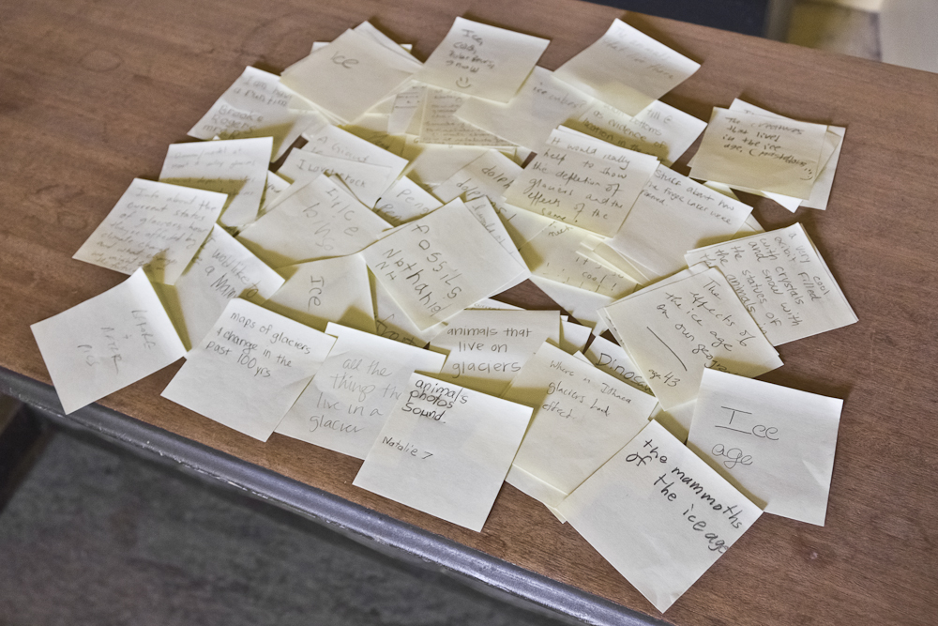
Notes:
We asked 3 questions, and had visitors answer by writing them on Post-It notes and putting them on bulletin boards.
The idea was to create a fun, casual, social media feel to the survey, as well as encourage more responses as visitors saw that other people had taken the time to answer the question.
Museum volunteers were asked to start populating the bulletin boards to encourage other visitors to participate. Our regular volnuteers include a cardiologist, a chemical engineer, and a botanist. They are a knowledgeable bunch, and their responses tended to be more in-depth, specific, and scientific answers.
We also had a number of school groups visit the museum during the evaluation. Every year, we see all of the first graders in 2 local school districts, and they provided a number of responses in our survey and are a significant portion of our “average visitorship.” This combination of scientist and first grader is representative of the Museum of the Earth’s average visitor.
It’s possible that both school friends answering with their friends, and other visitors reading posted answers before they wrote their own may have decreased the variety of responses we received.
We asked 3 questions. The boards were up for 4 weeks, and we received between 75 and 100 responses to each question.
Unrelated responses (like Justin Bieber) were left out of the final analysis.

Slide 9
The Questions
Question 1: What things come to mind when you hear the word “glacier?”
Question 2: What things come to mind when you hear, “we can learn a lot about the past and present from studying glaciers?”
Question 3: If you came to see an exhibit about glaciers, what would you hope or expect to see?

Slide 10
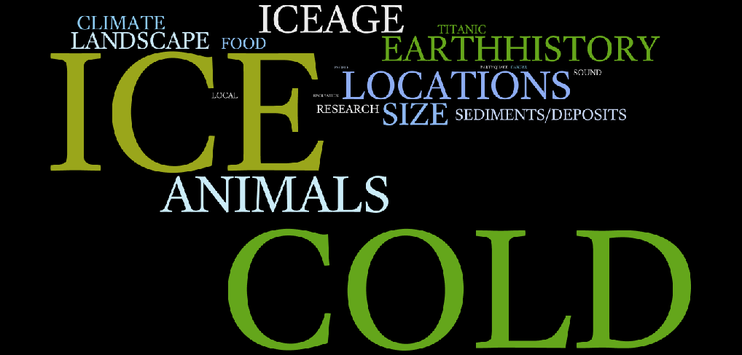
The Answers
Notes:
These are the categorized responses from all three questions.

Slide 11
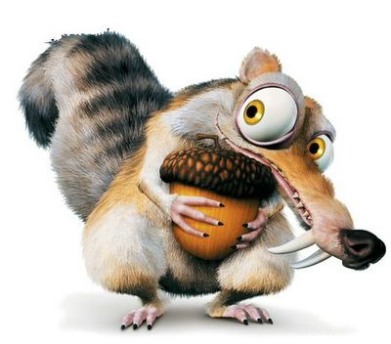
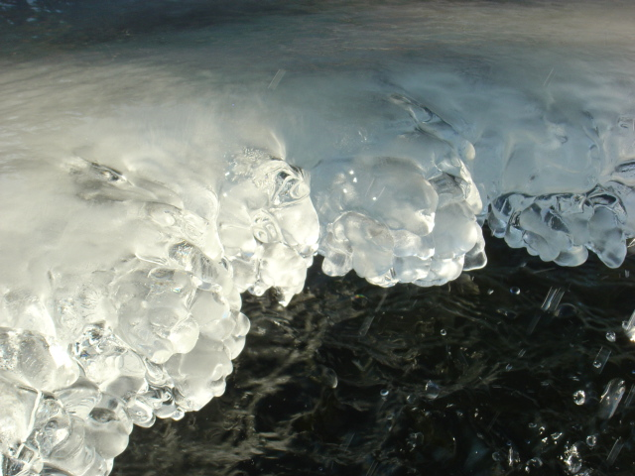
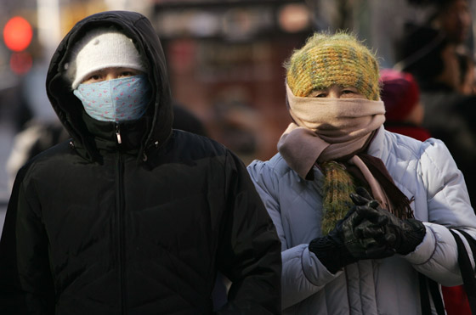
In other words…
Notes:
But the largest chunk, by far was Ice, Cold and Animals. A combined total of 49% of our visitors connected the word glacier with these things alone.
Even though we live in an area where the landscape was so profoundly affected by glaciation, our average visitor does not have a deep understandong of what a glacier is. They kind of know, but there is still some confusion. Cold and icy, yes. But did a glacier sink the Titanic? What kinds of animals live or used to live on them? Dinosaurs? Mammoths? Dolphins?
In other words, we do have to start with the basics, Glaciers 101. THIS ISN’T A BAD THING. We have an opportunity to use this exhibit to deepen visitor’s understanding of glaciers.

Slide 12

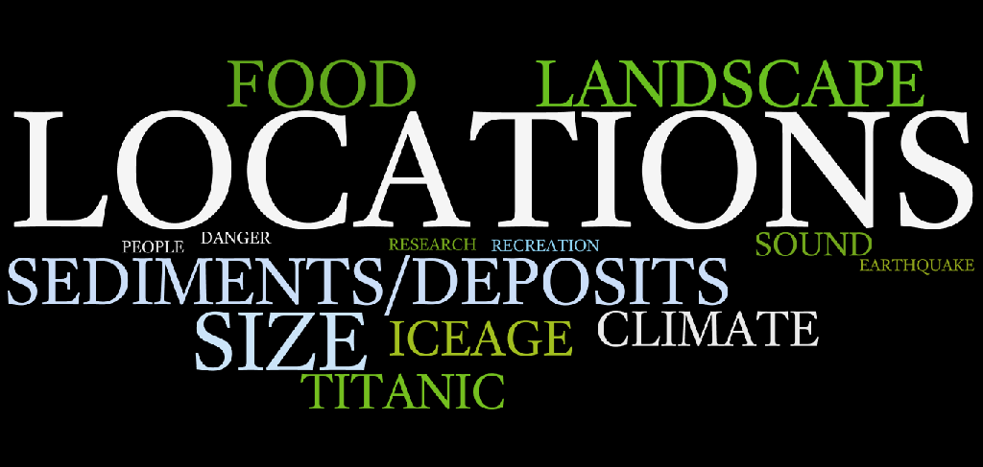
Question 1: What things come to mind when you hear the word “glacier?”
Notes:
49% of our visitors connect the word glacier with ice, cold, or animals.
The other half of the responses were encouraging.
11% of our visitors thought of glaciers in particular places, like Greenland and Alaska, and this was the largest single answer besides ice, cold, and animals.
Titanic and Ice Age the movie each claimed 4%.
Because of the large minority that connected the word glacier with Titanic, the Ice Age movies, or particular locations in the world where glaciers are present, we have an opportunity to refer to these pop-culture and real-world examples to help connect this audience with the rest of the content, either in the exhibit itself or in programming developed around it.
Landscape changes, climate change, sediment deposits, or research came to mind for 15% of our visitors.
and the remaining 15% were distributed among food, disasters, size, and sound.
13 of 99 answers were unrelated to the question, and were excluded from this chart.

Slide 13
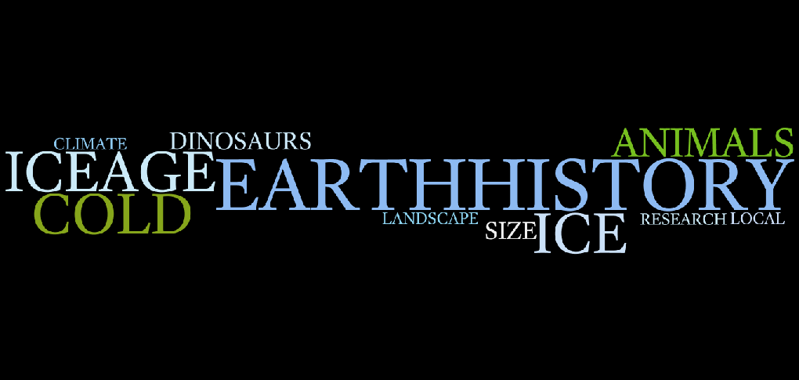
Question 2: What things come to mind when you hear, “we can learn a lot about the past and present from studying glaciers?”
Notes:
Ice, cold and animals were popular again, with a combined total of 32 percent of the responses. The animals were mostly mammoths and mastodons. There is a large mastodon skeleton in the room where the evaluation took place, so it is not surprising that these were foremost in visitors’ minds. We have found in education at the Museum that live, fossil, and taxidermied animals are very useful educational tools, and the exhibit will incorporate animals, including touchable pieces.
7% of the responses mentioned dinosaurs, which are not relevant to the time frame of this exhibit. This may be because of the previous area of the Museum, which was all about dinosaurs, but this exhibit might also be a good opportunity to revisit the geologic timescale.
General questions or topics pertaining to the history of the Earth were 20 percent of the responses.
10% of our visitors already connect glaciers with changing landscapes in general, with 5% referencing the local landscape specifically We can connect a wider local audience with how glaciers shaped the environment they live in.
Even though the question was about past changes due to glaciers, current and future climate change came up in a few of responses (5%). Plans for the exhibit include the subject of climate change, and it is encouraging that some visitors are already making the connection.

Slide 14
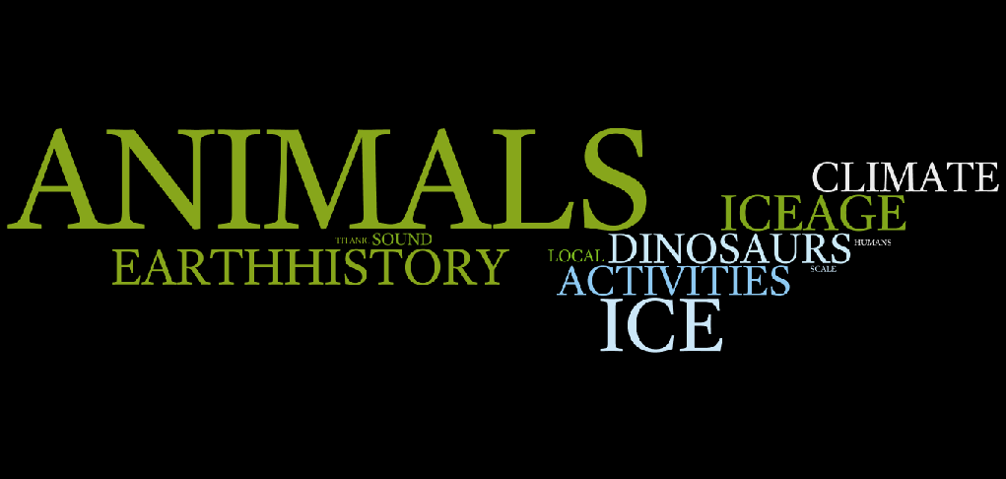
Question 3: If you come to see an exhibit about glaciers, what would you hope or expect to see?
Notes:
Only 11% of people expected interactives or sound (distinct from the less interactive visual component of exhibits), but the planned glacier sounds, touch-a-glacier interactive, and other activities will exceed their expectations and hopefully engage those who don’t expect them in new ways.
The size and scale of glaciers came up more often in questions 1 and 2 than it did in 3, but Titanic and local geography came up again in visitors’ minds in this question. Again, we have an opportunity to make glaciers “up-close and personal” not only through interactives, but also by connecting them to pop-culture and our local environment. We will help visitors understand the size of glaciers by sillouetting the height of a glacier against the Ithaca skyline in an interactive.

Slide 15
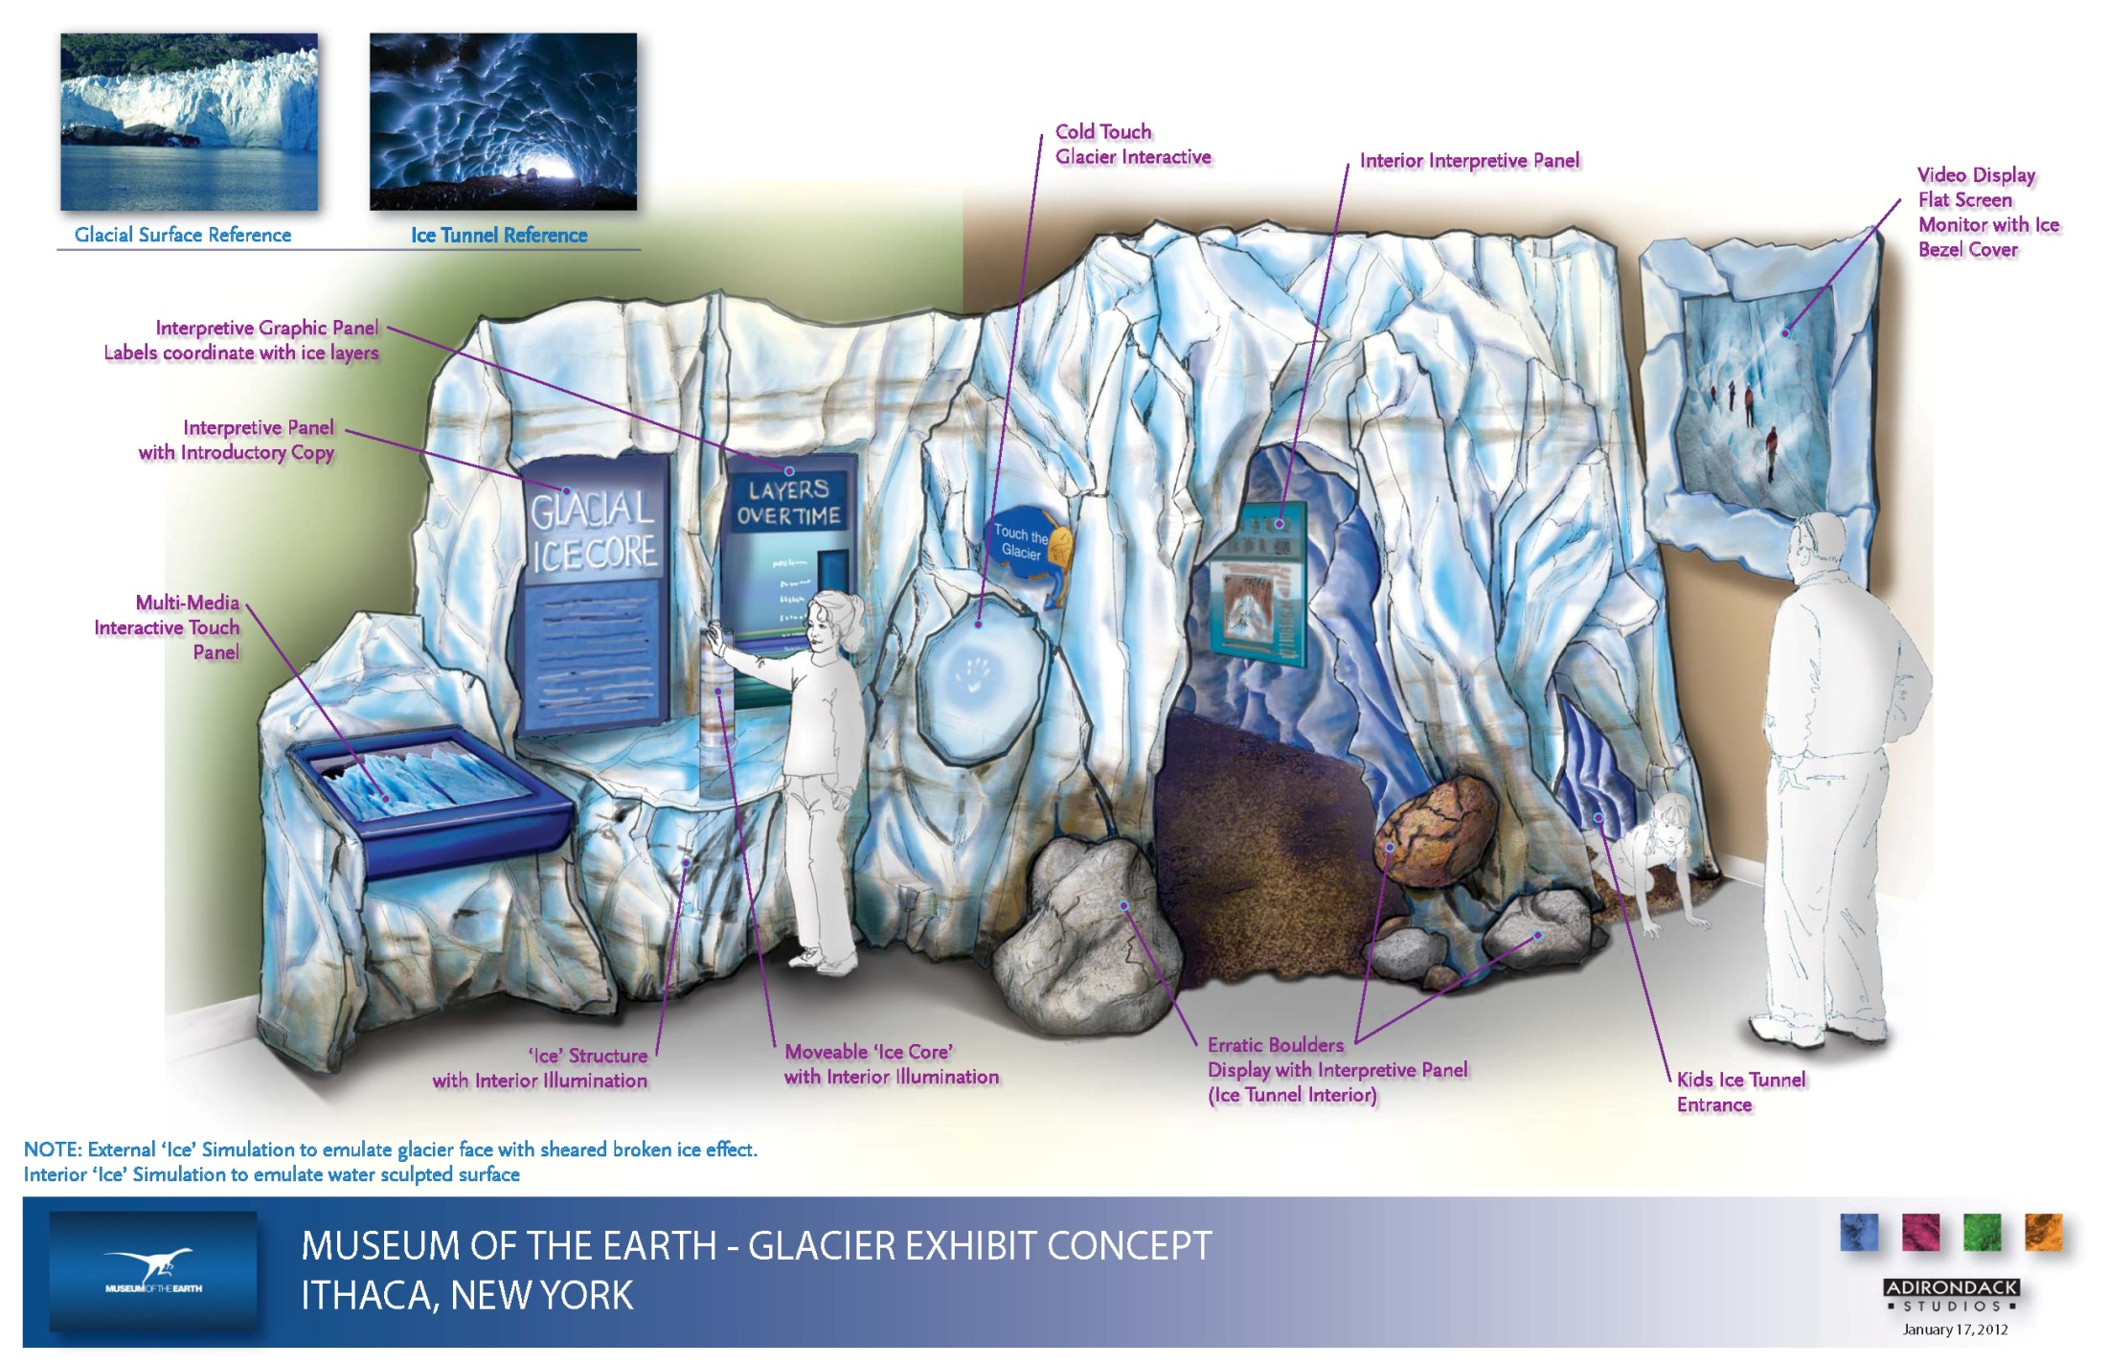
Notes:
This is a draft illustration of the design concept.
Now that we are working on the content, we started with Glaciers: 101
How big are they? Where are they found?
How do they move and what does that mean for landscapes and the planet more broadly? How and why do they advance and retreat?
Moving into the exhibit, visitors will learn about the effects that glaciers have had on the planet in Earths’ History, and the effects that they continue to have on humans and the environment now. Finally, the last section will deal with what we can learn from glaciers through scientific research, about past, present, and future climate.
When we assumed a higher level of knowledge than our audience had, we ran the risk of building an exhibit that wouldn’t cater to their needs. This survey was a simple and powerful too to match our content planning to visitor understanding.

Slide 16
THANK YOU

