Slide 1
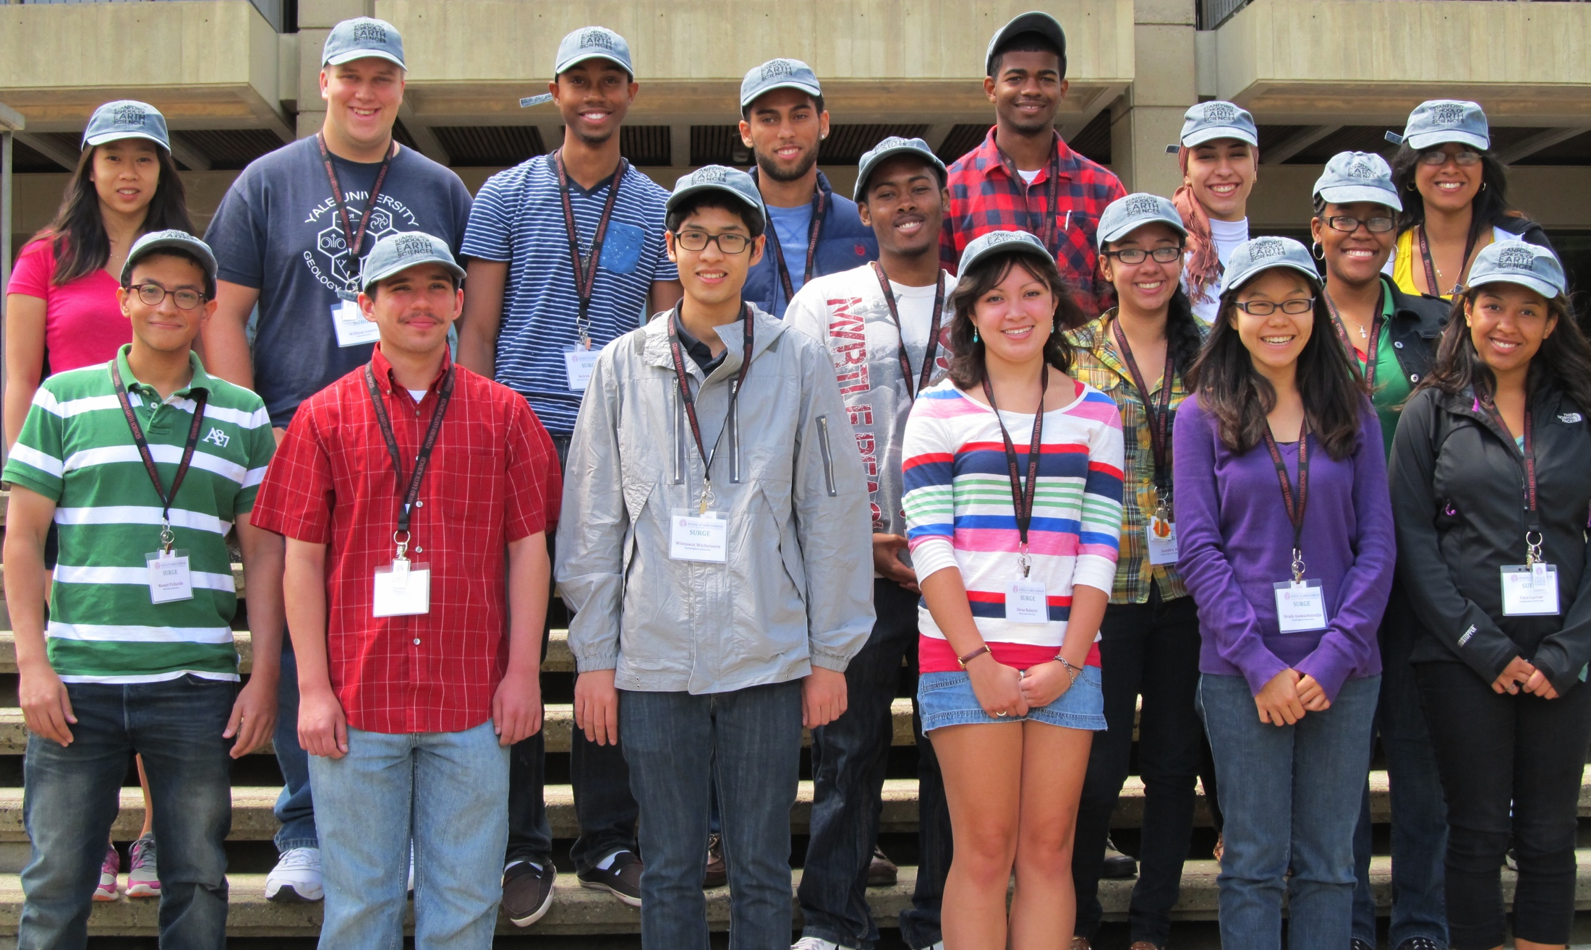

DESIGN AND EVALUATION OF THE SUMMER UNDERGRADUATE RESEARCH PROGRAM IN GEOSCIENCE AND ENGINEERING (SURGE)
Tenea Nelson, PhD
Assistant Dean, Office of Multicultural Affairs

Slide 2
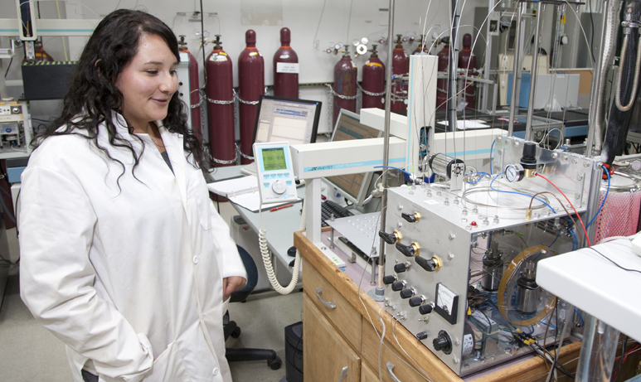
SURGE
Started Summer 2011
On campus summer residential program for undergraduates
Eight weeks
Travel, R&B expenses paid + stipend
Rigorous research assignment
Comprehensive training and mentoring program

Slide 3
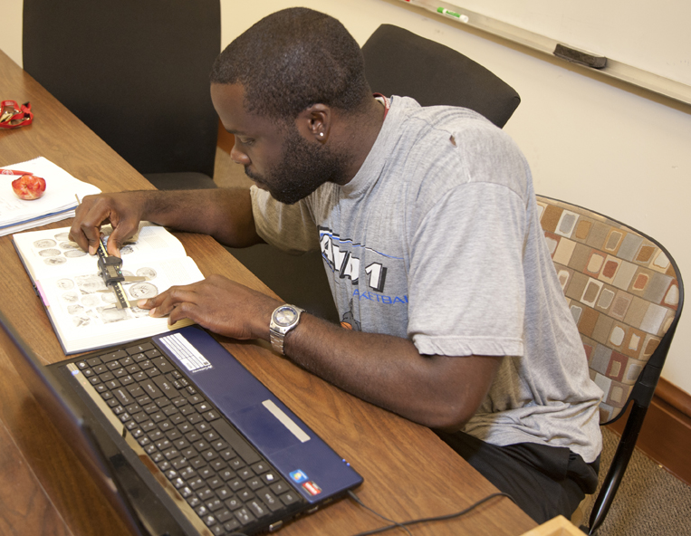
SURGE Goals
Retain diverse scholar interest in the Earth sciences and in obtaining an advanced degree
Create a network of community and professional development
Increase minority representation in the SES graduate programs and nationwide
  Providing scholars with a research experience in the Earth sciences
  Preparing scholars for the process of applying to graduate school
  Introducing scholars to career opportunities in geoscience and engineering

Slide 4
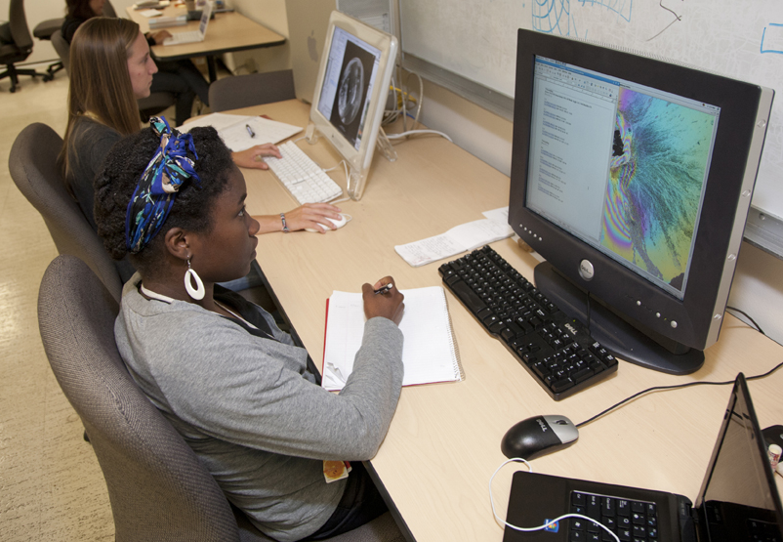
SURGE Participant Criteria
Sophomore or higher at time of application
Must be an undergraduate at time of participation
Express an interest in attending graduate school
Prior research experience not required
Must be a US Citizen/PR or have a student visa
Must have a minimum 3.0 GPA
Statement of Prior Research
How they Contribute to/Champion/Support Diversity
How participation will aid in their academic/career goals

Slide 5
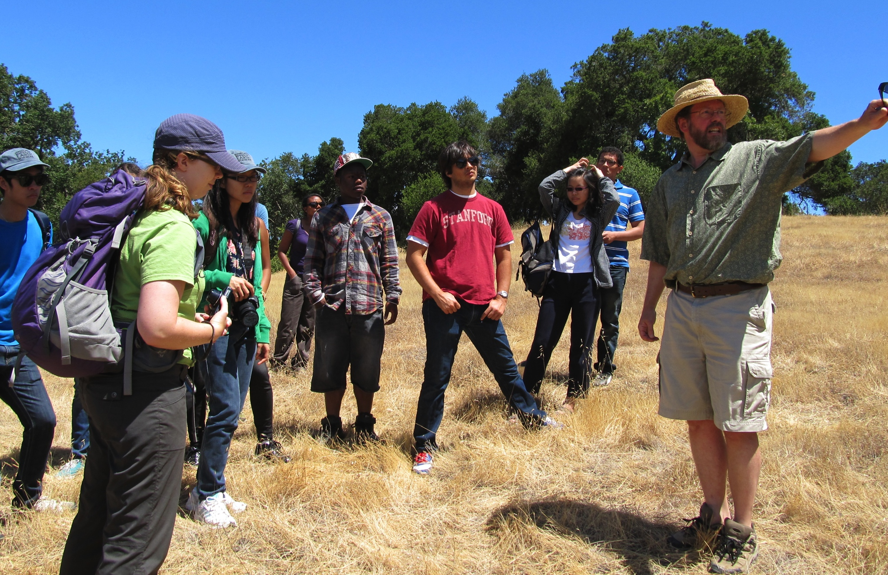
Program Components
Mentoring and Advising
  Daily-Weekly Interaction with Principal Investigator
  Daily Interaction with Research Mentors
  Weekly Interaction with Program Assistants
  Weekly emails and daily administrative presence from OMA
Community
  On campus housing and dining
  Access to libraries, gym facilities, bicycles
  Local geological field trips w/ Stanford students
Career Development
  Weekly Faculty Lectures
  Alumni Career Panel
Graduate School Preparation
  GRE Prep Classes
  MATLAB Workshop
  Application/Admissions Seminar
Final Research Symposium
  Oral and Poster Presentations
All Expenses Paid + Stipend (inc. health insurance if needed)

Slide 6
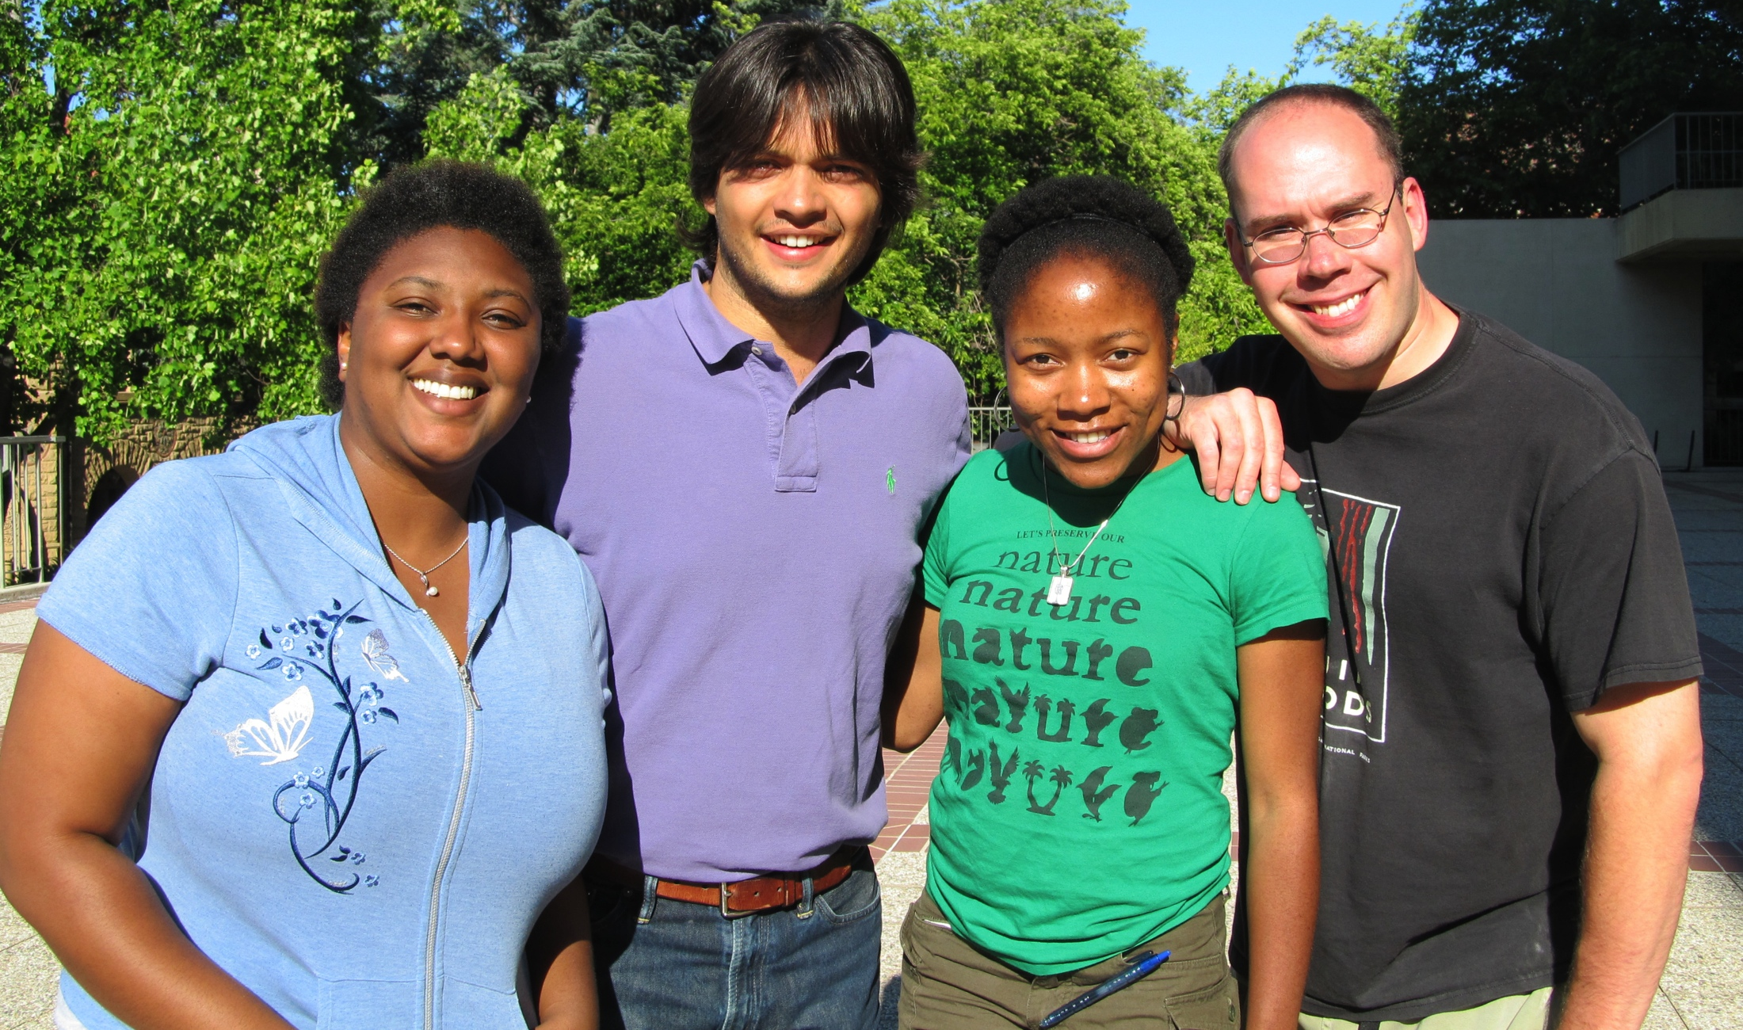
Showing Diversity Support
How the program is advertised
  Pictures on website and brochure
  Language (we encourage URMs to apply)
  Visiting minority conferences and programs
The Application
  Diversity essay as part of the evaluation process
Community of Inclusion: The experience – making sure they see people who look like them
  Program assistants
  Research mentors (grad/postdoc/staff sci)
  Faculty (assistant-full, women)
  People on campus
Encourage research presentation at conferences
  Field Specific
  Diversity Oriented

Slide 7
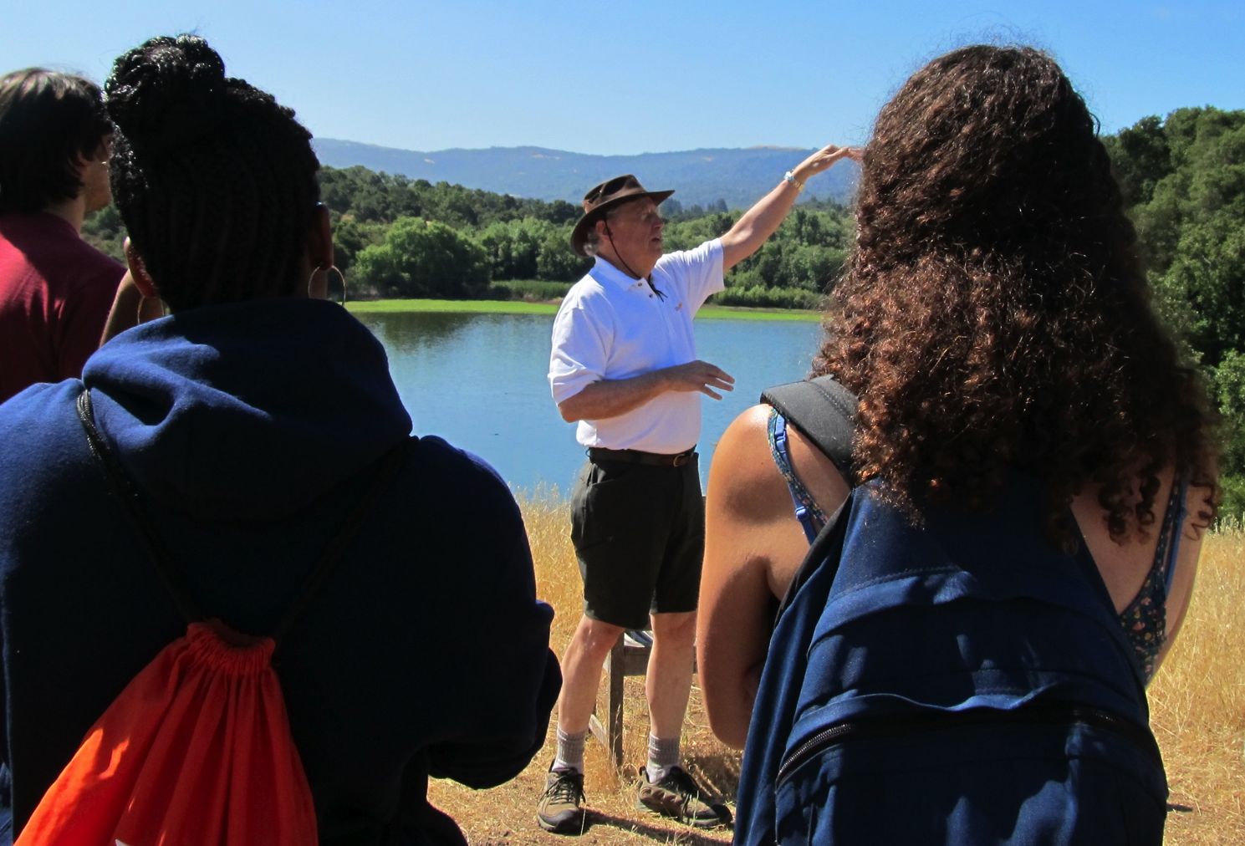
Application - 2012
Essays, LoRs, CV, Demographic Questions
220 Applicants for 16 positions
From 12 Universities
Rising juniors, seniors and senior+
10 had prior research experience
5 first generation college students
11 were from underrepresented backgrounds

Slide 8
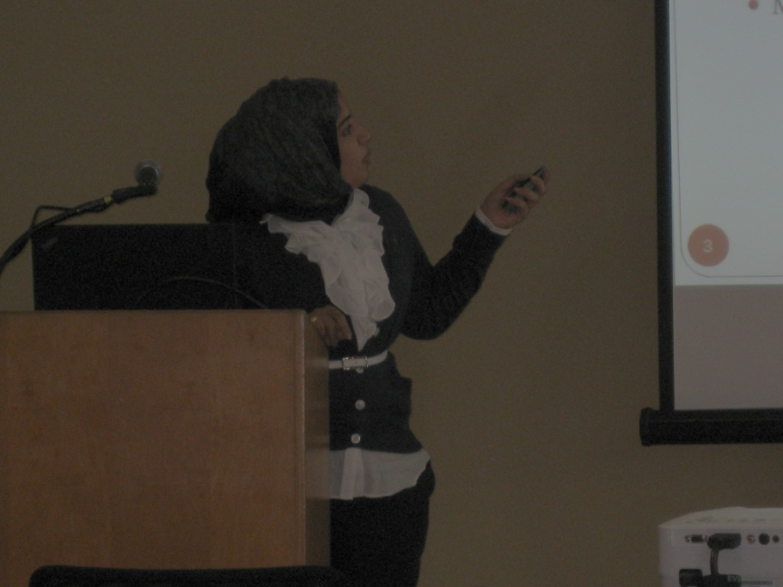
Evaluation
Success Parameters
  Increased proficiency in research skills
  Increased knowledge of Earth sciences fields
  More directed graduate school plans
  Positive faculty and research mentor interaction
  Increased quantitative GRE scores
  Overall satisfaction with the program
Pre and post program surveys
  Self assessed proficiency and Interest
Survey of faculty and research mentors
SURGE Alumni Survey

Slide 9
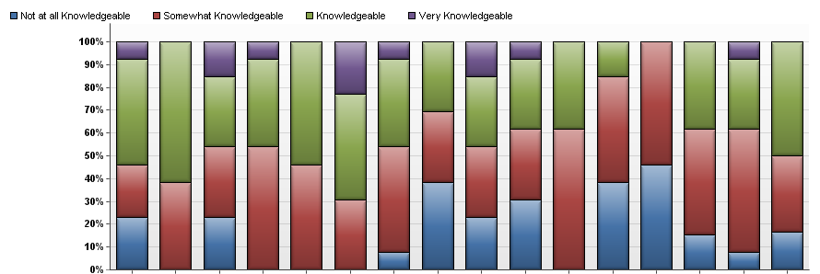
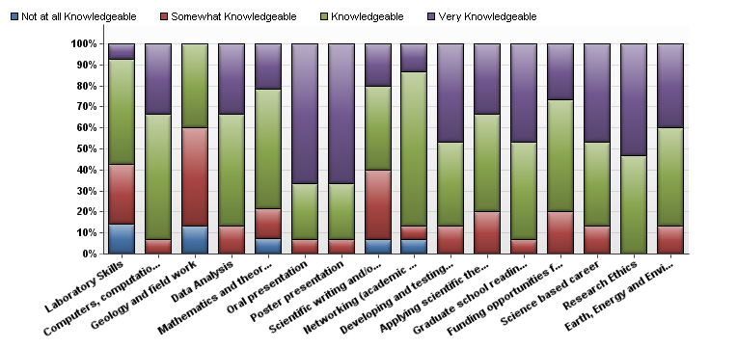
Self-Reported Level of Knowledge
Pre-Program
Post-Program
Notes:
Computers and computation, Graduate School Readiness,

Slide 10
Improved Quantitative GRE

Slide 11
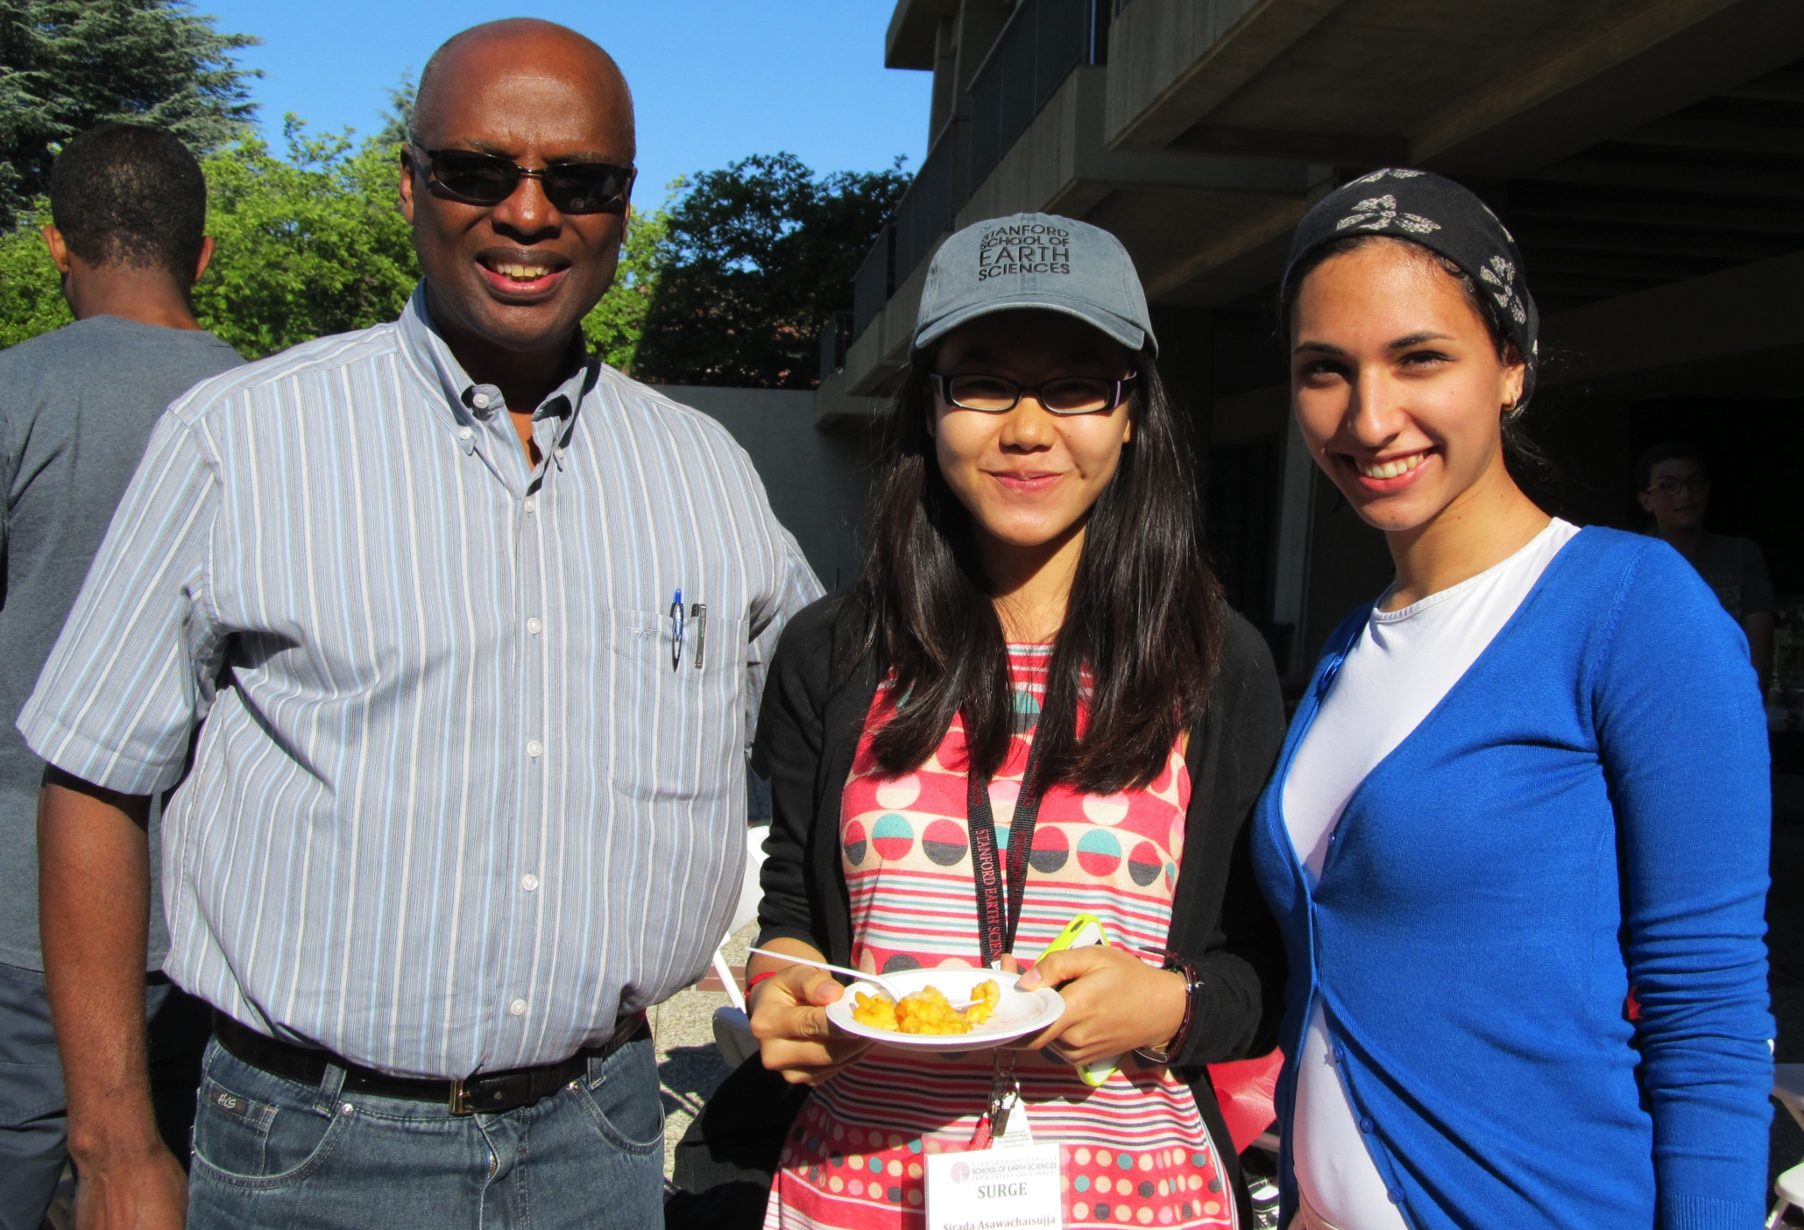
Evaluation Results
Future Academic and Career Plans
18%, 21% and 22% increased interest in Earthquakes & Volcanoes, Petrology, Geochemistry, Mineralogy and Mineral Physics, and Land Use Change
94% of respondents intend to continue conducting research this academic year.
94% of respondents plan to pursue an advanced degree; 53% are considering a M.S. and 80% a Ph.D.
94% of respondents plan to pursue science-based careers. 40% of respondents showed an interest in becoming industry scientists, along with 27% interested in becoming university scientists/professors, and 13% working for the government.

Slide 12
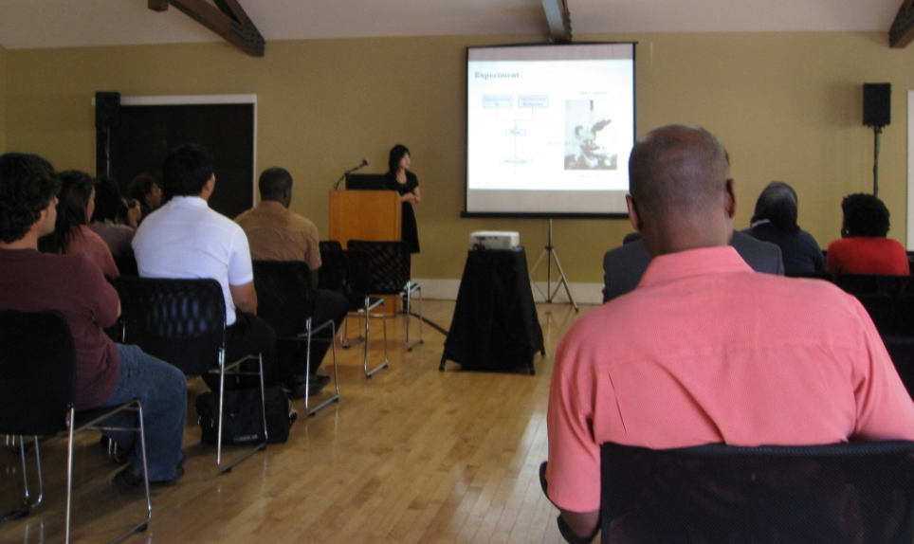
Evaluation Results
Program Experience
100% felt very much or somewhat a part of their research group
69% were very satisfied or somewhat satisfied with the time spent with their PI
100% were very satisfied or somewhat satisfied with the time spent with their Research Mentor
Participants rated the quality of the program a 4.94 (on a 5 point scale). All respondents said they would recommend SURGE to peers.
67% of PIs considered their scholar to have the potential to become a graduate student at Stanford.

Slide 13
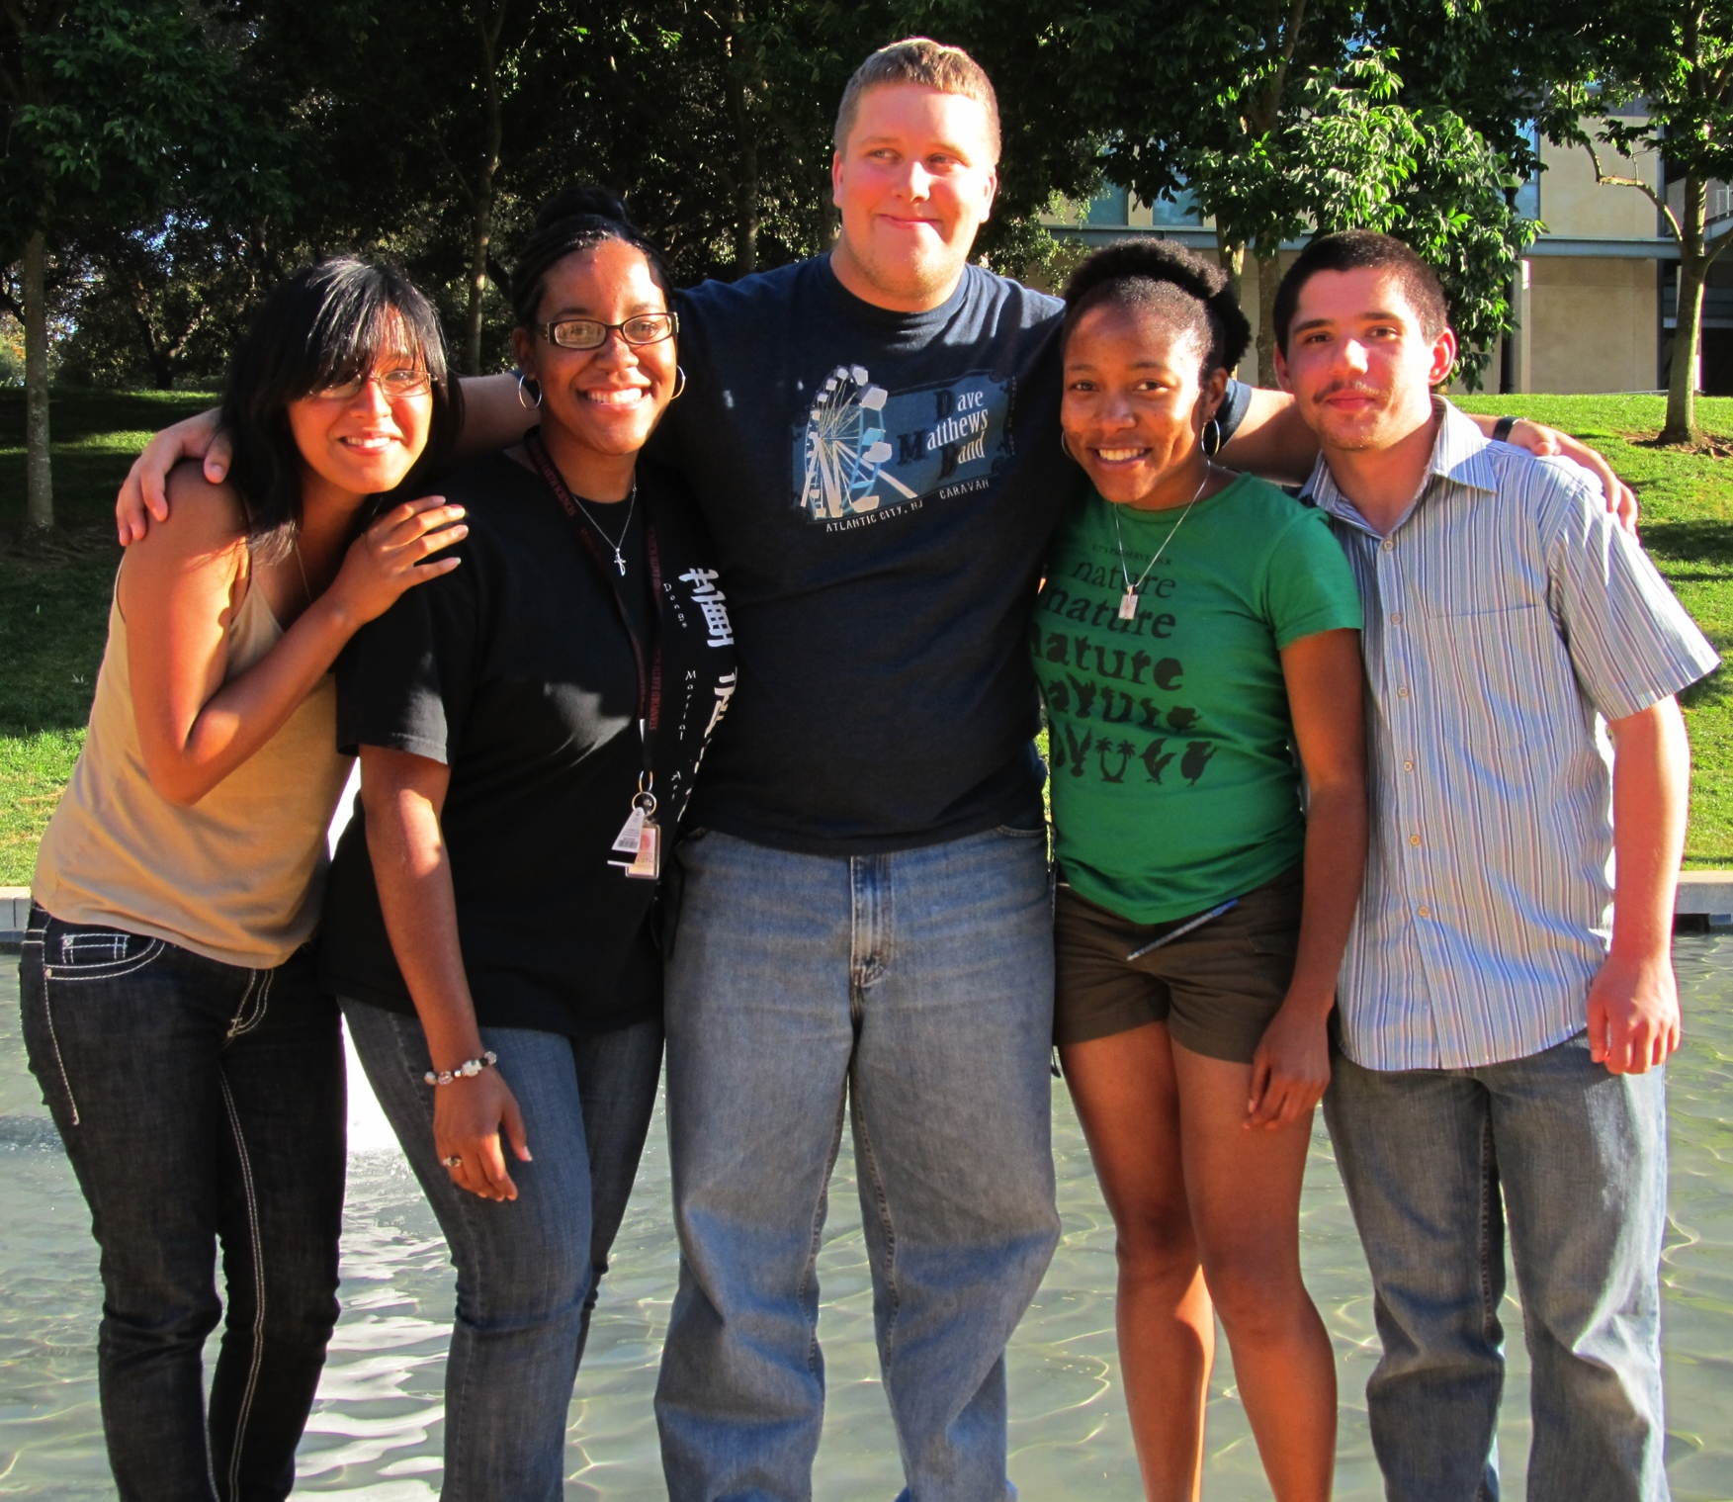
2011 Alumni Feedback
Three are in graduate school pursuing a Ph.D. or master's degree
  Geophysics, Chemical Oceanography, Earth and Planetary Science, and Secondary Science Education
Four are employed as geologists and petroleum engineers
" The SURGE program was a marvelous opportunity and I hope that future generations of students can have the same experience. I am better prepared for graduate school and feel more ready to enter the work force as a researcher. “
“I feel that the SURGE Scholars program has been one of the most influential experiences so far in my career. I gained an incredible amount of knowledge and experience from not only the lab work but also the networking and workshops provided by the program."

Slide 14
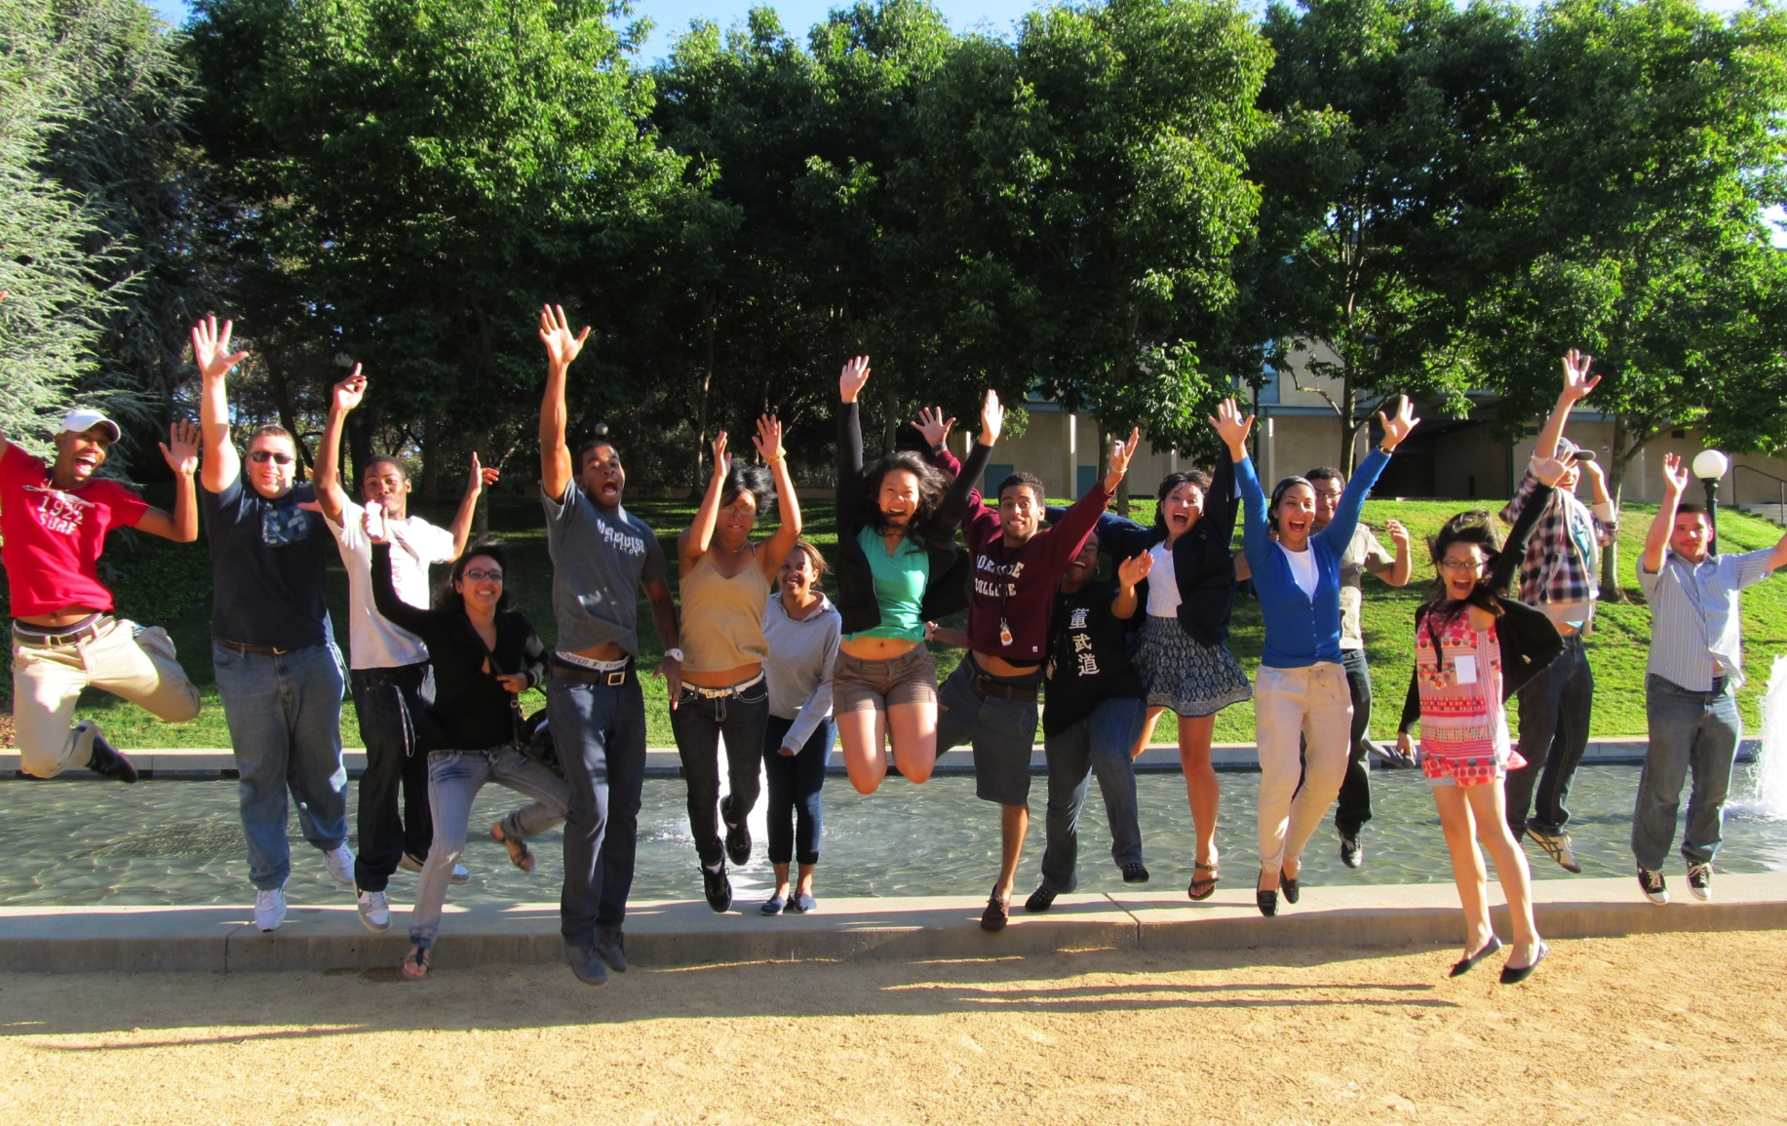
Questions?

Slide 15
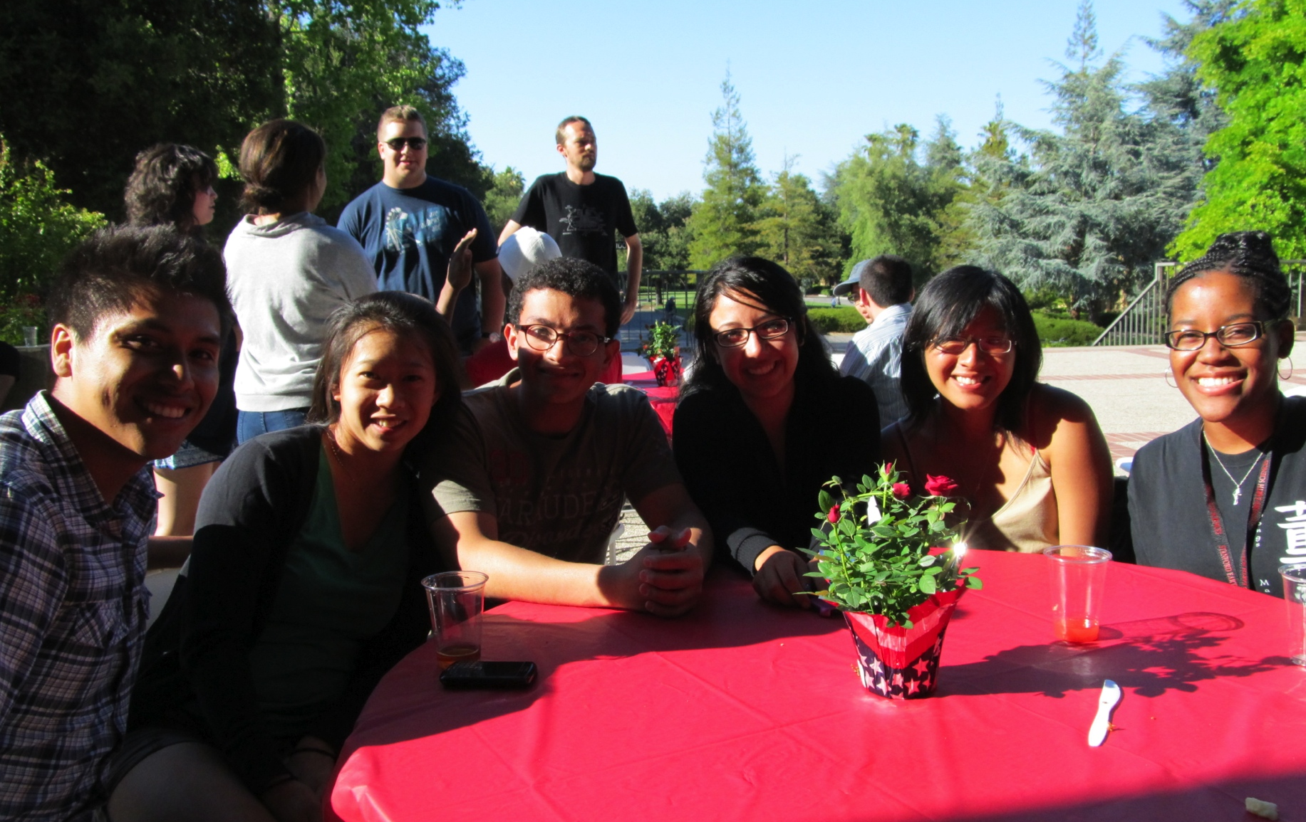
Thank you!

