Slide 1


Phytolith Record Of Deep-Time Vegetation Dynamics: Early-Late Miocene Of Vasa Park, Washington
Tony Jijina¹
Caroline Strömberg^{1,2}
Richard Dillhoff²
Thomas Dillhoff²
1 – University of Washington, Seattle, WA, 2- Burke Museum, Seattle, WA

Slide 2
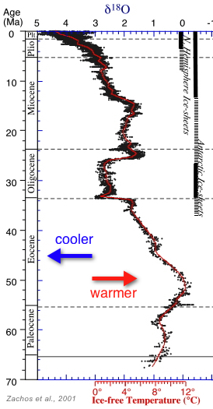

Mid-Miocene Climatic Optimum
Youngest
Oldest
Notes:
Get phytolith peel picture.

Slide 3
Mid-Miocene Climatic Optimum
Youngest
Oldest
Notes:
Get phytolith peel picture.

Slide 4
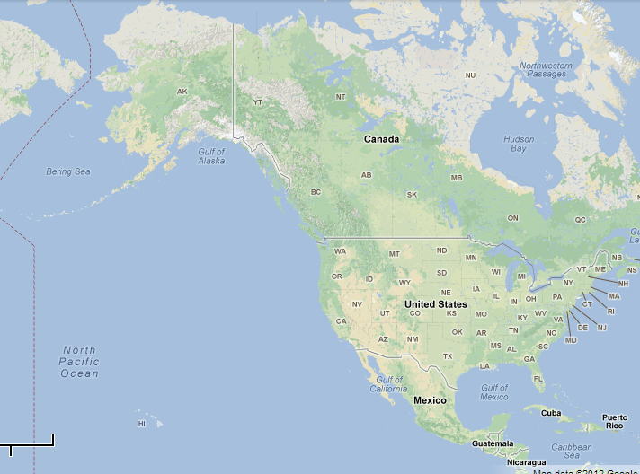
Vasa Park, WA

Slide 5
Vasa Park, WA

Slide 6
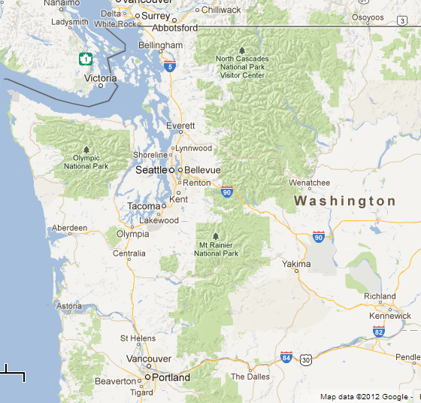
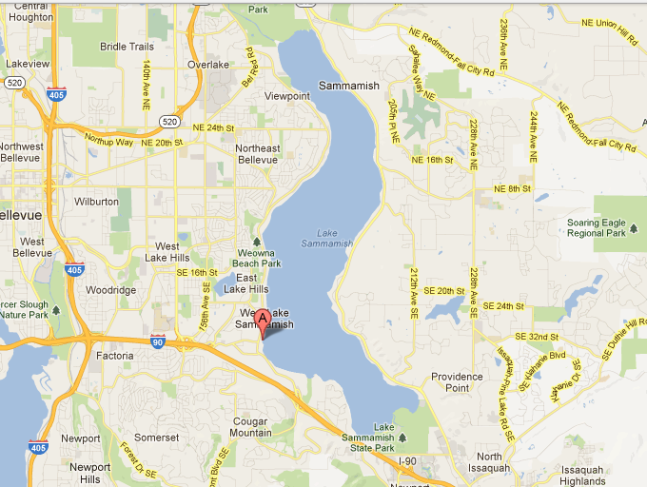
Vasa Park, WA
VASA PARK

Slide 7
Outline
Geology
Phytolith
Macroflora
Pollen
Conclusions

Slide 8
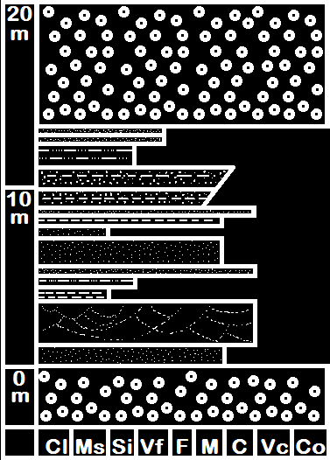
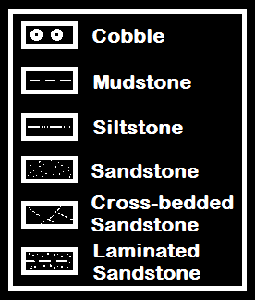
Vasa Park Beds

Slide 9
Vasa Park Beds
⁴⁰Ar/³⁹Ar dating:
11.4 Ma
late Miocene
Haugerud et al., 2003
Notes:
Get phytolith peel picture.

Slide 10
Vasa Park Beds

Slide 11
Vasa Park Beds
Macrofossils

Slide 12
Vasa Park Beds
Pollen and
Phytolith

Slide 13
Outline
Geology
  11.4 Ma, 3 lines of fossil evidence
Phytolith

Slide 14

What is a Phytolith?
Notes:
Get grass picture.

Slide 15
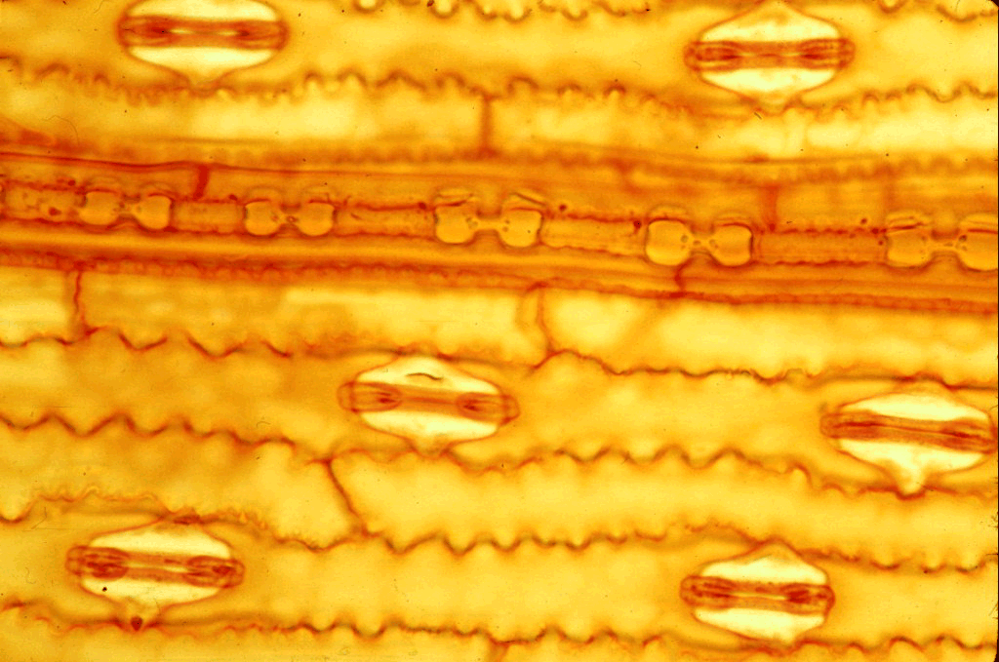
What is a Phytolith?
10µm
10µm
Notes:
Get epidermal peel picture.

Slide 16
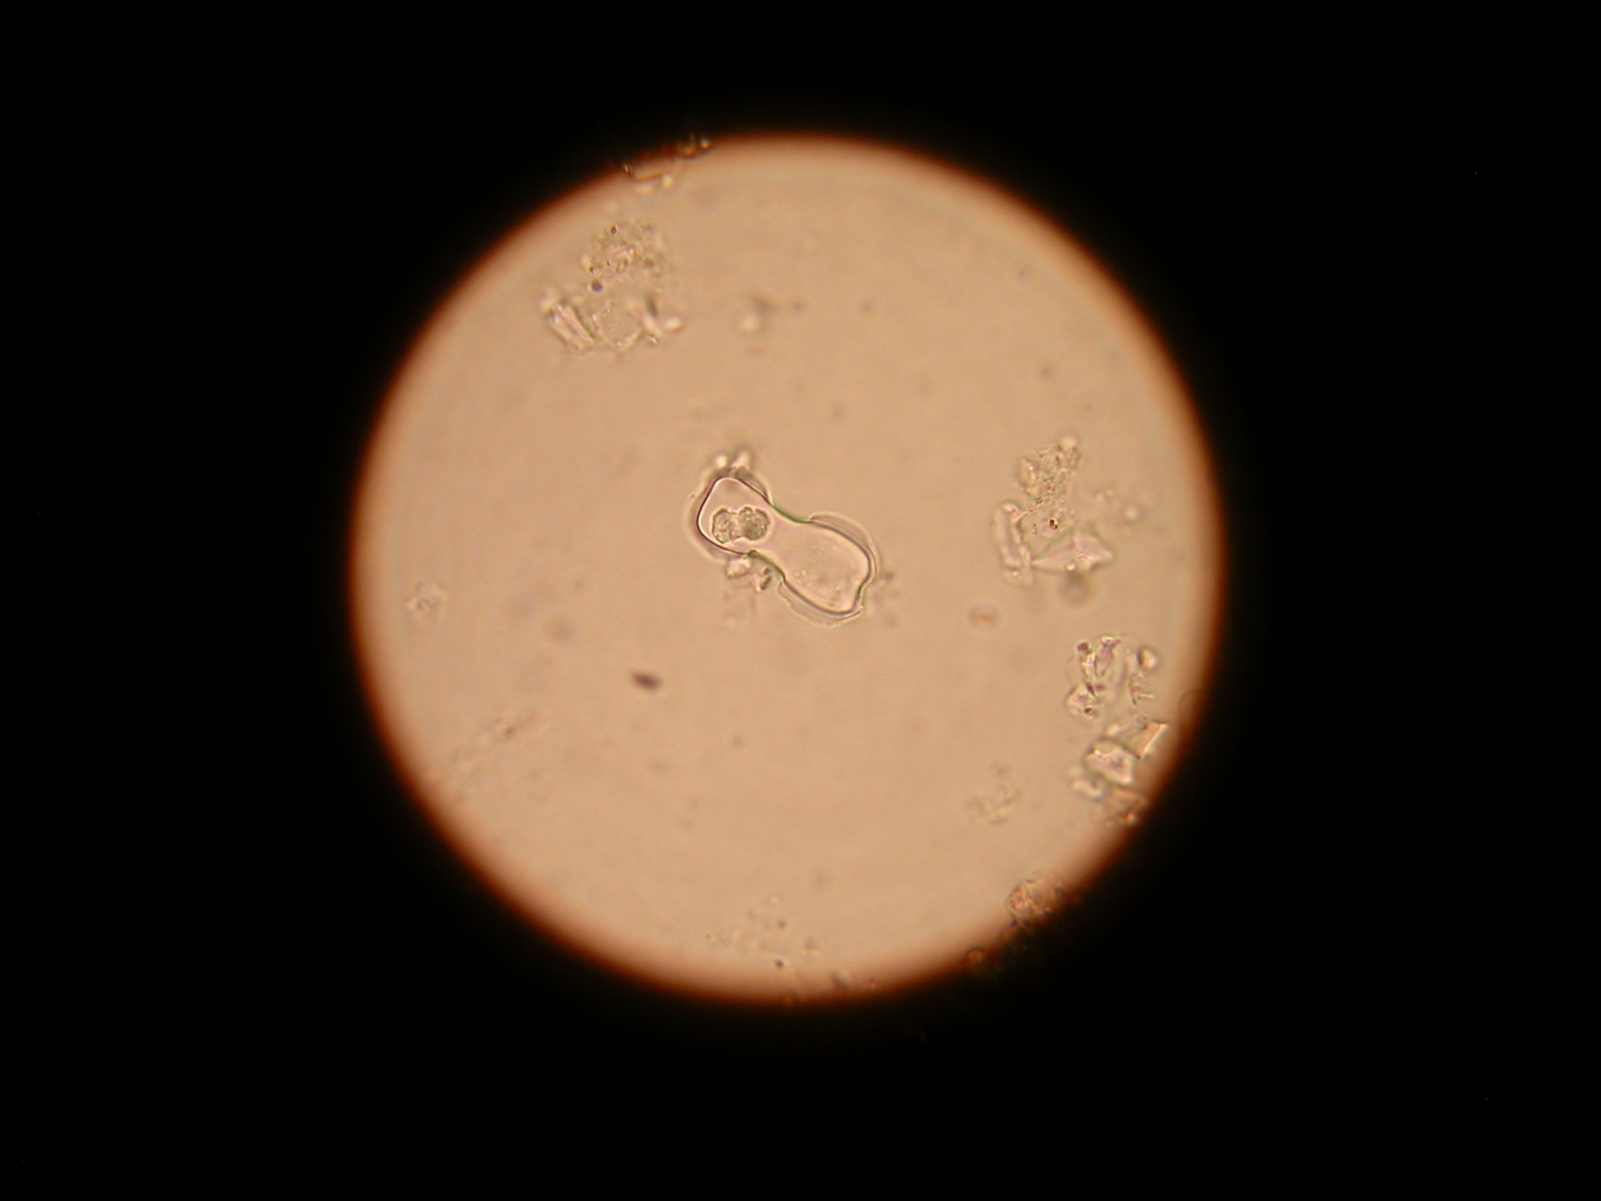
What is a Phytolith?
10µm
Notes:
Get phytolith peel picture.

Slide 17
Methods
10µm
Notes:
Get phytolith peel picture.

Slide 18
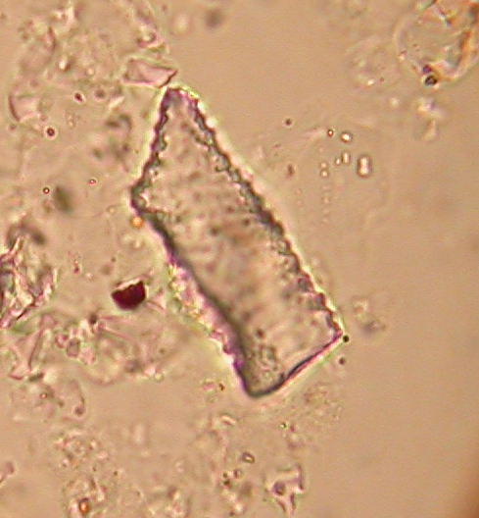
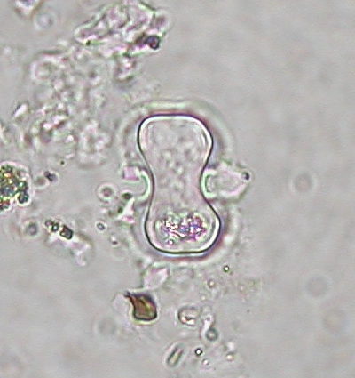
Preliminary Phytolith Data
Forest Indicator
Grassland Indicator
VS.
10µm
Notes:
Show make up of phytolith sections. Mention that they are tied directly into Pollen.

Slide 19
Preliminary Phytolith Data
Phytolith

Slide 20
Preliminary Phytolith Data

Slide 21
Preliminary Phytolith Data
Youngest
Forest
Indicator
Oldest

Slide 22
Preliminary Phytolith Data
Youngest
PACMAD
Grass
(Warm-adapted)
Oldest

Slide 23
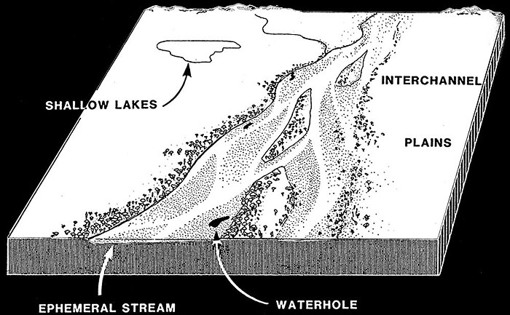
Preliminary Phytolith Data
After Hunt (1990)

Slide 24
Outline
Geology
  11.4 Ma, 3 lines of fossil evidence
Phytolith
  Forest dominated, warm-adapted grasses
Macroflora

Slide 25
Preliminary Macroflora Data
After Hunt (1990)

Slide 26
Outline
Geology
  11.4 Ma, 3 lines of fossil evidence
Phytolith
  Forest dominated, warm-adapted grasses
Macroflora
  Woody, riparian vegetation
Pollen

Slide 27
Preliminary Pollen Data
Pollen

Slide 28
Preliminary Pollen Data
After Hunt (1990)

Slide 29
Summary
Geology
  11.4 Ma, 3 lines of fossil evidence
Phytolith
  Forest dominated, warm-adapted grasses
Macroflora
  Woody, riparian vegetation
Pollen
  Lower: dominated by upland conifer
  Upper: dominated by lowland floodplane vegetation

Slide 30
Future Work
Address climate in late Miocene of Pacific Northwest

Slide 31





Acknowledgements
FRIENDS, FAMILY, AND COLLABORATORS
Brian Sherrod
Susie Winkowski
Johnathan Hager
Brian Buchwitz
Regan Dunn
Elisha Harris
Marijana Surkovic Davis
Avery Cook Shinneman
Stephanie Zaborac-Reed
Don Hopkins
Jeff Benca
Erik Fredrickson
Kim Smith
Thien-Y Le
Janine Jijina
Henry
Hannah Ginn
SUPPORT AND FINANCING
Strömberg Lab
Vasa Park Resort
Burke Museum of Natural History and Culture
Mary Gates Research Grant Scholarship
Howard Hughes Medical Institute
University of Washington Department of Biology
The Geological Society of America Travel Grant

