Slide 1







Federal Work Group on Uncertainty Analysis and Parameter Estimation
Tom Nicholson, U.S. Nuclear Regulatory Commission
Mary Hill, U.S. Geological Survey
2012 Geological Society of America Annual Meeting
November 7, 2012
Charlotte, NC

Slide 2
Outline
Work Group 2 (WG2) Objective and Goals
Members and Participants
Activities and Technical Projects
Seminars at the WG2 Meetings
Methodologies, Tools and Applications
Forward Strategy
Recommendations for FY2013

Slide 3
Work Group Objective
Coordinate ongoing and new research conducted by U.S. Federal agencies on:
parameter estimation
uncertainty assessment
in support of environmental modeling and applications
Focus on strategies and techniques
Includes sensitivity analysis
What is needed to achieve this objective?
Coordination of research staff and their management thru efficient and targeted use of our limited resources.

Slide 4
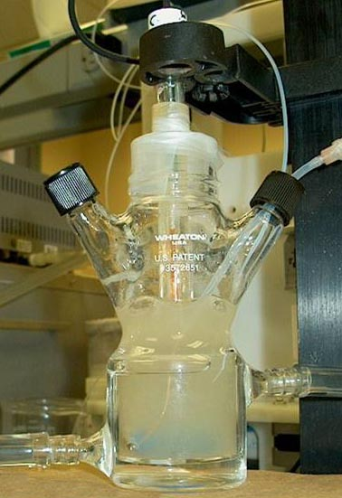
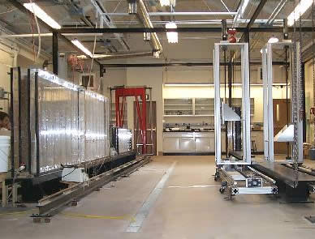
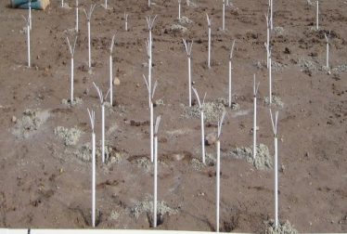
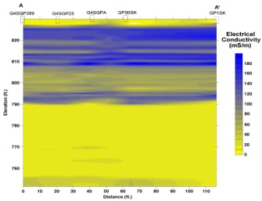
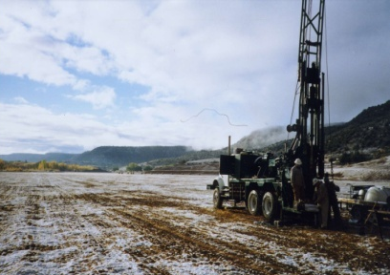
Work Group Goals
Basics:
Develop a creative, collaborative environment to advance
parameter estimation in the context of model development .
sources of uncertainty in the context of model predictions.
Develop a common terminology.
Identify innovative applications.
Existing Tools: Identify, evaluate, and compare available analysis strategies, tools and software.
New Tools: Develop, test, and apply new theories and methodologies.
Exchange: Facilitate exchange of techniques and ideas thru teleconferences, technical workshops, professional meetings, interaction with other WGs and ISCMEM
Web site links: https://iemhub.org/groups/iscmem.
Communicate: Develop ways to better communicate uncertainty to decision makers (e.g., evaluation measures, visualization).
Batch scale (0.01m)
Column scale
(0.1 m)
Intermediate scale (2m)
Tracer test scale (1-3m)
Electrical Conductivity
Geophysics
(2-200m)
Butler et al.
Plume scale (2000m)

Slide 5
Members and Participants from U.S. Federal agencies, universities, and industry
Tom Nicholson, NRC, co-Chair
Mary Hill, USGS, co-Chair
Todd Anderson, DOE
Tommy Bohrmann, EPA
Gary Curtis, USGS
Bruce Hamilton, NSF
Yakov Pachepsky, USDA-ARS
Tom Purucker, EPA-Athens
Yoram Rubin, UC Berkeley
Brian Skahill, USACOE
Matt Tonkin, SSPA
Gene Whelan, EPA-Athens
Steve Yabusaki, PNNL
Ming Ye, Florida State U
Ming Zhu, DOE
Larry Deschaine, HydroGeologic, Inc.
Boris Faybishenko, LBNL
Pierre Glynn, USGS
Philip Meyer, PNNL
Candida West, EPA
Debra Reinhart, NSF
You?

Slide 6
Activities: Conference Sessions
2011 Fall AGU: Mary Hill, WG2 Co-Chair organized session “Uncertainty Assessment, Optimization, and Sensitivity Analysis in Integrated Hydrologic Modeling as Application of Hydroinformatics.”
2011 NSF Statistical and Applied Mathematical Sciences Institute (SAMSI): WG2 Co-Chair M. Hill co-organized “Workshop on Uncertainty in the Geosciences,” Research Triangle Park, NC
2012 Society of Toxicology/EPA “Contemporary Concepts in Toxicology Workshop” WG2 Co-Chair T. Nicholson presented invited paper, volunteered poster, and participated in technical sessions. Focused on exposure, dose-response, ecosystem impacts, life cycle/cost-benefit, and information technology.

Slide 7
Activities: Conference Sessions
2012 Fall AGU: Co-chair Mary Hill organized session “Complexity, Falsifiability, Transparency, and Uncertainty in Environmental Modeling”
2012 Geological Society of America Annual Meeting: Co- Chair Tom Nicholson presented invited paper co-authored with Mary Hill, WG2 Co-Chair on “Federal Work Group on Uncertainty Analysis and Parameter Estimation” in technical session “T103. Ground-Water Model Calibration and Uncertainty Analysis” organized by Ming Ye, Florida State University and WG2 member.

Slide 8
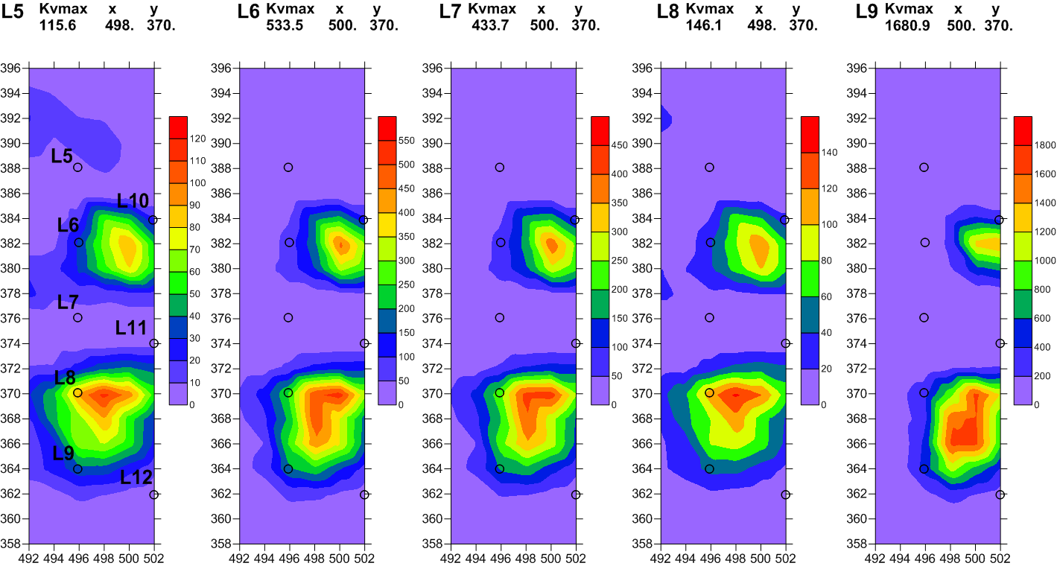
Activities: Teleconferences
We conduct teleconferences to:
review and discuss ongoing research studies and software development
formulate proposals for field applications
What measure-ments would help discriminate between two models?
from 2/22/2012 seminar by Yakov Pachepsky, USDA, on model abstraction

Slide 9
Activities: Teleconferences
We conduct teleconferences to:
review and discuss ongoing research studies and software development
formulate proposals for field applications
How does moisture travel in the atmosphere and lead to big storms?
from 9/21/2012 seminar by Mike Dettinger, USGS, on atmospheric rivers

Slide 10
Seminars at WG2 Teleconferences in FY2012
Multi-Scale Assessment of Prediction Uncertainty in Coupled Reactive Transport Models by Gary P. Curtis, USGS; Ming Ye, Florida State University; Philip D. Meyer and Steve B. Yabusaki, PNNL to discuss the use of a Bayesian model averaging method to assess parametric and model uncertainty for improvement of predictive performance.
Briefing on the Chernobyl Cooling Pond Decommissioning and Remediation Proposal (ISCMEM Case Study for Improving Scientific Basis for Multimedia Environmental Modeling and Risk Assessment) by Boris Faybishenko, Lawrence Berkeley National Laboratory, to provide comments and questions for the international meeting in Kiev, Ukraine on remediation decision-making.

Slide 11
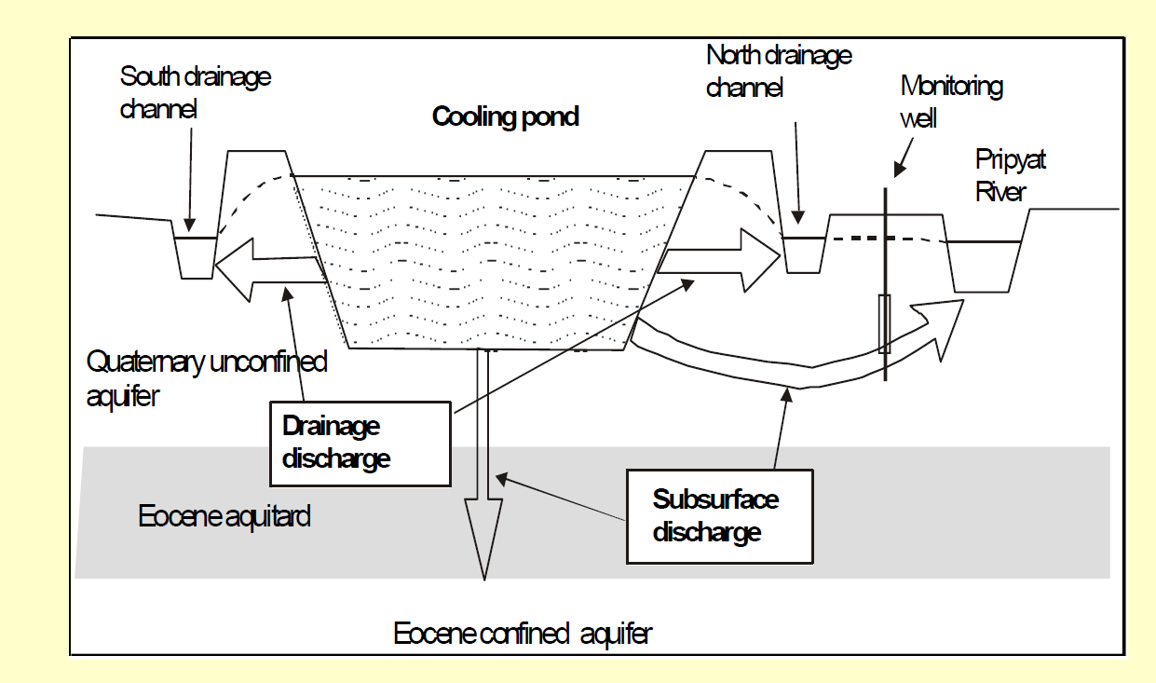
Chernobyl Cooling Pond Decommissioning and Remediation Proposal (ISCMEM Case Study for Improving Scientific Basis for Multimedia Environmental Modeling and Risk Assessment) by Boris Faybishenko, Lawrence Berkeley National Laboratory on October 2011.

Slide 12
Seminars at WG2 Teleconferences (continued)
Training Range Environmental Evaluation and Characterization System (TREECS) by B. Johnson, M. Dortch and B. Faybishenko to discuss an advanced spatially integrated, multi-scale, multi-pathway simulation capability for evaluation of distributed sources of contaminants from both on-site as well as off-site sources with applications to the Borschi Watershed, and military training range.
The “How” of Environmental Modeling: Toward Enhanced Transparency and Refutability by Mary Hill, USGS, to discuss advantages of establishing a base set of model sensitivity analysis and uncertainty evaluation measures, to be used along with any other performance measures of interest.

Slide 13
Computationally frugal methods (often 10s to 1,000s of model runs)
Computationally demanding methods (often 10,000s to 1,000,000s of model runs)*
Notes:
Common questions of concern when modeling environmental systems organized into categories for model adequacy, and sensitivity and uncertainty evaluation. The latter are organized by what part of the observation-parameter-prediction triad they address, which takes advantage of the quantitative connection any mathematical model provides between simulated equivalents of observations, parameters, and predictions.
Computationally frugal methods that tend to require 10s to 1,000s of model runs are in red;
Computationally demanding methods that tend to require 10,000s to 1,000,000s of model runs are in green, underlined and have an asterisk *.
SOO and MOO, single- and multi-objective optimization, respectively;
b/SD_{b} forms a t statistic (a value over its standard deviation) on the estimate of parameter b;
CSS, composite scaled sensitivity;
PCC, parameter correlation coefficient;
SV, singular values obtained when a set of parameters is transformed using singular value decomposition;
OAT, one at a time sampling;
DoE, Design of Experiment using fractional factorial methods;
FAST, Fourier amplitude sensitivity testing (method of Morris, Sobol’ and MCMC methods are alternatives);
MCF, Monte Carlo filtered (generally equivalent to RSA, regionalized sensitivity analysis);
IR, influential rank;
CV, cross-validation;
PPR, parameter-prediction statistic;
OPR, Observation-Prediction statistic; and
z/SD_{z}, a t statistic on the prediction z.
#Uncertainty intervals can be calculated using classical or Bayesian approaches and linear, nonlinear*, Monte Carlo*, and bootstrapping* methods. References for the methods listed in figure 1 and additional definitions can be found in the supplementary material.

Slide 14
Methodologies, Tools and Applications
Proceedings of the International Workshop on Uncertainty, Sensitivity and Parameter Estimation for Multimedia Environmental Modeling (NUREG/CP-0187)
Joint Universal Parameter IdenTifications and Evaluation of Reliability Application Programming Interface (JUPITER API) for programming computer programs designed to analyze process models, joint USGS and EPA project (Banta and others, 2006)
Hydrologic Conceptual Model, Parameter and Scenario Uncertainty Methodology, cooperative project by the University of Arizona, PNNL and NRC staff (NUREG/CR-6940)

Slide 15
Methodologies, Tools and Applications (continued)
Model Abstraction Techniques for determining and identifying conceptual model structure and parameter estimation strategies, joint USDA/Agricultural Research Service and NRC staff (NUREG/CR-7026)
Approaches in Highly Parameterized Inversion: PEST++, a Parameter ESTimation code optimized for large environmental models by D. Welter, J. Doherty, R. Hunt, C. Muffels, M. Tonkin, and W. Schreuder. An object-oriented parameter estimation code that incorporates benefits of object-oriented programming techniques for solving large parameter estimation modeling problems. (USGS Techniques and Methods: 7-C5)

Slide 16
Forward Strategy
Energize the science and technology thru closer linkage to decision making:
better understand the methods being used in parameter estimation and uncertainty analyses
establish a base set of model sensitivity analysis and uncertainty evaluation measures, in addition to the other performance measures
use and compare different methods in practical situations

Slide 17
Recommendations for FY2013
Assist development and creation of other working groups
Take advantage of the relevance of uncertainty and parameter estimation to all environmental modeling and monitoring fields.
Develop and conduct joint ISCMEM teleconferences
WG1 (Software System Design; design of uncertainty and parameter estimation software and data fusion)
WG3 (Reactive Transport Models and Monitoring; support decision making)
Act as an incubator to build support for new ideas
Proposed WG on monitoring based on the importance of monitoring to uncertainty and parameter estimation, and visa versa
Sponsor technical workshops on endorsed studies
U.S. studies: Naturita, CO; Hanford-300 Area; OPE3 Beltsville, MD
International study on monitoring and remediating Chernobyl Cooling Pond
ISCMEM Website
Use EPA’s iemHUB to enhance Information Transfer of Technical Reports and Data Sources

Slide 18

https://iemhub.org/groups/iscmem

