Slide 1

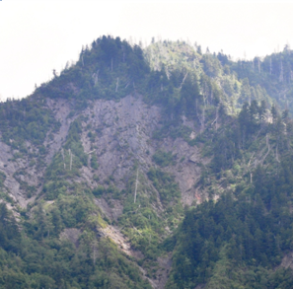
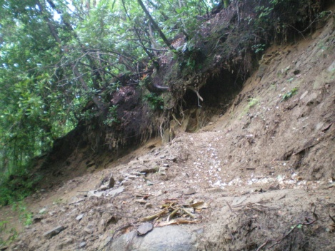
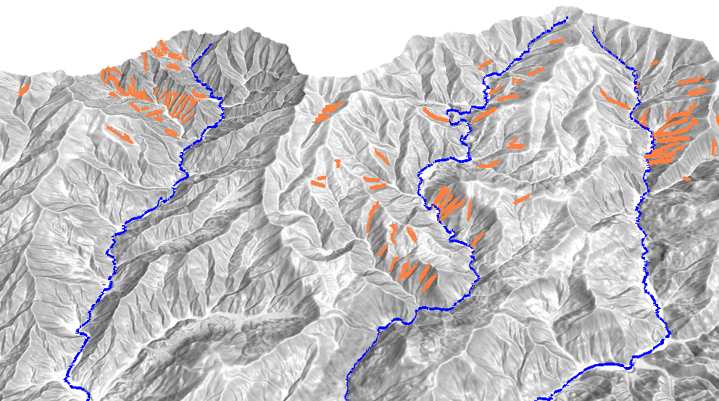

A Geomorphic Process-Based Approach to Delineate
Debris Flow Activity
Nathan J. Lyons Helena Mitasova Karl W. Wegmann
Geological Society of America National Meeting
November 6, 2012

Slide 2
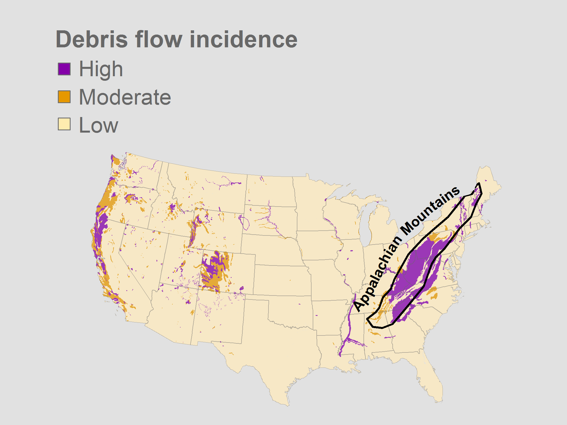
Recurrence interval [ky]
In lower order basins
0.4 (May and Gresswell, 2008)
2-4 (Eaton et al., 2003)
0.3 (Hubert and Filipov, 1989)
0.4-1.6 (Kochel, 1990)
Radbruch-Hall et al. (1982)

Slide 3
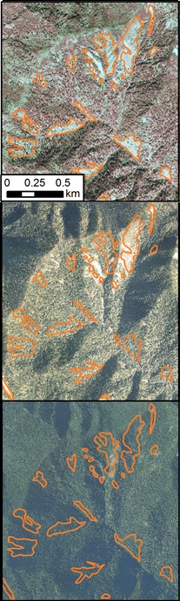
Inventory methodologies
1998
Field mapping
Aerial photography interpretation (API)
Digital elevation models (DEMs)
  Landform indicators
  Semi-automated detection
2006
2008

Slide 4
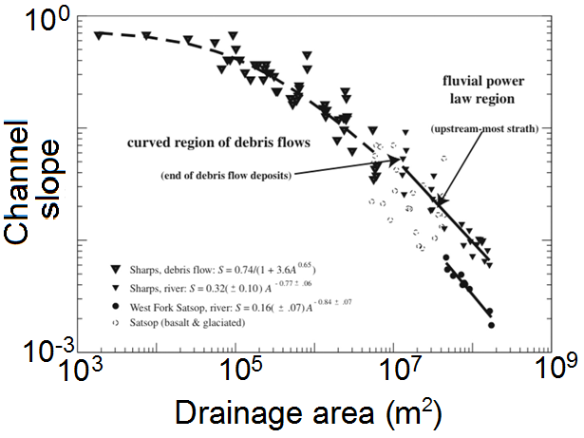
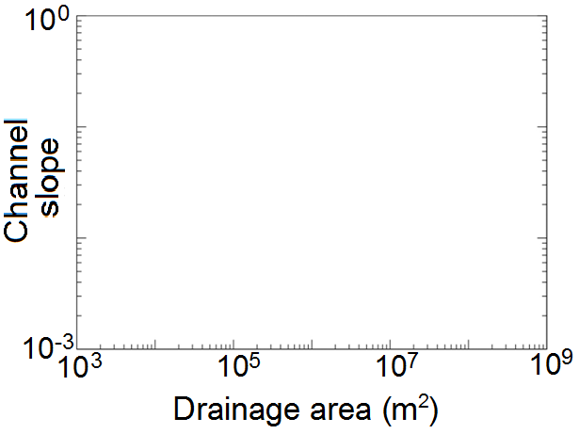
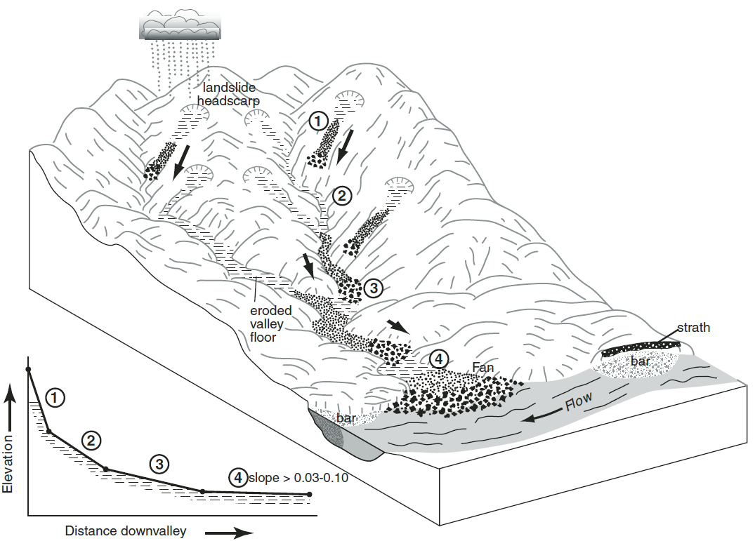
Process regions
Area-Slope Plot
Curved region
Scaling break
Transition
Power law region
Stock et al. (2005)
Stock and Dietrich (2005)

Slide 5
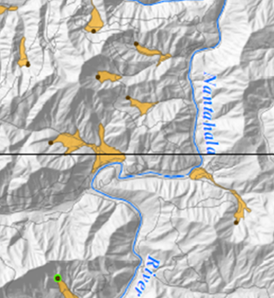
Our questions
Can we determine debris flow extent, the critical drainage area of debris flows (A_{df}) ?
Identify process signatures in a DEM.
Will inventory proficiency improve when we limit it to A_{df} ?
Semi-automated land classification.
Compare evaluations of 2 inventories.
Macon County landslide inventory, NCGS (2005)

Slide 6
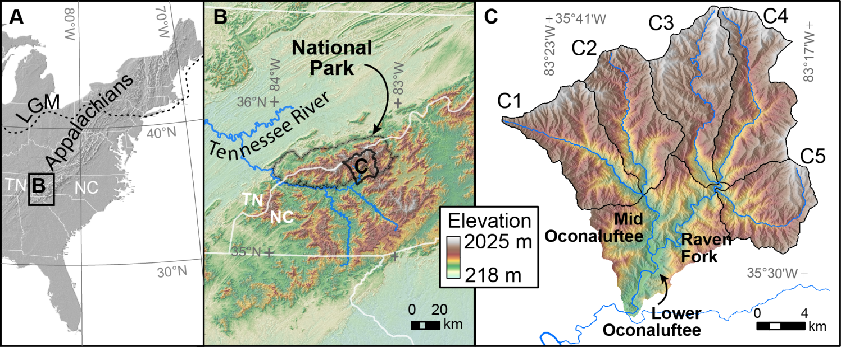
Setting
5 catchments (C) of the lower Oconaluftee River
Area: 269 km²

Slide 7
Identifying debris flow-dominated channels
Area-slope plot data obtained from a digital elevation model
Multiple regressions in area-slope plots bound by:
  Transition from hillslope to channel processes (A_{C})
  Knickpoints
Maximum negative concavity index, in
  Defined as the scaling break, A_{df}
  Indicates a decrease in reach channel slope

Slide 8
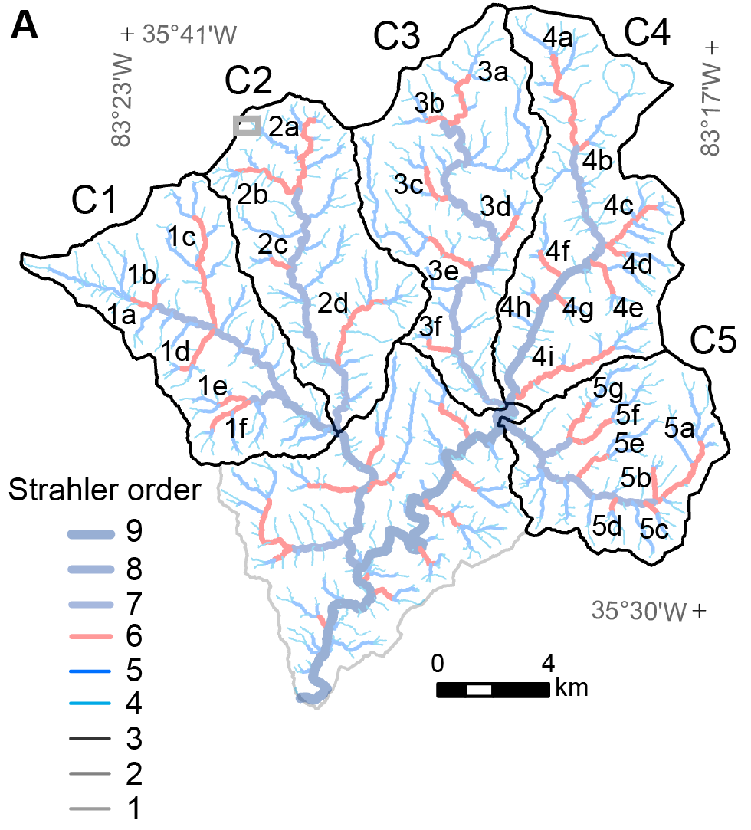
Study streams
Area-slope analyses:
Limited to “6th order channels”
  32 in 5 catchments
  Drainage area: 1.2 ±0.2 km²
Catchment truck channels included

Slide 9
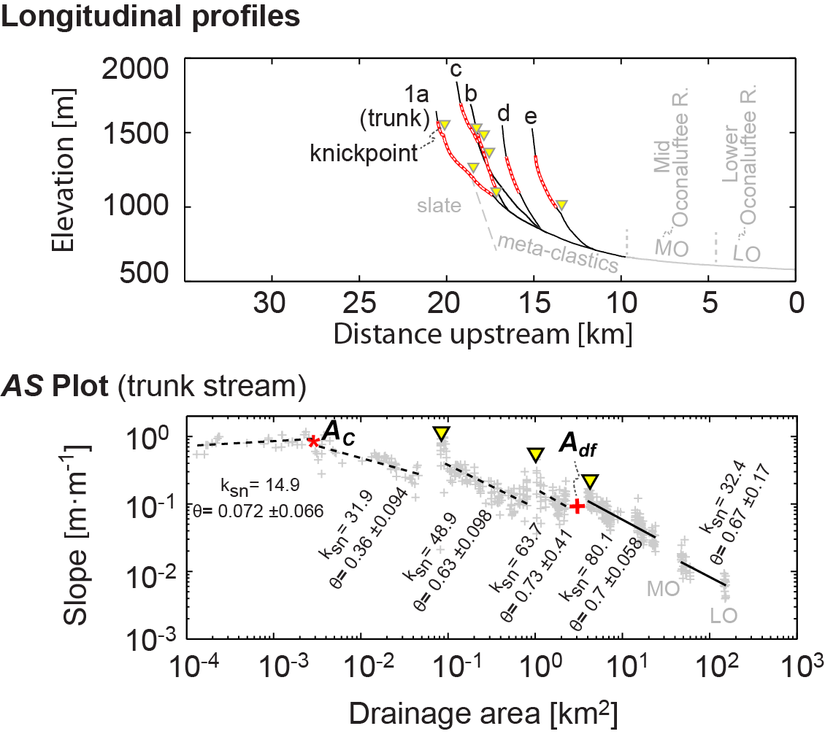
Catchment 1

Slide 10
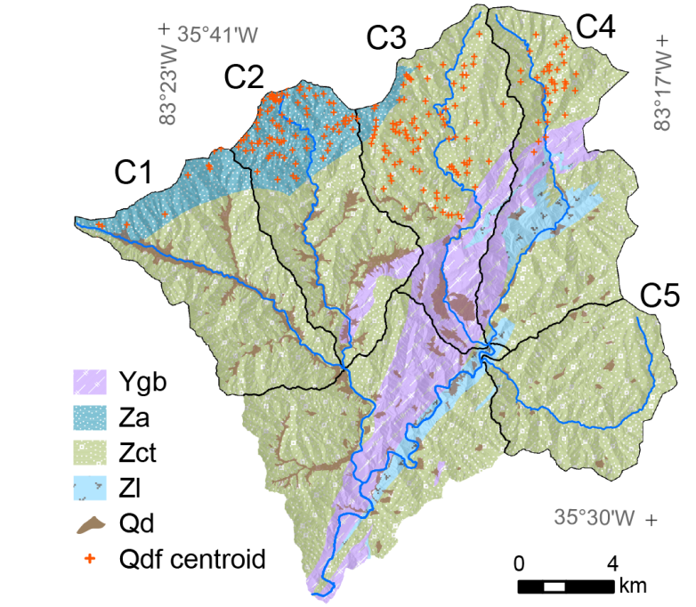
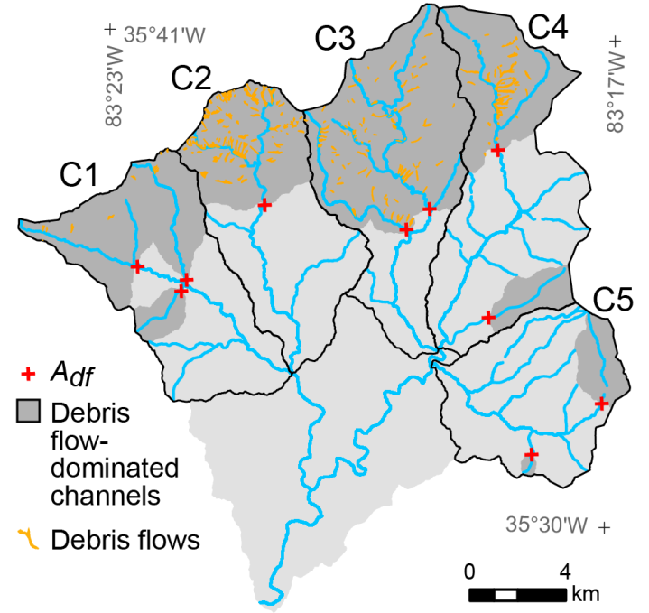
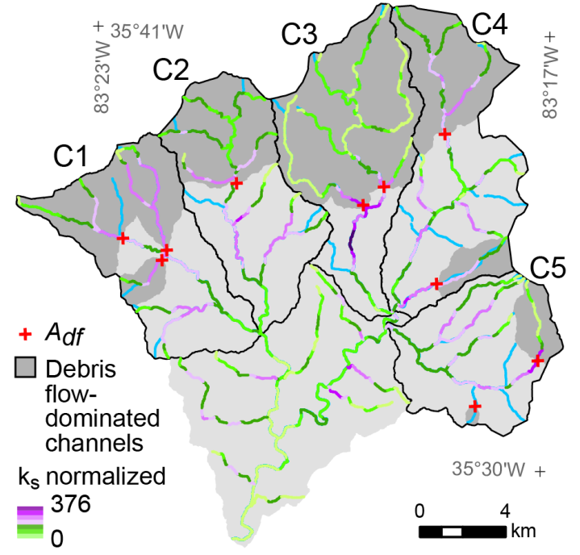
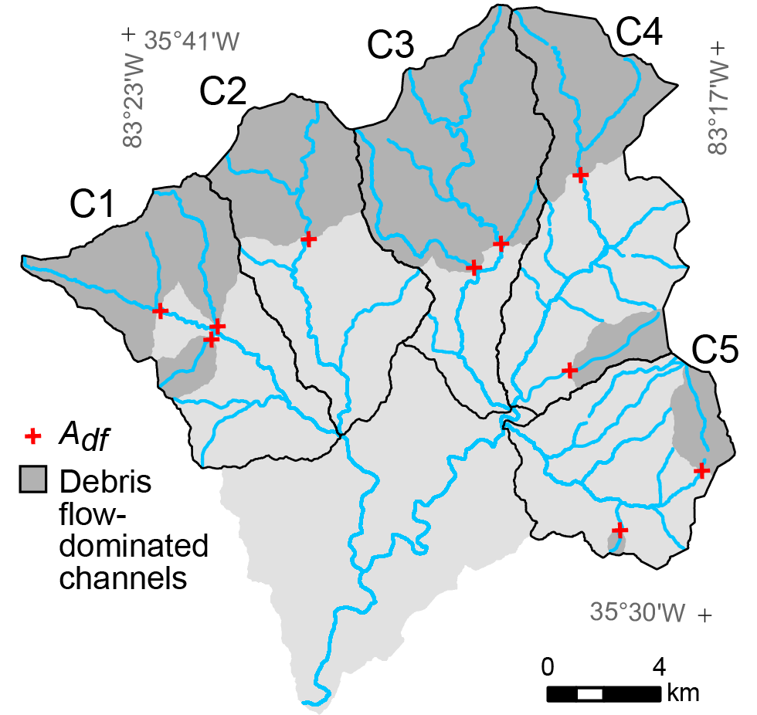
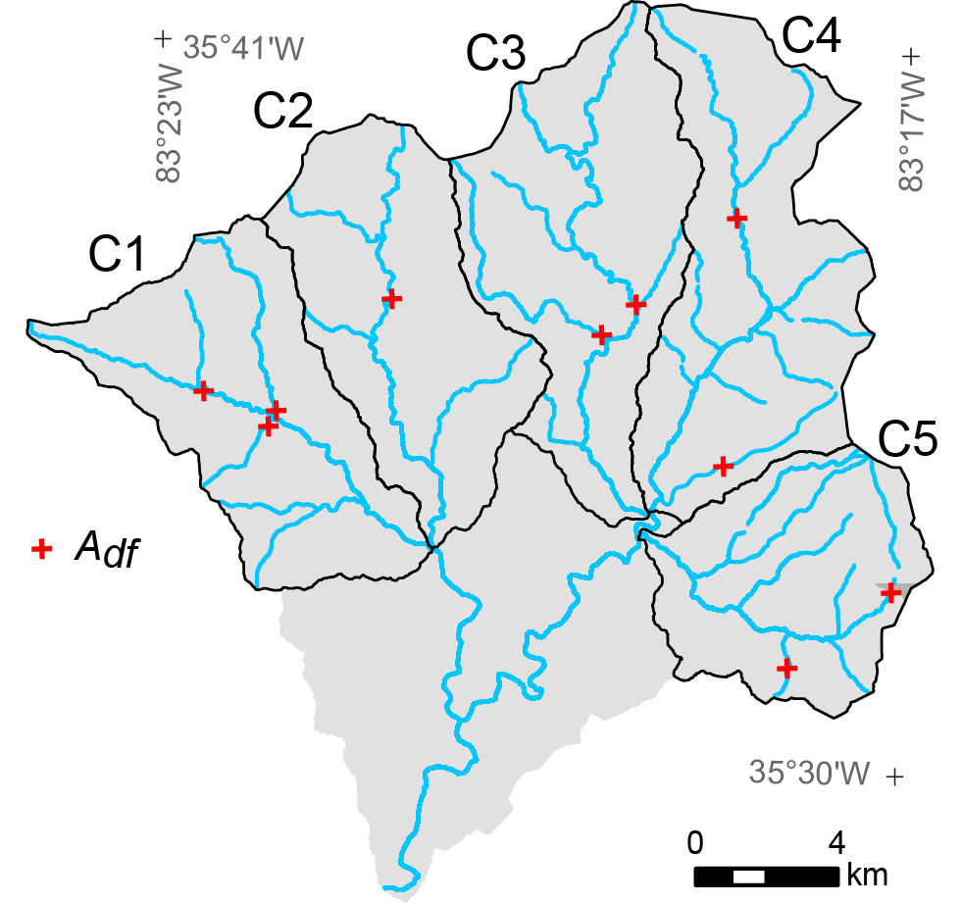
Critical drainage area of debris flow activity
Debris flow deposits above A_{df}
k_{sn} peaks near A_{df}
Position of A_{df} influenced by bedrock
gneiss
slate
metasandstone
quartzite
debris fan
debris flow

Slide 11
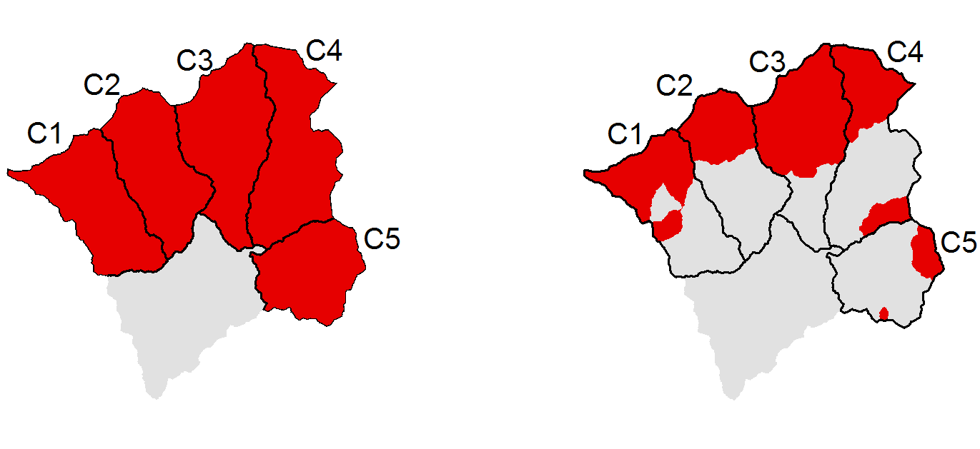
Debris flow inventories
Two inventories compared:
Same methodology for both inventories
Catchments: 269 km²
A_{df}: 111 km²

Slide 12
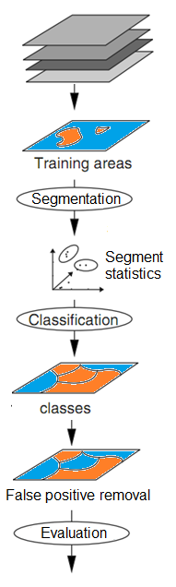
Inventory methodology
Texture maps of inputs (slope, hillslope curvature, NDVI)
Subareas: “Is a debris flow” or “Is not a debris flow”
defined by USGS debris flow map
Segment statistics
“Is not a debris
flow candidate”
Classes: “Is a debris flow candidate” or
Length:width = 1.8 to 16
True positives Area = 0.5 to 20 ha
Slope > 0.03
USGS debris flow map
Figure modified from Neteler and Mitasova (2008)

Slide 13
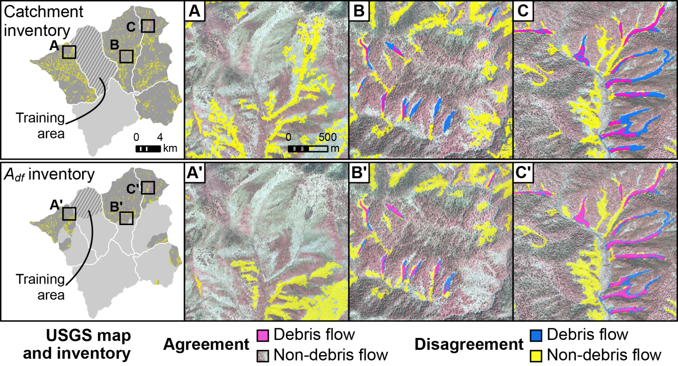
Inventory results

Slide 14
Evaluation
Inventory | Agreement by debris flow count [%] | Agreement by area [%]
 |  | Debris flow | Non-debris flow
Catchment | 70 | 44 | 89
A_{df} | 82 | 58 | 91

Slide 15
Conclusions
Limiting debris flow inventories can improve inventory proficiency.
Detection outperforms semi-automated classification without spatial extent limit
Target inventory areas in other methods
Especially well suited for regions with:
Large areas of incidence
Long recurrence interval

Slide 16
References
Eaton L, Morgan B, Kochel R, Howard A (2003) Role of debris flows in long-term landscape denudation in the central Appalachians of Virginia. Geology 31:339–342.
Gilbert GK, (1877) Report on the geology of the Henry Mountains [Utah]. Publication of the Powell Survey, US Government Printing Office, Washington DC.
Hubert JF, Filipov AJ (1989) Debris flow deposits in alluvial fans on the west flank of the White Mountains, Owens Valley, California, U.S.A.
Howard A (1994) A Detachment-Limited Model of Drainage-Basin Evolution. Water Resour Res 30:2261–2285.
Korup O, Schlunegger F (2007) Bedrock landsliding, river incision, and transience of geomorphic hillslope-channel coupling: Evidence from inner gorges in the Swiss Alps. J Geophys Res 112:F03027.
Matmon A, Bierman P, Larsen J, Southworth S, Pavich Matmon, Caffee M (2003) Temporally and spatially uniform rates of erosion in the southern Appalachian Great Smoky Mountains. Geology 31:155–158.
Neteler M, Mitasova H (2008) Open Source GIS: A GRASS GIS Approach. Third Edition.
The International Series in Engineering and Computer Science: Volume 773, New York, NY.
Radbruch-Hall DH, Colton RB, Davies WE, Lucchitta I, Skipp BA, Varnes DJ (1982) Digital compilation of landslide overview map of the coterminous United States. US Geological Survey Open-File Report 97-289.
Southworth S, Schultz A, Denenny D, Triplett J (2005) Surficial geologic map of the Great Smoky Mountains National Park Region, Tennessee and North Carolina. US Geological Survey Professional Report and Geological Map, scale 1:100,000.
Stock J, Dietrich WE (2003) Valley incision by debris flows: Evidence of a topographic signature. Water Resour Res 39:1089.

