Slide 1
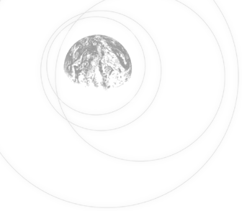
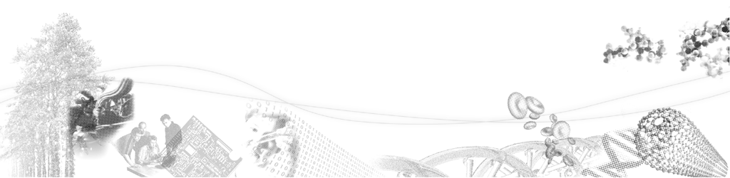
Applications of Raman microspectroscopy to fluid inclusions phase identification.
S. Mamedov *, R. S. Darling**
*Horiba Scientific, Edison, NJ, USA
**SUNY Cortland, Cortland, USA

Slide 2
Information from Raman Spectroscopy of Fluid Inclusions
Provide identification of molecules in inclusions such as CO₂, CH₄, N₂, -SH, H₂O as an aid to understanding the geochemistry of rock formation as it evolved.
Calibrated relative intensities can provide concentration ratios.
Peak shifts indicate pressure of inclusion.
Maps and depth profiles provide insight into the structure of the inclusion, but are susceptible to artifacts due to the instability in the position of the bubbles.

Slide 3
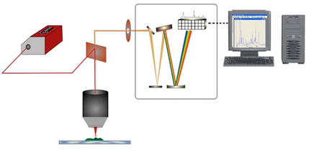
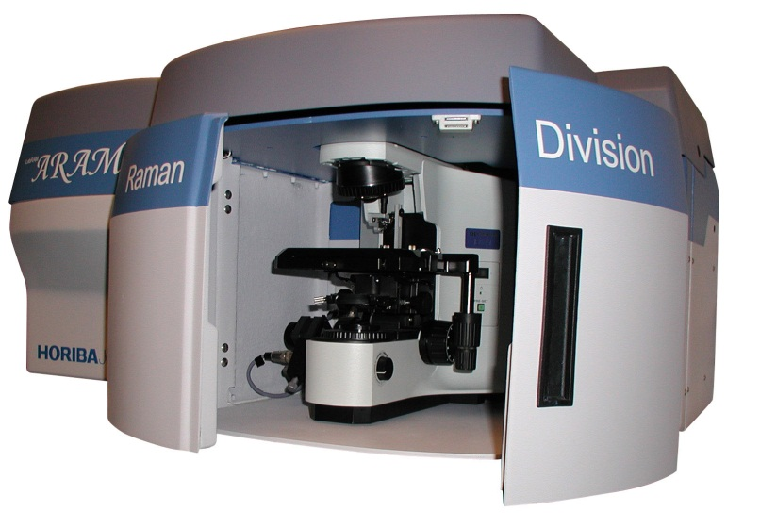
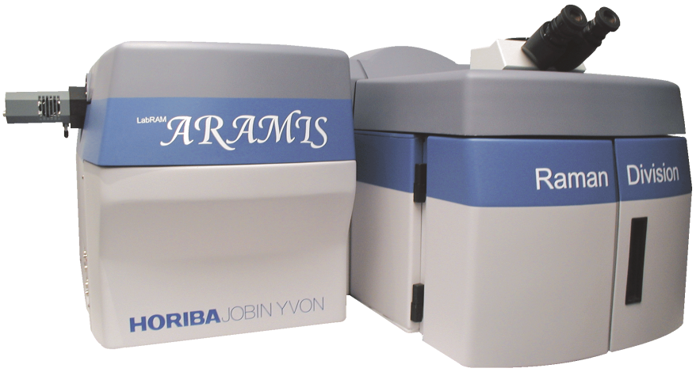
Experimental Set Up
Laser – 532 nm, 25 mW
Objective – Olympus x100, N.A. 0.9
Mapping step size – 0.1 microns

Slide 4
Raman spectra of SiO₂
Quartz, cristobalite and amorphous SiO₂
Intensity

Slide 5
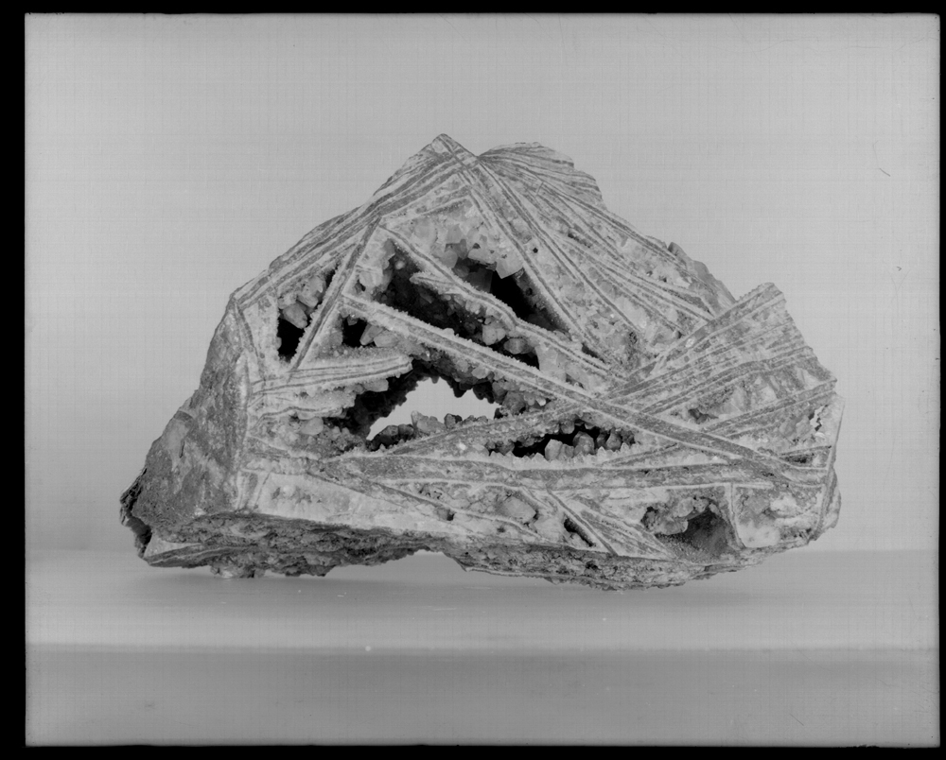
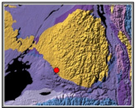
Image of the box vein cavities (now in the NYS museum collection); Source of photo: Dale, N.C., 1924, The box-vein of Lyonsdale, Lewis County, N.Y., New York State Museum Bulletin 251. The quartz-lined cavities contain the secondary CH₄ inclusions we analyzed.
Box vein location in northern NYS. Yellow are Grenville metamorphic & igneous rocks of the Adirondacks, Blue & purple are lower-middle Paleozoic sedimentary rocks.

Slide 6
Inclusion 1

Slide 7
Inclusion 1
SiO₂
CH₄
N₂
Raman spectrum in the center of the inclusion. Laser 532 nm, confocal hole 1000 microns = spectrum from full depth of inclusion.

Slide 8
Inclusion 1 – distribution of methane, carbon and SiO₂
Red – CH₄
Green – SiO₂
Blue - carbon

Slide 9
Inclusion 1 – depth profile in the center
Red – CH₄
Green – SiO₂
Blue - carbon

Slide 10
Inclusion 1 – depth profile in the center
Green – SiO₂
Red – CH₄
Blue - carbon
“Second peak” in methane concentration due to the fact that second order line from carbon between 2878 and 2973 cm⁻¹ overlaps with line of CH₄ at 2910 cm⁻¹.

Slide 11
Inclusion 1
Black dots – photo induced damages due to the interaction of the laser beam with something on the inner surface of the inclusion. Spectral features are the same at high and low power (no damages) and it looks like amorphous carbon.

Slide 12
Inclusion 2 – depth profile in the center
Red – CH₄
Green – SiO₂
No carbon detected in this inclusion

Slide 13
Inclusion 2
Inclusion contains water

Slide 14
Inclusion 3

Slide 15
Inclusion 3 – depth profile in the center
Red – CH₄
Green – SiO₂
No carbon detected in this inclusion

Slide 16
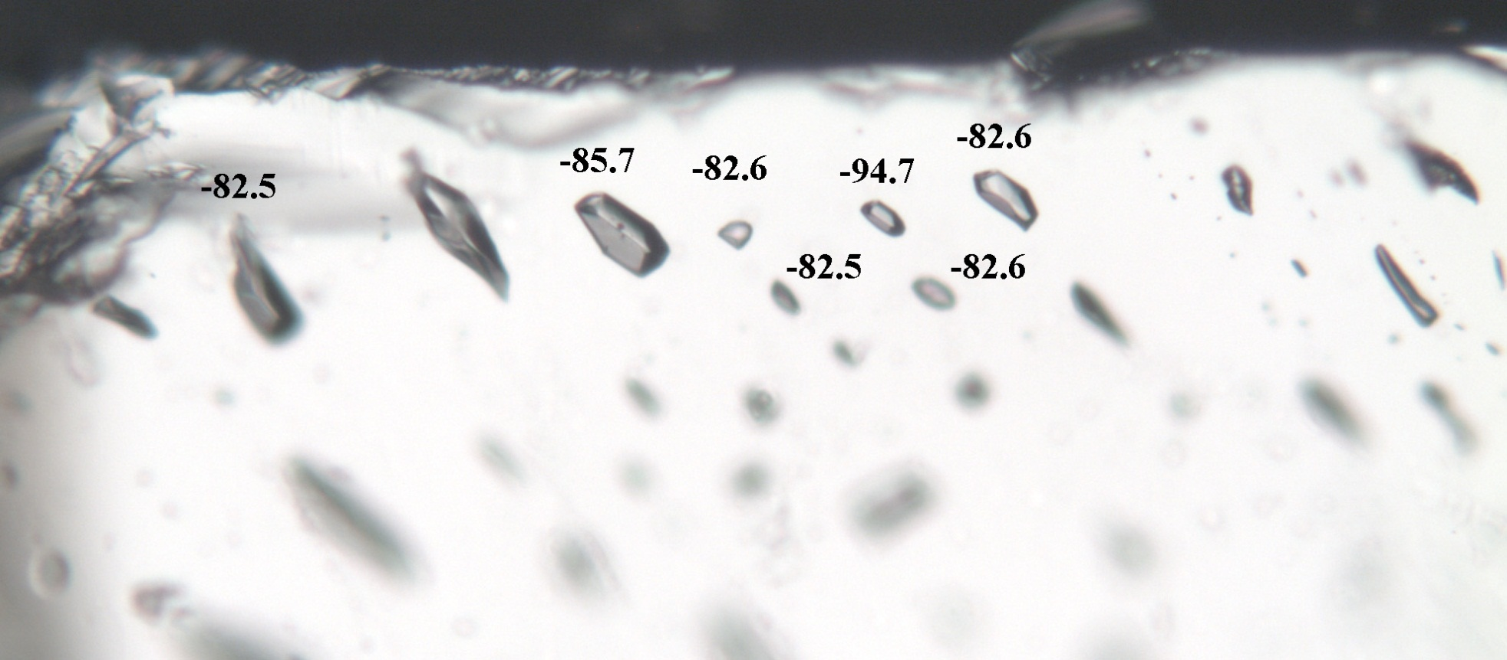
Homogenization Temperatures
1
3
The two inclusions on which Raman data obtained show up lowering the Th measurements. Inclusions not probed with the laser give a uniform Th of -82.5C to -82.6C.

Slide 17
Summary
Raman spectroscopy is a practical exploration tool to study geological materials including fluid inclusions.
With its high spatial resolution, Raman spectroscopy is very useful to determine the composition of the embedded fluids and gas phase.
Imaging of fluid inclusion allows obtain information about distribution of liquid and gas phase and detect thin layer of water or carbon on the surface.
Light induced changes are observed in some inclusions
Inclusions on which Raman spectra obtained show lowering in Th (-85.7C and -94.7 C) but inclusions not probed with the laser give a uniform Th of -82.5C to -82.6C.
It was found that there is a shift of 2914 cm⁻¹ band of CH₄ to 2910.8 cm⁻¹ which can be explained by high pressure in the inclusion.

Slide 18
Thank you for your attention!
732-623-8284
sergey.mamedov@horiba.com

