Slide 1


Middle Miocene Dinoflagellates Demonstrate the Presence of Upper Choptank Marine Beds Beneath the Midlothian Gravels in Southern Virginia
Robert E. Weems, Lucy E. Edwards, Mark W. Carter –
U. S. Geological Survey
David B. Spears – Virginia Division of Geology and Mineral Resources

Slide 2
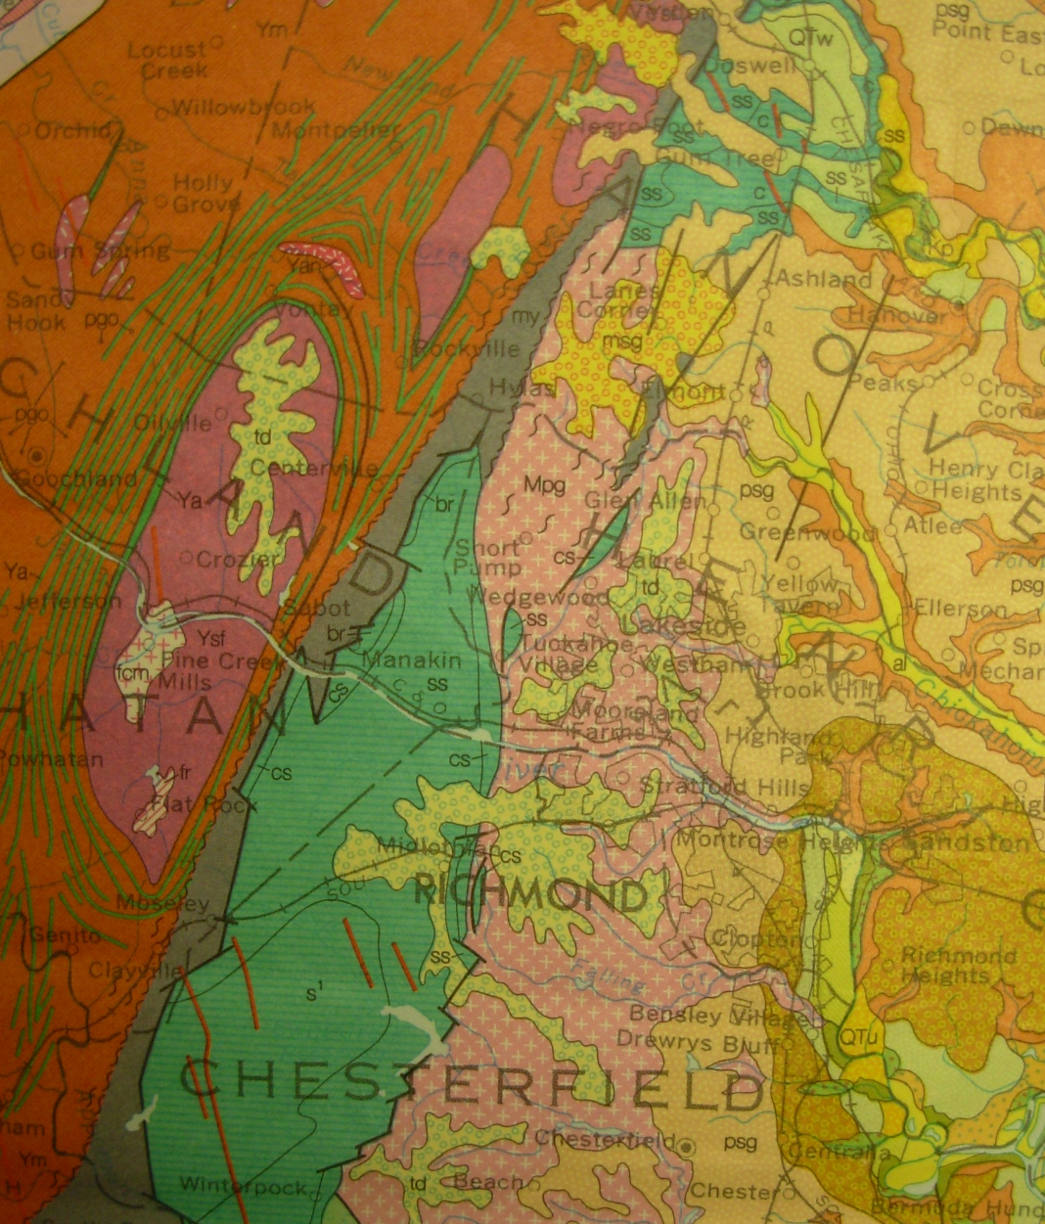
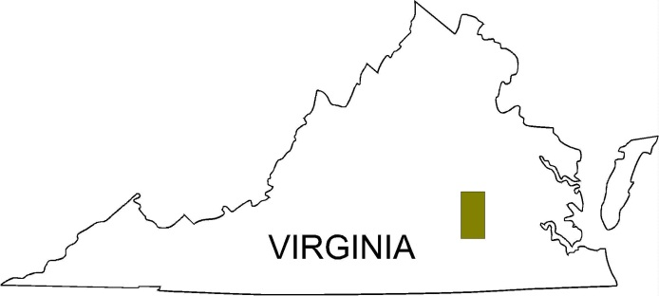
The Midlothian gravels are located far to the west of the Tidewater Fall Line (near star)

Slide 3
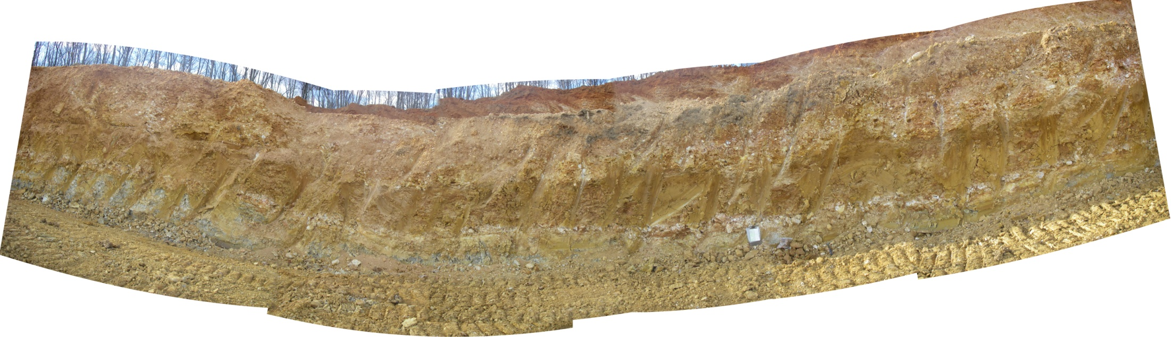
Outcrop of weathered fine-grained marine beds between Midlothian gravels (above) and Richmond Basin Triassic strata (below). Carter and others (2008) assigned this unit to the middle Miocene based on lithologic similarity to the Calvert and Choptank Formations. Maximum thickness 18 feet.
Tg₁
Tg₁ gravel
Tcl
Tg₁ sand
Triassic
gravel at base of Tcl
Photo by Mark Carter

Slide 4
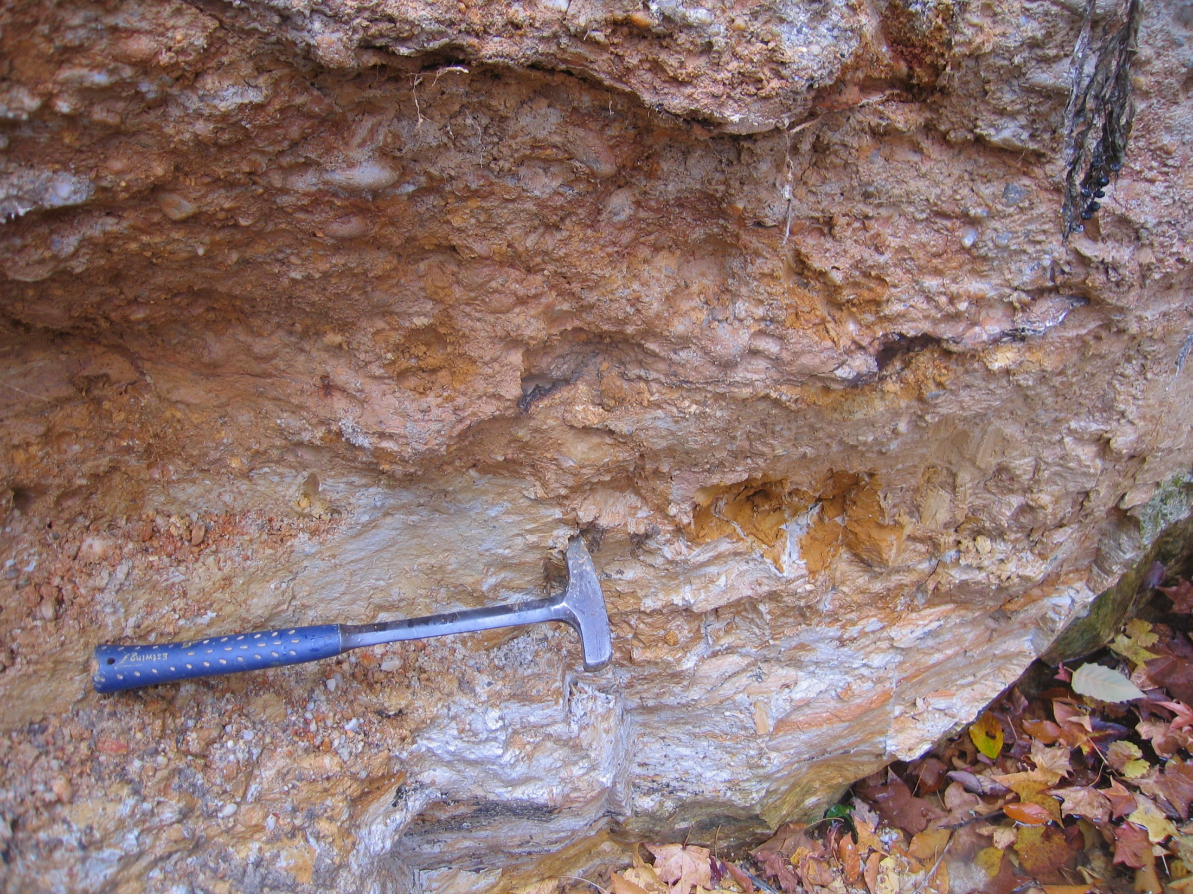
Contact between blue-gray clay and high-level Midlothian gravel at Station BAMC-678/680, marked by 3 cm-thick ferricrete (Fe) layer
Photo by Mark Carter

Slide 5
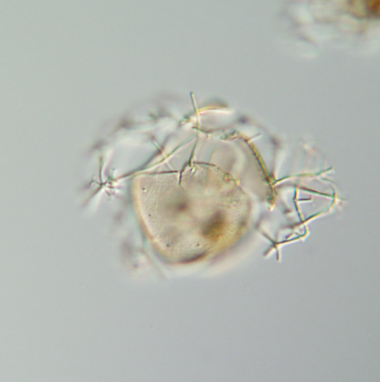
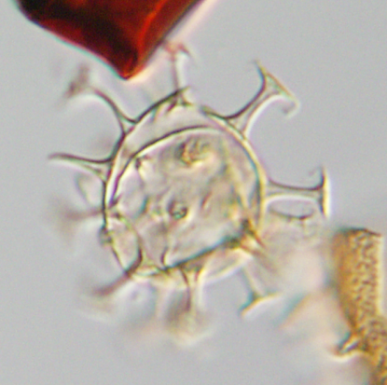
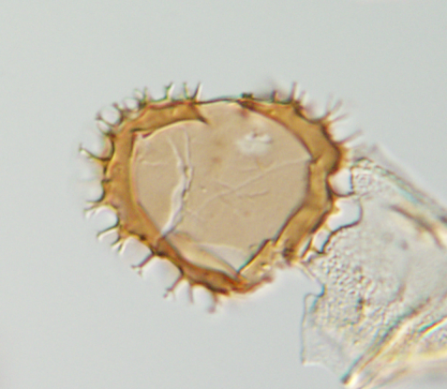
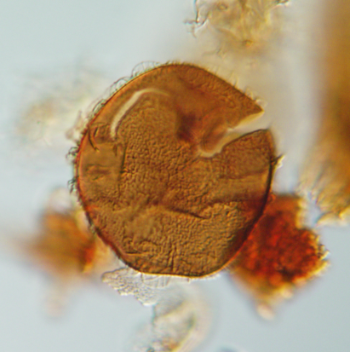
Stratigraphically important Miocene dinoflagellates in Midlothian samples
Range – DN7 marker species
Range top –
low in DN8
Range base –
base of DN6
Range – DN7 through DN10
20 µm
20 µm
20 µm
20 µm
Erymnodinium delectabile
Minisphaeridium latirictum
Selenopemphix dionaeacysta
Cannosphaeropsis passio

Slide 6
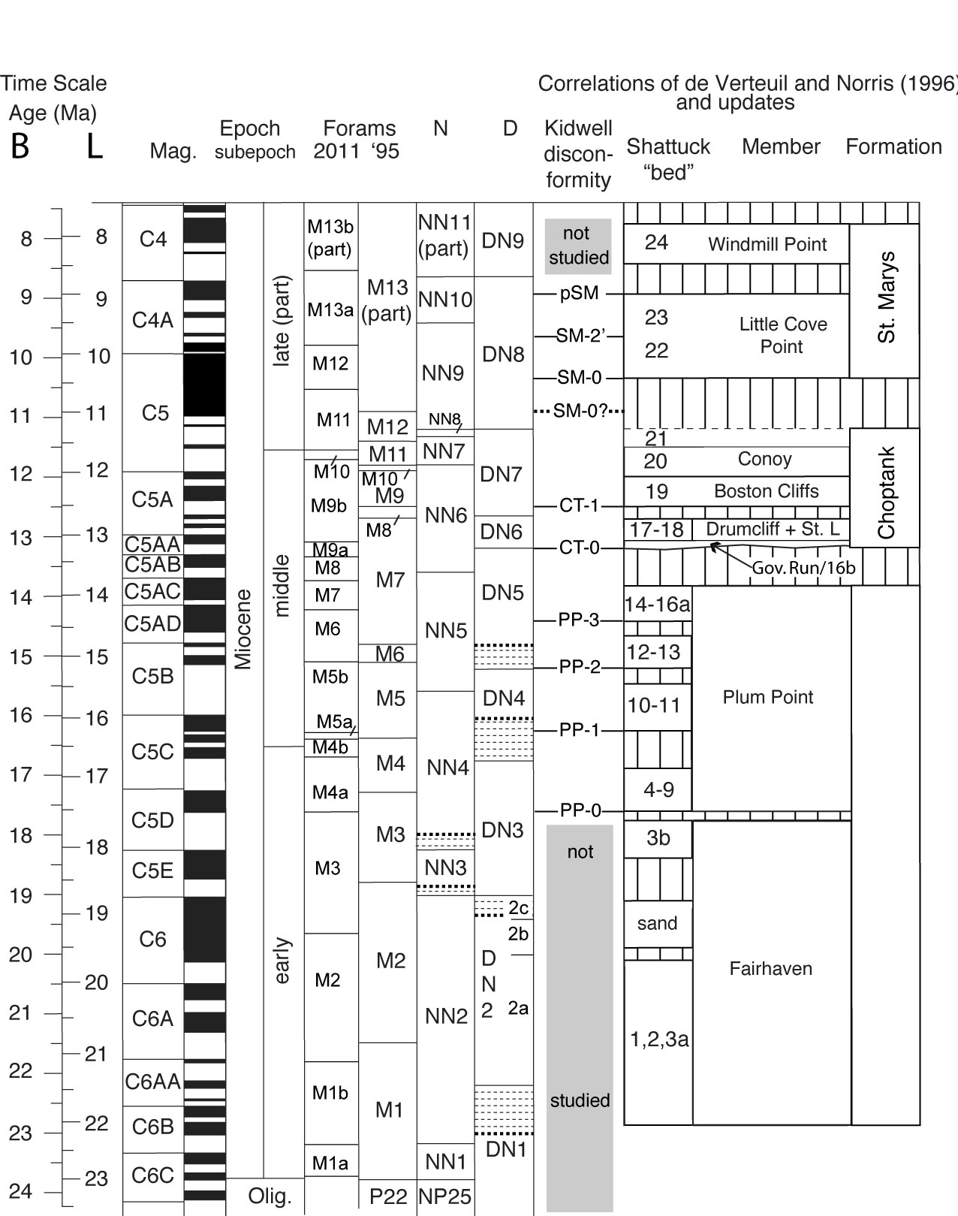
Dinoflagellate Zonation of the Maryland & Virginia Miocene

Slide 7
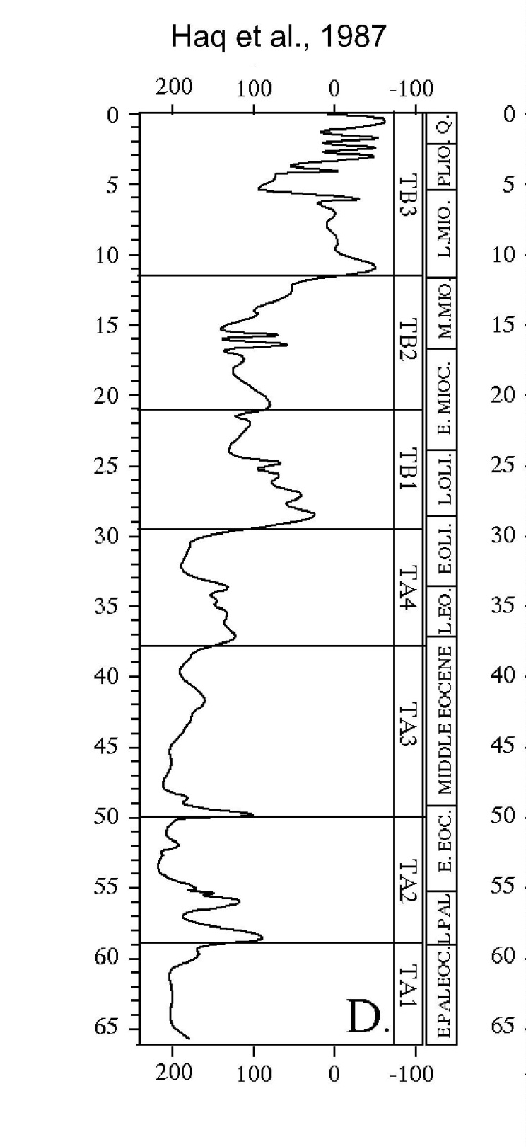
Generalized eustatic sea level curve for the Cenozoic Era
Late Miocene sea levels were much lower than in the middle Miocene

Slide 8
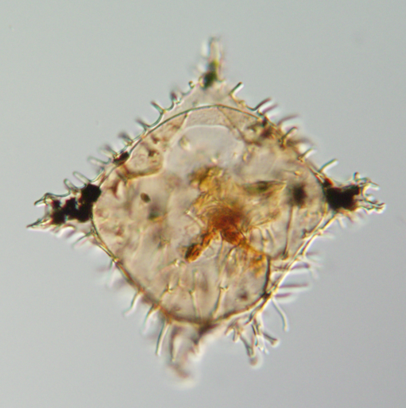
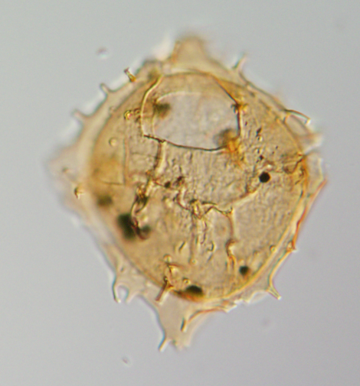
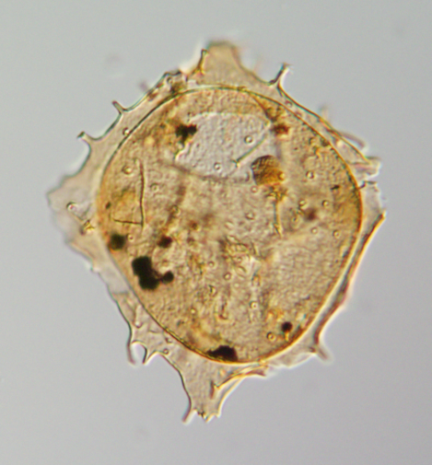
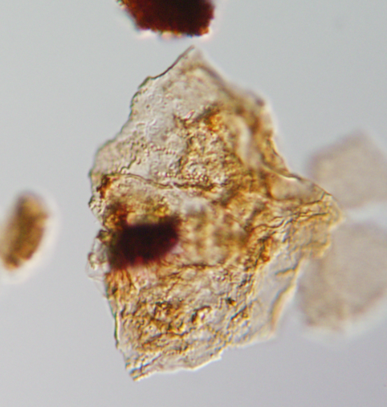
Nanjemoy Formation only
A few obviously reworked pre-Miocene
dinoflagellates also are present
Eocene only
Cretaceous only
20 µm
20 µm
20 µm
Wilsonidium tabulatum
Wetzelielloid
Chatangiella sp.

Slide 9
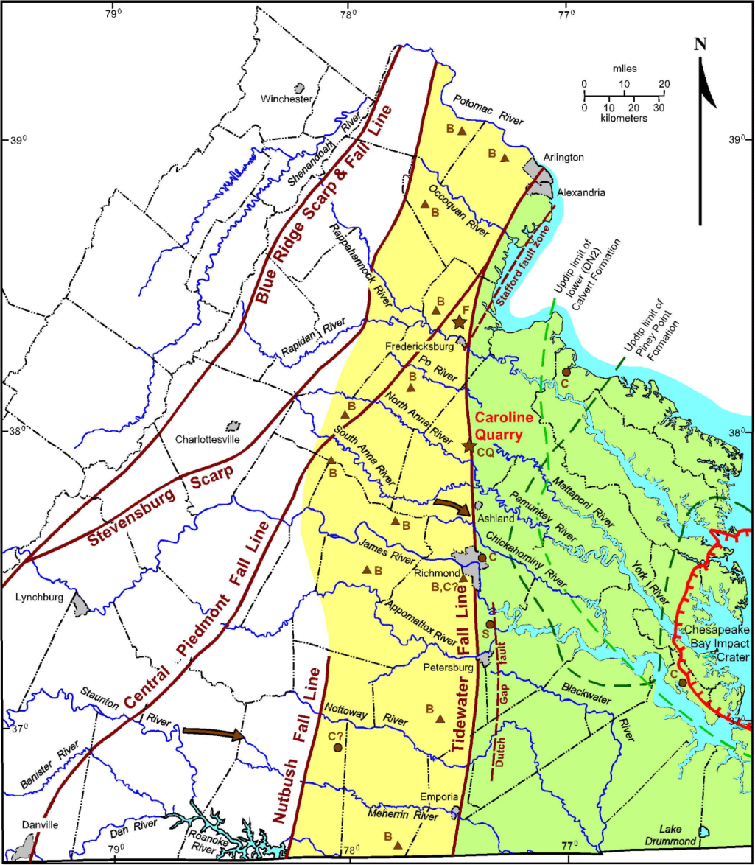
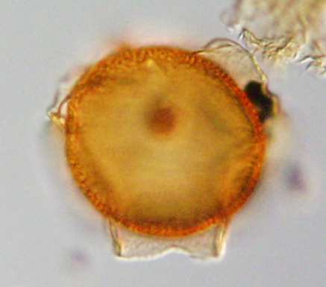
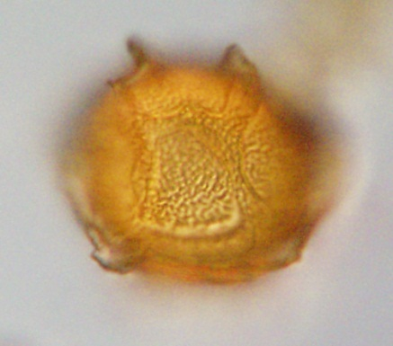
Could the pre-Miocene dinoflagellates be from the Chesapeake Bay impact event?
Pentadinium goniferum, a
robust and common
dinoflagellate in the impact
ejecta, is not found reworked
into the Midlothian marine
Miocene unit. Thus, an ejecta origin seems unlikely.
Pentadinium goniferum

Slide 10
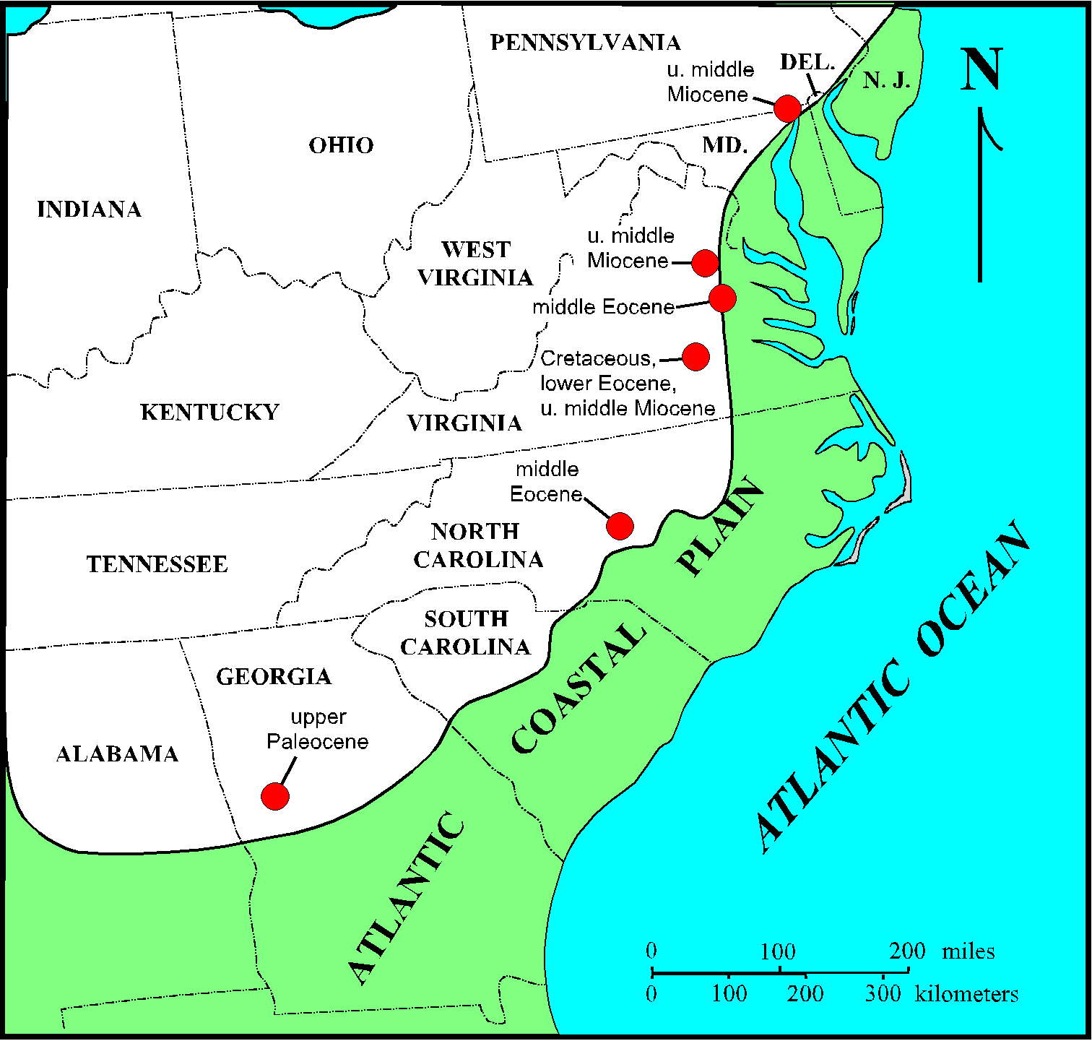
Known Cretaceous, Paleocene, Eocene, and Miocene Piedmont deposits in Georgia, NC,
VA, and MD

Slide 11
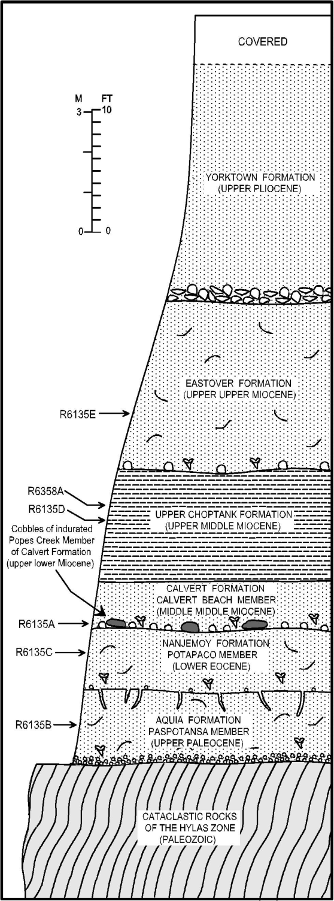
Corrudinium incompositum
Reworked Piney Point dinoflagellates occur in reworked cobbles of lower Calvert Formation (Popes Creek Member) at the base of the upper Calvert Formation, so the Piney Point probably was still present in the eastern Virginia Piedmont until the mid-early Miocene

Slide 12
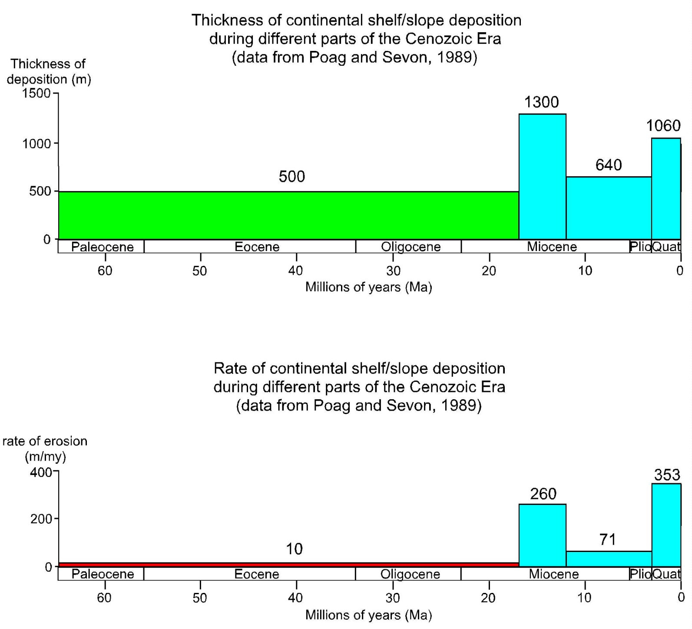

Slide 13

Estimated region of eastern Piedmont covered by Late Cretaceous to mid-Cenozoic transgressions

Slide 14
Conclusions
Dinoflagellates are an invaluable tool for deciphering the former depositional history of the eastern Piedmont
The eastern Piedmont Province in the past has been submerged repeatedly by marine transgressions
The oldest of these transgressions was in the Late Cretaceous
The last transgression was at the end of the middle Miocene (and perhaps the earliest late Miocene?)
Since then, marine submergence of the eastern Piedmont has been prevented due to a combination of tectonic uplift in the Piedmont and a global drop of sea level due mostly to Antarctic glaciation

