Slide 1

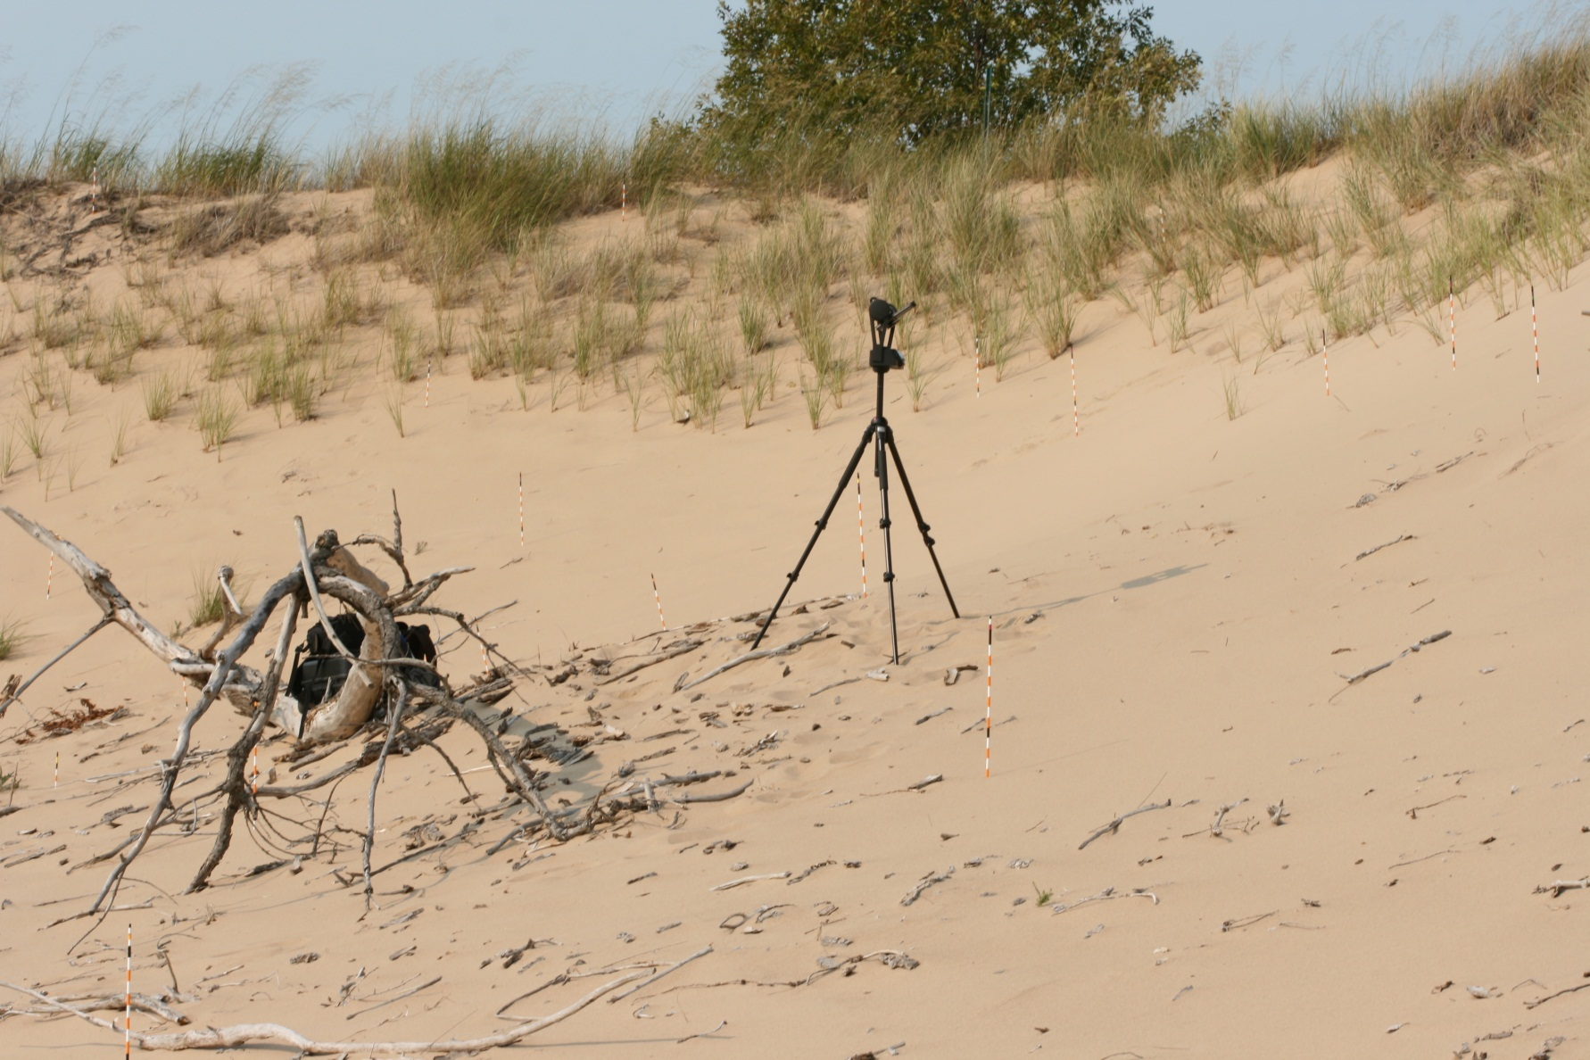
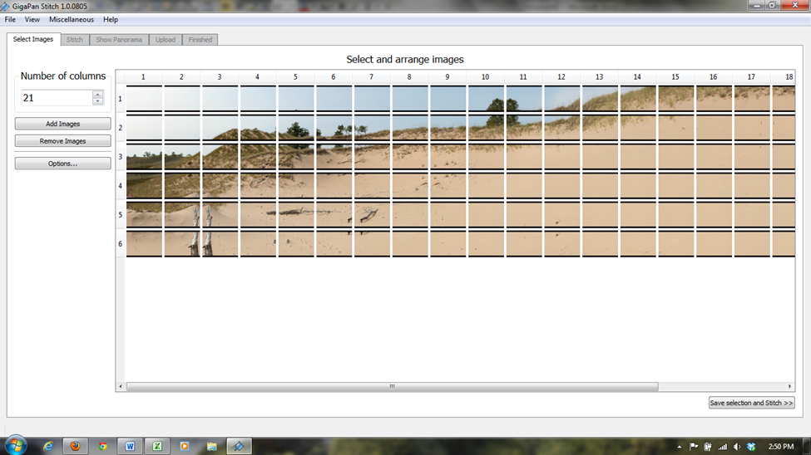
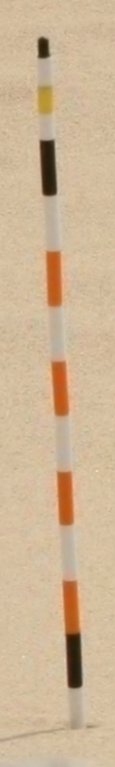
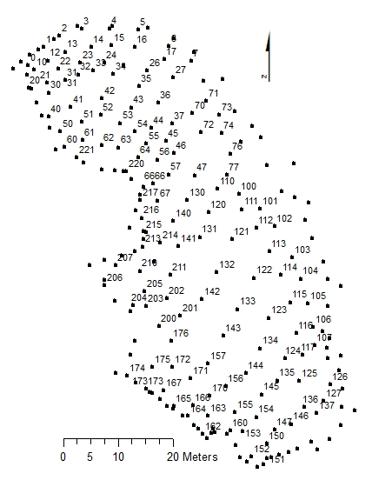
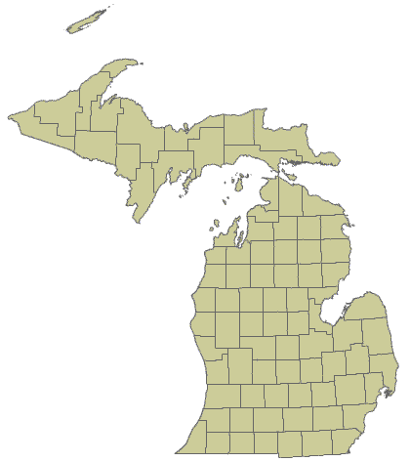
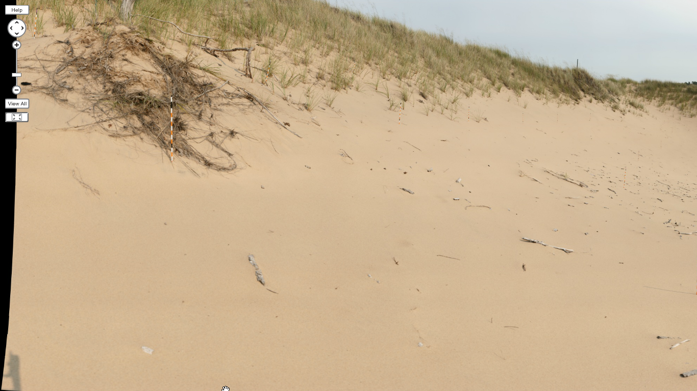
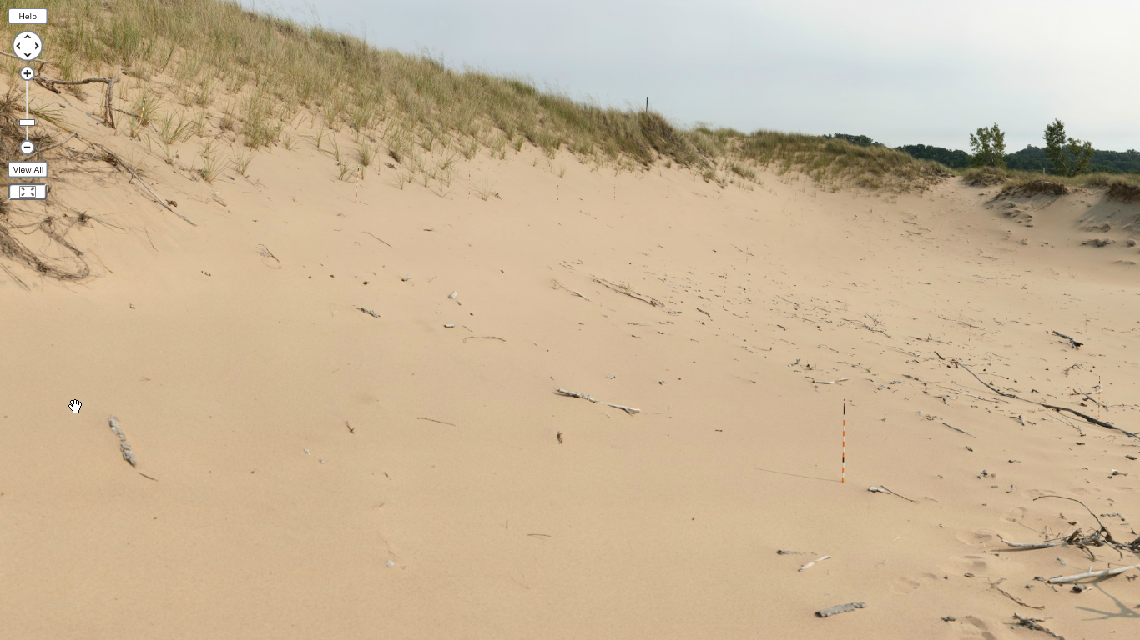
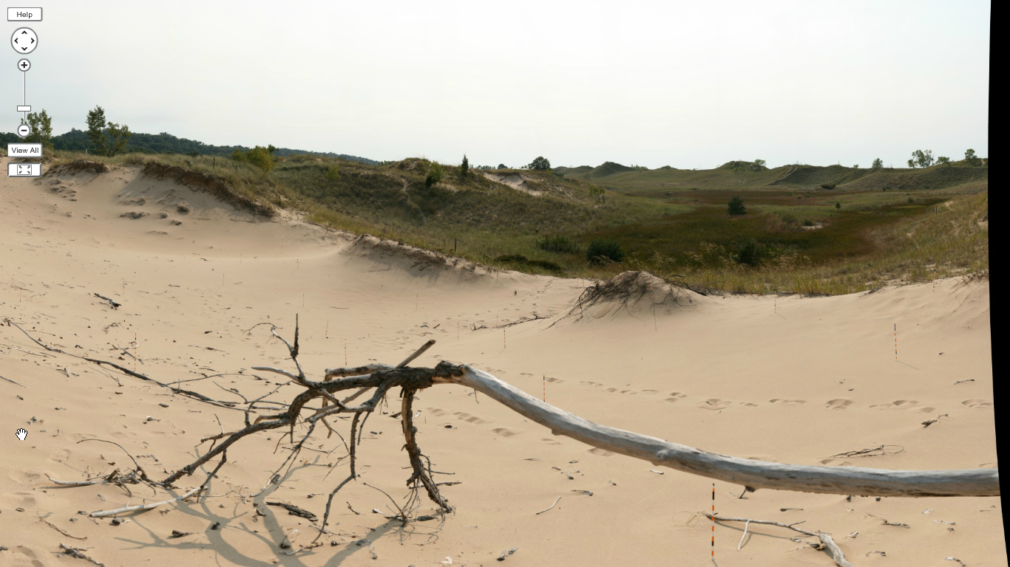
Using GigaPan Measurement of Erosion Pins to Monitor Surface Changes in Sand
Scott T. Cathey, Kara N. Seymour, Nyun P. Hein, and Brian E. Bodenbender
Department of Geological and Environmental Sciences, Hope College, Holland, Michigan
Abstract
Regions of open sand on beaches and active dunes are dynamic yet fragile environments. They can respond dramatically both to natural events such as strong winds or waves and to human incursions such as vehicular or foot traffic, so sand surfaces are difficult to monitor without disturbing them. We use the GigaPan system to make photographic panoramas to unobtrusively measure and document an array of erosion pins in an active dune blowout at the Saugatuck Harbor Natural Area, Saugatuck, Michigan.
The GigaPan system features a robotic camera mount, photo-stitching software, and an on-line web hosting interface. It creates a gigapixel-sized image by merging a series of close-up, overlapping photos (up to 147 in our work, although more are possible) into a single panorama that is uploaded to the GigaPan website. Whereas the final image is too large to display on most personal computers, the website allows zooming in to any part of the panorama to examine details up to the resolution of the original photos. We zoom to view individual erosion pins, then use a screen ruler software tool to measure the exposed length of the pin as scaled to a known distance between marks on the pin. The erosion pins are alternating colored plastic jump rope beads, which provide highly visible, uniform distance increments, epoxied onto 122 cm fiberglass rods.
This method has many advantages over manual measurement of erosion pins. The GigaPan can photograph a scene in less than 15 minutes, speeding up data gathering in the field since measurement is done in the lab. The panorama permanently records the raw data, allowing reexamination of pins, and is spatially organized, allowing quicker reference to specific pins than does sorting through the set of original photos. Most importantly, the method avoids disturbance inherent in manual measurements, which can be quite significant when climbing steep slopes in open sand to measure pins. Data for individual pins may be lost, however, if vegetation or debris obscures the base of a pin in the images, and care must be taken to avoid measuring areas with image distortion if a pin crosses the stitching boundary between photos.
GigaPan camera mount on tripod at camera station in middle of site
Stitching software arranges individual images in preparation for merging into a full panorama.
The GigaPan
The GigaPan is a motorized station for docking a camera to take detailed and accurate panorama portraits of an area. While this is possible to do manually, the GigaPan offers a simpler, more accurate, and less time consuming way to take panorama shots. After an initial set-up to adjust the GigaPan’s settings to the specifics of the camera and lens, all one does mount the camera onto the GigaPan and attach a data cable. To take a panorama, one simply sets the upper left and lower right corners to mark the boundaries of the panorama. From there, the GigaPan automatically adjusts into position to take each image. Our site requires two panoramas (one facing north, the other facing south, taken from camera stations near the center of the blowout) consisting of about 140 photos each. Each set of photos takes less than 15 minutes to acquire. To stitch the individual images together to form a single picture, we input the images into the GigaPan’s photo stitching computer software for processing. From there, one can upload the panorama directly to GigaPan.org, where other people can view the overall panorama as well as zoom in to see details in the image down to the resolution of the original photographs.
We use a 10.1 megapixel Canon Rebel XTi digital single lens reflex camera with a 100 mm macro lens. For typical daylight conditions in the dunes we shoot in manual mode at aperture settings between f8 and f14 with exposure times of 1/100th second. The GigaPan is set with approximately 33% overlap between photos.
GigaPans have been used in the study of Earth and space science primarily for science education, particularly for virtual field trips (e.g. Auer Perry et al., 2011; Neville et al., 2011; Piatek, 2011) or as pre-field trip preparation for undergraduate field research projects (Anderson et al., 2011). GigaPans have been used as part of a program of simulated robotic planetary exploration (Helper et al., 2010), and are seeing increased use as research tools in geological applications. For example, they have been used to examine the shape and orientation of cobbles in outcrops of undeformed conglomerates to test their appropriateness for calibrating finite strain analyses in deformed rocks (Merkhofer et al., 2010), and to correlate strata in rugged terrain (Campbell and Kuster, 2011).
Introduction
Sand in dune environments responds rapidly to environmental changes. Being able to monitor sand movements is important in order to evaluate lakeshore responses to individual weather events and to possible long-term climate change. Data on sand movement are also critical for developing a more nuanced understanding of factors such as wind direction, surface moisture, and slope that affect sand movement as well as more sophisticated models of dune formation. We have developed a method to monitor sand movement in an area by deploying an array of dune pins and then monitoring sand accumulation or removal at the pins photographically.
Survey map of pin array. Unlabeled dots indicate high points in topography surrounding the open sand blowout.
The Pins
In order to track the motion of sand on the dunes, we assembled 500 color-coded, visually distinctive dune erosion pins. We made dune pins suitable for photographic measurement by epoxying alternating colors of 3.8 cm (1.5 in) jump rope beads to 121.9 cm (4 ft) fiberglass rods (1 black, 4 orange alternating with 4 white, 1 black, 4 orange alternating with 4 white, 1 black, and 3 top half-sized beads with colors coded as digits for a unique identification number). Normally, erosion pins do not have to be bright or color coded, but in order to measure them using the GigaPan, the pins need to stand out against the sand easily. We placed 148 pins in the sand at our location.
Study site
Location of Saugatuck Harbor Natural Area
Photo credit: Ted Swoboda
The Location
We set up our experiment in a 30 by 80 m open blowout dune formed at the nose of a larger, east verging, partially vegetated parabolic dune at the Saugatuck Harbor Natural Area, Saugatuck, Michigan. The location is separated from the beach by a well developed foredune ridge, and while surrounded by trails is somewhat sheltered from major human disturbance. The dune that we chose is a large open area of sand, which generally allows unobstructed viewing of our pins.
View of southern half of blowout in the Saugatuck Harbor Natural Area. Image is a 1.023 gigapixel panorama made by stitching 230 images.

Slide 2
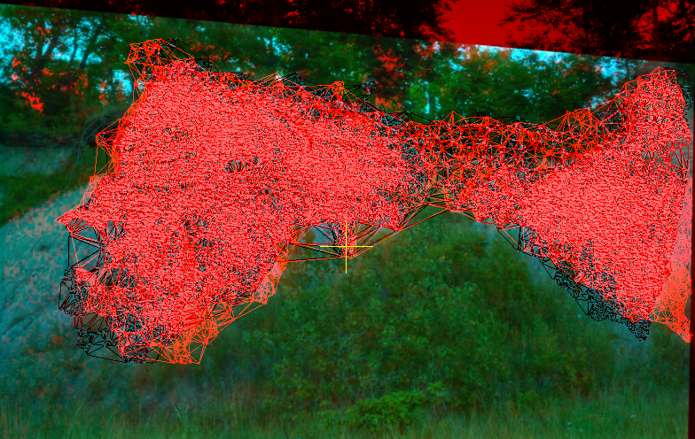
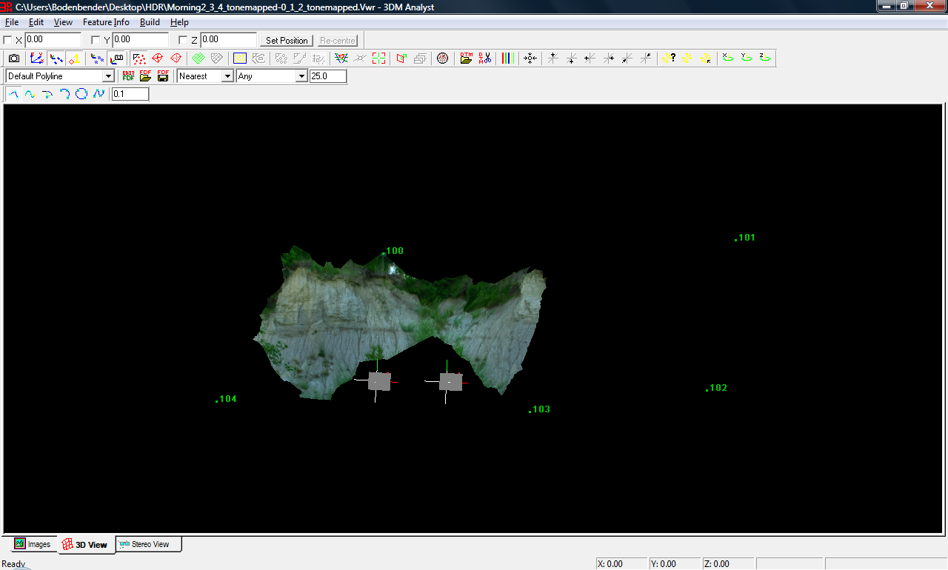
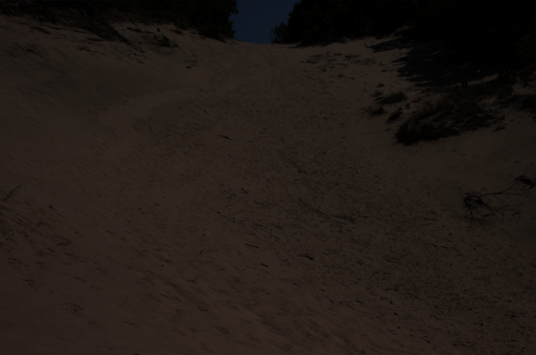
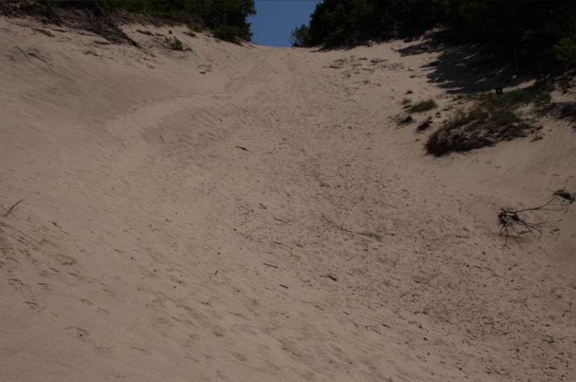
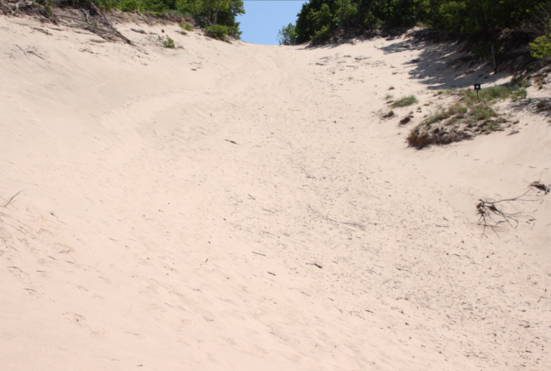
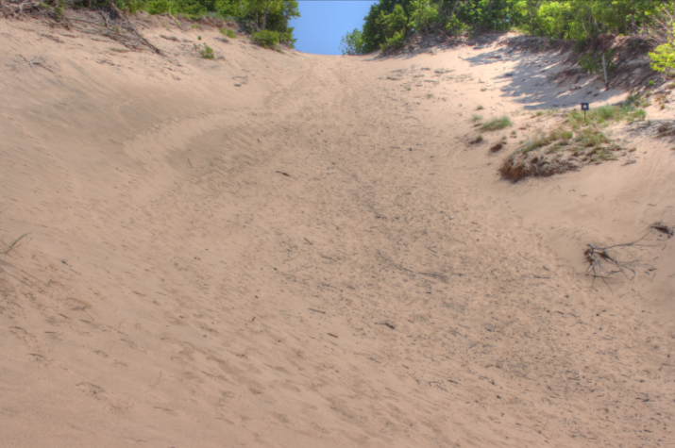
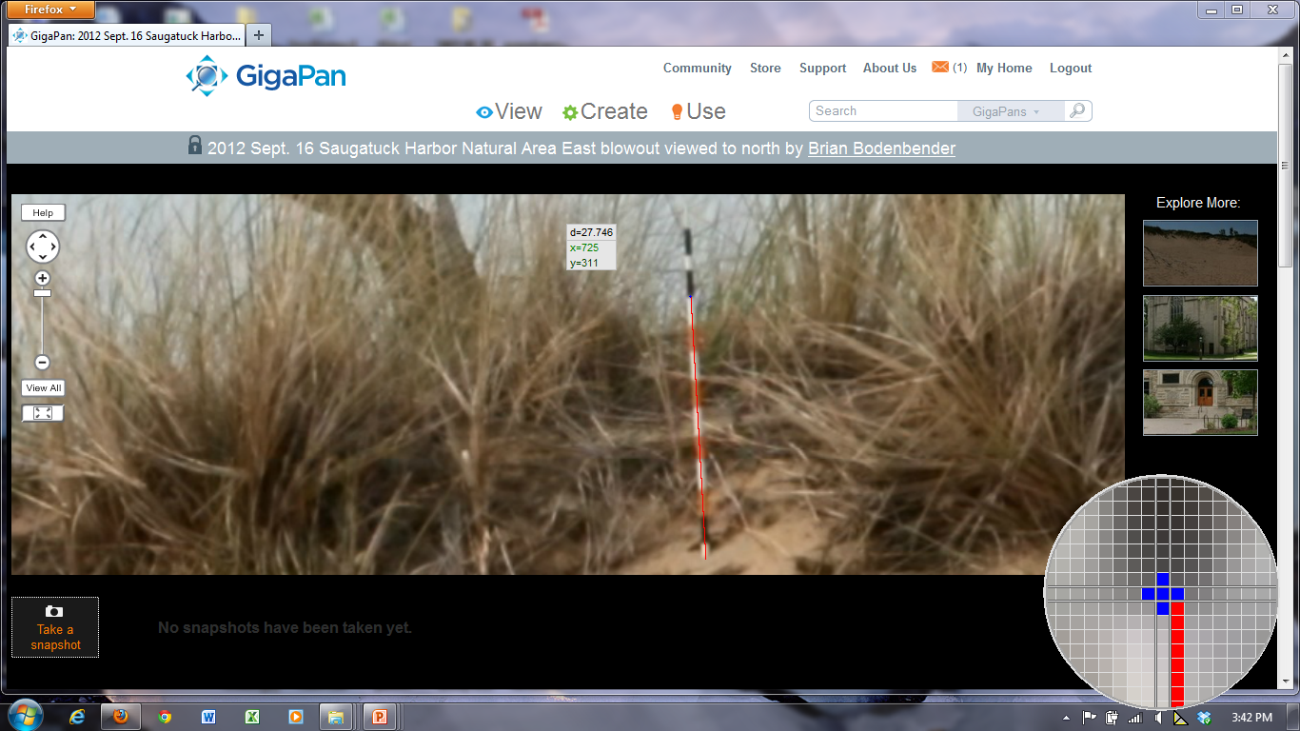
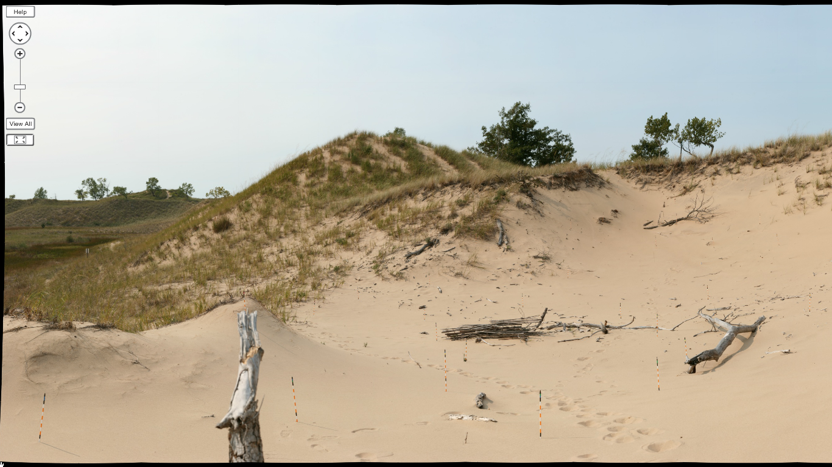
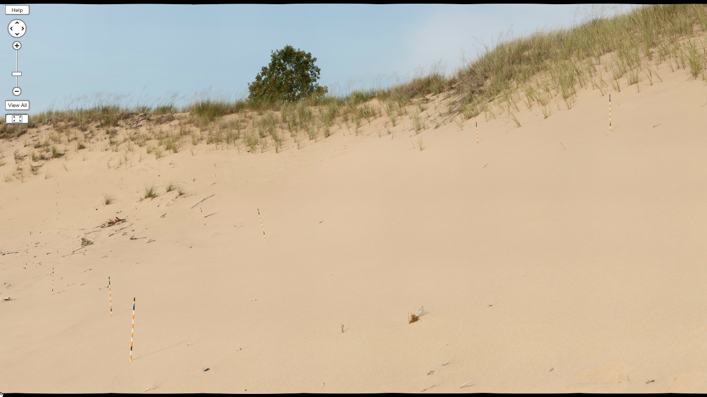
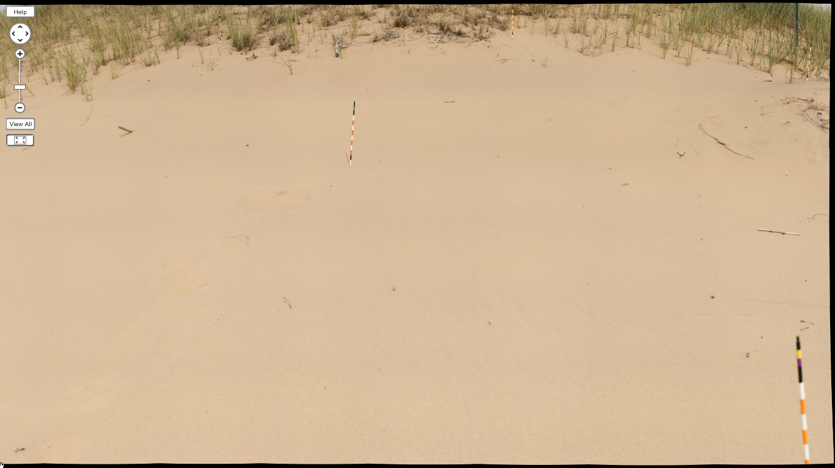
The Measurements
We use an on-screen measurement application (MB-Ruler) to measure the height of a pin from the sand surface to the bottom of the uppermost black bead on the pin, and then measure a known distance between beads on the same pin. We record the measurements in a spreadsheet, and use the known distance to compute the total exposed length of the pin. Comparison with previous measurements at each pin allows us to track sand accumulation and removal across the site.
Sensitivity analyses suggest that for typical measurements, variations of plus or minus one pixel in indicating the starting or ending point of a pin measurement can cause a difference of up to 0.4% in the final calculated length.
Digital Photogrammetry
If the GigaPan is placed at two or more appropriately spaced camera stations at a site, individual photos taken with the GigaPan can be used for close range digital photogrammetry. In digital photogrammetry, computer software matches points in photos of the same scene taken from slightly different viewpoints, and then uses the parallax between matched points to calculate their relative locations in three dimensions, creating a 3D rendering of the surface. One of the photos can be draped over the 3D surface to create a photorealistic computer model of the scene.
The Results
Our main goal in this project was to develop a new method to measure sand accumulation or removal at the base of dune erosion pins. Using the GigaPan, we are successfully able to measure the majority of the pins at the site. This method provides several advantages:
(1) it greatly reduces disturbance of the study site.
Previously, one would go to the field site, walk to each pin, and physically measure it by hand with a meter stick. Not only does this take appreciable time and energy, it also can disturb the sand surface significantly, especially on steep slopes;
(2) housing the panoramas on-line provides a permanent record of the raw data;
(3) housing the panoramas on-line greatly simplifies data management, since the panorama shows the relative position of each pin, so that each can be located quickly and examined at the full resolution of the original photo. This eliminates the difficult task of searching for relevant data in 100–200 individual photos or of managing a large composite photo (our panoramas are about 0.8–1.2 gigapixels in size) on a desktop computer;
(4) fieldwork is more feasible for a single researcher; and
(5) shortened time in the field makes fieldwork more feasible in inclement weather, when conditions might be too cold to spend 3–4 hours making manual measurements.
Several problems, however, may arise with this method:
(1) vegetation may obscure the view to a critical portion of a pin;
(2) a pin may cross the boundary between photographs, where the stitching process has the potential to distort the image and confound measurements;
(3) pins too close to the GigaPan may be out of focus or require many additional photos to be included in a complete panorama; and
(4) some of the colored beads for our pins fade upon UV exposure.
We are still assessing the accuracy of the method. Inter-observer variation in manual measurements yields an average standard deviation of 0.23 cm. Initial on-screen measurements of GigaPan images by users following written instructions yielded an average standard deviation of 0.34 cm, with one observer’s results as outliers relative to other measurements. This suggests that additional training will be necessary to ensure reliable measurements, but omitting the outlier results, the GigaPan measurements had lower standard deviations than manual measurements. The GigaPan method also permits remeasurement of the same pins, to better explore sources of measurement error.
Other Photographic Methods
GigaPan panoramas are one of an array of photographic methods that can be applied to study changes in sand dunes.
3D points and computer model of a shoreline exposure surface
Pole Aerial Photography
Slopes in dune landscapes rarely exceed 30°, so sand surfaces of interest will often be oriented at a shallow angle relative to the line of sight from a camera station. The resulting highly oblique views may make it difficult to capture details across a surface. Increasing the height of the camera above the landscape can improve the viewing angle.
Underexposed photo Normal exposure photo
This can be done with a painter’s pole for a camera alone, but a pole is not sufficiently strong nor stable enough to accommodate a camera mounted on the GigaPan robotic unit. Aerial photography might be combined with GigaPan panoramic photography using a very large, sturdy tripod, but we have not yet attempted this.
Time Lapse Photography
The GigaPan system has built-in functionality for time lapse photography, but as supplied the power supply and hardware are not weatherized nor otherwise optimized for long-term deployment in the field. We have instead developed a weatherproof enclosure for an inexpensive point and shoot camera controlled by CHDK software for use in the dunes.
Overexposed photo HDR photo
High Dynamic Range Photography
High Dynamic Range (HDR) photography combines 3 or more exposures of the same scene to enhance the detail visible in an image. A normal exposure typically optimizes camera settings based on the average light sampled from the scene, but bright areas in the scene may be overexposed and dark areas underexposed. HDR photography accounts for this by additionally taking an underexposed image that can reveal details in brighter areas and an overexposed image that can reveal details in dark areas, then merging the images into a final, more detailed composite image. HDR is particularly effective in bringing out details of normally homogeneous sand surfaces.
The GigaPan system has the ability to do the exposure bracketing required for HDR photography. This was not necessary for our application here but is useful if features of the sand surface, such as ripple marks or exposed cross-laminations, are of particular interest. HDR will increase the time spent in the field, since it requires three times the number of photographs needed for a regular panorama.
Acknowledgments
We thank the Land Conservancy of West Michigan and the City of Saugatuck for access to the study site. We also thank the Michigan Space Grant Consortium and donors to the Holleman Geology and Environmental Sciences Student Research Fund, the Smies Geology Student Research Fund, and the Ver Hey Geology Summer Research Fund at Hope College for support of this project.
References
Anderson, Jennifer L. B., William Lee Beatty, Candace L. Kairies Beatty, and Holly A. S. Dolliver. 2011. Interdisciplinary investigation of crater-related deposits in the Upper Midwest using GigaPan technologies. Geological Society of America Abstracts with Programs 43 (5): 623.
Auer Perry, Sara, Christine Besemer Whitaker, Don Duggan-Haas, Richard A. Kissel, and Robert M. Ross. 2011. Falls & fossils: A model virtual field experience focusing on Taughannock Falls State Park, NY. Geological Society of America Abstracts with Programs 43 (1): 157.
Campbell, Carl E., and Kuster, Stephanie. 2011. GigaPaning in Montana's Hell Creek Formation. Geological Society of America Abstracts with Programs 43 (5): 478.
Merkhofer, Lisa, Paul Karabinos, and Chris Warren. 2010. Preferred orientation of cobbles and boulders in unstrained alluvial fan deposits: Implications for Rf-Φ analysis of deformed conglomerates. Geological Society of America Abstracts with Programs 42 (5): 422.
Neville, Sara, Labanya Mookerjee, and Laura Guertin. 2011. Uses of existing GigaPan images in the Earth and space science classroom. Geological Society of America Abstracts with Programs 43 (1): 79.
Piatek, Jennifer L. 2011. Utilizing high resolution panoramas as virtual field experiences in undergraduate planetary science courses. Abstracts of Papers Submitted to the Lunar and Planetary Science Conference 42. Abstract no. 1796. http://www.lpi.usra.edu/meetings/lpsc2011/pdf/1796.pdf
View of northern half of blowout in the Saugatuck Harbor Natural Area. Image is a 0.715 gigapixel panorama made by stitching 126 images.

