Slide 1


Determining a PROXY for Sediment Oxygen Demand of Coastal Estuaries
Erin Anderson¹, Karen McNeal¹, Mel Parsons², Sandra Ortega-Achury³, Curry Templeton¹, Alon Blakeney⁴, Jonathon Geroux¹
¹Department of Geosciences, Mississippi State University, PO BOX 5448, Mississippi, 39762
² USEPA Region 4 Science & Ecosystems Support Div., 980 College Station Road, Athens, GA 30605-2720
³Department of Civil and Environmental Engineering, Mississippi State University, PO Box 9546, Mississippi, 39762
⁴Department of Biology, Mississippi State University, PO Box 9536, Mississippi, 39762
This material is based upon work supported by the National Science Foundation under Grant No. DGE-0947419 and the USEPA under Grant No. AE83604801at Mississippi State University. Any opinions, findings, and conclusions or recommendations expressed in this material are those of the author(s) and do not necessarily reflect the views of the National Science Foundation and the USEPA.

Slide 2
Sediment Oxygen Demand
SOD = O₂ used by biological + chemical processes

Slide 3
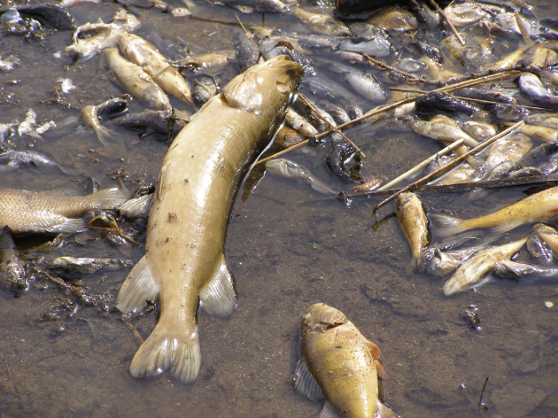
High SOD + Low O₂ =
http://apps.startribune.com/blogs/user_images/fdsmith_1332283277_1fishkill0321.jpg

Slide 4
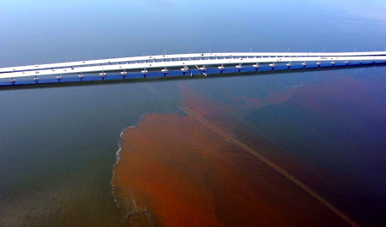
High SOD + Low O₂ =
http://www.tampabay.com/multimedia/archive/00188/clwbloom082711_188617c.jpg

Slide 5
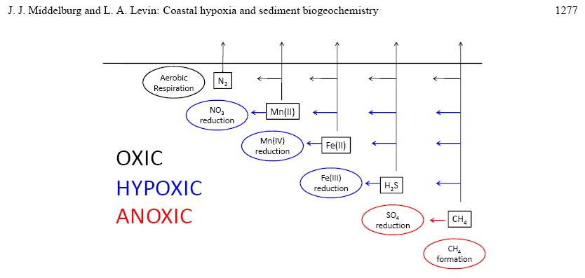
Microbial Metabolisms

Slide 6
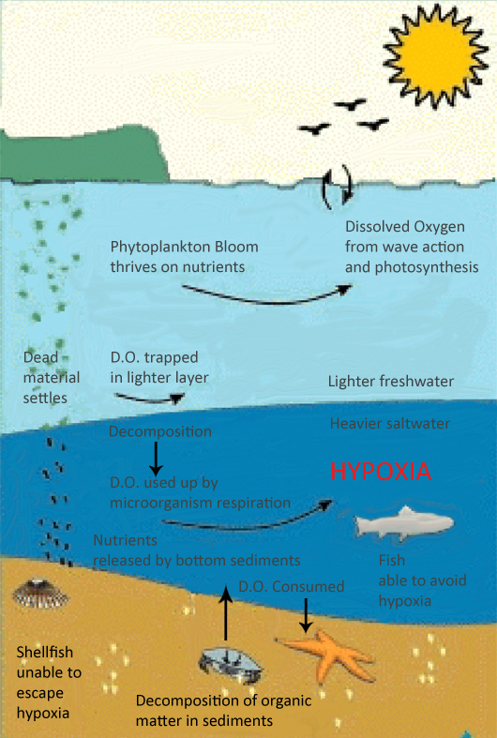
Biological SOD
Non-ubiquitous O₂ circulation
Decomposition and Respiration still occurring
Low O₂ levels cause death, continuing decomposition
http://njscuba.net/zzz_biology/low_oxy_evnt_1.gif
Notes:
For both bio and chem SOD environments, the amount of oxygen in the porewater is controlled by the decomposition of organic matter by heterotrophs.

Slide 7
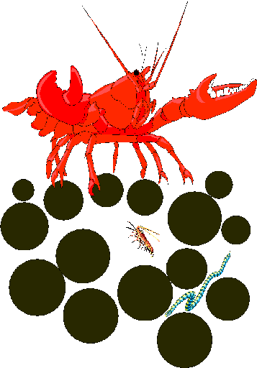
Chemical Sediment Oxygen Demand
Water current
Gas bubbles
Fe(OH)₂
Mn(OH)₃
Fe (II)
Mn (II)
Fe (II)
Mn (II)
Notes:
When any kind of benthic macrofauna stirs of sediments containing anoxic porewaters, transition metals can be released into the oxic zone and precipitate as metal hydroxides. Through subsequent burial, the metal hydroxides are surrounded by anoxic porewaters and reduce back into Fe (II) and Mn (II). Also, sediment resuspension can cause nutrients and contaminants to be re-released into the water column.

Slide 8
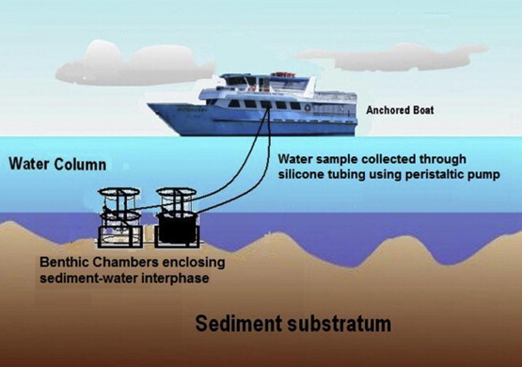
http://www.sciencedirect.com/science/article/pii/S0141113612001043
Notes:
Besides, being arduous and time-consuming, a good resolution of the studied bay is basically unachievable due to travel budget and travel time constraints.

Slide 9
Research Questions
Can we estimate SOD
without benthic oxygen
chambers?

Slide 10
Research Questions
Can we estimate SOD
without benthic oxygen
chambers?
2. Can geochemical measurements in the water column and porewater give an accurate prediction of SOD?

Slide 11
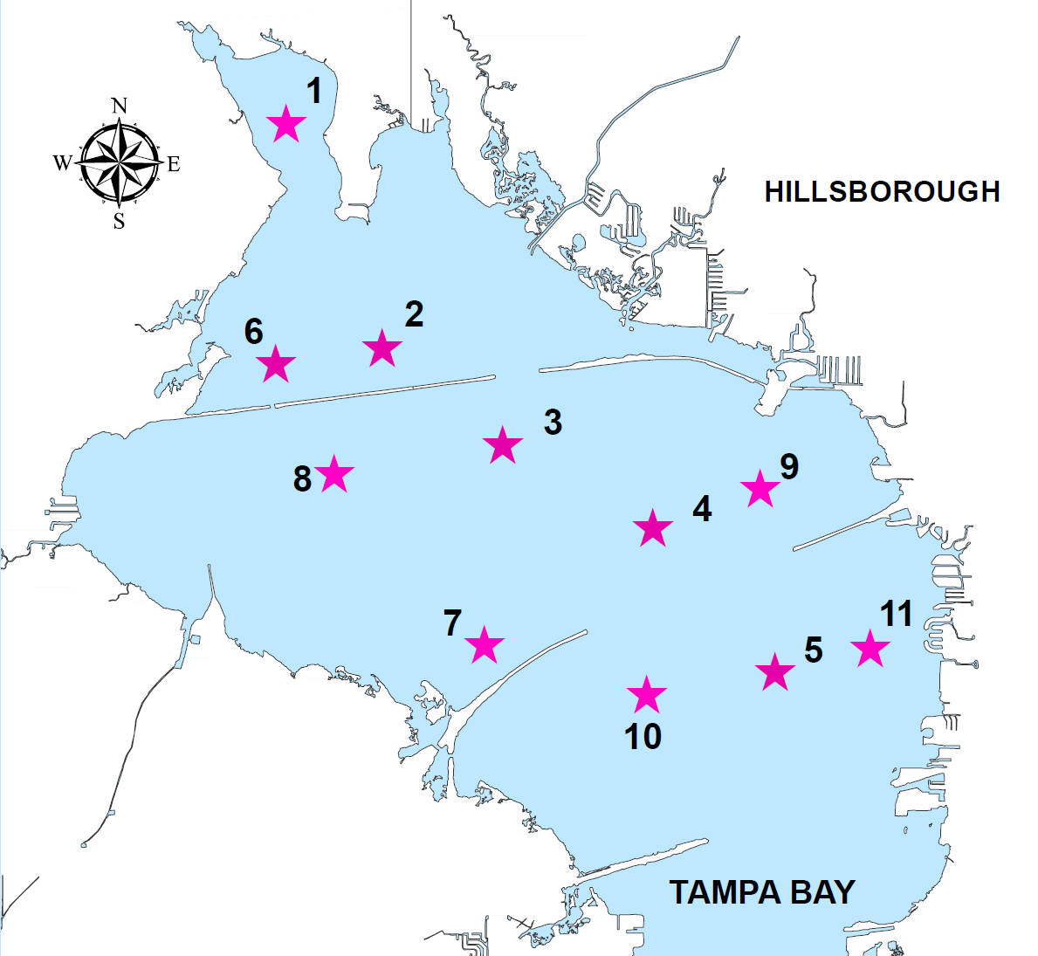
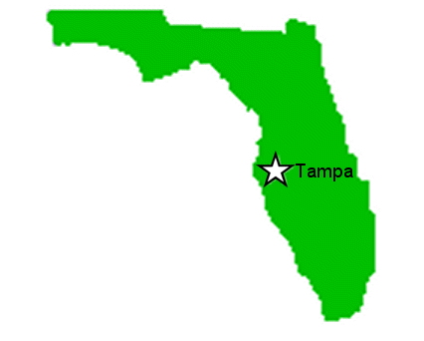

Slide 12
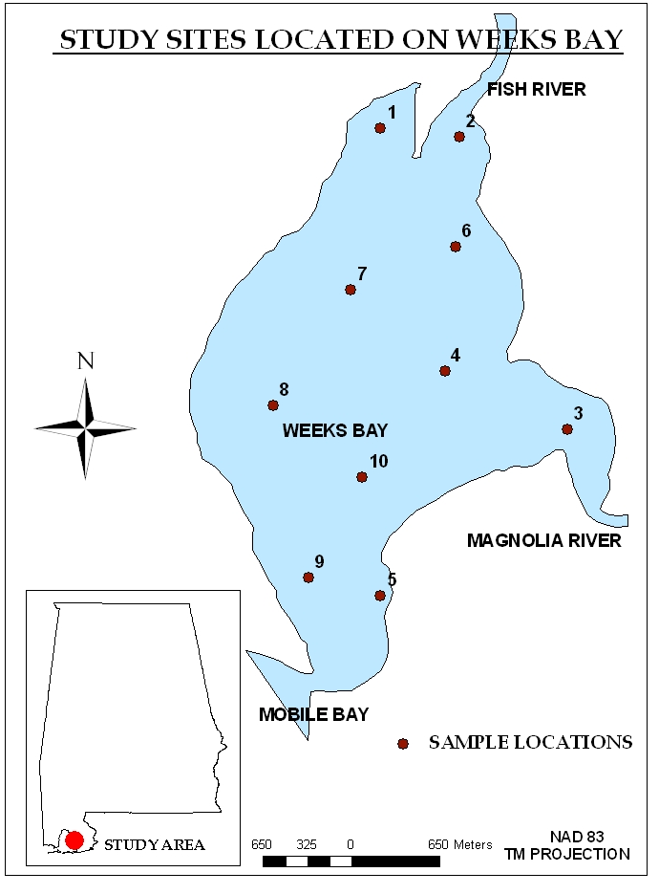
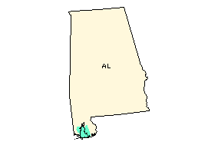

Slide 13
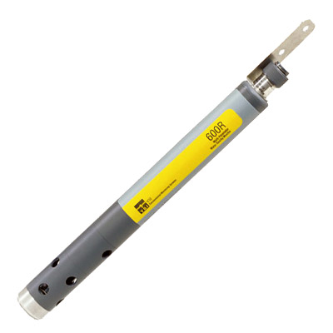

Water Column
pH
Eh
Temperature
DO
http://www.envcoglobal.com/files/MO-YSI-600R.jpg

Slide 14
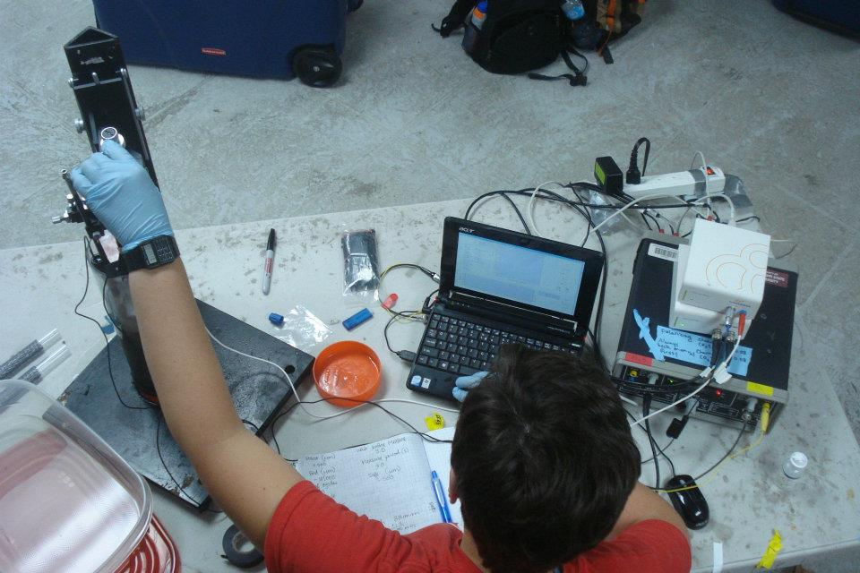
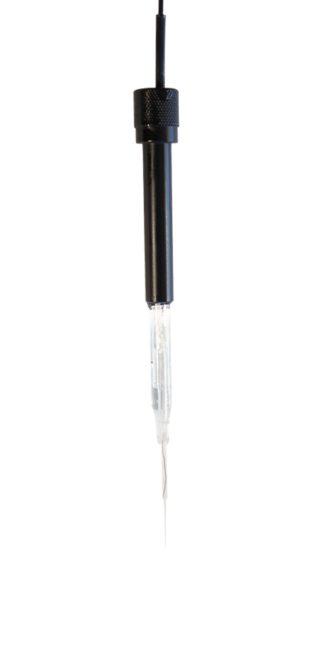
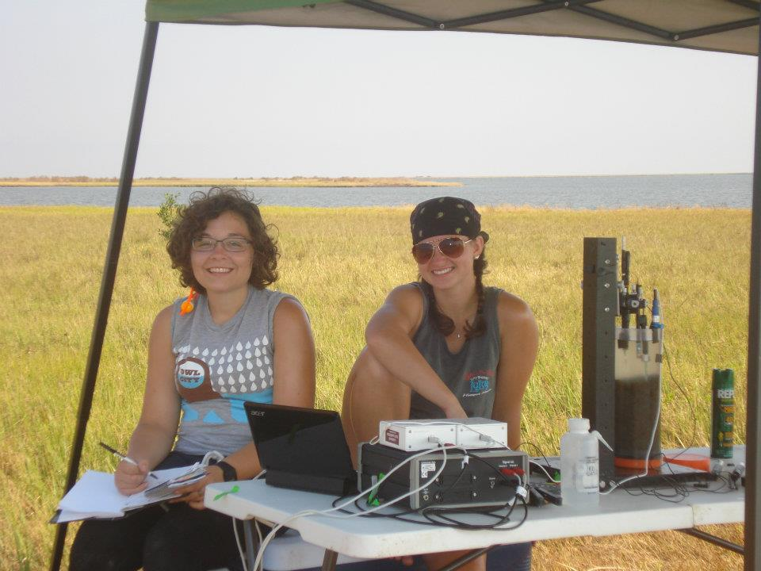
Porewater
Eh
pH
Oxygen
Sulfide
http://www.unisense.com/files/Images/Sensorbilleder/PH-100_900x430.jpg

Slide 15
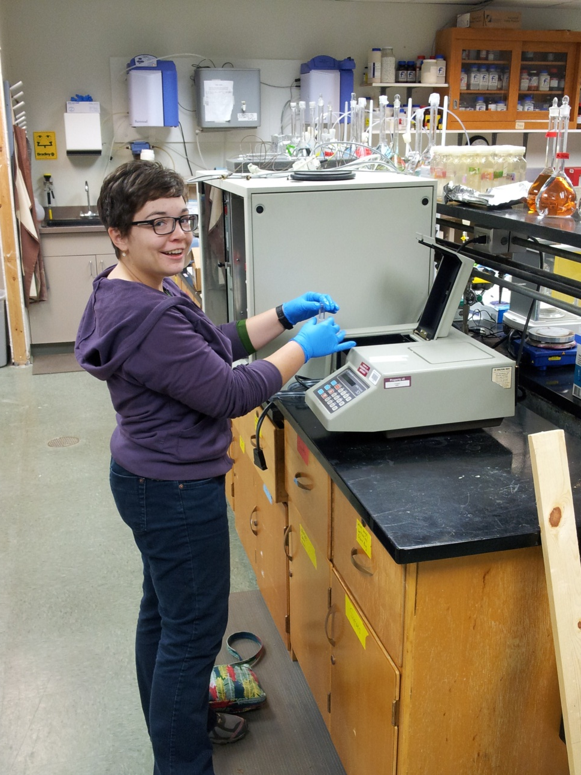
Porewater
Aluminum
Iron
Manganese
Sulfide

Slide 16
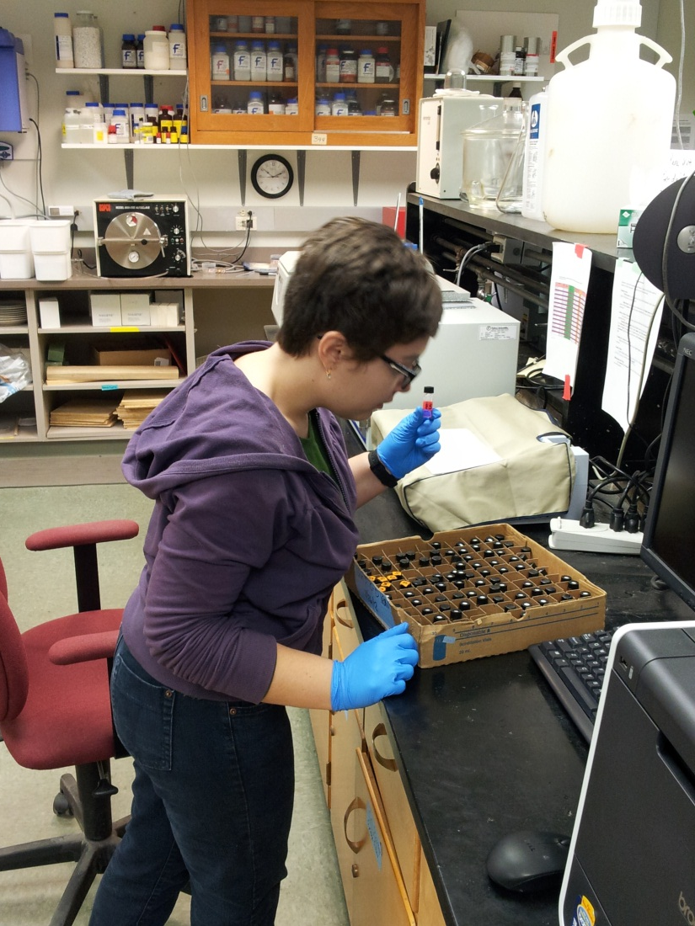
Sediment
Short-Term (C-D) Reactive Iron
Long-Term (HCl) Reactive Iron
Notes:
Cold .5M HCl Method(Reactive solid phase Fe oxides and some Fe silicates) (Long term diagenesis)
Citrate Dithionite Method(Reactive solid phase Fe oxides and little Fe silicates)(Short term diagenesis)

Slide 17
Water Column Data
Tampa Bay
Weeks Bay
Notes:
Weeks Bay is shallower than Tampa Bay! Mention sediment cross section displayed by graph.

Slide 18
Porewater Data
Tampa Bay
Weeks Bay
Consistent graphs!

Slide 19
Porewater Data
Consistent graphs!
Tampa Bay
Weeks Bay

Slide 20
Porewater Data
Tampa Bay
Weeks Bay

Slide 21
Solid-Phase Reactive Iron
Tampa Bay
Weeks Bay

Slide 22
Tampa & Weeks PCA
Eigenvalues > 1
Factor | Component 1 (49.89 %) | Component 2 (39.79%)
SOD | -.150 | -.741
H2S_core | .664 | .734
pH_core | -.926 | -.184
O2_core | .889 | .413
Eh_core | .429 | .818
Fe_PW | .189 | .910
CD_Fe | .892 | .398
HCl_Fe | .876 | .456
H2S_OW | .704 | .684
O2_OW | .262 | .941
Eh_OW | -.625 | -.704
pH_OW | -.899 | -.401
Temp | -.909 | -.090
*
*
Notes:
% variance, star equals significant . Principal Components Analysis is not based on the idea that there are underlying factors that are being measured. It is simply a technique for reducing the number of variables by finding a linear combination of variables that explains the variance in the original variables.

Slide 23
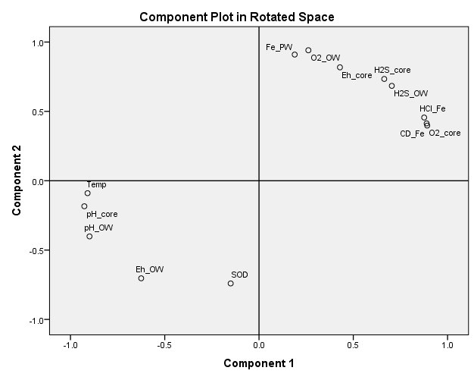
Key
WC = Water Column
PW = Porewater
Core = porewater
Component Plot in Rotated Space
O2_OW
Fe_PW
Eh_core
H2S_core
H2S_OW
HCl Fe
O2_core
CD_Fe
Component 2
Component 2
Temp
pH_PW
pH_OW
Eh_OW
SOD
Component 1
Component 1
Notes:
Fix key, gray out unimportant factors

Slide 24
Key
WC = Water Column
PW = Porewater
Core = porewater
Component Plot in Rotated Space
Fe_PW
O2_OW
O2_OW
Fe_PW
Eh_core
H2S_core
Eh_core
H2S_OW
H2S_OW
H2S_core
HCl Fe
HCl Fe
O2_core
O2_core
CD_Fe
CD_Fe
Component 2
Temp
Temp
pH_PW
pH_PW
pH_OW
pH_OW
Eh_OW
Eh_OW
SOD
SOD
Component 1

Slide 25
Conclusion & Future Goals
Preliminary data suggest an easier indirect proxy to estimate SOD exists
Why do certain factors fluctuate with SOD?
Which proxies consistently fluctuate with SODs in SEUS estuaries?
Can we build and validate a diagenesis model, using an empirical model based on the Chesapeake Bay Sediment Flux Model for SOD estimation?

Slide 26
Acknowledgements
Erin Anderson ela52@msstate.edu
NSF GK 12 Project Grant No. DGE-0947419
USEPA under Grant No. AE83604801
A.D.’s camera skills

