Slide 1
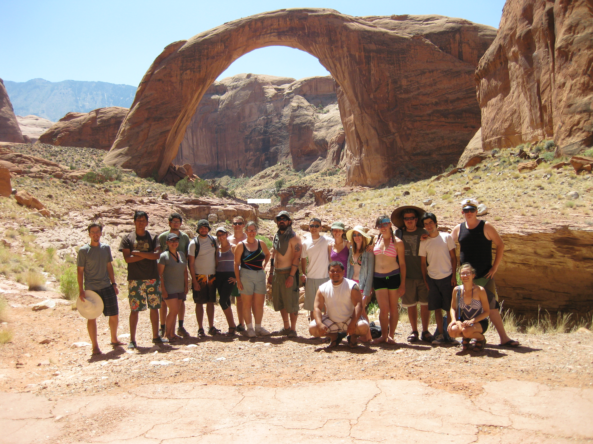
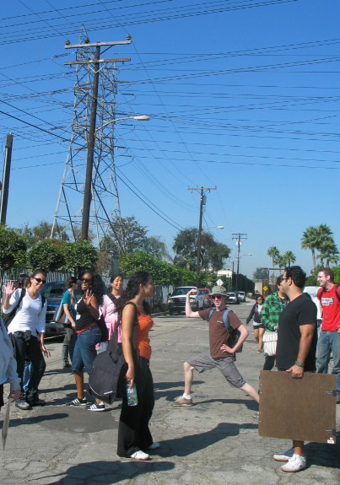
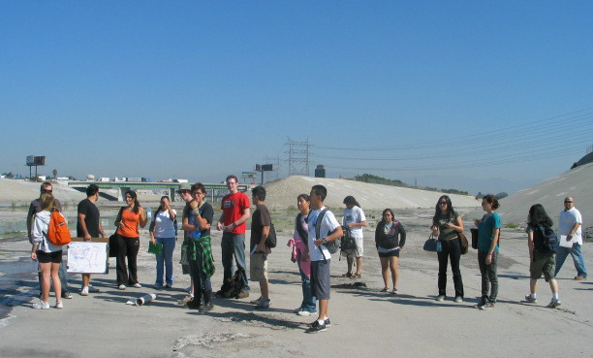
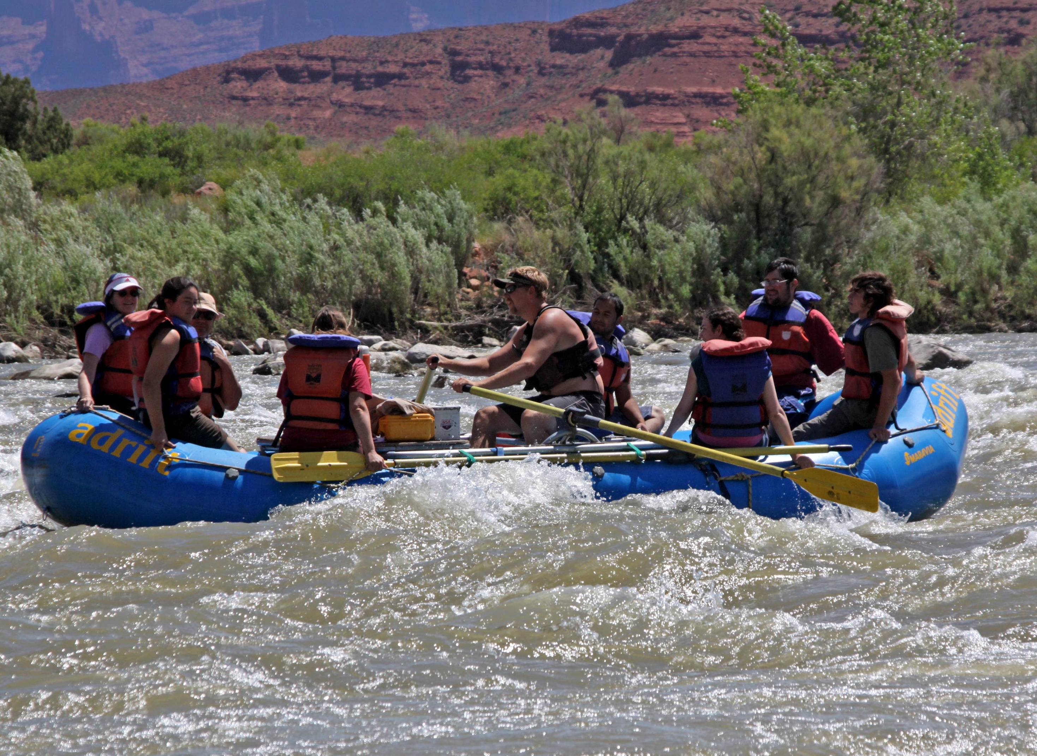
Stimulating Interest of Non-science Majors with Course Activities that are Relevant to Their Own Surroundings and Lives
Elizabeth Nagy-Shadman
Pasadena City College, California
Elizabeth Nagy-Shadman
Pasadena City College, California

Slide 2
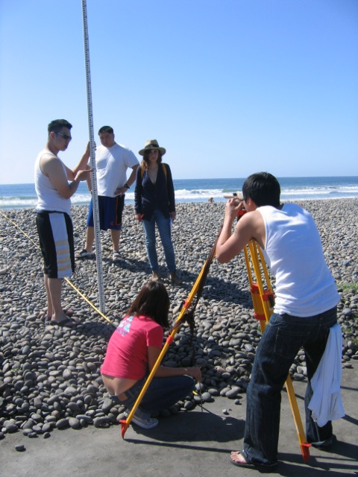
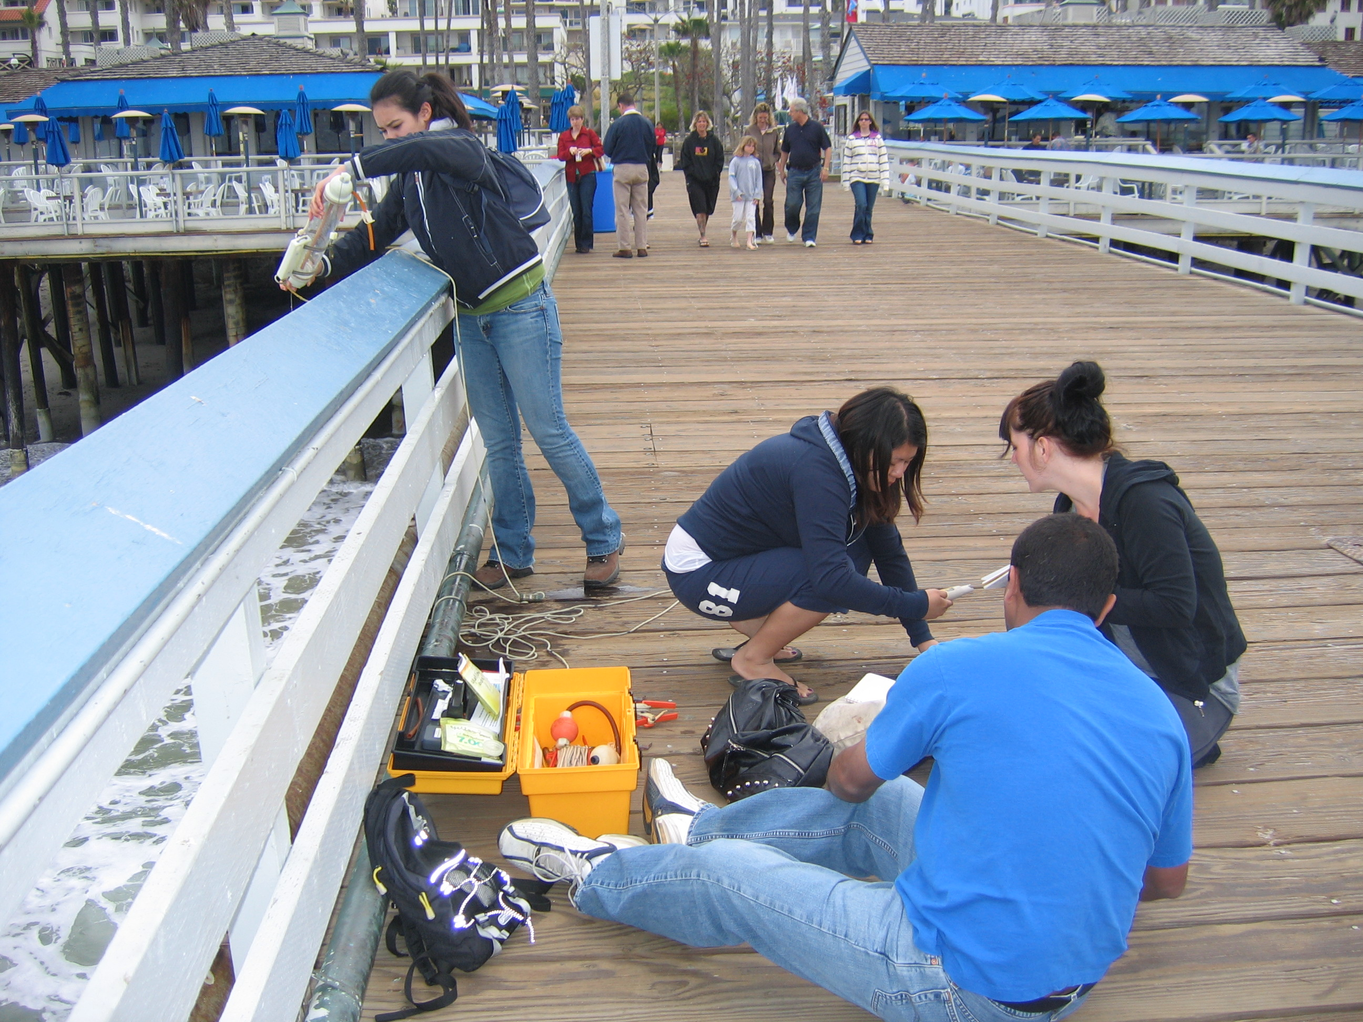
Introductory geoscience courses…
…serve as opportunities to stimulate interest in the geosciences
…provide the opportunity to identify potential majors and promote the major
…generally serve a large number of students who may never again take a geoscience course
…improve geoscience literacy in the general public

Slide 3

Geoscience Literacy
NSF-funded document
written, evaluated, shaped, and revised by the top scientists working in Earth science.
establishes the “Big Ideas” and supporting concepts that all Americans should know about Earth sciences
www.earthscienceliteracy.org

Slide 4
Geoscience Literacy “Big Ideas”
Earth scientists use repeatable observations and testable ideas to understand and explain our planet.
Earth is continuously changing.
Humans depend on Earth for resources.
Natural hazards pose risks to humans.
- Hazardous events can be sudden or gradual.
- Natural hazards can be local or global in origin.
www.earthscienceliteracy.org

Slide 5
Many incoming non-science majors “dread” science classes
Informal first-day polls from introductory geology courses at Pasadena City College:
“Do you like/dislike science? Why?”
Many students enter these courses with a negative attitude towards science:
science is boring
too hard
too quantitative
requires too much memorization
It is not uncommon for students to express doubt, anxiety, and even fear about successfully completing these introductory level courses.

Slide 6
One way to alleviate the “dread” is to emphasize direct connections between course topics and the students’ own lives
Earth science is relevant to their…
lives,
jobs,
family,
hobbies, and
future.
Increasing demands for limited resources
Ocean acidification
Energy resources
Local water quality
Global warming: fact or fiction?
Understanding natural hazards

Slide 7
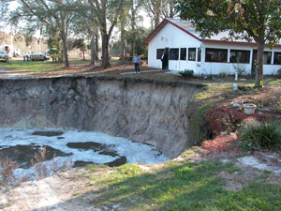
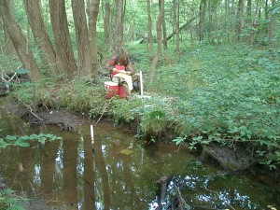
Examples of opportunities that can make connections between geoscience topics and students’ own interests:
Local geologic structures
Local hydrology
Local institutions/museums/industries
Classroom activities that touch on topics relevant to students’ lives

Slide 8
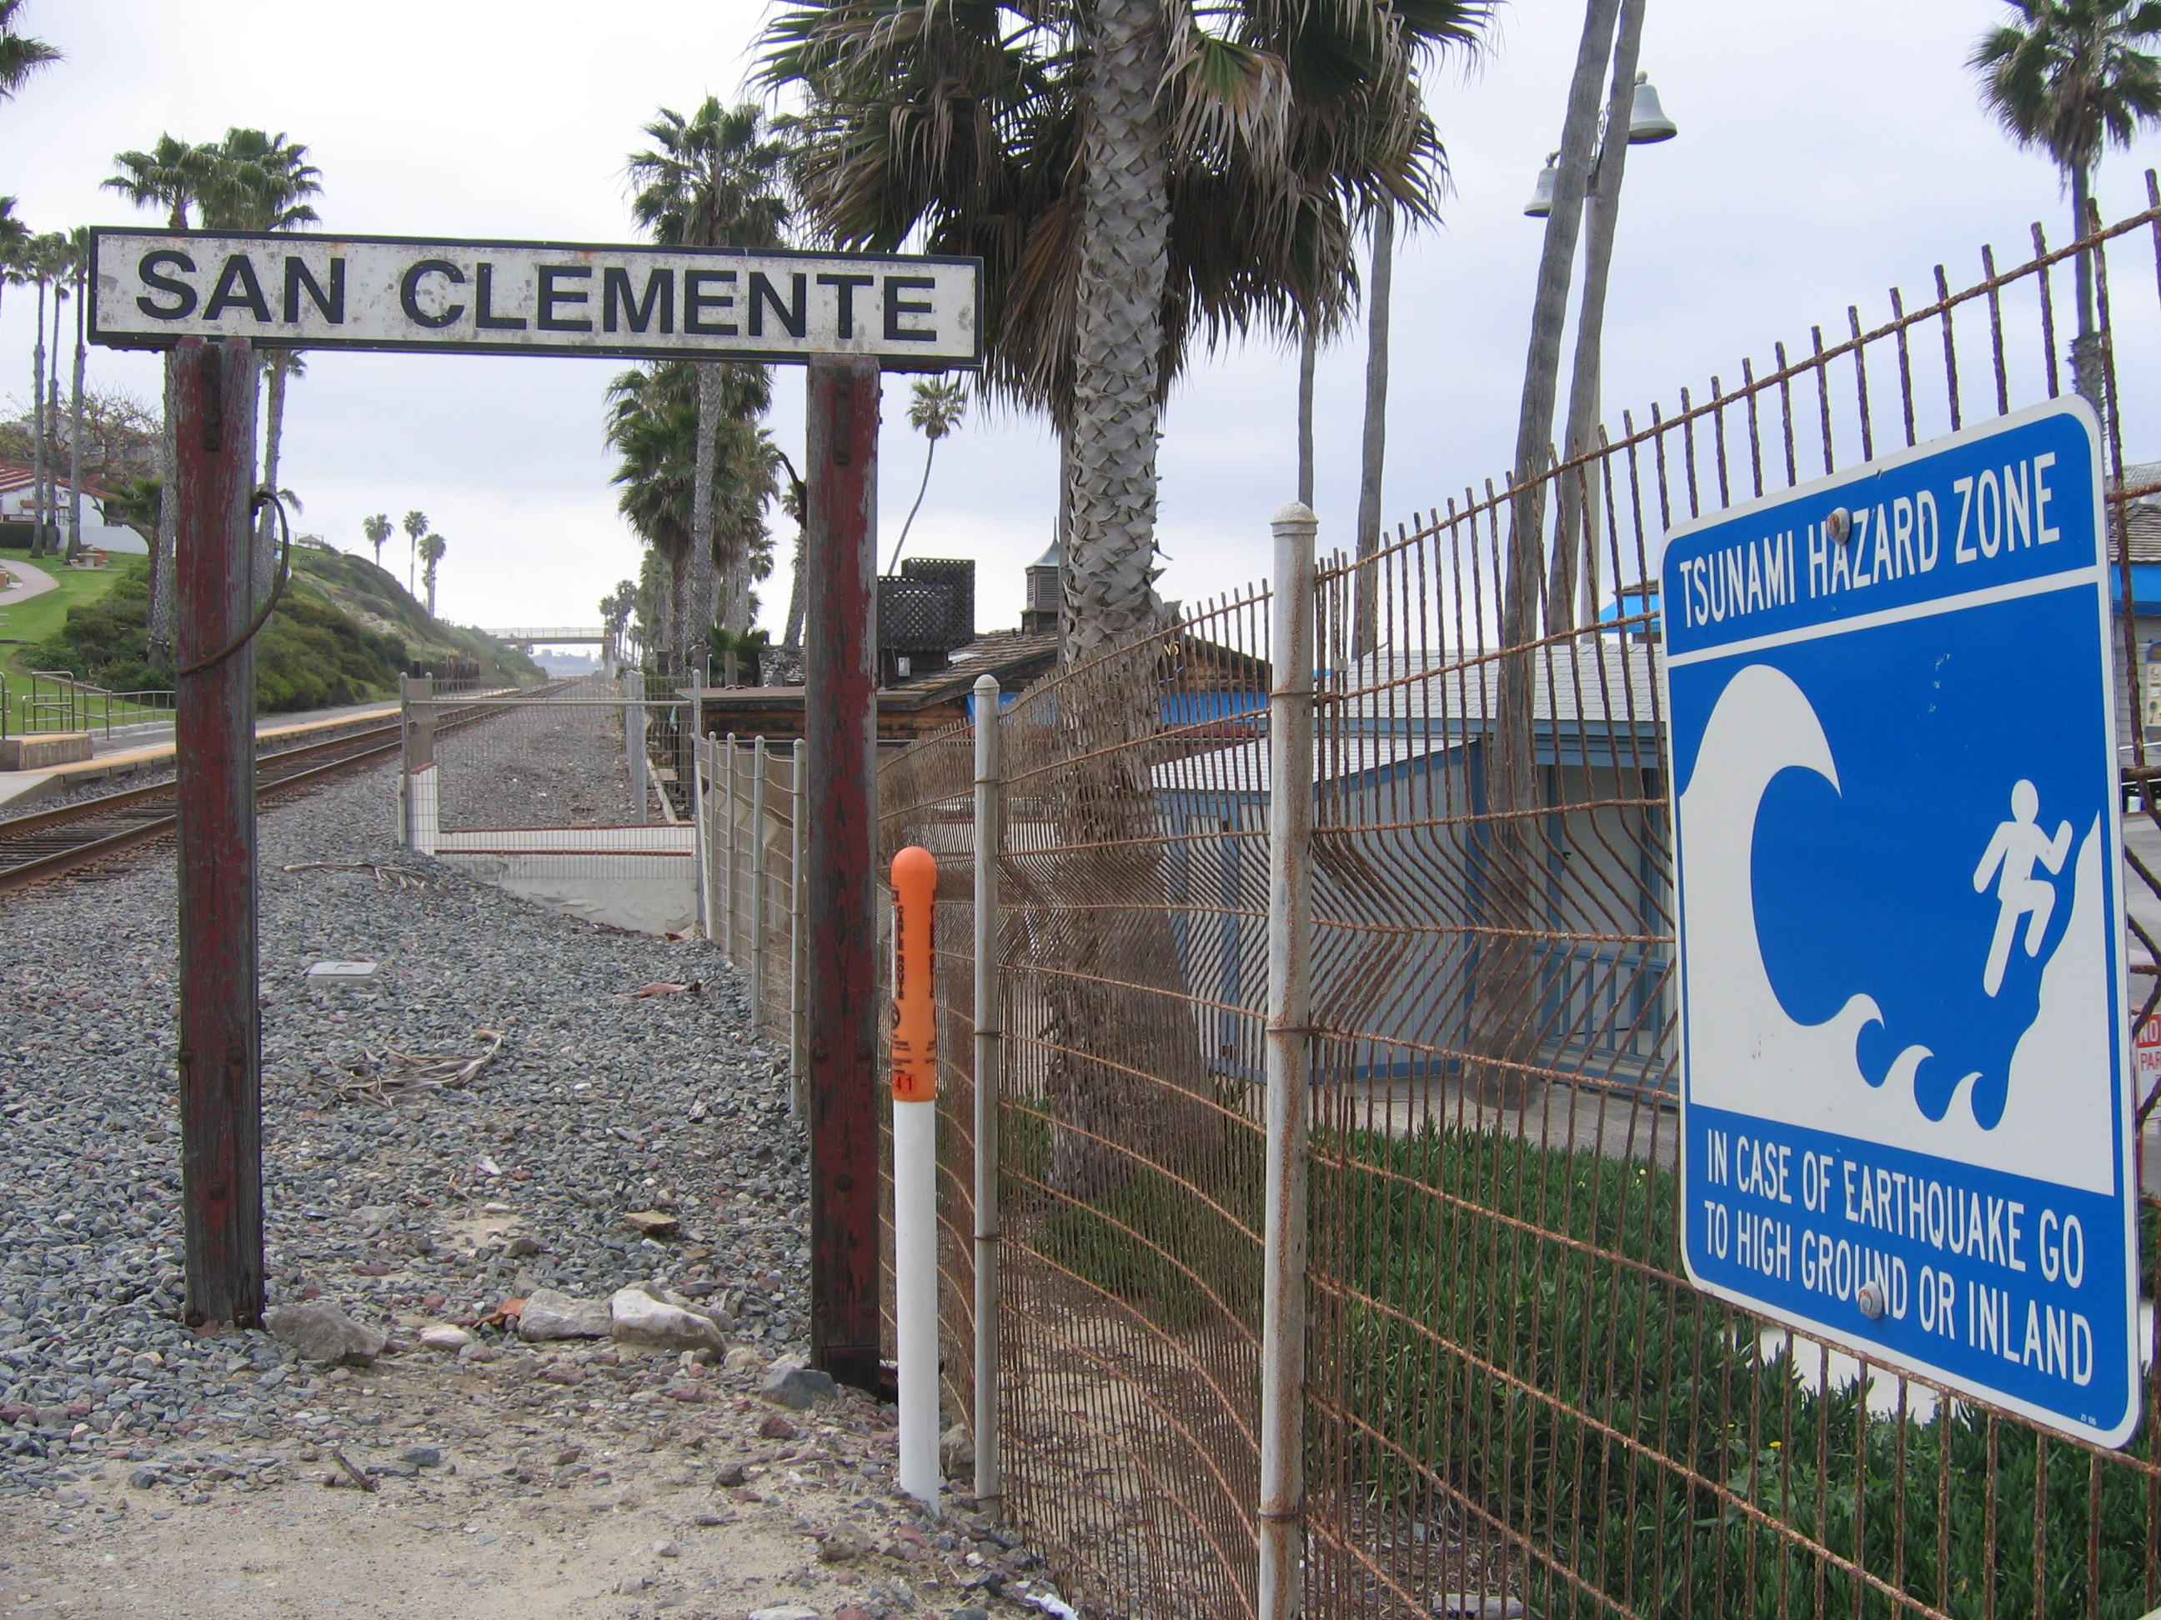
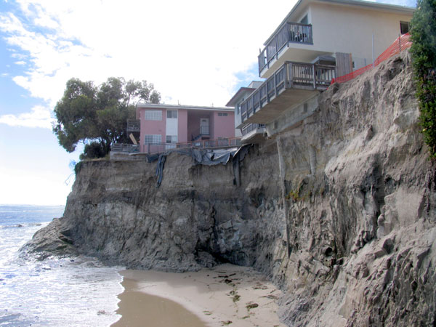

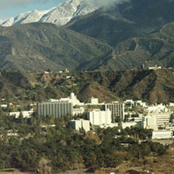
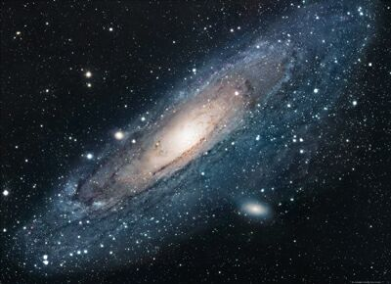
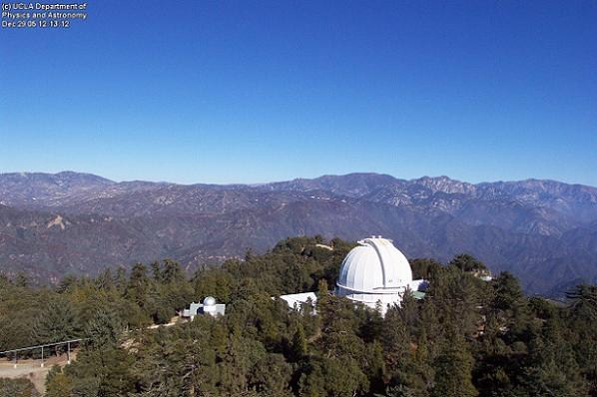
Southern California opportunities
Local geologic structures
active faults
Local hydrology
Los Angeles river/urban hydrology
Pacific ocean/coastal processes
Local institutions/museums
Jet Propulsion Laboratory
Mount Wilson Observatory

Slide 9
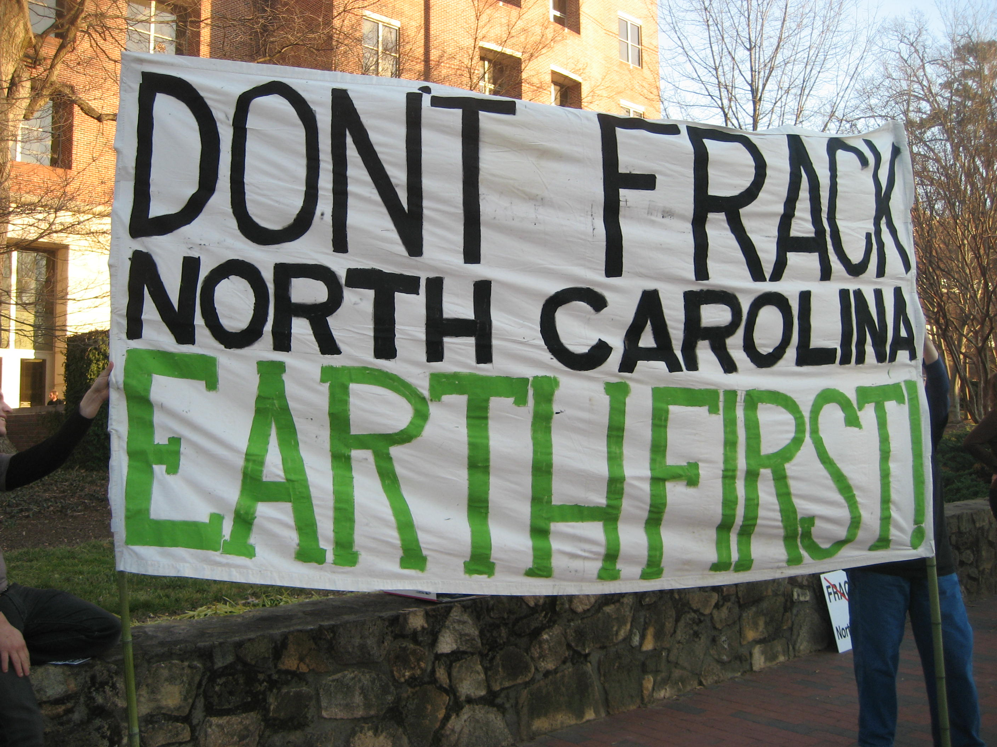
Classroom activities that touch on topics relevant to students’ lives
What are the local natural hazards?
Floods, earthquakes, hurricanes, tornadoes, sinkholes, volcanic eruptions, lahars, landslides, tsunamis, blizzards,…
What are local environmental concerns?
Groundwater quality, soil contamination, air quality, urban sprawl, pollution, fracking, sanitation, coastal erosion, …

Slide 10
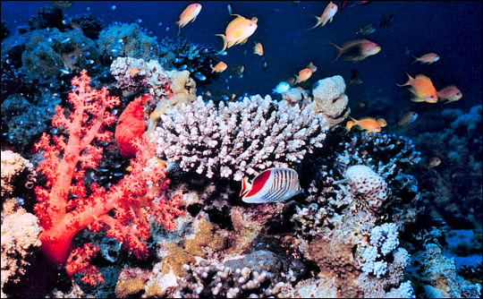
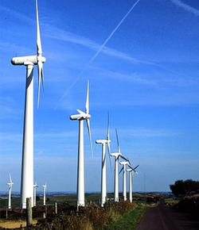
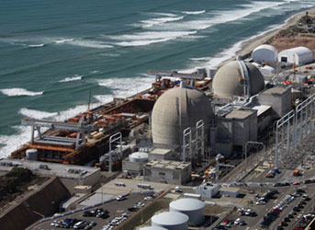
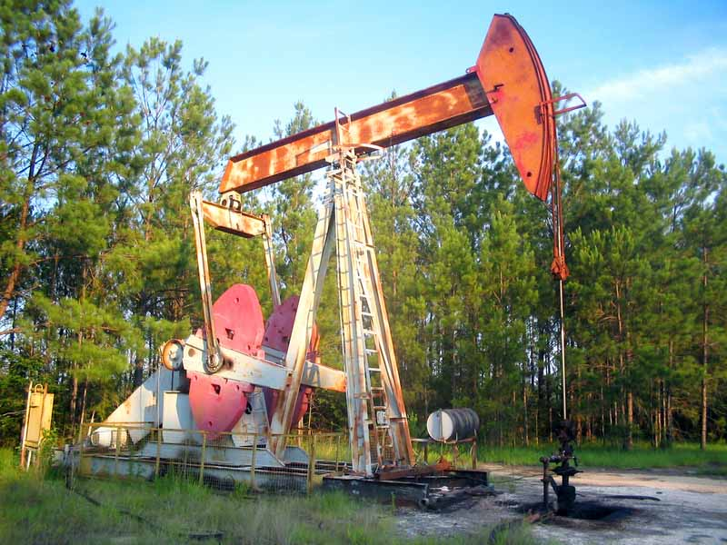
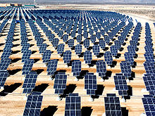
Classroom activities that touch on topics relevant to students’ lives
What are global environmental concerns?
Loss of biodiversity and extinctions (ocean acidification)
Climate change and global warming
Ozone depletion
Resource depletion
Renewable vs. nonrenewable energy

Slide 11
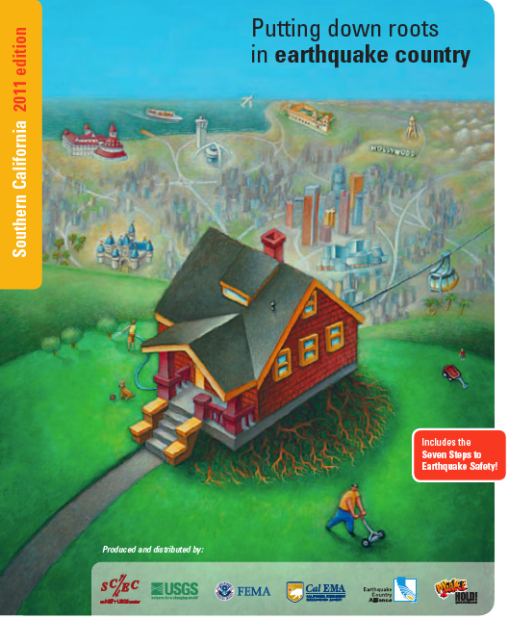
Earthquake (or other natural disaster) preparedness
Visit the website: “Putting down roots in earthquake country” and read the 7 steps outlined for earthquake safety.
http://www.earthquakecountry.info/roots/steps.html

Slide 12
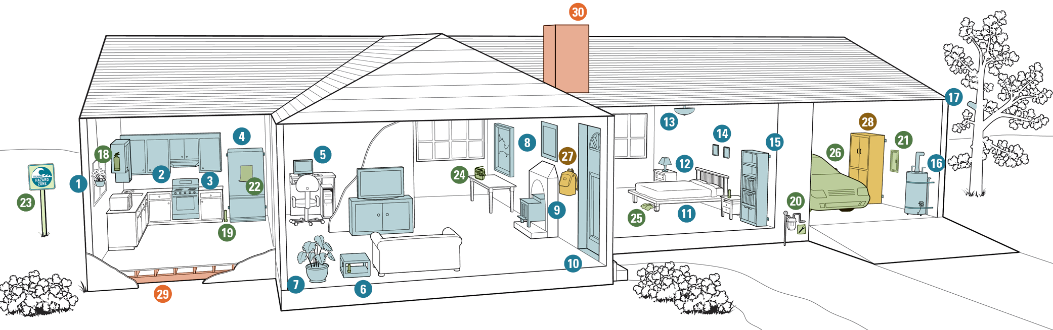
Earthquake (or other natural disaster) preparedness
Respond to the following 5 steps with action. Below are instructions for completing this exercise
Step 1: Home Hazards. Use the website to document home hazards. List hazards that you find and document them with photos. Take measures to correct at least 1 hazard and document your repair with a photo.
Step 2: Disaster Plan. Using the website guidelines, create a disaster plan for your housemates and you. Summarize your plan in one page.

Slide 13
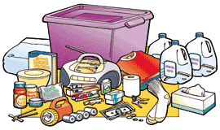
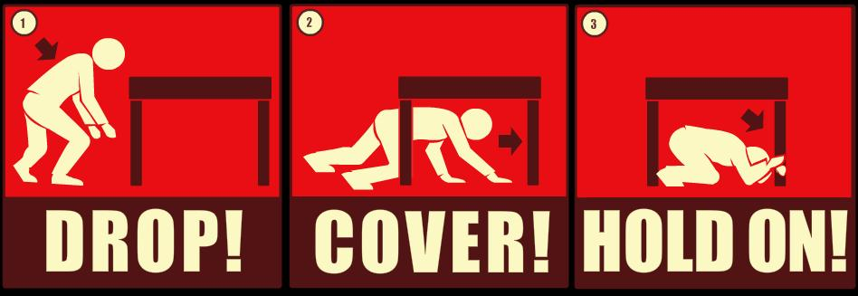
Earthquake (or other natural disaster) preparedness
Step 3: Disaster Kit. Use the website to guide you in constructing your own disaster kit for home. Bring the kit to school on the date specified in the calendar. (You can leave the water at home, but bring a picture of you with the water).
Step 4: Building safety. Follow the guidelines to inspect the building in which you live. Take the structural safety quiz and report the results for your home.
Step 5. Protection during shaking. Visit the discussion of the “triangle of life”. Write a brief (1 paragraph) comparison of this technique to the recommended strategy of “drop-cover-hold”. What do the experts recommend?

Slide 14
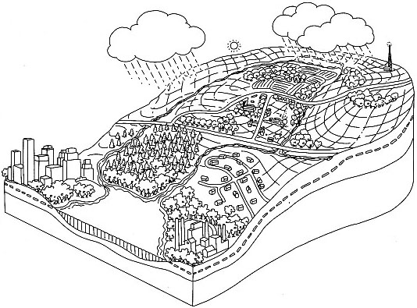
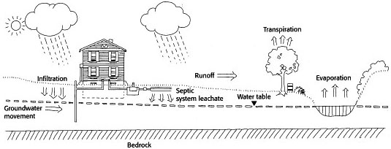
Water quality around your home
PART 1: Students follow instructions to characterize the physical aspects around their homes:
- soil type and depth
- depth to bedrock
- depth to the water table
- location of wetlands, streams, or other surface water
Steve Mellis, Water Quality Associate, MU (University of Missouri) Extension. Adapted from a work sheet by Alyson McCann, University of Rhode Island Cooperative Extension.

Slide 15
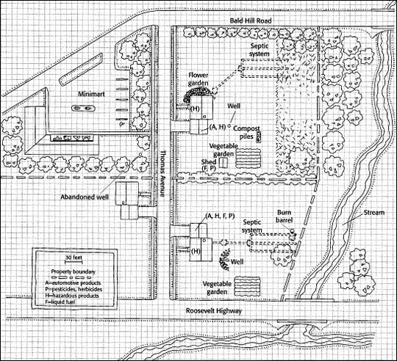
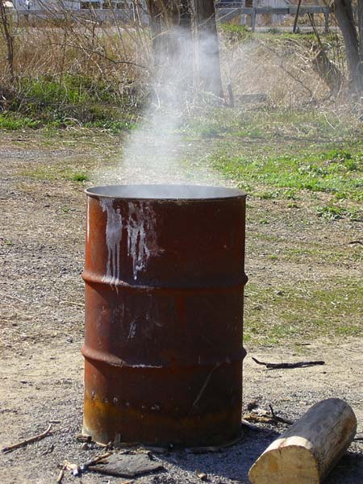
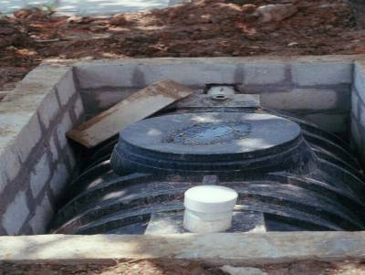
Water quality around your home
PART 2: Students create a map of their homes showing potential sources of trouble:
- buildings
- roads
- other constructed
or natural features

Slide 16
Water quality around your home
Washing spilled motor oil and grass clippings into storm drains or surface waters.
Storing gasoline and other hazardous chemicals near children's toys.
Paving walkways instead of using porous material, thus increasing runoff.
Placing sprinklers so the water runs onto a sidewalk or street.
Planting flowers and other vegetation that may require fertilizers and pesticides near a wellhead.
Students identify potential problem areas on their own property and can take steps to correct these problems.

Slide 17
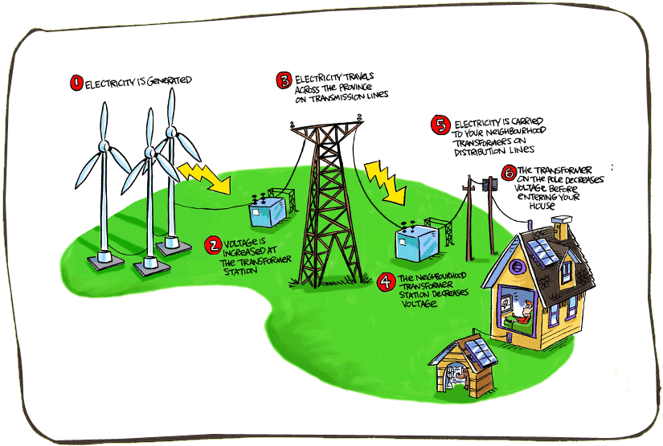
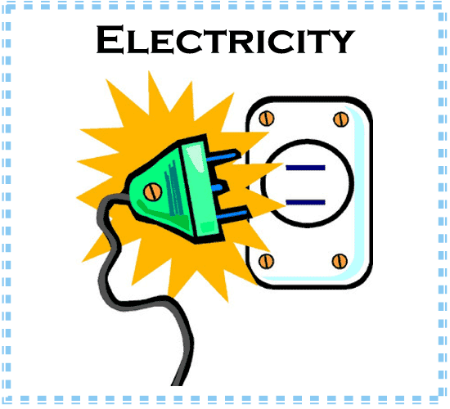
Where does your electricity come from?
Student investigate the source of their neighborhood’s electricity all the way to the geologic source.

Slide 18
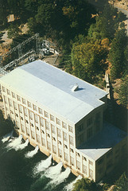
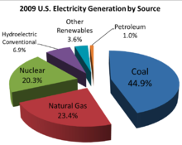
Where does your electricity come from?
Student investigate the source of their neighborhood’s electricity all the way to the geologic source.
Sothern California Edison’s Big Creek Hydroelectric System.
The twin reactor units at Southern California Edison’s San Onofre Nuclear Generating Station.

Slide 19
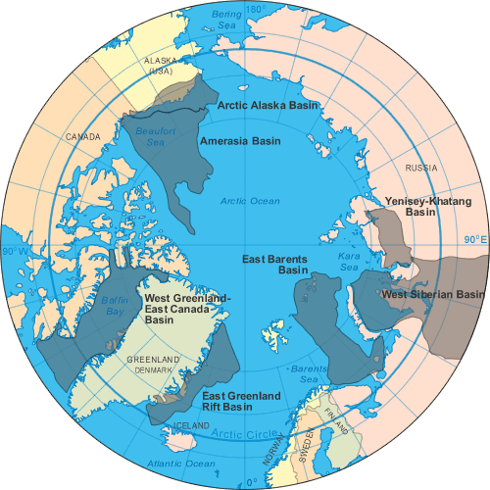
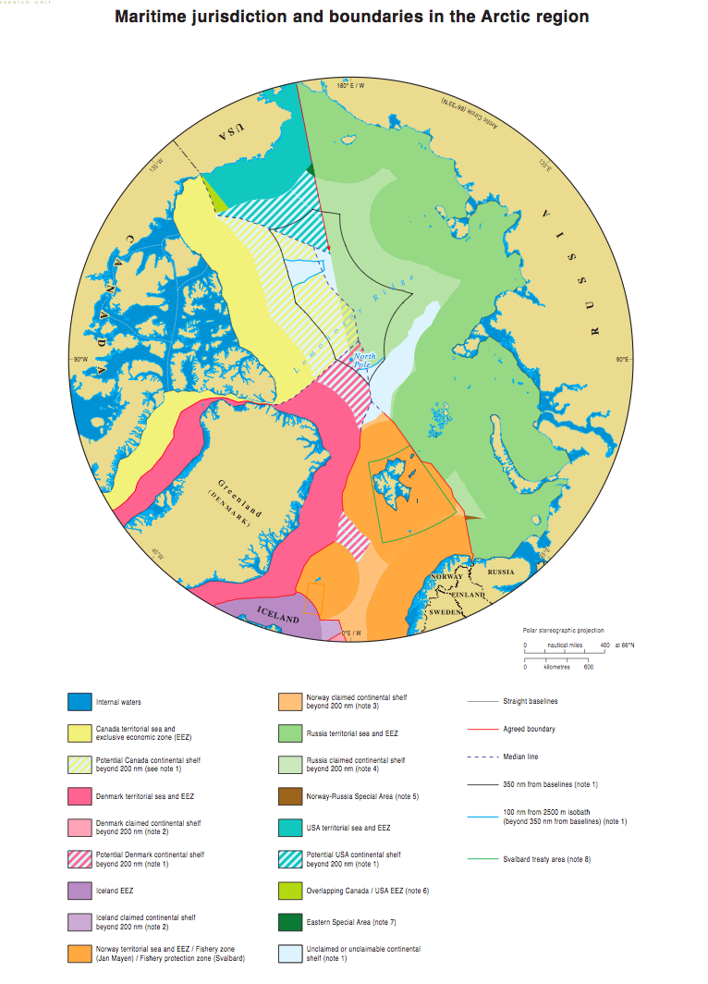
Arctic Ocean Energy Resources
Which country would gain the most? What to do about overlapping regions?

Slide 20
Arctic Ocean Energy Resources
Students are divided into 6 teams:
Team 1: investigates estimates of Arctic Ocean oil and natural gas resources
Team 2: investigates where Arctic Ocean oil and natural gas resources are believed to be located
Team 3: investigates the high cost of oil exploration and production in the Arctic ocean
Teams 4, 5, and 6: each team represents one country (United States, Canada, or Russia) and investigates how the United Nations Law of the Sea affects their nation’s claim to Arctic territory

Slide 21
Arctic Ocean Energy Resources
Members from Teams 1, 2, and 3 are distributed as the geology experts to each country (Teams 4, 5, and 6).
Each country devises a map showing where they believe their maritime boundaries should be in the Arctic.
Moderate a debate that encourages the geologic information to be used in support or to refute various points of view.

Slide 22
SUMMARY
Improvements in geoscience literacy and general interest by non-science majors can be facilitated by:
Make it relevant to the local area
Focus on local earth science features (e.g., faults, landslides), phenomena (e.g., hurricanes, soil erosion), and institutions (e.g., museums, observatories)
Include activities that require students to investigate conditions of their own house or apartment building
Use non-traditional teaching strategies such as debates, jigsaws, etc. once in a while!

