Slide 1
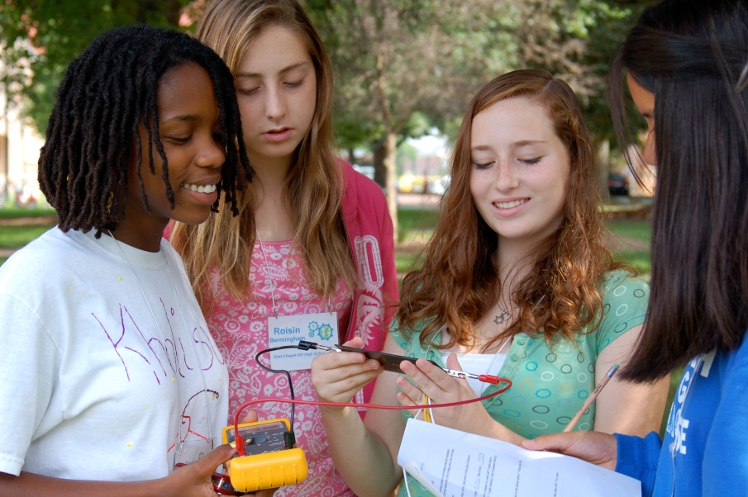
Dana Brown Haine, M.S. Program Director, UNC-Chapel Hill’s Climate Leadership and Energy Awareness Program
Empowering
Pre-college Students To Engage
In Climate Change Solutions

Slide 2
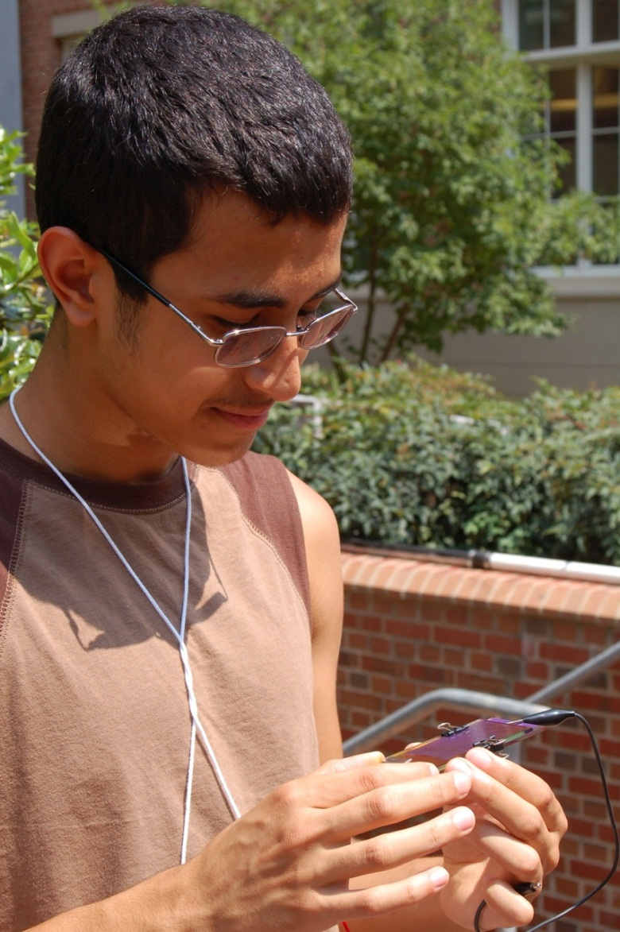
We need a way of exploring environmental issues that is realistic and honest, yet hopeful and inspirational.
M.G.H. Gilliam, Publisher, Orion

Slide 3
Today’s Fossil Fuel Based Economy
Climate
Science
Climate Change Impacts
Increased CO₂ emissions
Climate Change Science
The Future
Energy Efficiency
Nuclear Energy
Renewable Energy
Civic Engagement
The Greenhouse Effect
Energy
Decreased CO₂ emissions
Notes:
We present climate change in the context of our energy story…

Slide 4
Empowering Students To Engage In Climate Change Solutions
discuss impacts of fossil fuel based economy;
feature scientists and engineers who are working to develop solutions to increase the use of renewable energy sources;
provide opportunities to develop science communication and leadership skills.

Slide 5
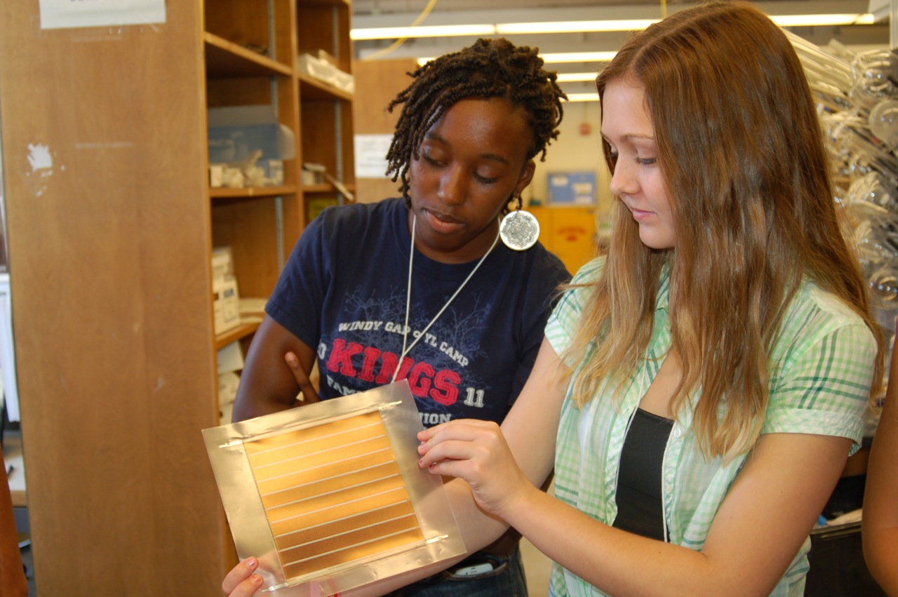
Overarching Program Goals
Improve students’ competence in science
Nurture students’ enthusiasm for science
Foster student interest in science-related careers

Slide 6
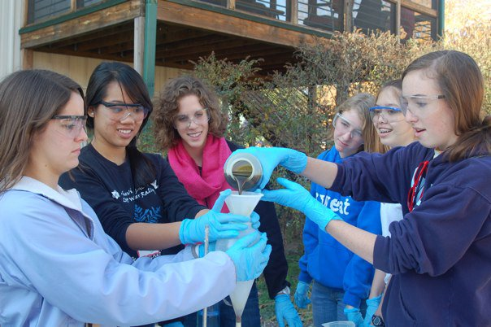
Program Components
One-week, non-residential summer institute
Four academic year Saturday academies
Community outreach project

Slide 7
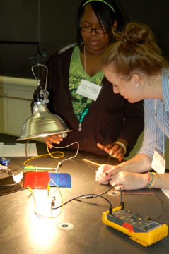
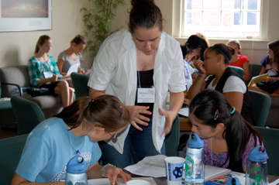
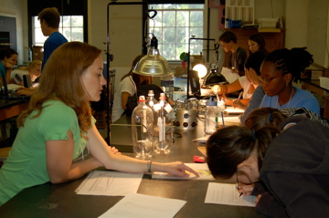
Program alumni serve as peer mentors

Slide 8
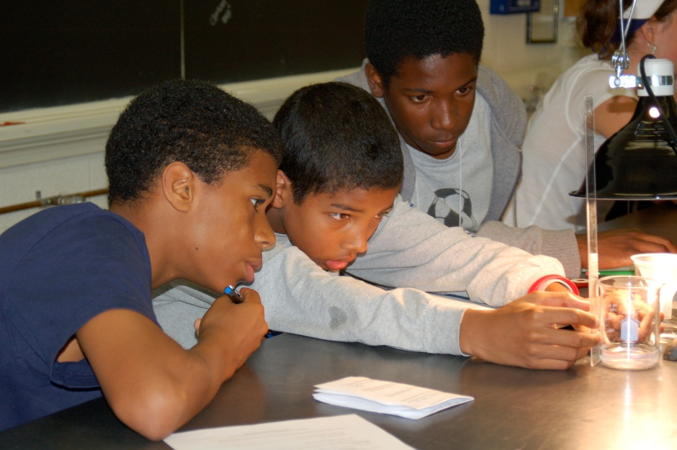
Students engage in hands-on science enrichment activities

Slide 9
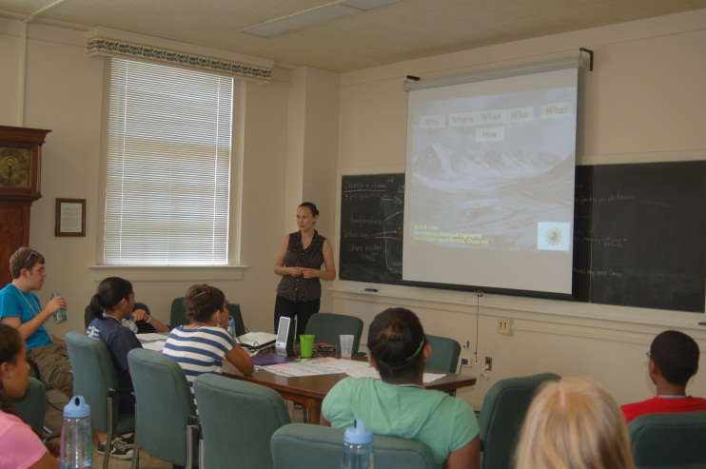
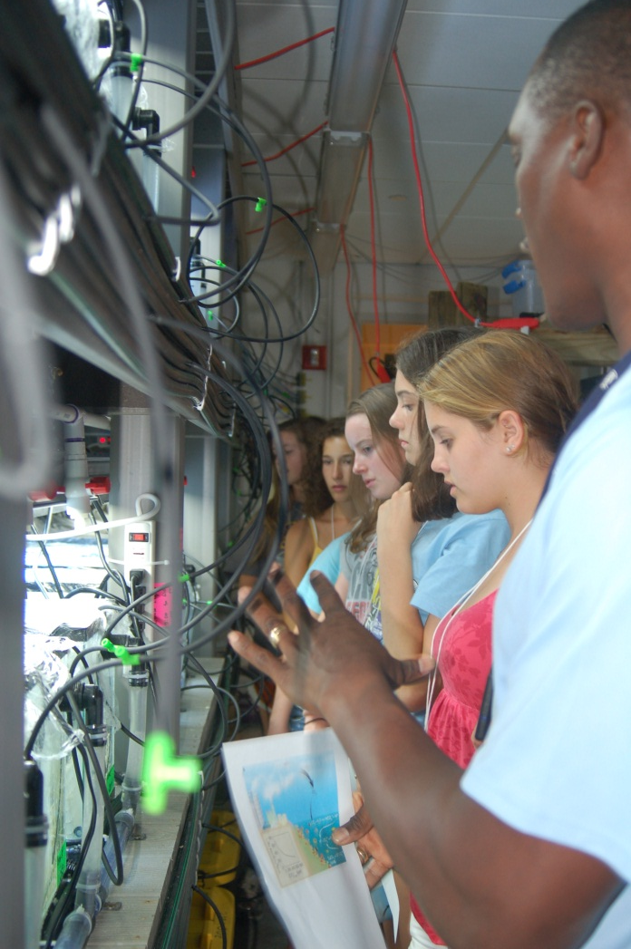
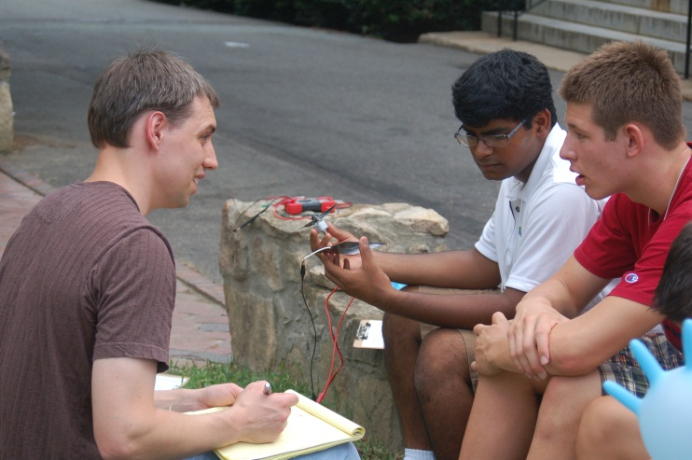
Numerous scientists directly interact with participants
Presentations
Lab Activities
Lab tours
Field trips

Slide 10
Student reported gains in knowledge
Table 1. Evaluation of 2011 Summer Institute: Student Knowledge and Understanding of Climate Change Science and the Solutions that Exist to Address Climate Change
On a scale of 1 to 10, with 10 being very knowledgeable, how would you rate your: | Pre-Survey (n=38) | Post-Institute Evaluation (n=48) | Paired Samples t test (n=35)
Overall knowledge of climate change? | 6.41 (1.56) | 8.13 (0.89) | p <0.001
Overall knowledge of the various solutions that exist to address climate change? | 5.51 (1.85) | 8.23 (1.12) | p <0.001
Overall knowledge of available alternative energy sources? | 6.08 (1.96) | 8.25 (1.19) | p <0.001

Slide 11
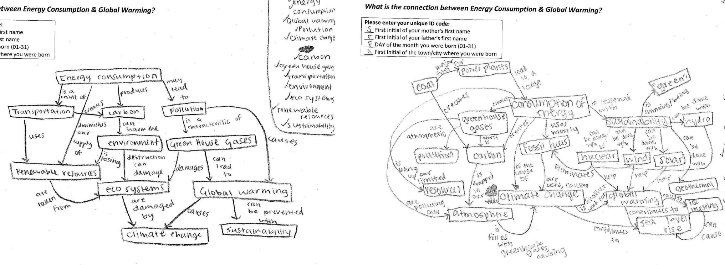
Informal learning assessment strategies
What is the connection between energy consumption & global warming?
Pre- and Post- Concept Maps

Slide 12
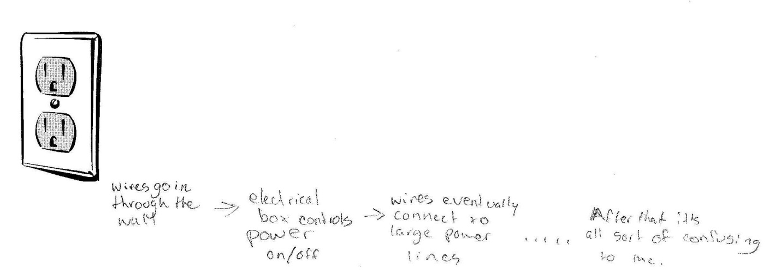
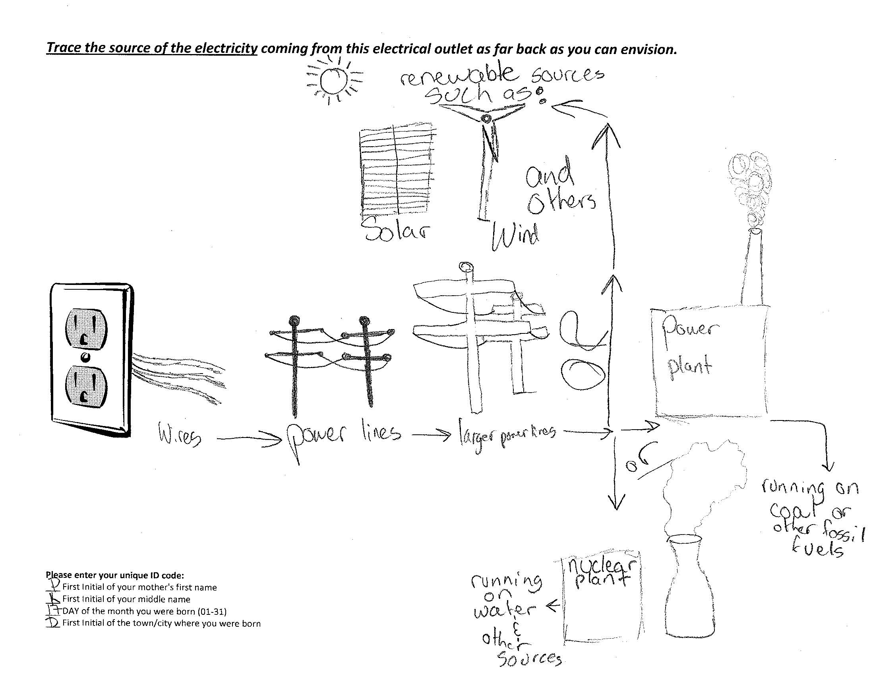
Informal learning assessment strategies
Pre- and Post- Drawings

Slide 13
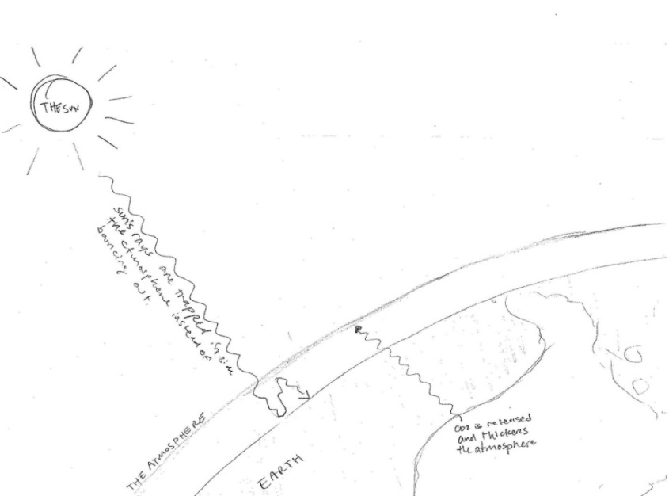
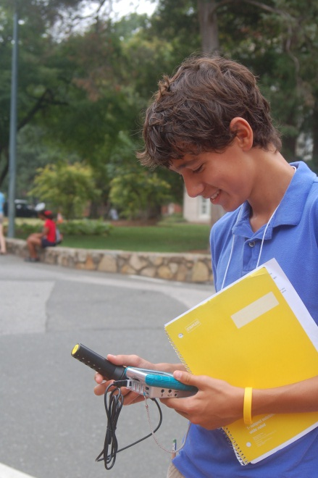
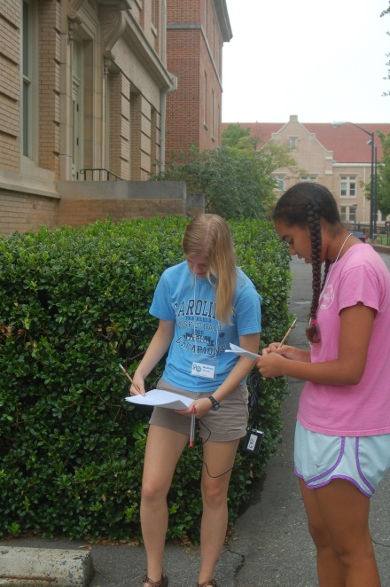
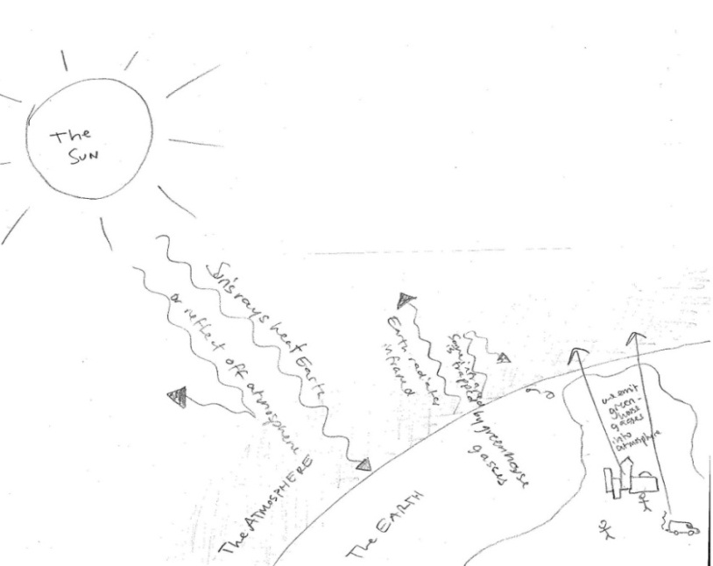
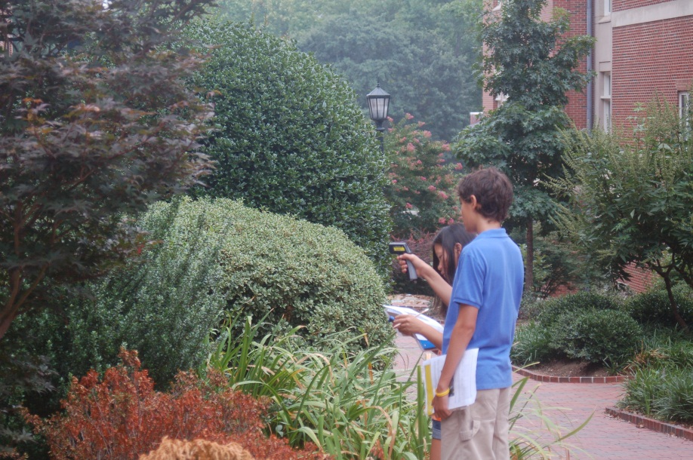
Informal learning assessment strategies
Pre-Drawing
Post-Drawing
Notes:
Pre-Drawing

Slide 14
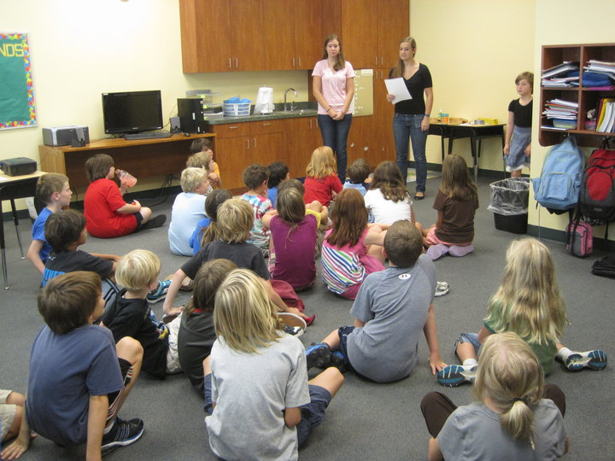
Empowering Students To Engage In Climate Change Solutions
126 students have completed the program
86 (68%) completed at least one community outreach project;
43 (34%) participated in one or more ACE leadership trainings;
31 (25%) were selected to serve as Climate LEAP peer mentors.

Slide 15
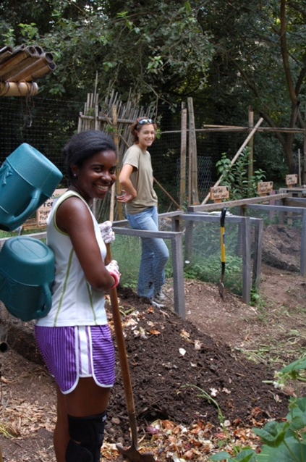
Inspiring Behavior Change
A recent survey of program alumni (n=28) indicated that 89% of respondents were motivated by the program to make at least one behavior change to conserve energy and resources in their daily life.

Slide 16



This student science enrichment program is made possible with support from:
In partnership with the UNC Department of Physics and Astronomy

Slide 17
climateleap.unc.edu Dana Brown Haine, M.S. Program Director dhaine@unc.edu (919)843-5735

