Slide 1


Abiotic and biotic influences on Arsenic mobilization: Insights from a Pristine Wetland
Hersy Enriquez
Natalie Mladenov, Siva Damaraju,
Piotr Wolski, Ganga Hettiararchchi,
Diane M. McKnight, Jessica L. Ebert, Philippa Huntsman-Mapila,
Michael Murray-Hudson, and
Wellington Masamba
NASA/Corbis
Notes:
I’m going to talk about the mechanism of As mobilization in groundwater in a pristine wetland.

Slide 2
Overview
Study Site
Arsenic Mobilization Mechanism
Abiotic
Biotic
Importance of Biotic Process in As Mobilization
Notes:
I will go over our study site, abiotic and biotic process mechanism of As mobilization and why we conclude that biotic processes may be important.

Slide 3
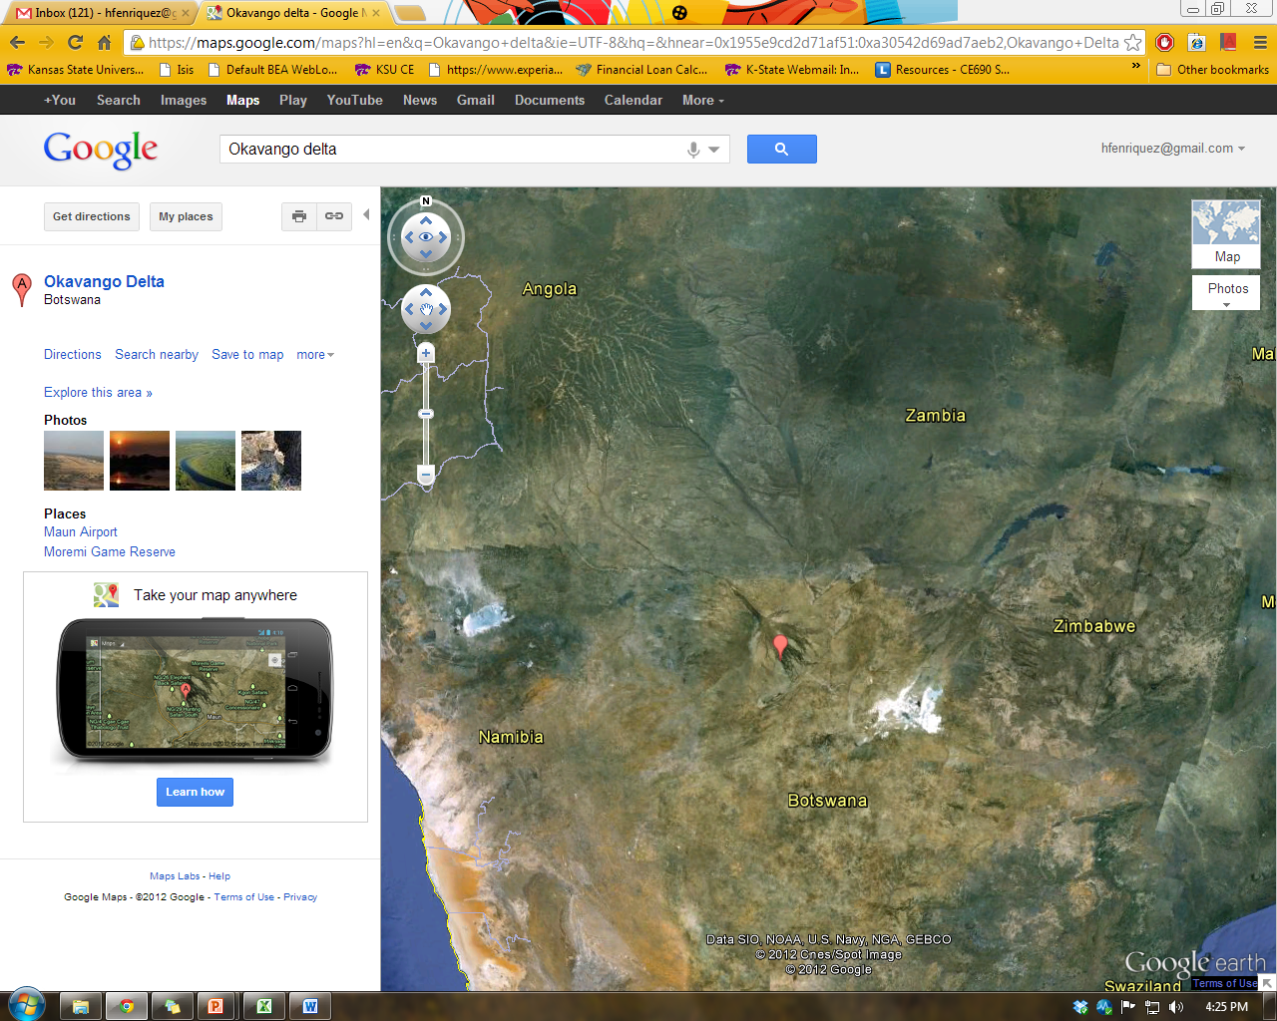
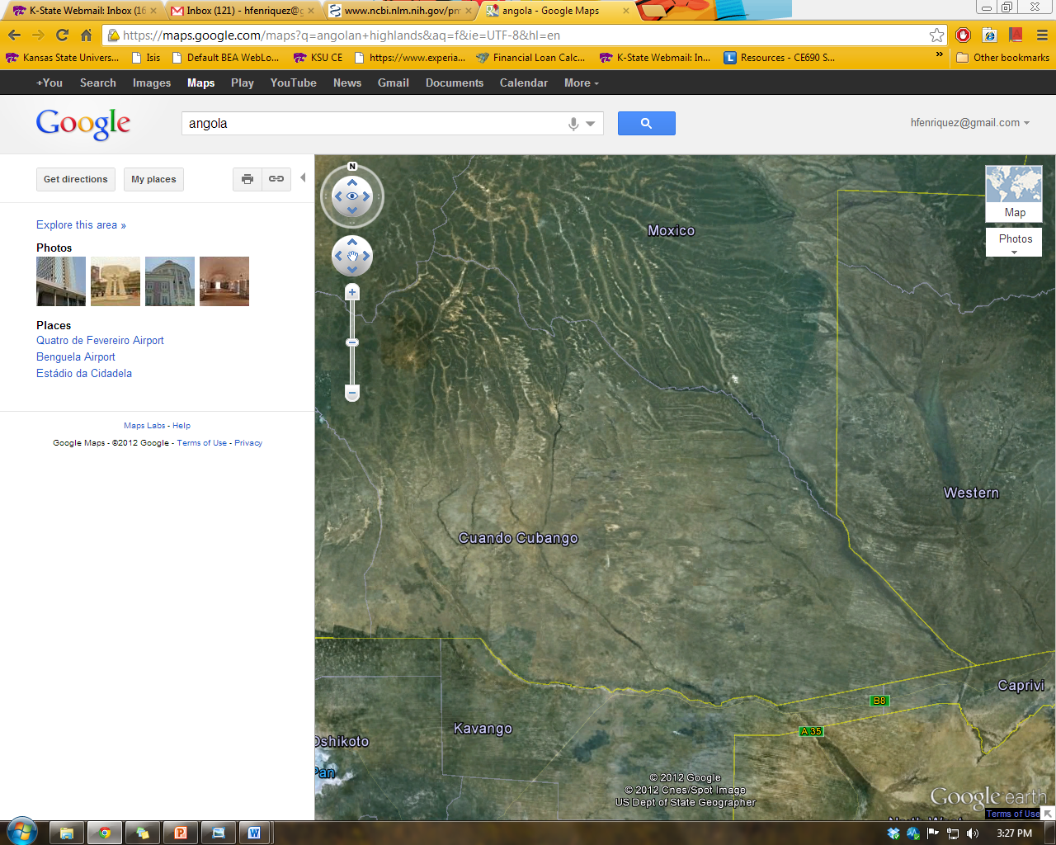
Results
Study Site
Mechanism
Method
Results
Conclusion
Cuito River
Okavango River or Cubango River
Length: 1000 miles (1600km)
Flow: 10km³
Cubango River
Notes:
The catchment of the Okavango River and Delta are shared between 3 countries. All inflow to the delta comes from the angolan Highlands. There are no dams constructed along the 1000 miles length of the Okavango river which makes this a pristine and unique river system.

Slide 4
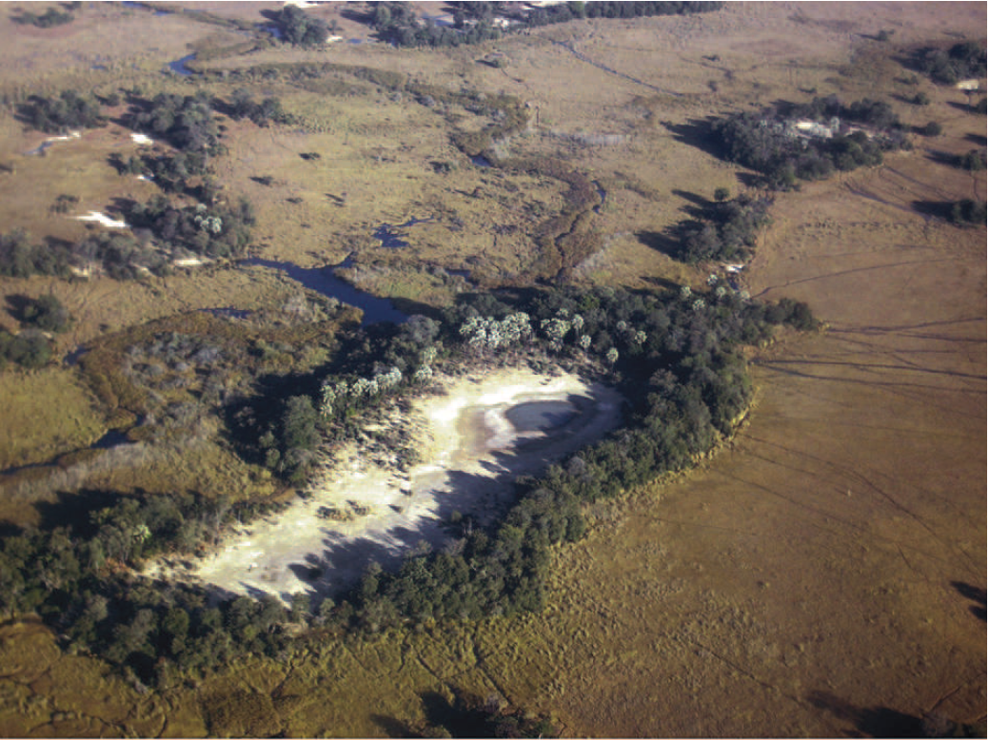
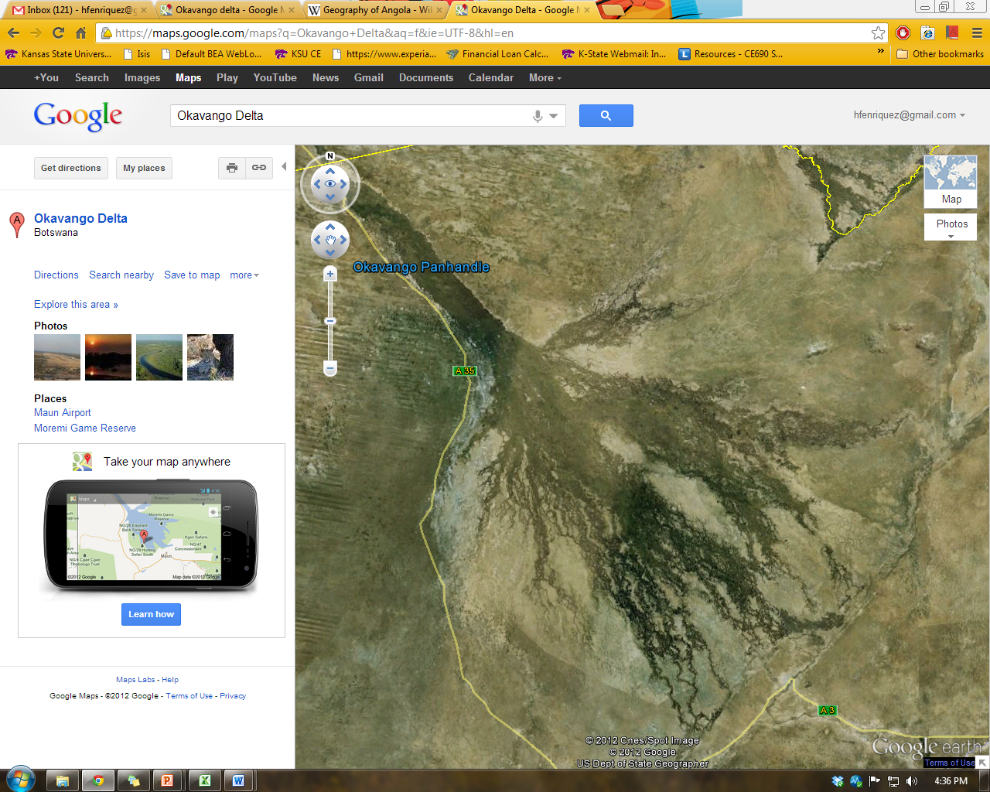
Results
Study Site
Mechanism
Method
Results
Conclusion
Area: 13,500 km²
Number of Islands: 150,000
Islands size: up to 500km²
98-99% of inflow is lost through evapotranspiration
Annual Flooding from the Angola drainage basin: April to September
(Bauer-Gottwein et al, 2007)
Notes:
The Okavango delta is a very arid zone with an area of 13,500 squared kilometers and has been reported to have very high evapotranspiration.
What’s unique about this wetland is the occurrence of seasonal flooding which results to expansion and contraction of the delta.
This is an example of an island which is characterize by the vegetation on the island fringe. As we can see here, the center of the island is barren because of high saline groundwater underneath which results to minimal to no growth vegetation.

Slide 5
Results
Study Site
Mechanism
Method
Results
Conclusion
Solute Accumulation Beneath the Island
Transpiration
Evaporation
Evaporation
Boro Channel
Chemical Precipitation
Infiltration
Solute Accumulation
McCarthy, Remote Sensing for detection of landscape form and function of the Okavango Delta, Botswana, 2002)
Ramberg and Wolski, Plant ecology journal, 2008
Notes:
The key driver of surface water flow to the groundwater is exapotranspiration. Evaporation from the surface water and groundwater and transpiration from vegetation on island fringe. Over a period of time, 2 things happen: 1. Solute accumulates underneath the island and water becomes highly saline and 2. island continues to develop because of chemical precipitation.
The key hydrological feature of the Okanvango Delta is the interaction between the surface water and groundwater which strongly influences the structure of wetland by restricting formation of salt pans keeping surface water fresh. During seasonal flooding, floodplain and nearby island aquifer serves as storage site for flood and losses water due to evaporation and transpiration. This hydrologic cycle however increased solute concentration in groundwater and silica and calcite formation affecting vegetation along the center of the island. Evapo-concentration generates geochemical reaction and mineral precipitation.

Slide 6
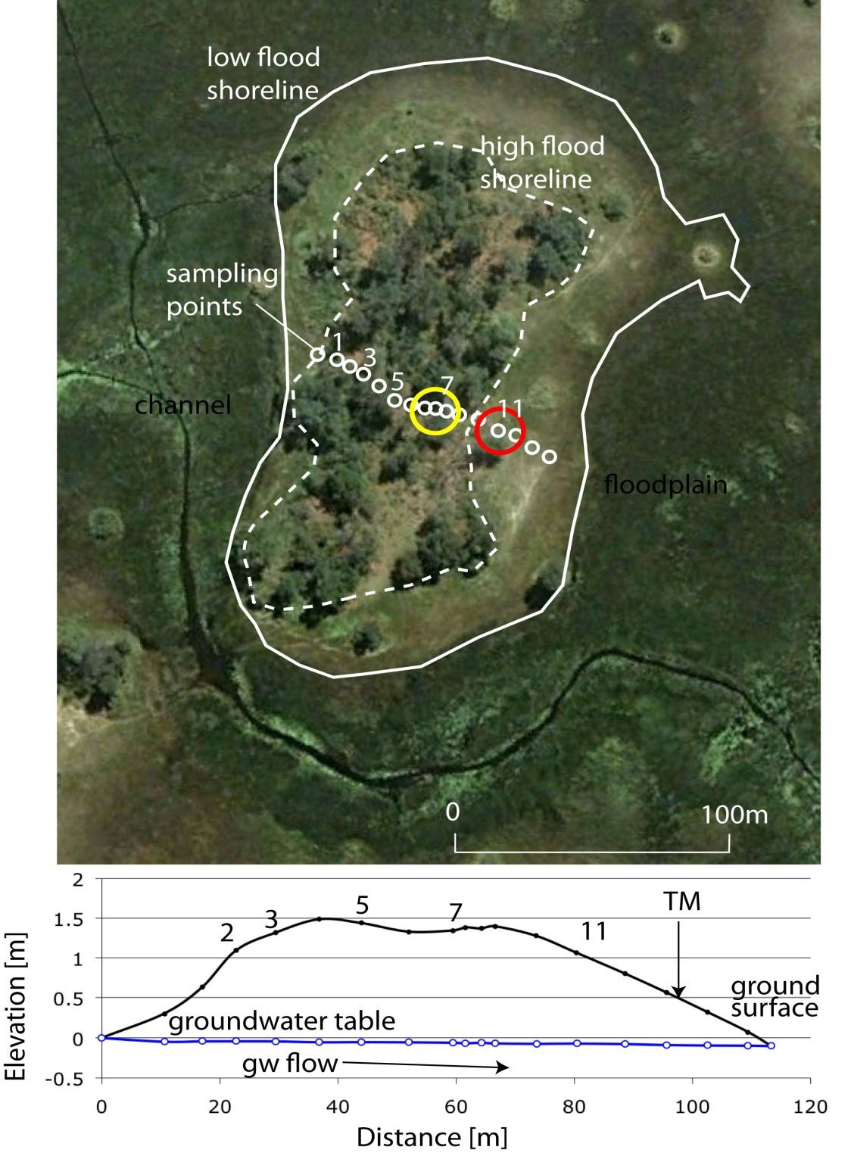
Results
Study Site
Mechanism
Method
Results
Conclusion
New Island
Flow-through island
Shifted “center” at Site 11 with high arsenic
GW flow from NW to SE
Ca and Mg-rich calcrete precipitation at Site 7
11
Floodplain
Notes:
New island is located along the lower part of Boro river which exhibits a somewhat higher conductivity compared to other islands. Throughout my talk I will be referring to 3 sites, edge, Ca and Mg-rich calcrete formation and center. Island’s center is where solute accumulation occurs and where high arsenic is found. Our center compared to other islands, is shifted because of the difference in groundwater elevation.
The slightly higher groundwater level on the upstream side of the island results to assymmetric pattern of salt accumulation that is the highest concentration is not measured at the center but shifted downstream. And take note of the where the calcrete and high solute and arsenic is located because I’m going to be referring to it for most of this talk.

Slide 7
Objective
Study Site
Mechanism
Method
Results
Conclusion
To evaluate how abiotic as well as biotic mechanisms influence As mobility in this setting
Abiotic Mechanism
Evapoconcentration
Desorption of As at high pH
Biotic Mechanism
Reductive Dissolution of As-rich Fe oxides
Additional role of microbial processes such as Sulfate Reducing Bacteria (SRB) under reducing conditions
Notes:
Our objective mainly to evaluate how abiotic and biotic mechanism influence As mobility.
2 mechanism that we consider abiotic are 1. evapoconcentration which is expected to dominate in this setting; 2. desorption of arsenic at pH.
And biotic process, includes 1. reductive dissolution of iron-bearing minerals in turn reduces Arsenic as well; 2. the role of sulfate reducing bacteria in sequestering arsenic.

Slide 8
Hypotheses
Study Site
Mechanism
Method
Results
Conclusion
Island Edge
The biotic influence is more important in groundwater closer to the island edge
Bacterial degradation of DOM results As and Fe reduction
Sulfate reduction and As sequestration
Island Center
Abiotic conditions dominate
Arsenic desorbs from sediment under more alkaline conditions
Evapoconcentration results in even more elevated dissolved As concentrations
Notes:
I am going to present our general hypotheses, but when I started this past summer I mainly worked on evaluating the presence of sulfate reducing bacteria.
So We hypothesize that biotic mechanism is more significant along the island edge. Arsenic and iron reduction occurs because of DOM transformation by bacterial degradation. And again the role of sulfate reducing bacteria in Arsenic sequestration.
Abiotic process is more substantial at the island’s center where 1. Evapoconcentration dominates in even higher arsenic level and 2. desorption of arsenic at high pH.

Slide 9
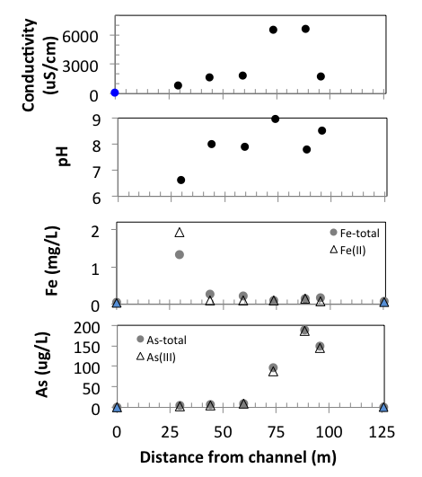
Results
Study Site
Mechanism
Mechanism
Results
Conclusion
CaCO₃
Abiotic Mechanisms
Evapoconcentration
As mineral dissolution at high Eh
Biotic Mechanism
Is As precipitation in early part of flowpath influenced by SRB?
Is the calcrete formation influenced by SRB?
9
Notes:
Conductivity, pH and arsenic follow the same trend where you can see an increase of each parameters starting at the tipping point that is where the calcrete formation is located. This trend is mainly due to evapoconcentration.
Under alkaline environment, however, arsenic is desorb because bicarbonate outcompete arsenic for sorption sites.
Iron on the other hand is significant at the edge because of reductive dissolution, but reduced iron tend to precipitate with carbonate.
Why we think biotic mechanism is simultaneously happening because under reducing condition, bacteria are more active thus potentially contributing to reducing arsenic.
This is contrasting with other studies of oxidizing aquifer of argentina where they found arsenic in it less toxic form arsenic (5).

Slide 10
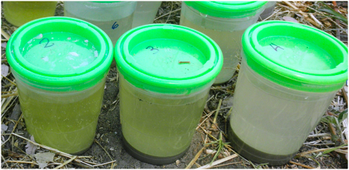
Why Sulfate Reducing Bacteria (SRBs)?
Study Site
Mechanism
Method
Results
Conclusion
They can reduce sulfate to H₂S – and H₂S was smelled in groundwater previously
They can precipitate CaCO₃ – there is CaCO₃ precipitation (calcrete) on islands of the Okavango
They can transform complex DOM to more transparent exopolymeric substances (EPS)
Notes:
3 thing why we tested for srbs are 1. Hydrogen sulfide, produced by sulfate reduction, was smelled while digging some of the wells, 2. presence of calcrete and 3. decreasing aromaticity of the DOMs to a more transparent substances.

Slide 11
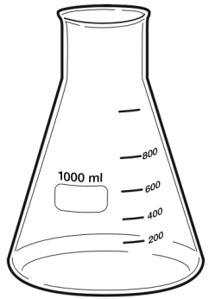
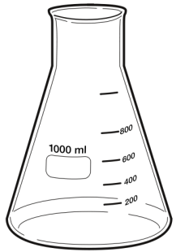
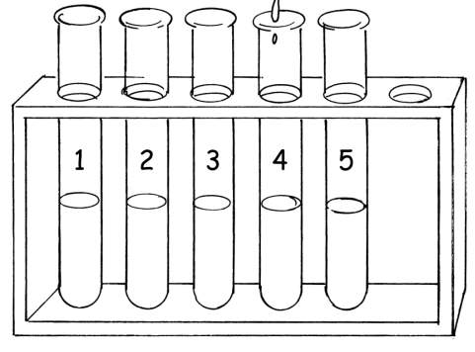
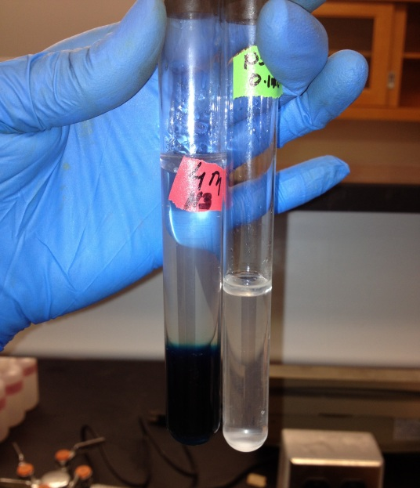
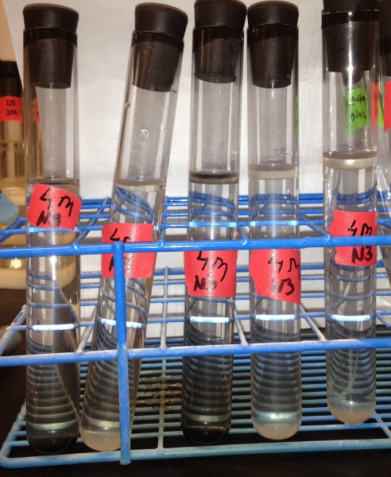
Sulfate Reducing Bacteria: MPN Method
Study Site
Mechanism
Method
Results
Conclusion
Starkey’s Medium A
10 mL 2x medium + 10mL sample
9 mL 1x medium + 1.0mL sample
9.9 mL 2x medium + 0.1mL sample
Double strength
Single strength
After 21 days of incubation (20ºC under a fume hood)
Formation of black precipitate confirms positive presence of H₂S
Additional confirmation test.
Blue solution confirms H₂S.
Notes:
This methods detects the presence or absence of SRB in a given water sample by the most probable number (MPN).
Isolation of SRBs in water was achieved by maintaining the temperature of dilution blanks, broths and incubations at 45C.
There are 5 replicates of different dilutions as stated by protocol we used.
This is such a labor-intensive method that we can only test for 6 samples where we collected 3 samples of different depths from each site.
After 21 days of incubation (20oC under a fume hood)

Slide 12
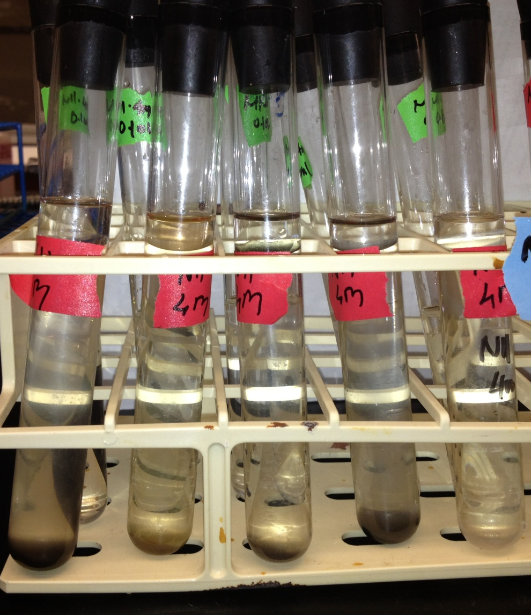
Sulfate Reducing Bacteria
Study Site
Mechanism
Method
Results
Conclusion
CaCO₃
Sample Name | MPN/100mL | As (III) (μg/L)
Edge
2m | 0 | 2.59
4m | 4.5 | <DL
6m | 4.5 | <DL
Center
2m | 0 | 185.78
4m | 14 | 16.80
6m | 3.7 | 2.64
Single strength
Additional confirmation test.
Blue solution confirms H₂S.
Island’s Edge (4m depth)
Island’s Center (4 m depth)
Notes:
As a result, we confirmed the presence of sulfate reducing bacteria along the flowpath. Surprisingly, our highest number of SRB colonies is located at the center where we expected to have no srbs present. Although compared to SRBs found in sediments these numbers are not that low. Since we tested SRBs from our water samples some studies have found 2 to 100MPN/100 mL of SRBs in their sample.
Arsenic level is however consistent with our hypothesis of where you have srb activity, arsenic will be sequestered and vice versa.
We also found that at the edge, srbs are more active and this is depicted by formation of a more black color precipitate at the edge compared the precipitate formed at the center.

Slide 13
Study Site
Mechanism
Method
Results
Conclusion
Calcrete
Center
Edge
CaCO₃
Biotic Mechanism
DOM consumption and reducing conditions
pH rise induces precipitation of carbonate
H₂S and As precipitate.
Needs further study
As desorption with high pH?
Evapoconcentration
Sulfide Oxidation at higher Eh?
(Labile DOM)
SRB
SO₄²⁻+ 2CH₂O
H₂S + 2HCO₃⁻
CO₂
Fe(II)
As (III)
e-
Free As (III)
As(III) (23.5%)
Orpiment (76.5%) As
Labile DOM
CaCO₃
As-S mineral
Geobacter
As-S mineral
Fe(III)-bearing mineral
Notes:
The groundwater flows laterally from both sides of the island and due to evapotranspiration, solute and arsenic accumulates at the center. And again our main sites are, edge, calcrete and center. The center is where high arsenic and solute accumulation happens. This is just to remind you where everything is located along the island.
Earlier along the flowpath, as we hypothesized, iron reducing bacteria are active and consume labile DOM and release iron and arsenic into solution. Another microbial activity that we think is important is sulfate reduction by sulfate reducing bacteria and also consume of labile DOM. Sulfate reduction yields hydrogen sulfide which sequesters arsenic and bicarbonate which increase pH and alkalinity. Release of bicarbonate ions results to formation of calcrete which serves as the tipping point for high salinity and high reduced As level. Arsenic is mobilized by evapotranspiration and accumulates at the center of the island.

Slide 14
Way Forward
January 2013 planned trip objective:
To explore some of the open questions
Test for Sulfate Reducing Bacteria in sediments
Consistency of hypothesized mechanism in other islands of the delta
Confirm mineralogy of As association in sediments along the flow path
Confirm that DOM transformation occurs in groundwater of other islands
Notes:
For this upcoming trip,
We want to explore some of the open questions we had from this past trip.
Test for Sulfate reducing bacteria in sediments
We want to sample 5 islands to confirm the consistency of our hypothesized mechanism
Confirm the what mineral As is associated with along the flowpath.
Confirm DOM transformation in other islands.
Ultimately, determining the microbial community composition would tell us what bacteria are more dominant
DOM transformation : We will isolate fulvic acids from large volume samples that we collect (Jessica will do that with resin-filled columns) and we will collect smaller samples and analyze those for molecular weight (on GC/MS) - high MW means more recalcitrant, low MW means more labile. You can then combine molecular weight results with fluorescence and UV-vis analyses. This will tell us how the quality of DOM is changing. Right now we don't know if the color change means we have more labile or more recalcitrant DOM. (Just so you know, usually, the colored part contains the aromatic C, which is generally more recalcitrant. So I expect the DOM is becoming more labile. There should be an experimental portion that can test that, but we can discuss that later.
How the DOM change is related to arsenic? The way it is related is this: if the color change is due to microbial consumption by SRB, then that may mean that DOM stimulates the microbes that reduce sulfate and indirectly cause the precipitation of arsenic. If DOM color change is due instead to sorption of some part of the DOM molecule to sediments along the flowpath, then maybe the DOM is desorbing something else; maybe it's competing for sorption sites with arsenic. You did not include that in your slides, because the desoprtion under high pH or Eh is more compelling. but the DOM story is worth considering.
If there's something they ask you that we didn't consider, you can say that this is pretty complex and "we can talk about that more during the break, but i don't know the answer right now. We may have considered it, but I am not familiar with that concept yet."

Slide 15

Acknowledgment
National Science Foundation (NSF)
NSF OISE Project #1105289
Kansas State University, Department of Civil Engineering
3. Okavango Research Institute staff and scientists
Ndobano Lokae and Kerapetse Phorano
Buddhika, Galkaduwa, Kansas State University Department of Agronomy

