Slide 1
Early Cambrian Microburrow Nests and the Origin of Parenting Skills
Mark McMenamin
Mount Holyoke College
2012

Slide 2
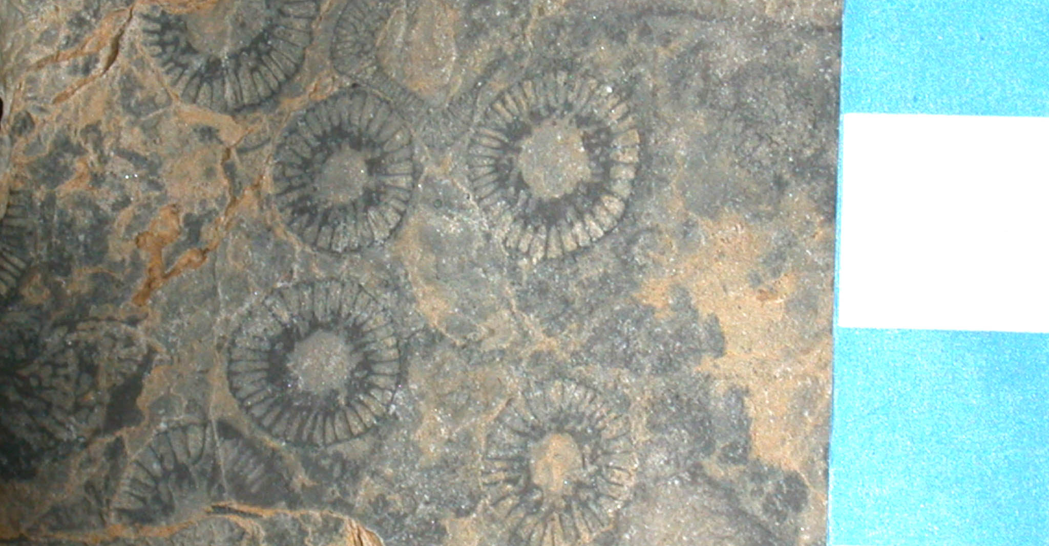
Archaeocyathan Biohermal Limestones
Ethmophylloid archaeocyaths: Barrel Springs, Nevada. Scale in centimeters.

Slide 3
Early Cambrian, Cryptic Habitat Microburrows
Microburrows in shelter porosity spaces were first reported by Debrenne et al. (1989, Geobios 22:137).
Comparable structures were recognized in Mongolia by Wood et al. (1993, Sedimentology 40:829), who referred to these structures as deposit feeder microburrows.

Slide 4
Cryptic Communities
Andrei Yu. Zhuravlev and Rachel Wood, 1995, Lower Cambrian Reefal Cryptic Communities, Palaeontology 38:443-470.
Microburrowed geopetal shelter crypts in toppled archaeocyath central cavities (Pl. 1, Fig. 4).
Crypt spaces packed with stowed fecal pellets (Pl 3, Fig. 1).
Comparable specimens from the Puerto Blanco Formation of Sonora, Mexico and the Poleta Formation of Barrel Springs, Nevada allow a link to be made between these two important features of archaeocyath biohermal carbonate crypts.

Slide 5
Microburrow Nest with Perimeter Burrows
Perimeter burrows on margins. Smaller diameter burrows clustered near nest interior. Similar perimeter burrows have been reported from Mongolia (R. Wood, Reef Evolution). Puerto Blanco Fm., Sonora. Width of view: 20 mm.

Slide 6
Microburrow Diameters
Note small burrows clustered in the center of the nest (upper right center on
this image). Width of view: 5 mm. Puerto Blanco Formation, Sonora, Mexico.

Slide 7
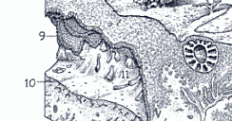
Microburrows at Base of Cavity (10), Fibrous Cement (9) Above
Source: R. Wood, Reef Evolution (1999) ; Artwork: John Sibbick

Slide 8
Clots and Pellets
Rachel Wood (1999, Reef Evolution, p 57) called the matrix “micritic sediment which is often clotted and microburrowed by an unknown deposit feeder.”
Archaeocyathan carbonates from New Jersey (Leithsville Formation) develop clotted textures but also pellets in direct association with burrows (McMenamin et al., 2000, Geobios 33:693-708).
The Sonoran and Nevadan microburrowed Cambrian micrites are derived from disaggregated pellets. The pellets fell apart to form the microburrowed micrite.

Slide 9
Pellets to Micrite
Width of view: 7 mm; pellet diameters 200-500 microns.
Archaeocyath interior; Poleta Formation, Barrel Springs, Nevada.

Slide 10
Pellets, Burrows inside dead Archeocyath
Irregular archaeocyath intervallar space. Note presence of microburrows in
pellet-derived micrite. Puerto Blanco Formation Unit 4, Cerro Rajón, Sonora.
Width of view: 8mm.

Slide 11
The Nest Hypothesis
Microburrows (now spar-filled) developed stabilized burrow walls to allow pore fluids to circulate.
The smaller diameter microburrows occur in the center of the nest. The opposite should be the case if the burrow systems were designed for adult occupation, as the larger burrows would have to be centrally placed to ensure adequate pore water circulation. (Initial, small central burrows received ample circulation as the outer pellets were still intact at the time.)
Pellets disaggregated into micrite riddled with microburrows. Some of the latter followed the contours of relict pellets.
Nest perimeter burrows conduct fluid past impermeable obstructions.

Slide 12
Evaluating the Null Hypothesis
The null hypothesis (N.H. = pellet caches were microburrowed by an unrelated organism) is falsified by the following evidence: microburrowing begins in the center and moves to the peripheral areas; the burrow network has an organized and even geometrical aspect (microburrows have angular bends, tend to avoid each other); burrow walls are stabilized, remain intact, and evidently do not represent deposit feeding traces made by vagrant burrowers.

Slide 13
Pellet Parenting
Step 1: Locate and/or excavate a shelter porosity space.
Step 2: Pack the space with pellets containing refractory organic matter.
Step 3: Deposit eggs near the center of the pellet nest.
Step 4: Hatchlings feed on microbial gardens while they master locomotion by navigating the temporary porosity space between pellets.
Step 5: Pellets disaggregate; porosity renewed by the apprentice burrowers moving through the micrite, thus allowing continued “microbial farming.”

Slide 14
Advantages
Hatchlings are protected in their sheltered nest from the onslaught of Early Cambrian predators.
This strategy provides for a hatchling food source, developed via an agrichnial, ectosymbiotic relationship with microbes lining the nest burrows.
Perimeter burrows provide enhanced circulation around impermeable barriers.
The cryptic nursery habitat is buffered from any of a variety of environmental insults.

Slide 15
Implications
1. Earliest evidence for “Mom,” that is to say, rudimentary maternal care. A trace maker female was likely responsible for pellet installation, as she was presumably in charge of laying the eggs.
2. Earliest evidence for significant parental investment in nest construction.
3. The advanced behavior reported here occurs in the Early Cambrian, thus adding significantly to the perceived magnitude of the Cambrian Explosion.

Slide 16
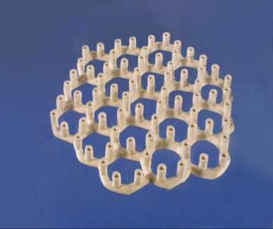
4. Graphoglyptid Controversy
Paleodictyon reconstruction by Hans Luginsland; Rona et al. (2009)

Slide 17
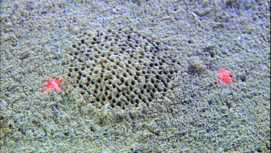
Paleodictyon nodosum
Image courtesy the Stephen Low Company. 10 cm laser beam separation.

Slide 18
Early Cambrian Protopaleodictyon
Lower Cambrian, western Canada. Photo credit: J. Magwood

Slide 19
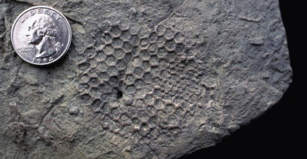
Eocene Paleodictyon
Sole of Eocene turbidite, Vienna, Austria.
Photo Credit: A. Seilacher and P. Rona

Slide 20
Graphoglyptids: Trace or Body Fossils?
A remarkable 2009 paper in Deep Sea Research II (56:1700-1712) presented conflicting interpretations of Paleodictyon.
Seilacher: These graphoglyptids are ectosymbiotic microbial culture chambers, hence they represent Cambrian to Recent trace fossils.
Peter Rona: Graphoglyptids are body fossils of some unknown organism (sponge? xenophyophore? Ediacaran?).

Slide 21
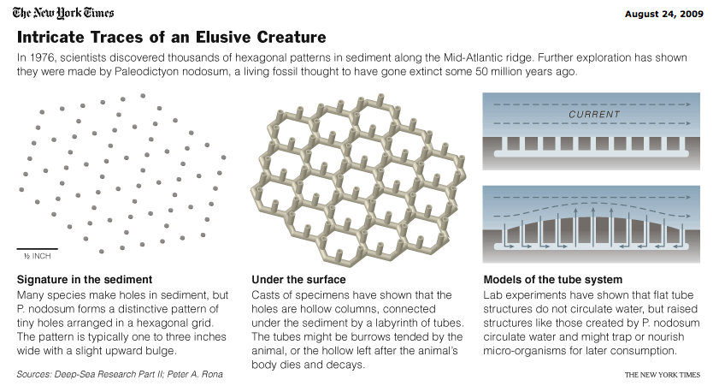
Graphoglyptids in the New York Times (2009)

Slide 22
Puzzle and Solution
Conundrum: No actual trace maker, no cytoplasm, no sponge spicules, no excess microbial biomass, nor the actual remains of the presumed hexagon network organism, has ever been recovered in the modern graphoglyptid examples.
Solution: Modern graphoglyptids are nests. The young have departed, leaving behind an empty nest that lasts decades or more on the deep sea floor.

Slide 23
Graphoglyptids as Nests
Modern graphoglyptids “may last for tens to hundreds of years under the prevailing conditions” at the TAG hydrothermal field at the mid-Atlantic Ridge (Rona et al., 2009).
Refractory organics are depleted by the time the nests are collected by researchers (hence only background levels of bacteria are detected). The microbial garden has been harvested.
Seilacher speaking in Stephen Low’s IMAX production Volcanoes of the Deep Sea as he searches for the animal: “Nothing!”

Slide 24
Conclusions
Graphoglyptids are trace fossils, ectosymbiotic mushroom farm nests (or, better to say, microbe farm honeycombs?) constructed for the care and feeding of hatchlings.
They first appear in the Early Cambrian in both carbonate (microburrow nests) and siliciclastic (Protopaleodictyon) environments. Nest perimeter microburrows provide enhanced circulation.
Graphoglyptid nesting behavior migrated into deep water during the Phanerozoic to avoid dangerous shallow water habitats. The nests are living fossils, optimized for passive seawater flow through the burrow nest network.

