Slide 1

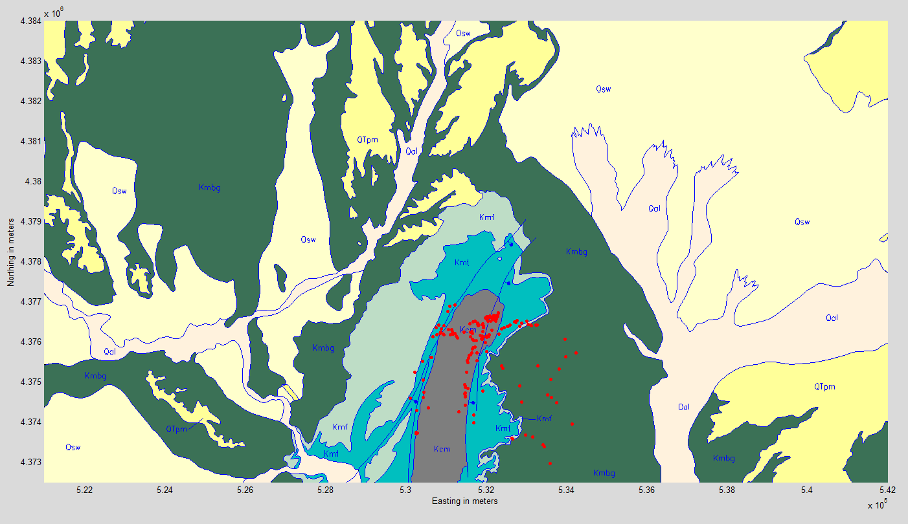
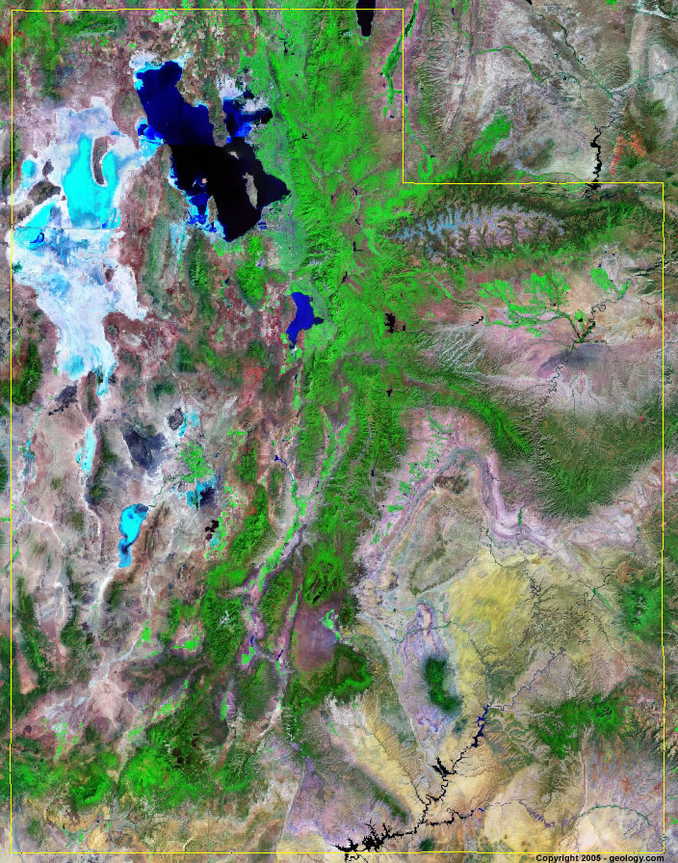
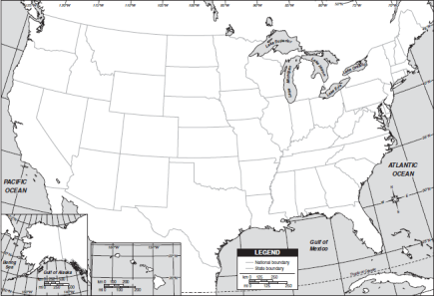
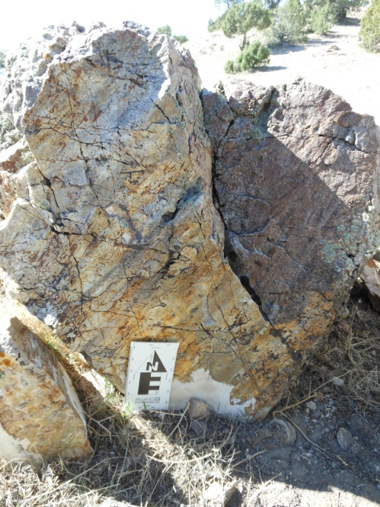
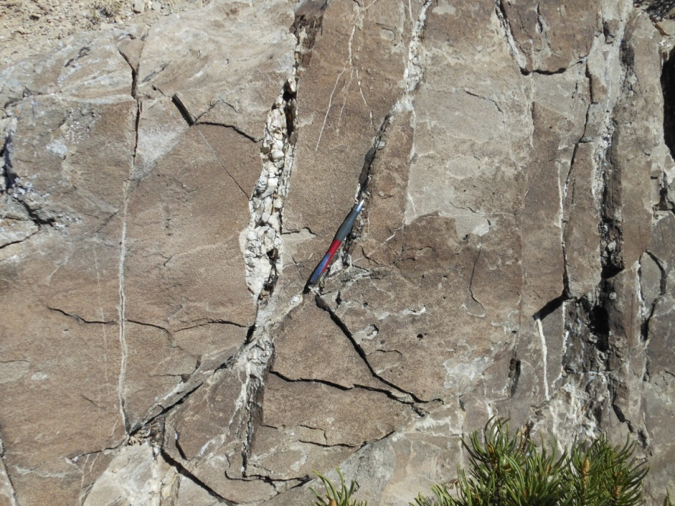
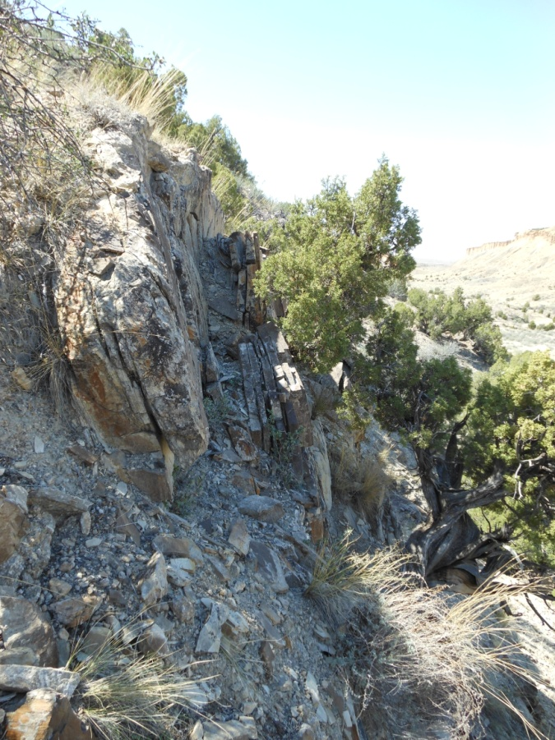
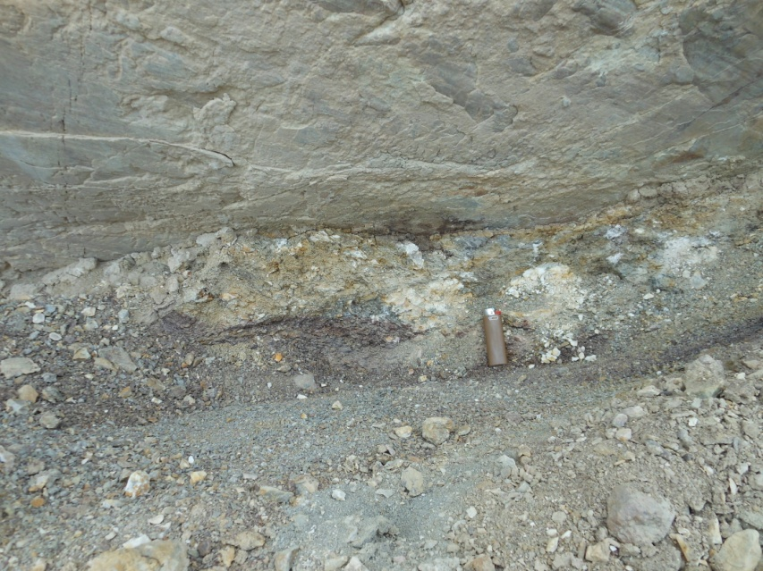
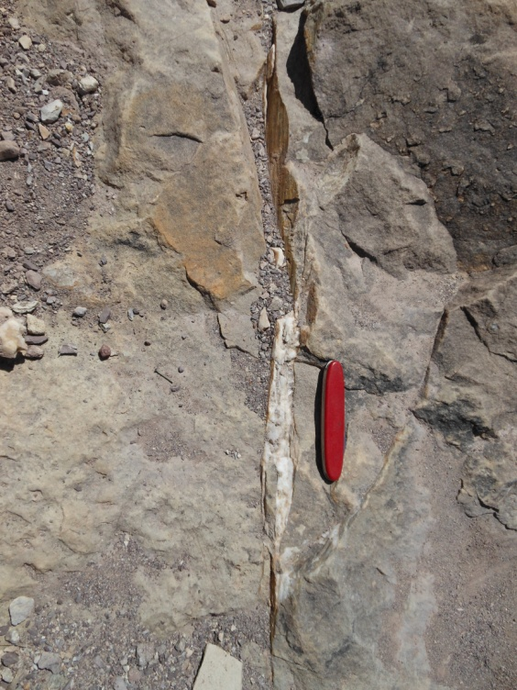
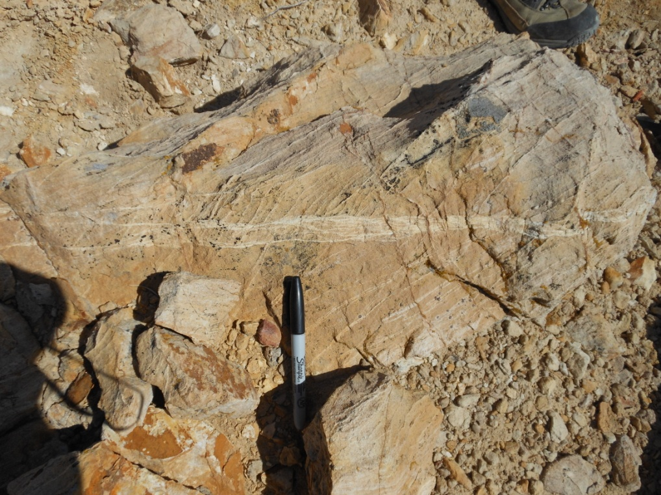
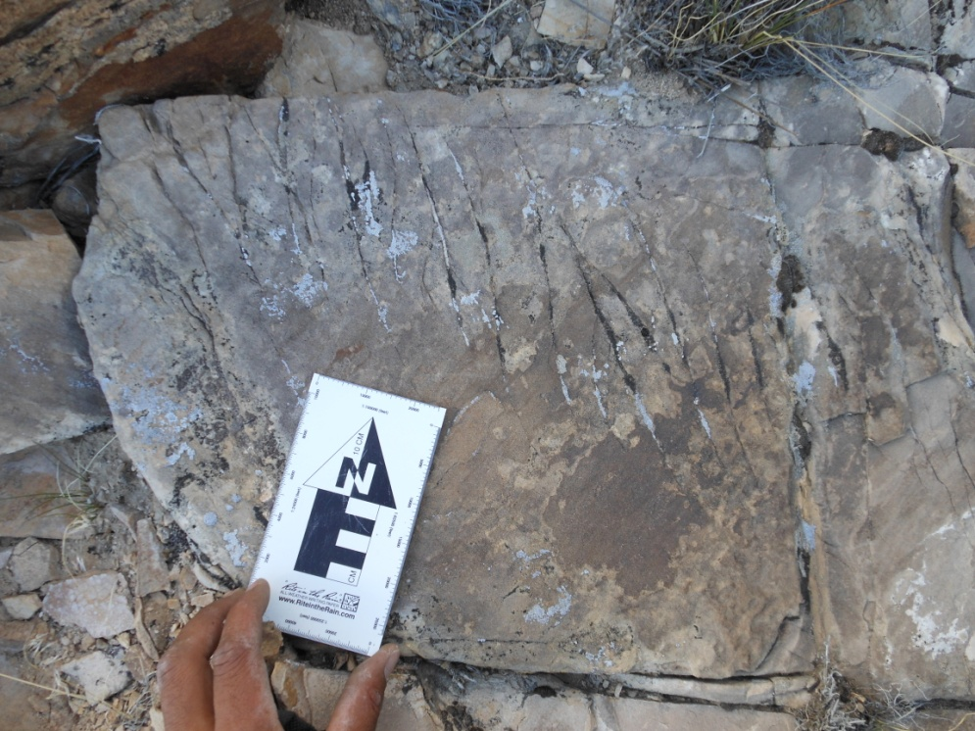
Structure and stable isotope systematics of the Farnham Dome, SE Utah P. Benjamin Luetkemeyer, Ethan Shavers¹ & David L. Kirschner²
¹Saint Louis University, Department of Earth and Atmospheric Sciences, St. Louis, MO
²Shell International Exploration and Production Inc., Houston, TX
Calcite samples were collected for stable isotope analysis to constrain sources of fluids migrating along faults and fractures.
Stress inversion was performed on structural data to constrain principal stress directions.
Our results are consistent with fluid mobilization along detachment and thrust faults during Sevier-age deformation.
Abstract
The Paradox Basin, SE Utah, hosts a number of large accumulations of hydrocarbons and CO₂. Many reservoirs are found in crests of north-northwest trending anticlines with four-way, fault-seal closure. These reservoirs in the Paradox Basin provide us an unique opportunity to explore issues related to CO₂ sequestration. Farnham Dome (FD) is a ~25 km² area in east-central Utah featuring a natural CO₂ reservoir. The FD is a Laramide-related anticline formed as a result of re-activation of older reverse faults. CO₂ found in the Jurassic Navajo sandstone and Permian White Rim Sandstone is believed to have formed from thermal decomposition of Paleozoic carbonates. It is believed that the reservoir has remained sealed for at least 10 million years. Questions still remain as to the source of extensive calcite deposits within FD. Calcite deposits are found on fault surfaces and as fracture fill. Previous workers proposed that e leaks developed during Sevier deformation with subsequent calcite precipitation eventually sealing the leaks. Alternatively, calcite precipitated from groundwater that came from the Uinta Basin to the north and migrated along a detachment zone in the Carmel Formation. This study seeks to determine whether the presence of calcite in the FD is related to leakage due to top seal failure or leakage associated with faulting during deformation.
Introduction
Field Work
Results
The Farnham Dome (FD) in east-central Utah (Fig. 1) is an elongate N-S trending, doubly plunging anticline that serves as trap for an estimated 430 BCF (12.2 x 10⁹ m³) of CO₂ within the Jurassic Navajo Sandstone (Morgan, 2008). Large-scale deformation was dominated by kilometer-scale thrusts and thrust–related folds (Fig 2). The faults have been interpreted as Sevier-style thrust faults that terminate in a detachment in the Jurassic Carmel Formation (Neuhauser, 1988).
Approximately 250 structural measurements were made on mesofault surfaces, calcite-filled veins, bedding planes, deformation bands, and en echelon vein arrays (Fig. 2). Majority of measurements were taken from the Dakota Sandstone. Mesoscopic structures are characterized by: (1) conjugate sets of reverse and normal faults oriented perpendicular to the fold axis and at high angles to bedding; (2) conjugate sets of strike-slip faults oriented parallel to the fold axis; (3) deformation bands; (4) calcite-filled en echelon vein arrays; and (5) calcite-filled fractures.
Approximately 120 samples were collected for stable isotope analysis of calcite veins and slickensides.
Isotopic values of syndeformational calcite show little variation between Farnham Dome and a similar structure located ~40 km (Little Grand Wash). Vrolijk and others (2005) estimate a temperature of 100 to 125°C for juxtaposed units at LGW based on a 38 Ma age of authigenic I/S and a regional basin model. We calculate a range of values representing δ¹³C(HCO₃⁻) and δ¹⁸O(H₂O) in equilibrium with the sampled calcite from 100 to 125°C. Morgan (2008) proposed that CO₂ may be sourced from decomposition of carbonates in the Uinta basin to the north. Isotopic composition of Uinta basin formation waters are shown (yellow circles). Isotopic composition of Navajo waters are represented by blue triangles.
SRS
b
c
d
Paradox Basin
a
b
c
d
100°C
125°C
Extensive calcite
Equity Mounds #3
Jurassic
CO₂
Navajo Sandstone
Triassic
Paleozoic
e
f
g
Precambrian
Figure 1. Geologic setting of the Farnham Dome. (a) Geologic map of the area showing rock units, faults, and sample localities (red dots). Inset - Satellite image of Utah. The study area (marked by a white star) is located on the northern flank of the SRS (SRS – San Rafael Swell). Geologic map of the area showing rock units, faults, and sample localities. (b) Cross-section modified from Morgan (2008).
Figure 2. Photos of structural features from various localities. (a) striated fault surface; (b) calcite-filled vein set; (c) overturned bedding; (d) fault gouge; (e) slickensided calcite in dilational jog; (f) deformation bands; (g) en-echelon vein array.
Figure 3. Stable isotope (δ¹⁸O VSMOW and δ¹³C VPDB) . Blue box represents the isotopic composition of water in equilibrium with FD slickensides and veins at temperatures ranging from 100°C to 125°C.

