Slide 1

Shock attenuation, waste shock heat and related hydrothermal effects in the central uplift from Manicouagan
Planetary and Space
Science Centre
Sarinya Paisarnsombat
University of New Brunswick
Canada

Slide 2
Outline
Introduction
Shock Decompression
Shock Pressure Calculation
Hydrothermal Evidence
Conclusions
Notes:
I would like to start my talk with an introduction, then talk about shock decompression in general, followed by a calculation of shock pressure. And I’ll end up with showing you the hydrothermal evidence at the Manicouagan and conclusions.

Slide 3
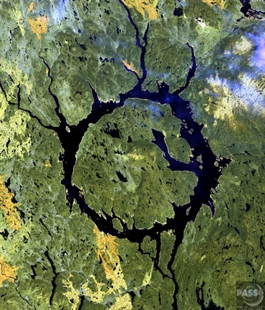

Introduction
Manicouagan Impact Structure
One of the best preserved complex impact craters
∼90 km rim-to-rim diameter
214 Ma formation age
Grenvillian metamorphic gneisses
Impact-induced hydrothermal systems
Shock Decompression
Presence of fluid
System permeability
Heat sources
Impact-generated melt sheet
Shock decompression
Central Uplift
Shock attenuation
Waste shock heat
3
Notes:
Manicouagan impact structure is one of the best preserved complex impact crater on earth.
Its rim-to-rim diameter is about 90 km.
Manicouagan was generated 214 million years ago on Grenvillian metamorphic gneisses target rocks.
When talking about impact-induced hydrothermal systems, there are three important factors that are required to generate the system
System permeability, for impact event it’s referred to the fracture systems created by impact
A presence of fluid, in this case, absolutely there is water a presence of
The most important factor is the heat, which can be generated from three different sources
- first, impact-generated melt sheet
- second is heat generated from shock decompression
- the last source is an elevated of buried rocks, or central uplift
I’m gonna be focusing on heat generated from shock decompression which is related to the shock attenuation and the waste shock heat.

Slide 4
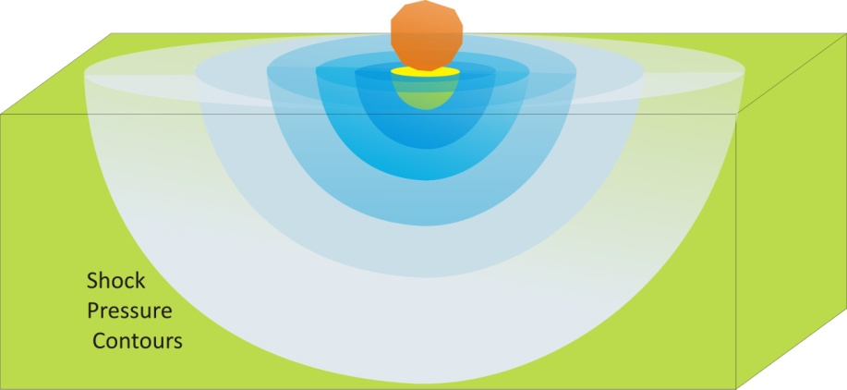
Shock Decompression
“Shock pressure” generated by an impact can be expressed into two pressure regimes:
1. Isobaric Core
Pressure slowly decays over an area from the point of impact to ∼ one projectile radius, r₀
Croft, 1982 : approximates the average pressure, P_{a} , in the isobaric core, P_{a} ≅ 0.67 P_{max}
P_{max} is a maximum impact pressure at the contact surface
2. Shock Attenuating zone
At radial distance, r, greater than r₀
Attenuation rate of
Isobaric Core
Shock attenuation
P_{(r)} = P_{a} (r/r₀)^{n}
4
Notes:
Shock pressure that generated by an impact can be expressed into two pressure-decay regimes
Isobaric Core
It’s a volume, shown as a yellow volume in the cartoon here, where pressure slowly decays over an area from the point of impact to approximately one projectile radius, referred to r₀
Croft, 1982 gives an approximation of the average pressure, referred to Pa, within an isobaric core to be equal to 67 percent of Pmax
Where Pmax is a maximum impact pressure at the contact surface
The second regime is a shock attenuating zone
In which shock pressure at the radial distance, r, greater than one projectile radius from the point of impact, decays as a function of radial distance shown as a relationship here, which I will talk about it later on.

Slide 5
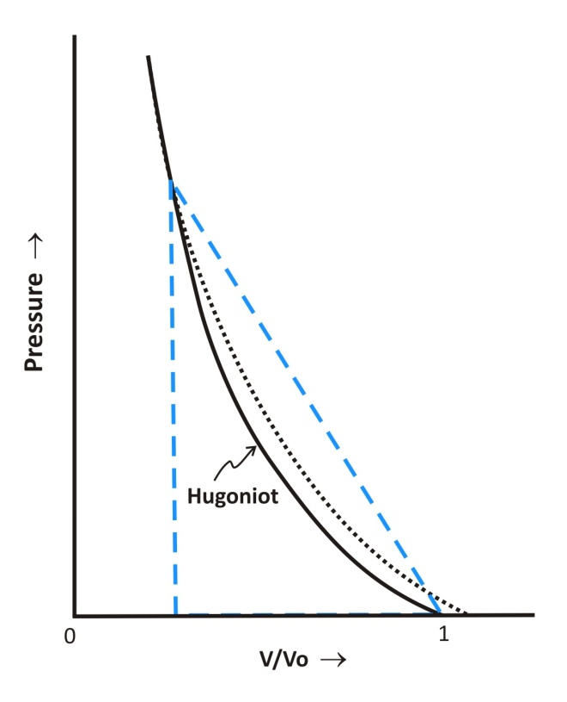
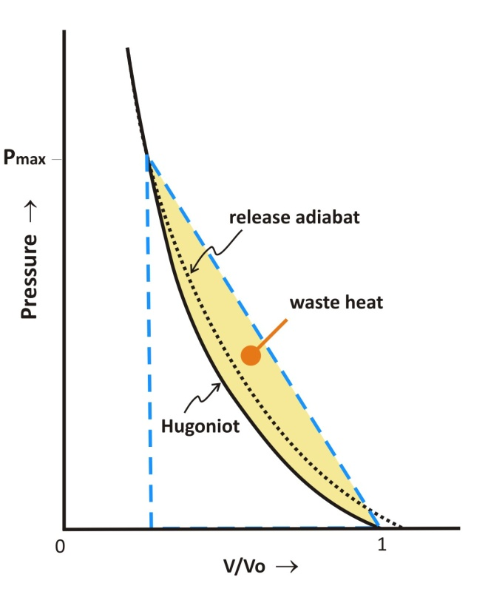
Shock Decompression
“Total energy” developed from shock decompression can be divided into two types:
1. Release Adiabatic Energy
Energy gives back to the shock
Approximately identical to the Hugoniot Curve
2. Waste Shock Heat
Irreversible energy deposited in shocked material
Raises temperature of the volume element
P_{max}
5
Notes:
Additional to the shock pressure, energy is also developed during the shock decompression and can be expressed using the Hugoniot Equations, which you all may have probably come across, or even familiar with these equations already. The sketch here showing different shock paths from maximum shock pressure release to zero-pressure on a Pressure-Volume plane, just to illustrated the energy produced by shock.
Total energy developed from shock decompression is an area within a triangle under the linear shock path, shown as a straight line from maximum pressure to zero pressure here.
It can be divided into two types:
Release Adiabatic Energy , which is the deposited energy that gives back to the shock, along the release adiabatic curve here. and it can be approximately identical to the Hugoniot Curve generated from the Hugoniot Equations.
The rest of the energy is irreversible energy deposited in shocked material called Waste Heat . This energy is a difference between total energy and release adiabatic energy, which illustrated as yellow area here. Waste heat will add up to internal energy of rock itself and raises temperature of the volume element. Which is the energy that I’m focusing on here.

Slide 6
Shock Pressure Calculations
Hugoniot Equations
Equation of state
U_{s} = C₀ + SU_{p}
Planar impact approximation
 | Projectile parameters for Manicouagan
 | Projectile | Type | Achondrite
 |  | Density | 3.1 Mg/m³
 |  | Diameter | 5 km
 |  | Impact velocity | 15 km/sec
Ahrens and O’Keefe 1977, Melosh 1989
Maximum impact pressure, P_{max}
Shock attenuation
Waste shock heat
6
Notes:
In order to estimate the waste heat at Manicouagan,
First we have to calculate shock pressure, and shock attenuation, by using the specific properties of projectile and target materials to create Equation of State based on reference data, and then using Hugoniot Equations and Planar impact approximation to determine the maximum impact pressure, then shock attenuation, and finally estimate the waste shock heat deposited in the target rocks at Manicouagan.
Impact conditions of a 5 km-diameter achondrite projectile, with density of 3.1 Mg/m³ impact on the target with velocity of 15 km/sec, were used in the calculation.

Slide 7
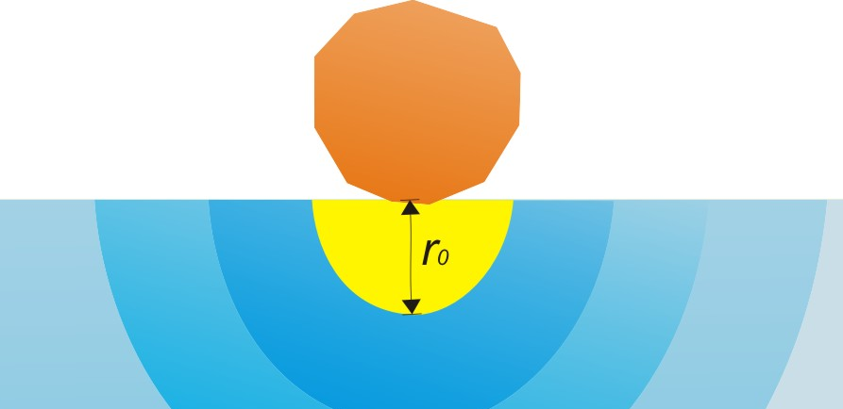
Shock Pressure Calculations
Isobaric Core
Gault and Heitowit 1963, Croft 1982, Collins 2002
Maximum impact pressure, P_{max}
 | Equation of State, U_{s} = C₀ + SU_{p}
 |  | Rock name | Sample density | C_{o} | s | Diameter | Impact velocity
 |  |  | (Mg/m³) | (km/sec) |  | (km) | (km/sec)
 | Projectile | Basalt | 3.1 | 4.96 | 0.88 | 5.0 | 15
 | Target | Gneiss | 2.79 | 2.68 | 1.54
 |  | Data from Ahrens and Johnson 1995
P_{max}
281 GPa
Average Pressure, P_{a}
Projectile radius r₀
P_{a} = 188 GPa
P_{a} ≅ 0.67 P_{max}
Isobaric Core
7
Notes:
Pressure within the isobaric core is calculated according to the method from these references here.
First, maximum impact pressure or P_{max}, which is the pressure generated at the contact is estimated using Equation of State data from Ahrens and Johnson 1995.
Basalt was used as a representative of a projectile on a gneiss target rock.
The results gives the maximum impact pressure of 281 Gpa
An average pressure within the isobaric core, then can be approximated as 67 percent of the maximum impact pressure, which is about 188 GPa.
Note: P_{a} ≅ 0.67 P_{max} gives “isobaric core pressure” at about 192 Gpa, which is also agreed with the attenuation rate of near-field calculated in Ahrens and O’Keefe 1977

Slide 8
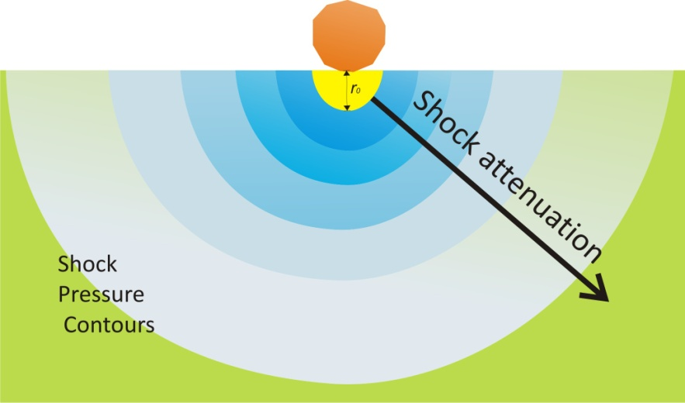
Shock Pressure Calculation
Shock Attenuating zone
Ahrens and O’Keefe 1987, Ahrens et al. 2002
P_{(r)} = P_{a} (r/r₀)^{n}
P_{a} = Average shock pressure in isobaric core, 188 GPa
r = Distance from a point of impact
r₀ = Projectile radius, 2.5 km
n = Attenuation index, -2 , n ≅ -0.625 log(v_{i}) – 1.25
8
Notes:
This average pressure at isobaric core, then attenuates with respect to radial distance from the impact point as a decay function here.
Where n is an attenuation index, which has a linear-relationship with a logarithm of impact velocity, approximated from Ahrens and O’Keefe 1987

Slide 9
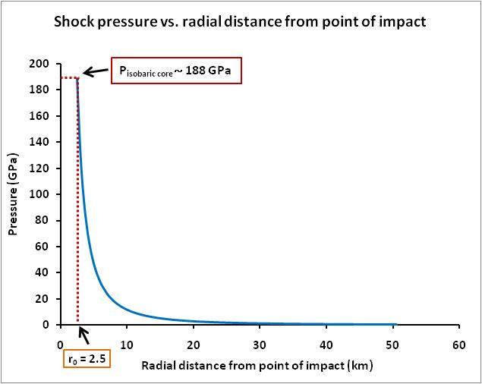
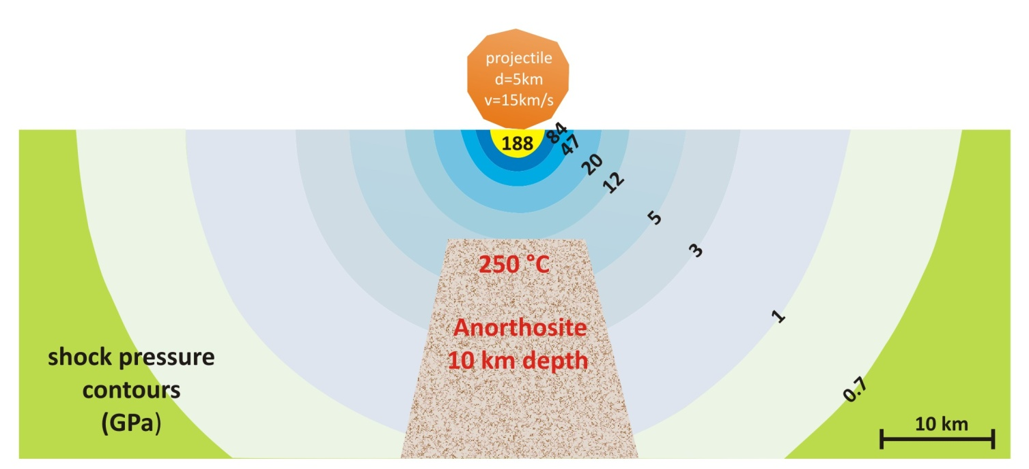
Shock Attenuation
Central Uplift :
Anorthosite
Depth of 10 km
Shock pressure of < 11.8 GPa
11.8 GPa
9
Notes:
The calculation suggests that pressure of 188 GPa within the isobaric core at distance of 2.5 km from the impact point rapidly decay as an exponential function shown as a diagram here.
A cartoon indicates shock pressure contours in GPa respect to the radial distance from the impact point, and it suggests that the central uplift which is an anorthosite rock that have been buried at about 10 km depth before the impact event, may have experienced shock pressure of 11.8 GPa or less.

Slide 10
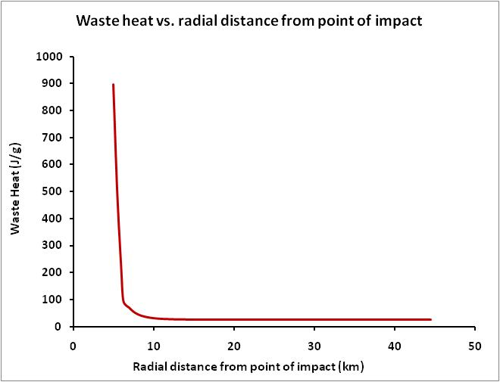
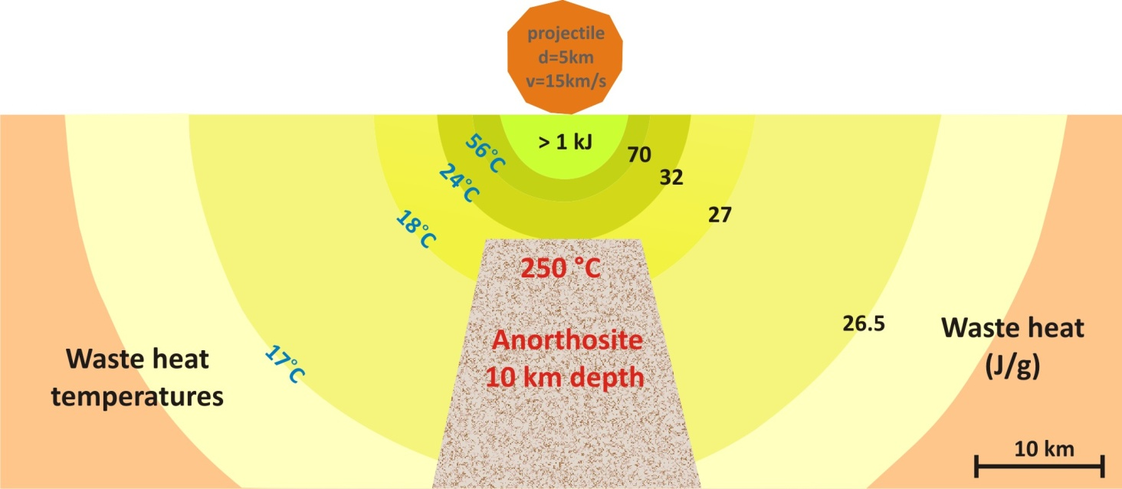
Waste heat
Sharp and DeCarli 2006
Central Uplift:
Waste heat ∼ 32.24 J/g
32.24 J/g
Waste heat temperature ∼24 °C
Postshock temperature ∼274 °C
Waste heat temperature
Waples and Waples 2004
Specific heat capacity of rock at 20 °C
C_{pnT} = 8.95x10⁻¹⁰T³ -2.13x10⁻⁶T² + 00172T + 0.716
10
Notes:
Waste heat can be estimated from shock pressure. At the distance close to isobaric core, pressure is quite high, and it’s resulting in an anonymous numbers of waste heat deposited in the rock relatively to waste heat at lower pressure. The maximum waste heat energy is about 5 kJ/g at 2.5 km to about 1 kJ at 5 km. It’s a huge number. This may be due to the phase transition occurred within this volume of material.
Considered the waste heat at the central uplift, an approximated energy of 32.34 J/g, due to shock pressure of 11.8 GPa, has deposited in the anorthosite rock, which raises the internal energy of the anorthosite. The waste heat temperature is estimated using the specific heat capacity of rocks at 20C and the normalized heat capacity, giving the waste heat temperature of 24C, and the postshock temperature of anorthosite approximately 274 C

Slide 11
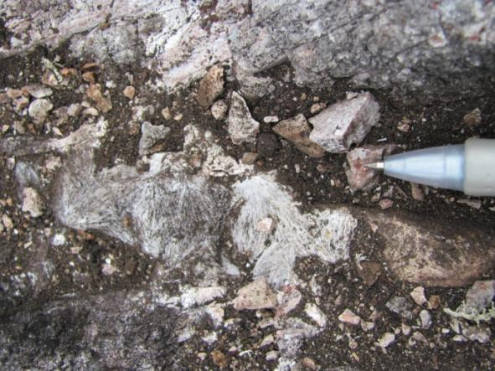
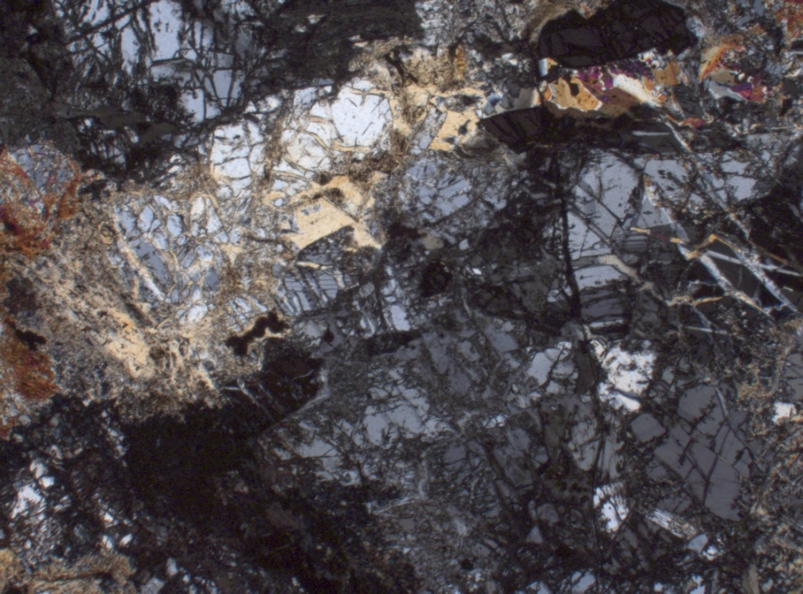
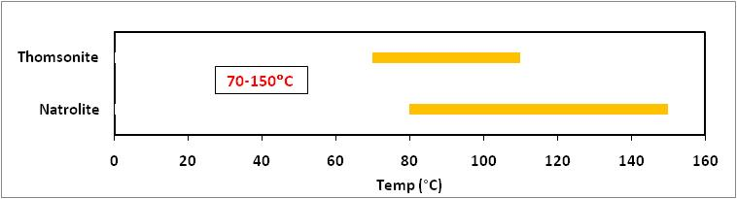

Hydrothermal Evidence
Hydrothermal minerals
Zeolite : natrolite, thomsonite
Natrolite
Thomsonite
1.5 cm
1 mm
Thermal constraint
11
Notes:
At the central uplift, the most abundant hydrothermal mineral present here are zeolite group mineral, which mostly are thomsonite and natrolite
Photo on the left showing 1.5-cm wide natrolite vein discovered on the central uplift, while an optical microscopic image on the right showing thomsonite present in the fracture of rocks.
From the presence of thomsonite and natrolite as predominant hydrothermal minerals, the approximate thermal constraint within the central uplift at Manicouagan would be around 70-150°C

Slide 12
Hydrothermal Evidence
Collapsed rim
~ 25 km from geometric center of the crater
Shock pressure : < 1 GPa
Waste heat : < 26.5 J/g
Temperature : ∼ 26.5°C
T_{postshock} : ∼ 51.5°C
Biren and Spray 2011
12
Notes:
From the shock attenuation,
Collapsed rim, which is now located at about 25 km from geometric center of the crater, shown in the yellow box here, may have been shocked at greater distance than 25 km before collapsed, and may have experienced the shock pressure less than 1 Gpa, with waste heat less than 26.5 J/g. Waste heat temperature can be approximated as 26.5°C , giving the postshock temperature of about 51 °C since it was at the surface at the time of impact event.

Slide 13
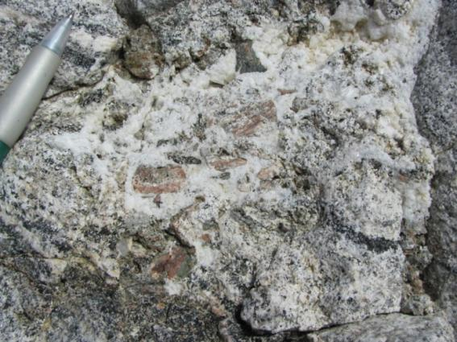
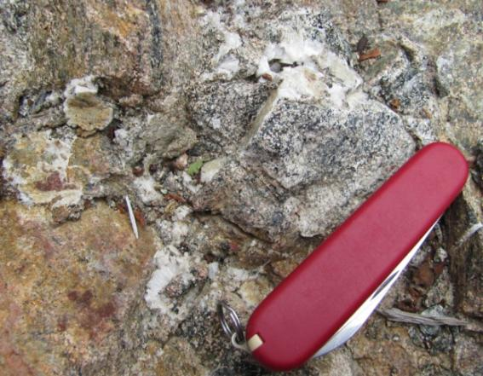
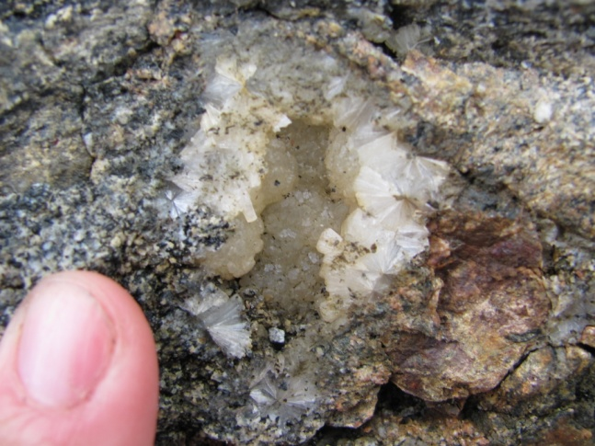
Hydrothermal Evidence
Collapsed rim
Zeolite : stilbite, chabazite
Chabazite
3 cm
Chabazite
Stilbite
3 cm
Thermal constraint :
50 – 140 °C
Stilbite
1.5 cm
13
Notes:
Not only at the central uplift, at a location about 25 km west of the center of the crater, which may considered as the collapsed rim, also have an evidence of hydrothermal alteration. Chabazite and stilbite which are zeolite group mineral present in this area. The temperature involved in the hydrothermal within this area would be around 50-140°C

Slide 14
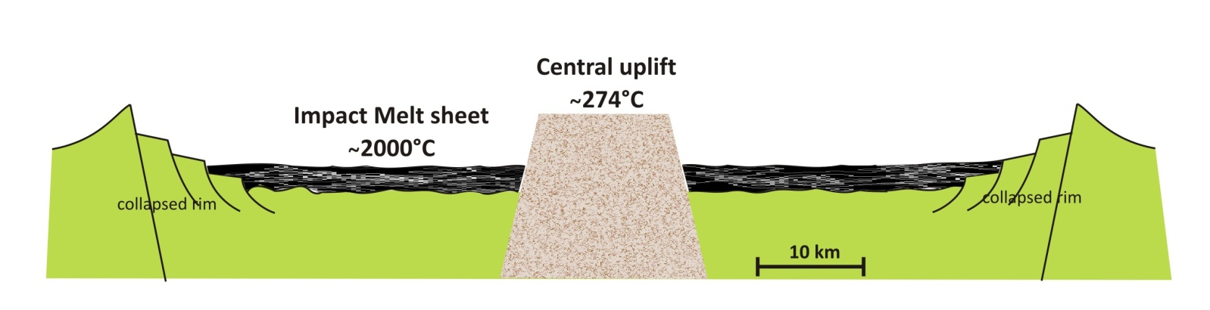
Conclusions
The central uplift at Manicouagan may have experienced shock pressure of 11.8 GPa or less, with waste heat of 32.3 J/g deposited in the rock, resulting in an increase of 24 °C in temperature
Waste heat generated from the shock pressure may not be an important heat source for hydrothermal alteration within the central uplift
Important heat sources for impact-induced hydrothermal systems :
14
Notes:
- The shock pressure calculation suggests that the central uplift at Manicouagan may have experienced shock pressure of about 11.8 GPa or even less, with 32.3 J/g waste heat deposited in the rock which giving an increased in temperature of 24 °C
The results also shows that waste heat generated from the shock pressure may not be a significant heat source for hydrothermal alteration within the central uplift
The most important heat source for impact-induced hydrothermal systems is impact melt sheet, which the temperature can be up to about 2000 °C. The central uplift which rocks at approximately 10 km depth have been brought up and carrying heat of about 250 °C to the surface, plus energy from waste heat, giving the possible temperature at the central uplift of about 274 °C
-Further study of shock effect on drill-core samples, together with calculations would give more precise shock attenuation and energy produced by shock pressure, which will be useful in order to investigate the post-impact hydrothermal systems at the crater.

Slide 15



Acknowledgement
The Geological Society of America
Development and Promotion of Science and Technology Talents Project (DPST)
The Royal Thai Government
Planetary and Space Science Centre (PASSC)
All PASSC Teams

Slide 16
Abstract
Hydrothermal systems in impact structures arise from three main sources of heat: (1) impact melt; (2) central uplift rocks that have been elevated from depth and (3) waste shock heat. The relative contributions of these sources depend on location within a given structure, as well as crater dimensions. In the central uplift of the 90 km rim-diameter Manicouagan impact structure of Canada, I attempt to differentiate thermal effects due to exhumation of previously buried anorthositic rocks, which have been virutally instantly elevated due to exacavation and modification stage processes, versus heat from shock. Given negligible structural disruption of central uplift units at Manicouagan, the elevated isotherms remain subhorizontal, or at least parallel to one another, whereas the waste heat contribution defines hemispherical zones about the projectile contact region, with higher temperatures being realized nearer the core of the uplift. The latter contribution is dependent on the maximum shock realized and the shock attenuation rate. Differentiation between these two heat sources (exhumed warm footwall and waste shock heat) is sought by characterizing associated hydrothermal effects in the anorthositic host rocks. These effects are manifest in zeolite development, the distribution, volume and mineralogy of which is defined across the uplift structure.

