Slide 1
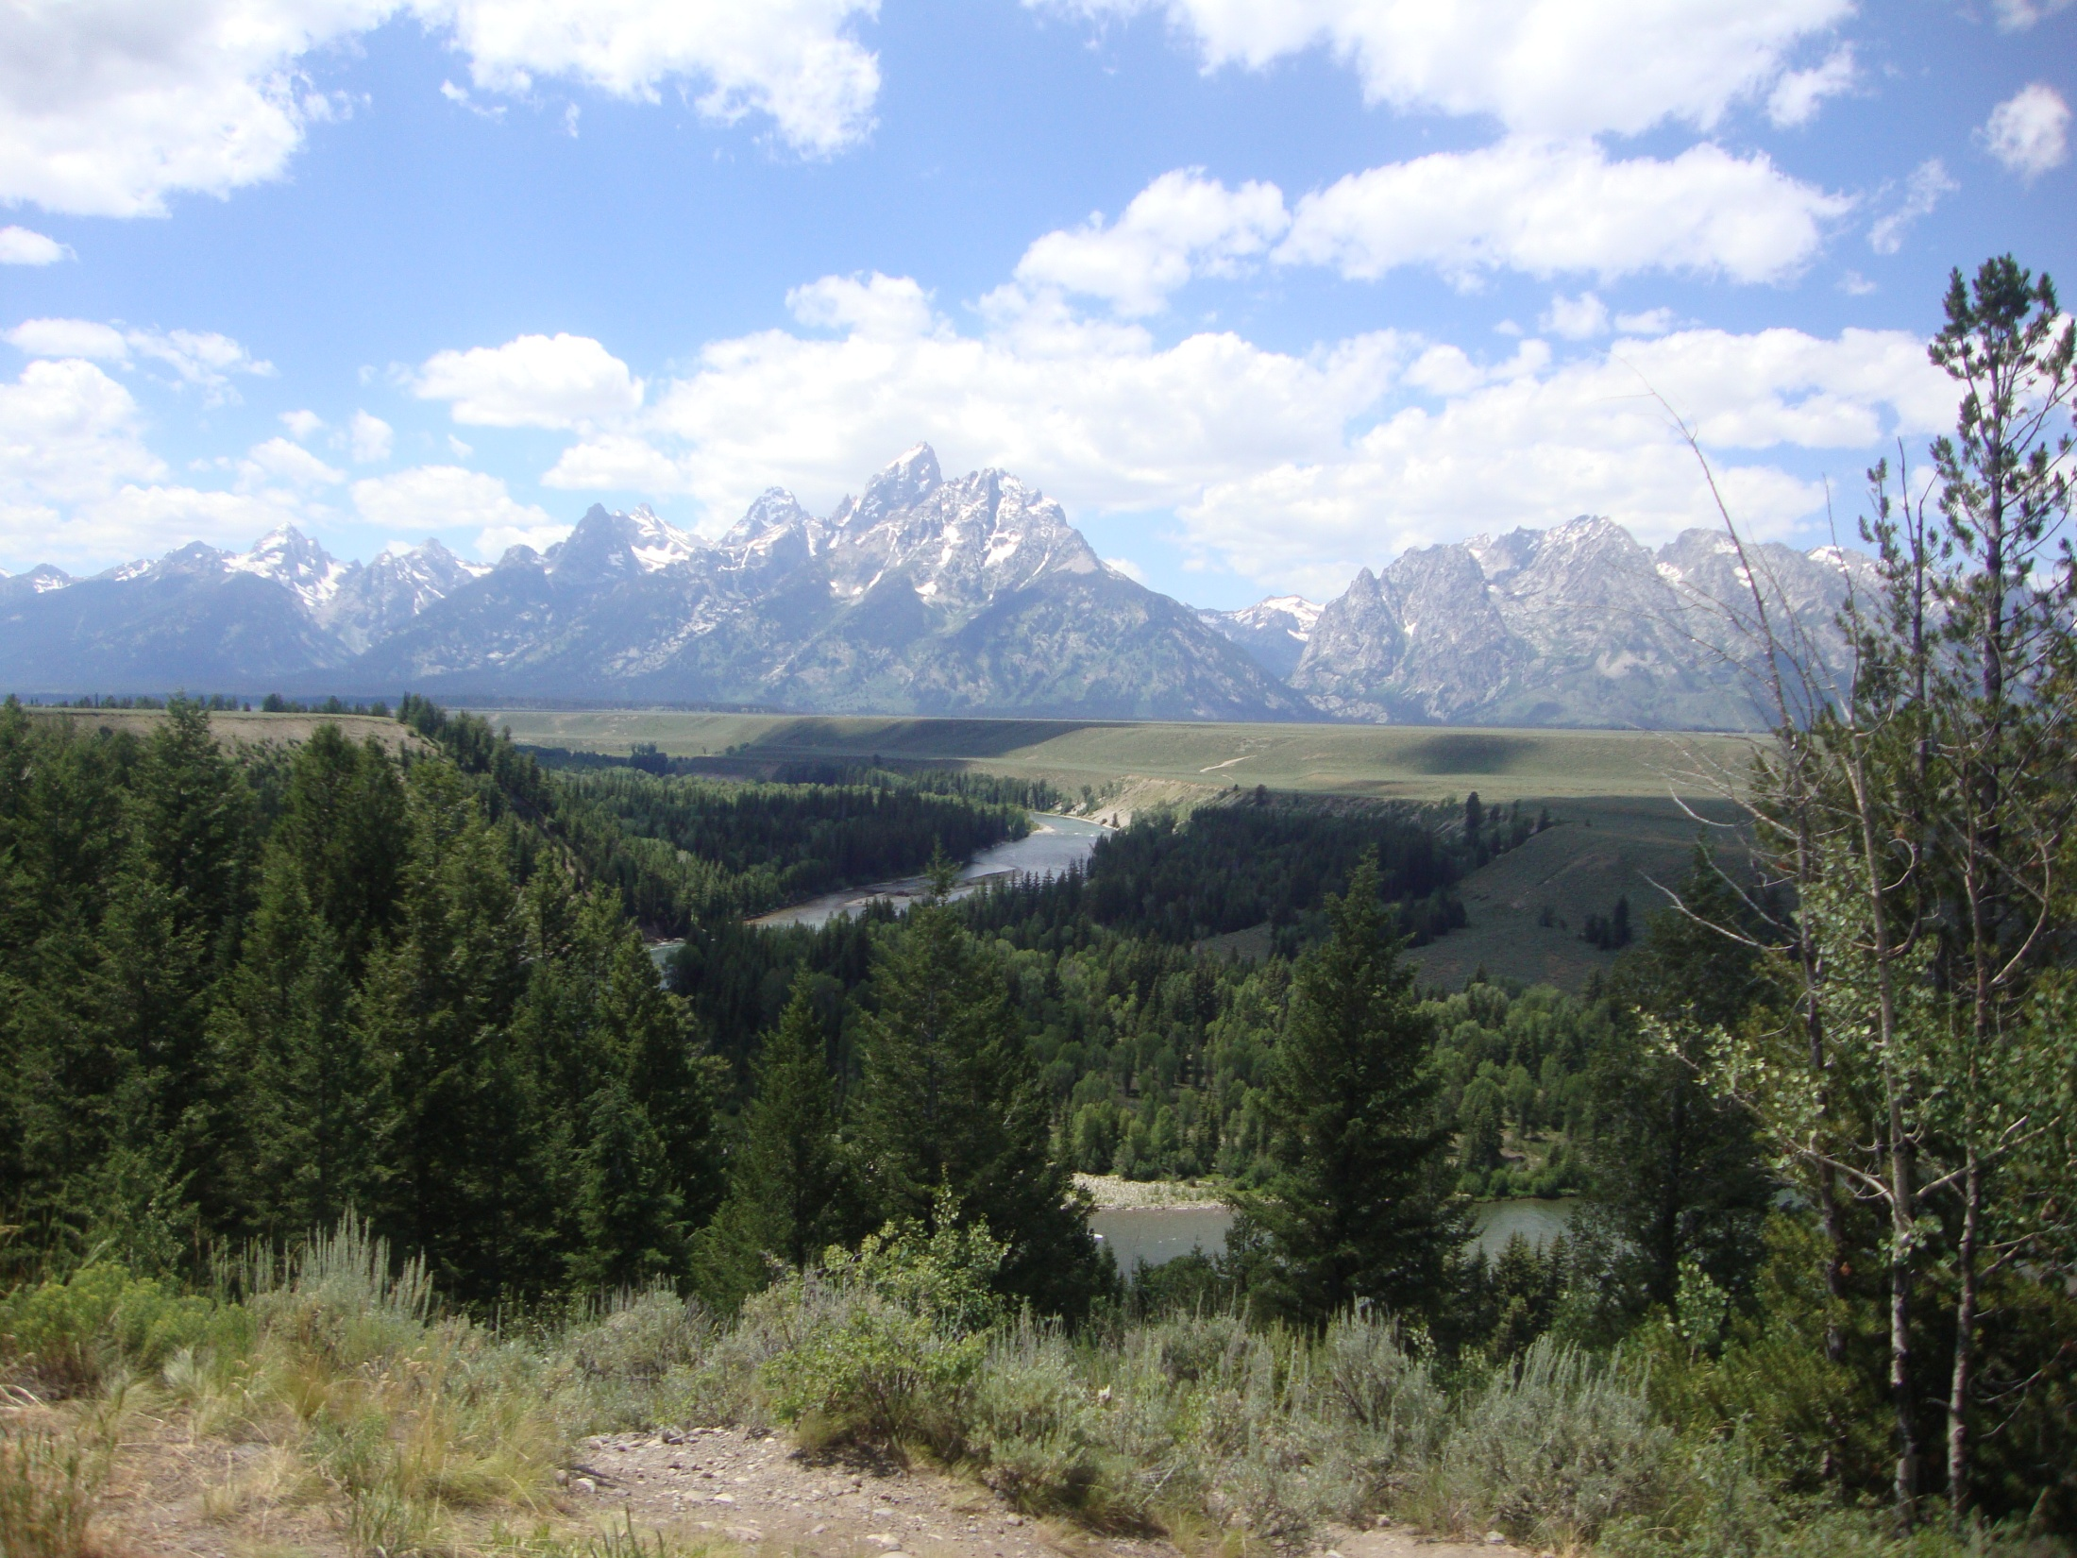


Purposeful Integration of Case Studies and Digital Technologies in
Introductory Geology Classes
Amanda Colosimo
Monroe Community College
Rochester, NY

Slide 2
Case Studies
Add Context and Meaning
“Reach Back” and “Pull Forward”
Conceptualize Relationships
Increase Student Engagement
Increases higher-order thinking
Flexible rigor and length

Slide 3
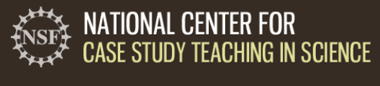
Discipline | Number of Case Studies Available
Biology | 250+
Chemistry | 36
Physics | 12
Geology | 11

Slide 4
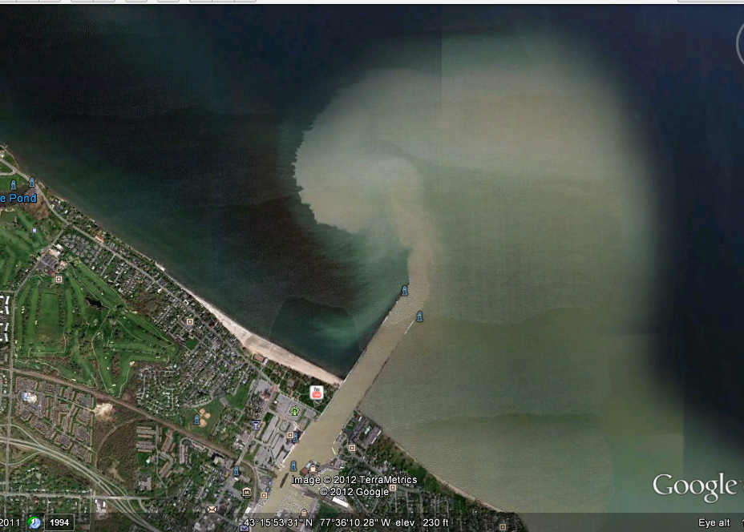
Know your population
81% Monroe County
24% never visited
State or National Park
80% Nat. Sci Course
20% Related to Major
Avg. Age: 24, Range 17-59

Slide 5
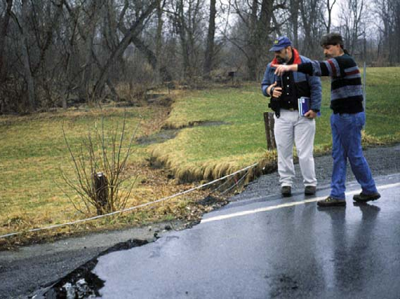
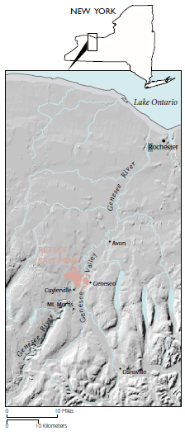
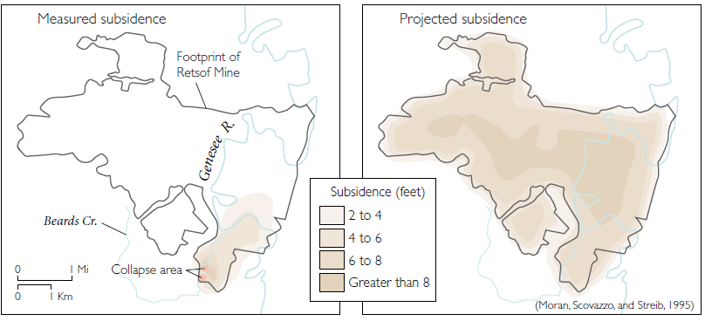
Case 1:
Retsof Salt Mine Collapse, Cuylerville, NY 1994
Mineral contribution to local economy
Mineral properties and uses
Environment of deposition
Deep Time
Problem solving
Kapel, Miller and Yager, 1998

Slide 6
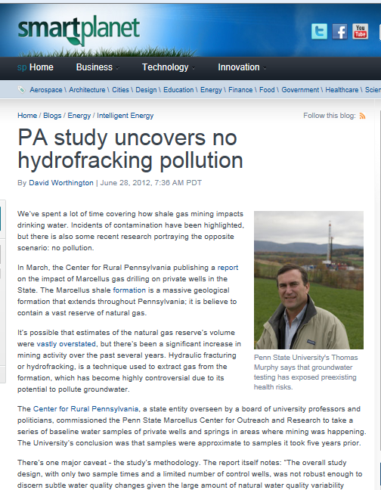
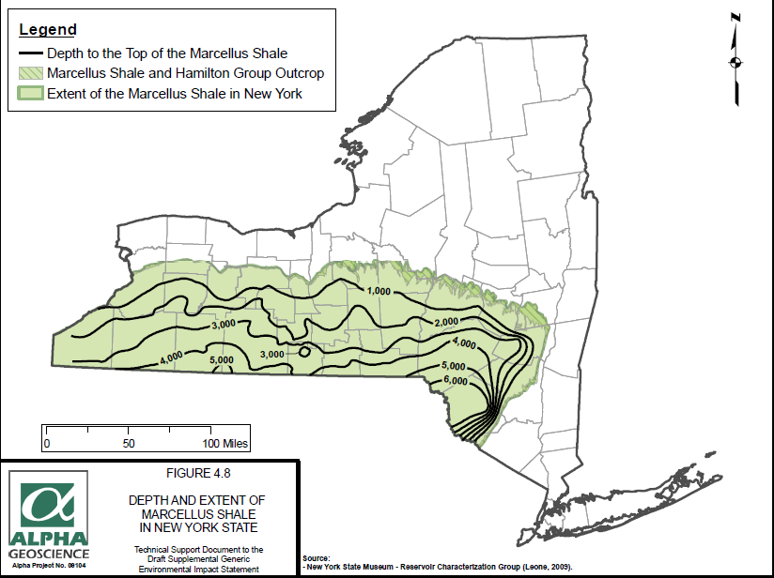
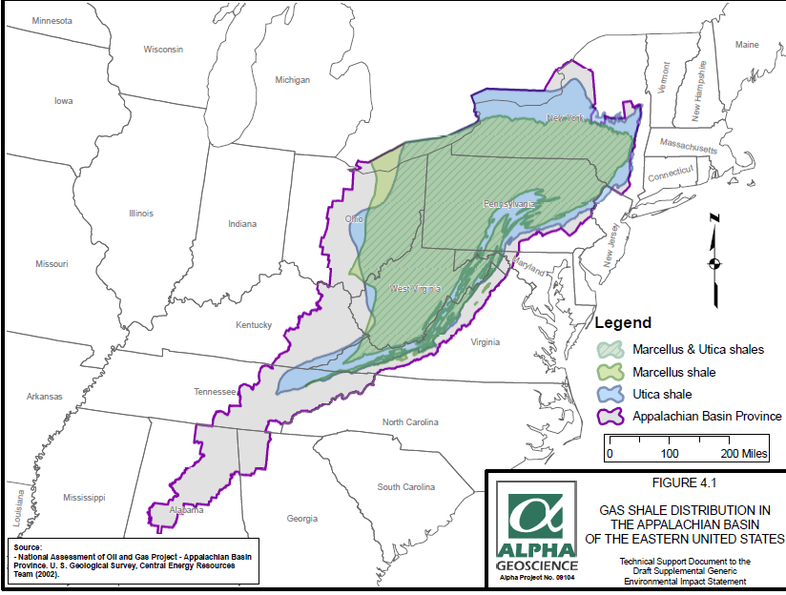
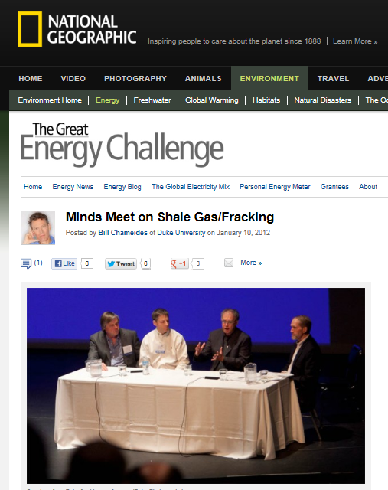
Case 2:
Hydrofracking in NY
Groundwater Basics
Pollution
Induced Seismicity
Cost-Benefit Analysis

Slide 7
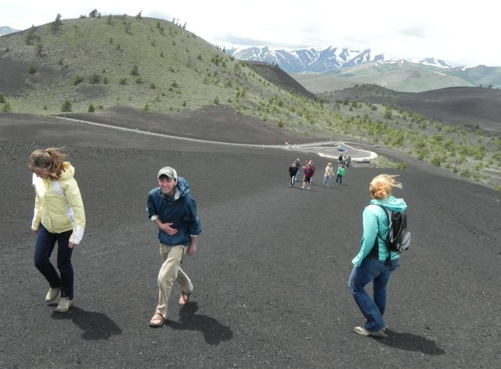
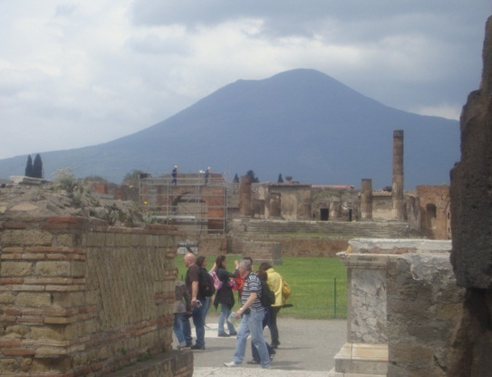
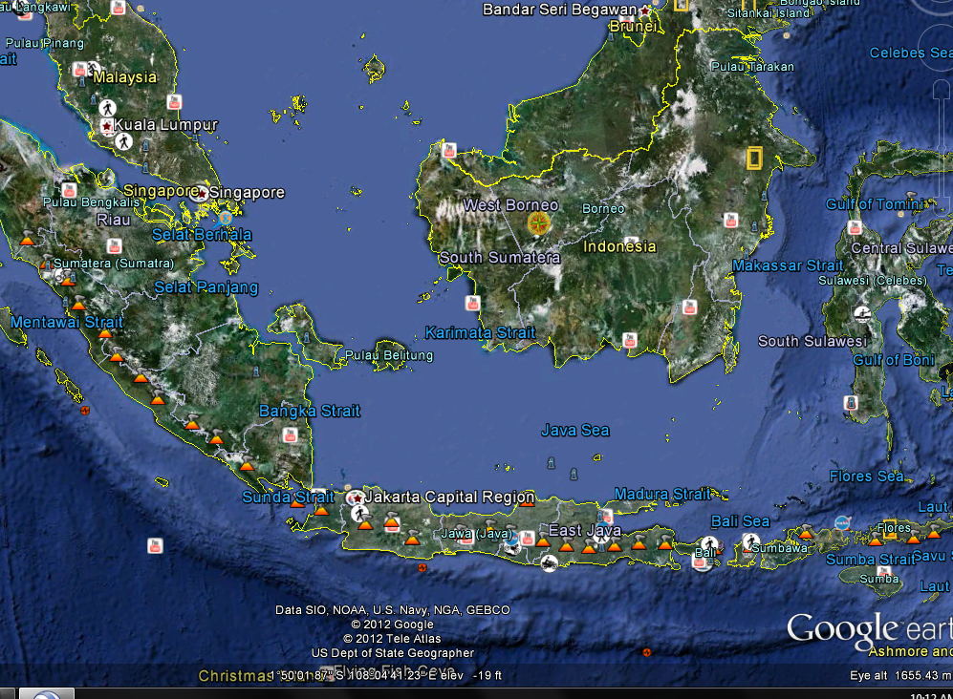
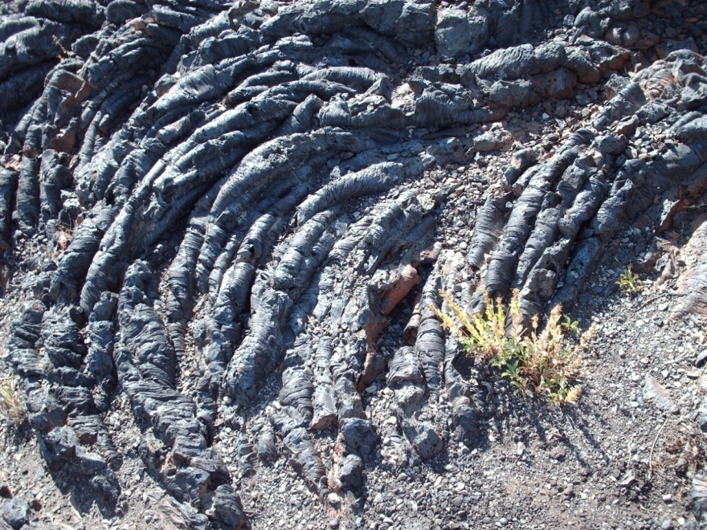
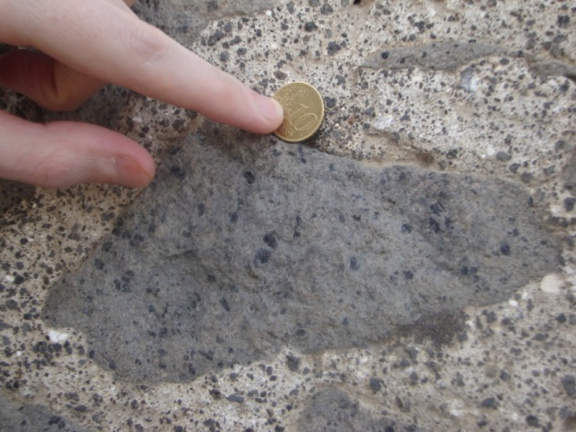
Case 3: Volcanoes
Igneous Rock textures
Chemical and Physical Characteristics of Lavas
Volcanoes and Volcanic Features

Slide 8
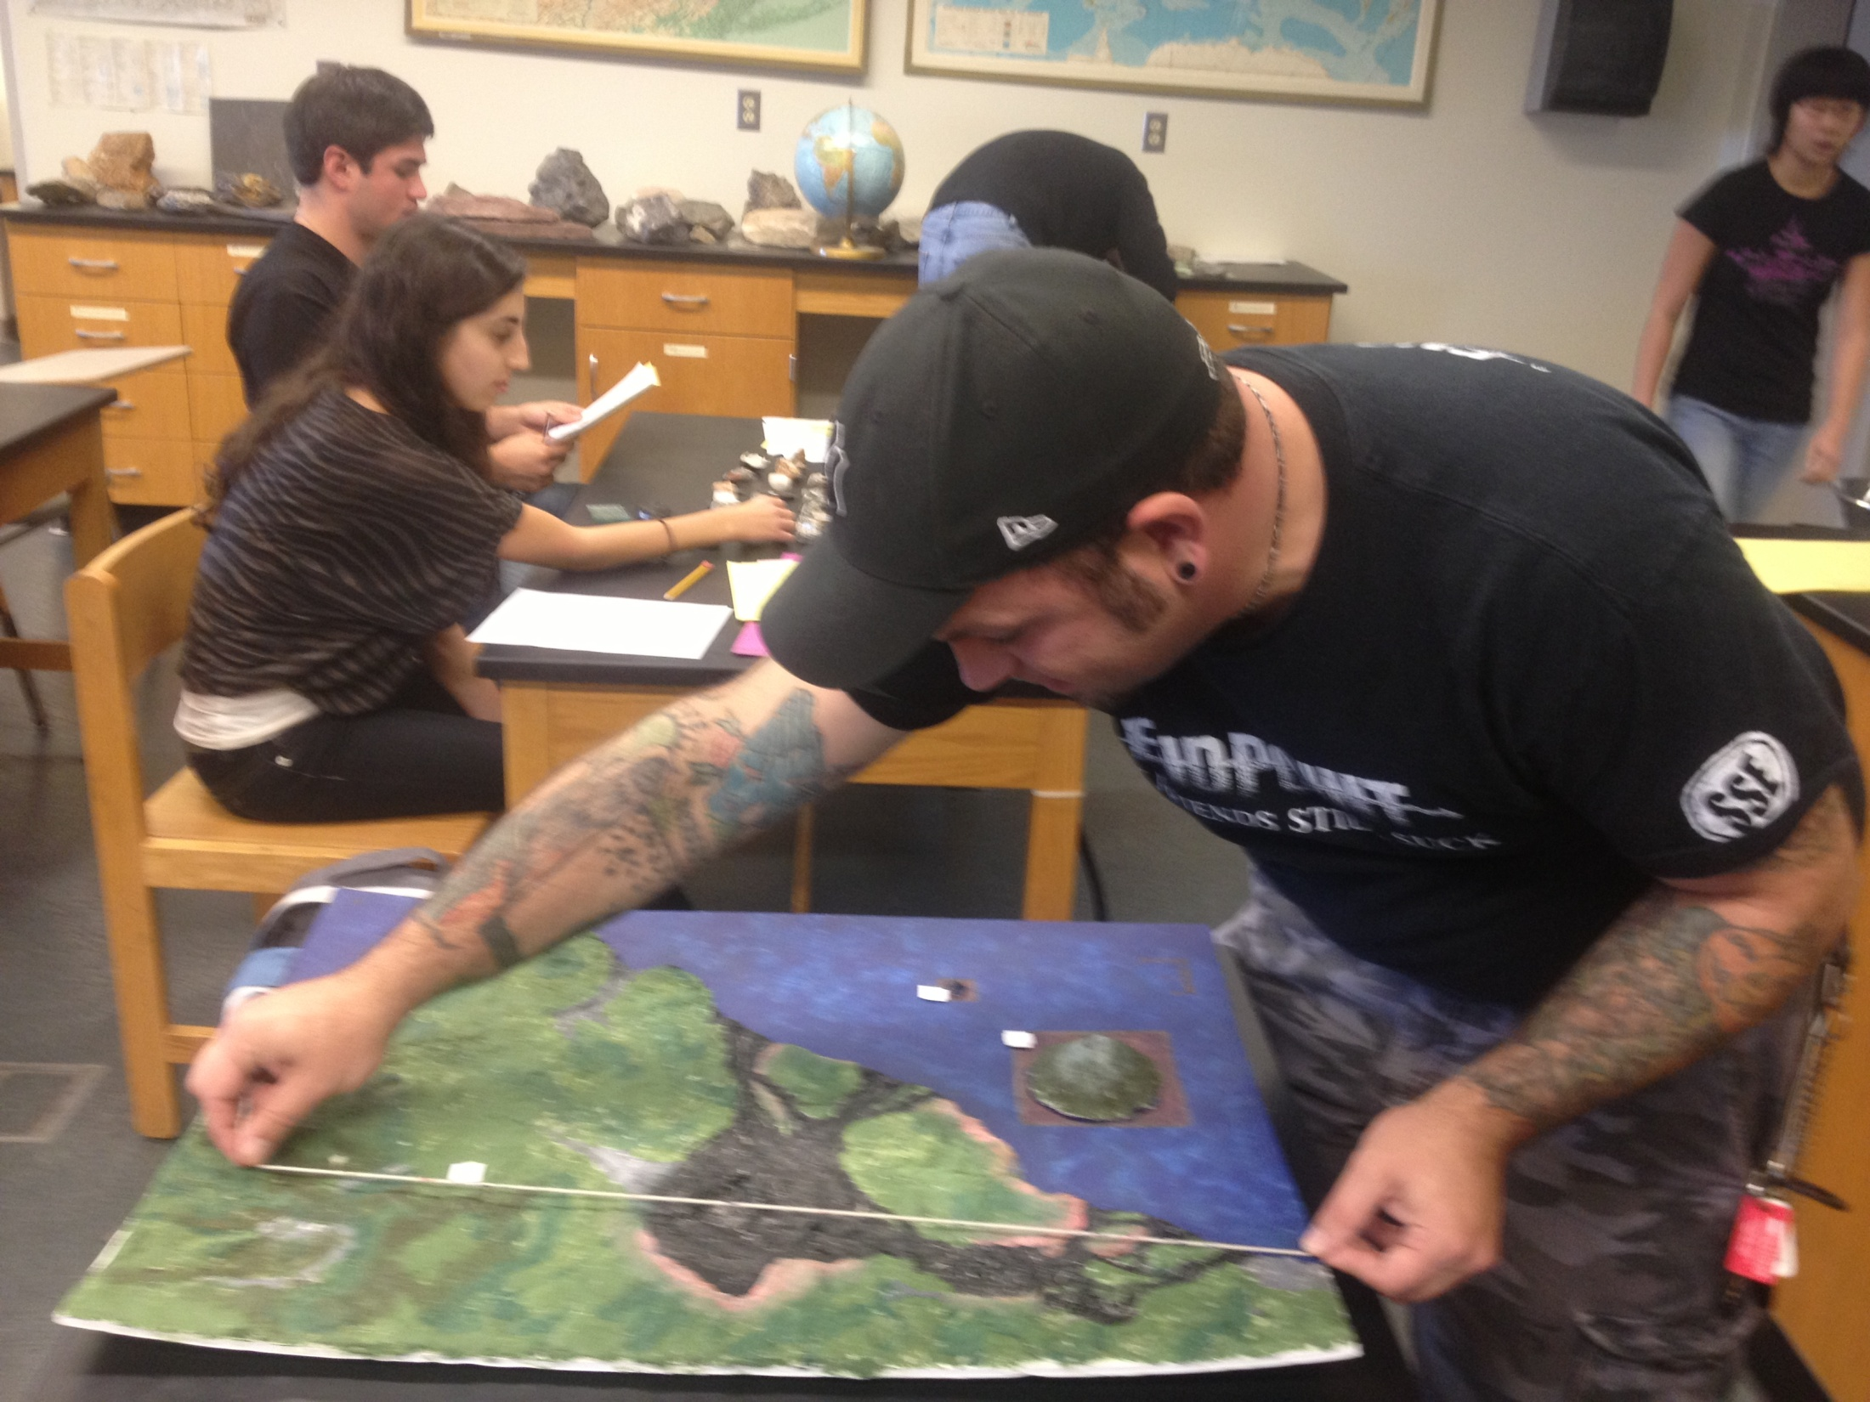
Volcano | Relief (ft) | Diameter(mi) | Slope (ft/mi) | Classification
1 | 4091 | 47.6 | 85.9 | Shield
2 | 3218 | 5.9 | 545.4 | Composite
3 | 221 | 0.4 | 552.5 | Cinder cone

Slide 9
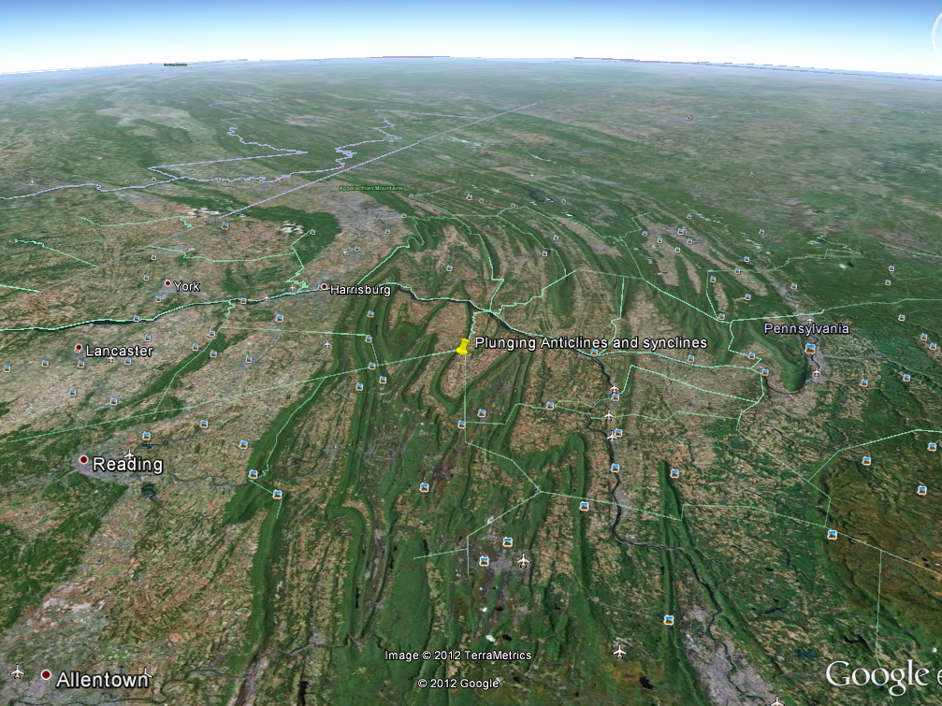
Case
Attention-grabber
Assessment
Content & data

Slide 10
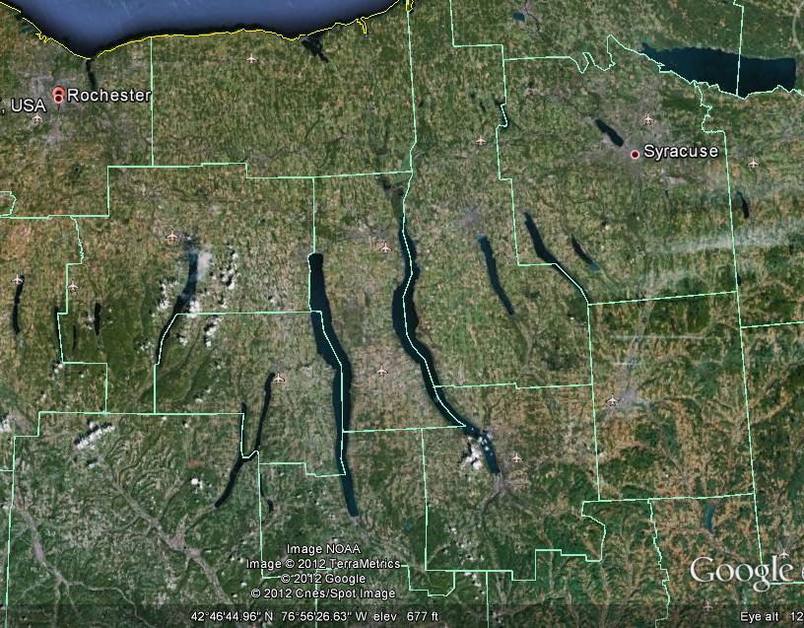
Resources
The Math You Need When You Need It
National Center for Case Study Teaching in Science
Top 25 Ranked Geology Blogs
GigaPan.com
Poll Everywhere
Useful Google Earth Layers
Mobile Geology Apps
Teaching with Google Earth (SERC)

