Slide 1





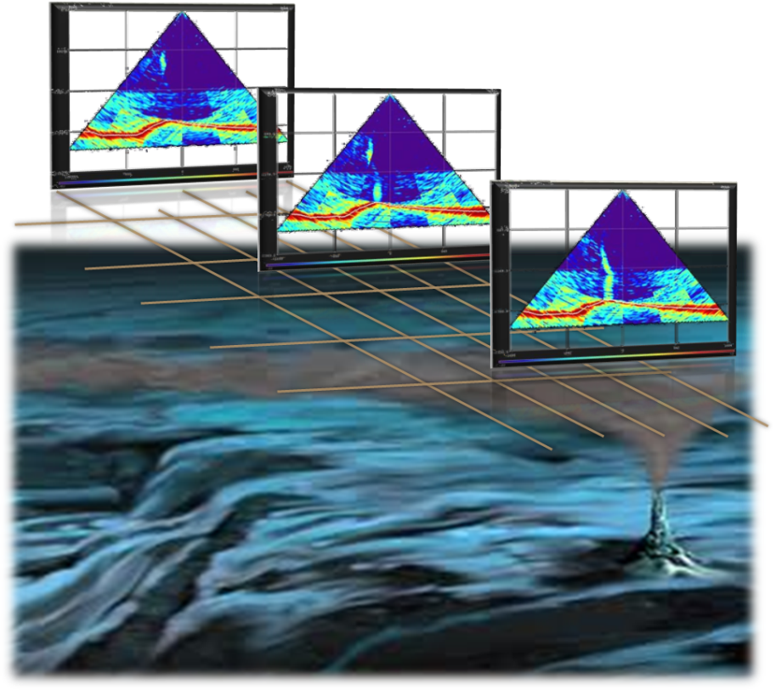
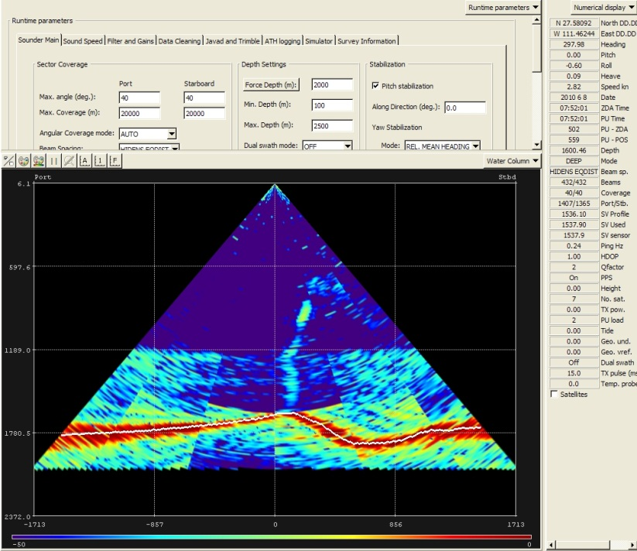
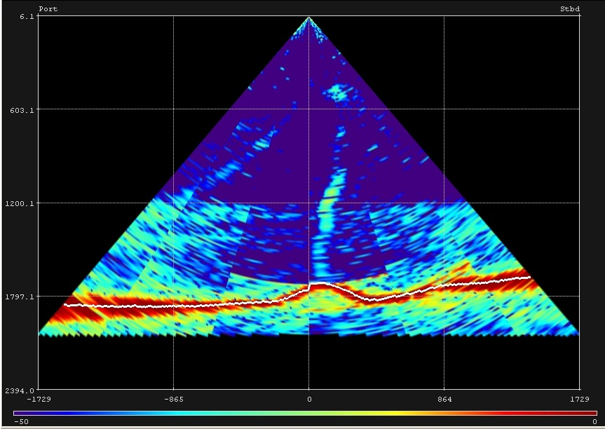
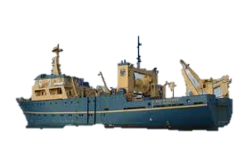
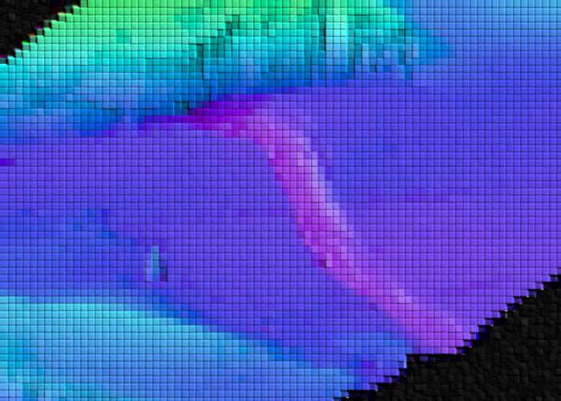
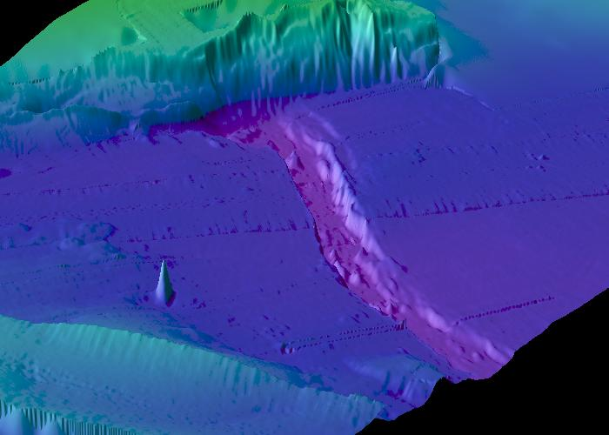
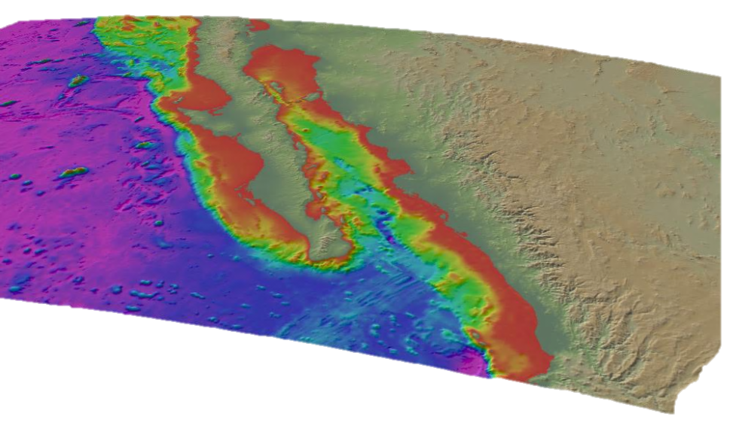
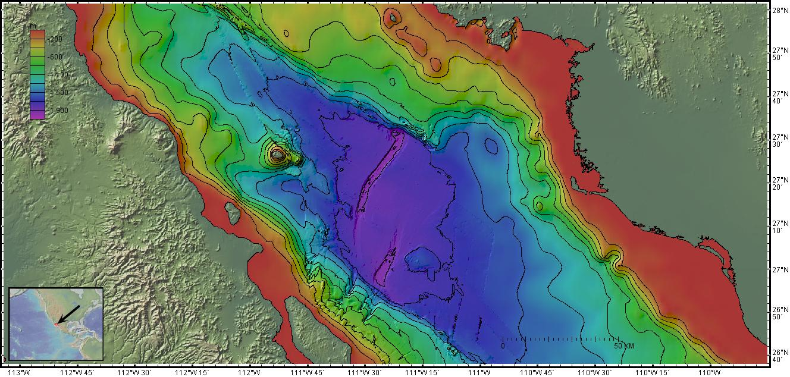
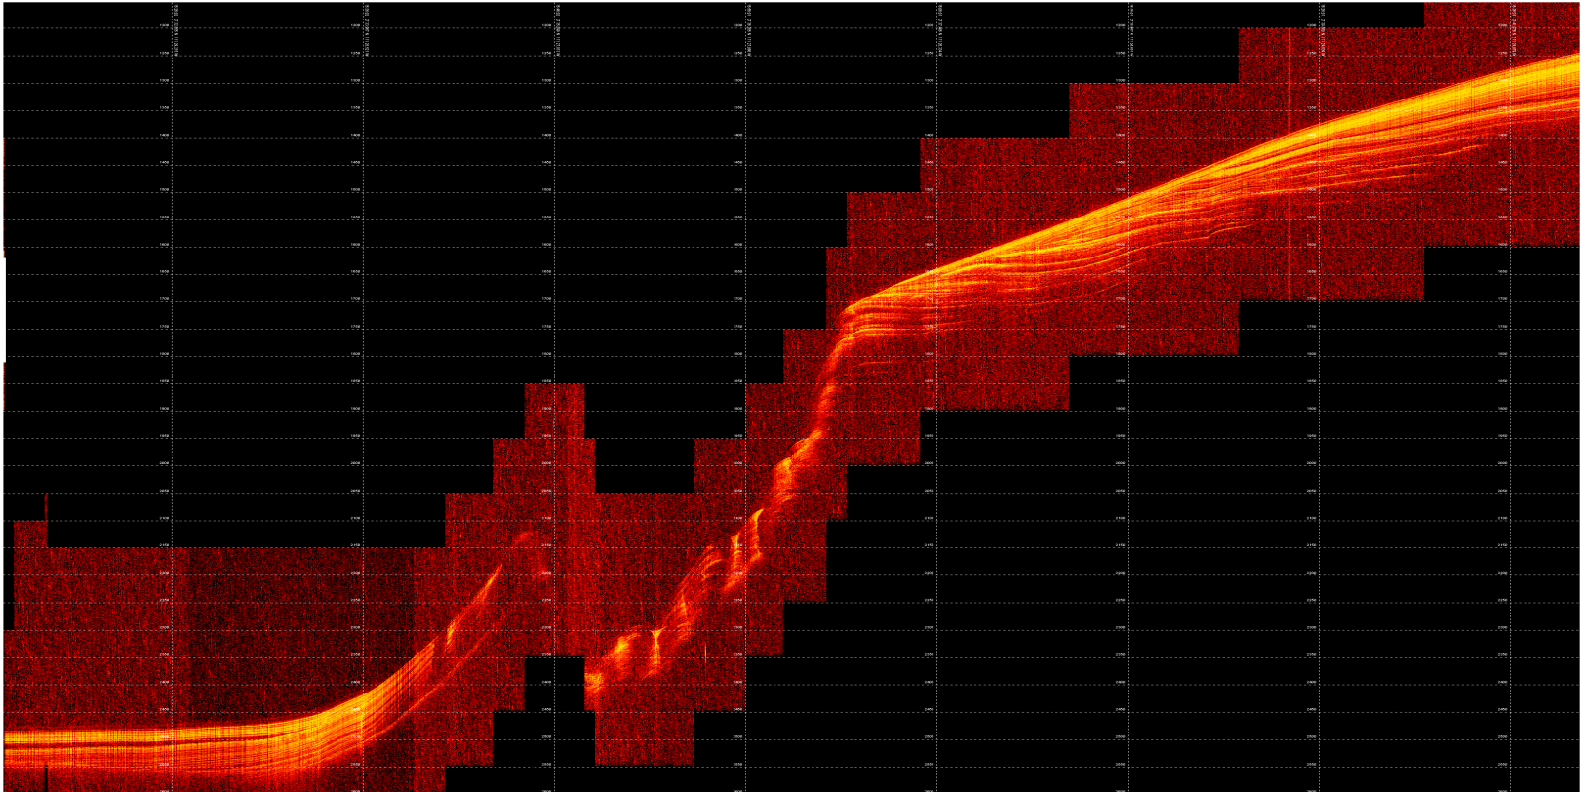
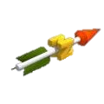
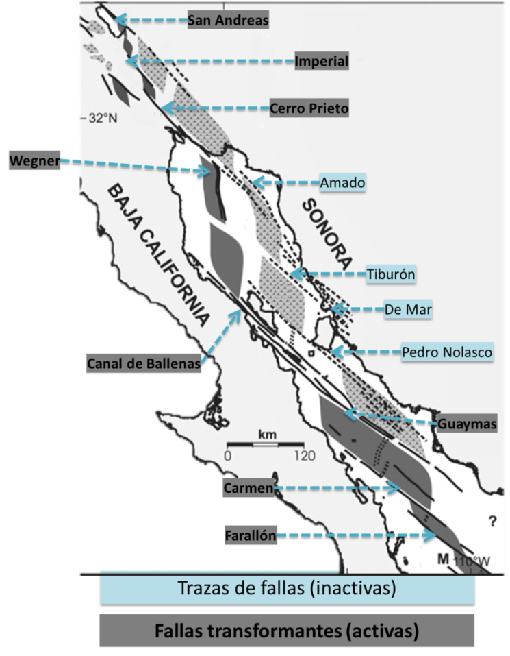
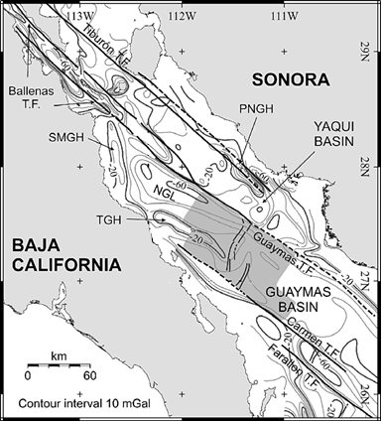
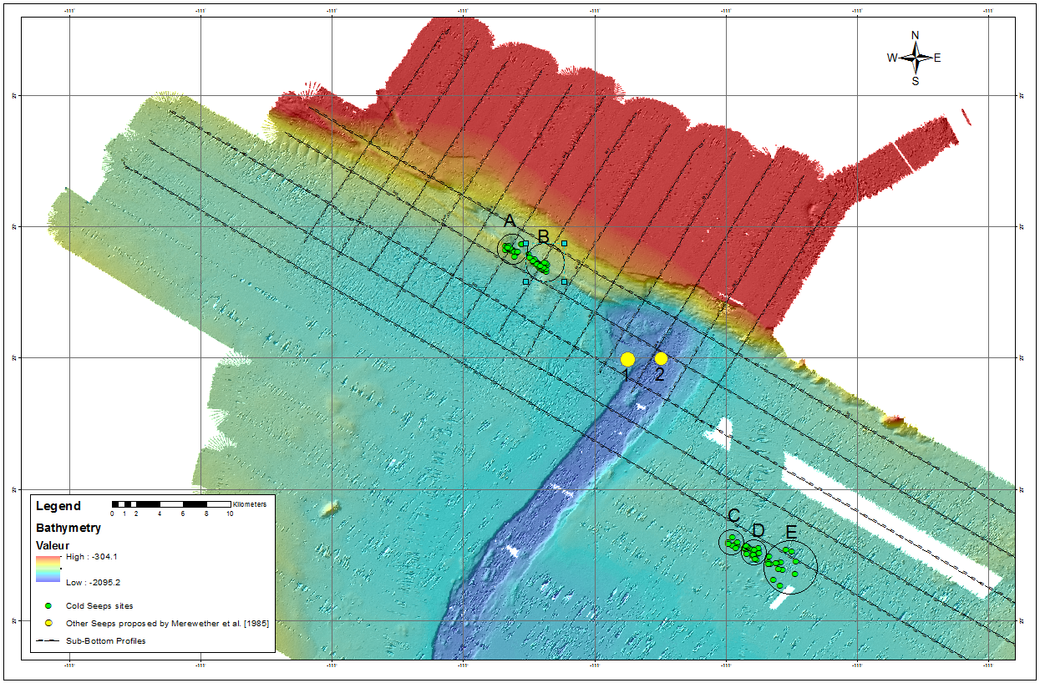
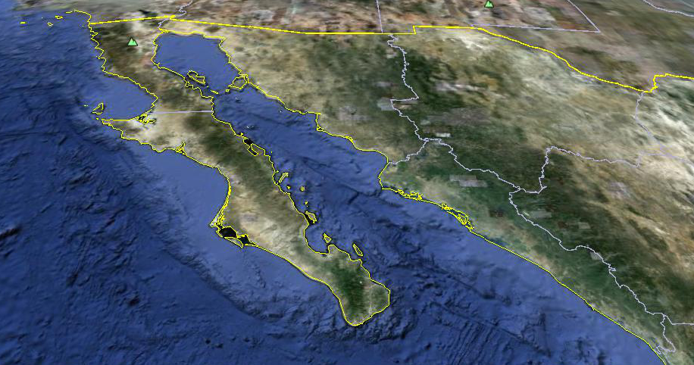
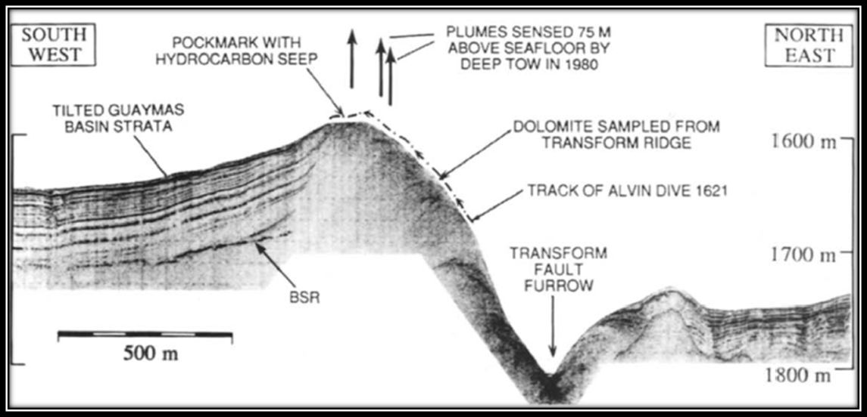
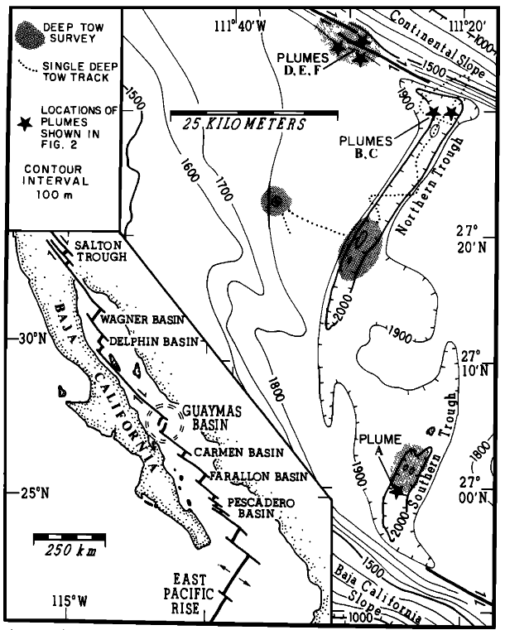
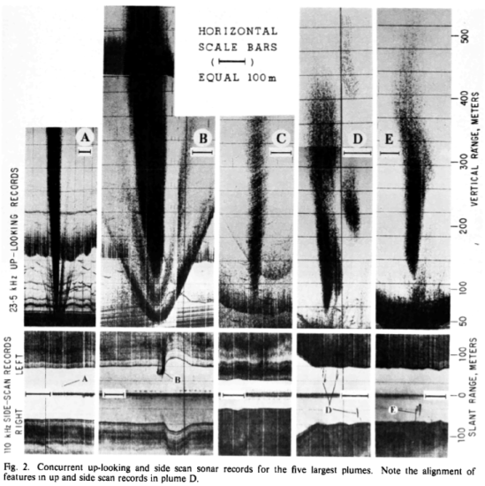
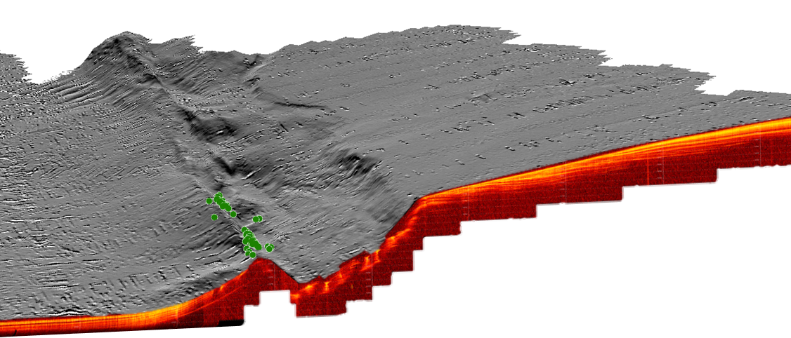
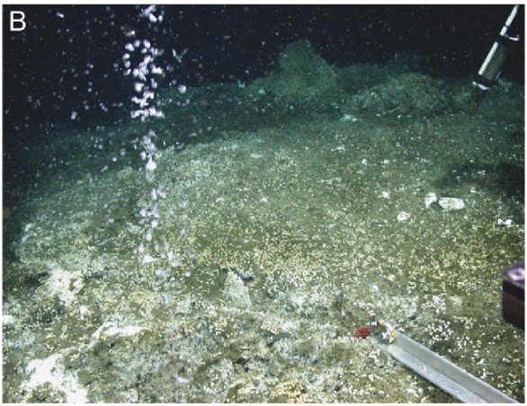
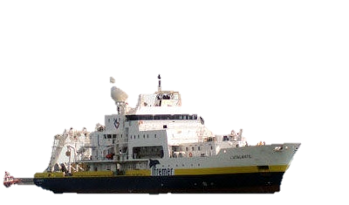
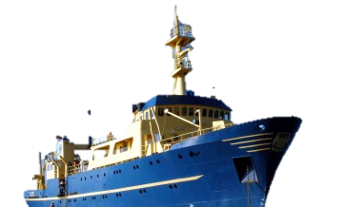
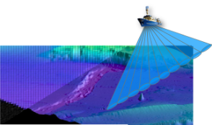
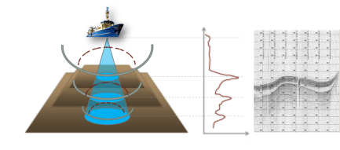

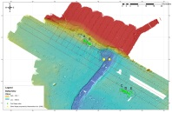
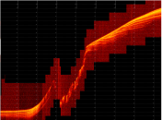

COLD SEEPS IN THE SONORA MARGIN BASIN AT GUAYMAS BASIN, GULF OF CALIFORNIA, MEXICO
FIGUEROA-ALBORNOZ, Leonardo^{1,2} [leonardo@geofisica.unam.mx]
MORTERA-GUTIERREZ, Carlos A.², ESCOBAR-BRIONES, Elva³,
GODFROY, Anne⁴, BANDY, William L.², PONCE, Francisco², TARAN, Yuri A.², and BERNARD, Rubén A.²,
Posgrado en Ciencias del Mar y Limnología, Instituto de Geofísica, Universidad Nacional Autónoma de México, Coyoacán, DF, 04510, México
(2) Instituto de Geofísica, Universidad Nacional Autónoma de México, Coyoacán, DF, 04510, México,
(3) Instituto de Ciencias del Mar y Limnología, Universidad Nacional Autónoma de México, Coyoacán, DF, 04510,México, y
(4) Laboratorio de Microbiologie des Environnements Extrêmes, IFREMER, Plouzane, 29280, France,
Lithosphere Stretching and Magmatism Leading to the Gulf of California
Session No. 10
Paper No. 10-3
Booth# 40
Cordilleran Section
108th Annual Meeting
Querétaro, México
29-31 March 2012
ABSTRACT
Using the multibeam EM-122 in the NO L'Atalante, which operates at a frequency of 12 kHz and configurations of variable angle for up to 150 °, it has up to 432 soundings per swath; are obtained acoustic reflectance images of the water column within the multi-beam projection cone (figure 6). This scan allows the detection of any body of density contrast within the water column, so both the seabed as a whole fish can cause a noteworthy contrast in these images. Likewise, the feathers of bubble produced by hydrothermal vents and cold leaks are also detectable in these multibeam images of the water column, because they have different densities and temperatures than those of the ocean. With this technique during the campaign BIG10, screen views were captured at intervals of 6 seconds and at a cruising speed of 3 to 5 knots to have an appropriate coverage. A total of 31,895 images were recorded. All these images were visual inspected, and 1,210 images selected where plumes were shown.
The Guaymas Basin is a tectonically active zone, as part of the Gulf of California Transtensional System, which accommodates the accretion of new oceanic crust along an overlapping center with two long grabens at its sides, referred as: Northern Rift and Southern Rift. The NE end of the Northern Rift is intercept by the SE segment of the Guaymas Transform Fault which has a deep pull-apart basin parallel to the Sonora Margin. There are many studies on the hydrothermal activity within the rift basins, because of its biological and magmatic process taking place there, although there has been few studies on the nature of cold seeps within the Sonora Margin Basin. On 2010, a research cruise, BIG10, on board the research vessel NO L'ATALANTE imaged several continuous plumes of bubbles in the water column within the Sonora Margin Basin. The images of these cold seeps at the Sonora Margin were recorded with the EM122 multi-beam echo-sounder on board the N/O L'ATALANT, and are used to locate and characterize some of their physical parameters. These images are correlated within the multi-beam bathymetry map that was gathered using the EM300 multi-beam echo-sounder during the research cruise, GUAYRIV10, on board the B/O EL PUMA on 2010. Also 16 high-resolution seismic profiles across the basin were recorded with the TOPAS PS18 sub-bottom profiler on board the B/O EL PUMA. These profiles are used to define the seismic stratigraphy in the basin and their relation with the cold seeps founded in the Sonora margin. 31,895 water column images were captured during BIG10. Only 5 cold seep sites were observed, and some shows plume heights greater than 750 m from the seafloor.
Figure 6. illustration of principle of recording echo-sound multibeam images of the water column, applied in the detection of bubbles plumes
Screen 00966
Each image records a set of information about the configuration and navigation data at the time of measurement, in addition to the plume geometry within the multi-beam projection cone. Using geometric relations of digital imaging and their pixel-meter ratio, it was possible to measure the plumes dimensions as well as its near location at the seafloor. Because the planning of this survey consider an overlap of more than 50 % between each ship transect, it produced a considerable data redundancy. After being analyzed each of the images, a database was generated to cluster the location of these plumes, as well to estimate the plume height from its base, height and width dimensions within the water column (figure 7).
750 m
Location
105.3m
The Guaymas Basin is located within the Gulf of California, in front of the Bay of Guaymas, State of Sonora, Mexico (figure 1), between 26° 15’ N and 27° 45’ N, and between 111° 40‘ W and 110° 45‘ W, with a depth ranging from 1,300 to the 2,030m. The study area is in the lower slope of the north-western margin of Sonora at the Guaymas Basin, and in the northern area of the northern rift (marked with a rectangle in Figure 1). The survey has a surface area of ​​approximately 1,200 km², parallel to the margin of Sonora and centered on the position 27° 40‘ N, 111° 30' W.
Figure 7. From a display image, the screenshot 00966, can be obtained the dimensions of height and width of the plume body as well as the location of it.
Additionally during BIG10, data of multibeam bathymetry were recorded and integrated into a bathymetric Chart of the Guaymas Basin. This bathymetric chart would be supplemented with data obtained during the campaign GUAYRIV10, done by the vessel El Puma, UNAM, which has the EM-300 multibeam echo sounder, operating at 30 kHz with an angular coverage of up to 150 °, with a total of 135 beams. A Digital Elevation Terrain Model is integrated from both bathymetry data sets, and used in positioning the seismic profiles and the seeps location.
SW
Profile L08
NE
Figure 8. Illustration of the multibeam bathymetric survey conducted during the campaign GUAYRIV 10, aboard the B/O El Puma
1200m
The sub-bottom profiler, TOPAS PS-18, onboard the BO El Puma is used to visualize a high-resolution seabed stratification. This profiler is a single beam echo sounder operating at a frequency range from 4 to 18 kHz with a Chirp pulse as a source. A total of 17 seismic reflection profiles we obtained during the campaign GUAYRIV-10, with a maximum penetration of over 100 m at the Guaymas Basin sub-bottom. These data is reduced and integrated into the interpretation of the structural and stratigraphic geology associated with the release of these fluids.
Figure 1. Relative location and bathymetry of the Guaymas Basin at the Gulf of California, on [image created from the GeoMapApp software].
2550m
0 2.8 5.6 km
Regional Geologic Setting
Figure 9. High resolution seismic profile number L08, the (•) represent the location of seeps plumes observed
The Gulf of California is a tectonically active area (figure 2), given by The Pacific-North America plate boundary, which consist of longs segments of en echelon transform faults linked by short sections of spreading centers [i.e. Mereweather et al., 1985; Lonsdale, 1989; Fenby and Gastil, 1991; Stock, 2000; Aragón-Arreola, 2005]. The Guaymas Basin is also an active transtensional pull-apart basin, associated to the Guaymas Transform Fault (T.F.) and the Carmen T.F. At its central part, new oceanic crust is accreated into two short rift grabens. The geometry of these rifts corresponds to a overlapping structure, where its ends converging toward each other, forming a non-transform zone between the rifts[Aragon-Areola, 2005].
Results
The bathymetry chart shows the locations of five plumes within the study area (figure 10). These locations will be compared to the existing catalog of hydrothermal vents from the literature to verify the correlation between them. It is seen that two groups (A and B) of cold seeps are on a ridge associated with transpressive movement of the
Guaymas Fault within the Guaymas Northern Rift at the Sonora margin edge (figure 11).
Three groups (C,D and E) of cold seep sites are far a way located from the Sonora margin edge and the northern rift.
2
Figure 2. Tectonically situation of the Gulf of California and of the Guaymas Basin. (left) Aragon-Arreola et al. [2007] and (right) Bischoff & Hanyey, [1974]
3
4
1
N
The Guaymas Basin is under highly productive surface water, which produce a heavy influx of planktonic diatomaceous debris especially during spring, as well the principal terrigenous sediment source on the Gulf of California (figure 3) are the rivers that drain from the states of Sonora and Sinaloa, and also the Colorado River [i.e. Lonsdale, 1989; Carranza et al, 1990]. However, a more detailed study for Guaymas Basin indicates that the downslope sedimentation from the delta of the Yaqui and Sonora Rivers, is the major source of clastic sediment [i.e. Merewether et al, 1985; Lonsdale, 1985]. Estimated accumulation rates for Holocene sediments on the upper continental slope are estimated in the order of 0.5 to 2.5 cm/yr [Calvert, 1966; Schrader, 1982].
Sediment Sources
5
1
1
Sonora and Sinaloa rivers
2
Colorado River
3
P. Baja California
4
Pelagic Detritus
5
Geochemical precipitates
Figure 3. Principal source of sediment into the Gulf of California. Data from Lonsdale [1989] and Carranza et al. [1990]
Conservation of organic material is enhanced by the low oxygen content of the basin's waters, especially in the oxygen-minimum zone at 300 to 900 m. The sea floor in this depth range accumulates finely laminated sediments (figure 4) under essentially anoxic conditions [Calvert, 1966], and even in the deeper parts of the basin, reducing conditions prevail just a few centimeters into the sediment. The combination of organic-rich sediments and high heat flow from igneous intrusions has produced recent petroleum at the spreading axes [i.e. Simoneit et al, 1990].
Figure 4. Finely laminated tilted strata in the Guaymas Basin is associated with hydrocarbon seeps and plumes at the Margin of Sonora. From Lonsdale [1989]
Figure 10. Bathymetric Chart of the Guaymas Basin, created from the campaign GUAYRIV10, showing the location of seismic profiles and location of the plumes observed during BIG10 (A, B, C, D and E), as well as the locations of vents 1 and 2 described by Lonsdale [1985] and Merewether et al. [1985]
B
Inside of the Guaymas Basin have been discovered and reported (figure 5.a and 5.b) a intensively hydrothermal activity into two different system : associated with magmatic activities in the southern trough, associated with shallow sill intrusions in the northern trough. Meanwhile, the presence of a system of cold seeps have been reported on the Sonora margin basin; however the latter system has not been extensively studied as the former system. The study of the cold seep system is the primary objective of this research. These seeps are detected by bubble plumes ascending from the seafloor. In the last decade, these plumes in the water column has been registered through hydro acoustic measurements, but there are very few geochemical data and direct observations of these cold seep vents. Paul et al. [2007] obtained water samples and sediment core at the vents of Sonora margin basin using a ROV (figure 5.c). Their geochemical analysis indicates that these cold seeps filtrates through a methane gas hydrate stability zone which, vents through the seafloor, and rises into the water column as a gas plume that is traceable over 800 m.
C
A
Figure 10. Integration of bathymetry in 3D model with the seismic profile L08, which describes the stratigraphy for the cold seep site A.
Figure 5. Catalogue of seeps sites on the Guaymas Basin discovered (A) by echosounding survey (B), and recently by direct measure whith a ROV ©. (A and B) Merewether et al., 1985, and (C) Paull et al. 2007
Summary
Acoustic Imaging of Plumes
For the present study, we integrated a systematic methodology to accurately locate each of the plumes that seeps through the sea floor, and to catalog the vent sites in the Guaymas Basin. The following block diagram shows the systematic approach to characterize these vent sites.
Through the multi-beam hydroacoustic survey of the water column profile during the campaign BIG-10, it was possible to catalog the existence of at least five sites of bubble plumes in the north central region of the Guaymas Basin. While in previous works such as Lonsdale [1985], Merewethere et al. [1985], and DSDP results [Curray, 1979] had been listed a group of vents, but they did not have a navigation system as accurately as today. In the correlation of our catalog with those locations observed in other studies, only the locations A and B are consistent, varying from tens of meters at its published location. Whereupon it was noted that at sites 1 and 2 described by Merewehere et al. [1985], no plume within the water column is observed in BIG10 survey. Either these vents are too small to be detected with the EM122, or perhaps are not longer active. The plumes of bubbles observed in the cluster locations (C, D and E) show no association with previous documented cold seeps at the Guaymas rift off-axis.
Regarding the locations of sites A and B, it seems that this vents corresponds to a set of cold seeps associated with methane emissions documented by Lonsdale [1985] and Paul et al [2007], where the methane is passing through the gas hydrate stability zone, venting through the seafloor, and rising into the water column in a gas plume. We observe now that certainly the release of these fluids takes place on a ridge, which is a consequence of transpressional movement of the fault of Guaymas. The TOPAS PS-18 high resolution seismic profiles of GUAYRIV10 document a flower structure in the northern edge of the Sonora margin basin. This active tectonics shear the strata within the Guaymas Basin (west of the fault) with folds, and with a fault escarpment where the fluids are released.
BIG-10
NO L’Atalante
Oceanographic research campaign during 2010
GUAYRIV-10
B/O El Puma
DATA ACQUISITION
EM-122
EM-300
TOPAS-PS 18
Screenshot of water column multibeam
images with bubbles plumes information
Multibeam bathymetry survey of regional scale of the Guaymas Basin
Multibeam bathymetry survey of detailed Sonora margin of the Guaymas Basin
Sub-Bottom profiles
PROCESSING
CATALOG OF ACTIVE HYDROTHERMAL STRUCTURES
BATHYMETRIC CHART
HIGH RESOLUTION SEISMIC REFLECTION PROFILES
RESULTS
INTERPRETATION AND CATALOGUE OF GEOLOGIC STRUCTURE ON THE BASIN
Acknowledgements
We are grateful for the assistance of both ship crews, NO L’Atalante and BO El Puma. This research is possible through the grants that we received from the research programs of IFREMER, CONACyT, UNAM-DGAPA-PAPPIT, UNAM-CABO, and UNAM-Coordinación de Estudios de Posgrado.
SEISMIC-STRATIGRAPHY
INTERPRETATION OF
RESULTS
GEOLOGOGIC AND STRUCTURAL ANALISIS
ESTRUCTURAL MODEL OF THE BASIN AT THE MARGIN
Reference
Aragón-Arreola, M., Morandi, M., Martín-Barajas, A., Delgado-Argote, L., & González-Fernández, A. (2005). Structure of the rift basins in the central Gulf of California: Kinematic implications for oblique rifting. Tectonophysics, 19-38.
Bischoff, J., & Hanyey, T. (1974). Tectonic elements of central part of the Gulf of California. Geological Society of America Bulletin, 85, 1893-1904.
Calvert, S. E. (1966). Accumulation of Diatomaceous Silica Accumulation of Diatomaceous Silica. Geological Society of America Bulletin, 77(6), 569-596.
Carranza, A., Rosales, L., Aguayo, J., Lozano, R. , & Hornelas, Y. (1990). Geochemical study of hydrothermal core sediments and rocks from the Guaymas Basin, Gulf of California. Applied Geochemistry, Vol. 5, 77-82.
Fenby, S., & Gastil, R. (1991). A seismo-tectonic map of the Gulf of California and surrounding areas. (J. S. Dauphin, Ed.) The Gulf and Peninsular Provinces of the Californias, 47, 79-83.
Google. (Enero de 2011). Google Earth. California, Silicon Valley, Estados Unidos.
Lonsdale , P. (1989). Geology and tectonic history of the Gulf of California. (D. Hussong, E. Winterer, & R. Decker, Edits.) The Eastern Pacific Ocean and Hawaii (The Geology of North America, N), 499-521.
Lonsdale, P. (July de 1985). A Transform Continental Margin Rich in Hydrocarbons, Gulf of Californial. The American Association or Petroleum Geologists Bulletin, 69(7), 22+0-1180.
Paull, C. K., Usler, W., Peltzer, E. T., Brewer, P. G., Keaten, R., Mitts, P. J., y otros. (2007). Authigenic carbon entombed in methane-soaked sediments from the northeastern transform margin of the Guaymas Basin, Gulf of California. Deep-Sea Research II, 1240-1267.
Ryan, W. B., & et al. (2009). GeoMapApp. Global Multi-Resolution Topography synthesis Geochem. Geophys. Geosyst. 10. (M. G. System, Ed.) United States.
Schrader, H. (1979). DIATOM BIOSTRATIGRAPHY AND LAMINATED DIATOMACEOUS SEDIMENTS FROM DIATOM BIOSTRATIGRAPHY AND LAMINATED DIATOMACEOUS SEDIMENTS FROM. En D. G. Curray, Initial reports of the Deep Sea (Vol. 64, págs. 973-981).
Simoneit, B., Lonsdale, P., & Edmond, J. (1990). Deep-water hydrocarbon seeps in Guaymas Basin, Gulf of California. Applied Geochemistry, Vol.5, 41-49.
Stock, J. M. (1989). Pre-Pliocene extension around the Gulf of California and the transfer of Baja California to the Pacific plate. Tectonics, 8, 99-115.

