Slide 1

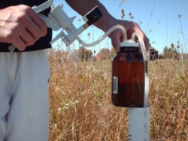
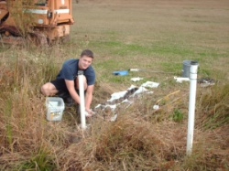
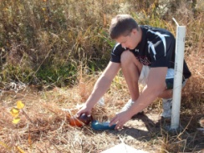
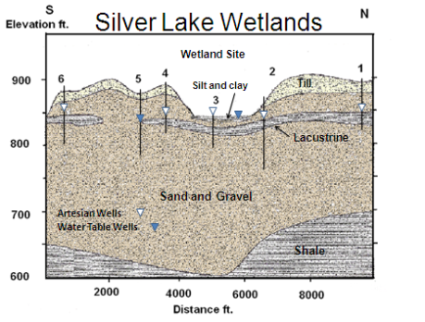
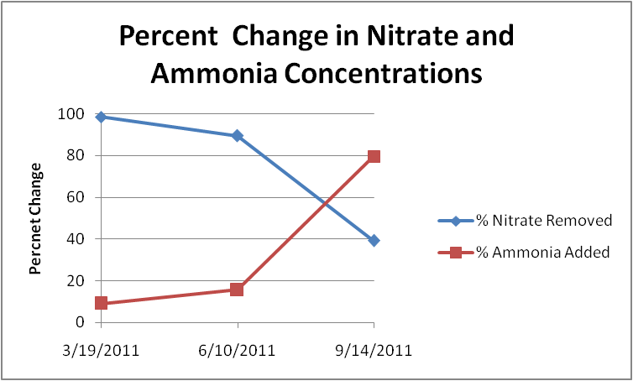
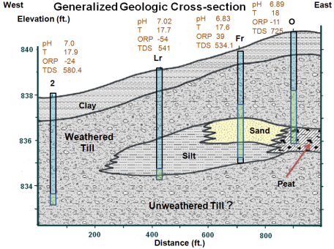
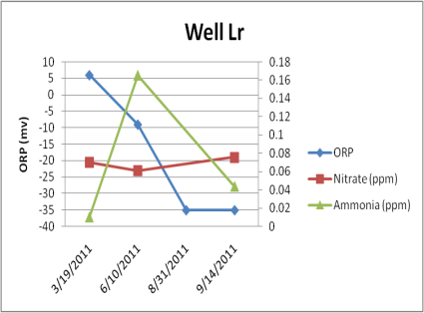
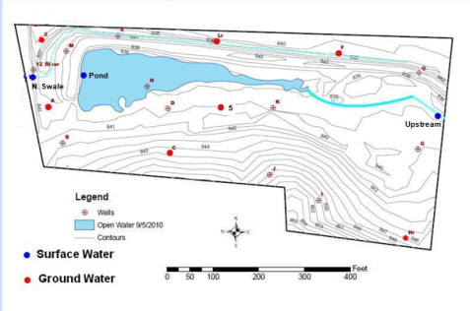
Hydrogeologic Investigations of the Silver Lake Wetland
Rich Bendula, Brad Hanson, Shayn Roeder and John Shiner
University of Dayton , Department of Geology
.
Introduction
Table 1 Water Quality data from 6/10/2011. Field parameters analyzed with a Myron Multimeter while specific elements were analyzed by OSU’s Starr Lab.
Data Evaluation
The general water quality differed between samples collected from the surface water, and from the ground water. The surface water had higher values for pH, lower concentrations of total dissolved solids, and positive values of ORP (Table 1). The shallow ground water system consists of hydric soils derived from the weathering of the glacial deposits. Seasonally, five of the seven wells installed into these soils produced water samples with negative values of ORP. This is an excellent indication that anaerobic conditions develop in the soils during the summer months and at times of limited recharge (Figure 4).
Water quality samples from the pond and from Well A, which are both downstream of the wetland, show that almost all of the nitrate and phosphorus have been removed from the water. To further analyze the treatment of fertilizers by the constructed wetland, the volume of surface water flow into the wetland was measured with a flow meter. Using the water quality data collected from the upstream location and from the pond, we calculated the quantity of nitrate being removed from the wetland (Table 2). Nitrate removal ranged from 35.9 pounds/day (98.4%) in the spring, to 0.343 pounds/day (39.1%) in the fall. As the removal rates for nitrate decline, the process of ammonification increases as nitrogen is transformed to ammonia (Figure 5).
The results from the water quality monitoring confirm the effectiveness of the constructed wetland in treating nutrients flowing through the site.
A water quality study was conducted to determine the quality of the surface and ground water flowing into and out of the Silver Lake Wetland, located in western Miami County, Ohio. The wetland is located on weathered glacial till and lacustrine deposits which overlie thick deposits of outwash sand and gravel (Figure 1). The site was originally part of an extensive wetland area prior to being drained and extensively farmed.
To assess the water quality and functionality of the wetland, water samples were collected from seven shallow monitoring wells which we installed, two streams that flow into the wetland, and from the discharge point of a pond at the end of the wetland (Figure 2).
Water samples from the wells were collected using a vacuum pump, while grab samples were taken of the surface water. All sites were sampled four times during 2011, and analyzed for field parameters, in addition to nitrate, ammonia and phosphorus which were analyzed in the laboratory (Table 1).
Sample Location | pH | Temp | ORP | Sp.C | TDS | Nitrate | Ammonia | Phosphorus
 |  | (°C) | (mv) | (umhos) | (mg/l) | (mg/l) | (mg/l) | (mg/l)
Up Stream | 7.98 | 29.8 | 65 | 594.7 | 398.7 | 0.352 | 0.08 | ND
Pond | 8.4 | 31.7 | 60 | 402.5 | 264.2 | 0.037 | 0.095 | ND
N. Swale | 7.94 | 31 | 84 | 581.3 | 387.1 | 0.049 | <0.01 | ND
Well A | 6.88 | 18.9 | 84 | 1301 | 924 | 0.026 | 0.149 | ND
Well C | 7.37 | 19.4 | 30 | 554.8 | 380.4 | 0.039 | 0.091 | ND
Well Fr | 6.94 | 21.8 | 37 | 667.5 | 453.3 | 0.056 | 0.179 | ND
Well Hr | 7.16 | 17.2 | -73 | 586.3 | 403.8 | 0.136 | 0.158 | ND
Well Lr | 6.93 | 19.9 | -9 | 801.6 | 559.7 | 0.061 | 0.165 | ND
Well 5 | 7.06 | 21.8 | -43 | 773.1 | 532.7 | 0.062 | 0.097 | ND
Well 6 | 7.11 | 21.5 | -62 | 786.2 | 741.6 | 0.191 | 0.516 | ND
Table 2 Calculations showing removal rates for nitrate, ammonia and phosphorus. Data compares the water quality data from the up stream location to the pond.
Date | Flow into Wetland (gpd) | Nitrate Removed | Percent Nitrate Removed | Ammonia Added | Percent Ammonia Added | Phosphorus Removed | Percent Phosphorus Removed
3/19/11 | 2,390,000 | 35.9 lbs/day | 98.40% | 0.02 lbs/day | 9% | 0.040 lbs/day | 16.70%
6/10/11 | 6,523,200 | 17.1 lbs/day | 89.50% | 0.812 lbs/day | 15.80% | 0 lbs/day | 0%
9/14/11 | 1,218,437 | 0.343 lbs/day | 39.10% | 0.435 lbs/day | 79.60% | .01 lbs/day (Added) | 16.6% (Added)
Figure 1: Regional cross-section by Bendula and Roeder.
Figure 5: Rates of removal of nitrate and the addition of ammonia.
References
Rich Bendula, Chris Khourey. "Arsenic: Its Occurrence in Water Wells in Ohio." Drinking and Ground Water News Spring 1998: 1.
Chemistry Daily. 2010. 20 December 2010 <http:/www.Chemistrydaily.com>.
Miriam Reinhardt, Beat Muller, Rene Gachter, Bernard Wehrli. "Nitrogen Removal in a Small Constructed Wetland." Environmental Science Technology (2006): 3313-3319.
Figure 3: Site cross-section showing screened interval of wells. Well Fr is screened in alluvial sand and has a positive ORP. Prepared by Bendula and Hanson, data from October, 2010.
Figure 4: Well Lr initially had a positive value of ORP after recharge in the spring but became negative as biological activity increased and water flow into the wetland decreased.
Figure 2: Site map

