Slide 1
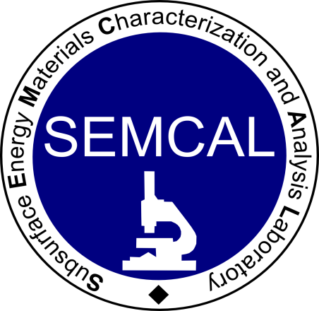

CO₂-brine-pore mineral interactions in the Mount Simon, Ohio
Alexander Swift, David Cole,
Michael Murphy, Julia Sheets,
Susan Welch

Slide 2
Introduction
Our overall objective is to parameterize models of CO₂-brine-mineral surfaces.
The key parameter, pore mineralogy, is informed by:
  Optical microscopy of thin sections (µm – cm)
  Backscatter electron (BSE) mapping (0.1 µm – cm)
  Elemental mapping (µm – cm)
  Pore identification and verification (0.1 µm - mm)
  Mineral identification and mapping (µm – cm)

Slide 3
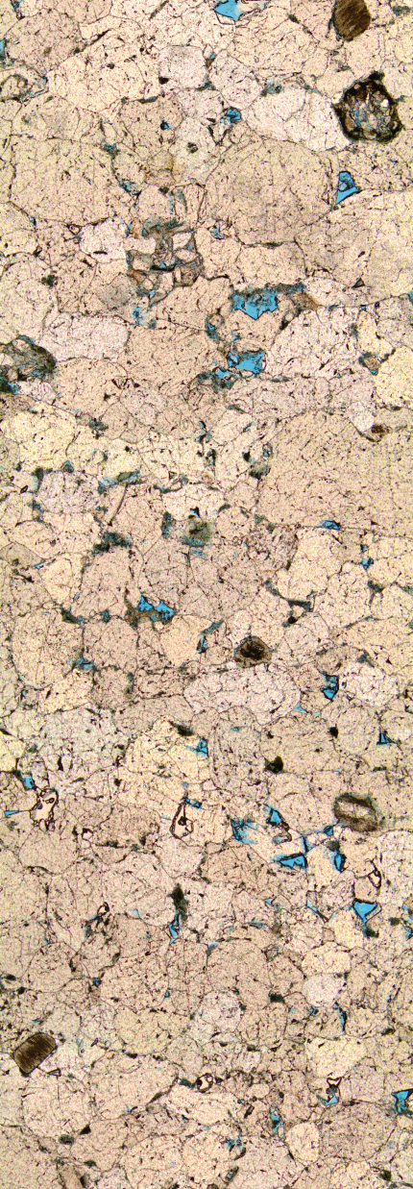
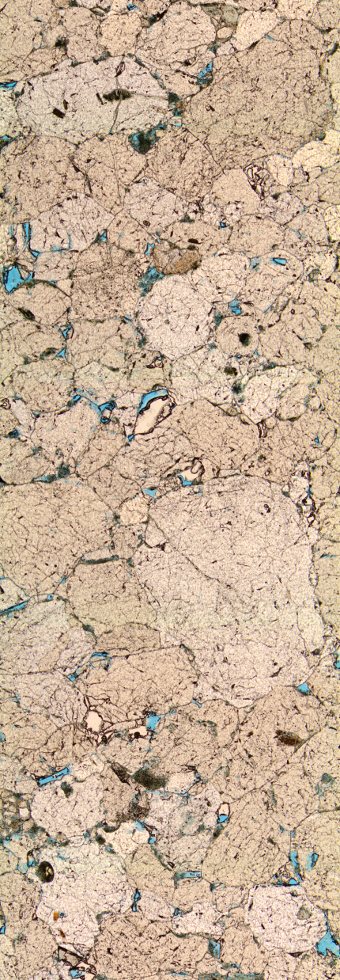

Mineralogical assessment
Mt. Simon Sandstone: 3190’, 40’ from top of Middle Run SS
Optical microscopy for initial mineral identification.
Vertical slice taken of each thin section.
Resolution ~5 µm.

Slide 4
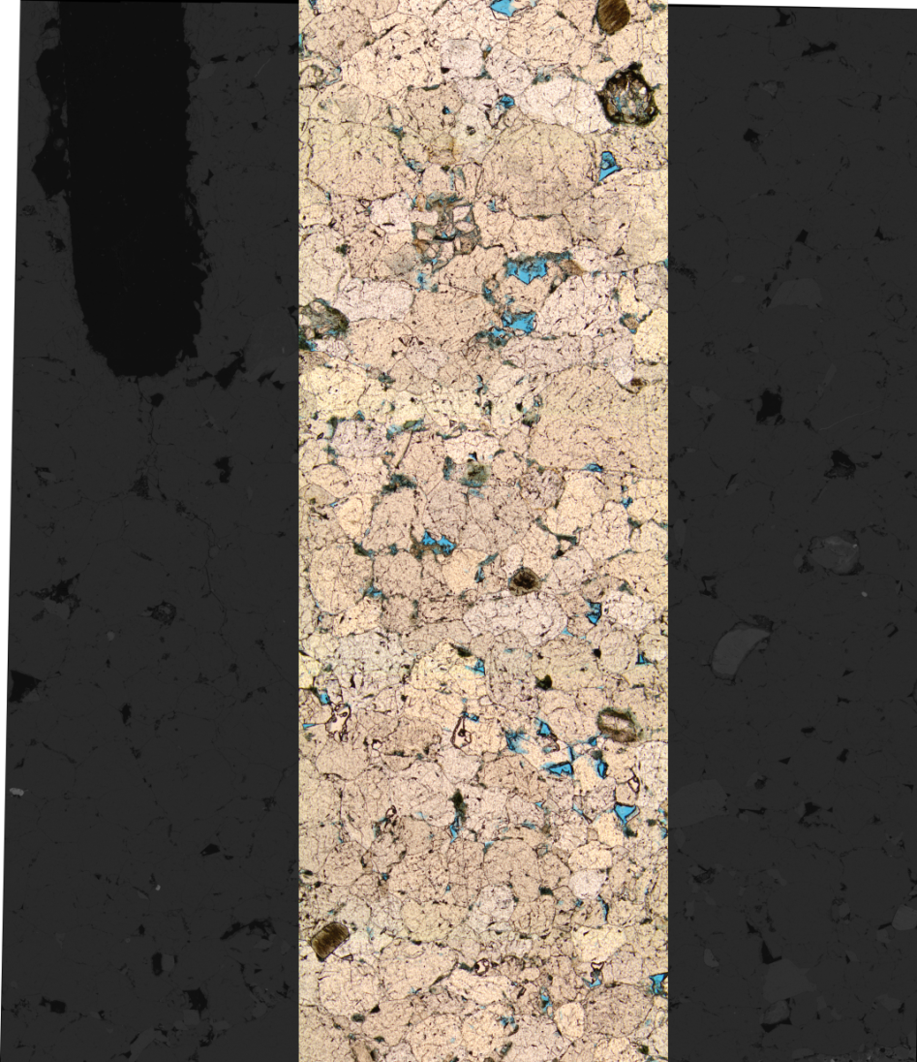
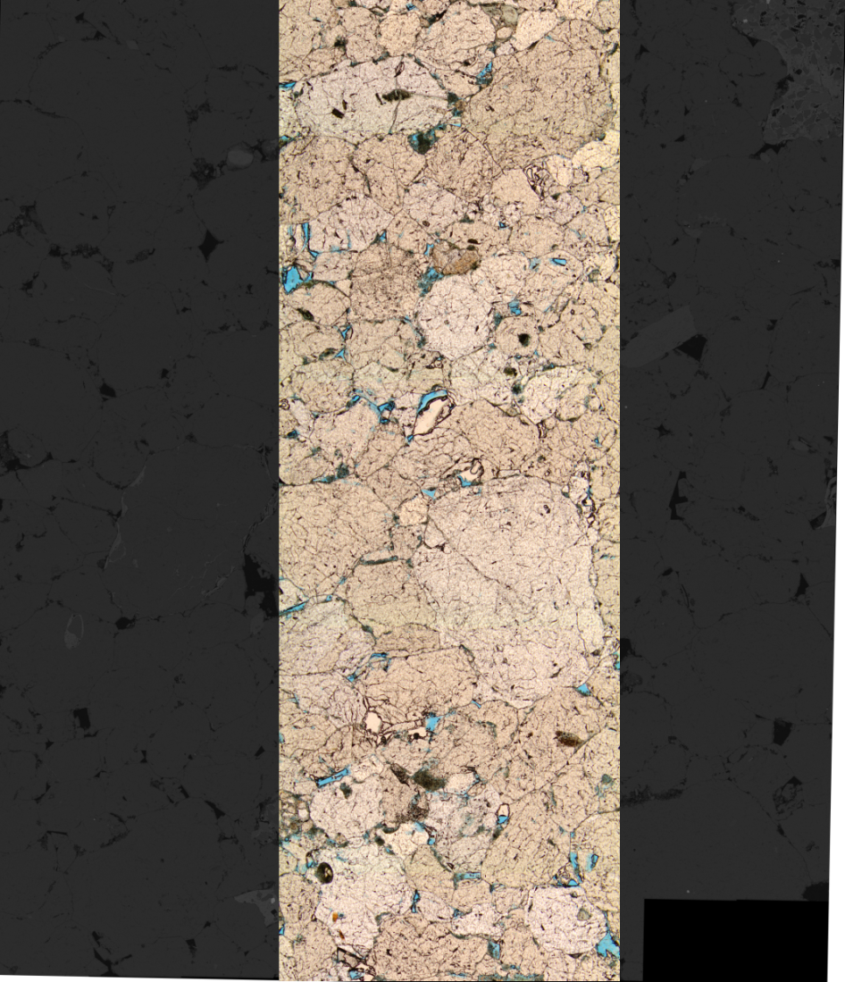
BSE Imaging - coverage
BSE image co-registered with photomicrograph

Slide 5
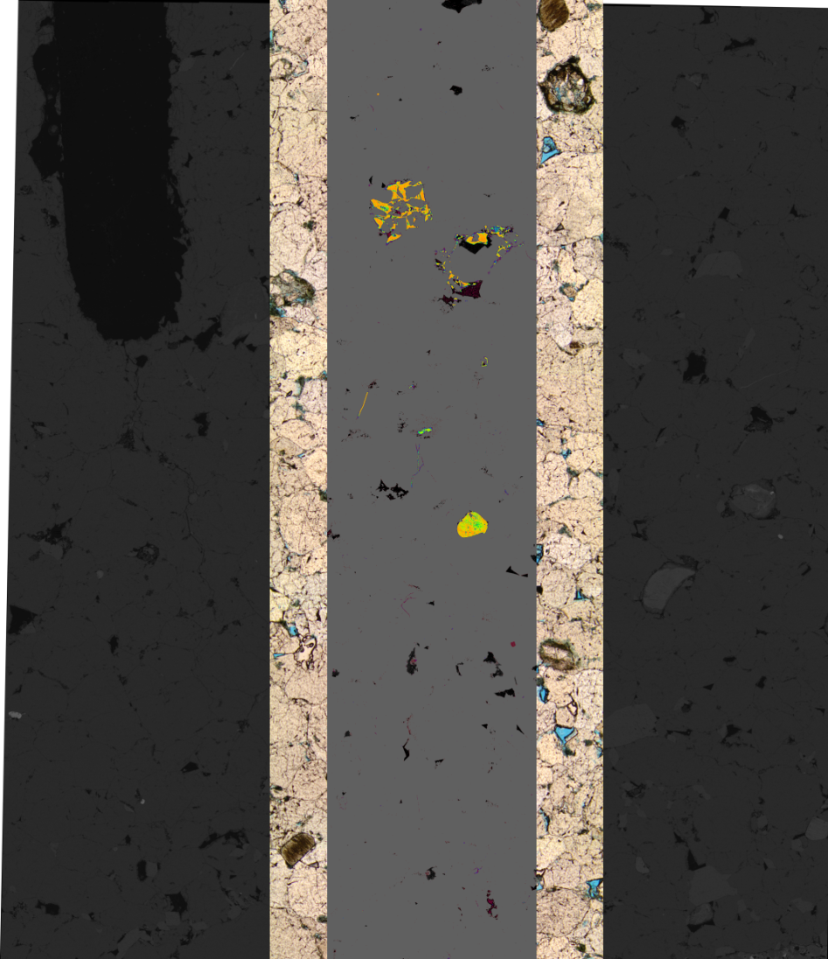
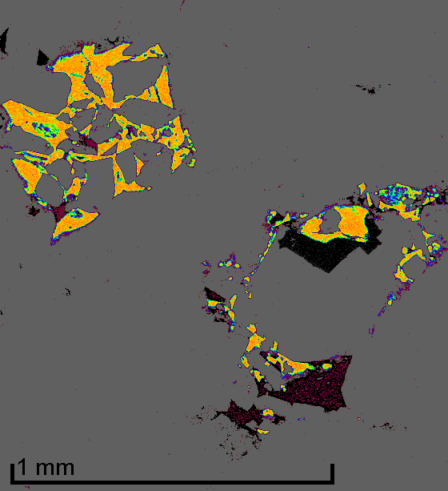

Elemental mapping: Calcium

Slide 6
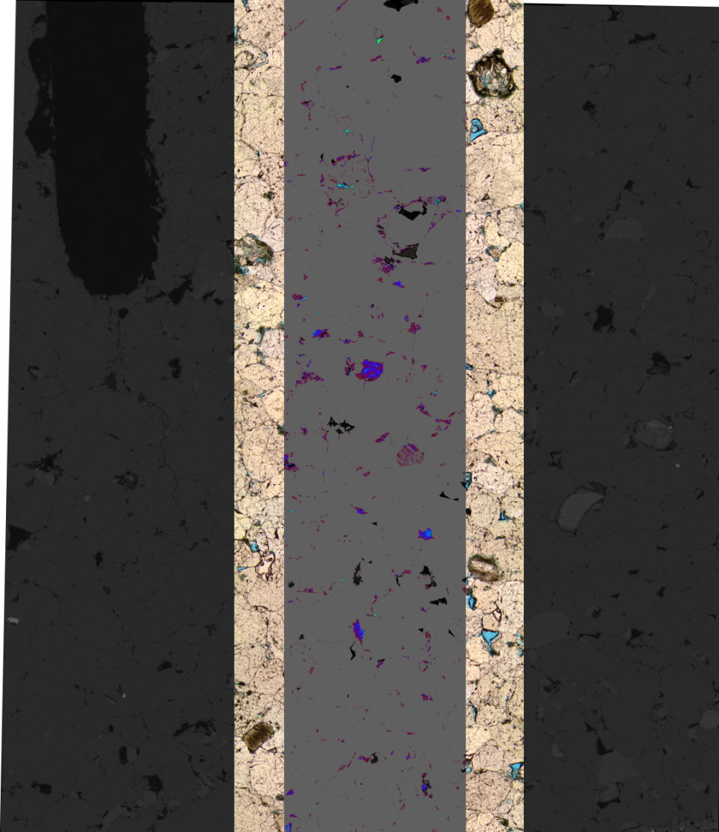
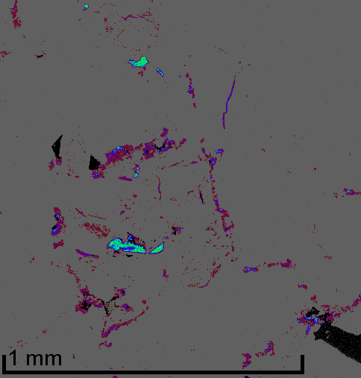
Elemental mapping: Iron

Slide 7
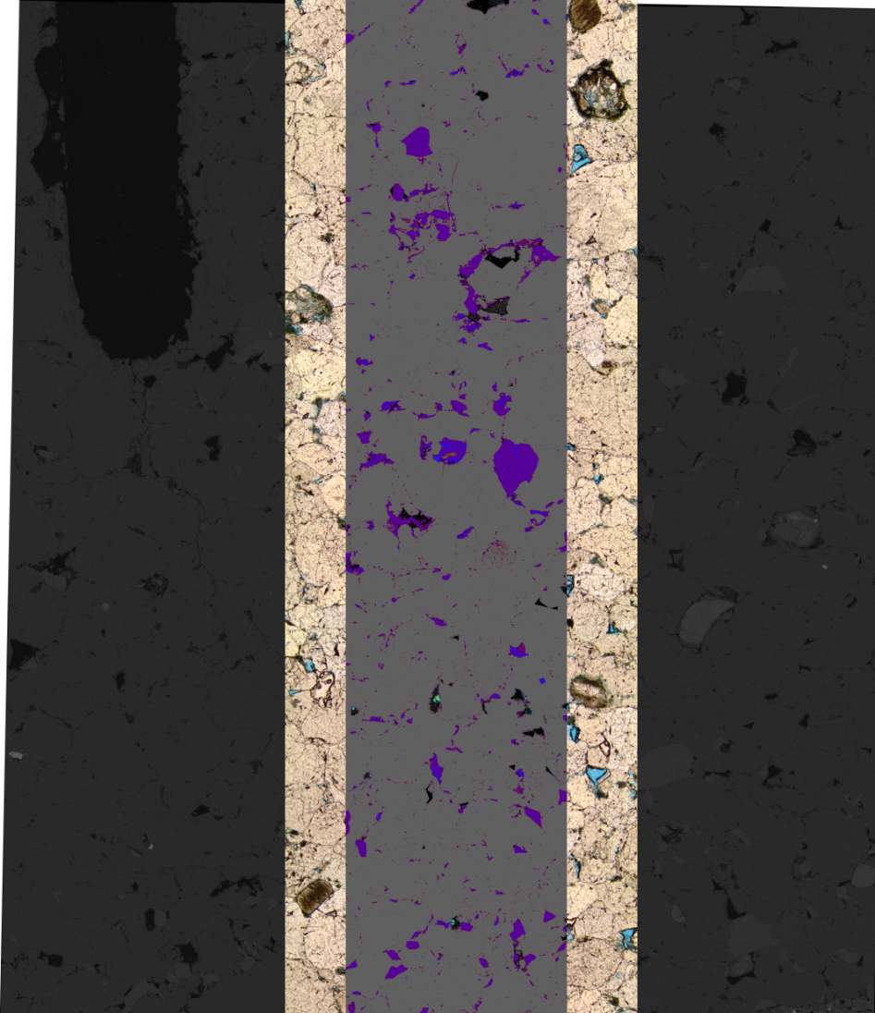
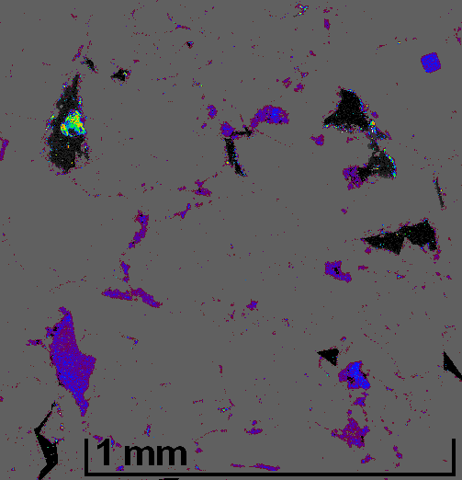
Elemental mapping: Aluminum

Slide 8
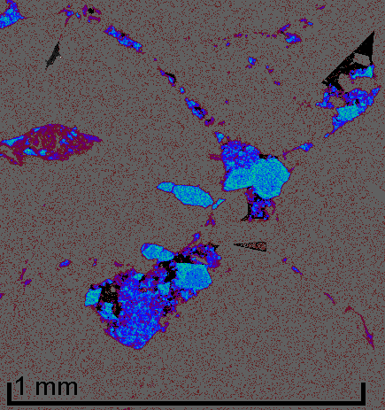
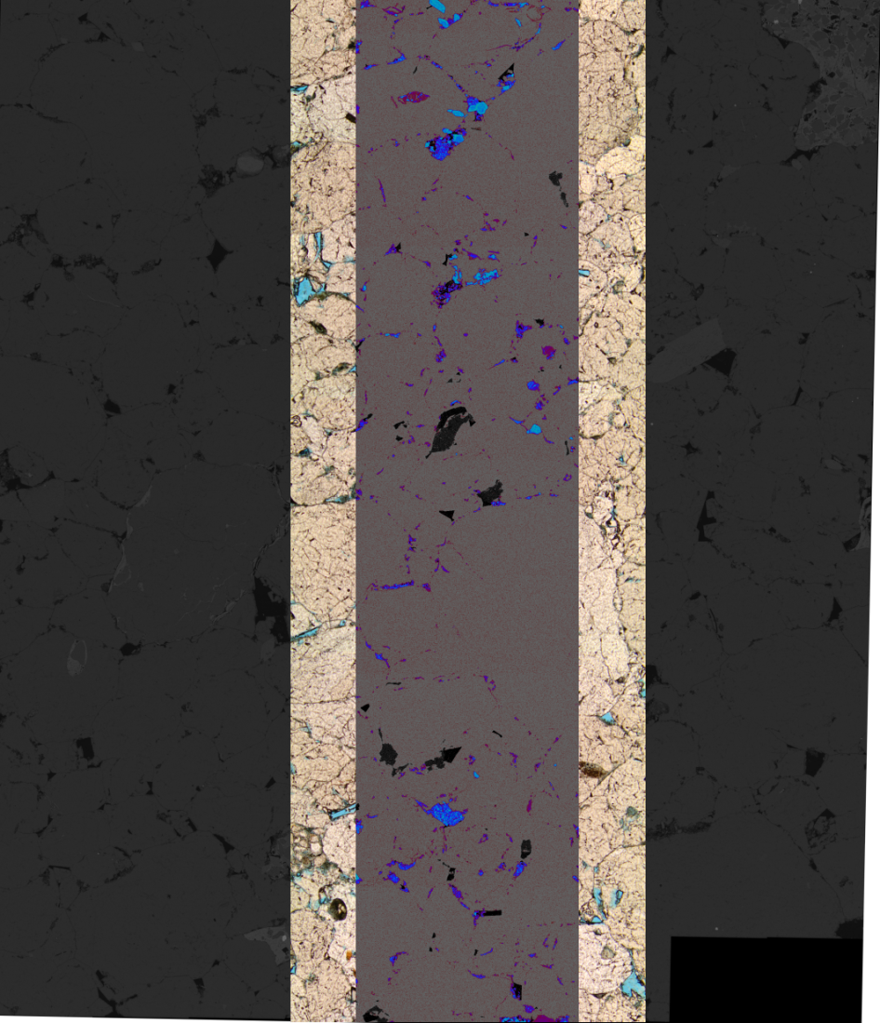
Elemental mapping: Potassium

Slide 9
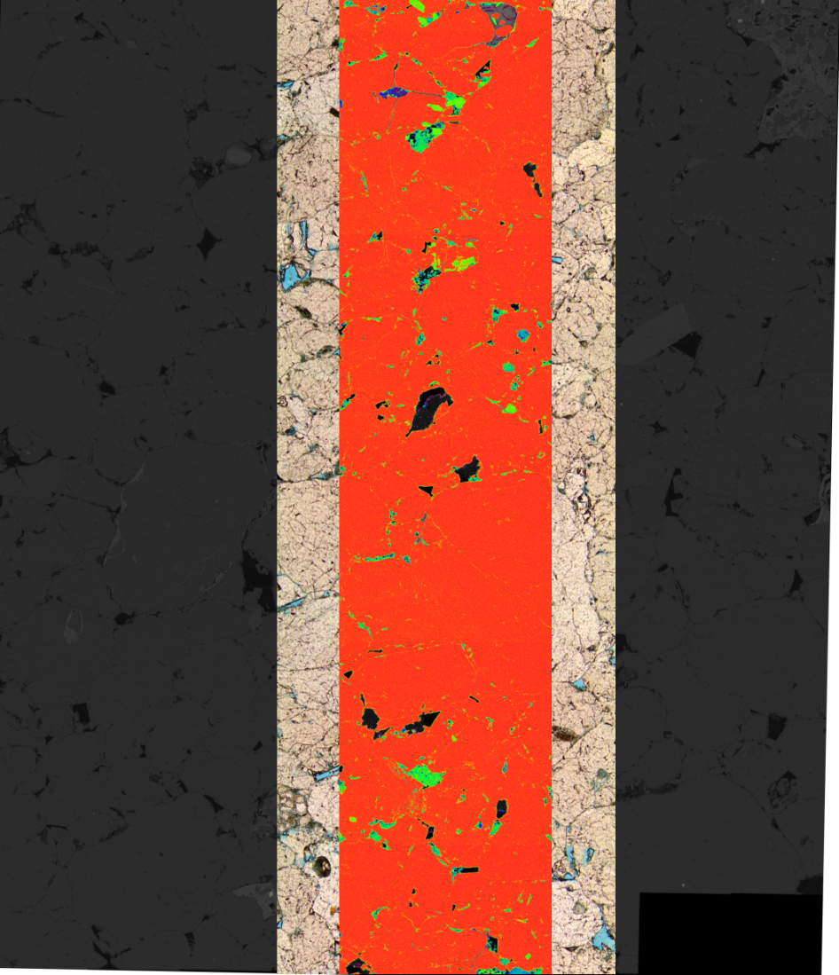
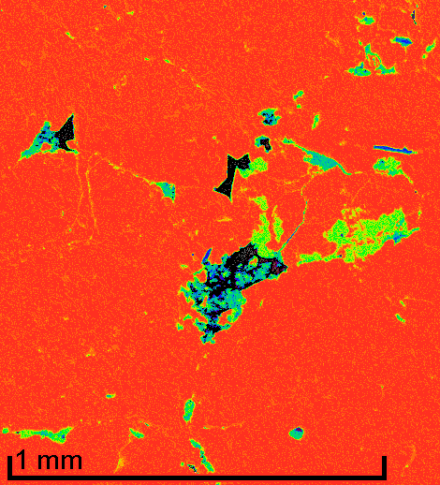
Elemental mapping: Silicon

Slide 10
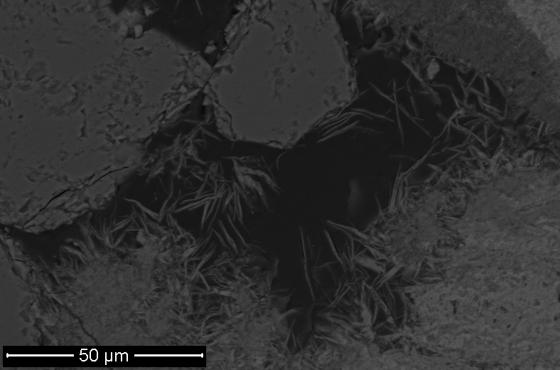
BSE Imaging – pore-scale

Slide 11
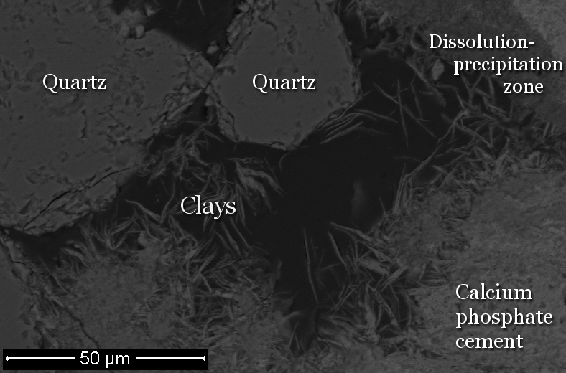
BSE Imaging – pore-scale

Slide 12
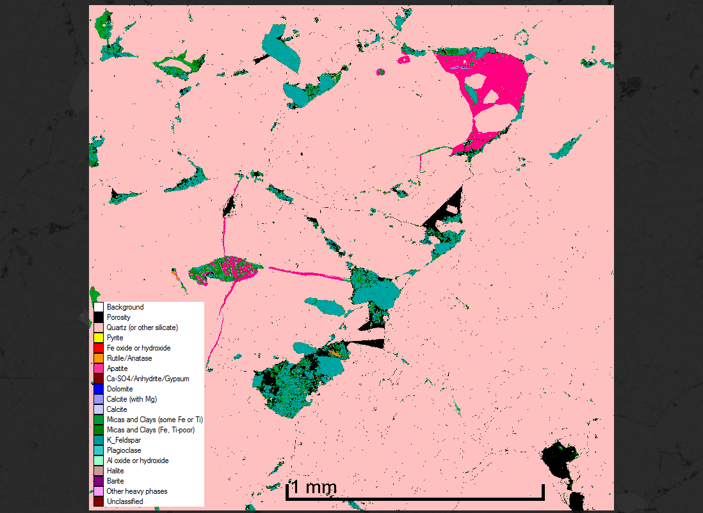
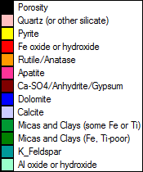
QEMSCAN mineral mapping

Slide 13
Minerals adjacent to pores
ODNR well #2843, at 3190’
Clays (primarily Chlorite and Illite):
  Comprise greater surface area accessible to CO₂-bearing brine
  Host reactive iron oxides
  Dominate pore throats, which they often form
Also of geochemical importance:
  Apatite
  Iron and Aluminum oxy-hydroxides
  Titanium oxides
  Salts such as Gypsum
  (minor) Carbonates
Estimate of surface area %
33.80% |  | K Feldspar
29.20% |  | Quartz
23.30% |  | Illite
10.80% |  | Chlorite
1.50% |  | Apatite
0.50% |  | Gibbsite
0.20% |  | Rutile
0.20% |  | Carbonates
0.10% |  | Goethite
0.10% |  | Gypsum
0.00% |  | Pyrite

Slide 14
Future work
Mapping
  Co-registration of images from multiple sources – in particular high-res BSE and lower-res QEMSCAN
  Increasingly rigorous quantification of pore mineralogy
Modeling
  Sensitivity studies on the effect of pore versus bulk model mineralogy
  2D, then 3D, reactive-transport modeling
In depth investigation at the pore scale and below
  Small-angle and ultra small-angle neutron scattering (SANS, USANS) to better characterize pore surfaces
  TEM mapping at 1-100 nanometer scales

Slide 15


Acknowledgements
Work performed by the Subsurface Energy Materials Characterization and Analysis Lab at The Ohio State University.
Funded by the Dept. of Energy “Nanoscale Control of Geologic CO₂” Energy Frontier Research Center.
Core and data provided by the Ohio Department of Natural Resources.

Slide 16
(spacer)

Slide 17
Geochemistry
Affects each of the CO₂ trapping mechanisms:
Stratigraphic – dissolution and precipitation alters permeability
Residual – pore geometry and brine composition mediate capillarity
Solubility – brine composition and ionic strength affect CO₂ solubility
Mineral trapping – formation brine, and minerals accessible to that fluid, provide cations (Ca, Fe, Mg, etc.) that form precipitants with CO₂.

Slide 18
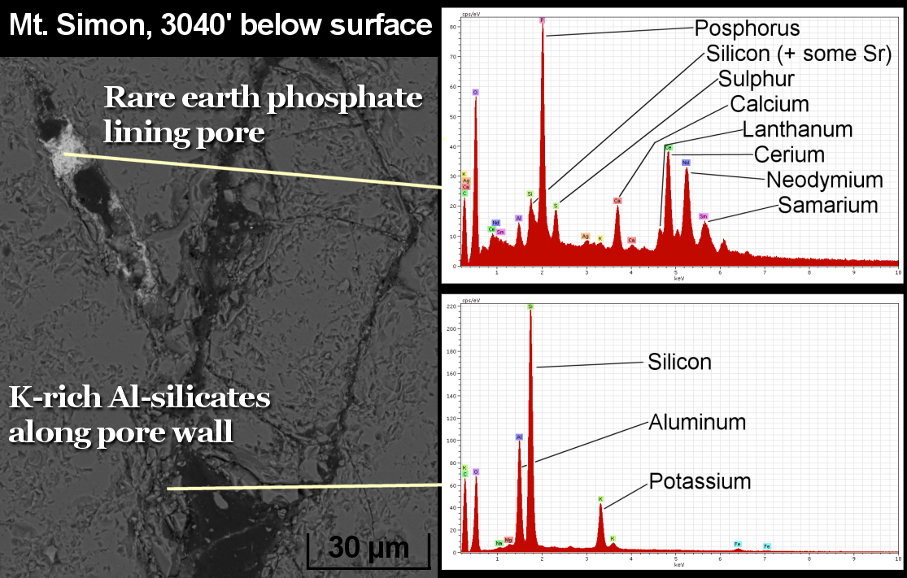
Pore-scale elemental investigation

