Slide 1
Incorporating a Groundwater Monitoring Project into an Introductory Geology Laboratory Class
John E. McCallen
Physical Sciences Department
Broome Community College
P.O. Box 1017
Binghamton, NY 13902
mccallenje@sunybroome.edu

Slide 2
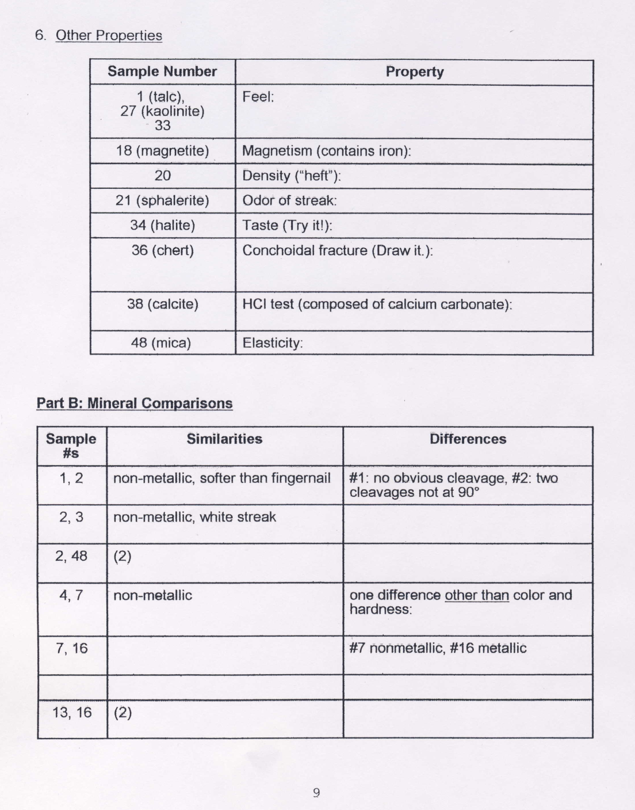
Student Labs
Usually paper copies
Worked on in a lab room
No real geological experience

Slide 3
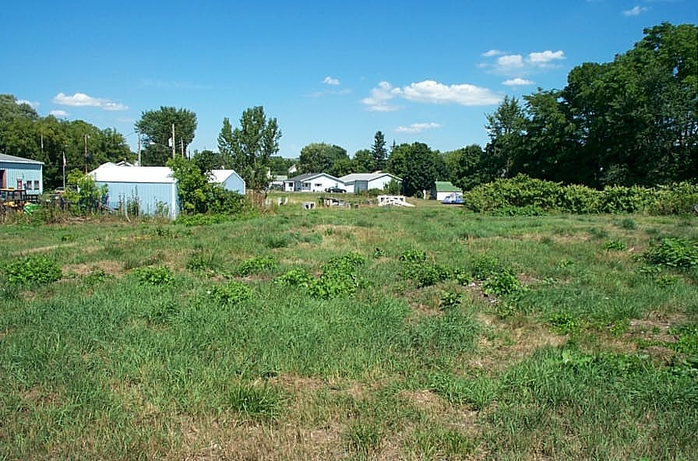
Cortland Salt Storage Area
Monitoring salt levels in the groundwater
Residential community down gradient of the shed

Slide 4
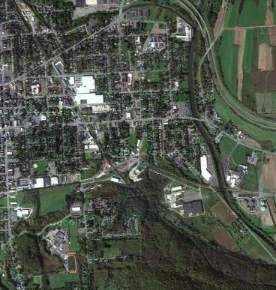
Part of the Rosen Inactive Hazardous Waste Site
Good project to get students involved

Slide 5
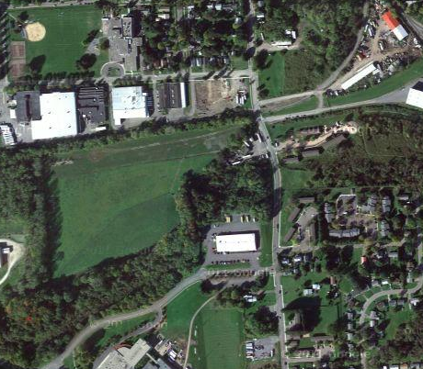
Rosen Site
20 acre industrial site in South Cortland
Former Wickmire Bros. wire screen and nail manufacturing operation
1908 - 1971

Slide 6
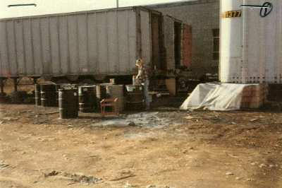
Student Involvement
Gain real world experience
DEC lists 780 Inactive hazardous Waste Sites in New York
297 sites in Region 7
www.hopewell-junction-citizens-for-clean-wate...

Slide 7
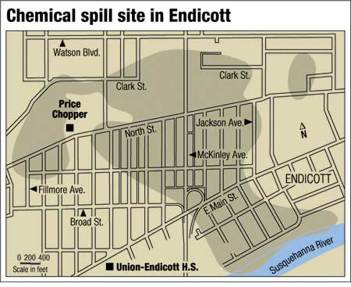
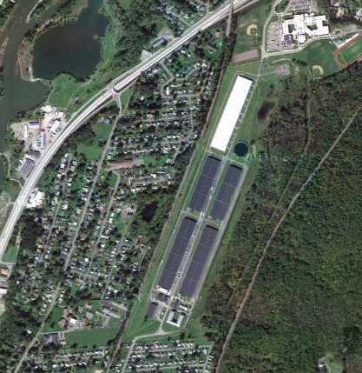
Two major sites in the Binghamton area Endicott and Hillcrest

Slide 8
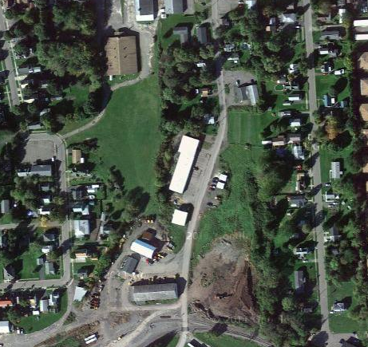
Cortland Salt Storage Area

Slide 9
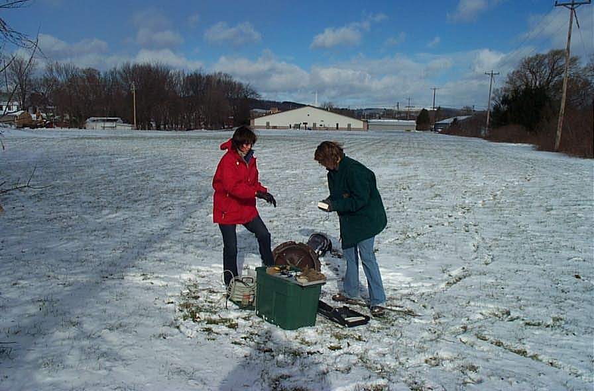
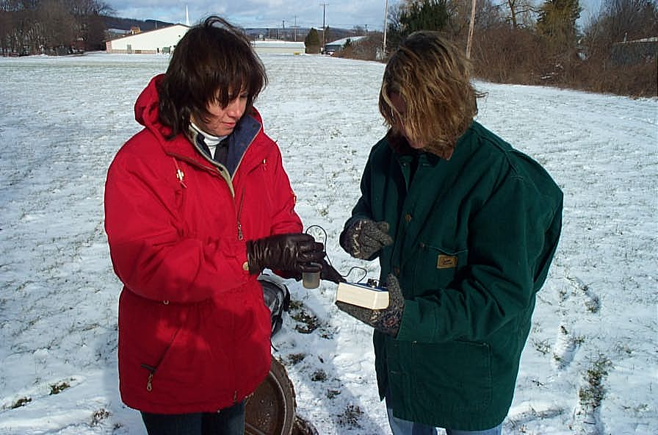
Two students the first semester
Decided to use as part of a lab exercise
Use the entire class

Slide 10
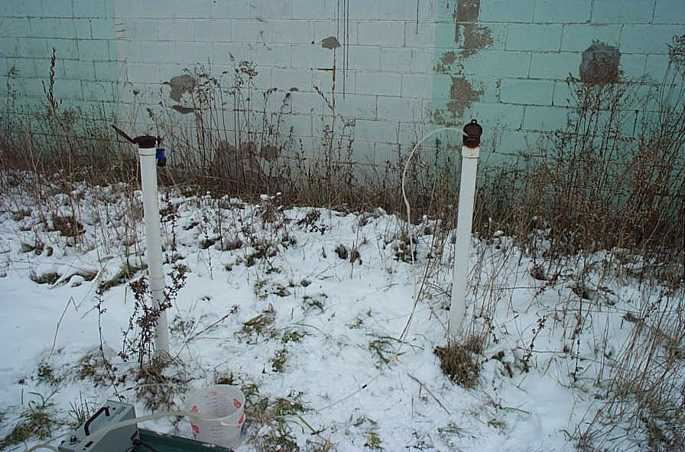
Students didn’t realize the conditions wells were in
Briars, weeds, overgrown areas

Slide 11
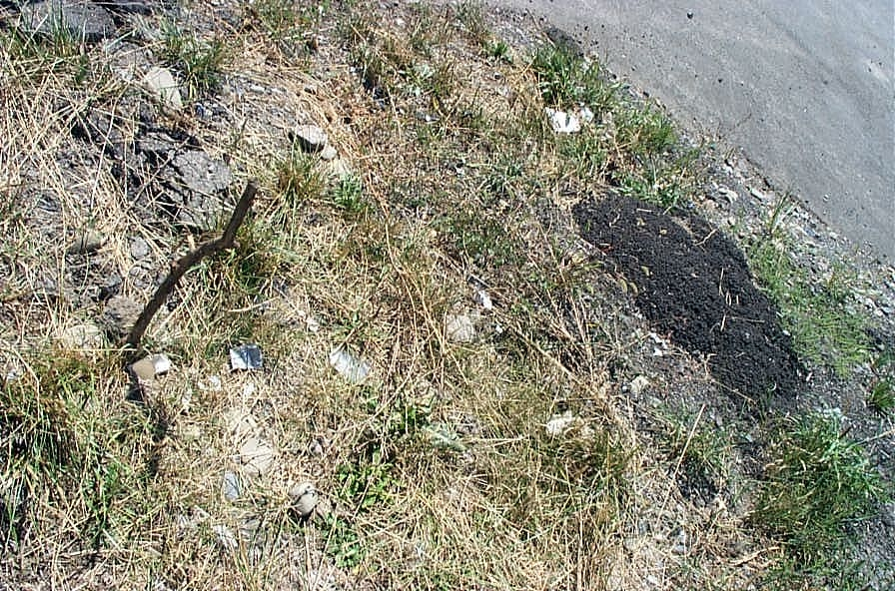
Some wells were damaged

Slide 12
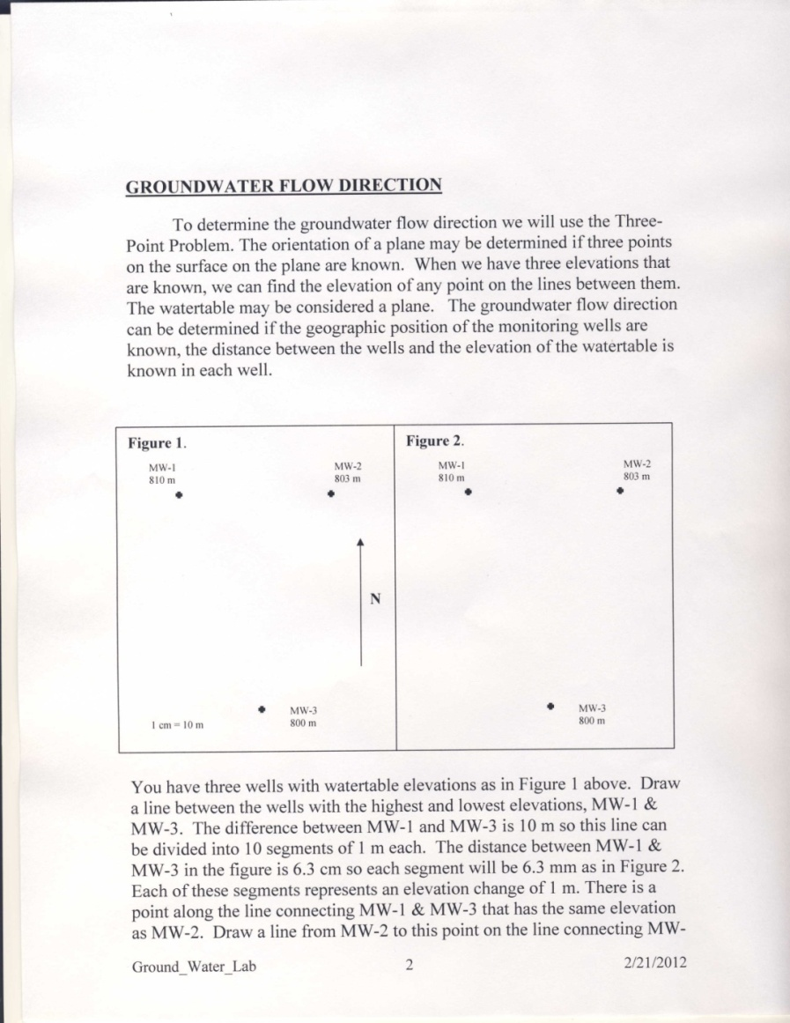
Student Involvement
Given a worksheet to find flow direction and hydraulic gradient

Slide 13
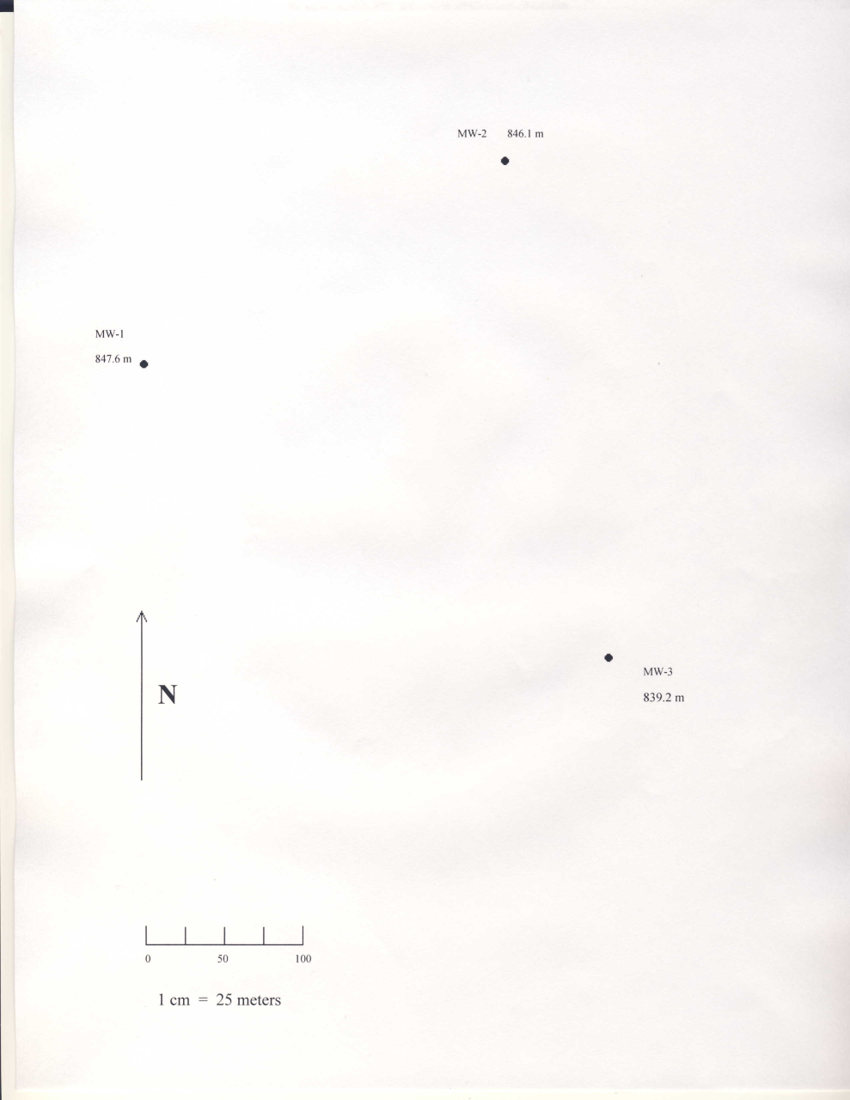
Students took groundwater elevation, pH, conductivity and TDS measurements in the field

Slide 14
Problems
Getting a van
Driver
Time must be < 3 hours

Slide 15
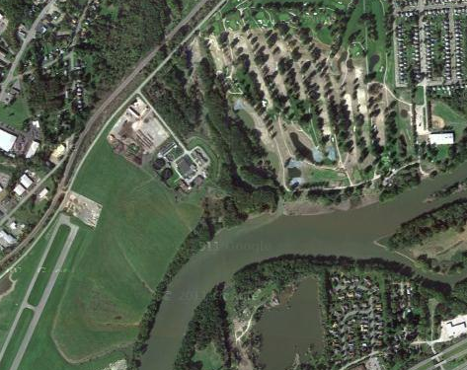
Student Interest
Class interest increased after the field trip
Started looking at hazardous waste sites in the area

Slide 16

Thank You
Questions?
Comments!

