Slide 1
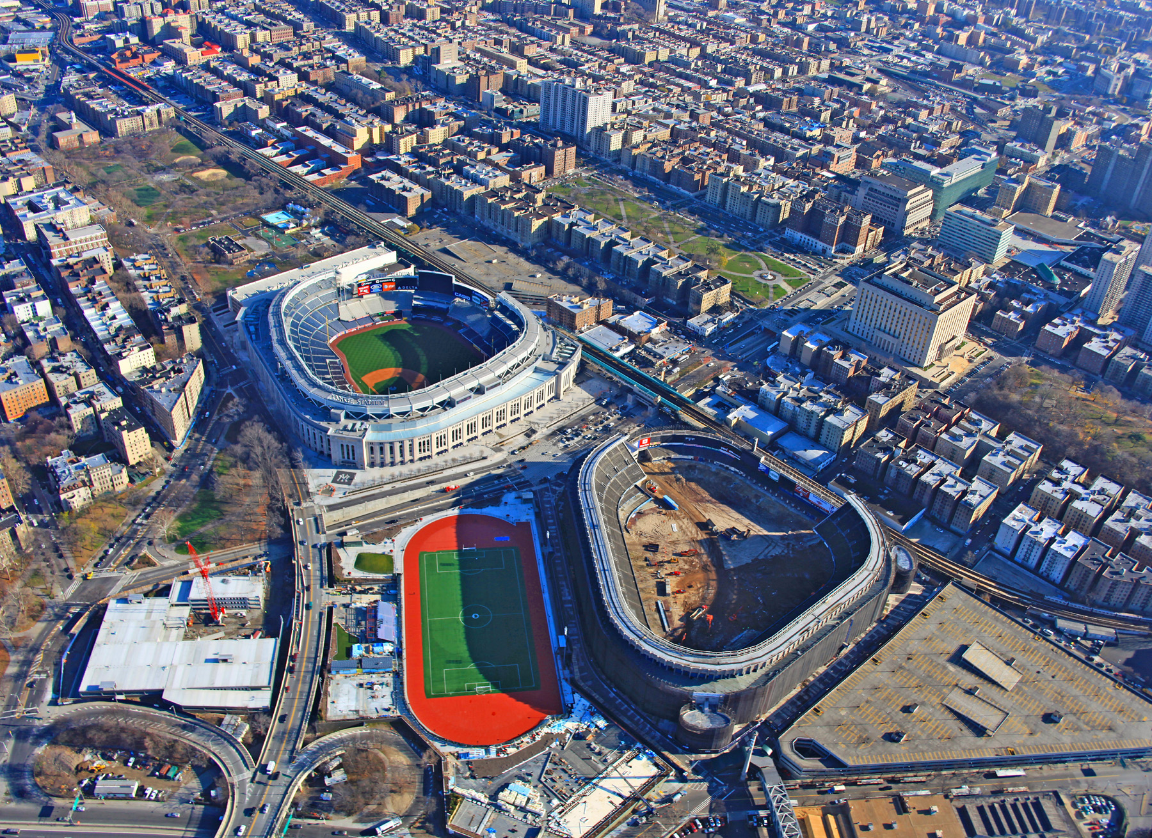
Evidence of Two Wisconsin Age Glacial Advances in a Valley
Beneath the New Yankee Stadium, Bronx, New York
Cheryl J. Moss
Mueser Rutledge Consulting Engineers

Slide 2
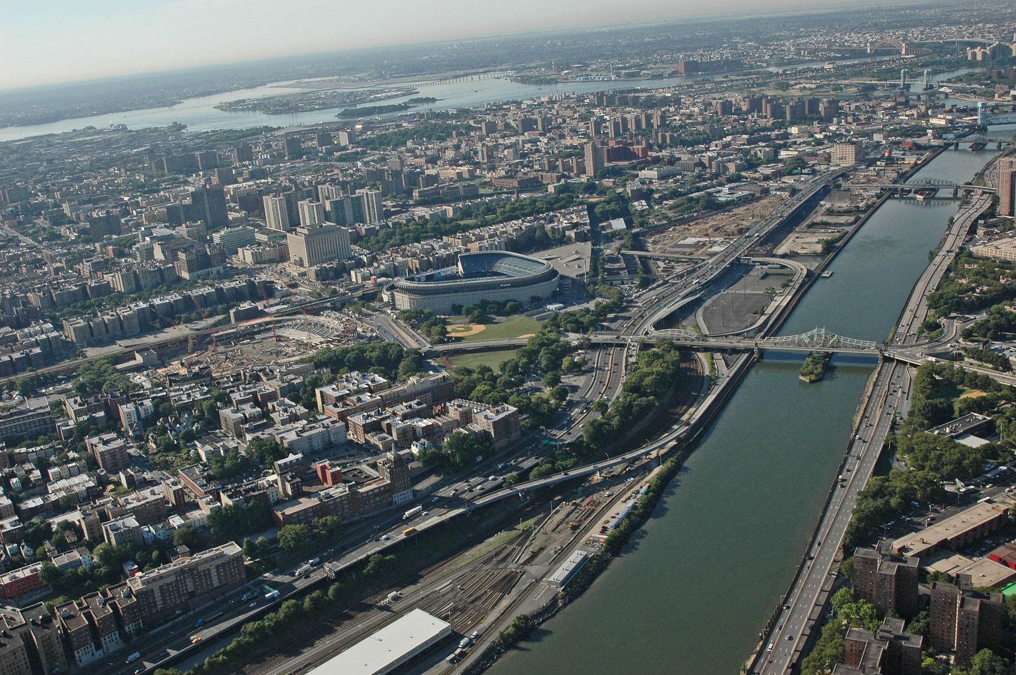
THIS AND OTHER NYC SITES DESCRIBED IN DETAIL
for the annual Long Island Geologists
Conference on the Geology of Long Island and Metropolitan New York
PDFs available online at: http://www.geo.sunysb.edu/lig/

