Slide 1
Introducing elementary school children to geologic fieldwork – from formulating the hypothesis to analyzing the data
Jane Alexander
College of Staten Island

Slide 2
Overview
Elements of the 3rd Grade Curriculum
Introducing the students to local geologic history
The fieldtrip and experiment
Classroom follow up

Slide 3
Elements of 3rd Grade Curriculum
Science
  The Scientific Method
  The Rock Cycle
Math
  Graphing
  Data analysis

Slide 4
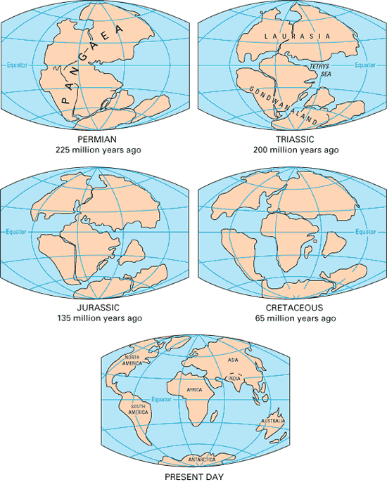
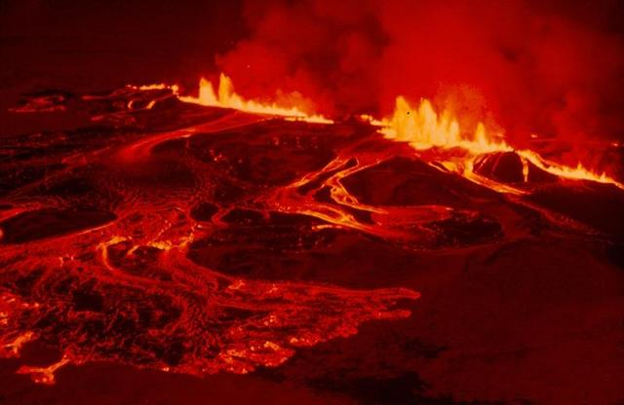
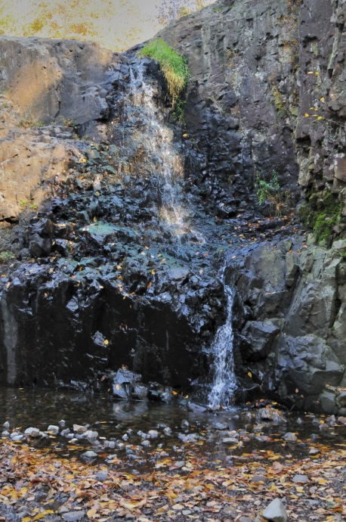
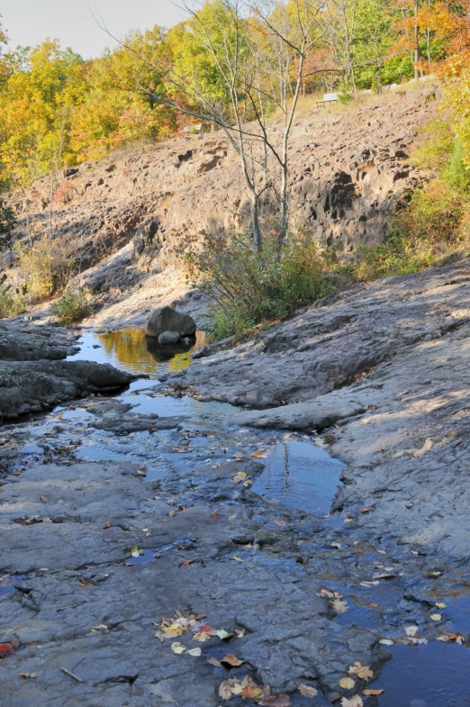
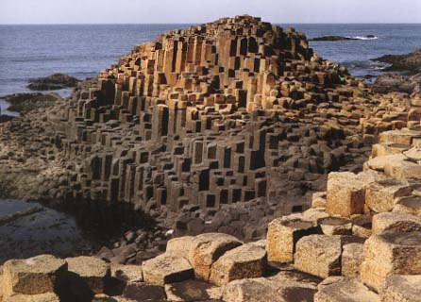
Introducing the students to local geologic history

Slide 5
Formulating the hypothesis
After the introduction, the students were encouraged to formulate a hypothesis relating to the shapes of the columns that they would see on the fieldtrip
  “We predict that the shapes of the columns at the South Mountain Reservation will have 6 sides”
We then discussed how to test the hypothesis

Slide 6
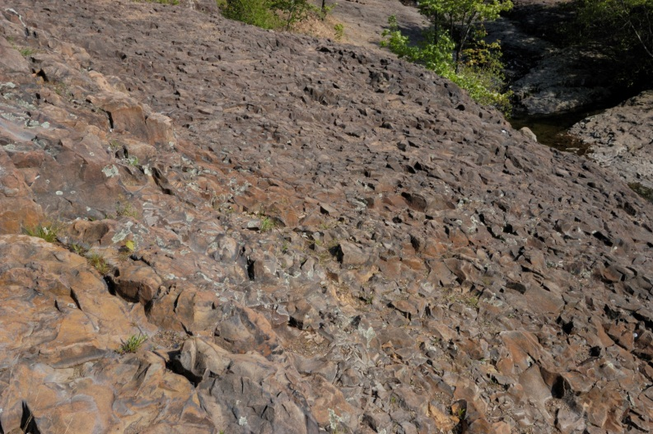
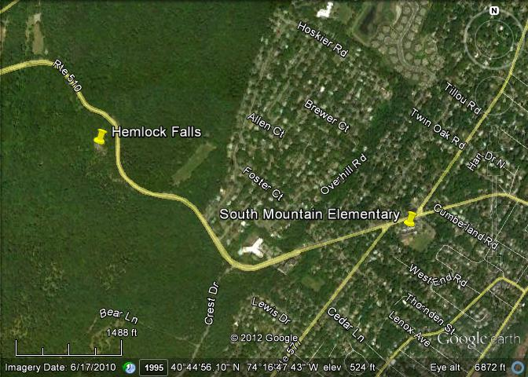
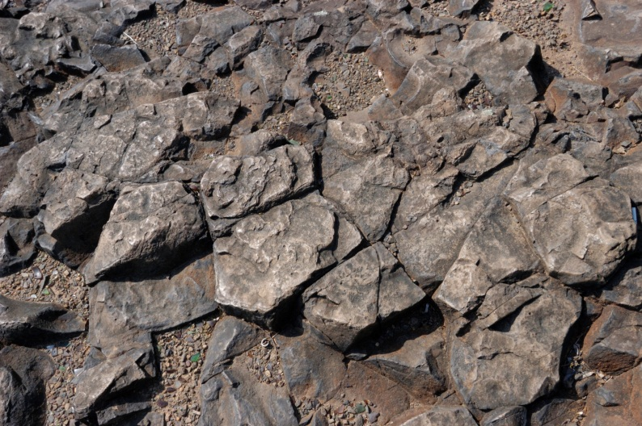
The fieldtrip

Slide 7
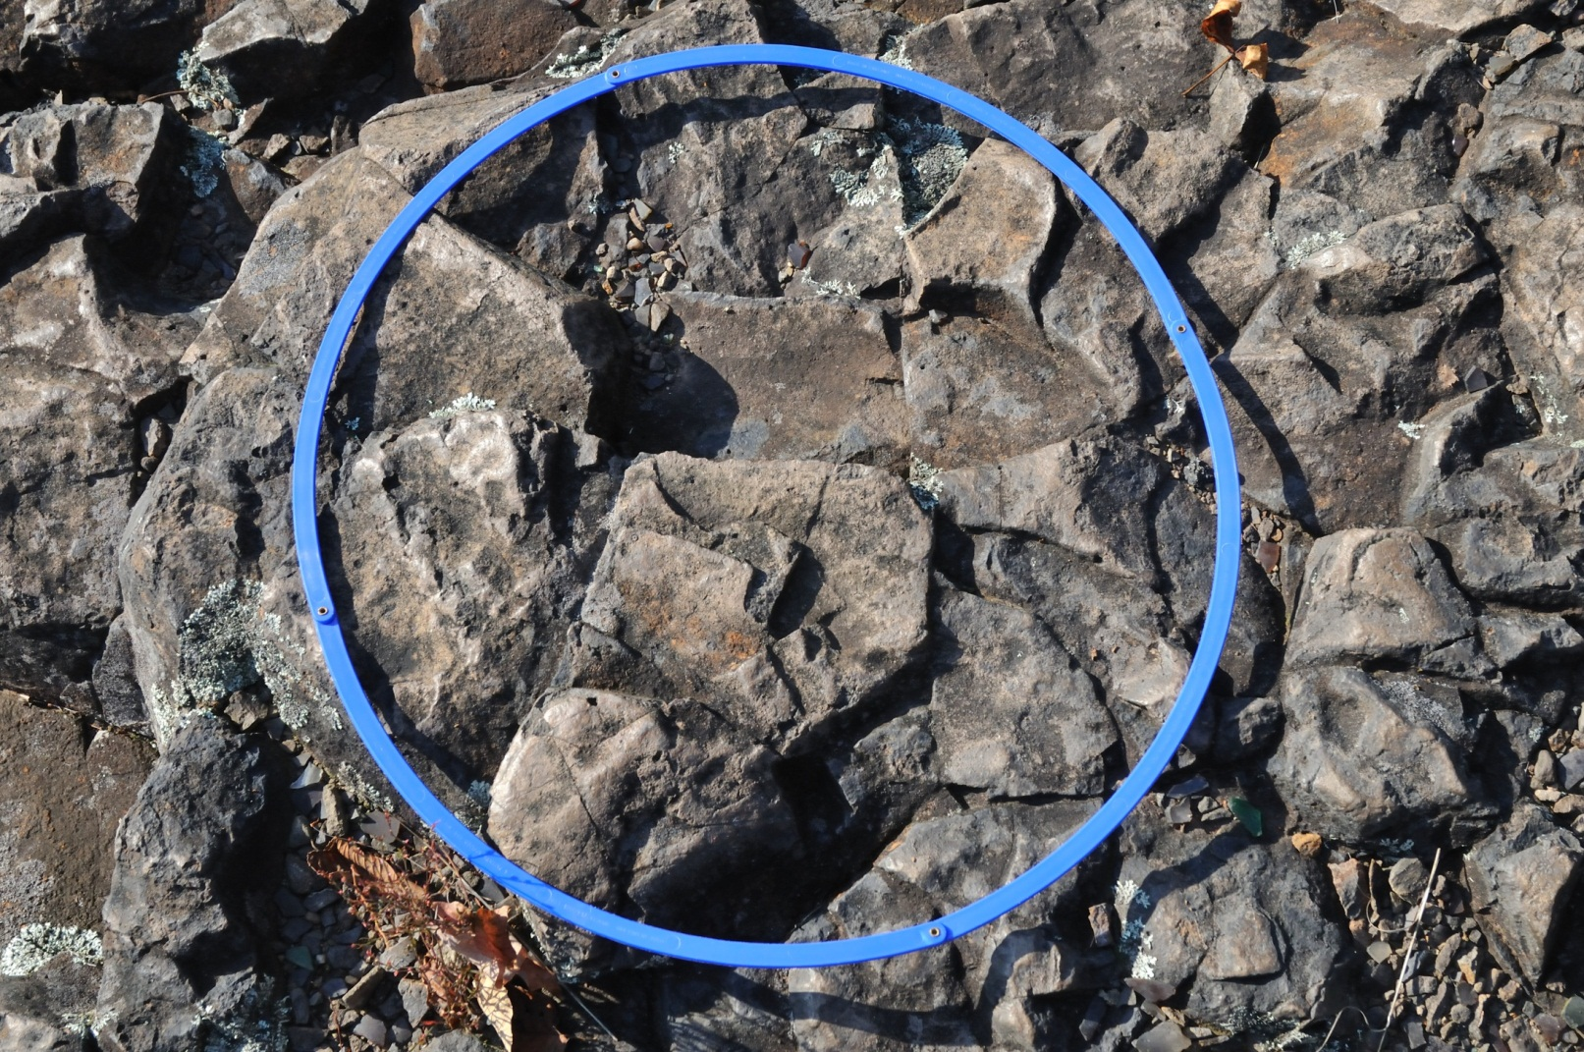
The experiment…

Slide 8
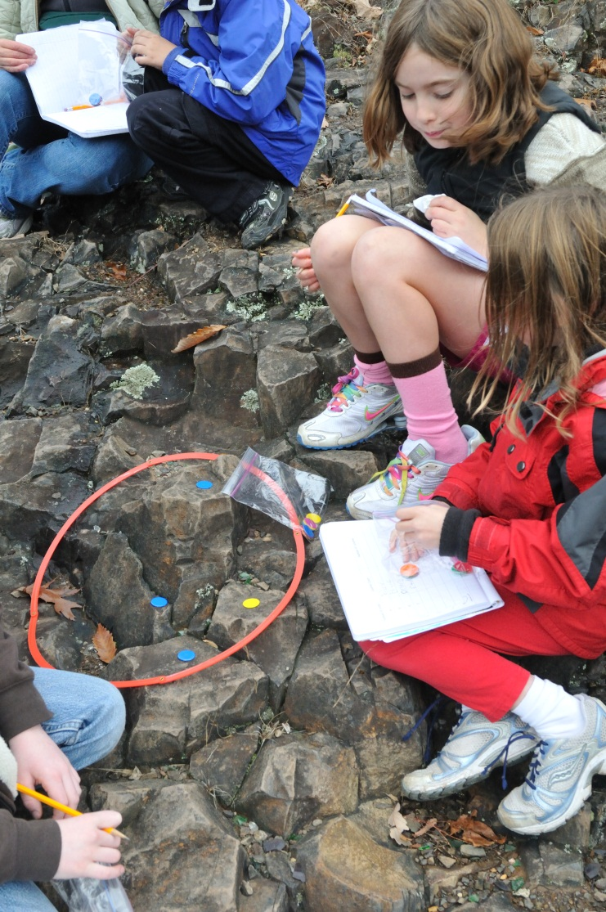
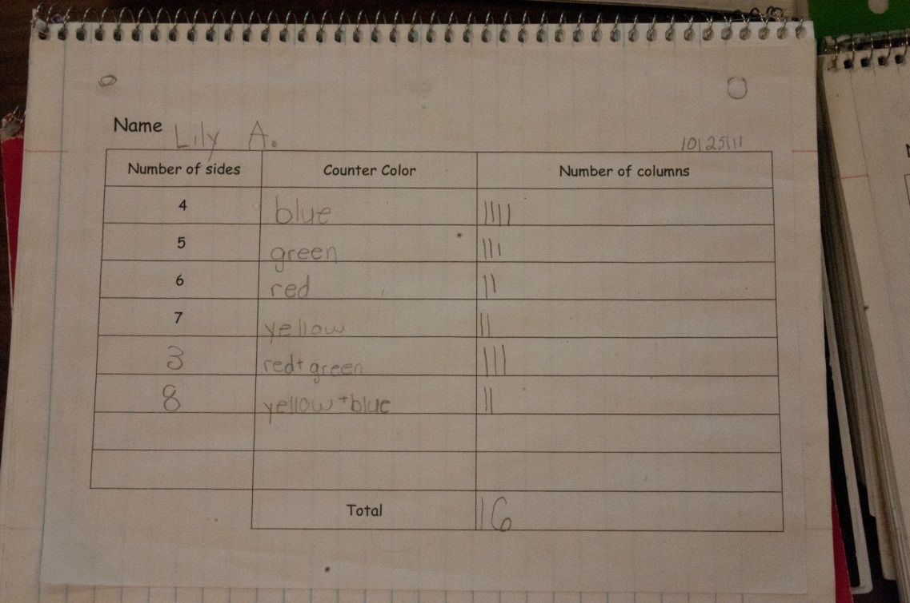
How do you keep track?

Slide 9
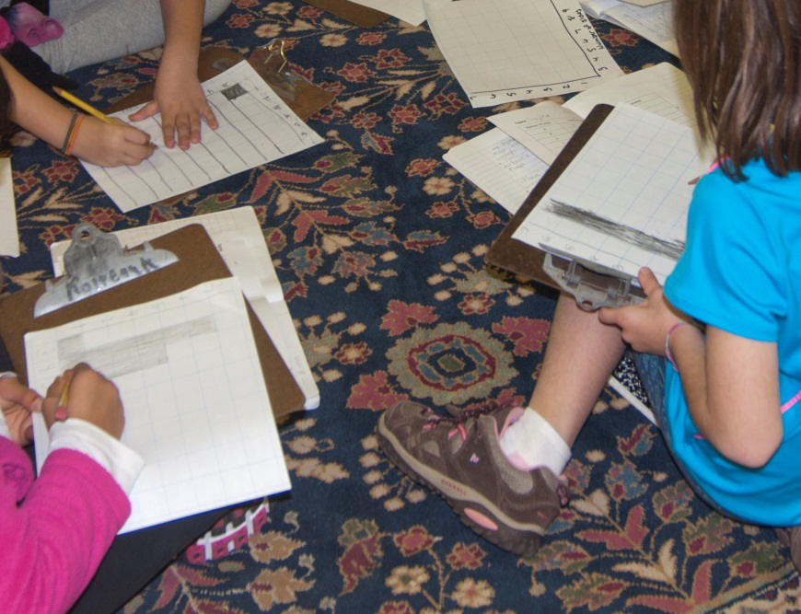
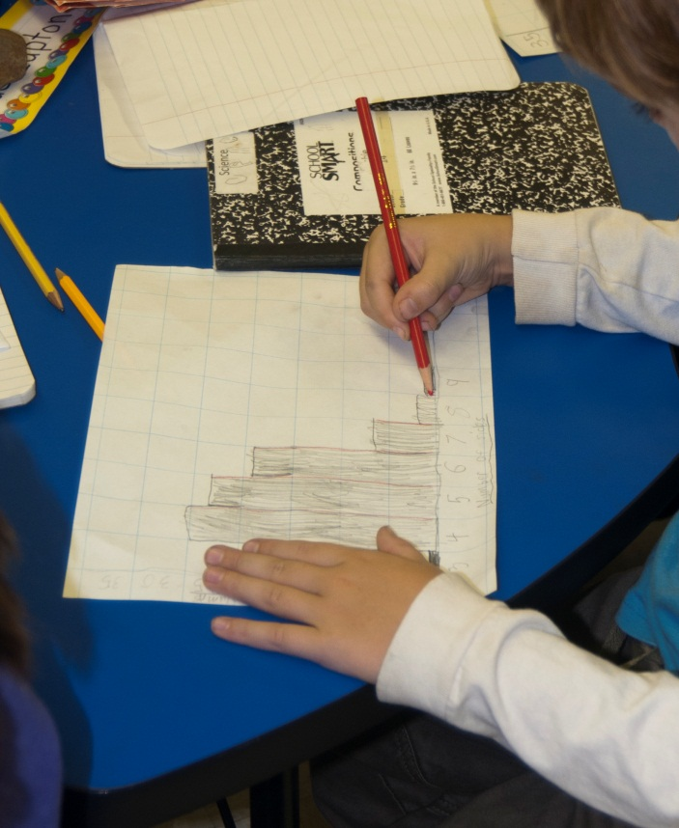
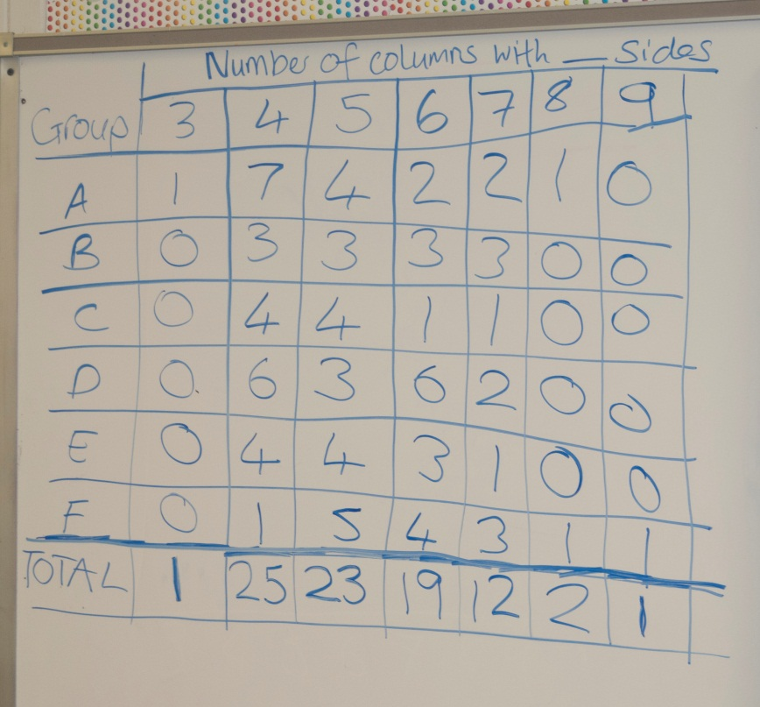
Classroom follow up

Slide 10
Conclusions
Students practiced and reinforced concepts from different parts of the curriculum
Everyone became actively involved in using the scientific method
  And the results were unexpected!
No real analysis of effectiveness yet – these students will have standardized science testing next year

Slide 11
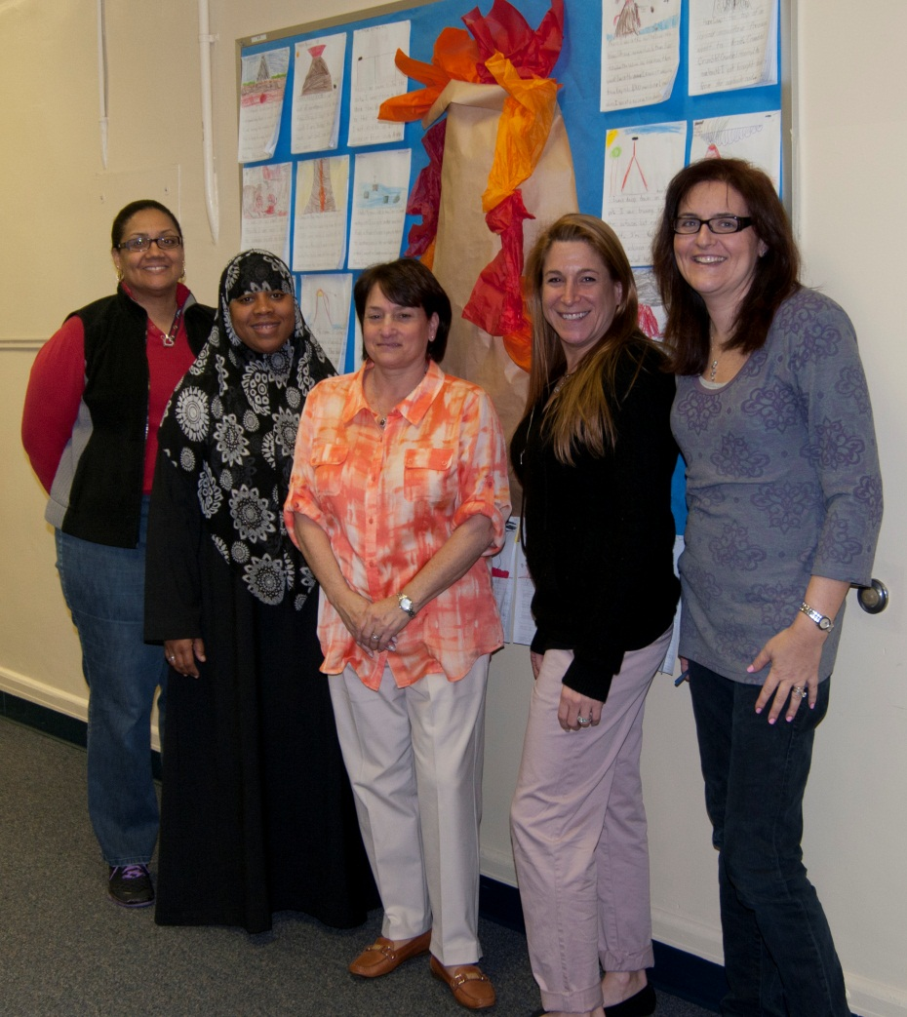
Thank you to these wonderful teachers!
L-R: Mrs. Conyers, Mrs. Henderson, Mrs. Ferrara, Mrs Bucich, and Mrs. Heumann (Absent: Mrs. Masters)

