Slide 1
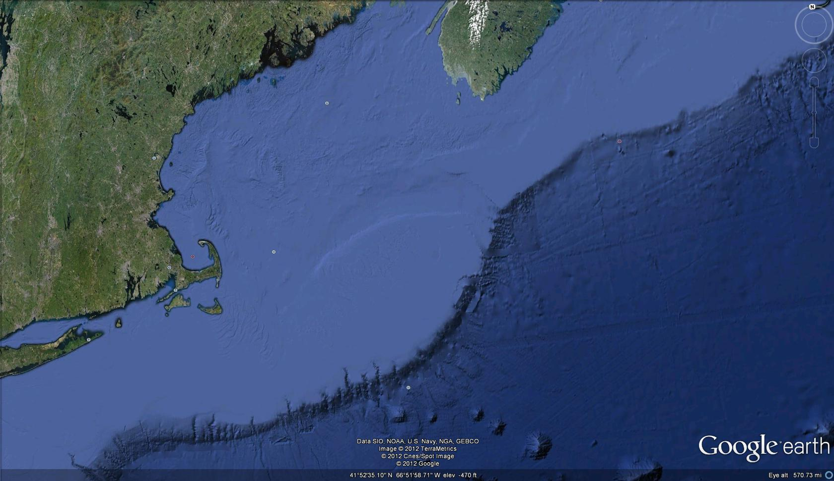
Multiple Glacial Development of Upper Georges Bank
Ralph. S. Lewis- UCONN-Avery Point
Byron D. Stone- U.S.G.S.
Northeast Channel
Great South Channel
Georges Bank

Slide 2
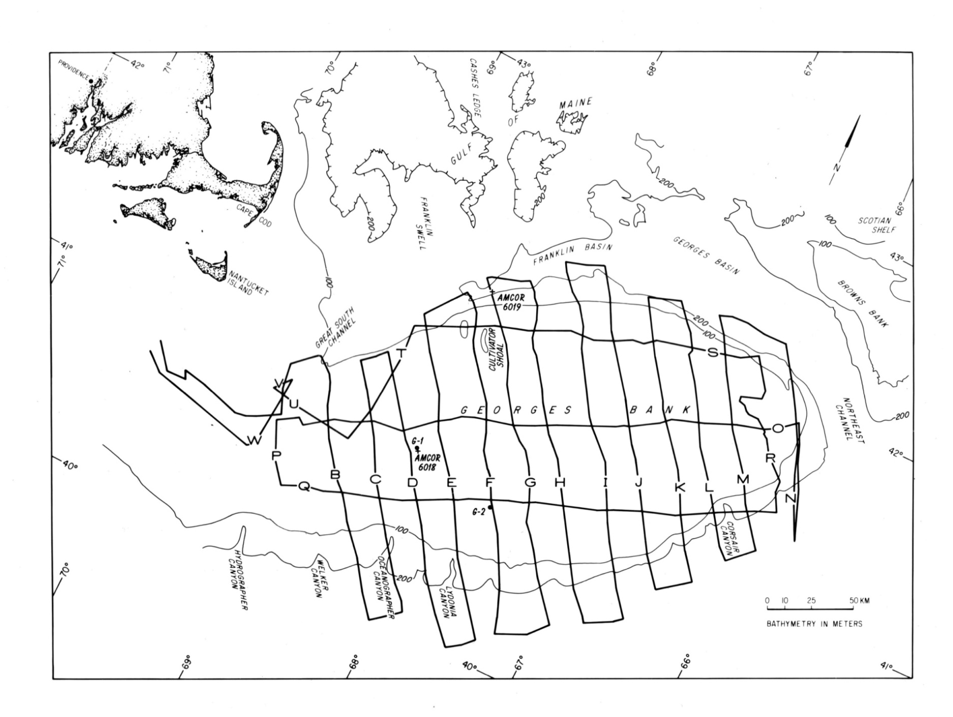
Index Map Showing 1975 Fay 003 Minisparker Track Lines In Relation To Geographic Features

Slide 3
On/Off Lap
Deltaic Thicken-SE
Deltaic Thicken-SW
CH

Slide 4
On/Off Lap
Deltaic Thicken-SW
Deltaic Thicken-SE
CH

Slide 5
On/Off Lap
Deltaic Thicken-SW
Deltaic Thicken-SE

Slide 6
Index Map Showing 1975 Fay 003 Minisparker Track Lines In Relation To Locations of AMCOR Holes and COST Wells G-I and G-2.
AMCOR 6016
AMCOR 6014
x
AMCOR 6013

Slide 7
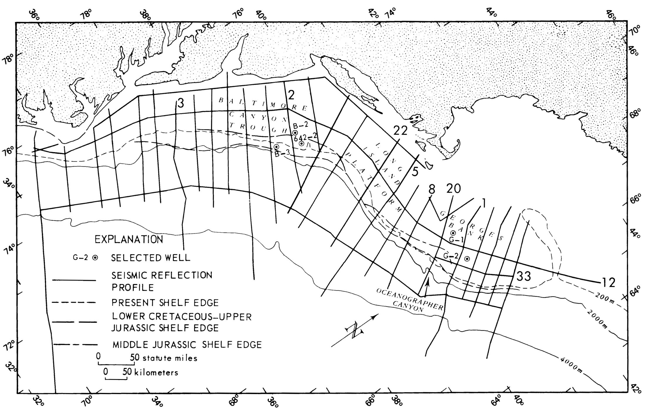
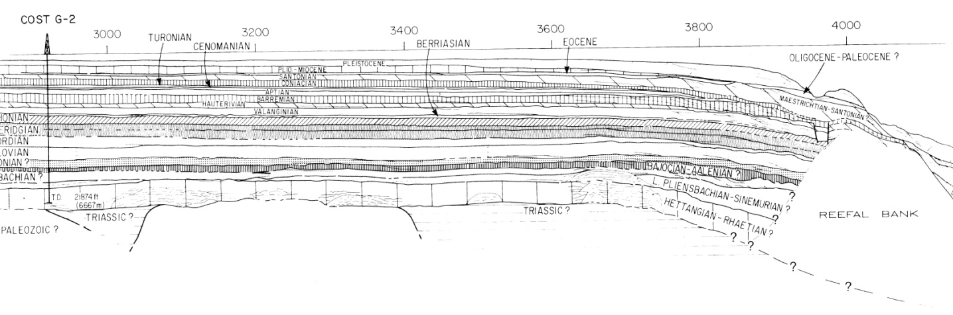
Index Map Showing COST Wells G-1 and G-2 In Relation To Multichannel Line. Poag (1982) Pleistocene Thickens Southward From COST G-2 (61m) To Two Prograded Wedges (>120M Shot Point 3800)
Pleistocene
Multichannel Line
COST Wells

Slide 8
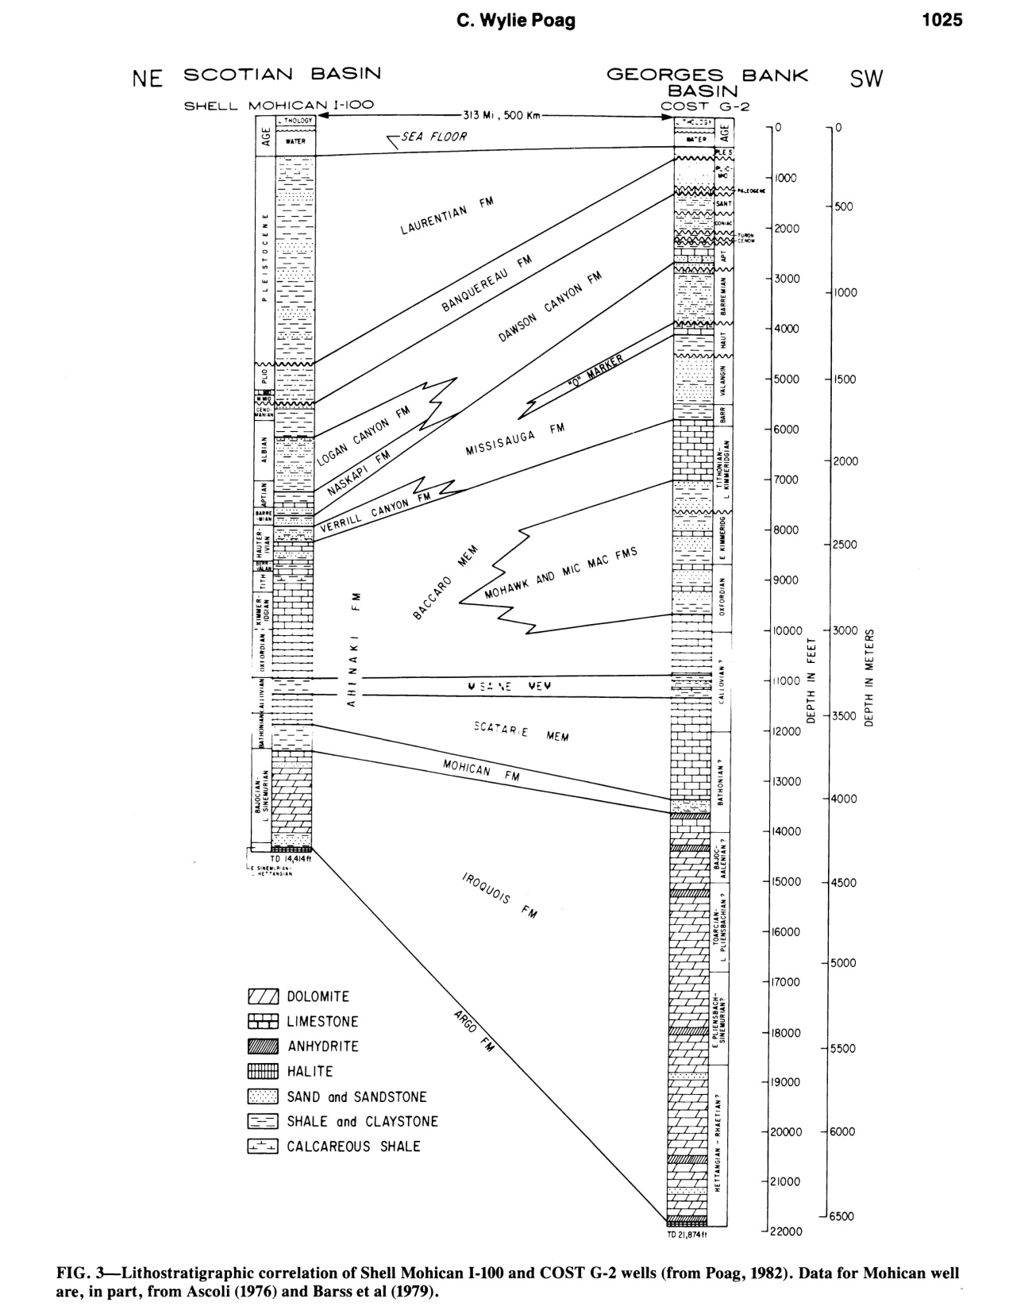
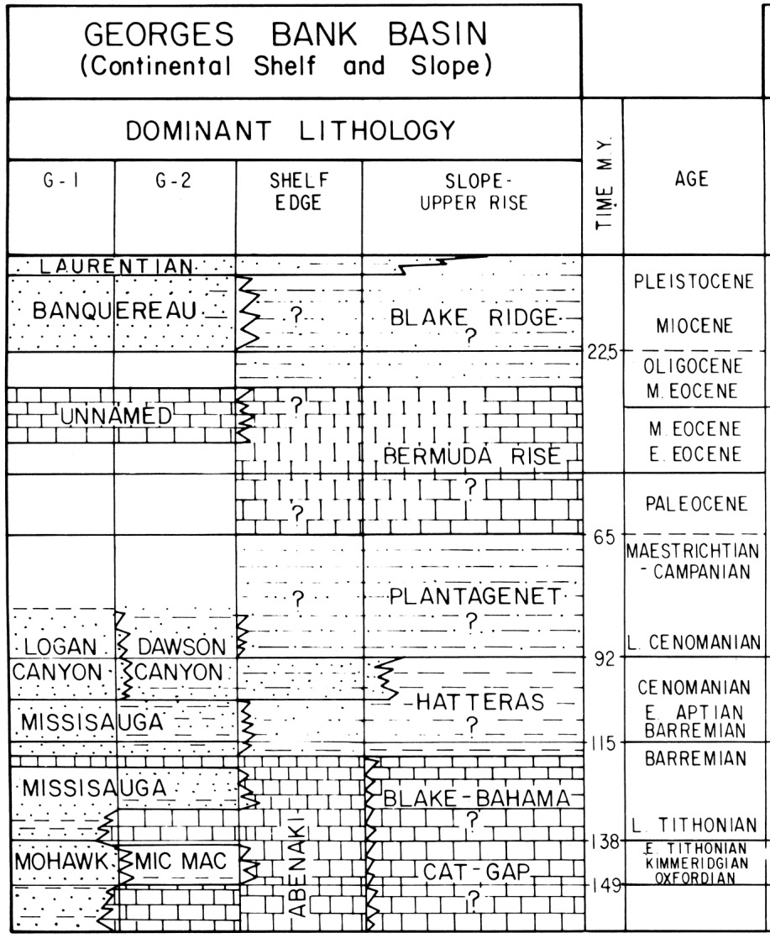
Poag, C.W., 1982, Stratigraphic reference section for Georges Bank basin-Depositional model for New England passive margin: AAPG Bull.,v66, p 1021-1041.

Slide 9
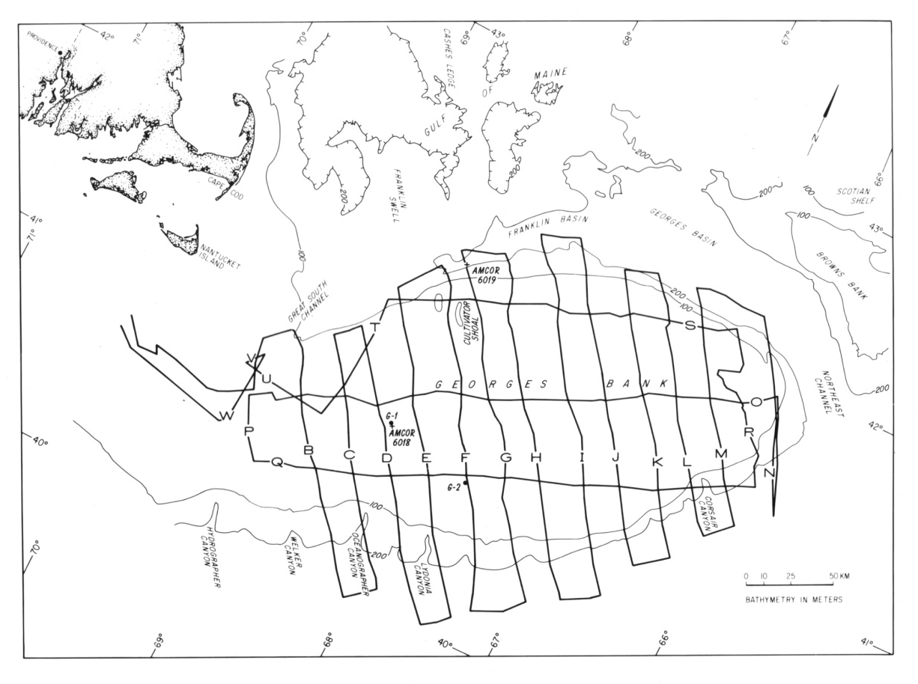
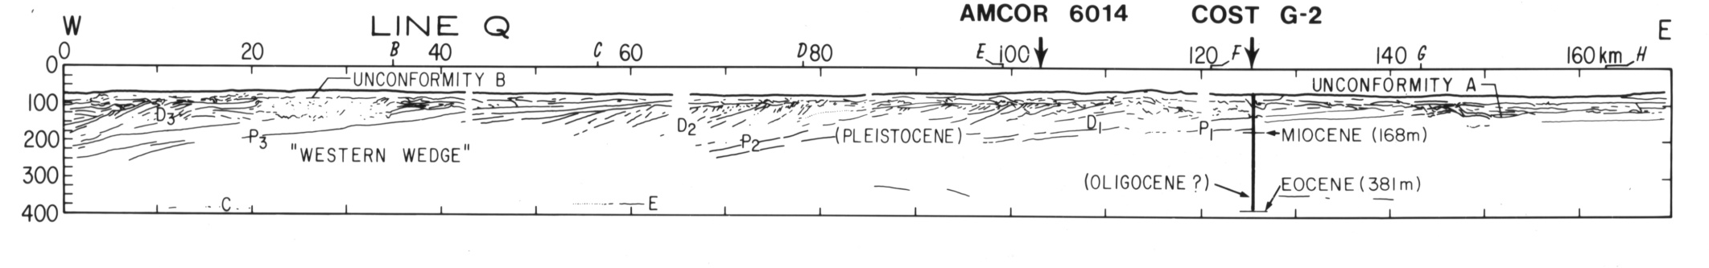

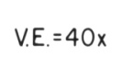
Deep Well Control Best on Line Q
Q
G-2
Poag, C.W., 1982, (COST G-2 Stratigraphy Projected to Line Q)
NOTE DIP OF PRE-PLEISTOCENE REFLECTORS

Slide 10
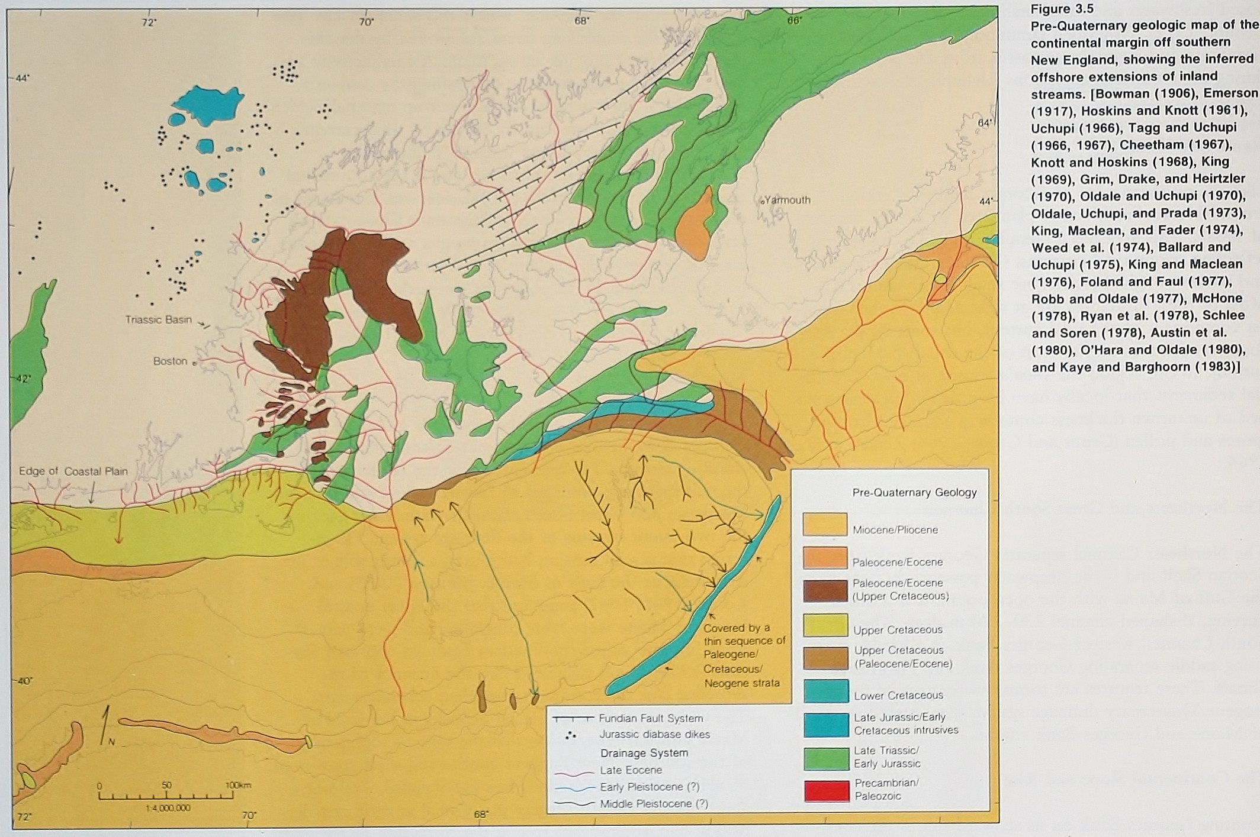
Uchupi, E. and James, A.A. Jr., 1987, Morphology, in R.H. Backus and W.D. Bourne, W.D., eds. , GEORGES BANK: The MIT Press, Cambridge, Mass.
Nova Scotia
Boston
Northeast Channel
Great South Channel
N

Slide 11
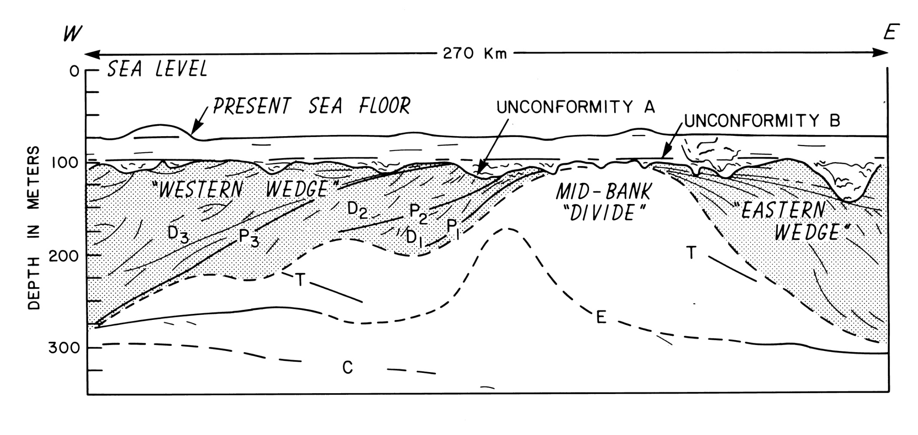
Idealized W-E Section Across Georges Bank (Not To Scale)

Slide 12

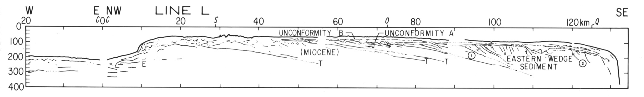

“Eastern Wedge” Area (Not Much Control)
O
L
Deltaic -Thicken Southward
O
Deltaic -Thicken Eastward
Line 0
(Mid Bank Area)
J
L
T

Slide 13


Prolific Source of Miocene Samples in Surface Grabs
“Mid Bank Area”
O
J
Q
O
Q
J
(Mid Bank)
Line 0
(Mid Bank)
J
Line Q

Slide 14
Good shallow well control in “Western Wedge” Area
AMCOR 6016
AMCOR 6014
x
AMCOR 6013

Slide 15
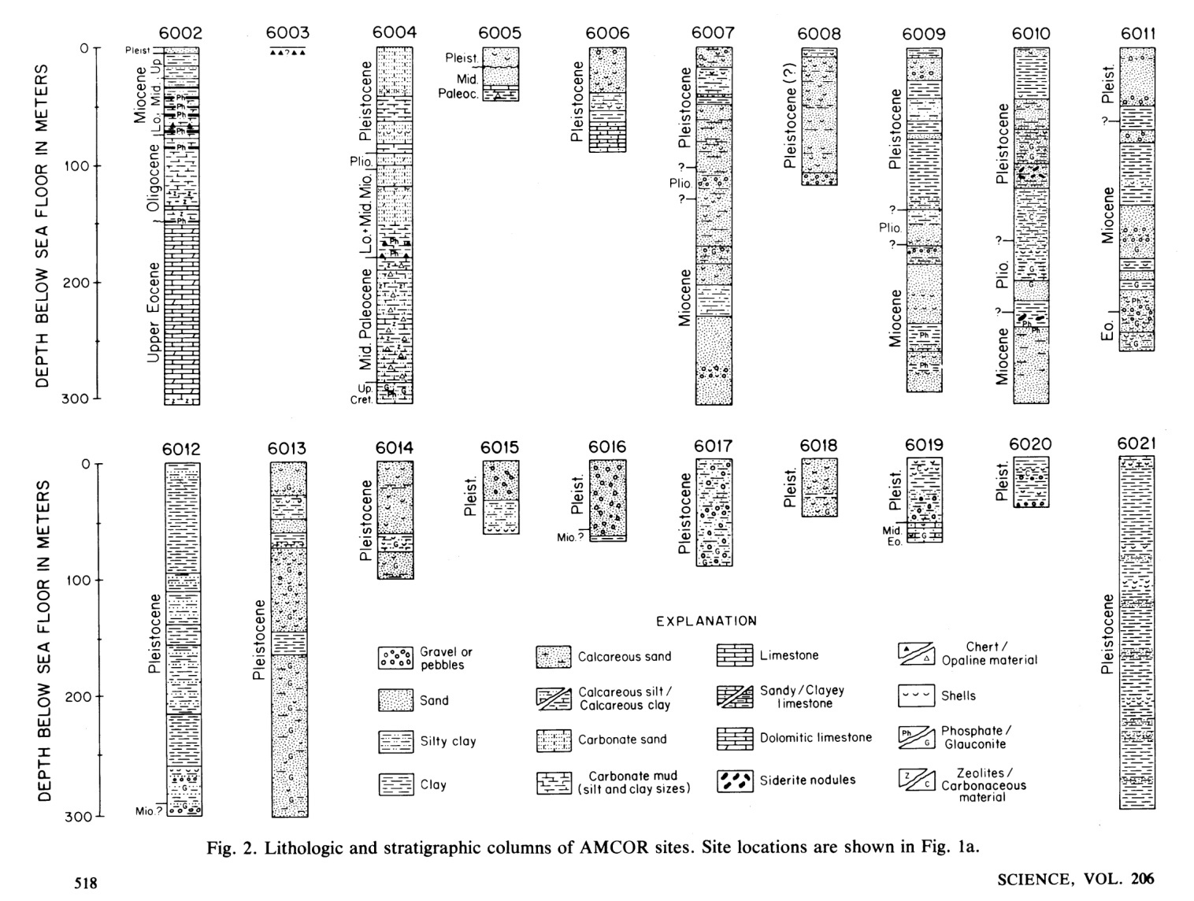
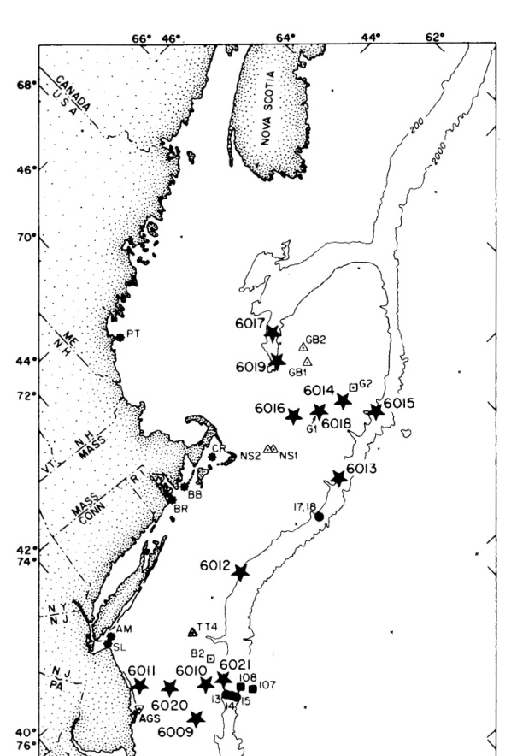
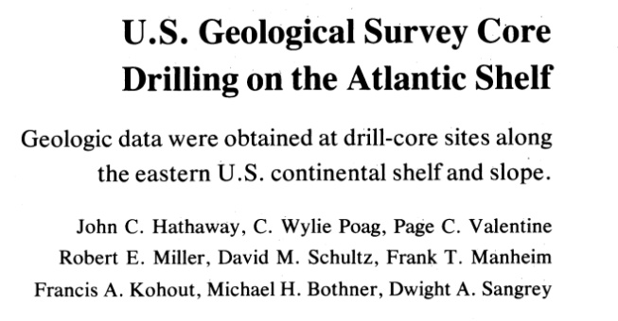
-6013 - 305 m Pleistocene Silty Sands, and Silty Clays (Maximum Core Depth Attempted =310 m) -6014 - 102 m Pleistocene Shelly , Silty Sands, and Clays (Calving and Stuck Core Barrels-Well Abandoned) -6016- 60m Pleistocene Coarse Sand and Gravel Over Miocene Clayey Silt-(Well Abandoned) -6018 - 49 m Pleistocene Coarse Shelly Sands (Calving and Stuck Core Barrels-Well Abandoned)

Slide 16
NOTE DIP OF PRE-PLEISTOCENE REFLECTORS
Well Control on Line Q
AMCOR 6014
Q
G-2
AMCOR 6013
AMCOR 6013
Poag, C.W., 1982, Stratigraphic reference section for Georges Bank basin-Depositional model for New England passive margin: AAPG Bull.,v66, p 1021-1041. (His COST G-2 and AMCOR Stratigraphy Projected to Line Q)

Slide 17

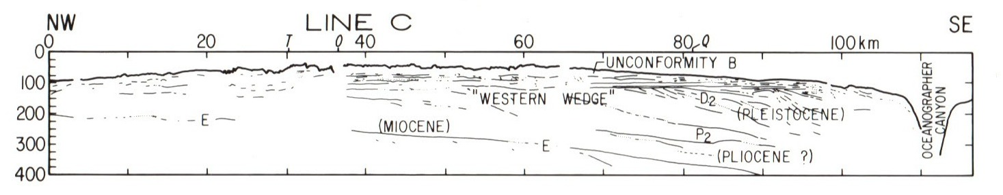

“Western Wedge”
AMCOR 6016
AMCOR 6014
Q
C
AMCOR 6013
Thickness of Pleistocene in AMCOR 6013
AMCOR 6016
Q
C

Slide 18
“Western Wedge”
Q
C
Deltaic -Thicken Southward
Deltaic -Thicken Westward

Slide 19
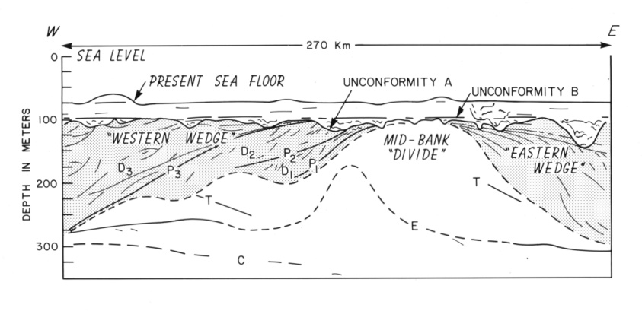
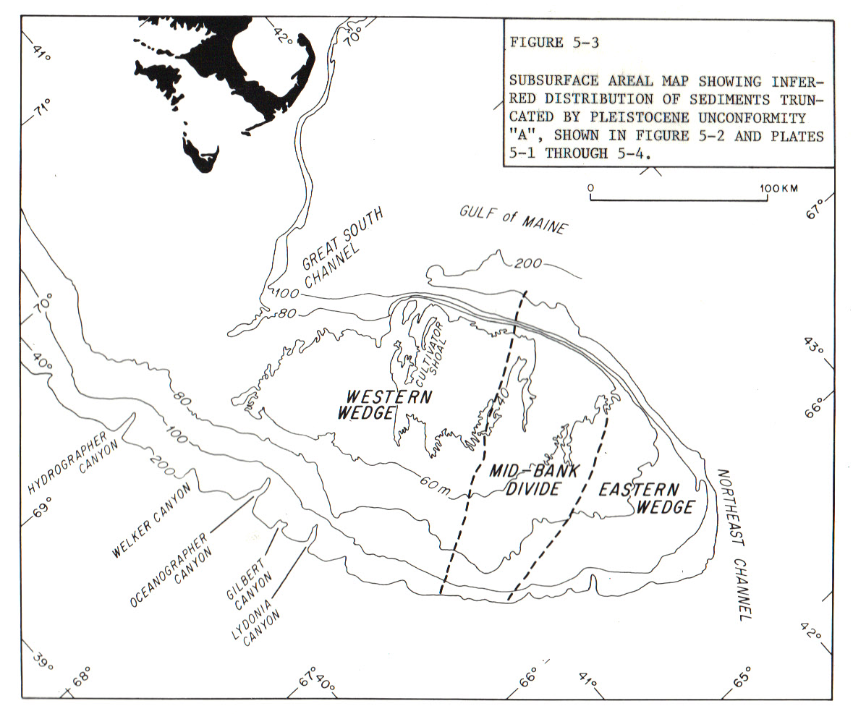

Slide 20

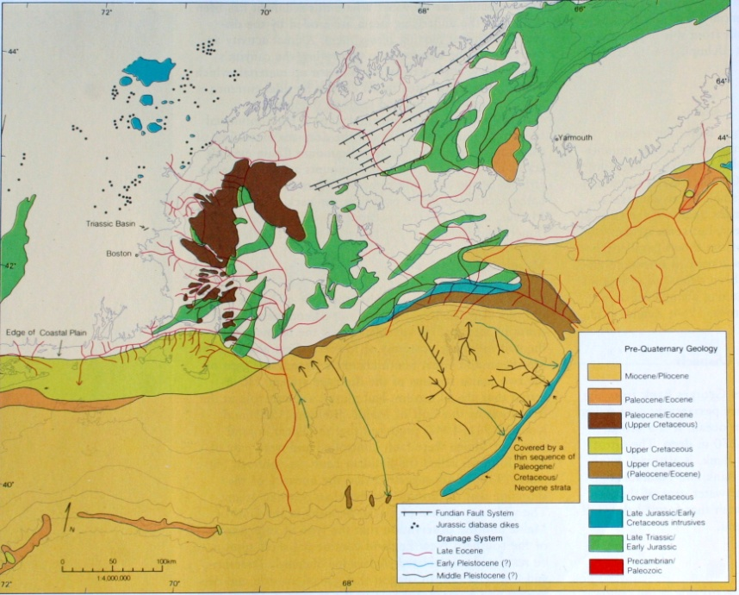
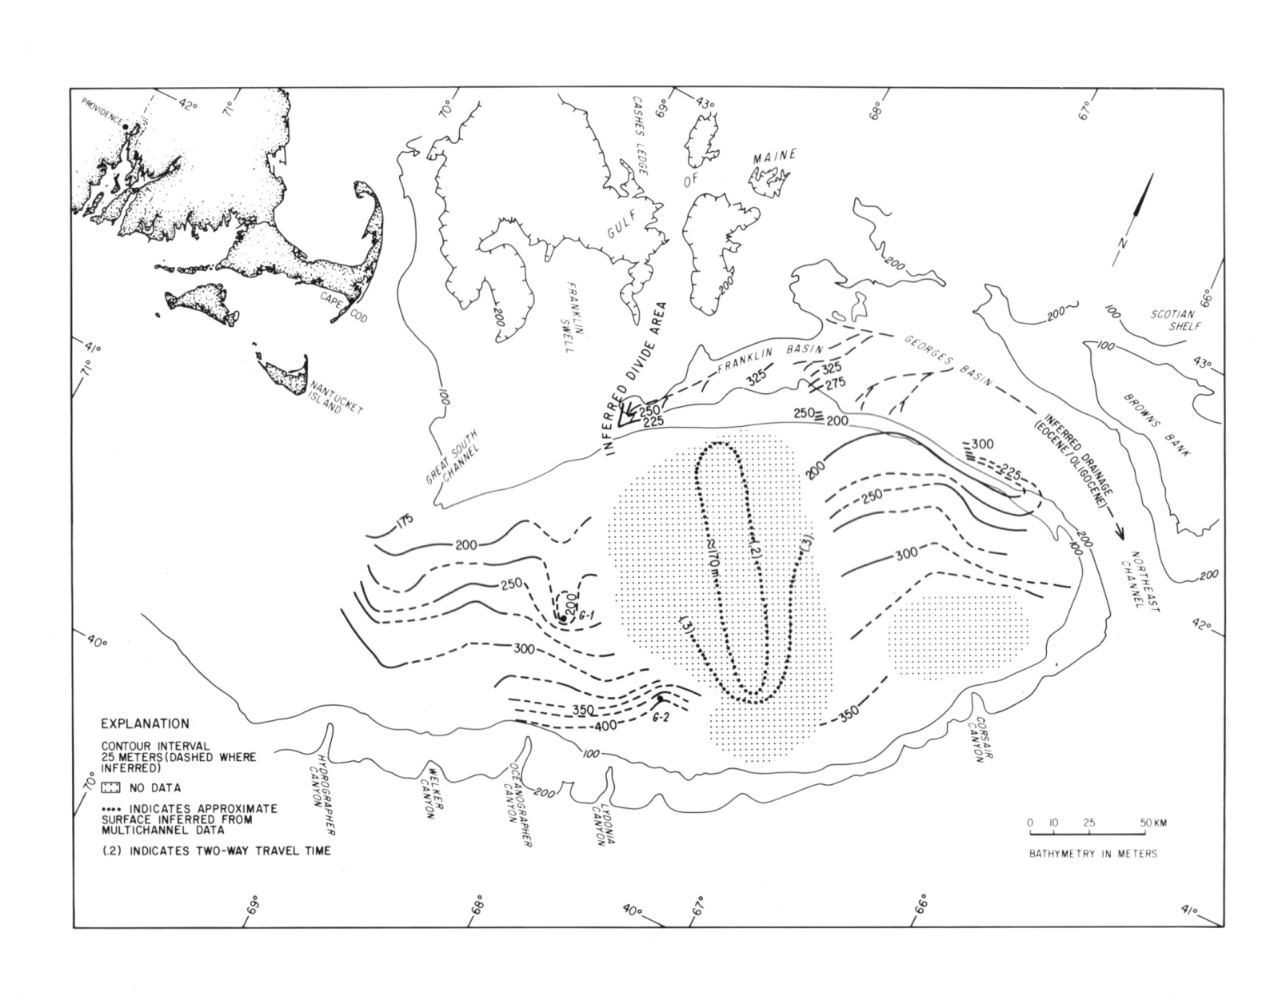
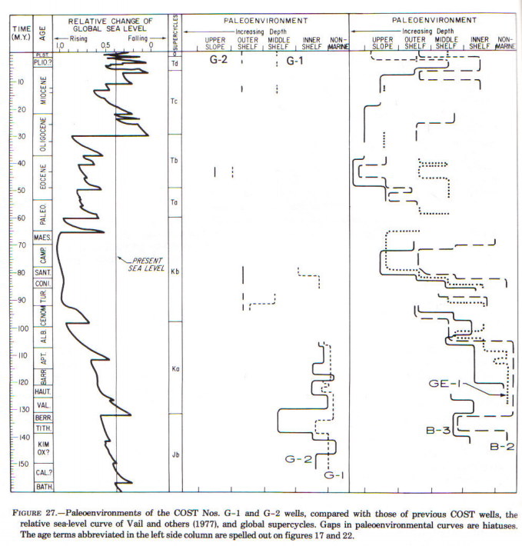
Structure contours drawn to the inferred erosion surface (reflector E) created during the major Oligocene regression postulated by (Vail et al., 1977). Fay 003 seismic data and multichannel data previously published by Oldale and Uchupi (1970) were combined to produce this map.
N

Slide 21
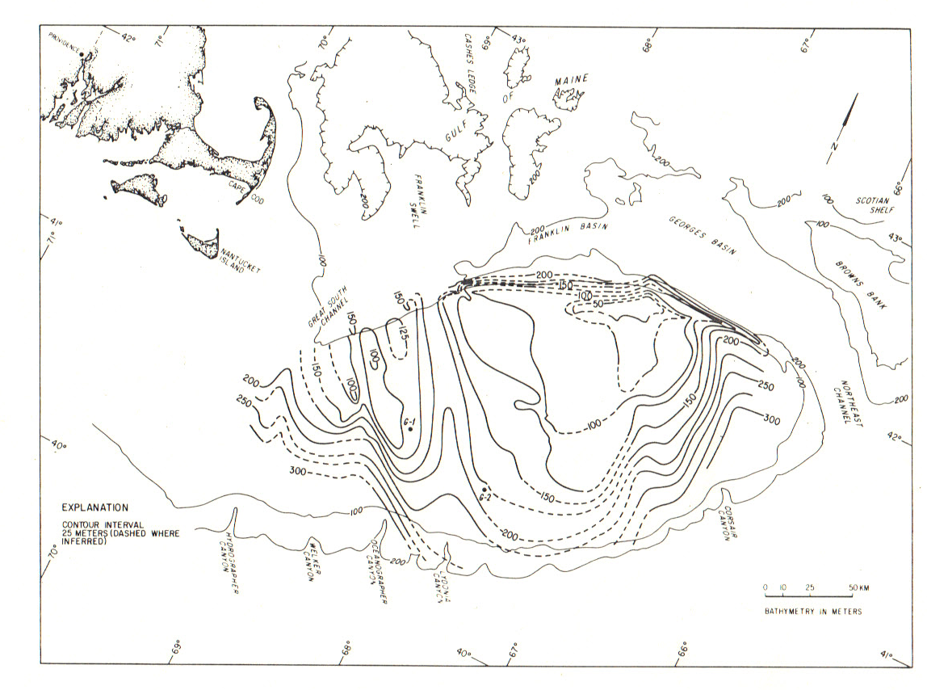

Structure Contours drawn to the upper surface of strata inferred to be of Miocene-Pliocene(?) age (Truncated T reflectors). Poag (1982) reports a Pliocene(?)- early Pleistocene unconformity that cuts chiefly Miocene age terrigenous strata- overlain by Pleistocene deposits in COST G-1 and G-2. Pleistocene over Miocene is also reported in AMCOR 6016 (Schlee et al., 1979). This surface is inferred to have been fluvially cut during the late Miocene, Pliocene, and early Pleistocene regressions postulated by Vail et al. (1977).
Prolific Source of Miocene Samples in Surface Grabs
(Remember Line J)
AMCOR 6016
N
NOTE POSITION OF CANYONS!

Slide 22
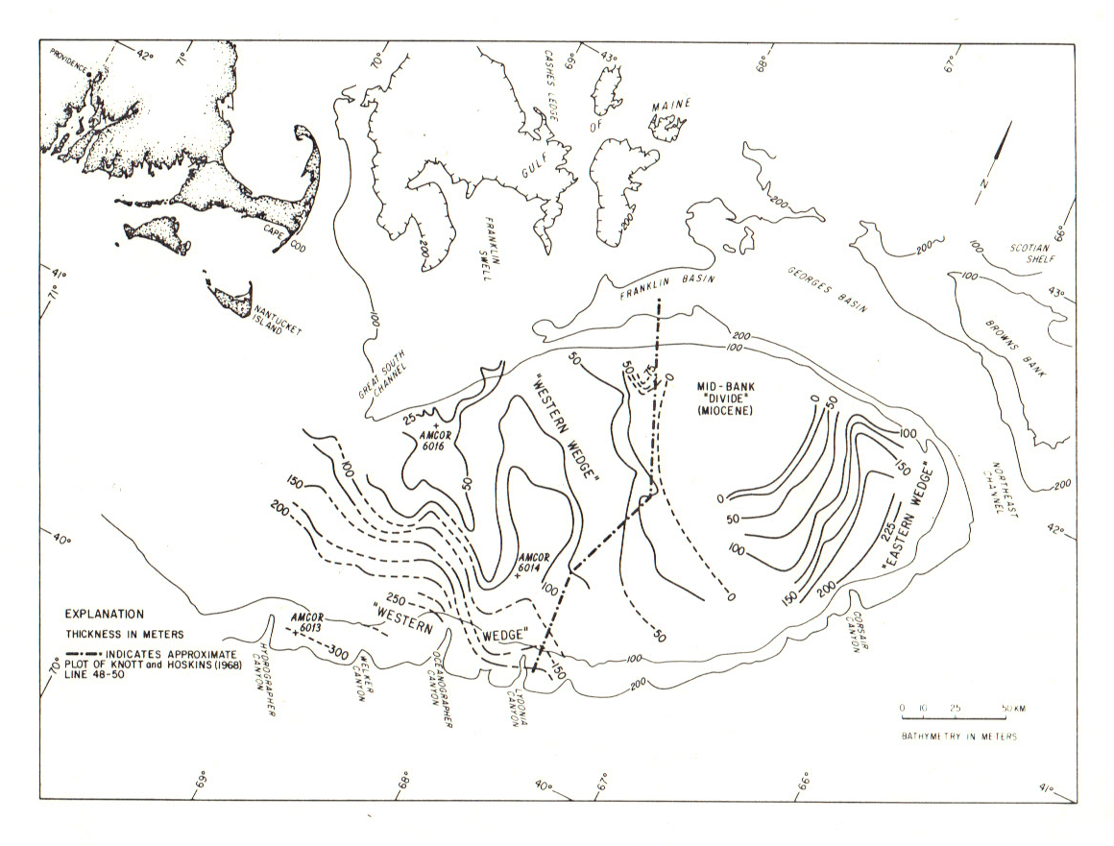
Inferred distribution and thickness of Pleistocene “Wedge” deposits. In the western half of the Bank, dating and thickness control is provided by AMCOR wells 6016 (60m Pleistocene sand and gravel over Miocene); 6014 (102m calcareous Pleistocene sands, silts, clays) and 6013 (300m Pleistocene sand and clay). Poag (1982) reported 61 m Pleistocene deposits over Miocene in COST G-1 –Thickening southward to over 120m on multichannel line.
Cost G-1

Slide 23
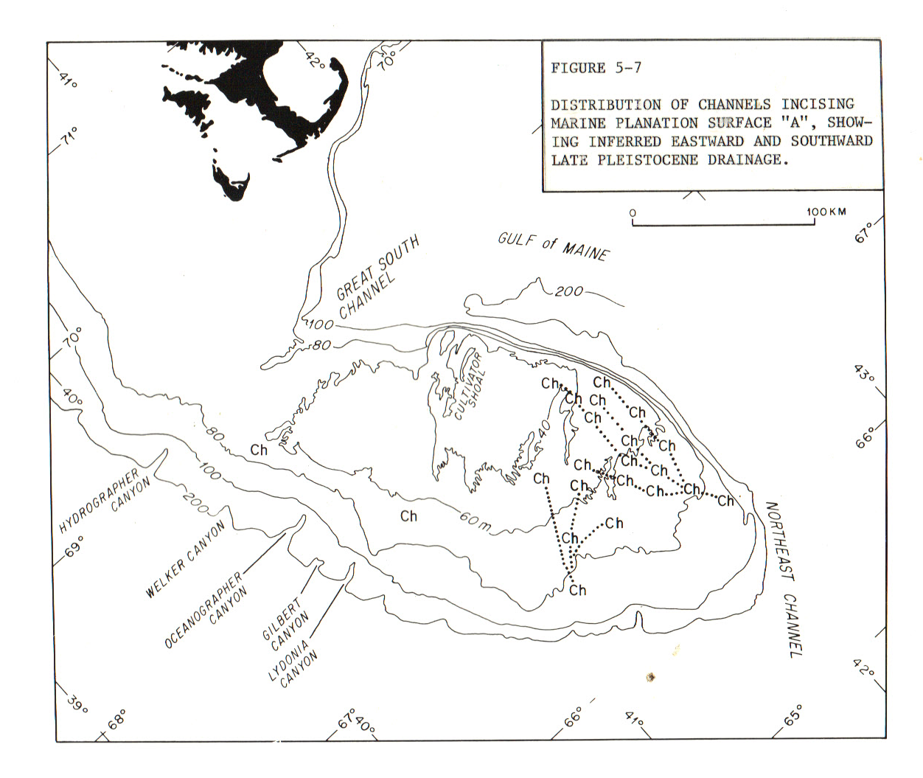

Channeling (Unconformity A) that cuts Miocene age strata of the Mid-Bank Divide as well as Middle Pleistocene marine glaciodeltaic deposits of the “Eastern and Western Wedges”. Late Wisconsinan (Bothner, et al., 1980) outwash in these channels is cut by a ravinement surface (Unconformity B) that is overlain by fairly ubiquitous sediment blanket .
SEDIMENT BLANKET
Ch DEPOSITS
Pleistocene
Miocene
Pleistocene ?
Eocene

Slide 24


The Pleistocene of Great South Channel
D₄
Ch DEPOSITS
Deposit (D₄) that blankets the Bank
Unconformity B: Late Wisconsinan ravinement.
Ch Deposits: Late Wisconsinan glaciofluvial channel deposits
Q
Unconformity A: Channeling that cuts Miocene strata and marine glaciodeltaic deposits D₁ , D_{2 ,} and D₃
“Western Wedge” Sediments: 3 successively younger marine glaciodeltaic deposits (D₁, D₂ and D₃) overlying the fluvially cut surface of Miocene strata and bounded by erosion surfaces P₁, P₂, and P₃. (Middle Pleistocene)

Slide 25
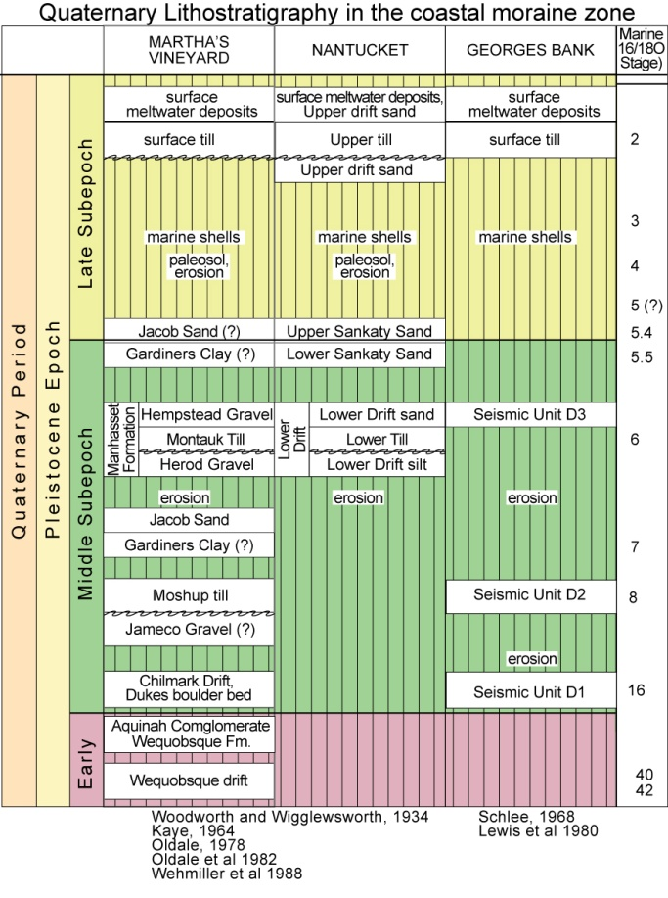
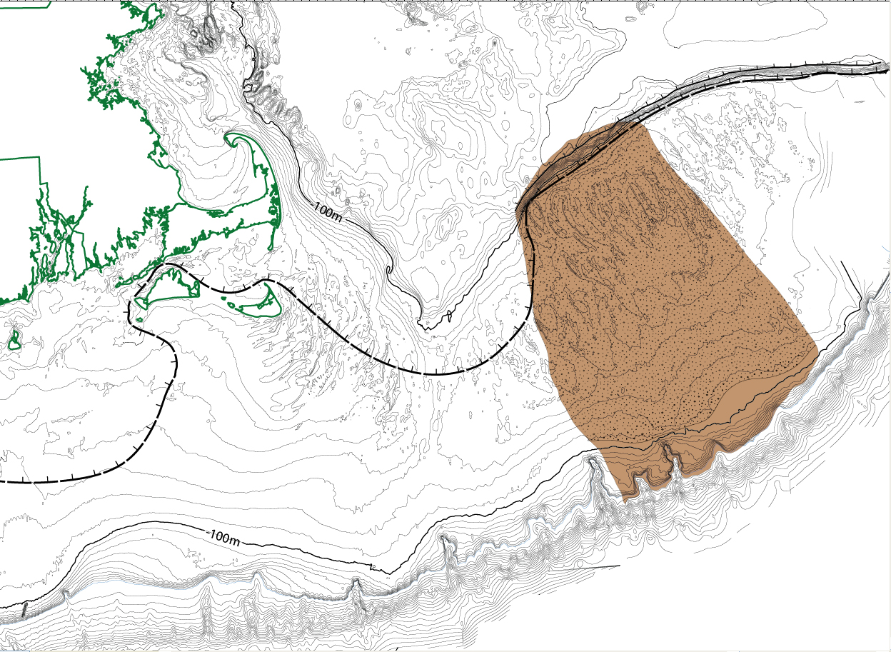
Scarp
Ice Position 1
Seismic Unit D_{1 (Early?/Middle Pleistocene)}
Ice Position 1

Slide 26
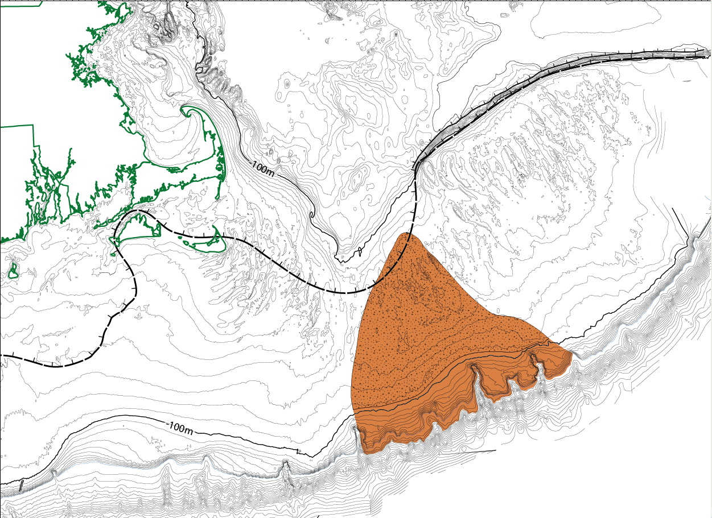
Scarp
Ice Position 2
Ice Position 2
Seismic Unit D_{2 (Middle Pleistocene)}

Slide 27
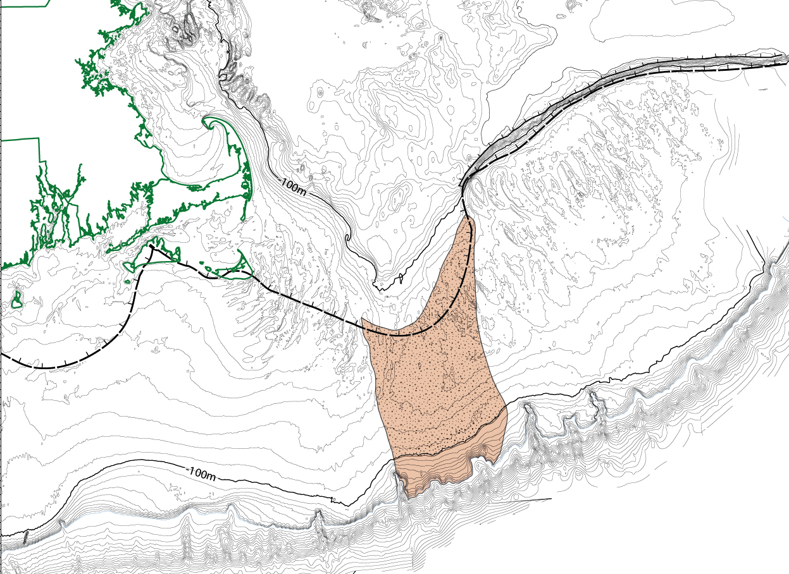
Scarp
Ice Position 3
Ice Position 3
Seismic Unit D_{3 (Middle Pleistocene)}
?

Slide 28
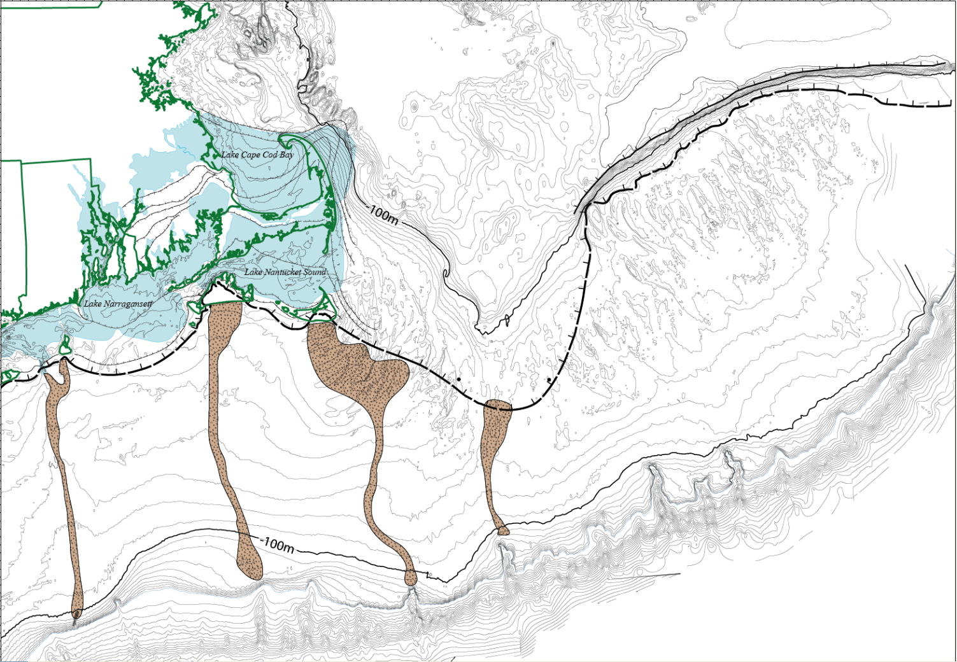
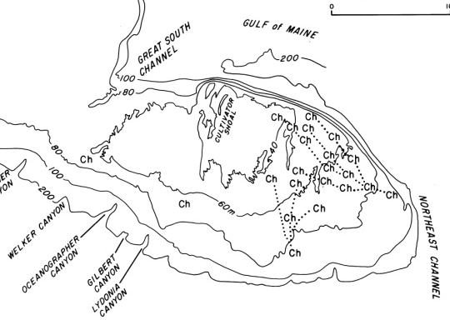
Four Events At NEARLY THE Same Terminal position !
Scarp
Ice Position 4

