Slide 1
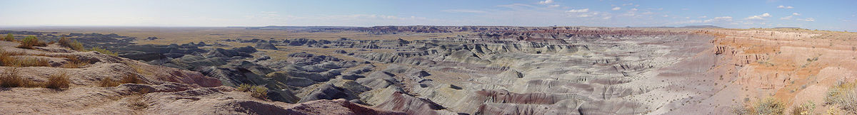
A Photo Tour of Animal Life in the
Triassic Chinle:
A View from the Water’s Edge
Presentation of Abstract 202548 - Paleontology

Slide 2

A Photo Tour of Animal Life in the
Triassic Chinle:
A View from the Water’s Edge
A study of the process of permineralization, previously
unrecognized in scientific research, that preserves plants
as well as soft-bodied animal tissues.
Originally thought to be unique to an area of the Triassic
Chinle’s Black Forest level in Arizona, this process of
permineralization was recently discovered in
a Sauropod femur from the Jurassic Formation
of Colorado.
Rocky Mtn. GSA-May, 2012

Slide 3
Topics:
a.Triassic Chinle Formation’s Petrified Forest, Black
Forest level of Arizona.
b. Unrecognized method of preservation that preserve animal soft and hard body tissues.
c. Woodworthia arizonica: Recognizing traits that are more similar to lycopods/cacti than conifer.
d. Dense and varied animal life of Triassic.
e. Jurassic fossil preservation similar to Black Forest.
Rocky Mtn. GSA-May, 2012

Slide 4
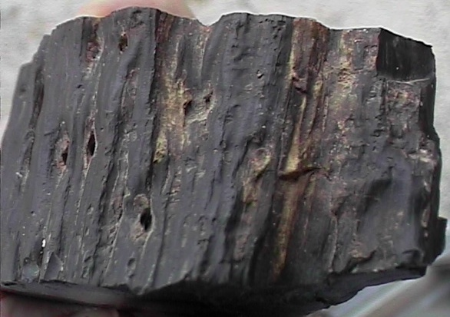
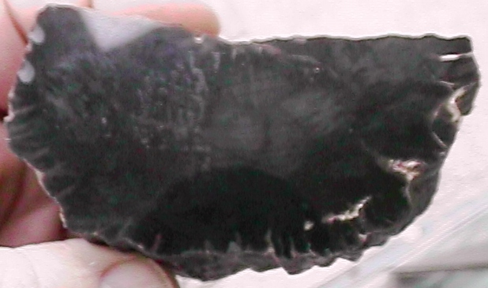
First piece of
Woodworthia arizonica
collected
Rocky Mtn. GSA-May, 2012

Slide 5
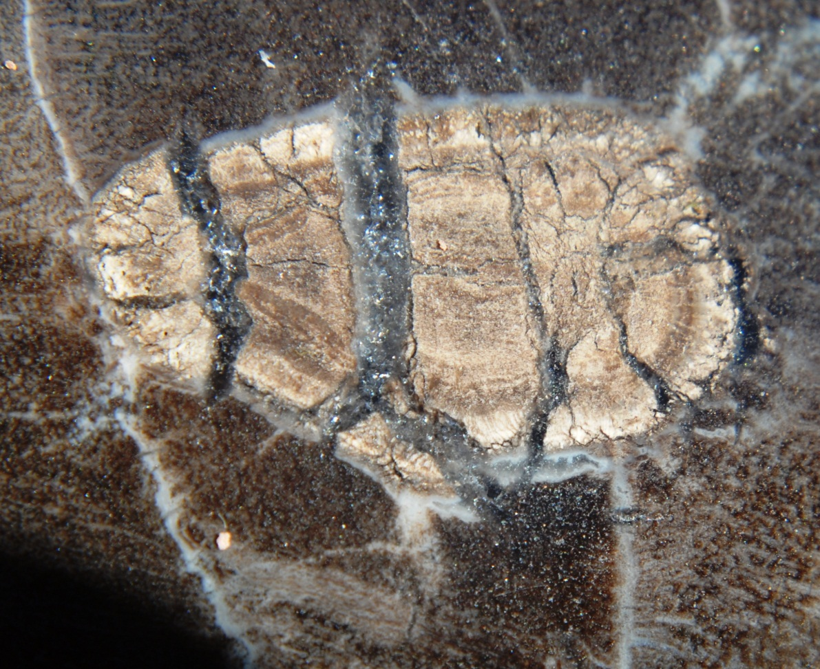
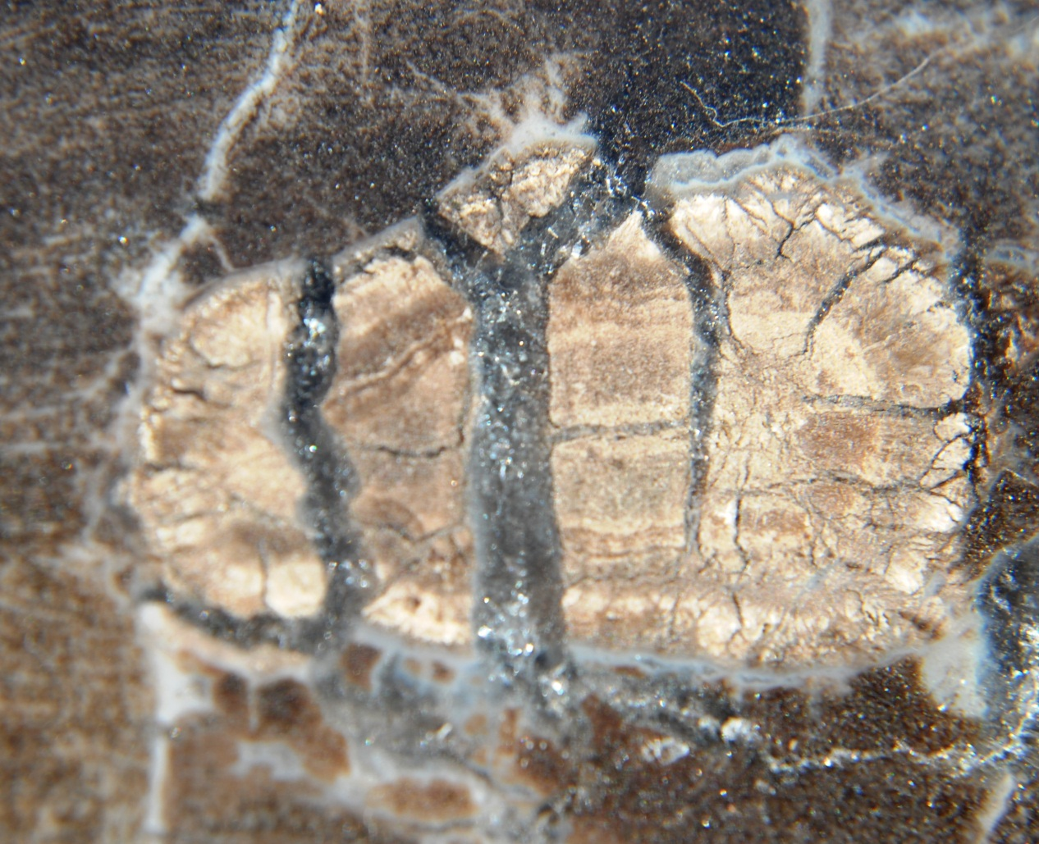
F
First Animal Observed in Fossil Wood
Identified as a Beetle
Upper and Lower ___________on two opposing sides
Rocky Mtn. GSA-May, 2012

Slide 6
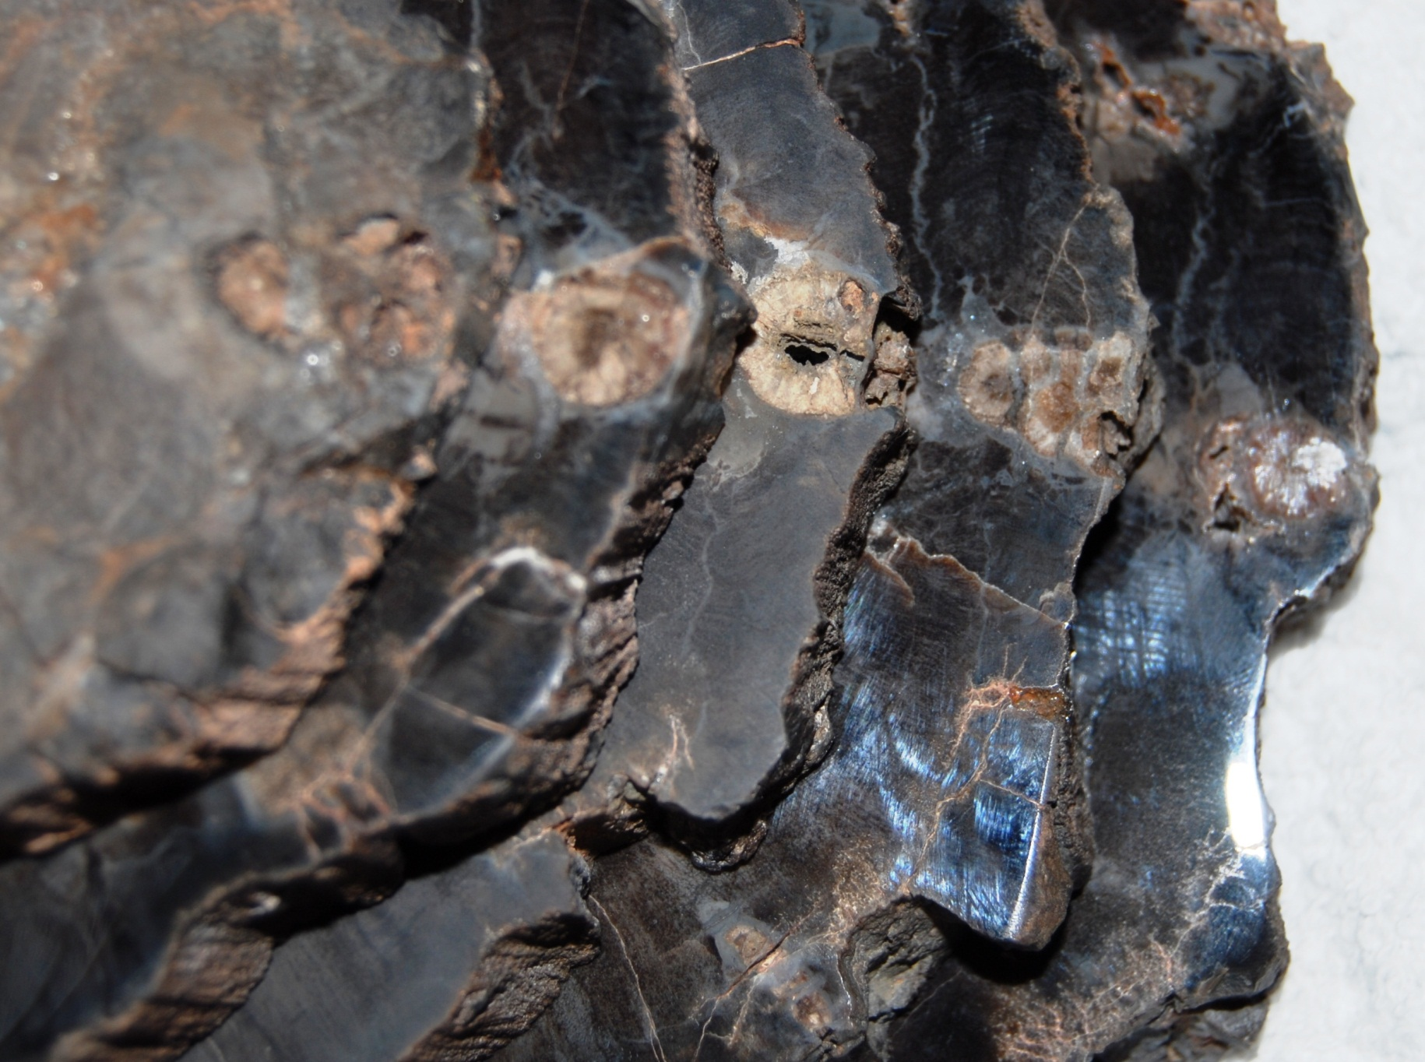
Woodworthia Sliced Log:
Small Log (approx. 5” X 8”)
cut into slices.
Caterpillar (?) running up
entire wall
Rocky Mtn. GSA-May, 2012

Slide 7
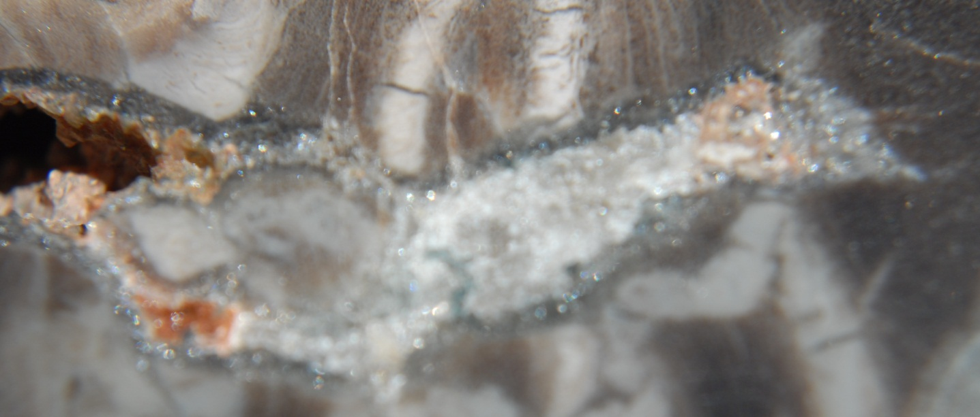
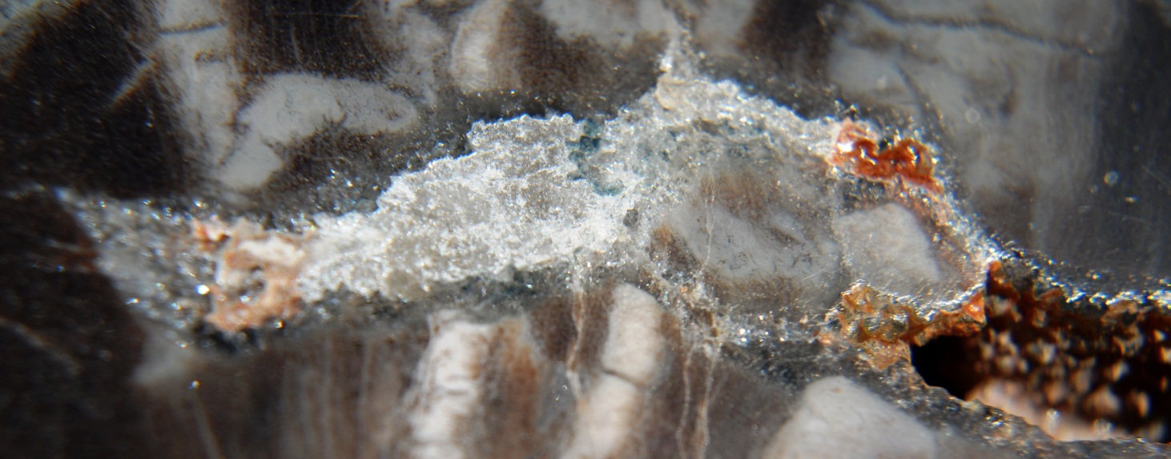
Sliced Log: Fish with well-defined fins
Fish lying on side
apparently indicating
death prior to
preservation
Rocky Mtn. GSA-May, 2012

Slide 8
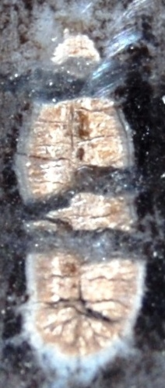
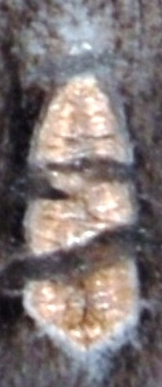
Sliced Log
Larvae:
Sliced in half
Upper
Lower
Rocky Mtn. GSA-May, 2012

Slide 9
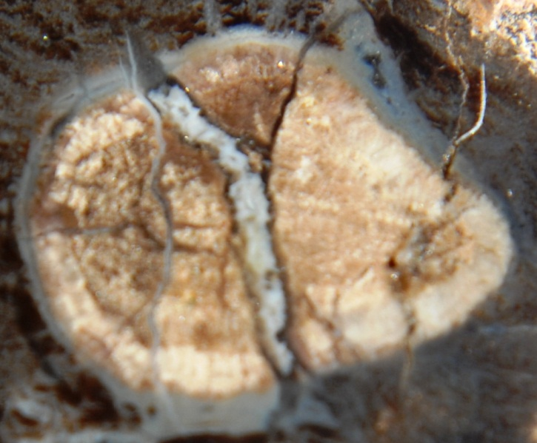
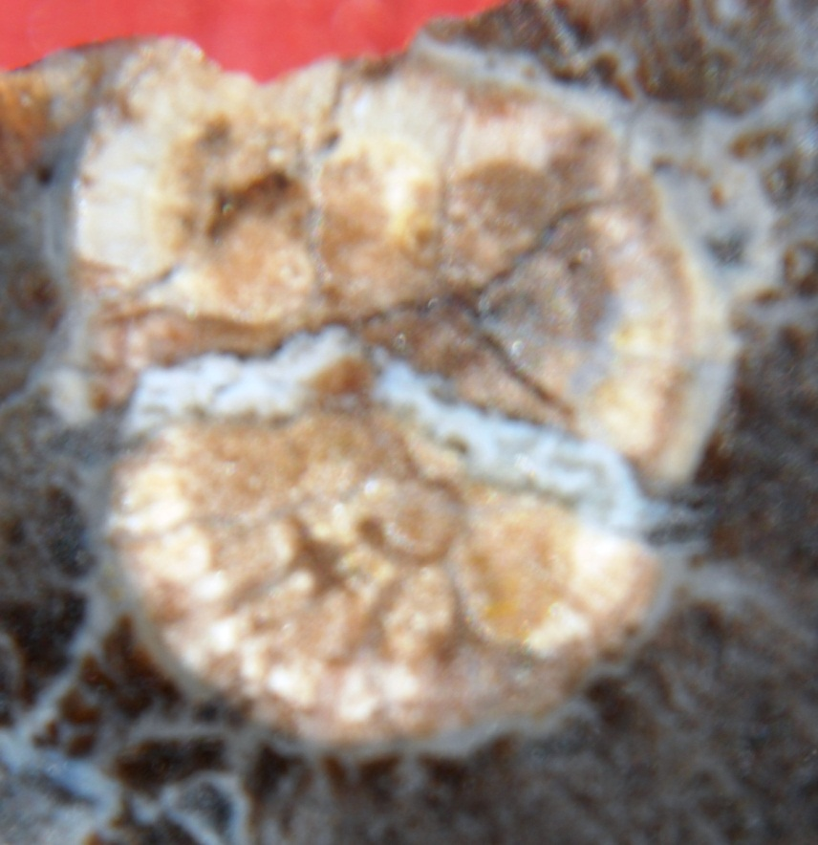
Sliced Log
Brachiopod:
2 opposing halves
Rocky Mtn. GSA-May, 2012

Slide 10
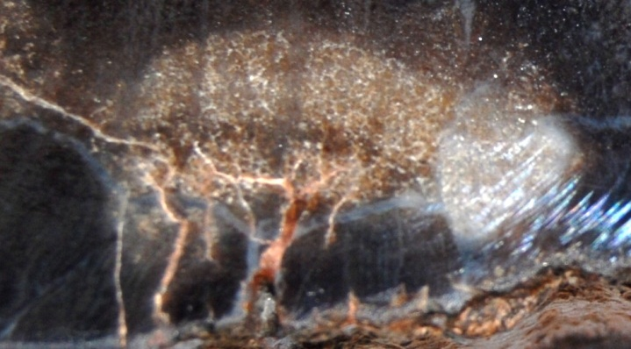
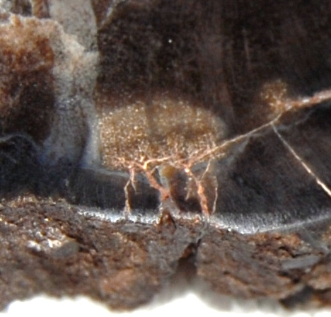
Sliced Log
Weevil:
Only one of approx.
fifty animals in one
small log
Rocky Mtn. GSA-May, 2012

Slide 11
Dr. Schopf’s Scenario for Permineralization
(1) plants die, in places become fugal infested and typically begin to crack -- radially and longitudinally, producing gaps and voids. (2) Ground water leaches silica from rocks in the area (typically, volcanic rocks). (3) the silica-charged groundwater permeates in the plant tissue. (4) Initially the silica is in a colloidal gel-like state -- the silica infuses into the cell walls, fills small cells, and begins to fill larger cells but often leaves voids, empty spaces, in especially large cells and in the larger cracks and fissures. (5) Later, additional silica penetrates into the now partially preserved logs, filling larger cells and cracks with fibrous chalcedony (which crystallizes on the previously deposited silica and grows inward to fill the cells/crack/fissures, etc.). (6) Later, the silicified logs are exposed at the surface where weathering produces cracks in the weather-out logs. (7) ground water carries dissolved minerals into these cracks - filling them with quartz and other minerals -- if traces of iron are present (e.g., from pyrite), oxygen in the atmosphere and dissolved in the ground water oxidize the iron to hematite, goethite, and other similar iron oxides and hydroxides (due to "sub aerial" weathering of the fossil logs).
Rocky Mtn. GSA-May, 2012

Slide 12
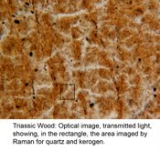
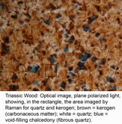
Dr. Schopf’s Lab Test Results for large
Woodworthia sliced log
Rocky Mtn. GSA-May, 2012

Slide 13
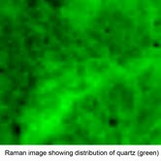
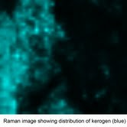
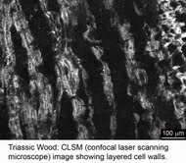
Dr. Schopf’s Lab Test Results for large
Woodworthia sliced log
Rocky Mtn. GSA-May, 2012

Slide 14
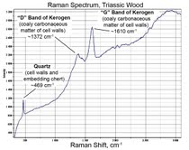
Dr. Schopf’s Lab Test Results for large
Woodworthia sliced log
Rocky Mtn. GSA-May, 2012

Slide 15
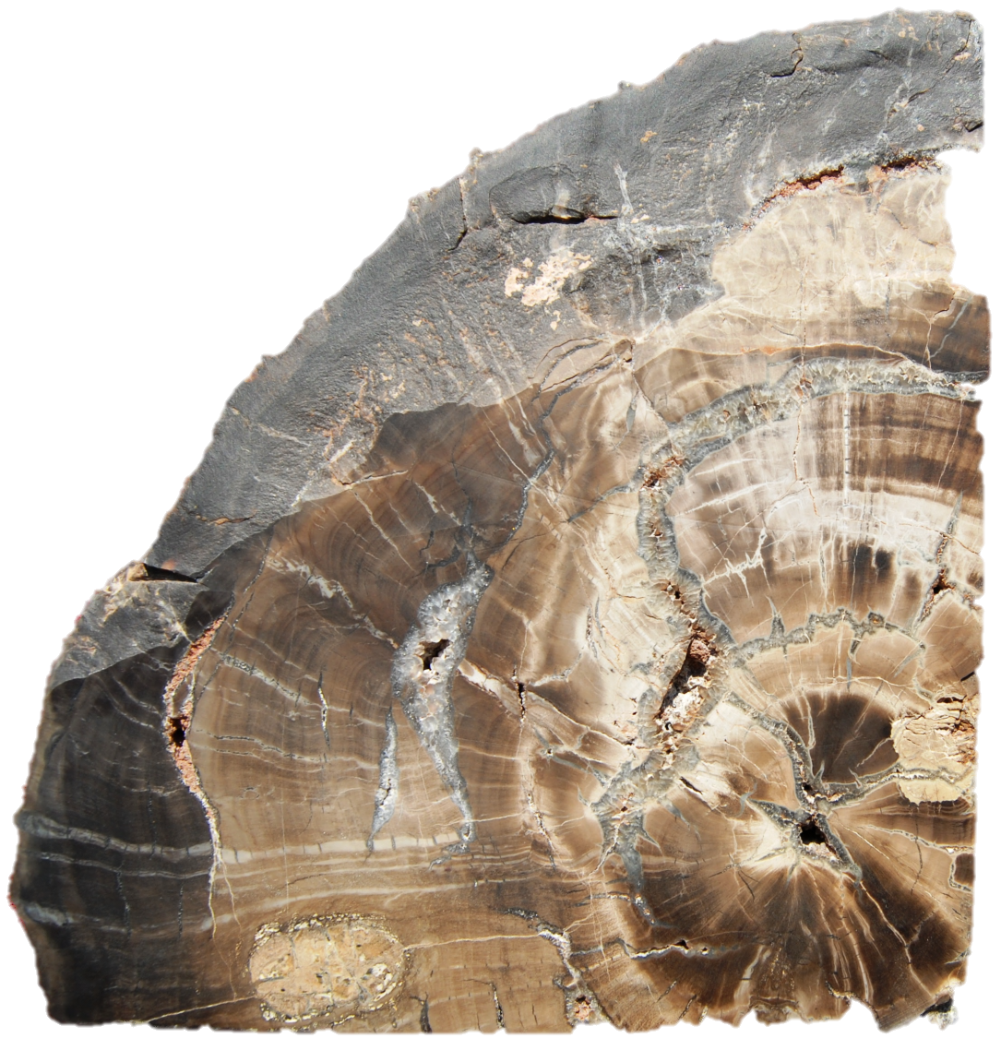
Woodworthia Bookend
Turtle Plastron
Lower Left
Rocky Mtn. GSA-May, 2012

Slide 16
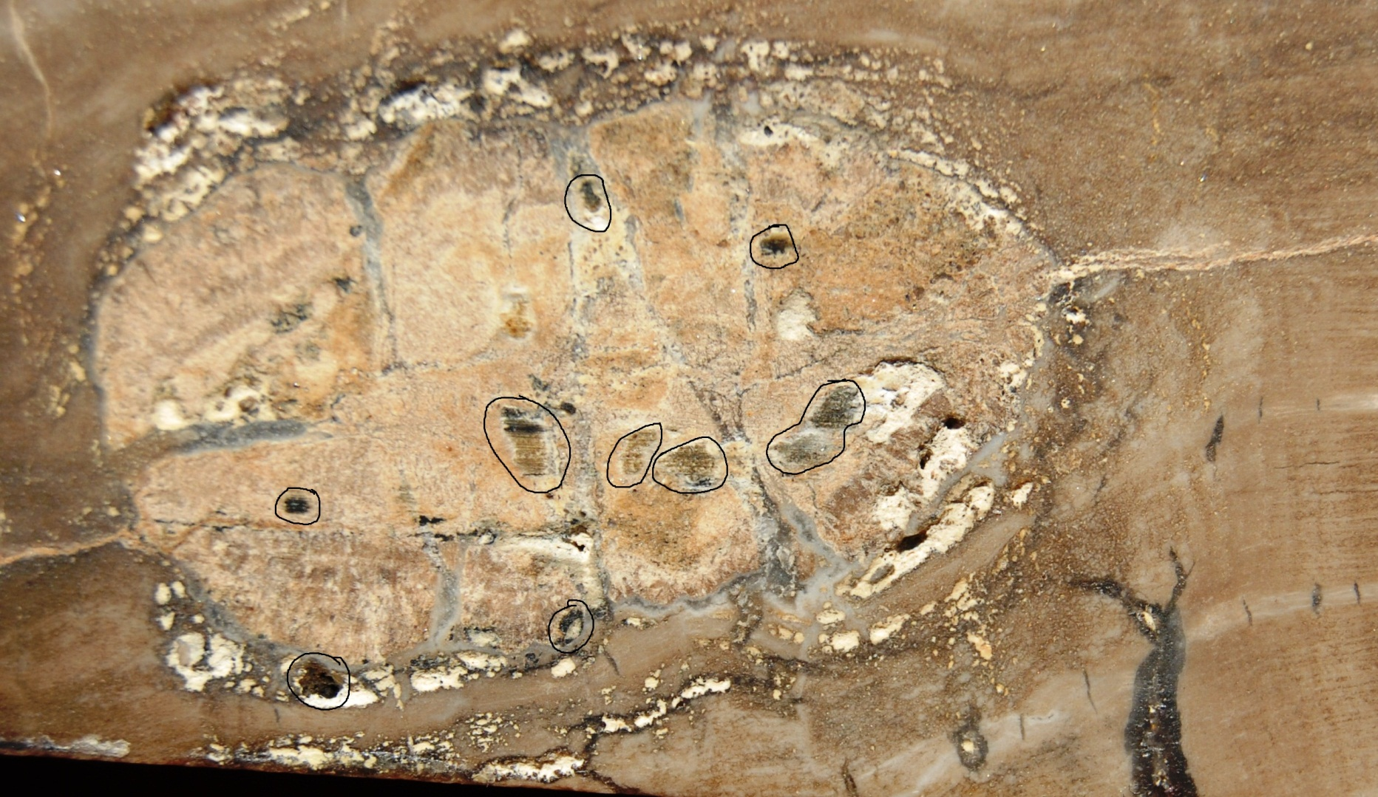
Woodworthia Bookend
Turtle Plastron –
Identified by Dr. George Zug as possible box turtle.
Rocky Mtn. GSA-May, 2012

Slide 17
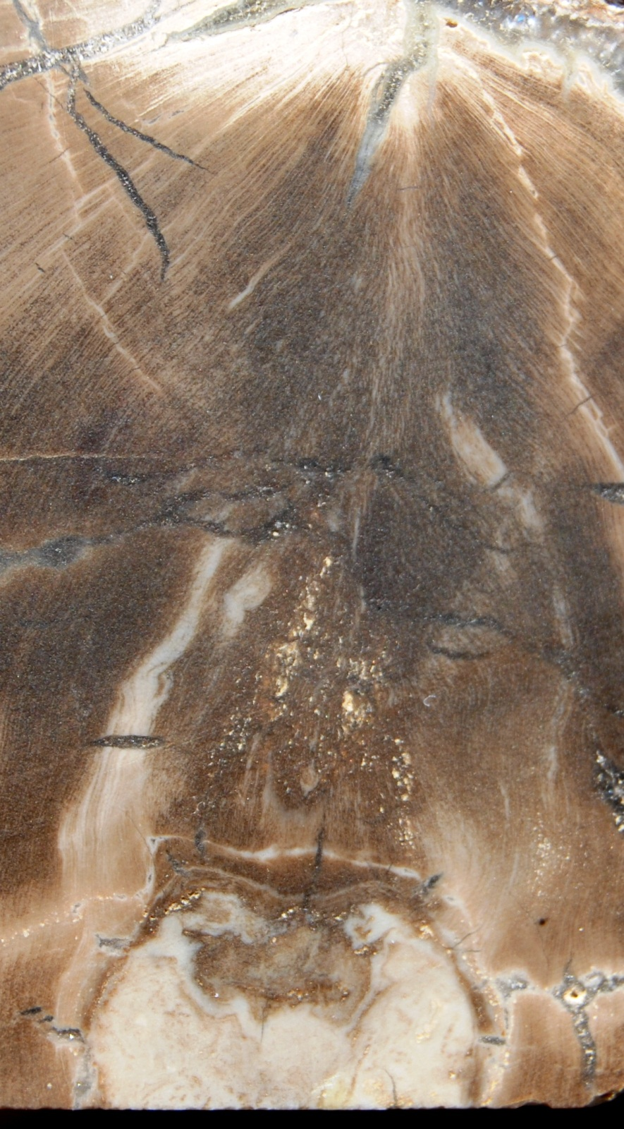
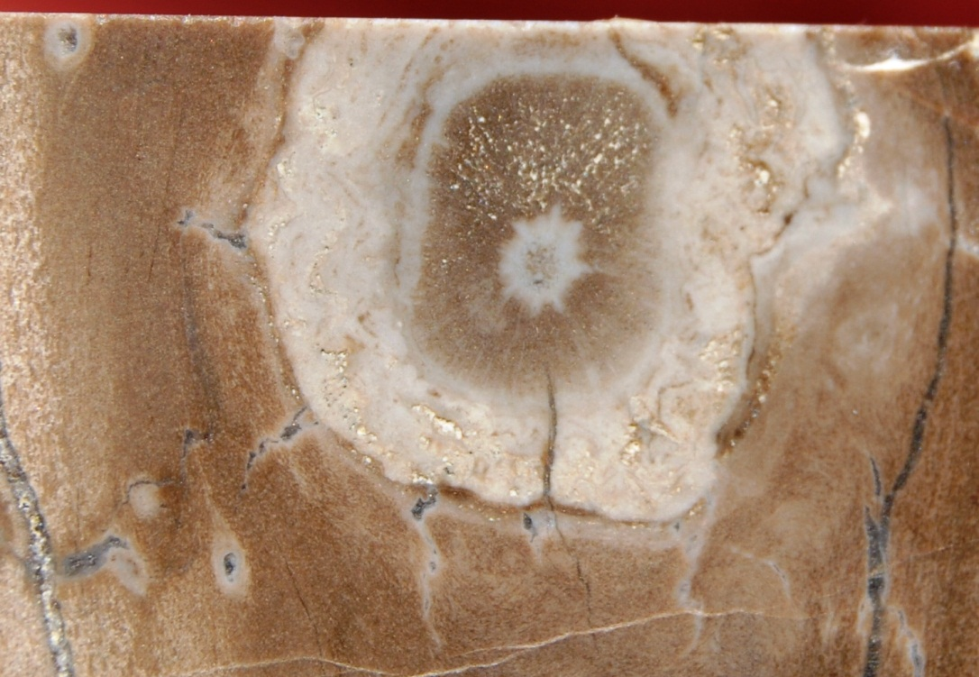
Woodworthia Bookend
Blossom?
Rocky Mtn. GSA-May, 2012

Slide 18
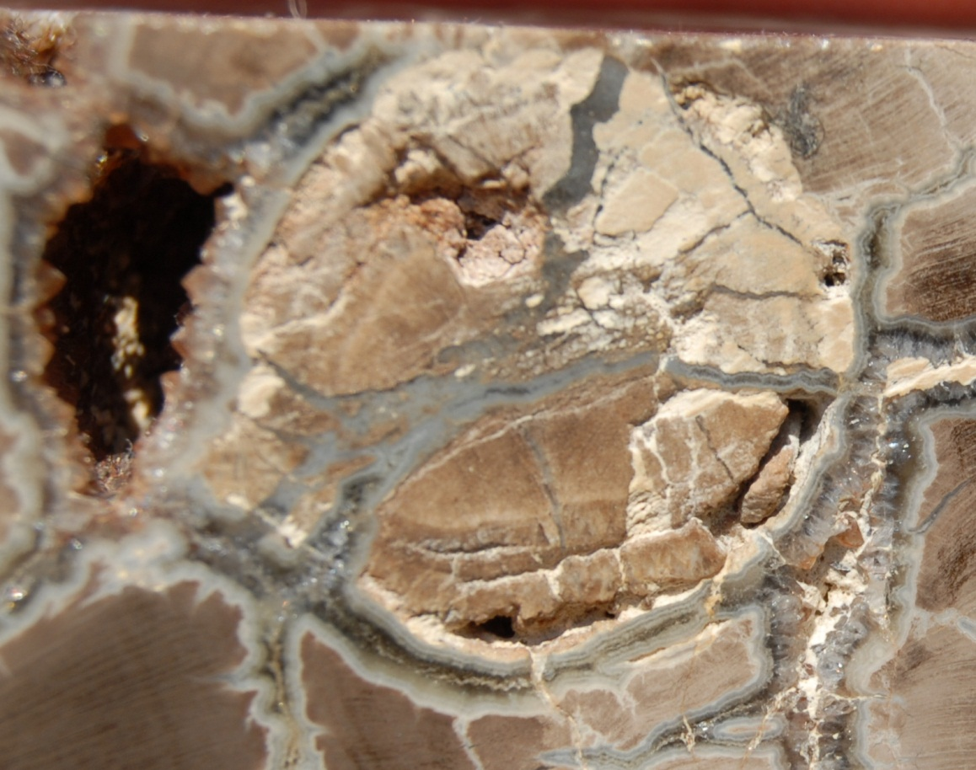
Woodworthia Bookend
Plant?
Animal?
Rocky Mtn. GSA-May, 2012

Slide 19
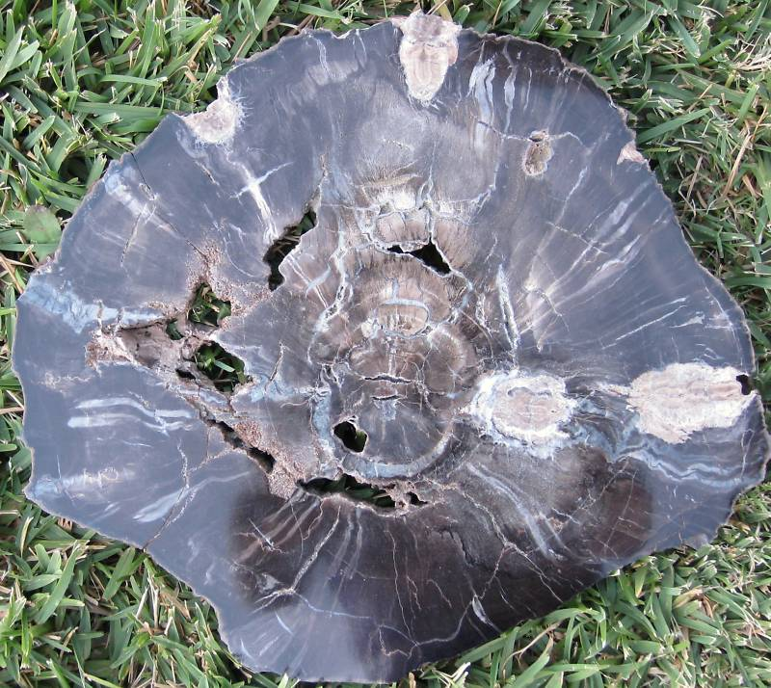
Woodworthia Turtles
Rocky Mtn. GSA-May, 2012

Slide 20
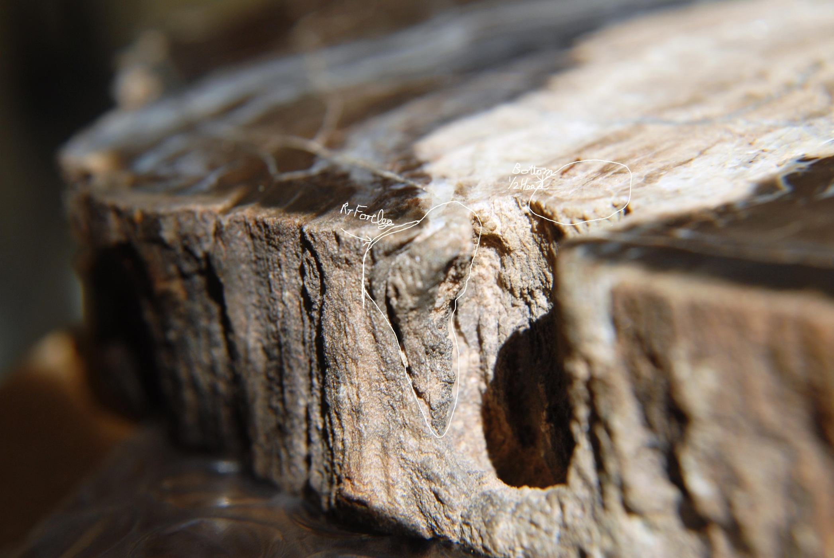
Woodworthia Bookend
Marine Turtle
Right Front Leg
at Exit Hole
Rocky Mtn. GSA-May, 2012

Slide 21
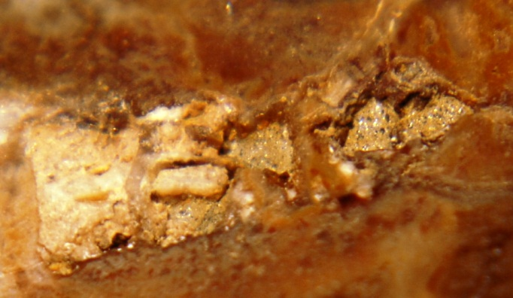
Right rear leg of interior turtle
Bone
Rocky Mtn. GSA-May, 2012

Slide 22
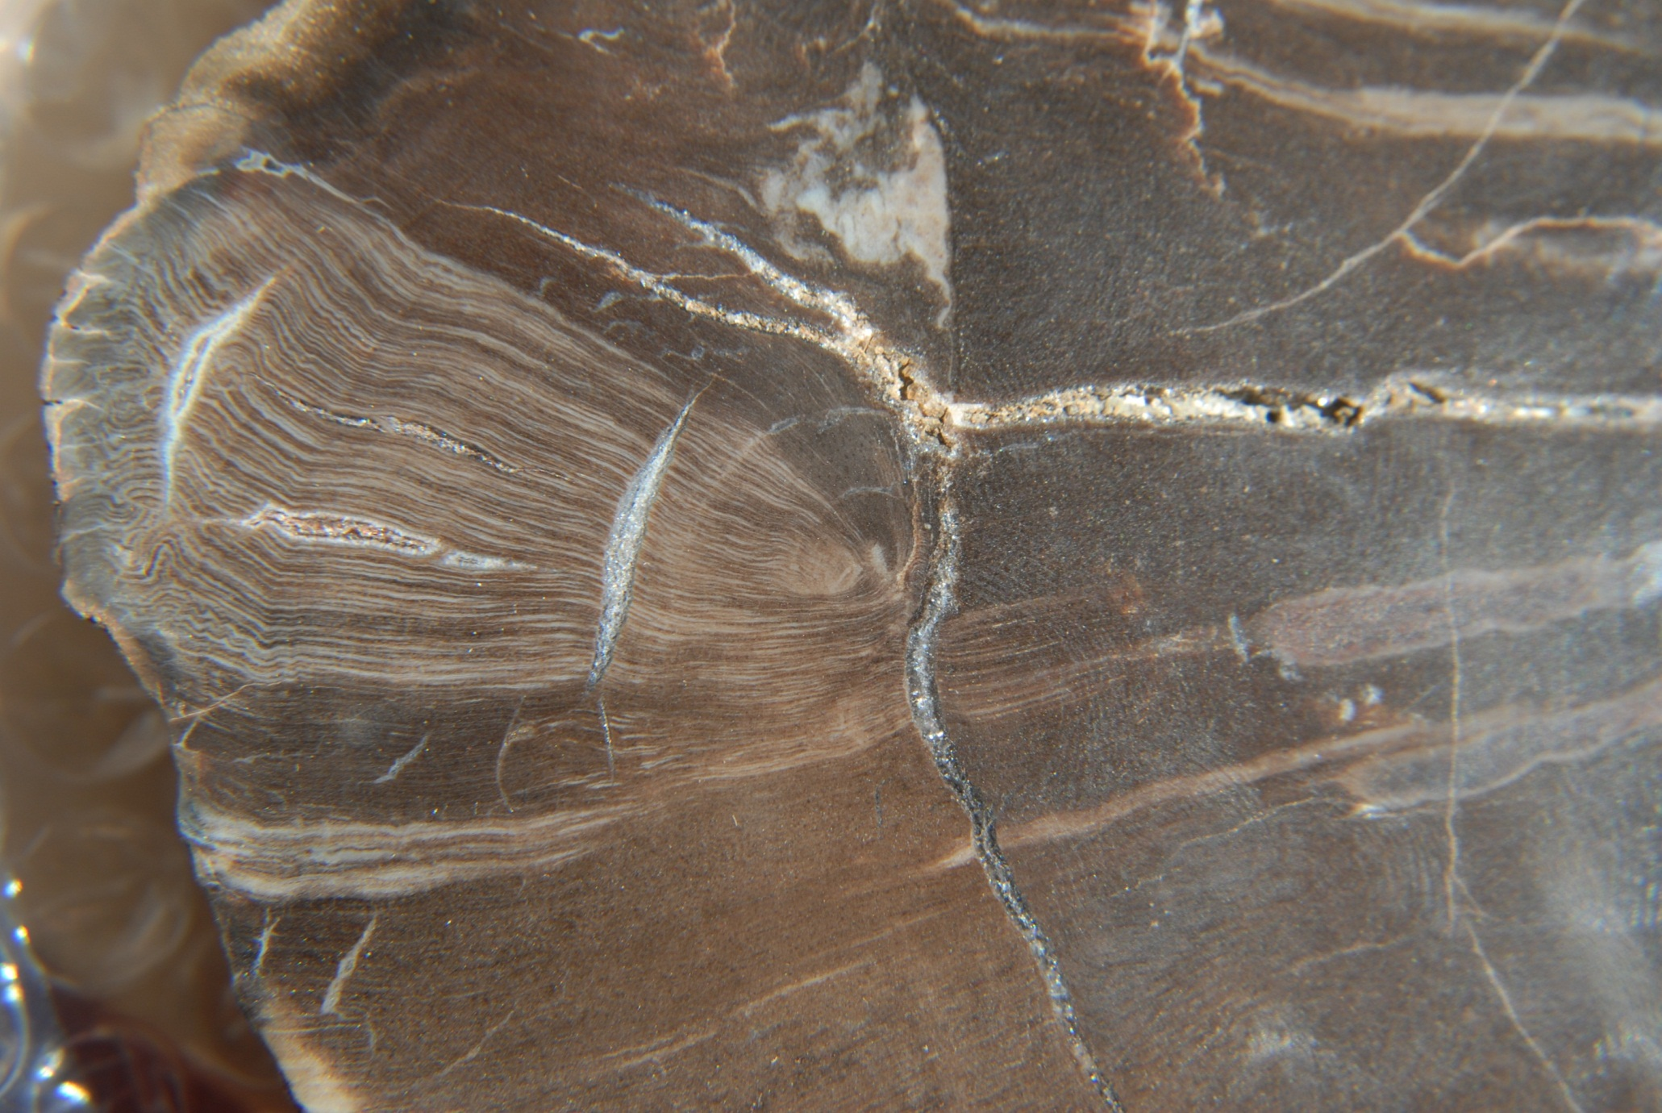
Woodworthia Bookend
Jelly Fish???
Rocky Mtn. GSA-May, 2012

Slide 23
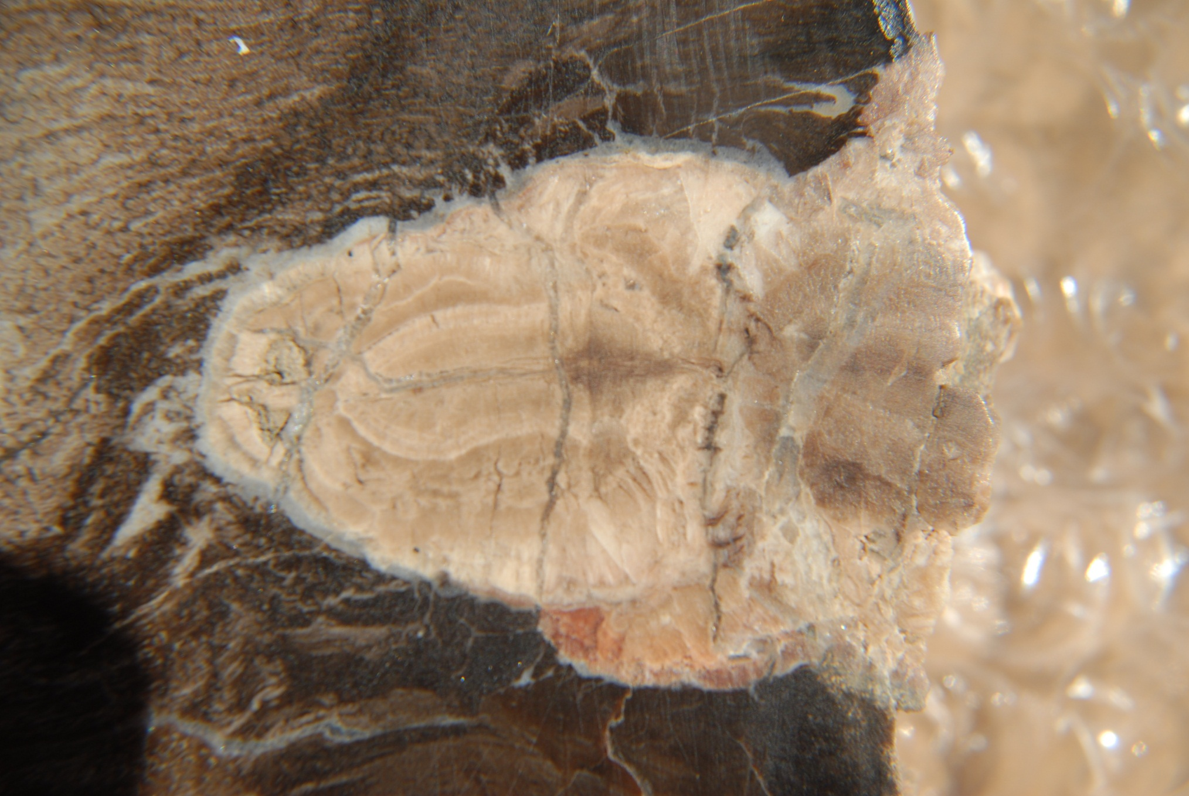
Woodworthia Turtle Slice
Lizard head and shoulders with
vertebrae visible
Rocky Mtn. GSA-May, 2012

Slide 24
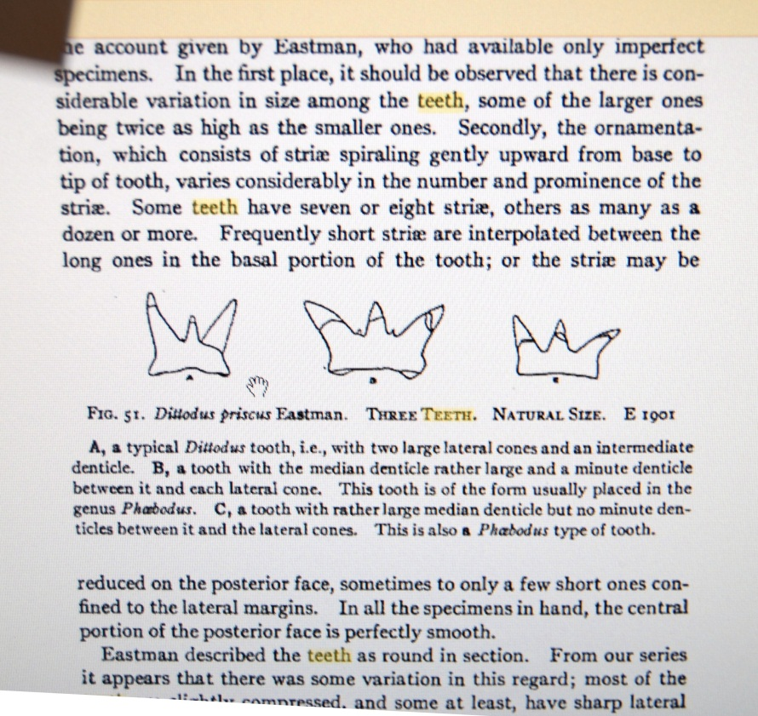
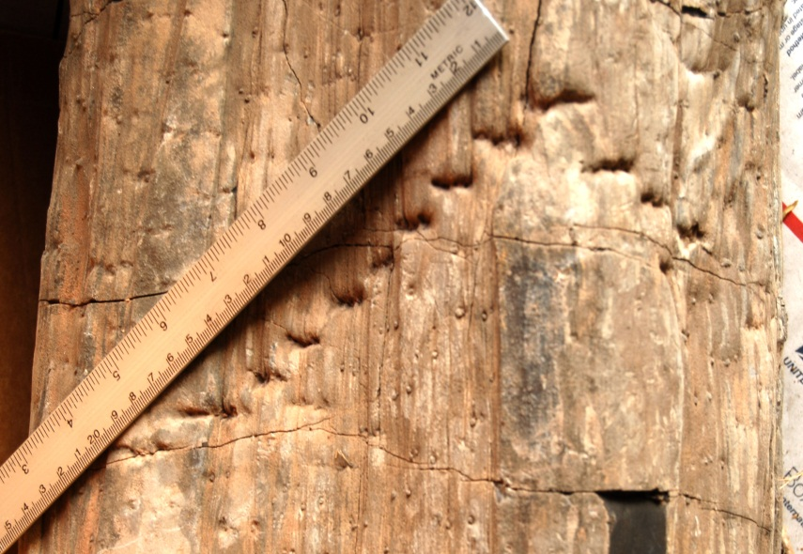
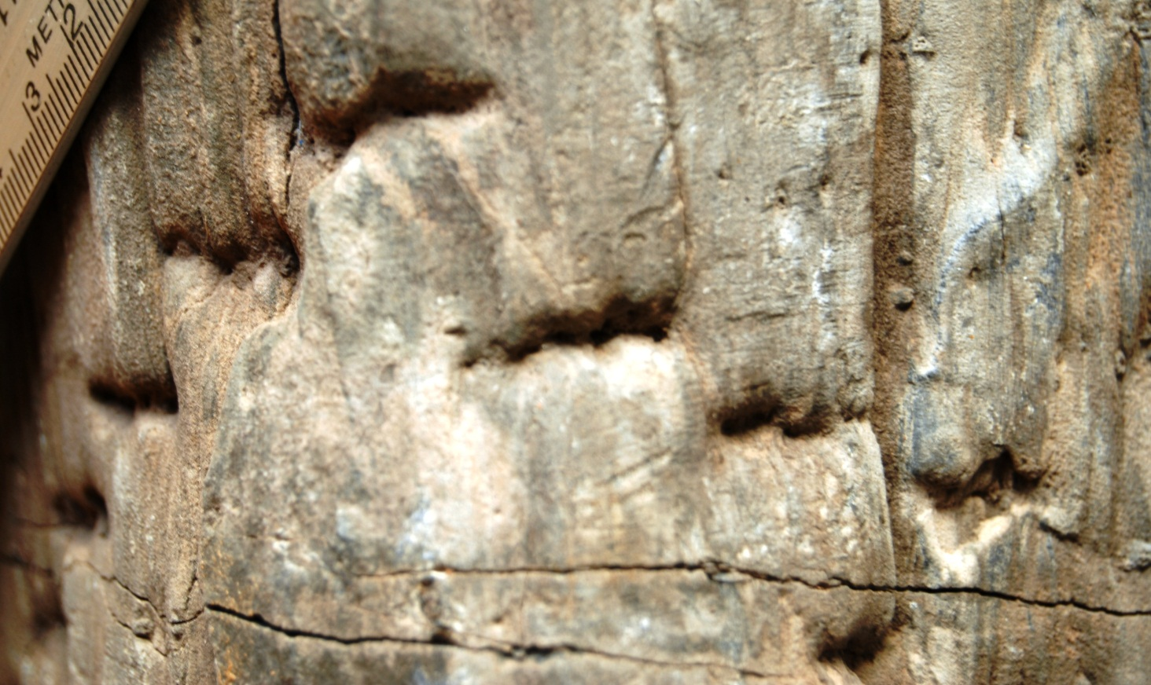
Woodworthia Teeth Marks
V-shaped jaw bites with
tricuspid teeth marks
clearly visible
Rocky Mtn. GSA-May, 2012

Slide 25
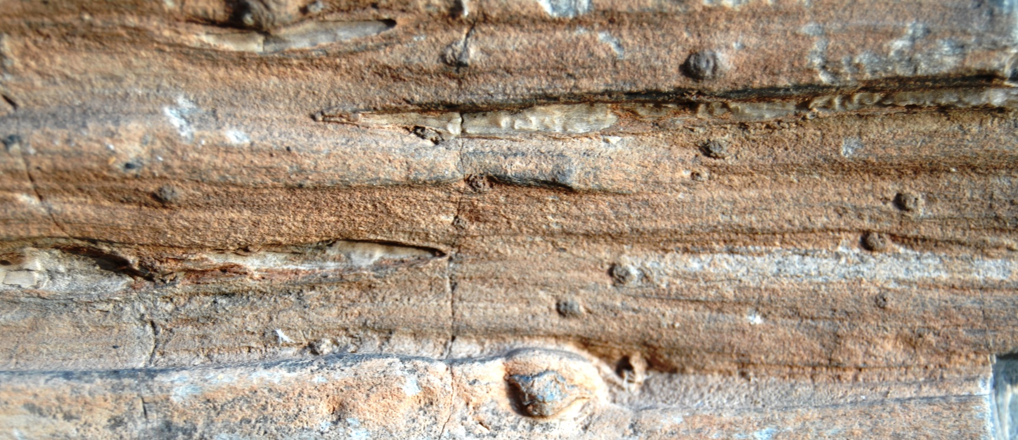
Woodworthia Claw Marks
Rocky Mtn. GSA-May, 2012

Slide 26
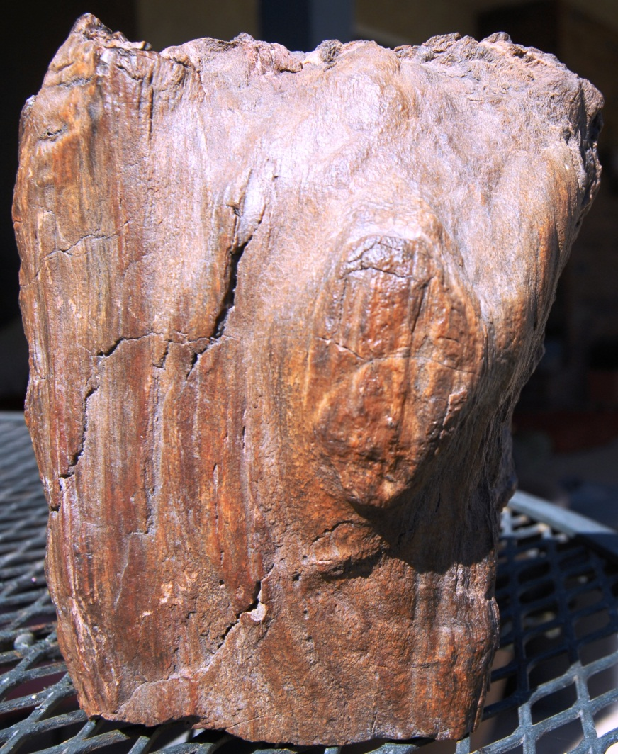
Fern???
Rocky Mtn. GSA-May, 2012

Slide 27
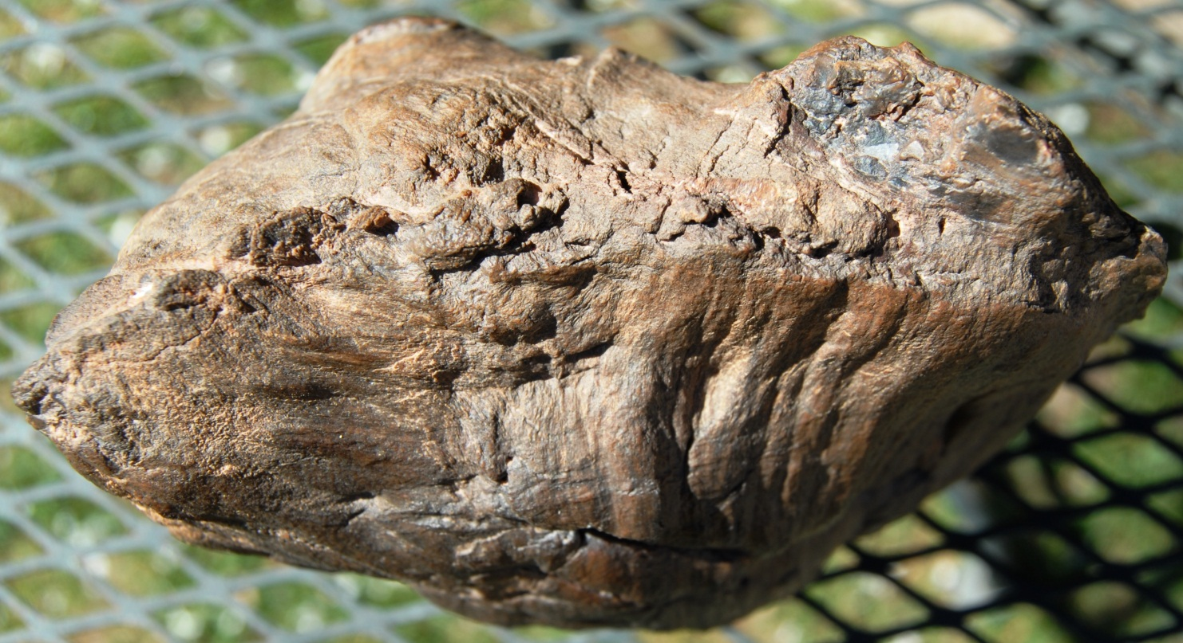
Fern Top
Rocky Mtn. GSA-May, 2012

Slide 28
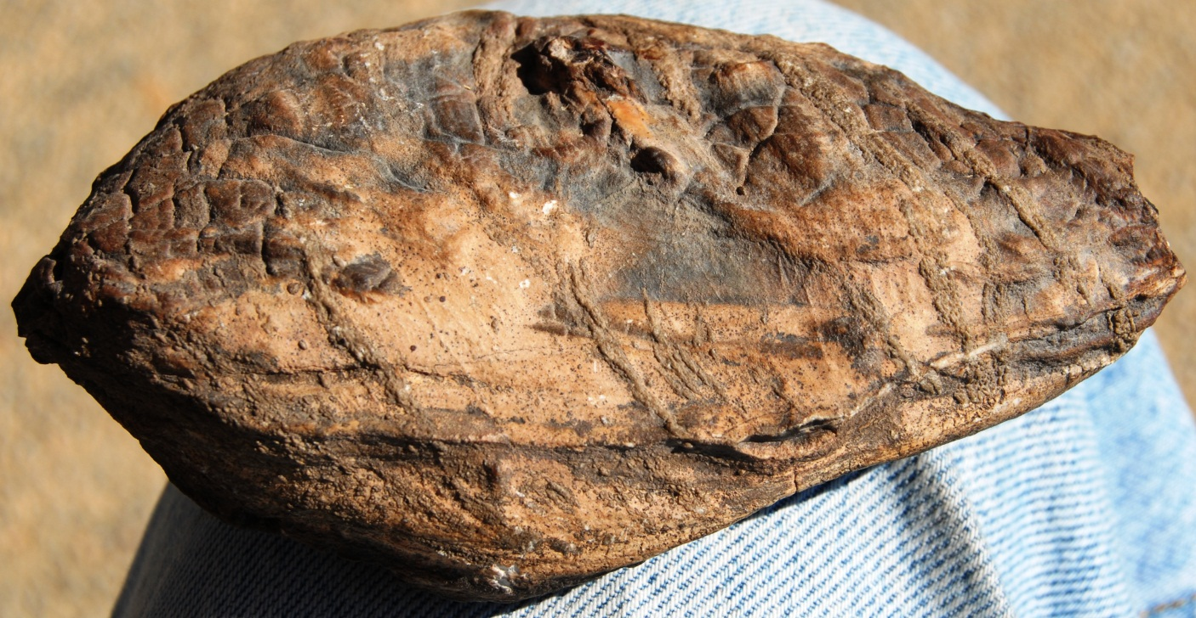
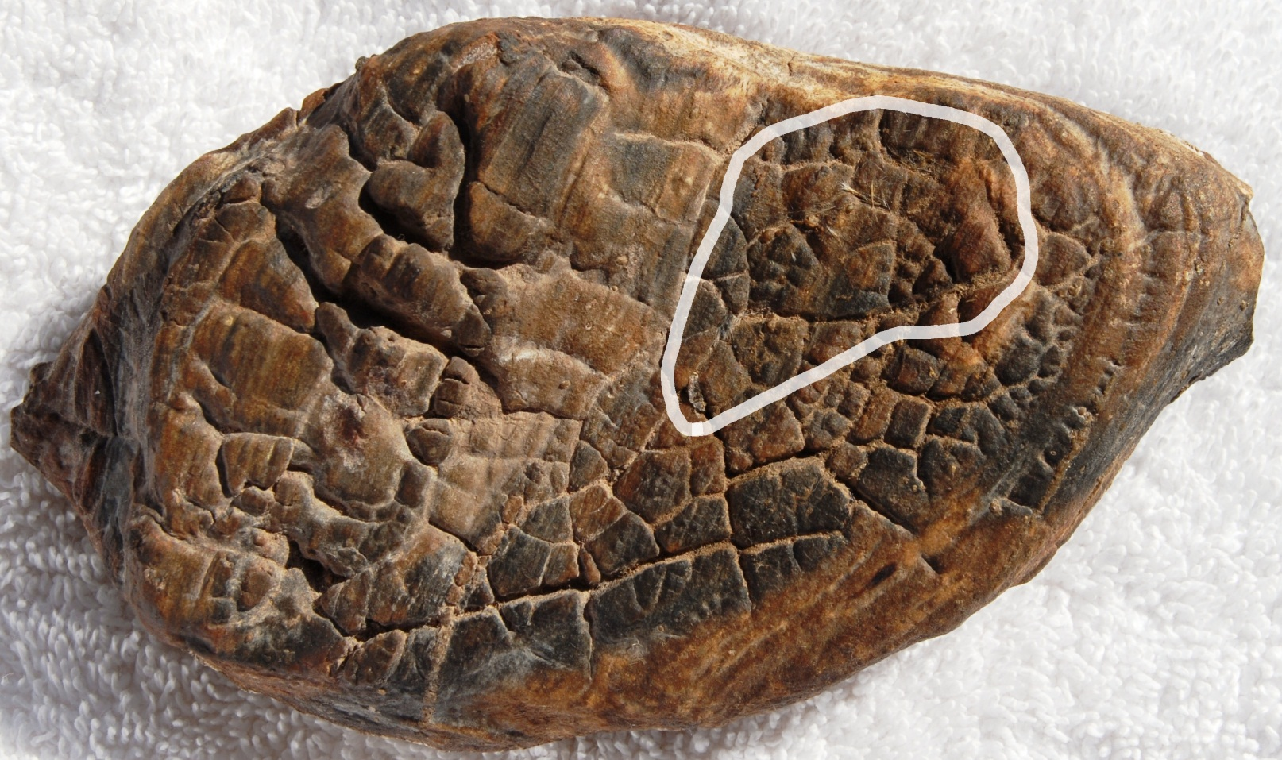
Seep
pod? (#2)
Embedded hair-like fibers
Rocky Mtn. GSA-May, 2012

Slide 29
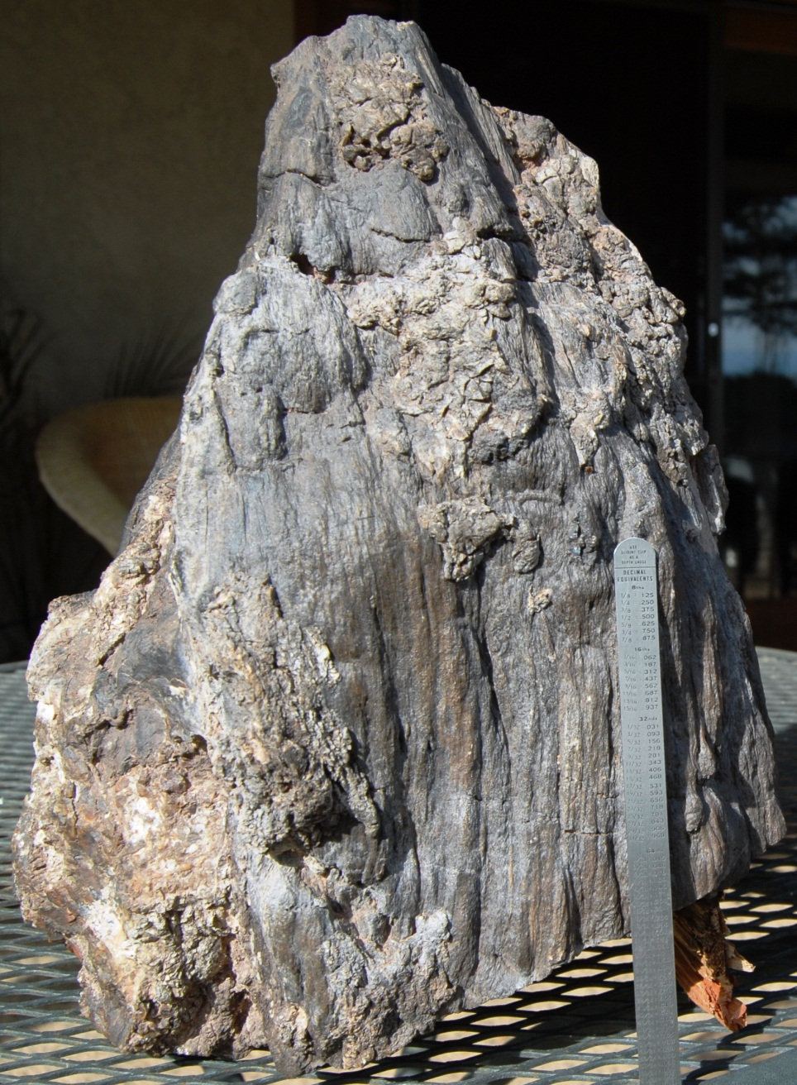
Triassic Fern? With Coprolite
Rocky Mtn. GSA-May, 2012

Slide 30
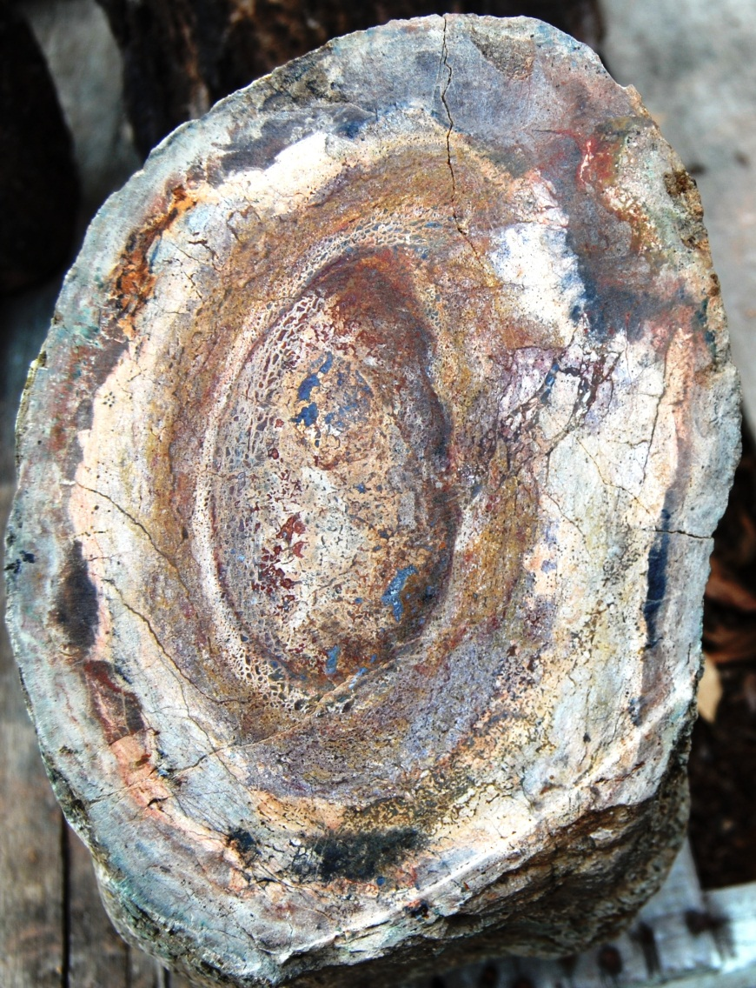
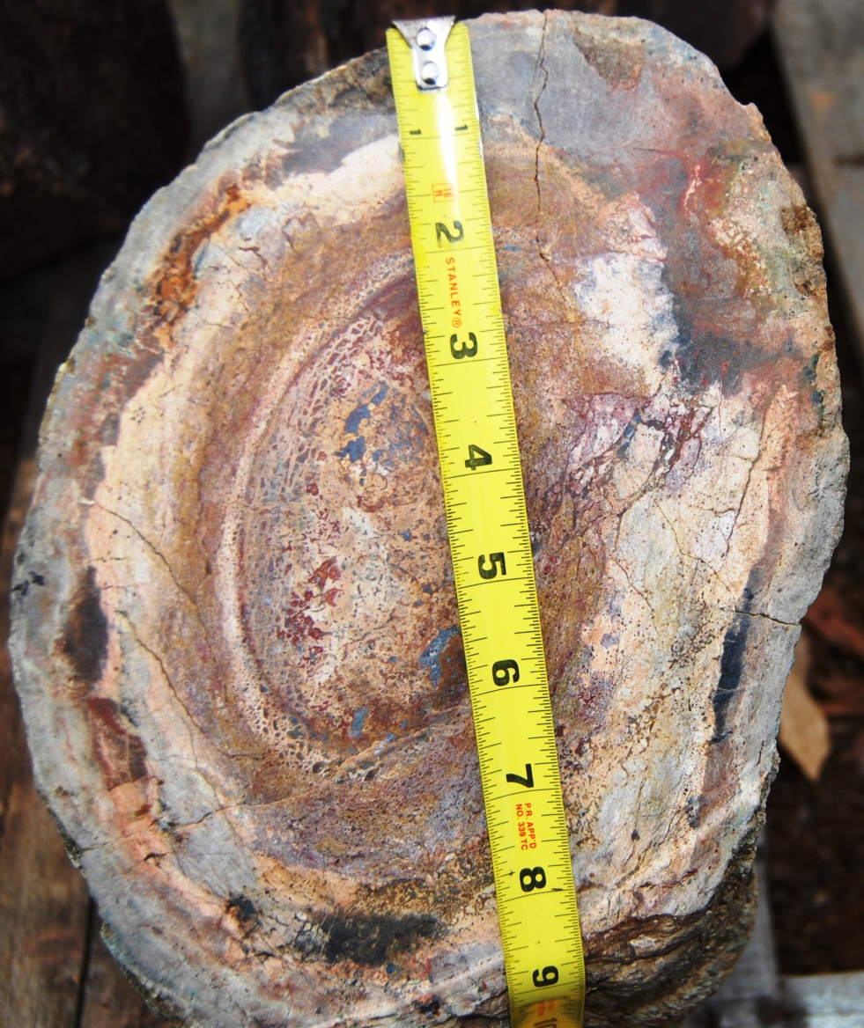
Jurassic Sauropod
Morrison Formation of Colorado
Femur at Upper joint Evidence of battle by aggressor
Rocky Mtn. GSA-May, 2012

Slide 31
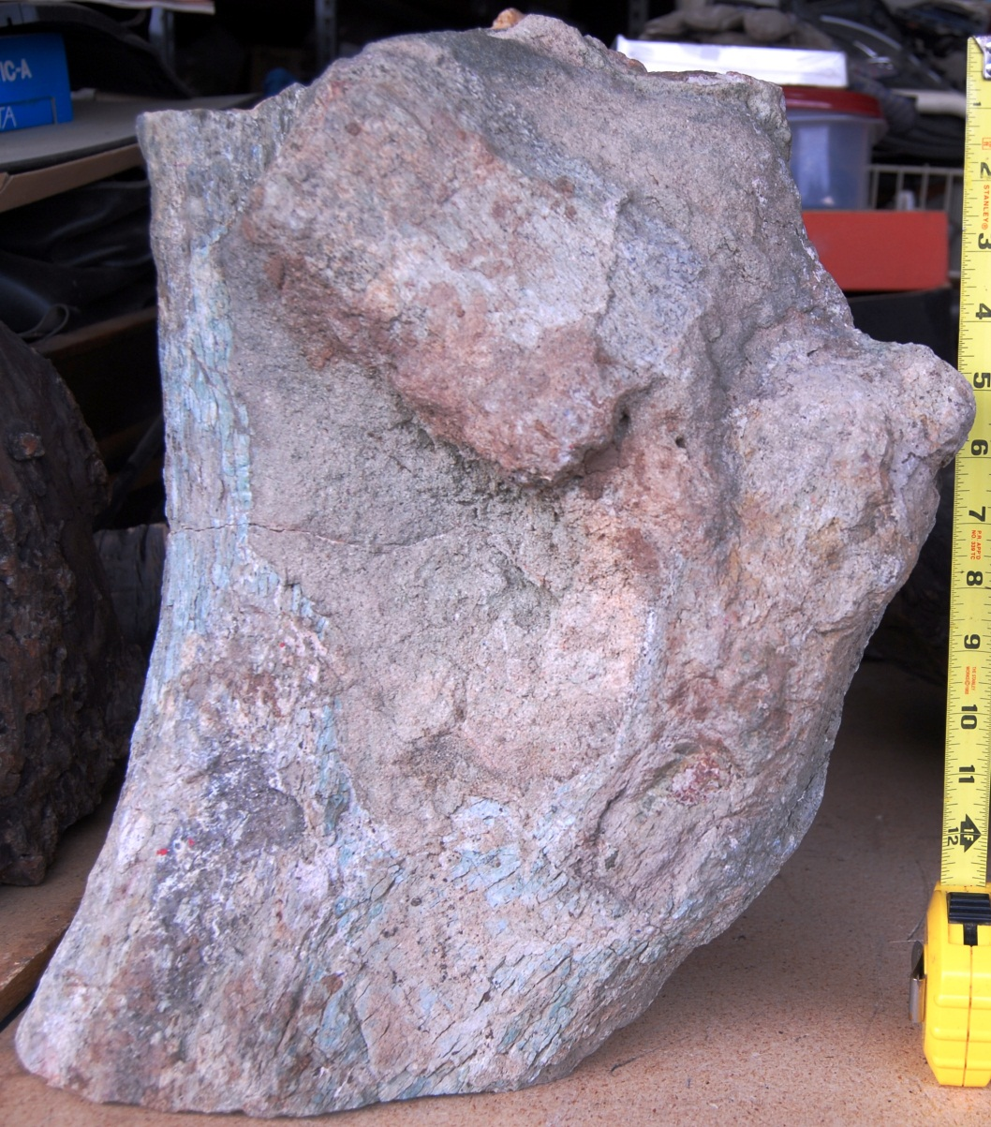
Jurassic Sauropod
Torn flap of skin and
body tissue
Permineralized limb
Rocky Mtn. GSA-May, 2012

Slide 32
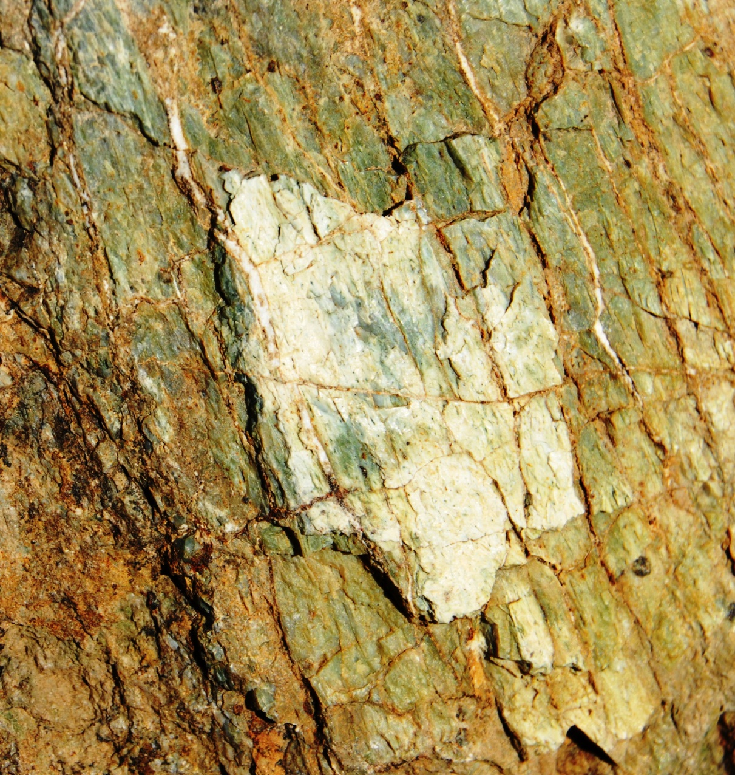
Jurassic Sauropod: Skin
Appears to be
layered skin scales
Rocky Mtn. GSA-May, 2012

Slide 33
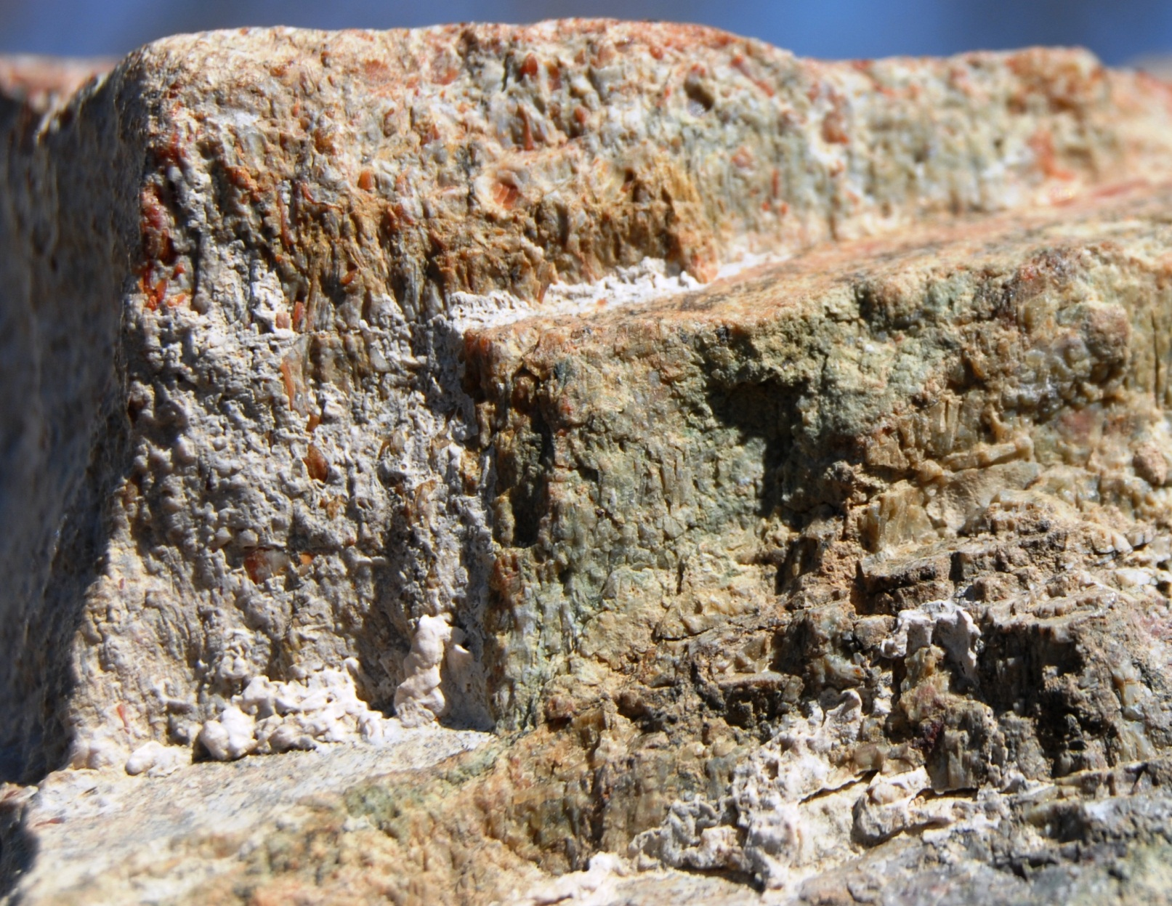
Jurassic Sauropod
Muscle tissues
Rocky Mtn. GSA-May, 2012

Slide 34
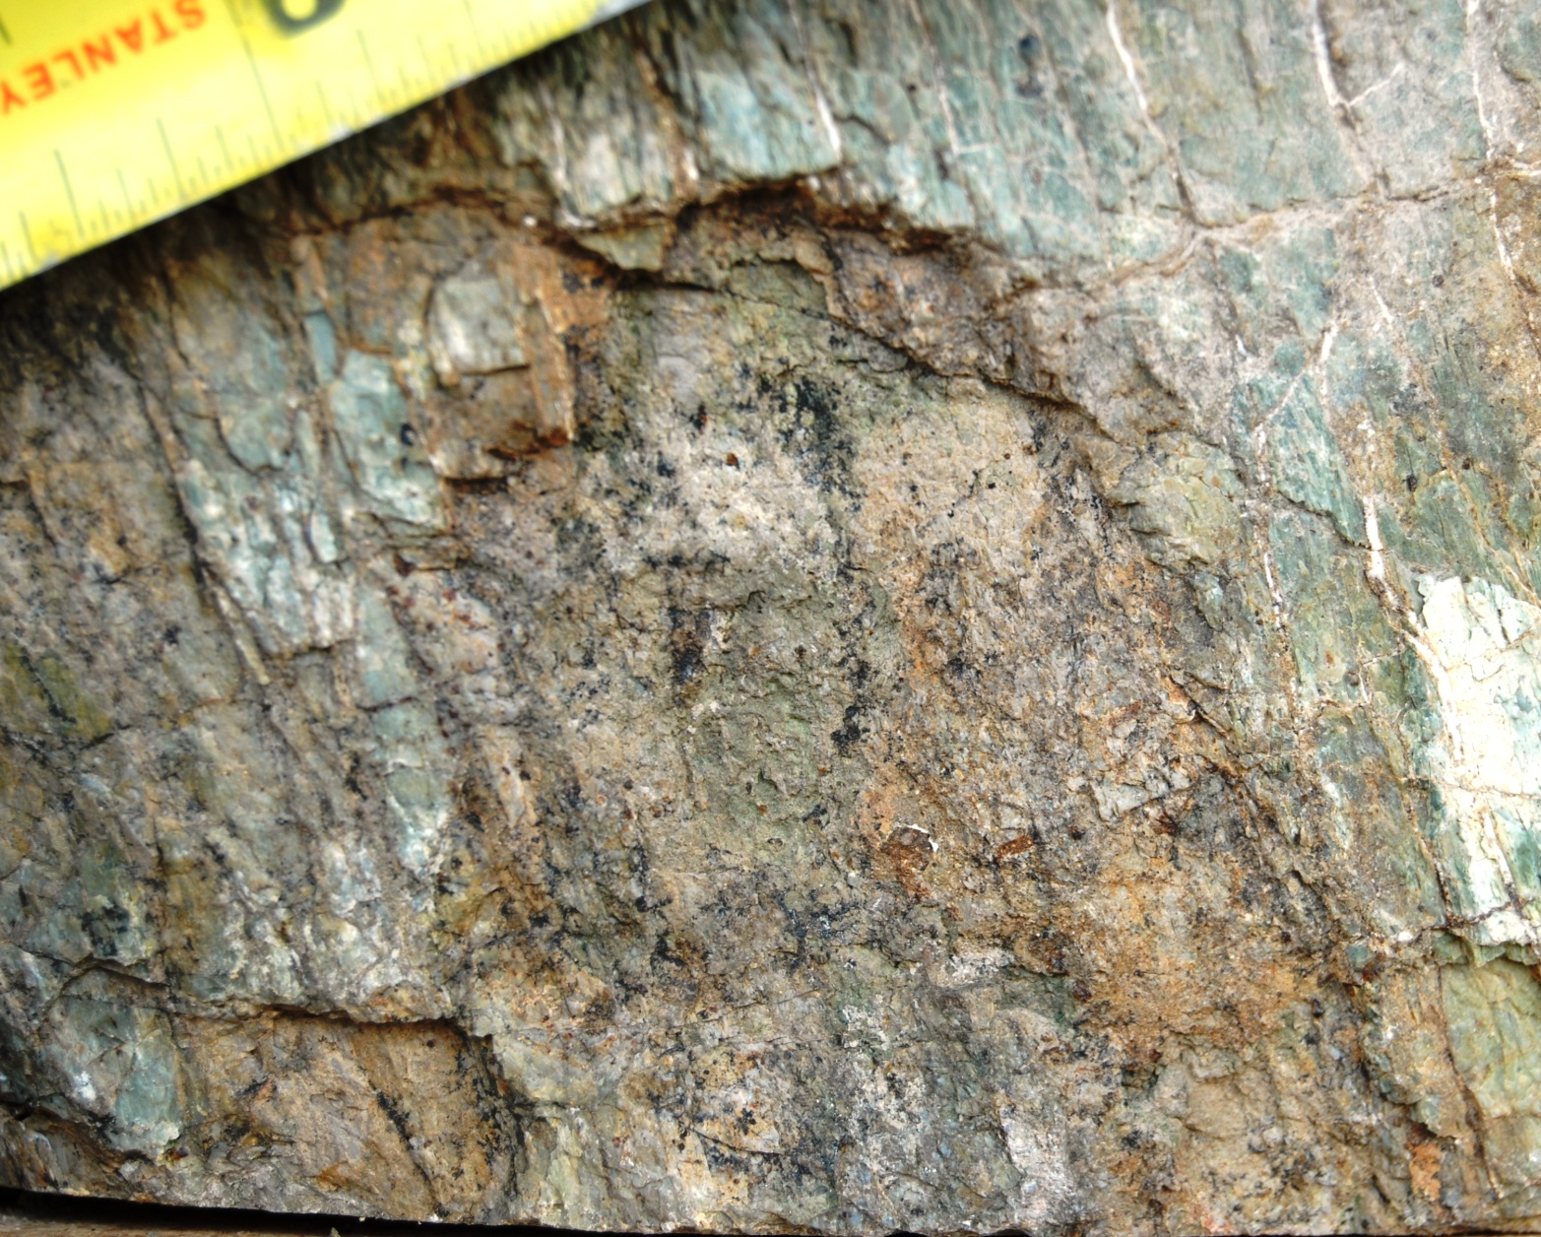
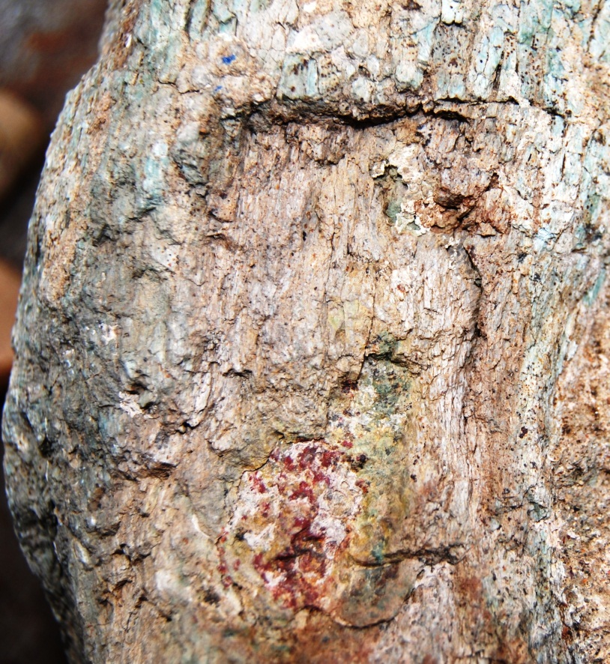
Jurassic Sauropod
Bite marks
Rocky Mtn. GSA-May, 2012

Slide 35
Dr. Bill Schopf’s response to inquiry regarding preservation of dino bones via mineralization vs. permineralization, dated 2-29-2012
“Dinosaur bones and fossil vertebrate bones, generally – have lots of open spaces where nerves, collagen = connective tissue, etc. are present, while the organism is alive. But the soft tissues ultimately decay to leave “holes” and “tunnels” in the bone. These open spaces(including microscopic holes) can become in-filled with mineral matter brought in by and then precipitated from groundwater. This is similar to petrifaction = permineralization which occurs most commonly in plants (though in plants, the organic walls of the plant cells become infused, permeated, with the mineral which preserves the plant cellular tissue - - minerals inside the cells, outside the cells and the mineral also “meshes” with the organic matter of the cell wall so that the walls are composed of mineral-organic mix. In dinosaur bones, it is typical for the mineral simply to fill open space, holes, tunnels, and the like.”
Rocky Mtn. GSA-May, 2012
Rocky Mtn. GSA-May, 2012

Slide 36
Reason for Presentation Anticipated Results
Discuss possible new tools to recognize life in ancient epochs.
Encourage scientific research into various methods of fossil preservation processes that occur as a result of methods other than those of burial/deposition
Encourage research and study of fossil sites in the U.S.
Solicit the research community to promote the concept of collegiality and openness when confronted with ideas with which they have limited knowledge.
Promote a “re-look” of all fossil specimens in collections to determine whether scientifically important fossil associations might have been overlooked.
Stimulate research in the Triassic Chinle and Jurassic Morrison that uncovers more “permineralized” fossils that will enhance an understanding of life in those ancient landscapes.
Rocky Mtn. GSA-May, 2012

Slide 37
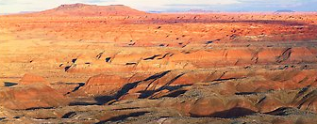
Rocky Mtn. GSA-May, 2012

