Slide 1


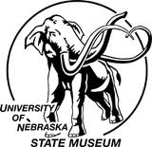

Minimal change in vegetation structure across the Eocene-Oligocene boundary in Nebraska as indicated by isotopes in mammals
Grant S. Boardman, Ross Secord
Department of Earth and Atmospheric Sciences
University of Nebraska-Lincoln.
William E. Lukens
Department of Earth and Environmental Science
Temple University

Slide 2
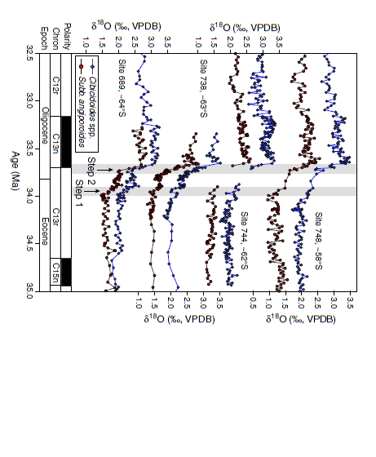
Eocene-Oligocene Climate Change
Oligocene
Oi-1
Eocene
Benthic foram record (blue) from Bohaty et al. (2012)
Benthic record from Zachos et al. (2001)

Slide 3
Broad changes in NA mid-continent
Proxies supporting increased aridification with minimal cooling.
Ecomorphological turnover in gastropod fauna (Evanoff et al., 1992)
Decrease in semi-aquatic herpetofauna (Hutchison, 1982, 1992)
Changes in paleosol character and geochemistry (Retallack, 1983, 1990, 1992, 2007; Sheldon and Retallack, 2004; Sheldon, 2009; Terry, 2001)

Slide 4
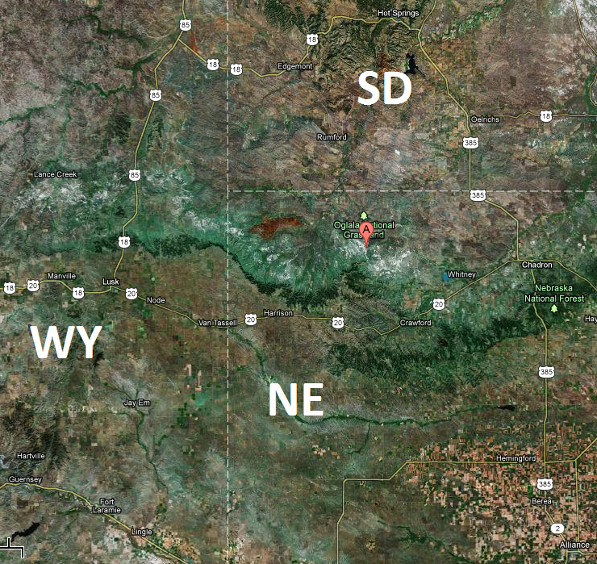
Toadstool Geologic Park

Slide 5
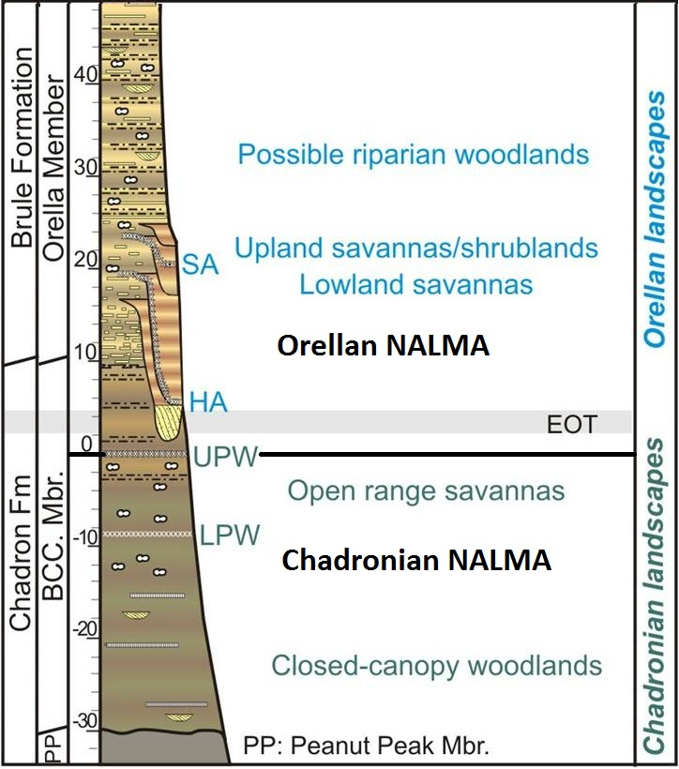
Paleosol Record in Nebraska
Pedogenic features:
Horizonation
Carb/clay accum.
“Paleofertility”
Trace metal conc.
Root traces
Decreasing root cast size up section.
Abundance of hairline roots in Orellan Paleosols
Figure based on Terry (2001); Kennedy and Terry (2010); and ongoing work by Lukens and Terry.

Slide 6
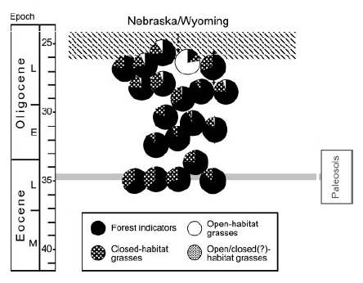
Phytolith Record in Nebraska
Predominance of forest indicators (woody and herbaceous dicots, conifers, ferns, palms) and closed-habitat grasses.
Chadronian and Orellan landscapes seen as closed-forest.
Figure modified from Strömberg (2005)

Slide 7
MAIN GOAL
Characterize EOT habitats in Nebraska based on ungulate proxies (δ¹³C_{E})…

Slide 8
Mammal enamel stable carbon isotopes
Carbon in enamel (δ¹³C_{E}) reflective of plants consumed.
Plant carbon values (δ¹³C_{P})
Photosynthetic pathway (C3, C4, CAM)
Water stress in C3 plants, open vs. closed C3 habitats
Atmospheric composition
Focus on C3 habitats
Previous isotope work suggests no C4 (Zanazzi and Kohn, 2008)

Slide 9
Constructing a predictive habitat/enamel isotope model
Modeled habitat/enamel values based on modern plant habitat values adjusted for:
Enamel enrichment, 14.1‰ (Cerling and Harris, 1999)
Latitude, +0.3‰/10° lat. (Secord et al., 2008) (adjusted to 42°N)
Altitude, +0.65‰/km altitude (Secord et al., 2008) (adjusted to ~ 1 km)
Δ atmospheric δ¹³C 2‰ more positive than modern (Tipple et al., 2010)

Slide 10
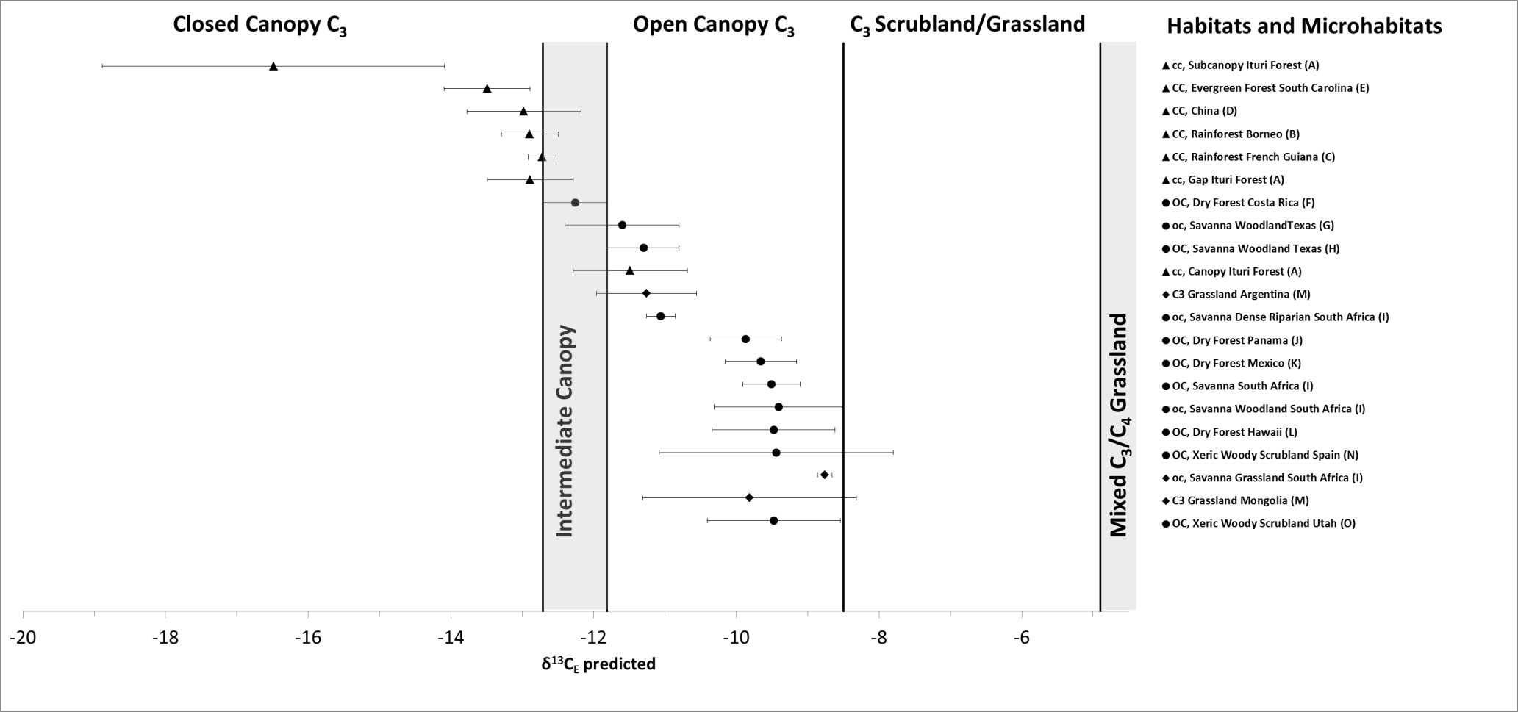
Predicative Enamel/Habitat Model (Kita-Boardman Model, E-O Version)

Slide 11
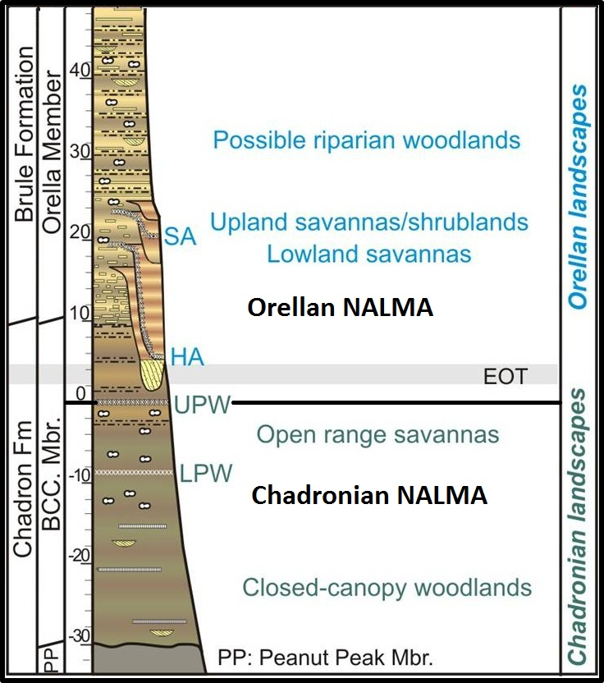

Nebraska’s Eocene-Oligocene Ungulates
12 ungulate taxa sampled, 11 from Chadronian (NALMA) BCC Mbr. below UPW and 7 from Orellan (NALMA) BCC and Brule Mbrs. above the UPW.
124 specimens total.
6 range-through taxa sampled (Hyracodon, Subhyracodon, Mesohippus, Archaeotherium, Agriochoerus, and Merycoidodon).
Enamel sampled and pretreated at UN-L, samples analyzed at UMSIL by Lora Wingate.

Slide 12
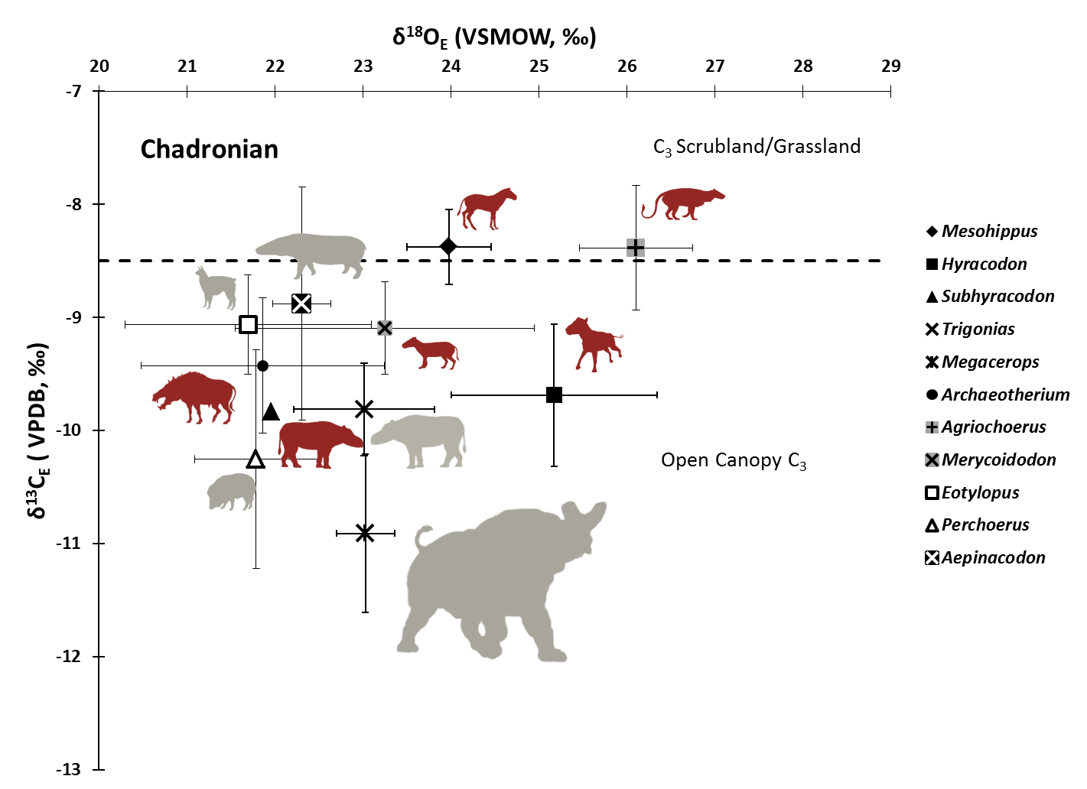
Chadronian

Slide 13
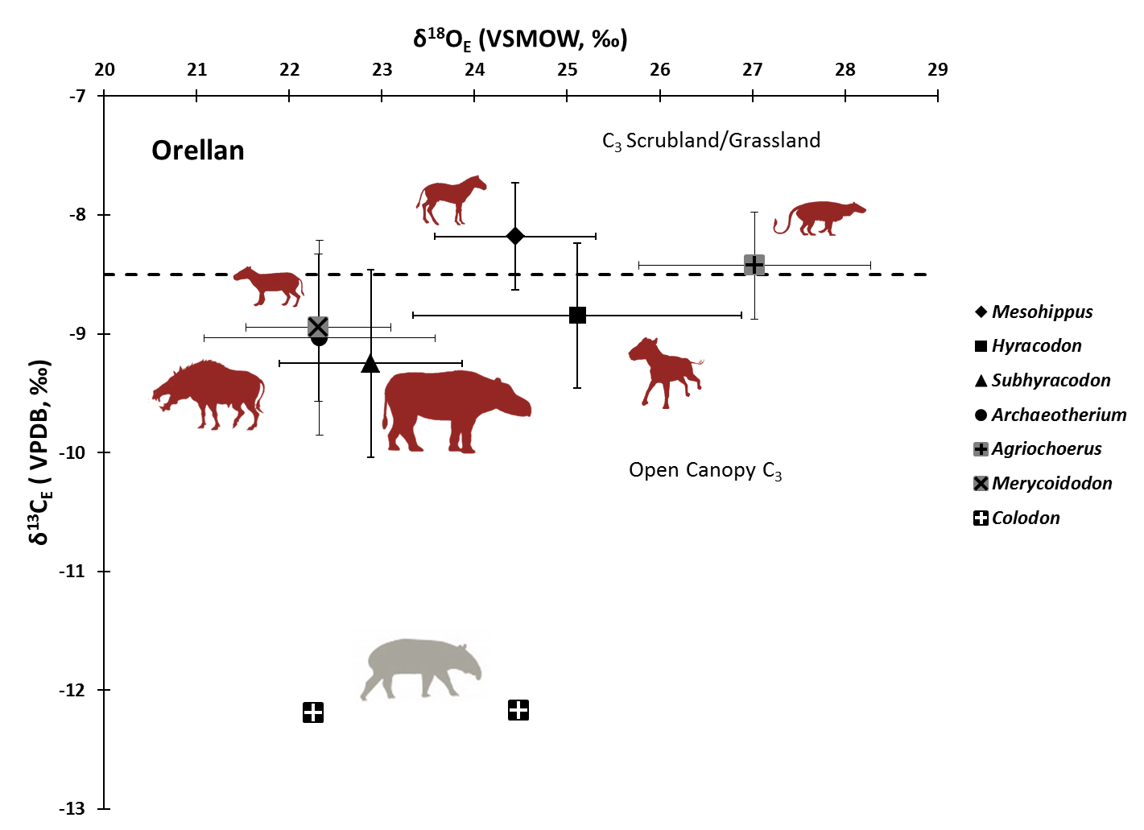
Orellan

Slide 14
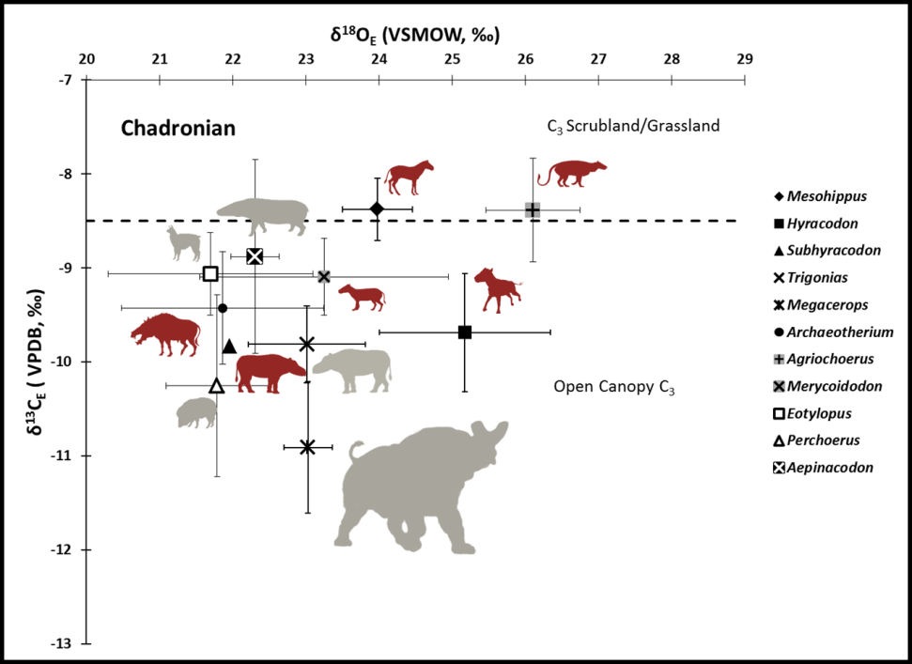
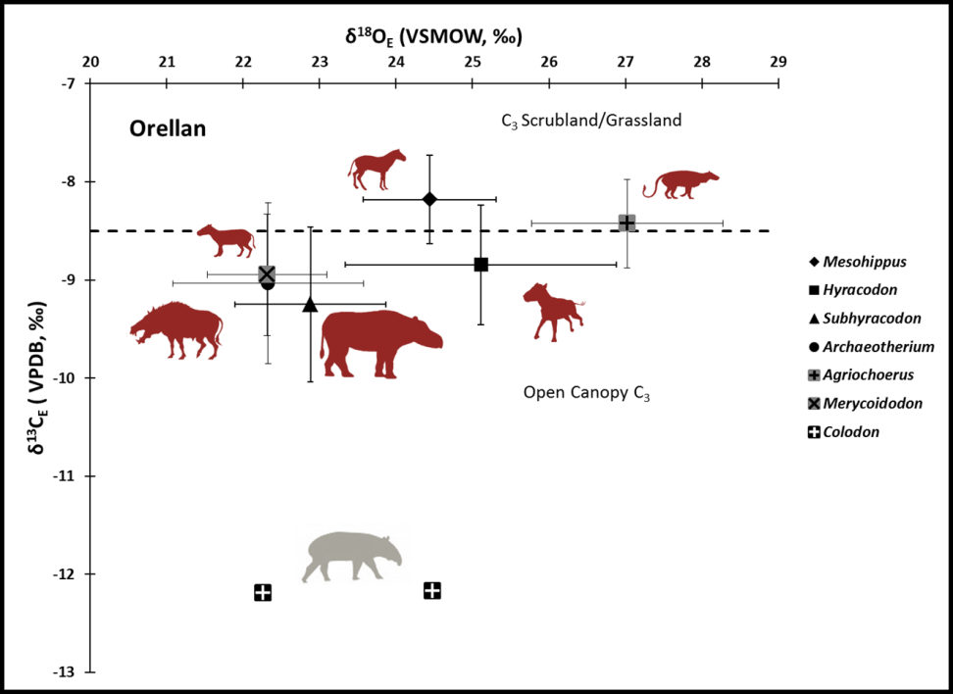
Little habitat change
Range-through intrataxon δ¹³C_{E} statistically indistinguishable … woodland/scrubland interface unchanged.

Slide 15
Acknowledgments
UN-L Dept. Earth & Atmospheric Sciences
George Corner, Greg Brown, Ellen Steppleton, Rob Skolnick at UNSM
Jakway Fund
Nebraska Geological Society Yatkola-Edwards Award and funding match by AAPG
GSA Graduate Research Fund
Lora Wingate at UMSIL

Slide 16
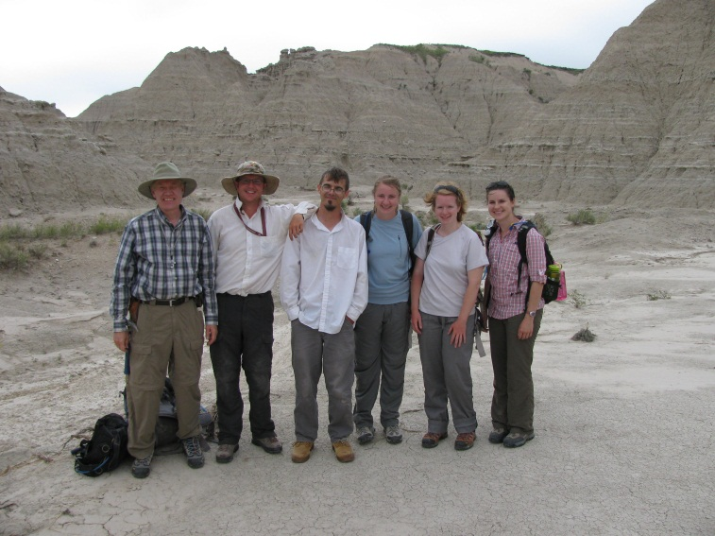
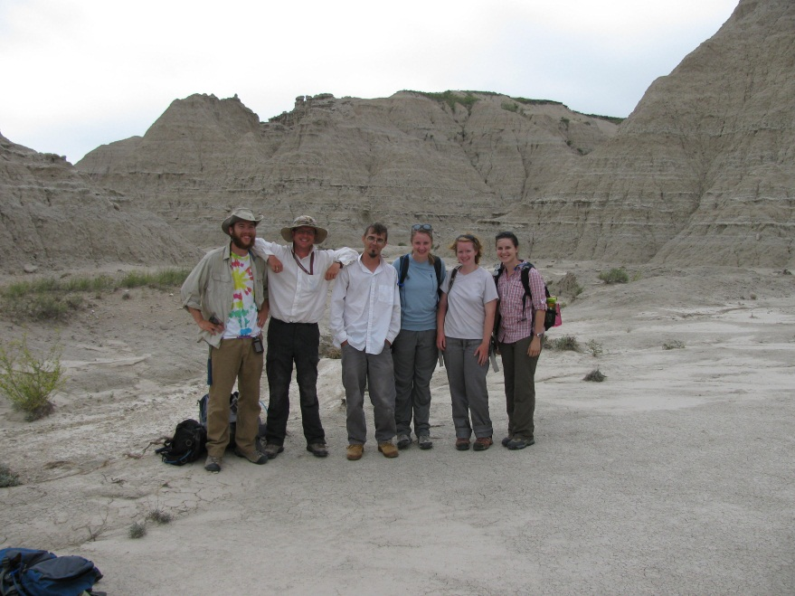
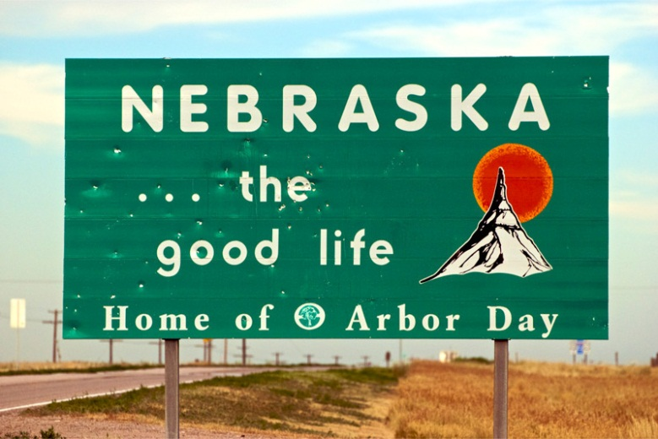
THANK YOU!

