Slide 1
Software Development for a Three-Dimensional Gravity Inversion and Application to Study of the Border Ranges Fault System, South-Central Alaska
Rolando Cardenas, UTEP Computational Science
Dr. Diane Doser, UTEP Geology
Dr. Mark Baker, Geomedia R&D
GSA Rocky Mountain Section (Paper #30-3)
64th Annual Meeting
May 11, 2012

Slide 2
Outline
Introduction
The Inverse Problem and Model
  Trouble with Typical Inversions
  Previous Studies
  Problem Formulation and Forward Model Generation
  Calculation Technique
Mathematical Approach to Inversion
  Advantages to New Technique
  Density Solution and its Characteristics
Preliminary Numerical Results
Discussion and Future Work

Slide 3
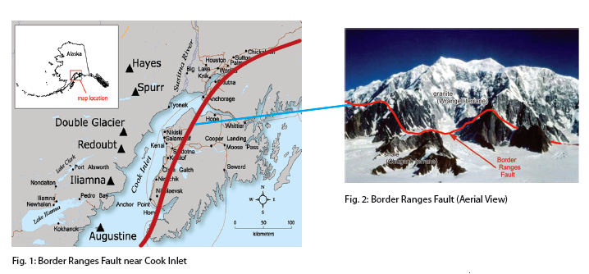
The Border Ranges Fault System

Slide 4
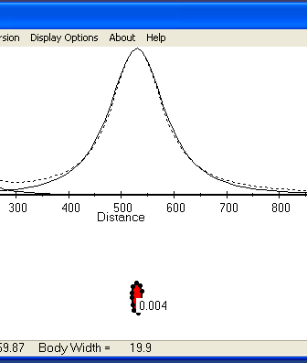
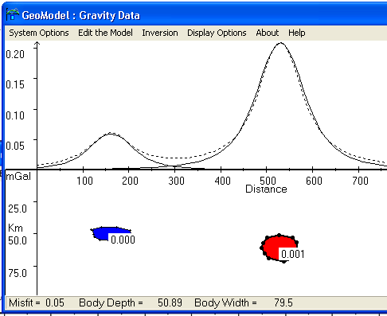
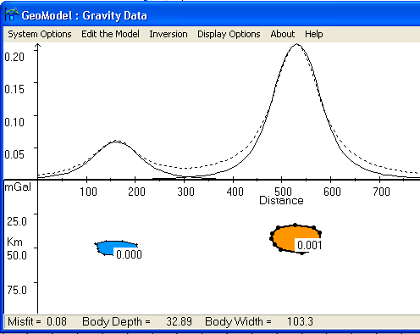
The Trouble with Typical Inversion Software
From “GeoModel” by Rockport Software

Slide 5
Other Problems with Typical Gravity Inversion Software
Can be rather expensive.
May not account for “a priori” information.
May not account for field data and digital elevation model (DEM) uncertainties.
May be difficult to constrain.
Difficulty with Complex Geologic Structures
2D – 2.5D Models don’t tell the “whole story”

Slide 6
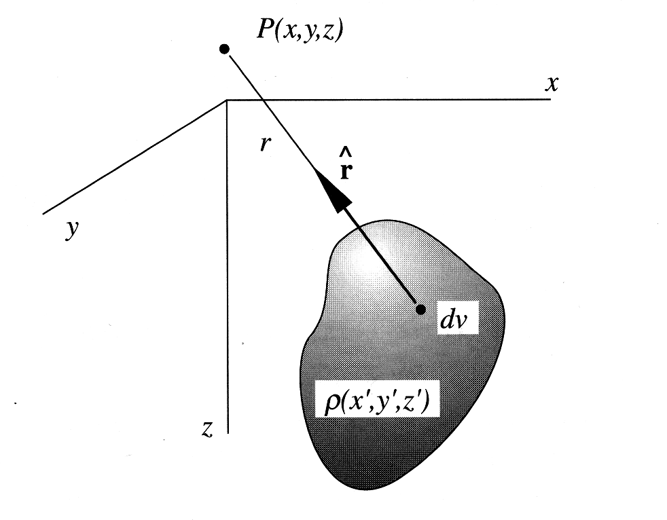
Forward Model Generation
Volume Integral
Total Gravity Contribution
User Defined Body

Slide 7
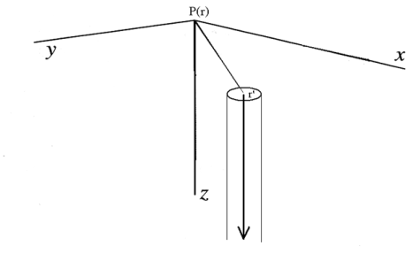
Forward Model Generation
Nettleton (1976) Modification for the plane on the slab.
Surface Node (“Semi-Infinite Line Element”)

Slide 8
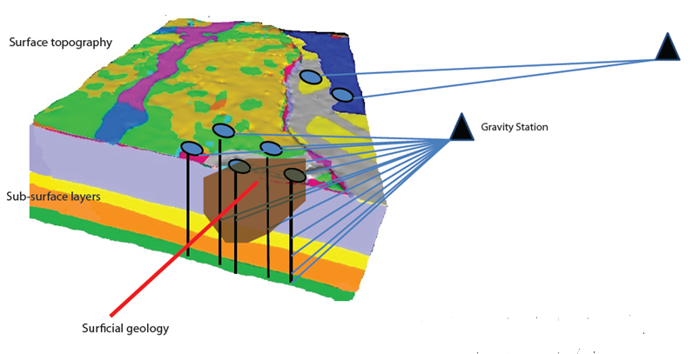
Forward Calculation Technique
Less gravity contribution for blocks much further away ~ fewer calculations
Blocks under study are divided into thousands of nodes ~ 10,000 per block

Slide 9
Advantages of Forward Calculation Technique
Computationally Efficient (station to block distance test)
Considers user-defined “a priori” information in model solution
Deals with uncertainties due to
density parameters
measurement error
surface elevation
model discretization
Provide 3D dimensional solution layers

Slide 10
The Inverse Model Solution **
Density model vector is iterative.
Considers covariance of forward model equations (data uncertainty).
Considers covariance of “a priori” uncertainties (elevations and initial densities).
Considers covariance of model estimate.
Minimizes misfit between observed and theoretical gravity computations.
** Based on a Generalized, Nonlinear Inverse Problem using Least Squares Criterion (Tarantola and Valette, 1982)

Slide 11
Characteristics of Inversion
Advantages:
Iterative
Common to Geophysics
Considers a priori, a posteriori covariances
Disadvantages:
Source of “a priori” uncertainties and data uncertainties and can be hard to determine.
Problem size amplifies the uncertainty.
Solution is not unique.

Slide 12
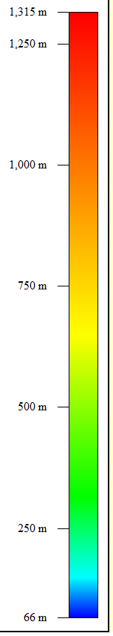

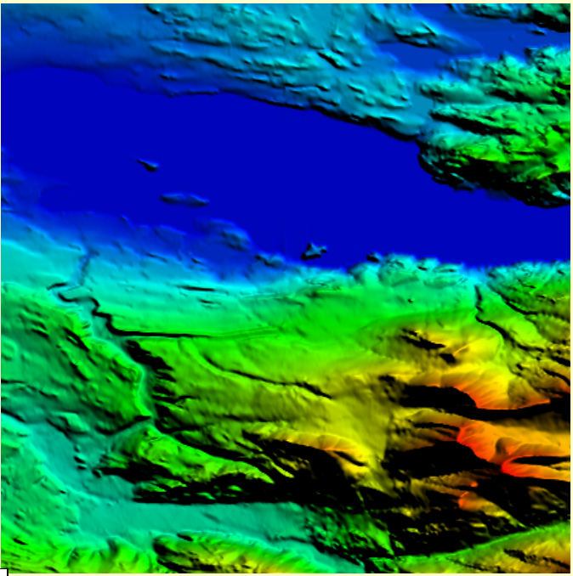
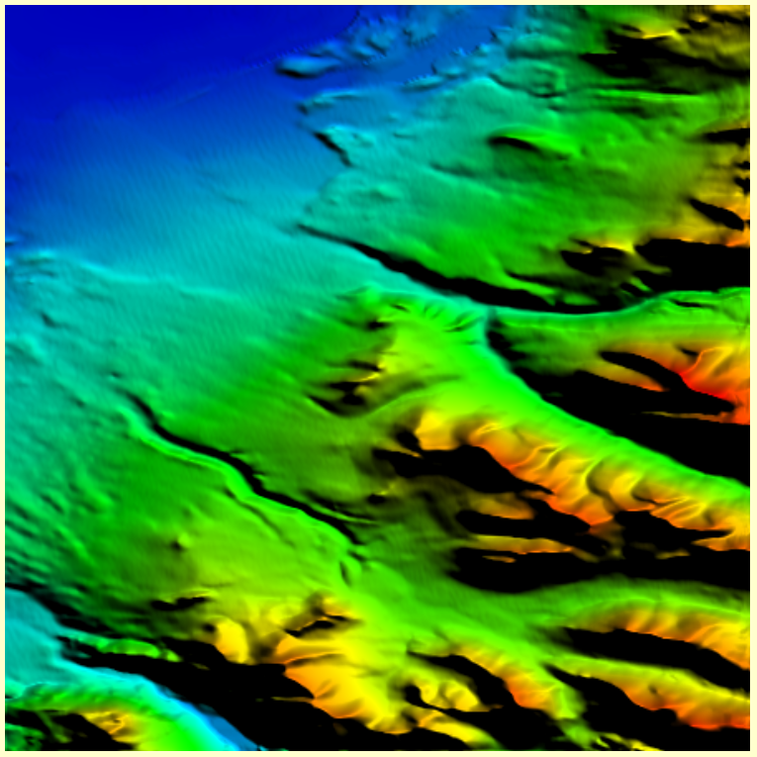
Two Layer Experiment
(hoping to resolve surface topography – minimal Constraining)
GlobalMapper Plot, W10625N6000.grd
GlobalMapper Plot, W15025N6075.grd

Slide 13
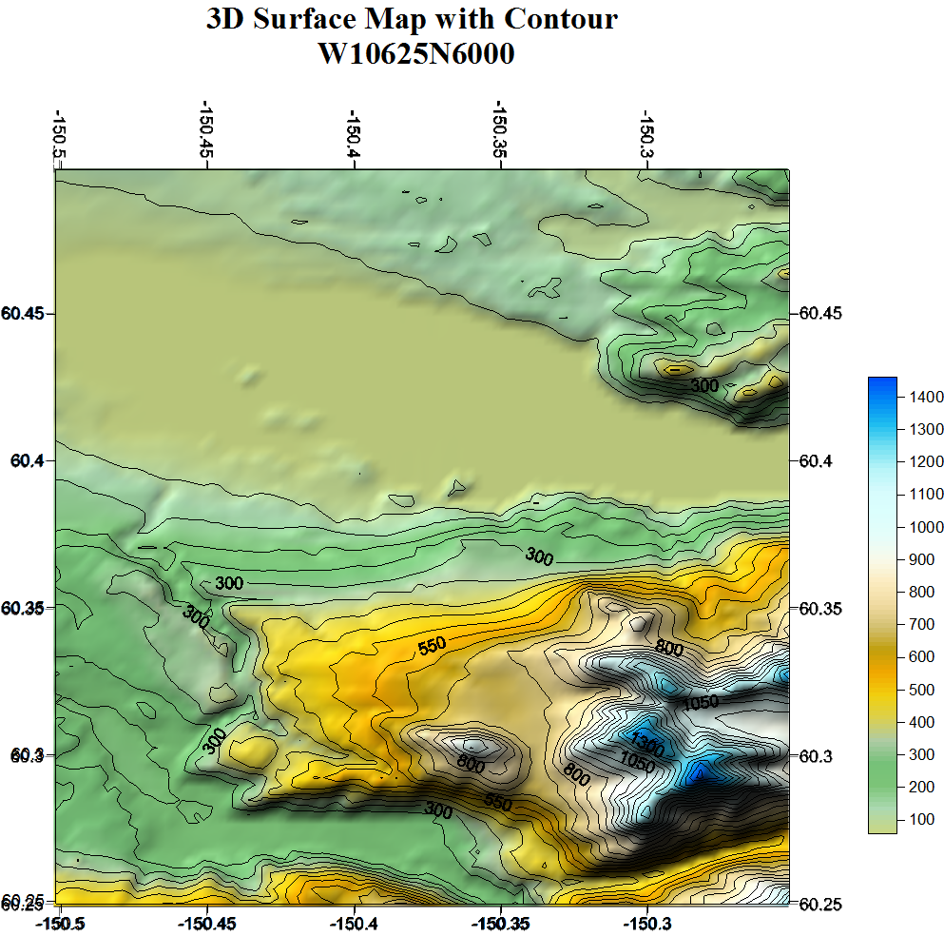
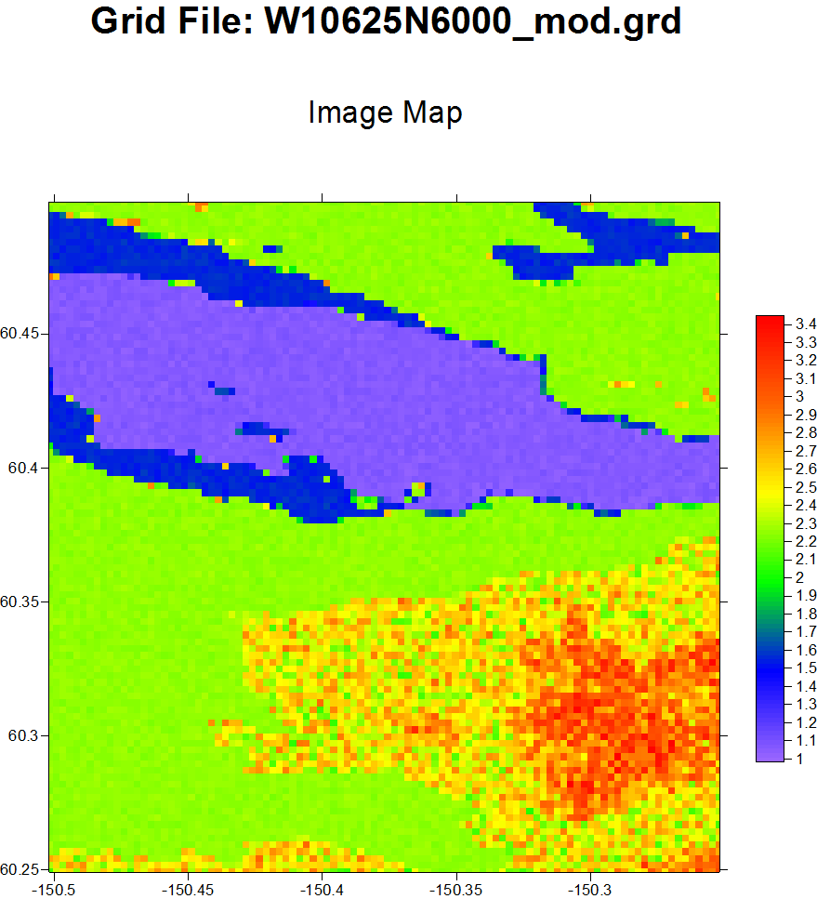
Preliminary Results

Slide 14
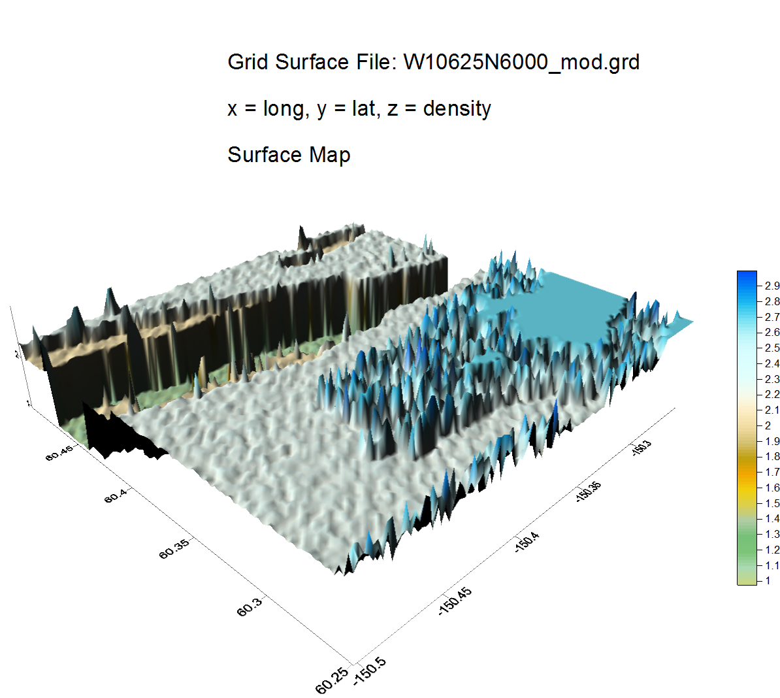
Preliminary Results

Slide 15
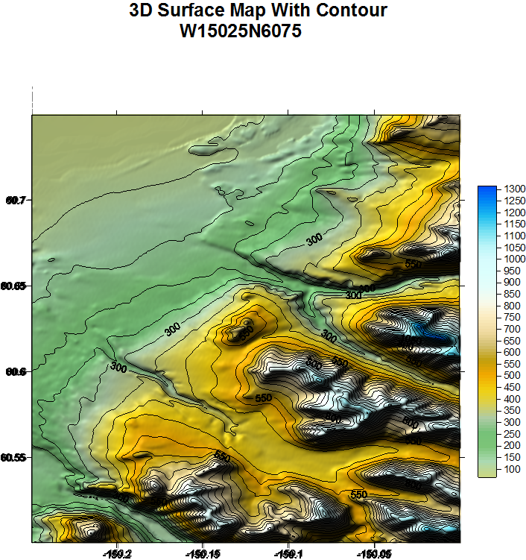
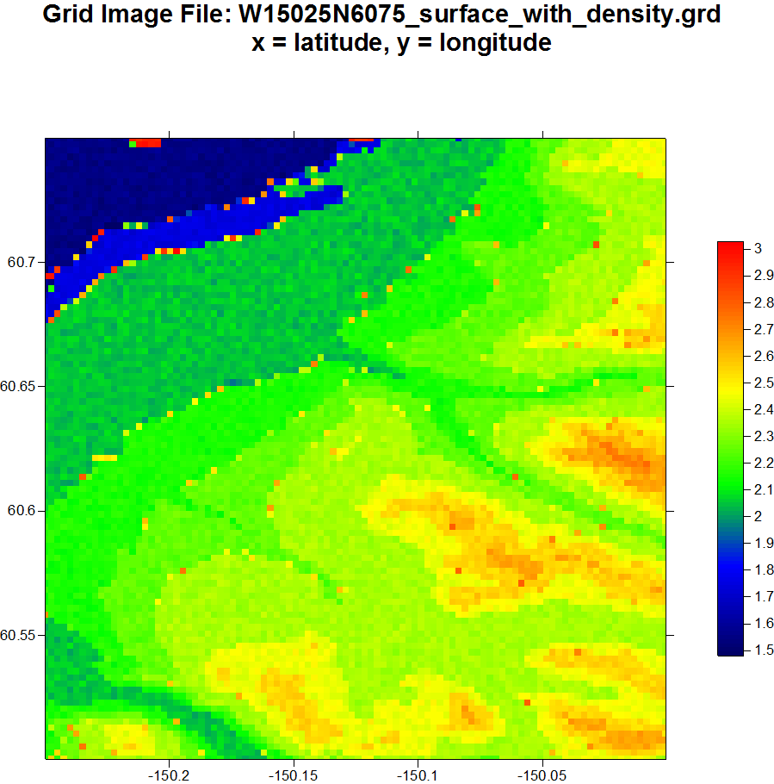
Preliminary Results

Slide 16
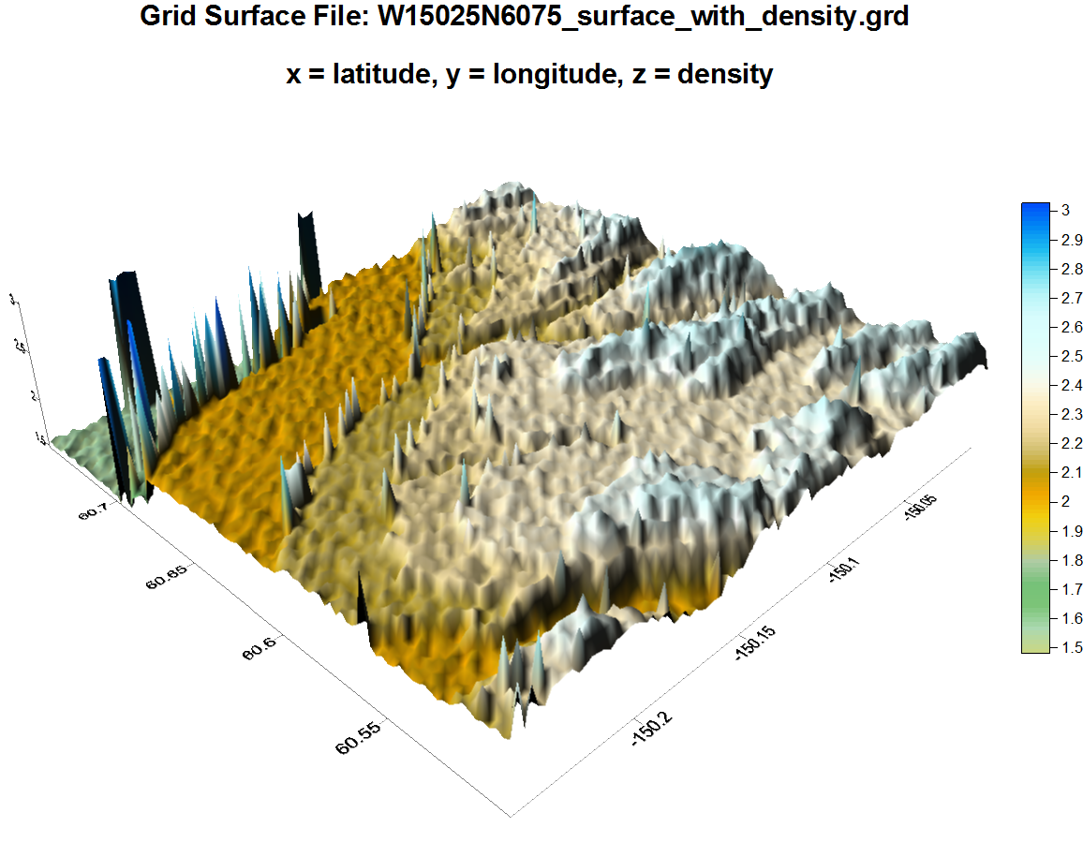
Preliminary Results

Slide 17
Concerns with Constraints
Mountainous Terrain has less density variation
Lose sediment has much uncertainty due to source of rock (i.e. glacier deposit, erosion, etc..)
Bathymetry of lake is tricky. (variations of lake bottom)
A priori information needed for upper and lower bound for density. (Borehole studies, Seismic information, etc..)
Preliminary computations do not incorporate Kalman filtering (process/measurement noise)

Slide 18
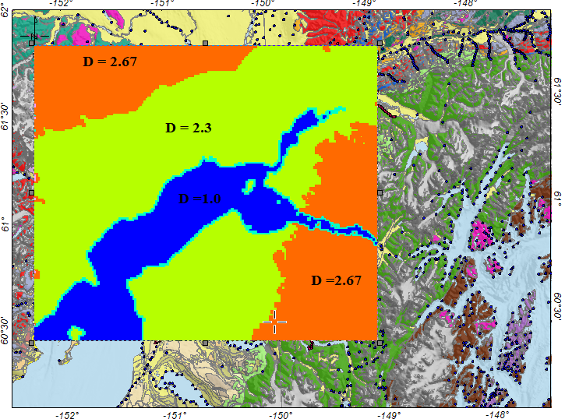
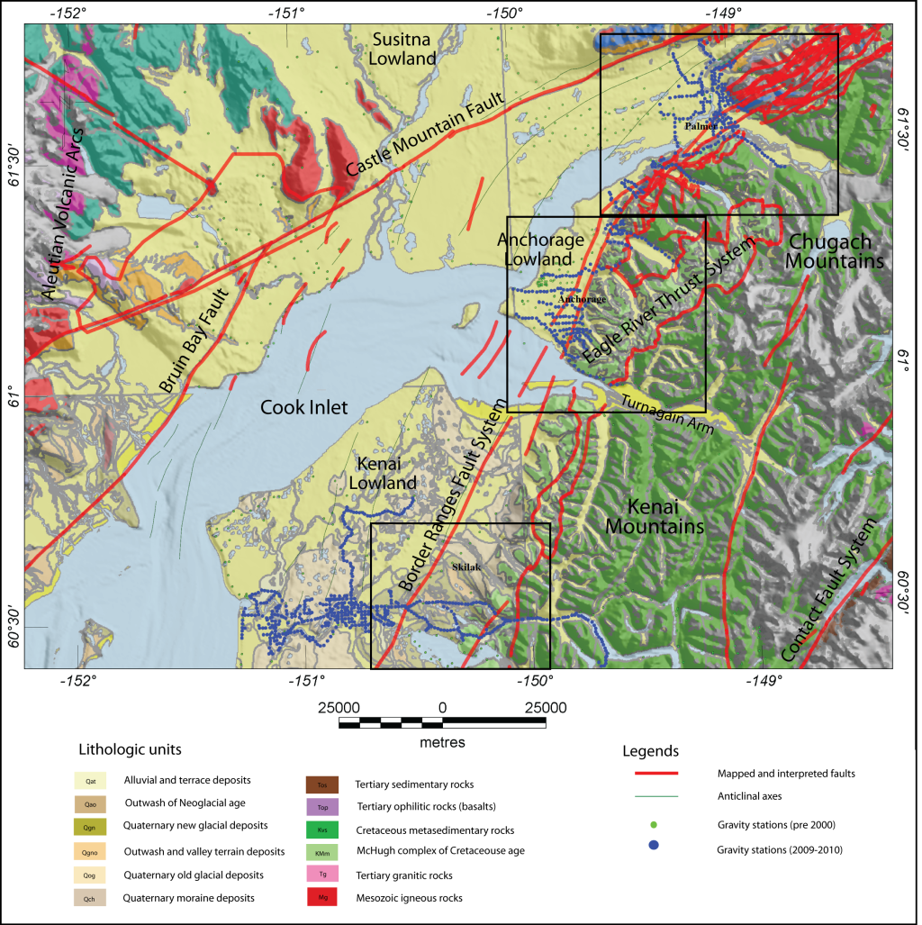
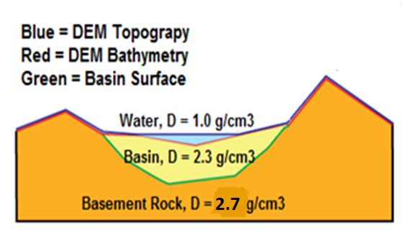
Three Layer Experiment
Courtesy of Mankhemthong, 2012

Slide 19
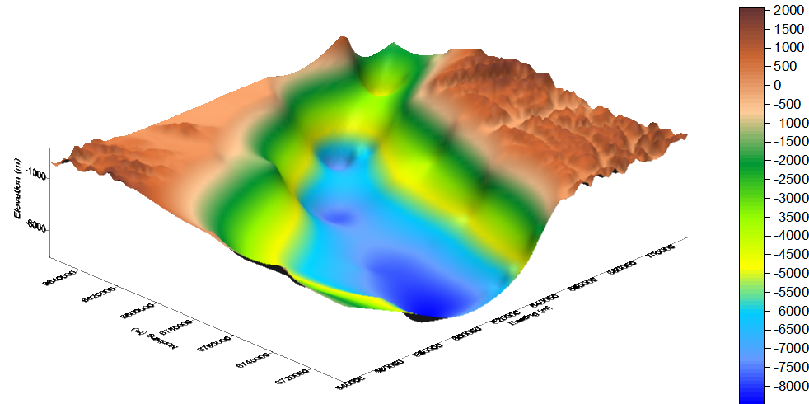
3D Surface Map and Elevation of Test Area

Slide 20
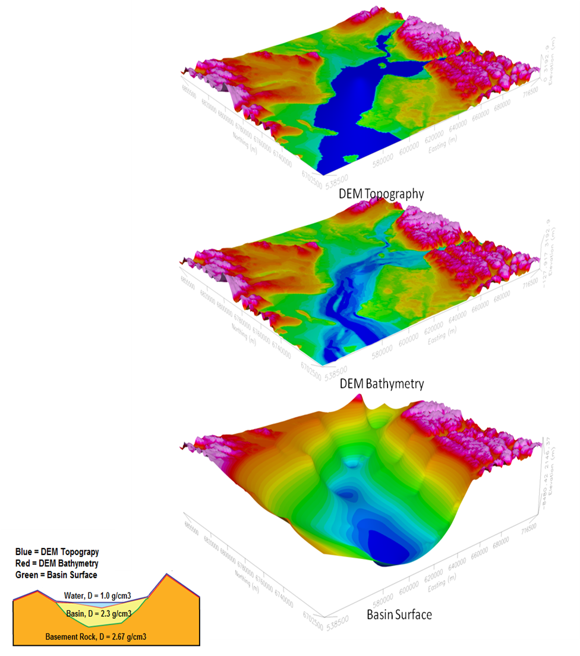
Surface Maps of Three Layers under Inversion Test
Courtesy of Mankhemthong, 2012

Slide 21
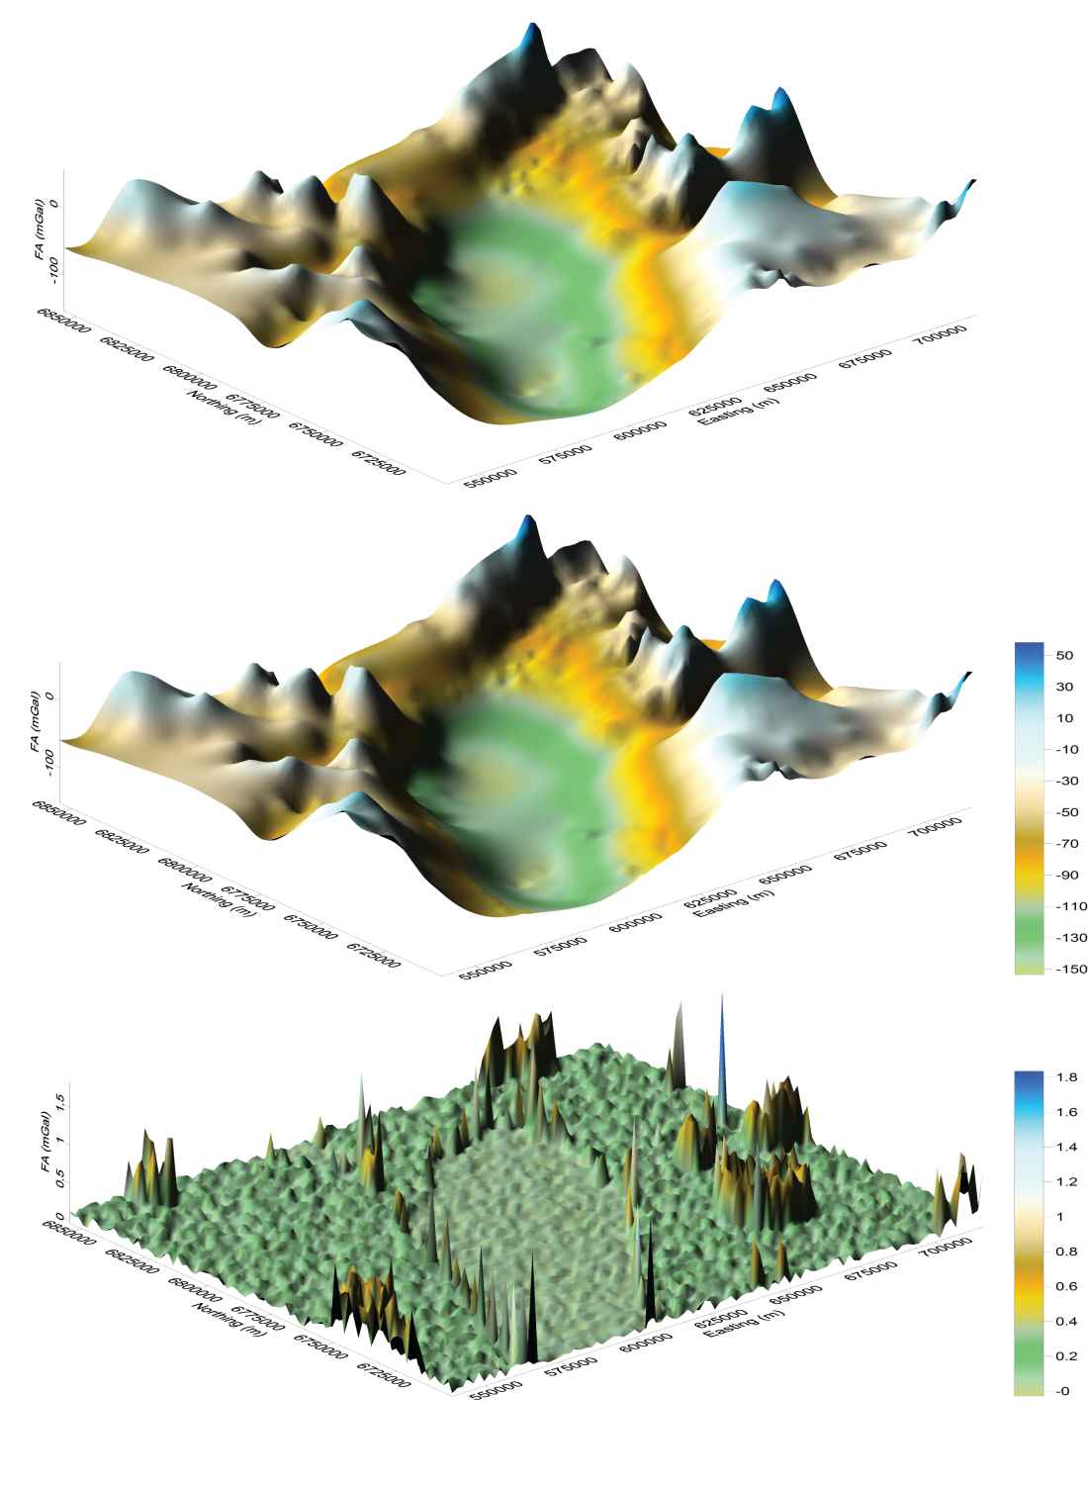
Observed Gravity, Theoretical Gravity, and Difference

Slide 22
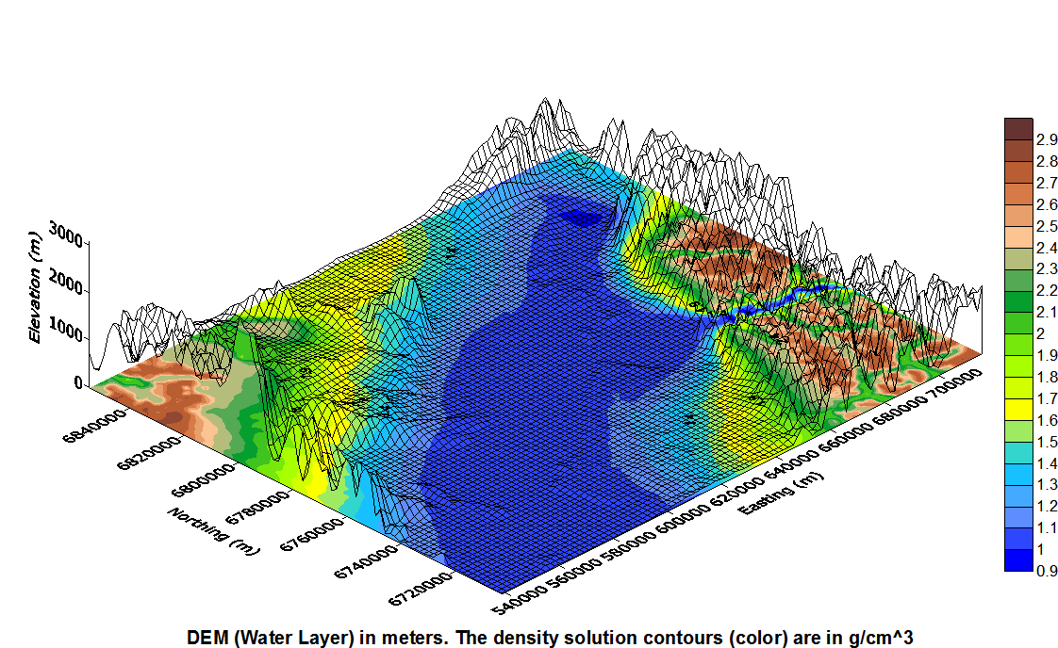

Slide 23
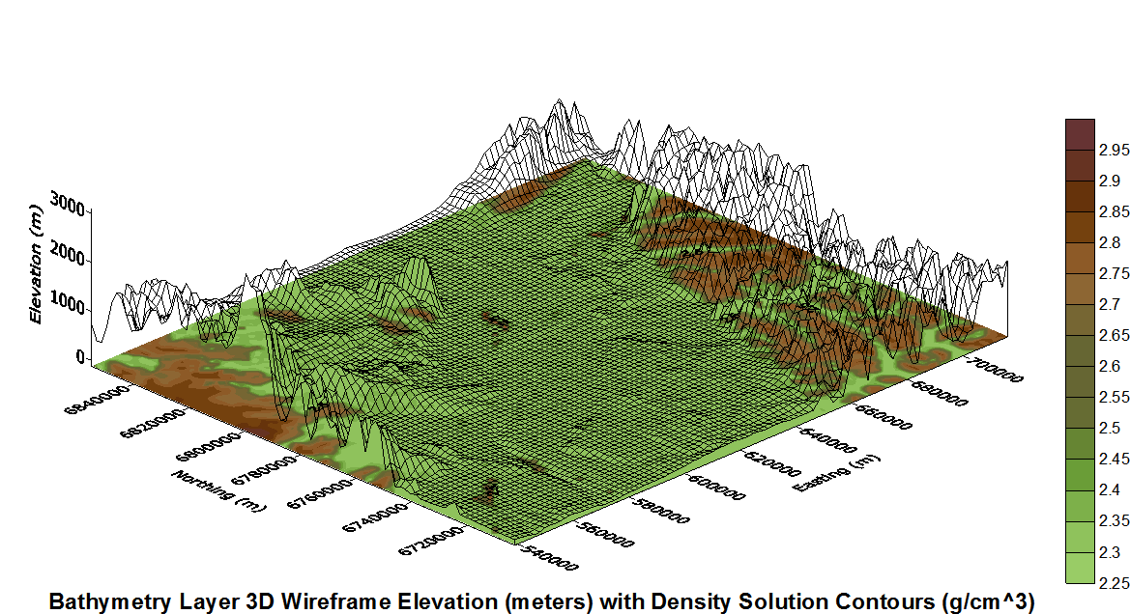

Slide 24
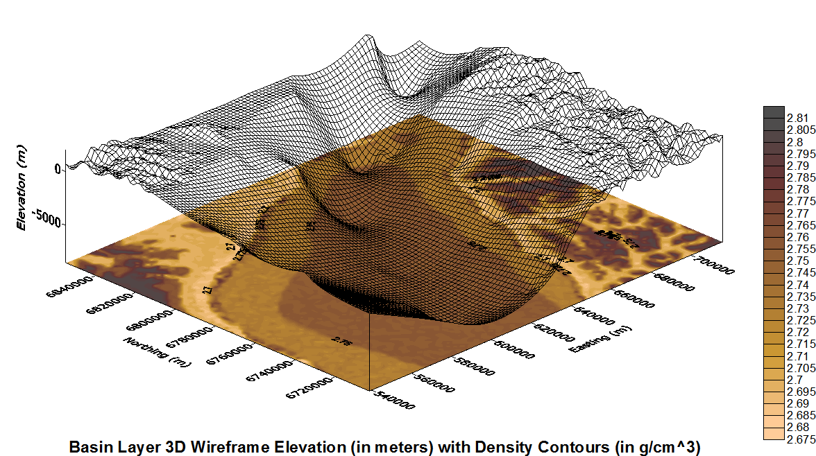

Slide 25
Future Work and Considerations
Two visualization Windows needed:
  SURFER plot from .GRD file of model
  Real-time Geologic Body Visualization
Use of MPI/Open MP to make computations on several blocks simultaneously (address processor latency issues)
Joint Inversion? (Magnetic Anomalies)
Need for interval computations due to measurement error.

Slide 26
Some References
[Baker, M.R.; Kreinovich, V., 1997. "Estimating Gridding Uncertainties with Interval Techniques", Proceedings Landmark Worldwide Technology Forum.]
[Baker, M.R., Crain, K., 2001, SURFGRAV html user’s guide. Unpublished document, Geomedia Research and Development, El Paso, Texas, 20 pp.]
[Benson, R., Kaufman, R., Yuhr, L., Hopkins, R. 2011. "Locating and Characterizing Abandoned Mines Using Microgravity", Geophysical Technologies for Detecting Underground Coal Mine Voids: An Interactive Forum, Federal Highway Administration, US Dept. of Transportation]
[Bishop, Gary and Welch, Greg 2006. "An Introduction to the Kalman Filter", TR 95-041, UNC – Chapel Hill.]
[Blakley, R.J., 1995. Potential Theory in Gravity and Magnetic Applications, Cambridge University Press, 441 pp.]
[Brew, G; 2004. "Gravity Calculations from 3-D, Geologically Driven Models: A New Approach", AAPG Annual Meeting, Dallas, Texas.]

Slide 27



Acknowledgements

Slide 28
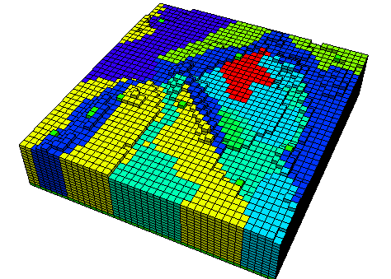
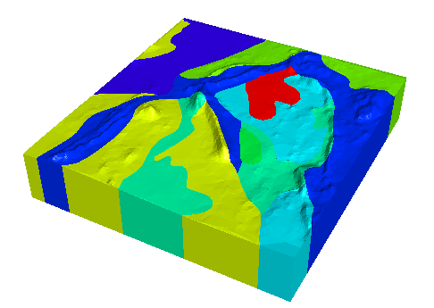
Questions??
Pitney-Bowes, University of British Columbia, Geophysical Inversion Facility – GRAV3D

Slide 29
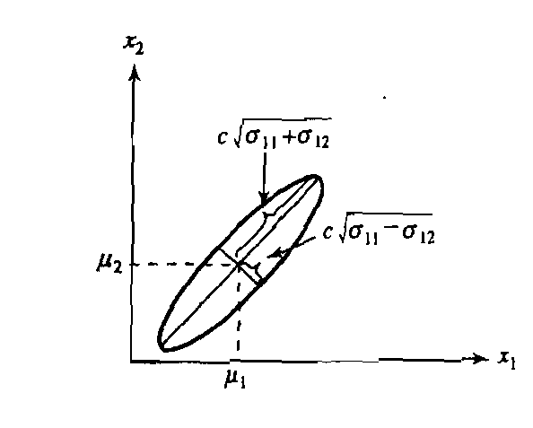
Finding the Density Solution
Probability Density Function
The possible model solution space is contained here
What will most likely satisfy the user based on “a priori” information
where
So we can now pose the problem
Generalized, Nonlinear Least Squares problem

Slide 30
Finding the Density Solution
Assumptions (Tarantola et al., 1982)
This is the solution to the General, Nonlinear Least Squares Problem

Slide 31
Finding the Density Solution
Substituting,

Slide 32
The Model Solution **
** Based on a Generalized, Nonlinear Inverse Problem using Least Squares Criterion (Tarantola and Valette, 1982)

